Slide 1
Pancreas
&
Biliary System
Dr. Vohra & Dr. Jamila

Slide 2
Objectives
At the end of the lecture, the student should be able to describe the:
Location, surface anatomy, parts, relations & peritoneal reflection of the pancreas and gall bladder.
Blood supply, nerve supply and lymphatic drainage of pancreas and gall bladder.
Course of each of common hepatic, cystic and common bile duct and pancreatic ducts

Slide 3
PANCREAS
LOCATION
Located in Epigastrium & Left upper quadrant of abdomen.
Pancreas is a soft, lobulated elongated gland with both exocrine and endocrine functions.
6-10 inch in length and 60-100 gram in weight.
Retro-peritoneal in position
Lies across the posterior abdominal wall in a transverse /oblique directions at the transpyloric plane (L1 vertebra).

Slide 4
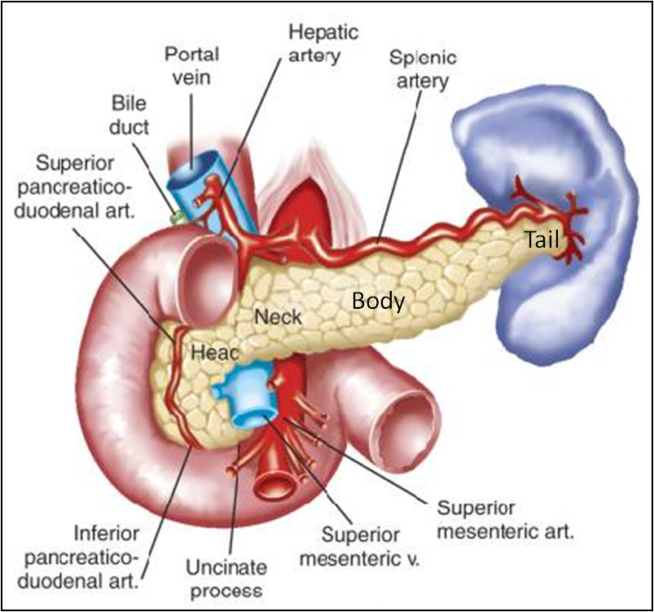
PANCREAS
PARTS
It is divided into:
Head
Neck
Body
Tail

Slide 5
Head
Disc shaped, lies within the concavity of the duodenum
Related to the 2nd and 3rd portions of the duodenum on the right & continues with the neck on the left
Includes uncinate process (part extending to the left behind the superior mesenteric vessels)
Neck
The constricted portion connecting the head & body
Lies in front of origin of superior mesenteric artery and the confluence of the portal vein
Its antero-superior surface supports the pylorus of the stomach
The superior mesenteric vessels emerge from its inferior border

Slide 6
Body
It runs upward and to the left.
It is triangular in cross section.
The splenic vein is embedded in its posterior surface
Tail
Narrow, short segment, ending at the splenic hilum
Lies in the splenicorenal ligament (may get injured during splenectomy), at the level of the T12 vertebra
Anteriorly, related to splenic flexure of colon

Slide 7
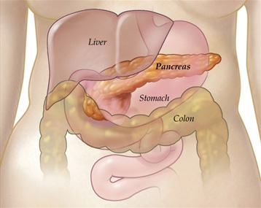
Anterior Relations
Stomach separated by lesser sac
Transverse colon & transverse mesocolon

Slide 8
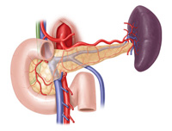
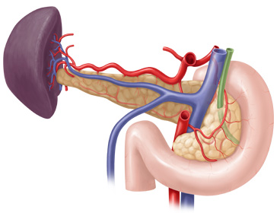
Posterior Relations
Bile duct, portal & splenic veins, inferior vena cava, aorta & origin of superior mesenteric artery
Left psoas muscle, left adrenal gland, left renal vessels & upper 1/3rd of left kidney
Hilum of the spleen.

Slide 9
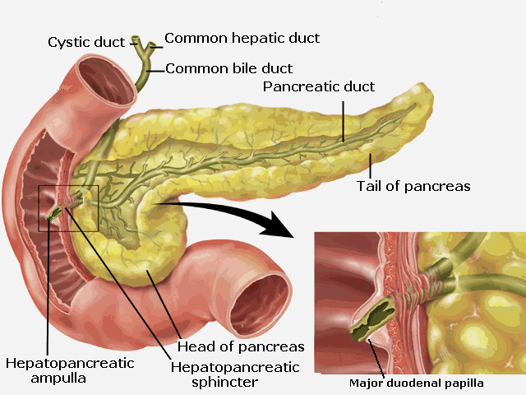
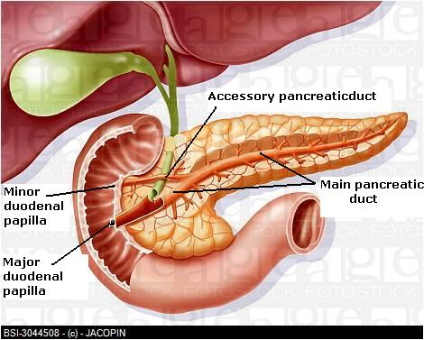
Pancreatic Ducts
Main duct (of Wirsung) runs the entire length of pancreas beginning from the tail.
It receives many tributaries from tail, body, neck, inferior portion of head & uncinate process.
Joins common bile duct & together they open into a small hepatopancreatic ampulla (Ampulla of Vater) in the duodenal wall
The ampulla opens into the lumen of the duodenum by means of a small Papilla, (Major duodenal papilla).
Accessory duct (of Santorini) drains superior portion of the head
It empties separately into 2nd portion of duodenum at (minor duodenal papilla)

Slide 10
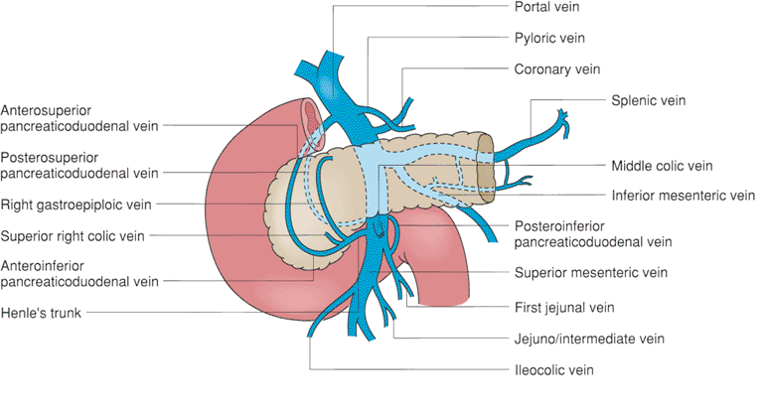
Blood Supply of Pancreas
Arteries
Head & neck: Supplied by branches from:
Celiac trunk through Superior pancreatico-duodenal artery
Superior mesenteric artery through Inferior pancreatico-duodenal artery
Body and tail: Supplied by Splenic artery through 8-10 branches
Veins
Head & neck: Drained by anterior and posterior venous arcades that form the superior & inferior pancreaticoduodenal veins which follow the corresponding arteries.
Body and tail: Drained by splenic vein, which is a tributary of portal vein

Slide 11
Lymphatic Drainage
Rich network that drains into pyloric, hepatic and splenic nodes
Ultimately the efferent vessels drain into the celiac & superior mesenteric lymph nodes.
Innervation
Sympathetic fibers from the thoracic splanchnic nerves. Sympathetic fibers have a predominantly inhibitory effect
Parasympathetic fibers from the vagus. Parasympathetic fibers stimulate both exocrine and endocrine secretions

Slide 12
Biliary System
The biliary system consists of the ducts and organs (bile ducts, liver & gallbladder) that are involved in the production, storage & transportation of bile.
Bile is secreted by the liver cells at a constant rate of about 40 ml per hour. When digestion is not taking place, the bile is stored and concentrated in the gallbladder; later, it is delivered to the duodenum.

Slide 13
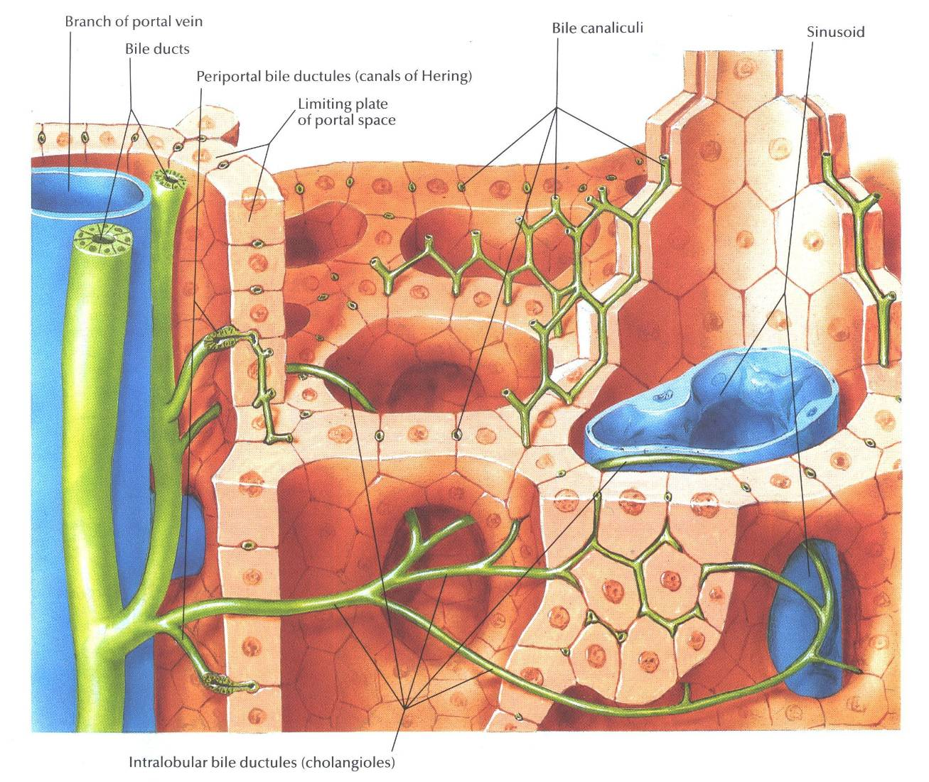
The Bile Ducts
The bile ducts consist of:
Bile canaliculi
Interlobular ducts
Intrahepatic ducts
Right and left hepatic ducts
Common hepatic duct
Cystic duct
Common bile duct (Bile duct)

Slide 14
The Bile Ducts
The smallest interlobular tributaries of the bile ducts are situated in the portal canals of the liver; they receive the bile canaliculi.
The interlobular ducts join one another to form progressively larger ducts and, eventually, at the porta hepatis, form the right and left hepatic ducts.

Slide 15
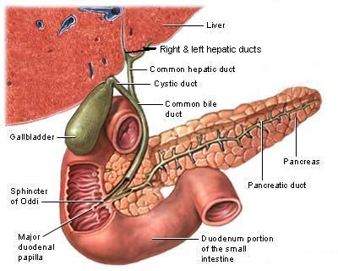
The right hepatic duct drains the right lobe of the liver and the left duct drains the left lobe, the caudate lobe, & quadrate lobe. After a short course, the hepatic ducts unite to form the common hepatic duct
The common hepatic duct is about 1.5 in. (4 cm) long and descends within the free margin of the lesser omentum. It is joined on the right side by the cystic duct from the gallbladder to form the common bile duct

Slide 16
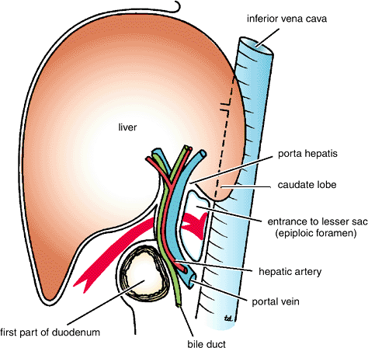
Common Bile Duct (Bile Duct)
The common bile duct is about 3 inches (8 cm) long.
Course:
First it lies in the right free margin of the lesser omentum.
Then it runs behind the first part of the duodenum.
Lastly it lies in a groove on the posterior surface of the head of the pancreas. Here, the bile duct comes into contact with the main pancreatic duct

Slide 17
Common Bile Duct (Bile Duct)
The bile duct ends below by piercing the medial wall of the second part of the duodenum about halfway down its length.
It is usually joined by the main pancreatic duct, and together they open into a small ampulla in the duodenal wall, called the hepatopancreatic ampulla (ampulla of Vater). The ampulla opens into the lumen of the duodenum by means of a small papilla, the major duodenal papilla.
The terminal parts of both ducts and the ampulla are surrounded by circular muscle, known as the sphincter of the hepatopancreatic ampulla (sphincter of Oddi).
Occasionally, the bile and pancreatic ducts open separately into the duodenum.

Slide 18
Gallbladder
A pear-shaped sac lying on the undersurface of the liver.
It has a capacity of 30 to 50 ml , it stores bile, which is concentrated by absorbing water.
The gallbladder is divided into the fundus, body, and neck.
The fundus is rounded and projects below the inferior margin of the liver, where it comes in contact with the anterior abdominal wall at the level of the tip of the ninth right costal cartilage.
The body lies in contact with the visceral surface of the liver and is directed upward, backward, and to the left.
The neck becomes continuous with the cystic duct, which turns into the lesser omentum, joins the common hepatic duct, to form the bile duct

Slide 19
Gallbladder
The peritoneum completely surrounds the fundus of the gallbladder and binds the body and neck to the visceral surface of the liver.
Relations
Anteriorly: The anterior abdominal wall and the inferior surface of the liver
Posteriorly: The transverse colon and the first and second parts of the duodenum
Function of the Gallbladder
When digestion is not taking place, the sphincter of Oddi remains closed and bile accumulates in the gallbladder. The gallbladder concentrates & stores bile; selectively absorbs bile salts, keeps the bile acid; it excretes cholesterol; and secretes mucus. To aid in these functions, the mucous membrane is thrown into permanent folds that unite with each other, giving the surface a honeycombed appearance.

Slide 20
Blood Supply
The cystic artery, a branch of the right hepatic artery.
The cystic vein drains directly into the portal vein.
Several very small arteries and veins also run between the liver and gallbladder.
Lymph Drainage
The lymph drains into a cystic lymph node situated near the neck of the gallbladder. From here, the lymph vessels pass to the hepatic nodes along the course of the hepatic artery and then to the celiac nodes.
Nerve Supply
Sympathetic and parasympathetic vagal fibers form the celiac plexus. The gallbladder contracts in response to the hormone cholecystokinin, which is produced by the mucous membrane of the duodenum on the arrival of fatty food from the stomach.

Slide 21
Cystic Duct
The cystic duct is about 1.5 in. (3.8 cm) long and connects the neck of the gallbladder to the common hepatic duct to form the bile duct. It is usually somewhat S-shaped and descends for a variable distance in the right free margin of the lesser omentum.
The mucous membrane of the cystic duct is raised to form a spiral fold that is continuous with a similar fold in the neck of the gallbladder. The fold is commonly known as the “spiral valve.” The function of the spiral valve is to keep the lumen constantly open.

Slide 22
Thank You

