Slide 1
BLEEDING DISORDERS BY:
DR. FATMA AL-QAHTANI
CONSULTANT HAEMATOPATHOLOGIST
HEAD OF HAEMATOLOGY UNIT
ASSISTANT PROFESSOR
DEPARTMENT OF PATHOLOGY, COLLEGE OF MEDICINE
KING SAUD UNIVERSITY

Slide 2
LEARNING OBJECTIVES
To know the main sequence of events in the coagulation pathways
To know the principles underlying the prothrombin time (PT), activated partial thromboplastin time (APTT) and thrombin time (TT)
To know the principles of investigation of a patient suspected of having a haemostatic defect

Slide 3
cont’d…
To know the mode of inheritance, clinical presentation, method of diagnosis and principles of treatment of haemophilia A (factor FVIII deficiency), haemophilia B (factor IX deficiency), haemophilia C (factor XI deficiency) and von Willebrand disease (VWD)
To know the alterations in the haemostatic and fibrinolytic mechanisms associated with disseminated intravascular coagulation (DIC) and the causes of DIC
To understand normal fibrinolysis and the principles of fibrinolytic therapy

Slide 4
cont’d…
To understand the principles of anticoagulant therapy with unfractionated heparin, low molecular weight heparin and warfarin and to know about the laboratory control of such therapy
To be aware of the natural anticoagulant mechanisms in blood and some of the prothrombotic states (thrombophilia)
To know the effects of vitamin K deficiency and liver disease on the clotting mechanisms

Slide 5
Normal Haemostasis
The cessation of bleeding following trauma to blood vessels results from three processes:
the contraction of vessel walls;
the formation of a platelet plug at the site of the break in the vessel wall; and
the formation of a fibrin clot.

Slide 7
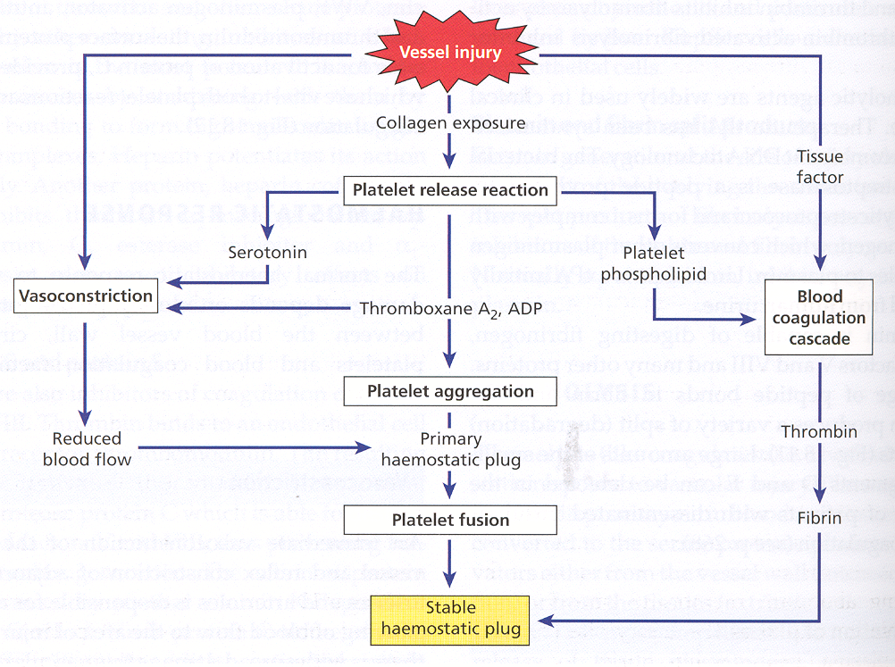

Slide 8
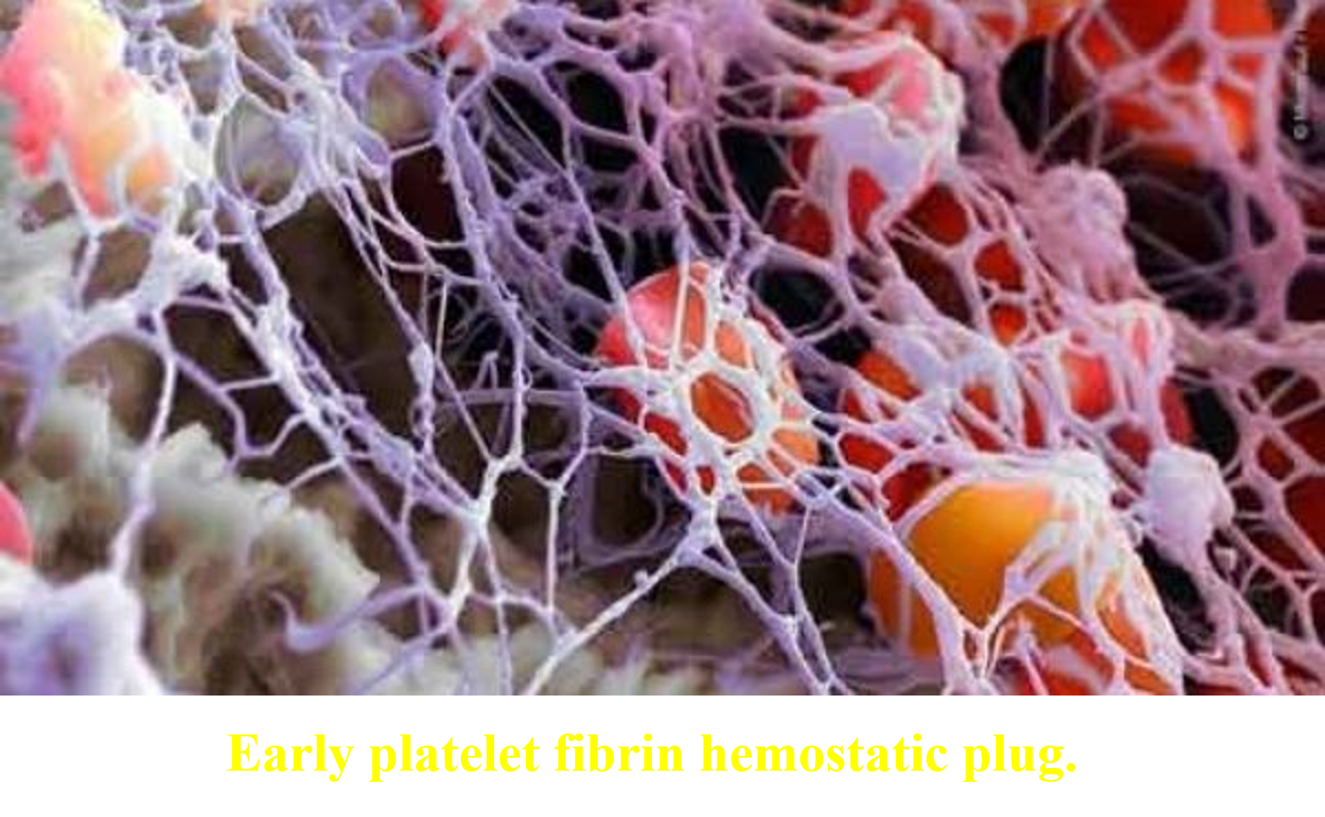

Slide 9
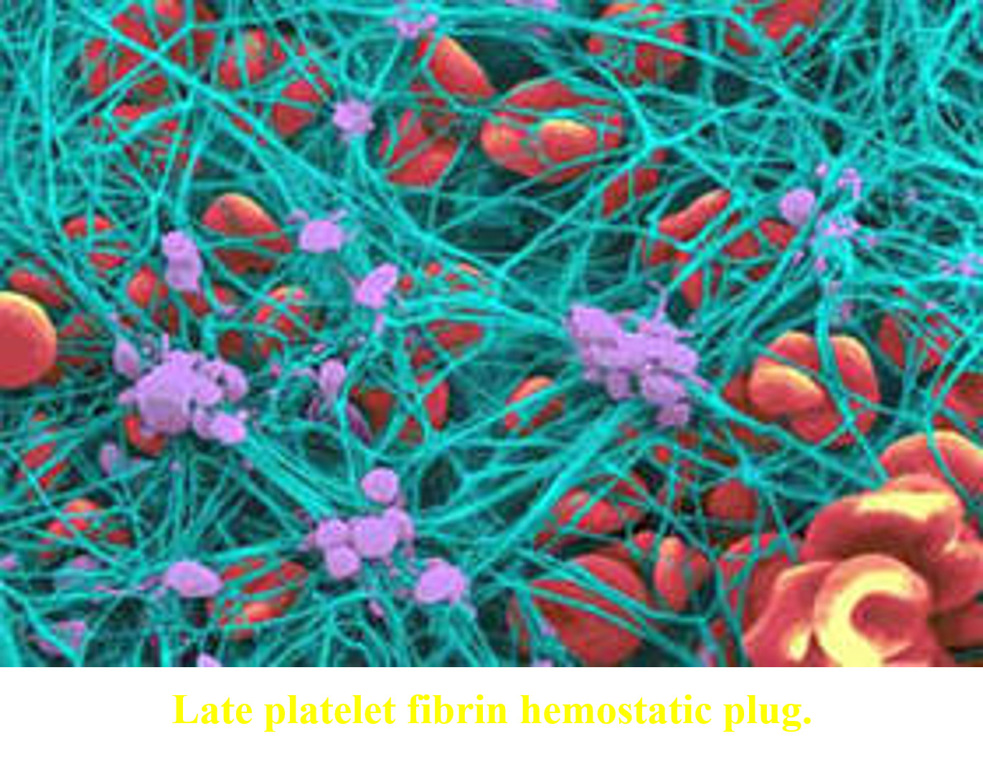

Slide 10
Normal coagulation mechanism
The mechanisms involved in the clotting cascade were elucidated in the period 1950-70.
The clotting sequence is initiated in vivo by tissue factor (TF) exposed on the surface of activated endothelial cells and leucocytes and on most extravascular cells in an area of tissue damage.
Calcium is required at several stages in the coagulation sequence.

Slide 11
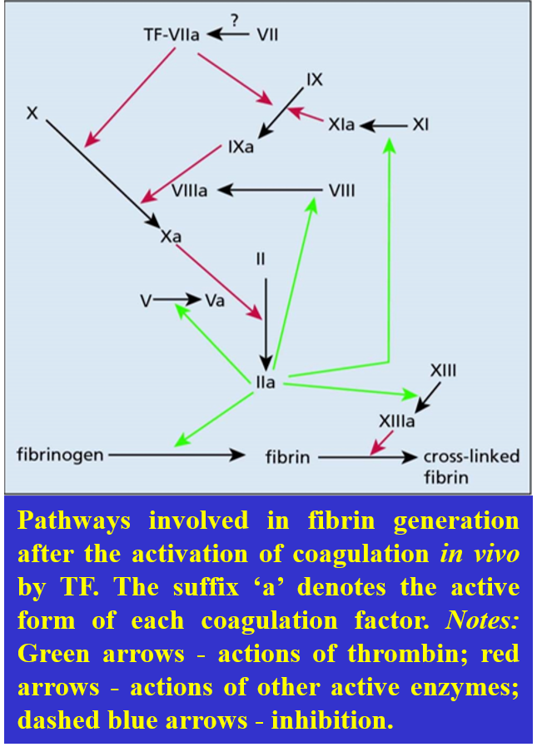

Slide 12
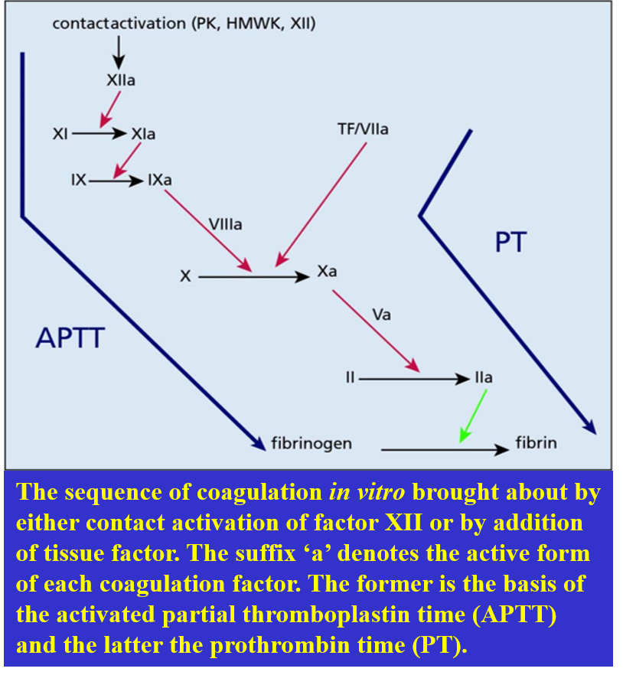

Slide 13
The fibrinolytic mechanism
After haemostasis has been achieved, the body has a mechanism for the enzymatic lysis of clots. The dissolution of the fibrin into fibrin-degradation products (FDPs) is carried out by the proteolytic plasma enzyme plasmin. Plasmin is present in the plasma in an inactive form.

Slide 14
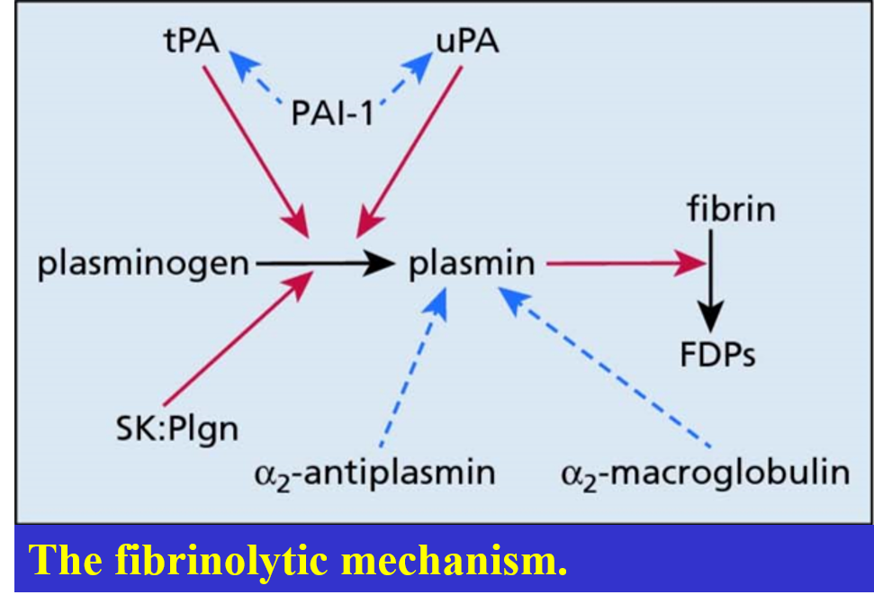

Slide 15
Tests for clotting defects
There are three basic tests that are widely used, all performed on platelet-poor plasma obtained by centrifugation:
The activated partial thromboplastin time (APTT), which estimates the activity of factors XII, XI, IX, VIII, X, V, II and fibrinogen (the ‘intrinsic system’).
The prothrombin time (PT), which estimates the activity of factors VII, X, V, II and fibrinogen (the ‘extrinsic system’).

Slide 16
cont’d…
The thrombin time, adding thrombin to plasma and measuring the time taken to clot, which is prolonged when there is an inherited or acquired deficiency of fibrinogen, or an inherited or acquired abnormal fibrinogen molecule (dysfibrinogenaemia) or in the presence of heparin or raised levels of FDPs.

Slide 17
Congenital coagulation disorders
Blood clotting abnormalities can be conveniently divided into two categories, congenital defects and acquired defects.
There is a group of patients who complain of excessive bleeding, either spontaneous or following trauma, usually starting early in life, and who frequently have a family history of a similar condition.
These patients usually have one of three diseases:
haemophilia A (Factor VIII deficiency)
haemophilia B (Factor IX deficiency)
haemophilia C (Factor XI deficiency)
VWD

Slide 18
Haemophilia A (factor VIII deficiency)
The term ‘haemophilia’, first used by Schönlein in 1839, was applied to a lifelong tendency to prolonged haemorrhage found in males and dependent on the transmission of a sex-linked abnormal gene.
Patients with factor VIII deficiency and those with factor IX deficiency.

Slide 19
THE BLEEDING DISORDERS INCLUDE
Inherited and acquired blood vessel disorders
Inherited and acquired platelets disorders
Inherited and acquired coagulation disorders

Slide 20
HEREDITARY COAGULATION DISORDERS

Slide 23
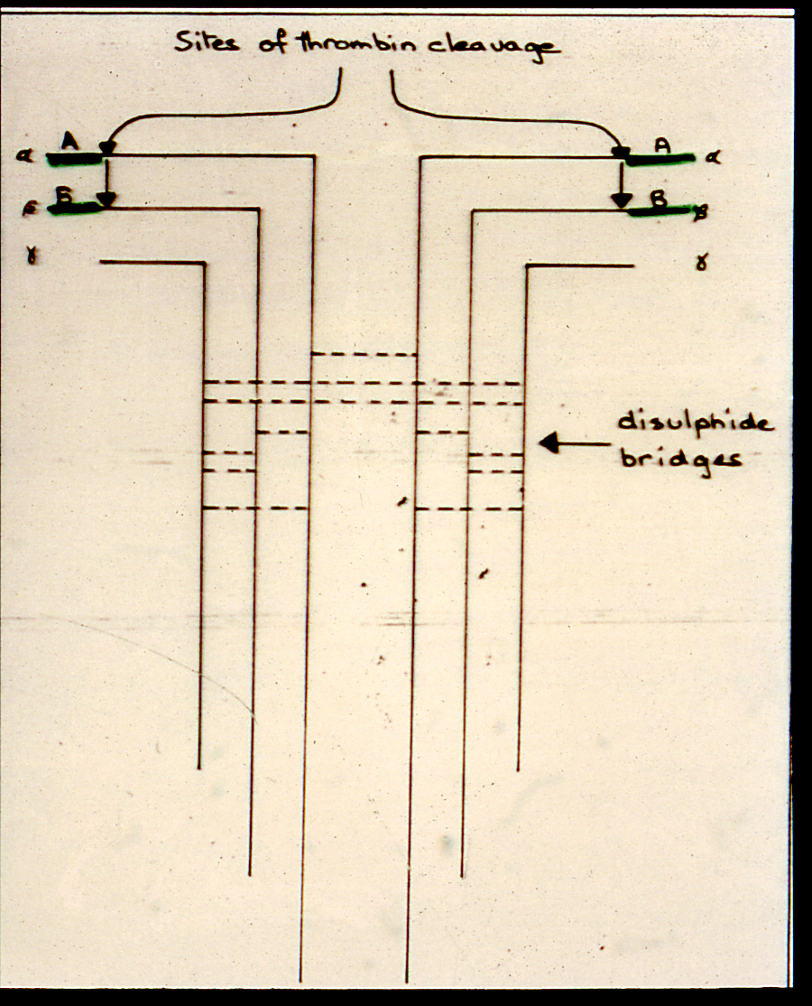

Slide 25
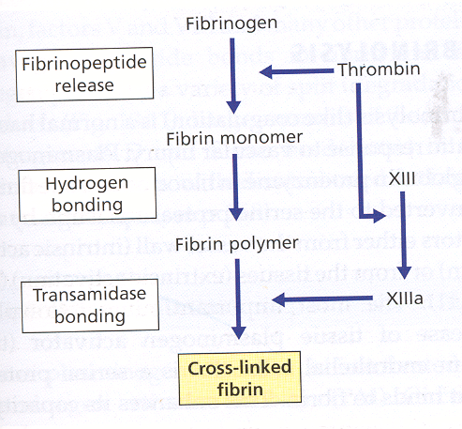

Slide 28
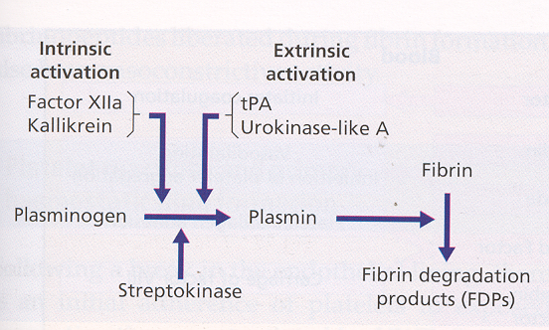

Slide 29
INHERITED COAGULATION DISORDERS
HAEMOPHILIA
Factor VIII Deficiency
Factor IX Deficiency (Christmas Disease)
Factor XI Deficiency
Von Willebrand Disease
Other Factors Deficiency

Slide 30
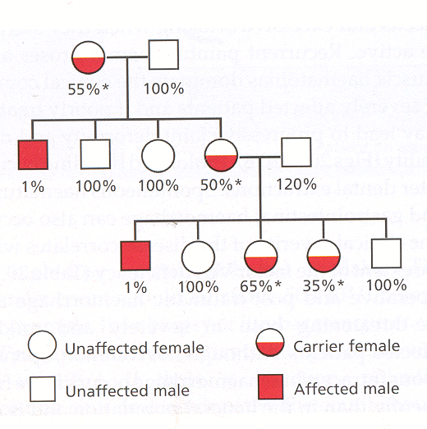

Slide 31
CLINICAL FEATURES OF HAEMOPHILIA

Slide 32
Correlation of coagulation factor activity and disease severity in haemophilia A or hemophilia B
---------------------------------------------------------------------------------------------------------------------------------------------------------------------------------------------------------------------------------------------------------------
Coagulation factor activity Clinical manifestations
(percentage of normal)
---------------------------------------------------------------------------------------------------------------------------------------------------------------------------------------------------------------------------------------------------------------
<1 Severe disease
Frequent spontaneous bleeding episodes
from early life
Joint deformity and crippling if not
adequately teated
1 - 5 Moderate disease
Post-traumatic bleeding
occasional spontaneous episodes
5 - 20 Mild diesease
Post-traumatic bleeding
---------------------------------------------------------------------------------------------------------------------------------------------------------------------------------------------------------------------------------------------------------------

Slide 33
Detection of carriers and antenatal diagnosis
Genetic mutational analysis allows carriers to be identified with accuracy and is the method of choice.
Prenatal diagnosis of haemophilia can be made by analysis of fetal DNA, which can be obtained either by chorionic villus sampling between 11½ and 14 weeks of gestation or by amniocentesis after 16 weeks.

Slide 34
Clinical features
The characteristic clinical feature of severe haemophilia is the occurrence of spontaneous bleeding into the joints and less frequently into the muscles.
The presenting symptom is pain in the affected area and this can be very severe.
Bleeding into joints results in crippling deformity.

Slide 35
cont’d…
The knees, elbows and ankles are most commonly affected.
Haematuria, epistaxis and gastrointestinal bleeding are less common.
Intracranial bleeding is the most common cause of death from the disease itself.

Slide 37
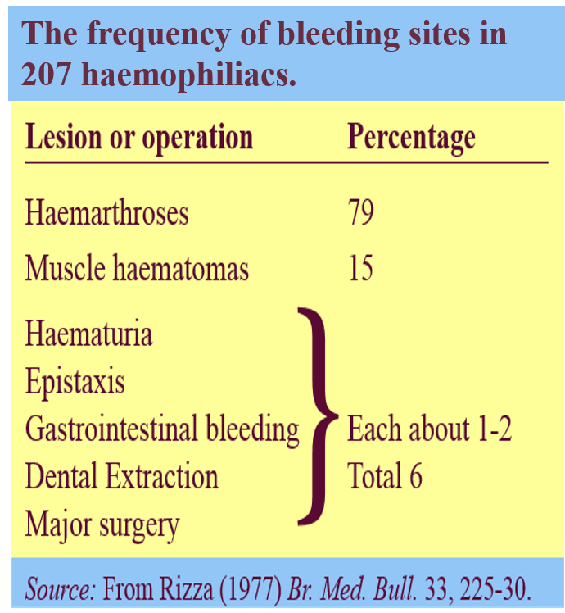

Slide 38
Diagnosis
The possibility of haemophilia is suggested by the finding of a normal PT and a prolonged APTT. Confirmation is by a specific assay of factor VIII coagulant activity with normal VWF. The combination of a normal PT and a prolonged APTT is most often caused by lupus anticoagulant.

Slide 39
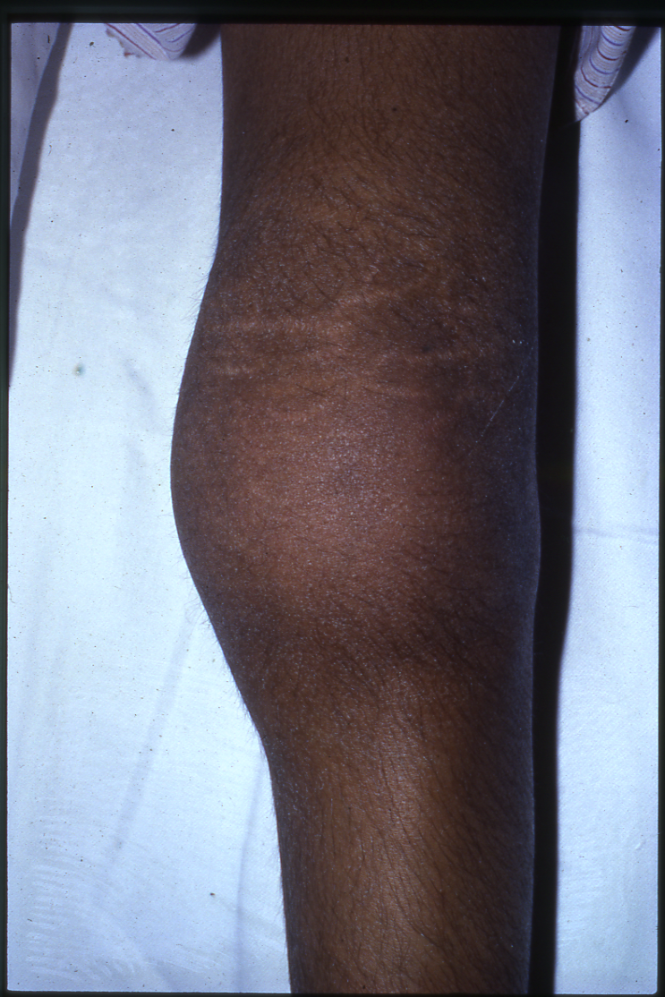

Slide 40
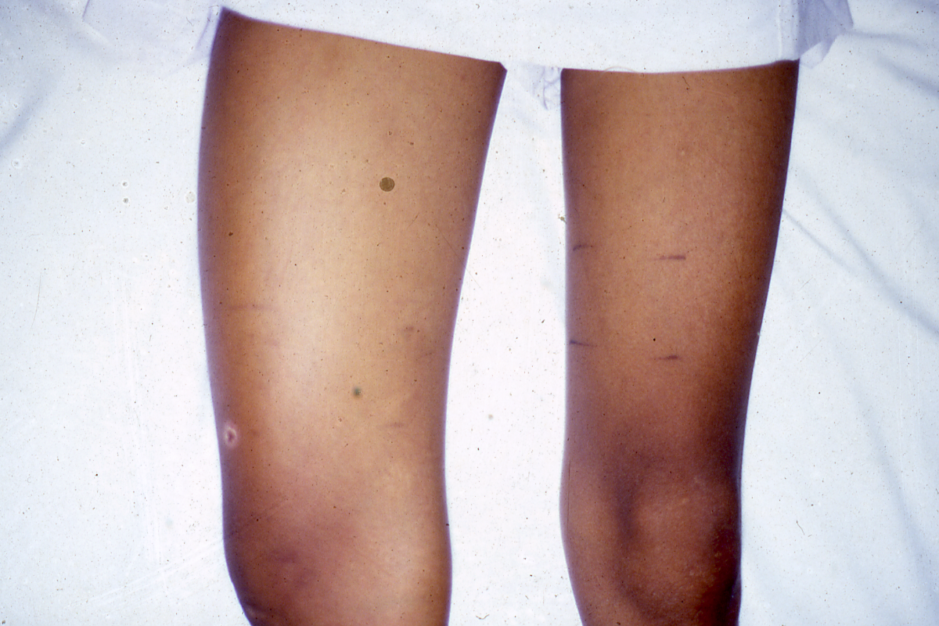

Slide 45
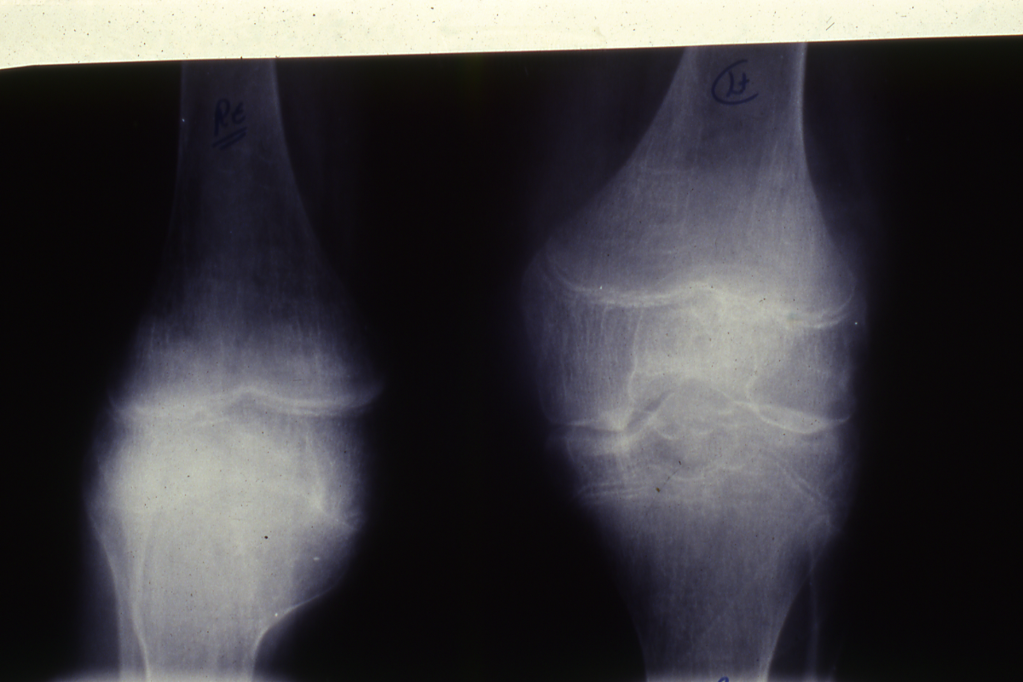

Slide 46
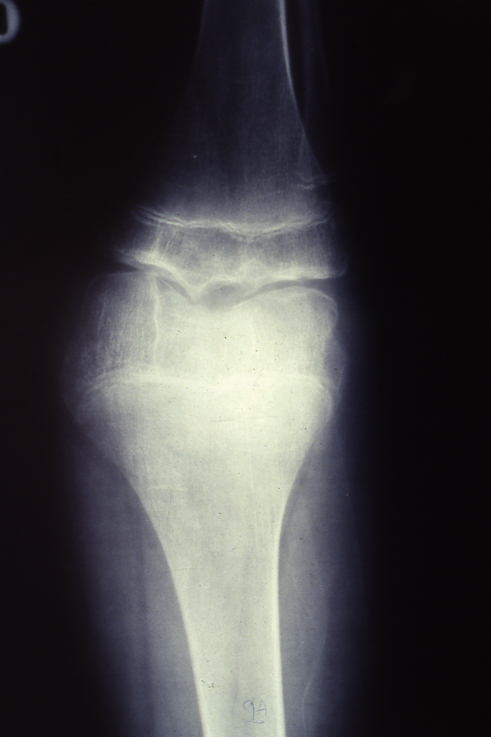

Slide 47
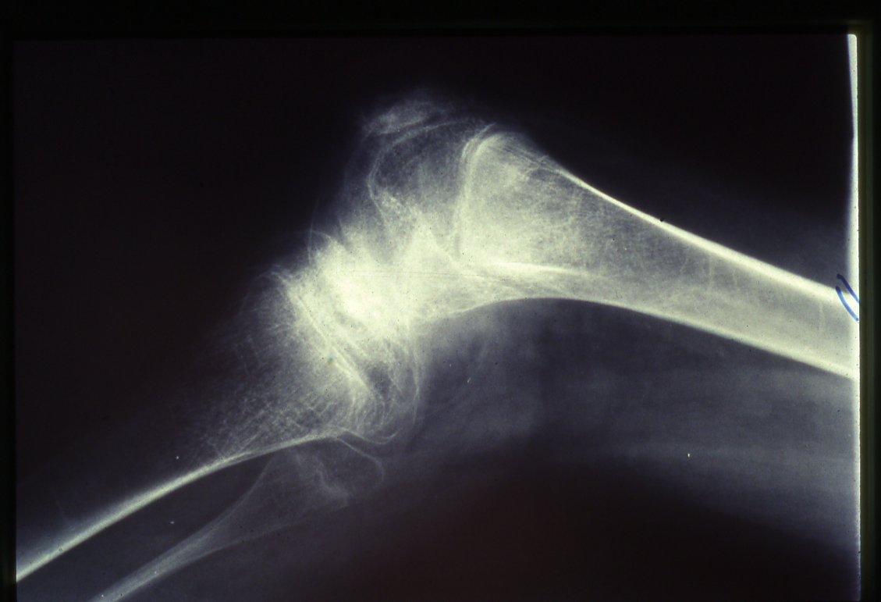

Slide 48
Treatment of Haemophilia
Treatment should be given at the earliest sign of spontaneous or post-traumatic bleeding.
Treatment consists of intravenous injections of virucidally treated plasma-derived high purity factor VIII concentrate or recombinant factor VIII preparations to maintain plasma factor VIII coagulant activity to between 30% and 100% of normal.
Approximately 25% of patients with haemophilia, usually after treatment with factor VIII on 10-20 occasions, develop antibodies that inhibit its functional activity and in 5-10% of patients these are of high titre.

Slide 49
cont’d…
Haemorrhage in patients with high-titre inhibitors may require treatment with ‘bypassing agents’ such as recombinant factor VIIa or FEIBA (factor eight inhibitor bypassing activity; that is, a plasma-derived activated prothrombin complex concentrate), which activate the coagulation cascade below the level of factor VIII.
The administration of factor VIII may be avoided in mild to moderate haemophilia by using the vasopressin analogue desmopressin (DDAVP), which causes a temporary increase in factor VIII and VWF by provoking the release of these factors from endothelial cells. DDAVP is used intravenously, subcutaneously or intranasally.

Slide 50
Deficiency of other clotting factors
Single deficiencies of factors other than VIII and IX are very rare, but all possible deficiencies have been found and all except contact factor (e.g. factor XII) deficiency give rise to bleeding disorders of varying degrees of severity.

Slide 51
Acquired coagulation disorders
The hepatocytes are the major cell type involved in the synthesis of all the coagulation factors. Hence, severe liver disease may result in bleeding, due both to a deficiency of several coagulation factors and to an abnormality in the structure and function of fibrinogen, as well as thrombocytopenia due to hypersplenism.

Slide 52
Haemophilia B (Factor IX deficiency, Christmas disease)
The clinical features and inheritance of factor IX deficiency are identical to those in factor VIII deficiency. Factor IX deficiency affects about 1 in every 50,000 males (i.e. it is less frequent than factor VIII deficiency). The factor IX gene is located on the long arm of the X-chromosome, is much smaller than the factor VIII gene (containing eight exons).
The APTT is prolonged and the PT normal. The diagnosis can be made by assay of the factor IX level. Plasma-derived factor IX concentrate or recombinant factor IX is available and should be administered intravenously as soon as spontaneous or post-traumatic bleeding starts. Factor IX has a longer half-life in the plasma (18-24 hours) than factor VIII and hence can be given at less frequent intervals.

Slide 54
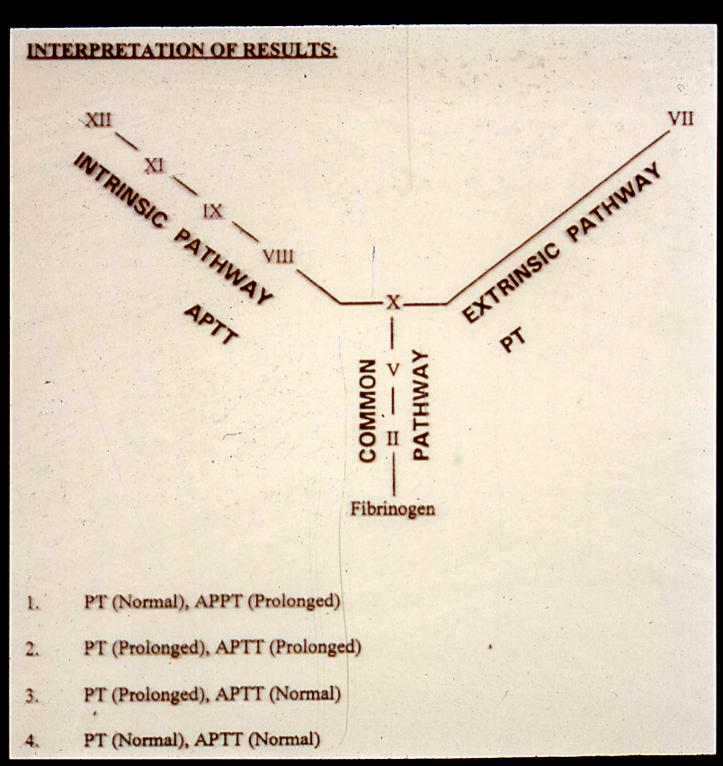

Slide 55
Genetics, prevalence and biochemistry
Deficiency of factor VIII results from an abnormality in the factor VIII gene, which is very large (186 kilobases, 26 exons) and lies at the tip of the long arm of the X-chromosome.
Ranging form single-point mutations to large deletions.
Half of all severe cases are due to an inversion involving intron 22.
The prevalence of this disorder is about one per 10 000 males.

Slide 56
cont’d…
Females with haemophilia have been observed extremely rarely and these are either homozygotes for the abnormal gene or are heterozygotes in whom the normal X-chromosome has not produced sufficient quantities of factor VIII due to lyonization.
The factor VIII molecule is a protein with a molecular weight of 8 X 10⁴ daltons. In the plasma, factor VIII is only found complexed with VWF, which acts as a carrier and prolongs its plasma half-life.

Slide 57
The Abnormalities in Von Willebrand Disease
Abnormal bleeding time
Prolonged APTT & normal PT
Deficiency of Factor VIII Clotting activity
Deficiency of Von Willebrand Factor
(Ristocetin Co-factors)
Low Von Willebrand Antigen
Abnormal Platelet Aggregations

Slide 61
Von Willebrand disease
This is the most common inherited bleeding disorder, with a prevalence of up to 1%, although most mild cases are undiagnosed. It was described by von Willebrand in 1926 as occurring in several families on islands in the Baltic (Åland Islands). It is an autosomal disorder characterized by mild, moderate or severe bleeding. The bleeding results from either a qualitative abnormality or a deficiency of VWF. This factor is a protein with a molecular weight of 2.7 X 10⁵ daltons and exists in the plasma as a variable-sized polymer, ranging from a dimer to a molecule containing 50-100 subunits. It has a dual function: first, it is an adhesive molecule that binds platelets to subendothelial tissues; second, it acts as a carrier for factor VIII. The reduction in VWF results in a reduction in factor VIII concentration (usually measured as clotting activity).

Slide 62
cont’d…
The gene for VWF is present on chromosome 12.
Some defects result in a reduction in the plasma concentration of structurally normal VWF molecules, but others cause different qualitative abnormalities in the VWF molecule. VWD has been divided into three types: in types 1 (most frequent) and 3 there is a partial reduction or nearly complete absence of VWF molecules, respectively, and in type 2 there are qualitative abnormalities.
Spontaneous bleeding is usually confined to mucous membranes and skin and takes the form of epistaxes and ecchymoses.
Bleeding into joints and muscles is rare except in type 3 disease.

Slide 63
cont’d…
The laboratory findings include a prolonged PFA closure time (if done), usually a prolonged APTT and reduced factor VIII clotting activity, reduced levels of VWF and impaired ristocetin-induced platelet aggregation; however, it is important to remember that the PFA and APTT may be within normal limits.
For mildly or moderately affected patients with type 1 disease, desmopressin (DDAVP), which increases plasma levels of both VWF and factor VIII, should be tried before using blood products.
Very high purity VWF may be used.
The antifibrinolytic drug tranexamic acid may be used for treating epistaxis or menorrhagia and in combination with DDAVP or VWF-containing concentrates to manage dental extractions.

Slide 66
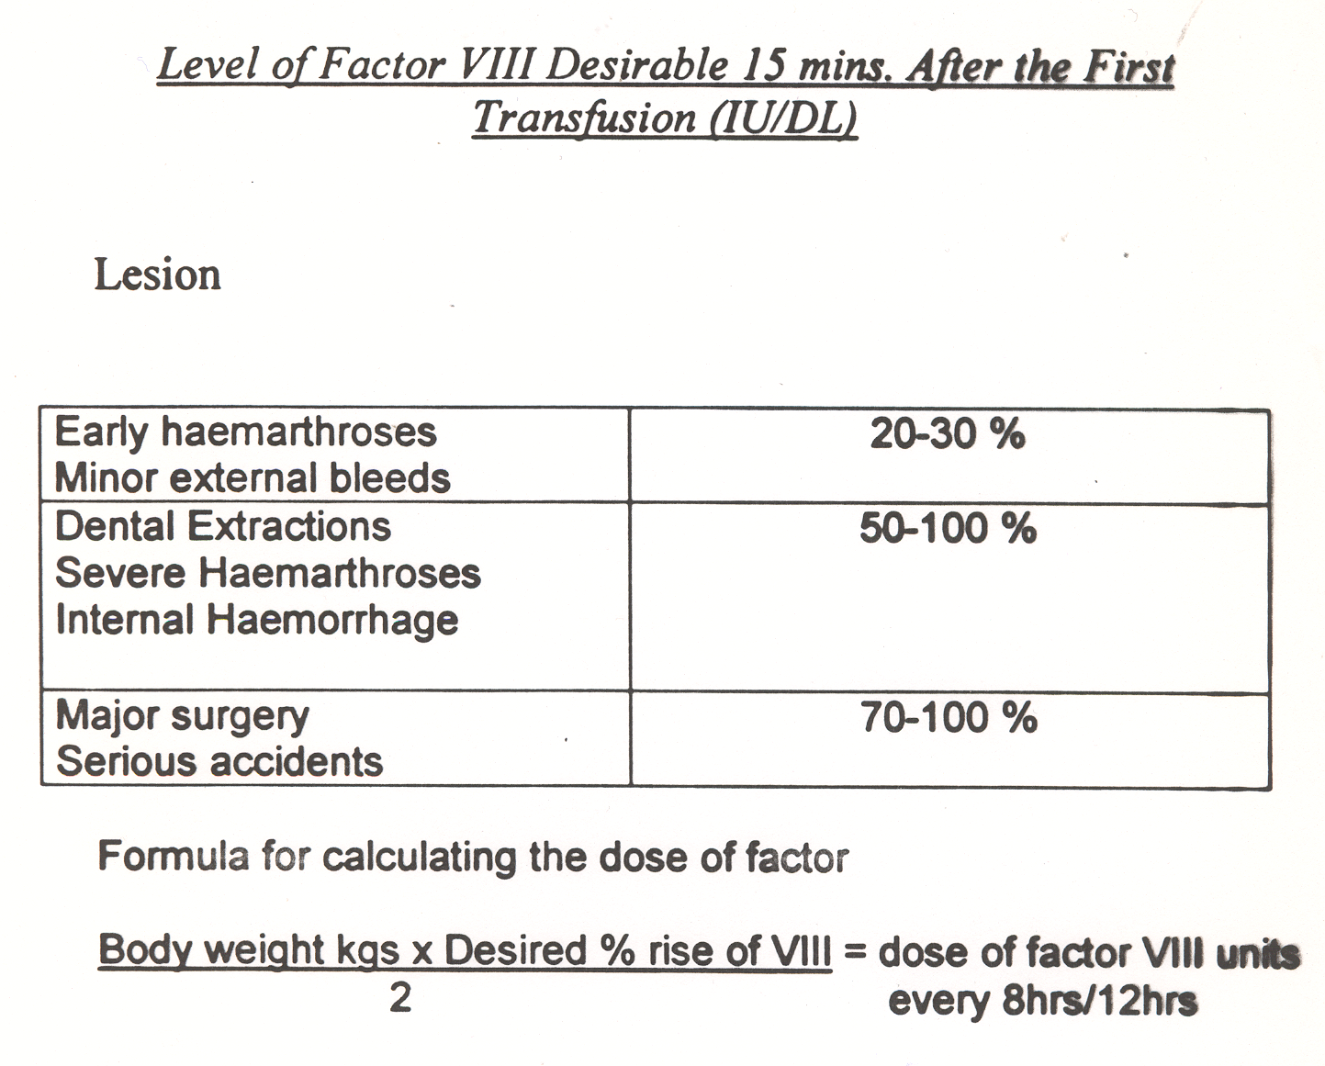

Slide 69
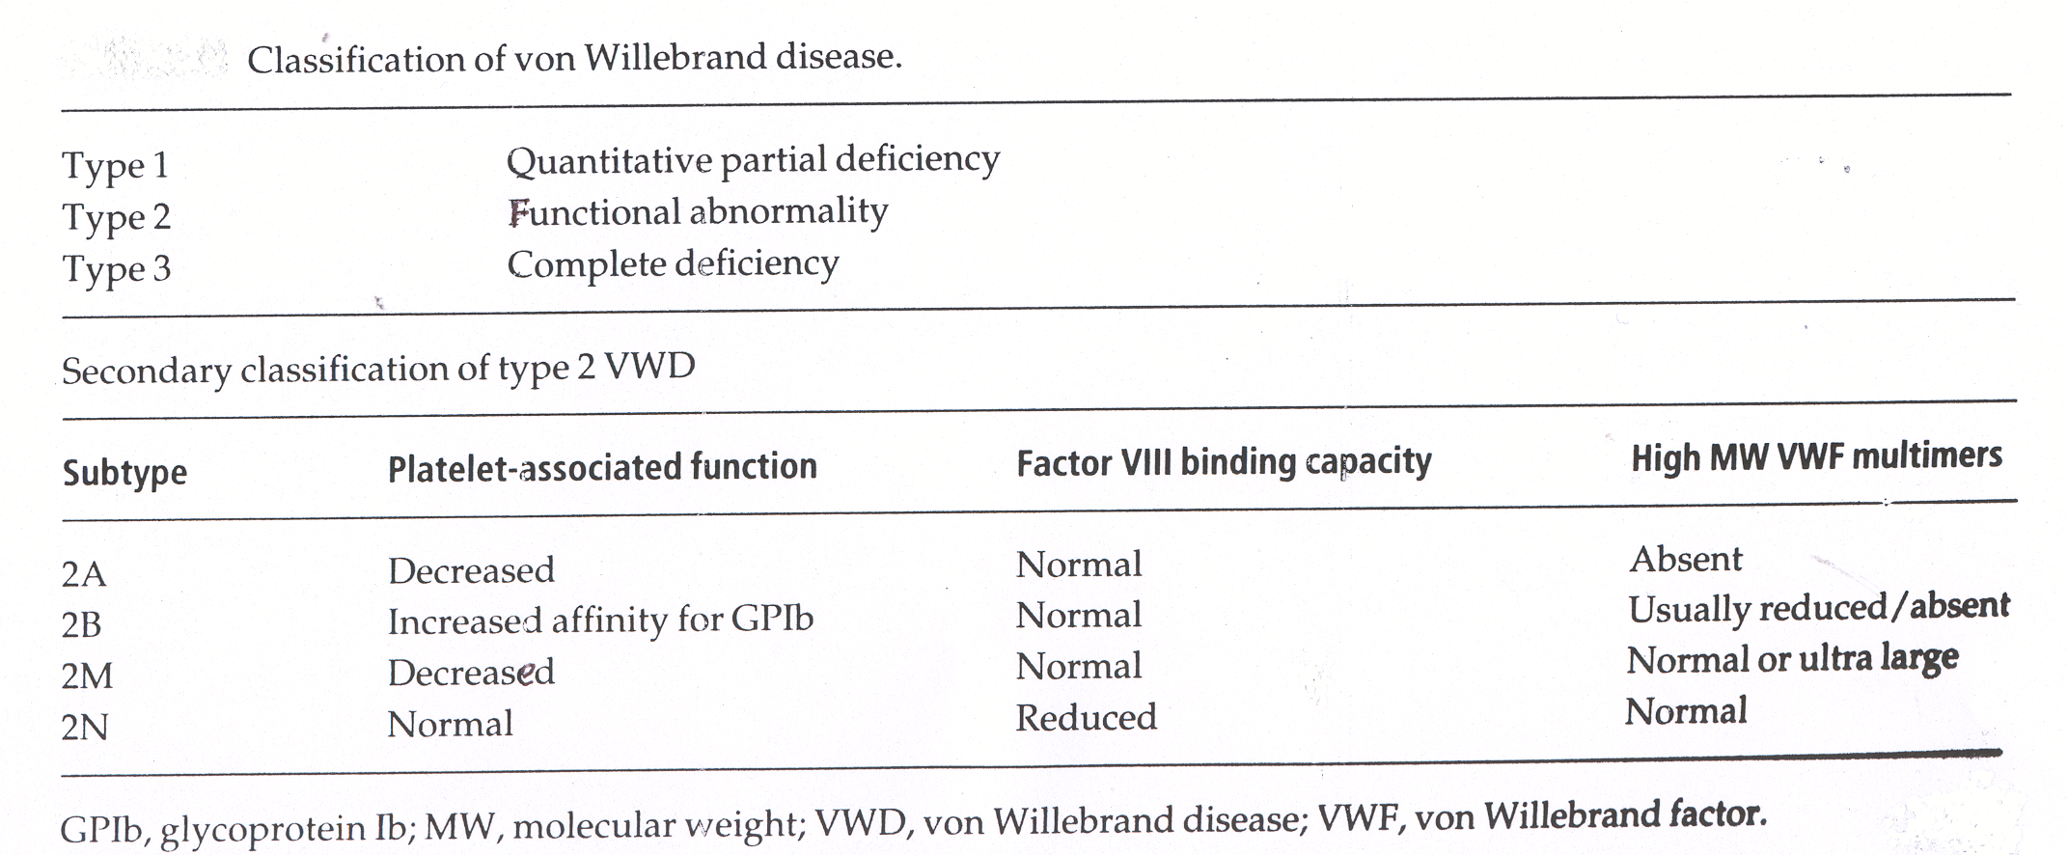

Slide 71
FACTOR XIII DEFICIENCY
Bruising with minor injury
Hematoma after trauma
Bleeding (secondary bleeding)
Abnormal healing of wounds with excessive scar formation (keloid formation)

Slide 72
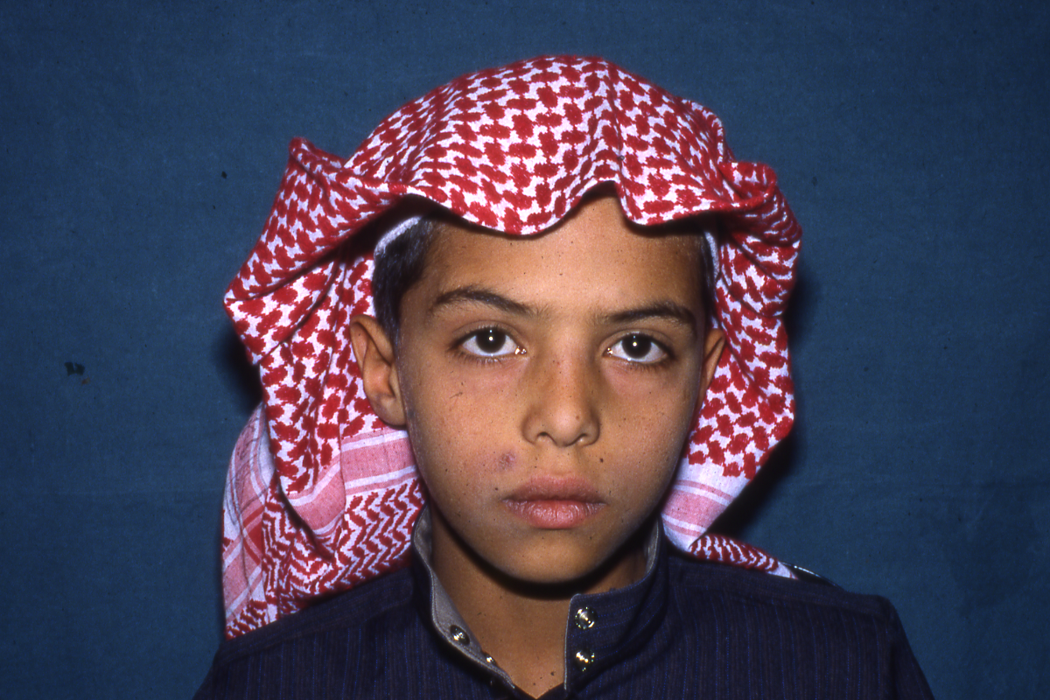

Slide 73
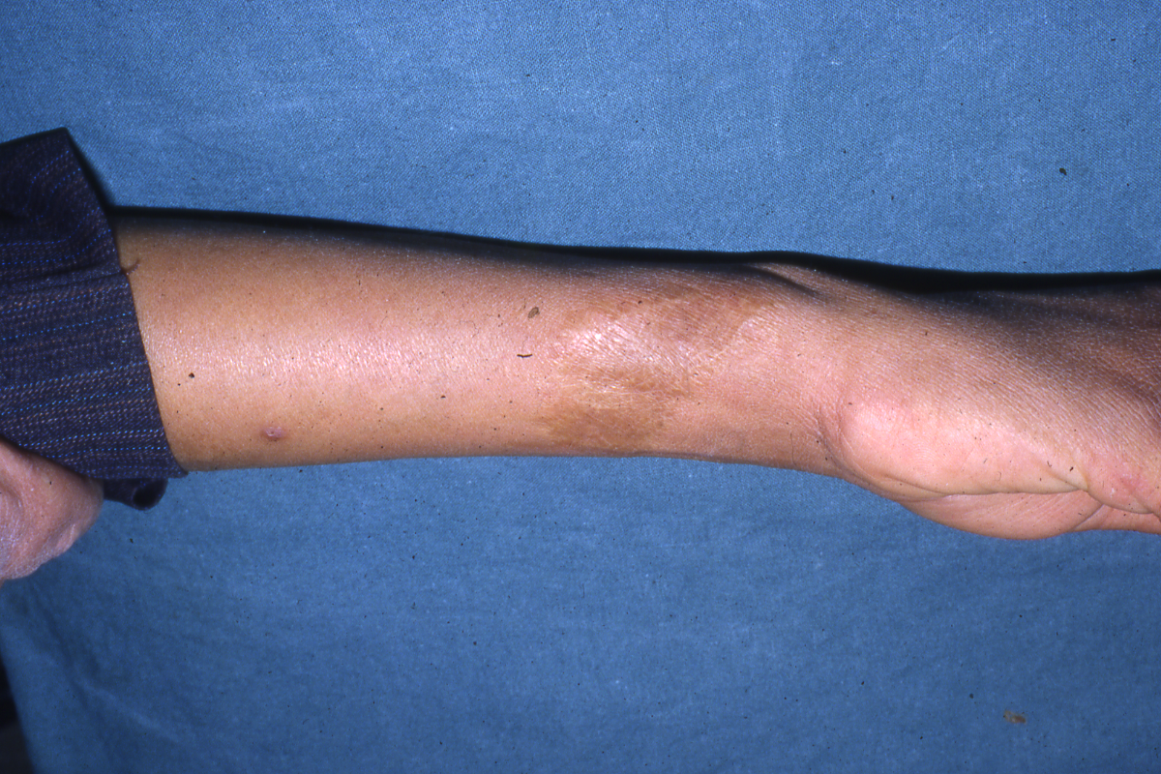

Slide 74
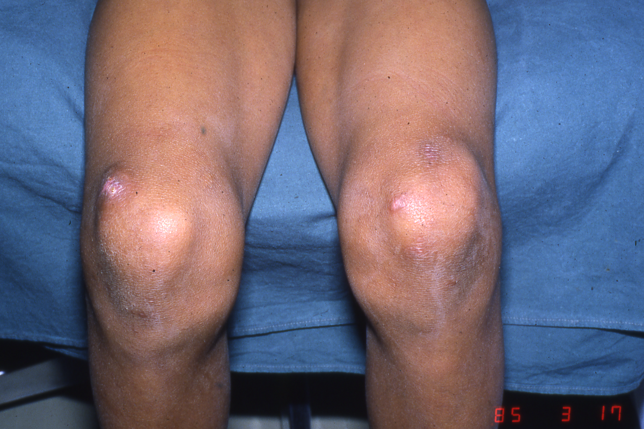

Slide 75
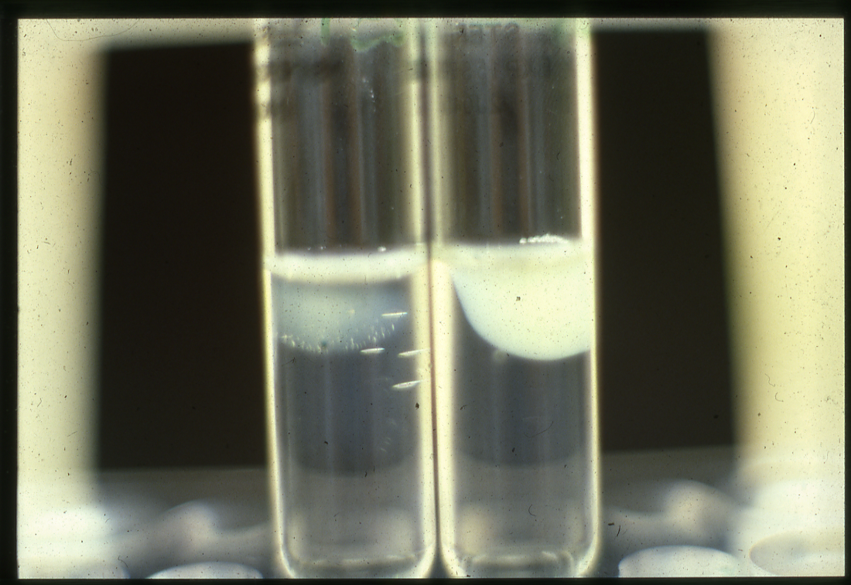

Slide 76
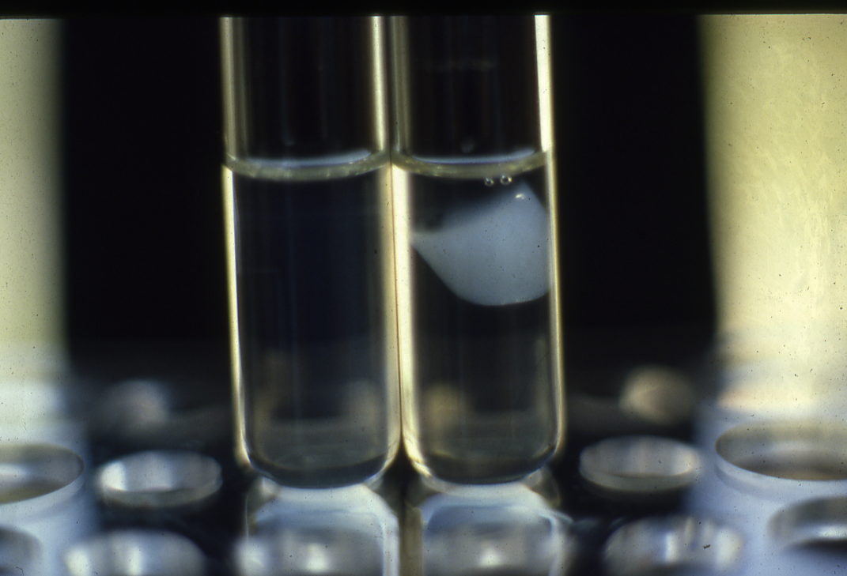

Slide 77
LABORATORY DIAGNOSIS OF FACTOR XIII DEFICIENCY
Normal PT & Normal APTT
Normal Bleeding time & Normal Platelet aggregation
Normal fibrinogen level
Abnormal clot stability with five molar urea
Low Factor XIII level

Slide 78
ACQUIRED COAGULATION DISORDERS

Slide 79
DIC
DISSEMINATED INTRAVASCULAR COAGULATION
‘CONSUMPTION COAGULATIONPATHY’
‘DEFIBRINATION SYNDROME’

Slide 80
Causes of disseminated intravascular coagulation
--------------------------------------------------------------------------------------------------------------------------------------------------------------------------------------------------------------------------------------------------------------
Infections
Gram-negative and meningococcal septicaemia
Clostridium welchii septicaemia
Severe Falciparum malaria
Viral infection – varicella, HIV, hepatitis, cytomegalovirus
Malignancy
Widespread mucin-secreting adenocarcinoma
Acute promyelocytic leukaemia
Obstetric complications
Amniotic fluid embolism
Premature separation of placenta
Septic abortion

Slide 81
Causes of disseminated intravascular coagulation (cont’d…)
----------------------------------------------------------------------------------------------------------------------------------------------------------------------------------------------------------------------------------------------------------------------------------
*Hypersensitivity reactions
Anaphylaxix
Incompatible blood transfusion
*Widespread tissue damage
Following surgery or trauma
After severe burns
*Vascular abnormalities
Kasabach-Merritt syndrome
Leaking prosthetic valves
Cardiac bypass surgery
*Miscellaneous
Liver failure
Snake and invertebrate venoms
Hypothermia
Heat stroke
Acute hypoxia

Slide 85
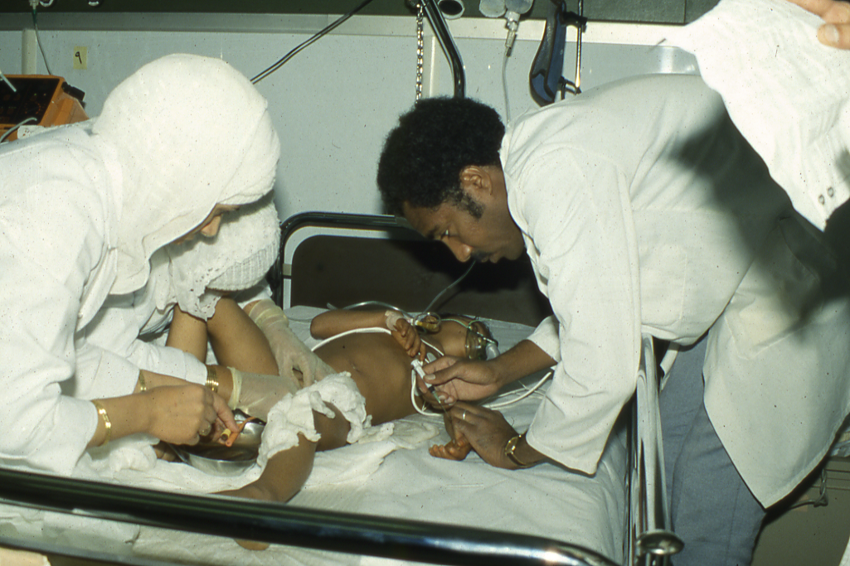

Slide 86
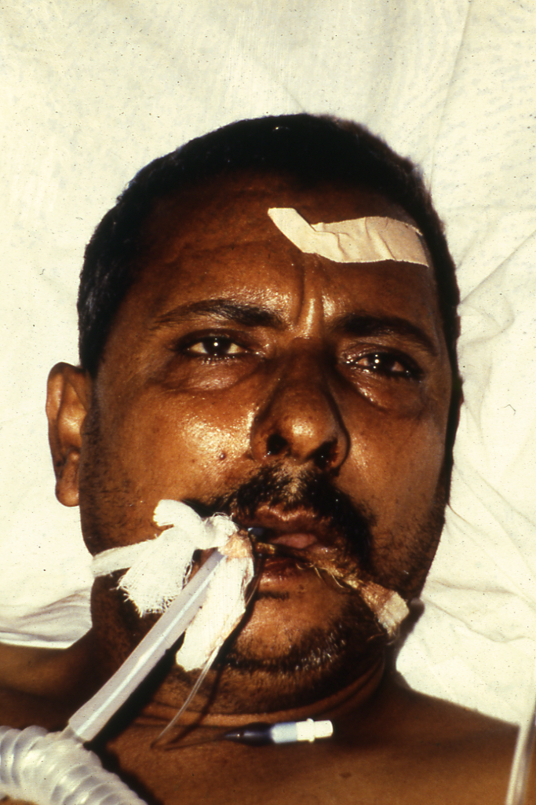

Slide 87
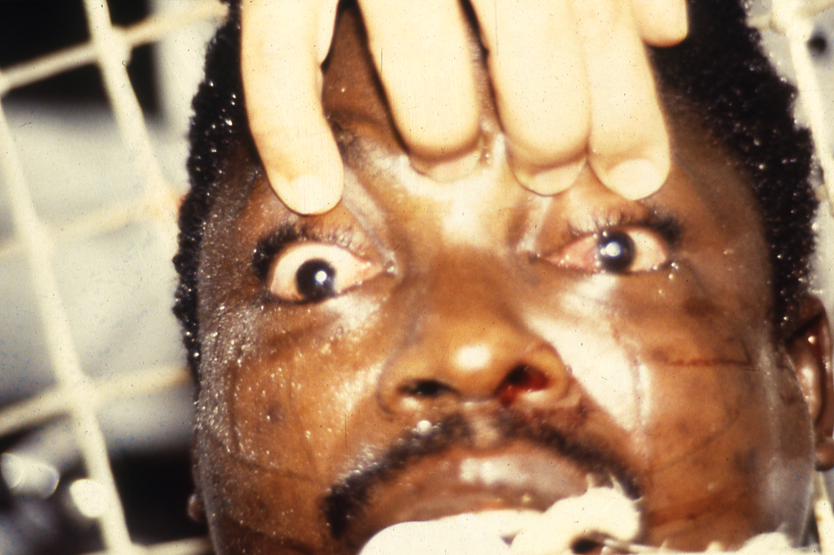

Slide 88
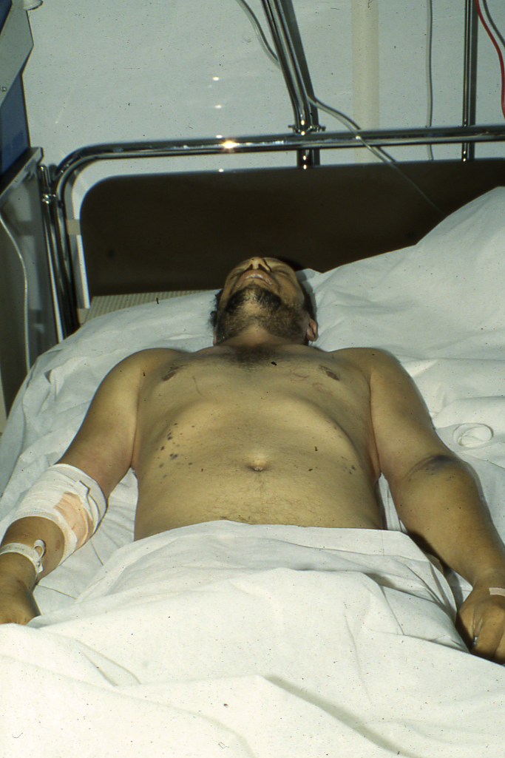

Slide 89
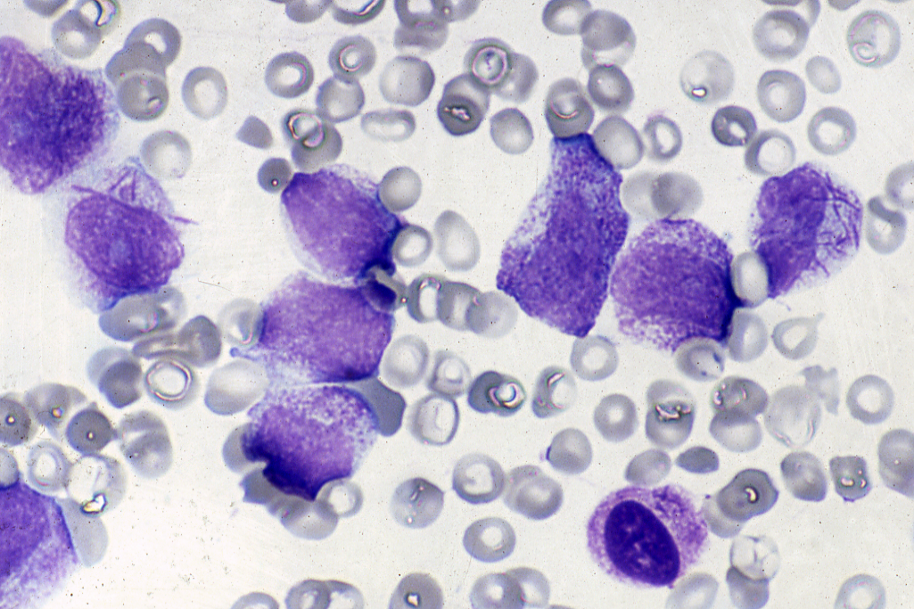

Slide 90
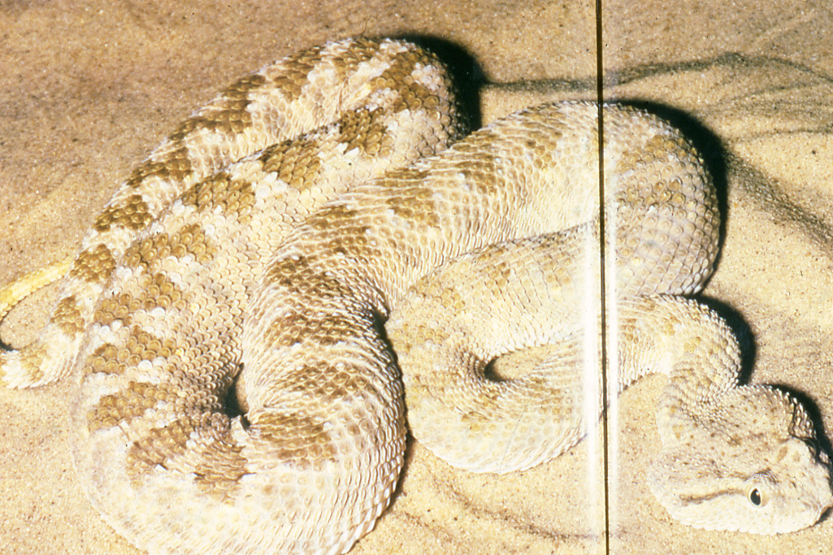

Slide 91
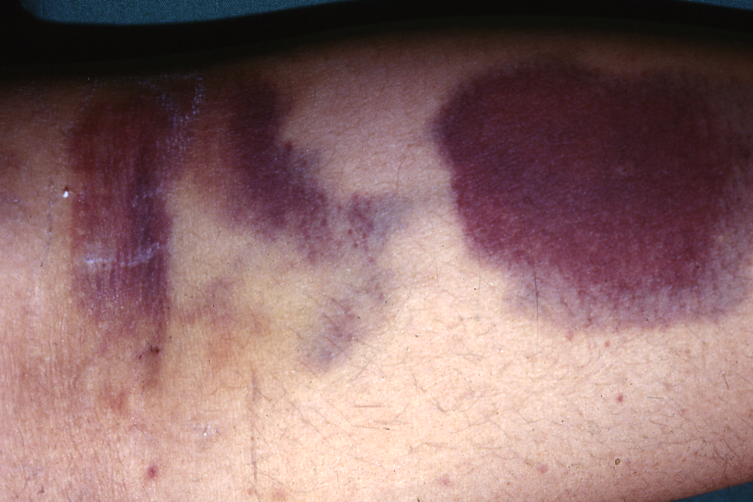

Slide 92
Disseminated intravascular coagulation (DIC)
DIC describes a process in which there is a generalized activation of the clotting system followed by marked activation of the fibrinolytic system.
Acute DIC may be associated with premature separation of the placenta, amniotic fluid embolism or shock, and may also be seen in certain bacterial infections such as meningococcal septicaemia.
It is a common complication following intravascular haemolysis of red cells after a mismatched transfusion.

Slide 93
cont’d…
Chronic DIC is seen when there is retention of a dead fetus as well as in patients with disseminated carcinoma, lymphoma and leukaemia (especially acute promyelocytic leukaemia).
Clotting cascade may be activated in various ways; namely:
by the release of TF from damaged tissues
by damage to endothelial cells
by abnormal activators of coagulation

Slide 94
cont’d…
Activation of the cascade leads to the generation and dissemination of large amounts of thrombin in the circulation, the activation of platelets and the formation of intravascular microthrombi.
As a consequence of the fibrin formation, the fibrinolytic mechanism is activated, resulting in high concentrations of FDPs, including D-dimers. This leads to further haemostatic impairment, since FDPs inhibit fibrin clot formation by interfering with the polymerization of the fibrin monomer. FDPs also interfere with the aggregation of platelets.

Slide 95
cont’d…
The haemorrhagic manifestations may be so severe in acute DIC as to lead to death
In chronic DIC, the haemorrhagic tendency may be mild or moderate. However, some patients with chronic DIC are asymptomatic because the activation of the clotting and fibrinolytic systems is finely balanced and the production of clotting factors and platelets is sufficiently increased to compensate for their increased consumption.

Slide 96
Diagnosis
The investigations of value in the diagnosis of acute or chronic DIC are as follows:
The platelet count: Platelets become enmeshed in the fibrin clots on the vascular endothelium and thrombocytopenia is an early and common sign.
The APTT and the PT: These are usually prolonged, due to the depletion of clotting factors, especially in acute DIC.
The fibrinogen concentration: This is reduced.

Slide 97
cont’d…
The thrombin time: This may be prolonged due to a combination of a low fibrinogen and excessive amounts of FDPs.
Estimation of FDPs using the D-dimer assay: FDPs including D-dimers are increased. D-dimers can be detected by rapid immunological tests in which latex particles coated with monoclonal antibody directed against D-dimer are agglutinated by D-dimers present in plasma.

Slide 98
Treatment
Treatment is aimed at preventing further coagulation by removal of the initiating cause.
Supported with transfusions of blood, fresh-frozen plasma and platelet concentrates in order to restore blood volume and replace clotting factors and platelets.

Slide 99
Acquired haemophilia
A rare but devastating acquired bleeding disorder is due to autoantibody-mediated factor VIII deficiency. It can occur in either sex, is more common in the elderly and has a high mortality. It is treated with ‘bypassing agents’ such as recombinant factor VIIa or FEIBA and immune suppression.

Slide 100
Anticoagulant drugs
The two most frequently used anticoagulant drugs are heparin and vitamin K antagonists such as warfarin. Parenteral heparin is used in patients with deep vein thrombosis (DVT) or pulmonary embolism (PE) and is followed by oral warfarin therapy. Subcutaneous heparin is used to reduce the risk of DVT and PE in hospitalized patients, including those undergoing surgery (especially hip surgery). Heparin does not cross the placenta and is therefore the preferred drug when anticoagulation is required during pregnancy. The oral anticoagulant warfarin is administered initially for three months to patients with DVT or PE and may be indicated long term to prevent recurrent venous thrombosis. Long-term warfarin is also used after the insertion of mechanical heart valves and in patients with atrial fibrillation.

Slide 101
Heparin
Standard unfractionated heparin is an acidic mucopolysaccharide (average molecular weight 1.5 X 10⁴ daltons) that has to be administered intravenously or subcutaneously. When administered intravenously, its biological half-life is 1 h. Heparin potentiates the action of AT, a molecule that inactivates the activated serine protease coagulation factors thrombin (IIa) and Xa.

Slide 102
cont’d…
Low molecular weight heparin (average molecular weight 4-5 X 10³ daltons) is used subcutaneously, it inactivates Xa to a greater extent than IIa and has a longer biological half-life. Examples of low molecular weight heparins currently in use are dalteparin, enoxaparin and tinzaparin. Fondaparinux is a synthetic pentasaccharide that induces AT specifically to inhibit Xa.

Slide 103
cont’d…
For the treatment of thrombosis or embolism, standard heparin may be administered as a bolus of 5000 units (70 units/kg) intravenously, followed by a continuous intravenous infusion of 15-25 units/kg/h. Treatment is monitored by performing the APTT, the heparin dosage being altered so as to maintain the APTT at 1.5-2.5 times the normal value. The treatment of choice is now low molecular weight heparin given subcutaneously once a day with no monitoring.

Slide 104
cont’d…
Haemorrhage due to overdosage is managed by stopping the heparin and, if necessary, by giving protamine sulphate intravenously. Side effects of heparin include heparin-induced thrombocytopenia (HIT) via an antibody-based mechanism, osteoporosis (following long-term use), alopecia and hypersensitivity reactions.

Slide 105
Warfarin sodium
This is a coumarin derivative that is administered orally once a day. It is a vitamin K antagonist and interferes with the carboxylation and hence with the functional activity of factors II, VII, IX and X, protein C and protein S. After the first dose, clotting factor activity is reduced in the order VII, IX, X and II.
It is customary to prescribe 5 or 10 mg warfarin on the first day and subsequent doses are based on the INR. The therapeutic range for the INR is usually 2-3. A higher range of 3-4 is used for recurrent DVT or PE, despite an INR >2 and for patients with certain prosthetic heart valves.

Slide 106
cont’d…
Bleeding is controlled by stopping the warfarin by administering vitamin K and, if necessary, administering prothrombin complex concentrates.
Warfarin crosses the placenta and may cause developmental abnormalities such as chondrodysplasia, microcephaly and blindness. It is therefore contraindicated in the first trimester of pregnancy. It should also not be administered during the last few weeks of pregnancy because of its anticoagulant effect on the fetus and the consequent risk of fetal or placental haemorrhage.

Slide 107
Direct oral thrombin inhibitors and direct oral Xa inhibitors
Drugs that directly inhibit thrombin (e.g. dabigatran etexilate) or Xa (e.g. rivaroxaban, apixaban, edoxaban) have been developed as oral anticoagulants that offer an alternative to warfarin in the treatment of venous thromboembolism and atrial fibrillation. They can be given in fixed dose without monitoring; they have relatively short half-lives (in the order of 9-17 hours) but no antidote.

Slide 108
Investigation of a patient with abnormal bleeding
A most important step in the diagnostic process is taking a good history from the patient.
The screening tests that are useful in investigating a patient who gives a history of excessive bleeding are the following:
A blood count, including a platelet count, and examination of a blood film.
The prothrombin time and the activated partial thromboplastin time.
The thrombin time or fibrinogen assay.

Slide 109
cont’d…
The PFA 100 can be used as a screening test for abnormal platelet function and platelet aggregation studies. If any of these tests is found to be abnormal, further specialized tests may be necessary.

Slide 110
Natural anticoagulant mechanisms and the prothrombotic state (thrombophilia)
There are natural anticoagulant mechanisms in the plasma that prevent localized fibrin formation from becoming widespread. The most important molecules involved in these mechanisms are AT, protein C and protein S, all of which are produced in the liver. Inherited or acquired abnormalities of these inhibitors of coagulation may lead to a prothrombotic state (thrombophilia).

Slide 111
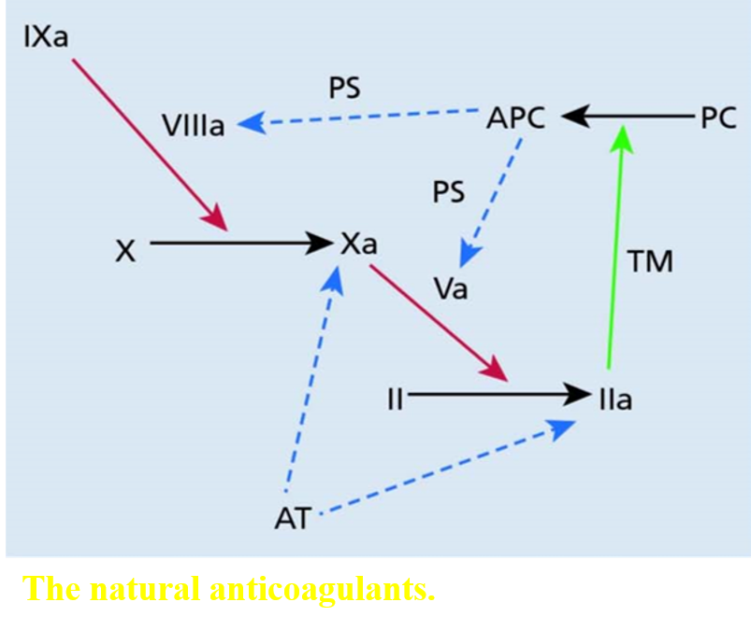

Slide 112
The antiphospholipid syndrome
The antiphospholipid antibody syndrome is defined by the presence of antiphospholipid antibodies (either anticardiolipin antibodies, antibeta-2 glycoprotein I antibodies or lupus anticoagulant) associated with thrombosis or certain problems in pregnancy. Lupus anticoagulant prolongs the results of coagulation tests that depend on phospholipid (e.g. the APTT).

Slide 113
cont’d…
Features of the antiphospholipid syndrome may include recurrent venous thromboses, recurrent arterial thrombosis (most commonly stroke) and recurrent miscarriage (due to placental thrombosis and infarction). Thrombocytopenia is common. Antiphospholipid antibodies are found in some patients with SLE or other autoimmune disorders as well as in individuals with no other evidence of an immunological abnormality.

Slide 116
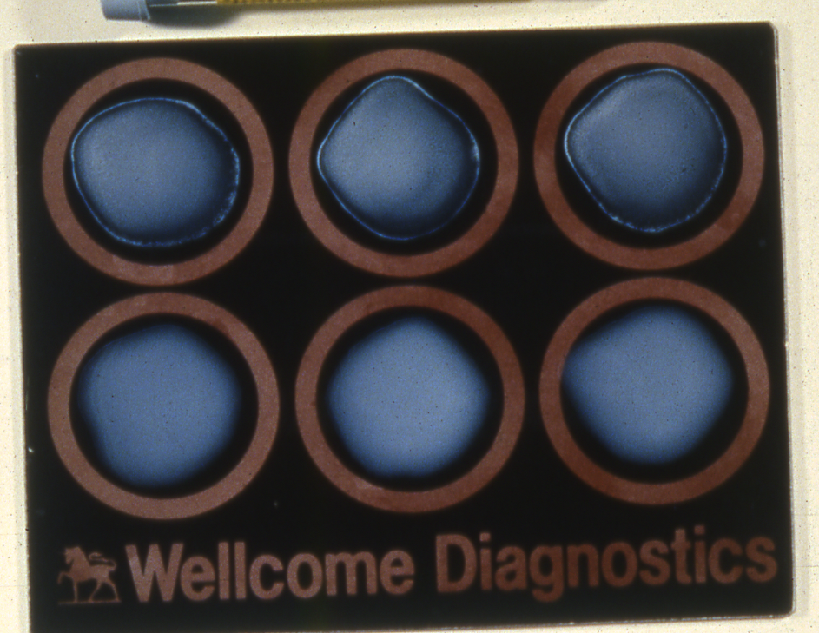

Slide 117
Haemostasis tests: typical results in acquired bleeding disorders
 | Platelet count | Prothrombin time | Activated partial thromboplastin time | Thrombin time
Liver disease | Low | Prolonged | Prolonged | Normal (rarely prolonged)
Disseminated intravascular coagulation | Low | Prolonged | Prolonged | Grossly prolonged
Massive transfusion | Low | Prolonged | Prolonged | Normal
Oral anticoagulants | Normal | Grossly prolonged | Prolonged | Normal
Heparin | Normal (rarely low) | Mildly prolonged | Prolonged | Prolonged
Circulating anticoagulant | Normal | Normal or prolonged | Prolonged

Slide 118
Screening Tests of Hemostasis
Screening tests | Defects
B.T. Prolonged | Platelets (↓ or dysfunction) + Von Willebrand’s disease
APTT prolonged | Factors: XII, XI, VIII, IX, X, V, II, I
P.T. Prolonged | Factors: VII, X, V, II, I
T.T. Prolonged | Fibrinogen (Factor I) high FDPS
Reptilase time prolonged | Fibrinogen (factor I) high FDPS. Not effected by Heparin therapy
FDPS high | ▪ D.I.C. ▪ Snake Bite ▪ Thrombolytic therapy ▪ Dysfibrinogenemia
Platelet Count Low | Thrombocytopenia
Platelet Count Normal | Platelet dysfunction

Slide 119
Indications for the use of fresh frozen plasma
Coagulation factor deficiency (where specific or
combined factor concentrate is not available)
Reversal of warfarin effect.
Multiple coagulation defects, e.g. in patients with liver disease, DIC
Massive blood transfusion with coagulopathy and
clinical bleeding
Thrombotic thrombocytopenic purpura
Deficiencies of antithrombin, protein C or protein S
Some patients with immunedeficiency syndromes

Slide 120
Oral Anticoagulants Indications
Venous thrombosis and pulmonary embolism.
Atrial fibrillation.
Heart valve prostheses.
Myocardial infarction (Selected cases)

Slide 121
Antithrombotic Therapy
2- Oral anticoagulants
* Antiplatelet drugs
* Warfarin
* New oral anticoagulant (Ximelagatran)

Slide 123
Oral Anticoagulants (Warfarin)
Doses and Preparations Available
Warfarin Preparations
Tablets 1 mg (Pink), 2 mg (Gray-Blue) 5 mg (Orange). 7.5 mg (Yellow) 10 mg (white)
Dosage: Large loading doses are no longer recommended. Depending on clinical circumstances, start with a daily dose of about 5 mg for 3 days. Check LFTs before starting treatment and do INR daily (the APTT as well) if the patient is receiving heparin, aiming to get the INR in the range between 2.0-4.5.
The usual daily dose for most patients lies between 3 mg and 6 mg but maintenance doses may vary widely and regular control, by means of an INR performed at no longer than 8 weekly intervals, is mandatory.

Slide 125
A lower dose of Warfarin may be
required in any of the following:
Elderly
Poor nutrition
Liver disease
Potentiating drugs (especially antibiotics)
Heart failure
Following surgery

Slide 126
Oral Anticoagulants (Warfarin)
INR : International Normalized Ratio
ISI : International Sensitivity Index
for the thromboplastin reagent used.
Patient’s PT ISI
INR = ---------------------
Mean normal PT

Slide 127
Oral anticoagulant control tests. Target INR levels.
-----------------------------------------------------------------------------------------
Target INR Clinical State
-------------------------------------------------------------------------------------------
2.5 Treatment of DVT, pulmonary embolism, atrial
(2.0 – 3.0) fibrillation, recurrent DVT of warfarin; symptomatic inherited thrombophilia, cardiomyopathy, mural thrombus, cardioversion
3.5 Recurrent DVT while on warfarin, mechanical
(3.0 – 4.0) prosthetic heart valves, antiphospholipid syndrome
(some cases)
-------------------------------------------------------------------------------------------

Slide 128
Recommendations on the management of bleeding and excessive anticoagulation.
__________________________________________________________________
INR 3.0 – 6.0 (target INR 2.5) Reduce warfarin dose or stop
INR 4.0 – 6.0 (target INR 3.5) Stop Warfarin,
Restart warfarin when INR < 5.0
INR 6.0 – 8.0
No bleeding or minor bleeding Stop warfarin,
Restart when INR <5.0
INR>8.0 Stop warfarin
No bleeding or minor bleeding Restart warfarin when INR<5.0
If other risk factors for bleeding
give 0.5 – 2.5 mg of vitamin K orally
Major bleeding Stop warfarin - Give prothrombin complex
concentrate 50 units/kg or FFP 15 ml/kg
Give 5 mg vitamin K (oral or i.v.)
_________________________________________________________________

Slide 129
Drugs and other factors which interfere with the control of anticoagulant therapy
---------------------------------------------------------------------------------------------------
Potentiation of oral anticoagulants Inhibition of oral anticoagulants
--------------------------------------------------------------------------------------------------
Drugs which increased the effect of coumarins Drugs which depress the action of coumarins
Reduced coumarin binding to serum albumin Acceleration of hepatic microsomal degradation of coumarin
sulphonamides barbiturates
Inhibition of hepatic microsomal degradation of coumarin rifampicin
cimetidine Enhanced synthesis of clotting factors
allopurinol Oral contraceptives
Tricyclic antidepressants
metronidazole Hereditary resistance to oral anticoagulants
Sulphonamides
Alteration of hepatic receptor site for drug Pregnancy
thyroxine
quinidine
Decreased synthesis of vitamin K factors
high doses of salicylates
some cephalosporins
Liver disease
Decreased synthesis of vitamin K factors
Decreased absoorption of vitamin K
e.g. malabsorption, anitibiotic therapy, laxatives

Slide 132
Fibrinolytic agents – plasminogen activators
Streptokinase (SK)
Tissue plasminogen activator (tPA)
Single – chain urokinase-type plasminogen activator (SCU – PA)
Acylated plasminogen – streptokinase activator complex (APSAC)

Slide 133
Contraindications to thrombolytic therapy
__________________________________________________________________
Absolute contraindications Relative contraindications
__________________________________________________________________
Active gastrointestinal bleeding Traumatic cardiopulmonary
Aortic dissection resuscitation
Head injury or cerebrovascular Major surgery in the past 10 days
accident in the past 2 months Past history of gastrointestinal
Neurosurgery in the past bleeding
2 months Recent obstetric delivery
Intracranial aneurysm or Prior arterial puncture
neoplasm Prior organ biopsy
Proliferative diabetic Serious trauma
retinopathy Severe arterial hypertension
(systolic pressure >200 mmHg, diastolic
pressure >110 mmHg)
Bleeding diathesis
__________________________________________________________________

Slide 134
Thank you

