Slide 1
Nutrition Education
Dr. Noura Abdulrahman Abouammoh
MBBS, MPH, PhD in Public Health
College of Medicine, KSU
December 2017

Slide 2
Objectives
At the end of the lecture you should gain
the ability to:
● Define nutrition education.
● Recognize the importance of nutrition
education.
● Understand methods used in nutrition
education.

Slide 3
Definition ofnutritioneducation
● It is the science of teaching the individual
how to practice proper and correct nutrition
in terms of:
1-Knowing the proper nutrition rules.
2-Knowing benefit of each nutrient.
3-More attention to quality and quantity of
foods.

Slide 4
● Nutrition: The process by which the
human intakes food for growth, energy,
and replacement of tissues; its
successive stages include digestion,
absorption, metabolism, and excretion
● Food: Any substance taken into the
body that will help to meet the body
needs for energy, maintenance and
growth.
● Nutrition requirements: The quantities

Slide 5
● Contribution differs between countries
Ignora
nce
Diseases
Malnutriti
on
Poverty

Slide 7
Importance ofnutritioneducation
● Man doesn’t have instinct nor inherit
knowledge that leads him to know the
effect of different foods on health.
● there is consensus that people’s food
choices, dietary practices, and physical
activities behaviors influence health.
● increased risk of chronic diseases.
● nutrition education can increase the
motivation, skills, and opportunities for
people to engage in health promoting

Slide 8
Aimsof nutritioneducation
To increase people’s ability to know the
following facts:
❑ The relationship between the body
growth, qualities of and appearance, and
the types of food they eat.
❑ Increased diversification in the food they
eat, and enjoy its taste.
❑ Planning and preparing of meals rich in

Slide 9
❑ The natural resources of food.
❑
Assessment of their nutritional
behaviors and beliefs.
❑
Appreciating the importance of the
standard of living improving
programs.

Slide 10
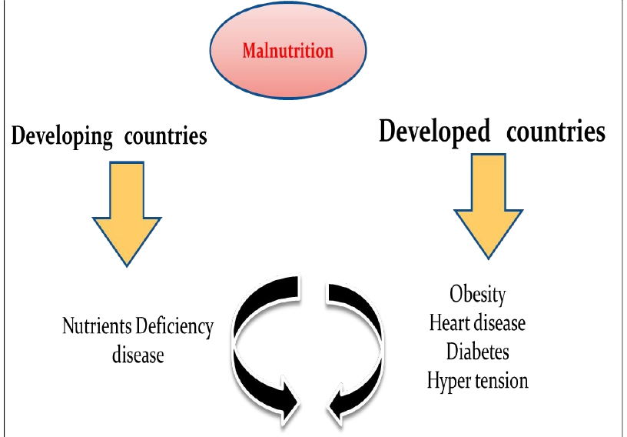

Slide 11
Factors affectedonhuman's foodconsumptions:
1-The healthy body and disease.
2-Psychological factors.
3-Food habits.
4-Economic levels.
5-Education level.
6-Religious beliefs
7-Political conditions

Slide 12
8-Social conditions
9-Form and offering way of food
10-Media
11-Travel & Tourism
12-Labor Migration
13-Geographical characteristics
15-Religious occasions

Slide 13
Nutrition Education strategy
Encouraging the targeted categories to
consume Balanced diets according to
the:
● available sources
● Renew the dishes
● Local food and eating habits
● The presenting ways
● The best preparing Methods
● Suitable food
● To Meet the needs

Slide 14
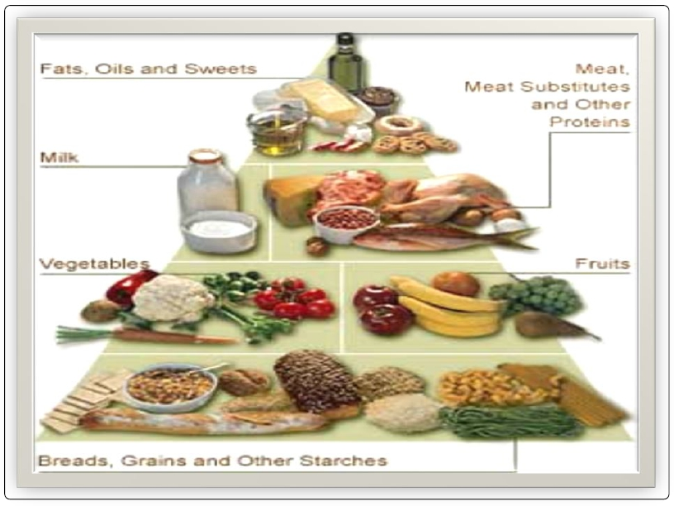

Slide 15
Changingtheeating habitsthroughnutrition
education
Food habits affect food consumption pattern.
Requirements:
● Diffusion of innovations : Spread of
innovations / (new ideas).
● Communication process: Methods of
conveying thought and
feeling, it describes interactions
between individuals and
groups as well on between various
media and people.

Slide 16
Channel: presentations,
lectures………….media
Message: simple (eat more vegetables and
fruits)
complex (how to get your child
to eat healthful)
Audience : individual, group or public.

Slide 17
Steps ofsocial change
●Innovation : Create or develop a
new idea
●Diffusion : Delivery of new ideas
through certain channels to
members of the social system
contribute a better translation.
●Results : Are those changes that
occur within the social system due to

Slide 18
Adoptionof Idea
Steps
❑ Awareness.
Recognizing innovative for the first
time
❑ Interest.
Collection of information available
about the idea as much as possible, and
more knowledge about characteristic ,
as a result of generating motivation to

Slide 19
❑
Decision & evaluation.
The adopter take decision continuing to
collect more information about the idea or to
quit , as well as begin to assess the information
which obtained according to the present
situation and future prospects for decision to
adopt it , or leave it.
❑
Trial.
In this stage the individual try to apply the
new ideas in small area , to esteem the
benefits of this new ideas.
❑
Adoption
After recognizing and after convicting the
benefits of the new ideas , the person will adopt

Slide 20
Classesof adopters
● Innovators
● Early adopters
● Early majority
● late majority
● laggards

Slide 21
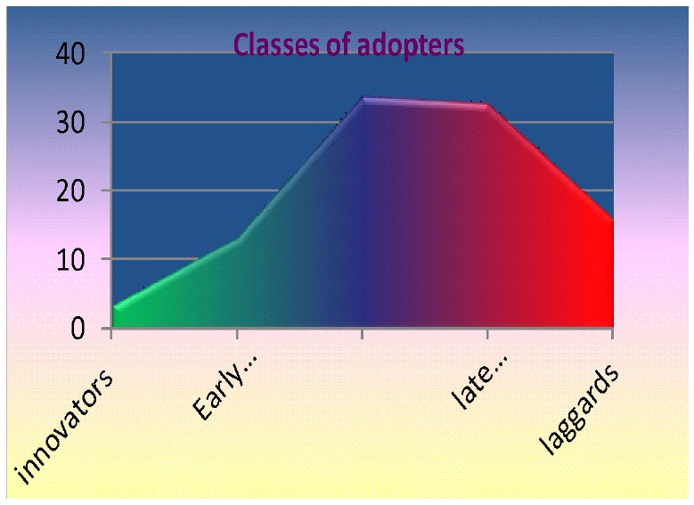

Slide 22
Criteriawhich affecton diffusionof innovation:
● Relative advantage of the new idea.
● Complexity (easy in understanding and applying)
● Compatibility (suitability) .
● Results observe-ability
● Societies characteristic, and thinking pattern .
● Coast of the new ideas.
● Education levels
● Socio-economic levels.
● Civilizing (modernizing ) and cultural practices of
the societies.
● Customs and traditions prevailing in the
community.

Slide 23
Choosing the channels of nutrition
education
1.Newspapers and publications.
2. The radio.
3. Television.
4. Space stations.
5. Telephone and fax.
6. Internet

Slide 24
Techniques
Ways in which educators could deliver
the massage to the receivers (target
groups)
1.lecture
2. seminars
3. symposium
4. role play
5. discussion groups

Slide 25
References
● El-Shafi M. Nutrition education.
Educational course. CHS456. KSU.
● Park K. Nutrition and health. In:
Preventive and social Medicine. Editor.
21th edition. 2011 pages 561-617.

