Slide 1

PRACTICAL ON BLOOD PARASITES

Slide 2
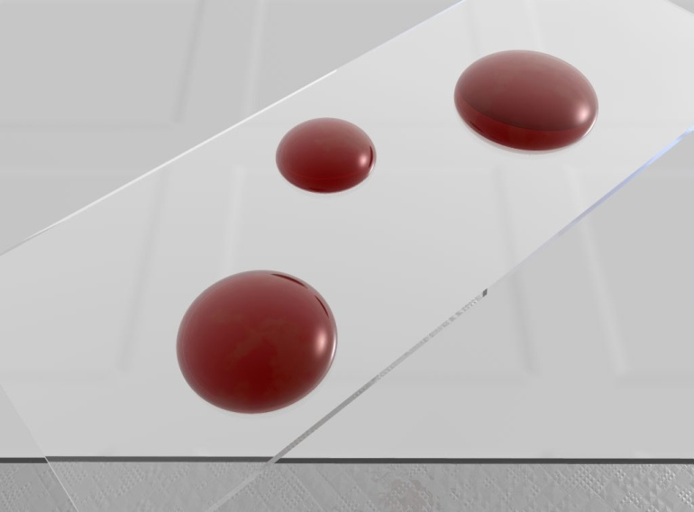
Common methods for parasitological diagnosis of malaria
The two methods common in use :
1: Light microscopy
2: Rapid diagnostic tests (RDTs).

Slide 3
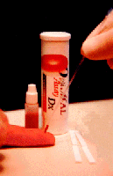
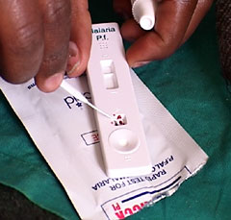
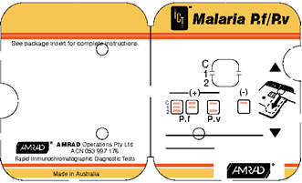
Laboratory diagnosis of malaria
Rapid diagnostic tests detect malaria antigens

Slide 4
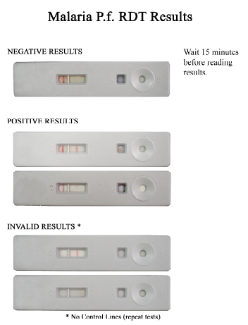

Slide 5
RDT procedure

Slide 6

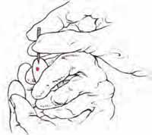
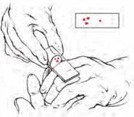
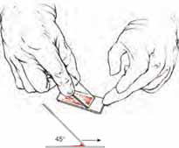
Laboratory diagnosis of malaria
Light microscopy:1: Preparing blood film

Slide 7
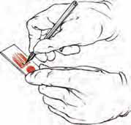

Laboratory diagnosis of malaria
Light microscopy:1: Preparing blood film

Slide 8

Laboratory diagnosis of malaria
Light microscopy: Thick and thin films

Slide 9
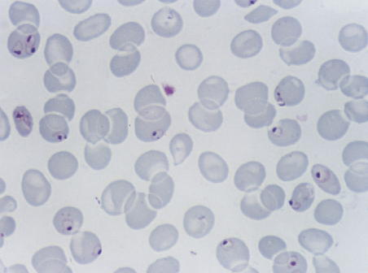
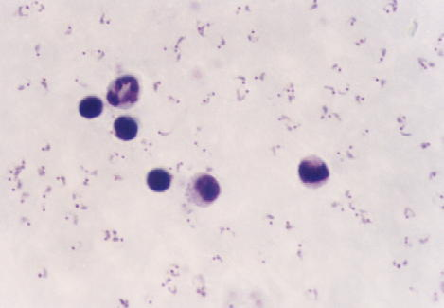
Laboratory diagnosis of malaria
Plasmodium falciparum (trophozoite stage in thin smear)
Plasmodium falciparum (trophozoite stage in thick smear)
CCMOVBD

Slide 10
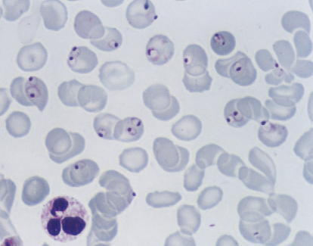
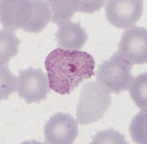
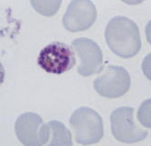
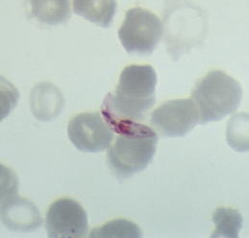
The Malaria Parasite
Trophozoites
Three developmental
stages seen in blood
films:
CCMOVBD
CCMOVBD
Trophozoite
Schizont
Gametocyte
2. Schizont
3. Gametocyte
CCMOVBD
CCMOVBD

Slide 11
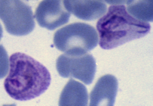
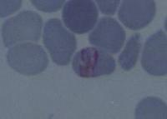
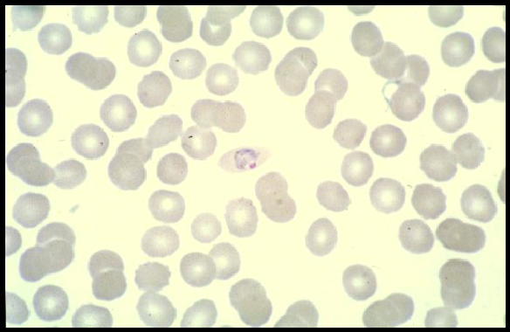
Plasmodium vivax
CCMOVBD
Species of malaria is identified by its chracteristic microscopic appearance:
Plasmodium malariae
Plasmodium ovale
CCMOVBD
Malaria Tutorials, Wellcome Trust

Slide 12
Plasmodium falciparum (trophozoite stage in thin smear)
CCMOVBD

Slide 13
Plasmodium falciparum (trophozoite stage in thick smear)
CCMOVBD

Slide 14
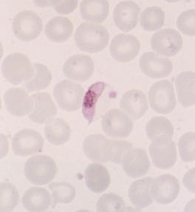
Plasmodium falciparum
(characteristic banana-shaped or crescent –shaped gametocyte stage in thin smear)
CCMOVBD

Slide 15
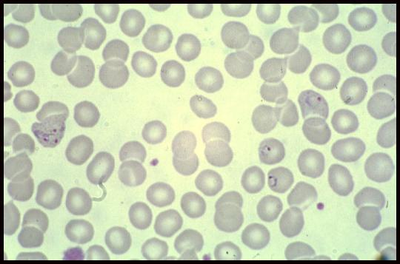
A 25 year-old male from India, who came 3 months ago was admitted in KKUH with a history of severe anaemia and intermittent high grade fever for the last two months not responding to antibiotics.
WHAT IS THE DIAGNOSIS?
Diagnosis: malaria or Plasmodium vivax

Slide 16
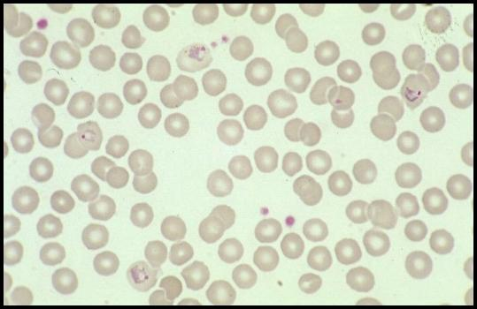
A businessman who makes frequent trips to Thailand , presents with intermittent fever .
WHAT IS THE DIAGNOSIS?
Diagnosis: malaria or Plasmodium vivax

Slide 17
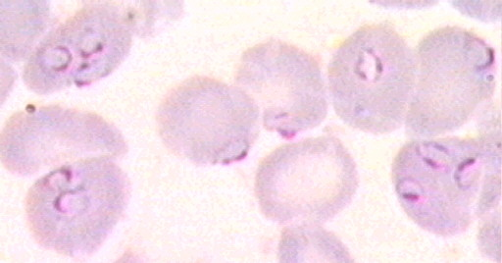
A student in KSU who returned three weeks from vacation in Africa , he developed intermittent fever last week and lost consciousness a short time ago.
WHAT IS THE DIAGNOSIS?
Diagnosis: malaria or Plasmodium falciparum

Slide 18
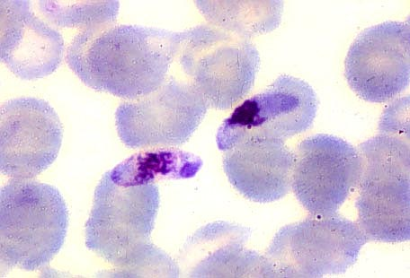
The patient was then treated with schizontocidal antimalarial drugs, a follow-up blood film is shown .
ARE THERE ANY PARASITES? WHAT STAGE ?
Plasmodium flaciparum , gametocyte stage

Slide 19
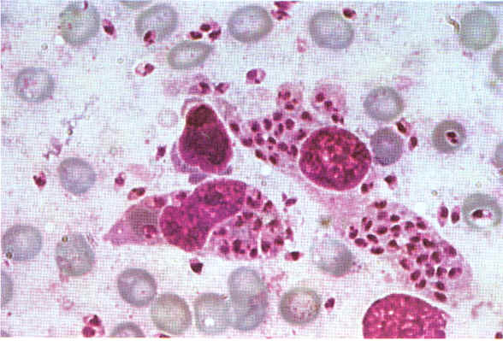
A 7 year old child presented with anemia , hepatospenomegaly and fever .Not responding to antimalarials and antibiotics . Bone marrow smear is shown
ARE THERE ANY PARASITES? WHAT STAGE ?
Leishmania , amastigote stage

Slide 20
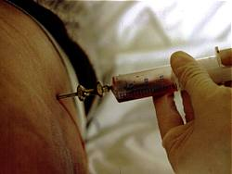
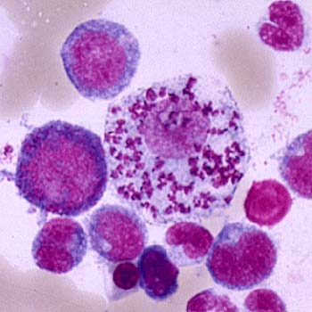
Bone marrow aspiration
Bone marrow amastigotes

