Slide 1
Salmonella & shigella
GIT BLOCK
Prof. Ali Somily & Prof .Hanan Habib
Department of Pathology
College of medicine

Slide 2
Objectives
1-Develop an algorithm using biochemical tests to
identify and classify Salmonella and Shigella
2- Describe the antigenic structures and virulence factors of Salmonella and Shigella
3- Compare the pathogenesis of various species of Salmonella and Shigella
4-Describe the clinical features and risk factors for the infection with the two organisms
5- Describe the general concepts for the management of gastroenteritis caused by both organisms.

Slide 3
Salmonella

Slide 4
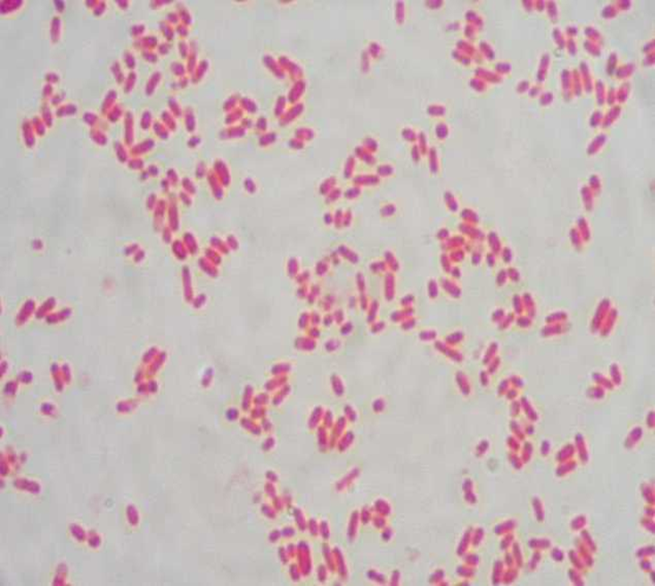
Introduction
Salmonella is a Gram negative facultative anaerobic bacilli
Non lactose fermenting
Motile

Slide 5
Classification -Has two species s.enterica (six subspecies I, II, III, IV, V, VI) s.borgori (rare) -Cold blooded animal, birds, rodents, turtles, snake and fish
Two species of salmonella : S.enterica (six subspecies I, II, III, IV, V, VI)& S.borgori (rare)
Found in cold blooded animal, birds, rodents, turtles, snakes and fish

Slide 6
Virulence factors
Fimbriae ( Pili) : for adherence
Enterotoxin

Slide 7
Antigenic structures
O. Somatic antigen
H. Flagellar antigen
K. Capsular antigen

Slide 8
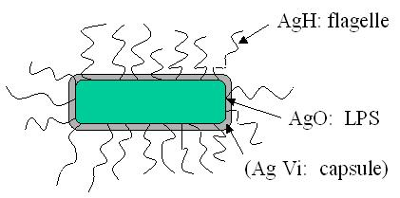
V_{i} surface polysaccharide antigen in Salmonella serotype typhi prevents phagocytosis & allow intracellular survival.
O Antigen (Heat – stable) is lipopolysaccharide in the outer membrane
H antigen (Heat labile)

Slide 9
Clinical diseases
Acute gastroenteritis
Typhoid fever
Nontyphoidal bacteremia
Carrier state following Salmonella infection

Slide 10
Source
Water, food and milk contaminated with human or animal excreta.
Salmonella typhi and S.paratyphi : the source is human.

Slide 11
Salmonella gastroenteritis
Food poisoning through contaminated food
S. enterica subsp. enterica the common cause
Source :poultry, milk, egg & egg products and handling pets
Infective dose: 10⁶ bacteria
Incubation period : 8 – 36 hrs.
fever, chills, watery diarrhea and abdominal pain. Self limiting.
In sickle cell ,hemolytic disorders , ulcerative colitis, elderly or very young patients; the infection may be very severe.
Patients at high risk for dissemination and antimicrobial therapy is indicated.

Slide 12
Enteric fever (Typhoid fever)
Prolonged fever
Bacteremia
Involvement of the reticulo endothelial system (liver, spleen, intestines and mesentery)
Dissemination to multiple organs
Ingestion of contaminated food by infected or carrier individual
Caused by Salmonella serotype typhi or S. paratyphi A, B and C (less severe)
Common in tropical , subtropical countries, and travelers to these countries due to inappropriate sewage disposal and poor sanitation.
Incubation period : 9 – 14 days.

Slide 13
First week: fever, malaise, anorexia, myalgia and a continuous dull frontal headache then,
Patient develops constipation
Mesenteric lymph node → blood stream liver, spleen and bone marrow
Engulfment of Salmonella by mononuclear phagocytes .
Bacteria released into the blood stream again and can lead to high fever . Blood culture is positive.

Slide 14
2nd and 3rd week
Sustained fever & prolonged bacteremia.
Invade gallbladder and Payer's patches
Rose spots 2nd week of fever
Billiary tract → GIT
Organism isolated from stool .

Slide 15
Management & Treatment
Enteric fever:
Ceftriaxone
Ciprofloxacin
Trimelhoprim – Sulfamethoxazole
Ampicillin
Azithromycin or Ceftriaxone for patients from India and SE Asia due to strains resistant to Ciprofloxacin. Ciprofloxacin can be used for patients from other areas.
Salmonella gastroenteritis:
Uncomplicated cases require fluid and electrolyte replacement only.

Slide 16
COMPLICATIONS
Necrotizing cholecystitis
Bowel hemorrhage and perforation
Pneumonia and thrombophlebitis
Meningitis, osteomyelitis, endocarditis and abscesses.

Slide 17
Shigella

Slide 18
Shigella is non lactose fermenting Gram negative bacteria
Cause bacillary dysentery ( blood, mucus and pus in the stool)

Slide 19
ANTIGENIC STRUCTURES
Shigella has four species and four major O antigen groups:
S.dysenteriae, S.flexneri. S.boydii & S.sonnei.
All have O antigens , some serotypes has K antigen
Shigella are non motile so lack H antigen

Slide 21
CLINICAL INFECTION
S. dysenteriae type 1 associated with morbidity and mortality
S. dysenteriae and S. boydii are most common isolates in developing countries
S.flexneri :2nd common in developing countries
S.sonnei : most predominant in USA. Produce fever & watery diarrhea.
Human is the only reservoir

Slide 22
Person to person through fecal –oral route .
Flies, fingers ( have a role in spread).
Food and water.
Young children in daycare, people in crowded area and anal oral sex in developed countries.
Low infective dose < 200 bacilli
Penetrate epithelial cells ,leads to local inflammation, shedding of intestinal lining and ulcer formation.

Slide 23
SYMPTOMS
High fever, chill, abdominal cramp and pain accompanied by tenesmus , bloody stool with mucus & leukocytes.
Incubation period : 24 - 48 hrs
Can lead to rectal prolapsed in children
Complications: ileus, obstruction dilatation and toxic mega colon
Bacteremia in 4 % of severely ill patient
Seizures, HUS ( hemolytic uremic syndrome)

Slide 24
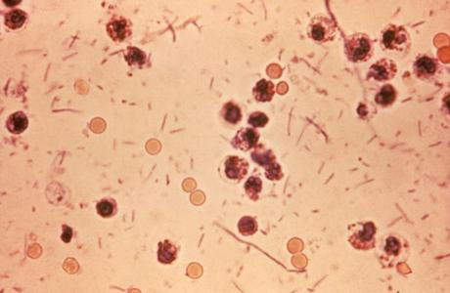
DYSENTRY STOOL

Slide 25
Laboratory diagnosis of Salmonella & Shigella from stool
-Both are Gram negative bacilli
-Culture in selective media ( Salmonella produce black colonies )
-Biochemical tests
-Motility test
-Serology for serotypes.

Slide 26
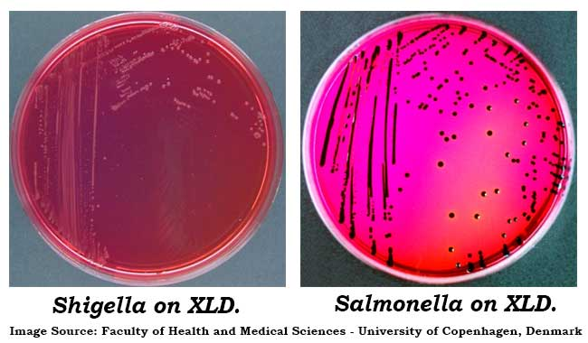

Slide 27
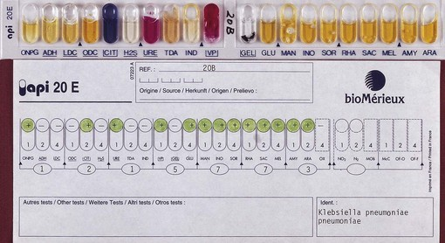
BIOCHEMICAL TESTS

Slide 29
Treatment of Shigella Dysentery
-Antibiotic indicated if symptoms severe and to reduce duration of illness.
-Antimicrobial agents depending on susceptibility testing including :
Ampicillin
Ceftriaxone
TMP-SMX
Ciprofloxacin

