Slide 1

Normal Flora Of The GIT And Introduction To Infectious Diarrhea
Prof .Hanan Habib
Department of Pathology, College of Medicine

Slide 2
Objectives
Know the common normal flora of the GIT
Understand the role of the GIT normal flora in diseases.
Recognize various types of acute diarrheal illnesses .
Describe the epidemiology & host defenses in preventing GI infections.
Explain the pathogenesis of E.coli , Campylobacter and Yersinea and their management.

Slide 3
Objectives
6.Discuss microbiological methods used for the diagnosis of common bacterial agents causing diarrheal infection.
7.Describe the pathogens, risk factors, clinical presentation and prevention of food poisoning ,travelers and antibiotics associated diarrhea.

Slide 4
Introduction to Normal Flora
Normal flora are microorganisms that are frequently found in various body sites in normal, healthy individuals.
Constituents and number vary according to the age and physiologic status.
Able to colonize and multiply under the exiting condition of different body sites.
Inhibit competing intruders.
Have symbiotic relationship that benefit the host.
Can cause disease in immunocompromized patients.

Slide 5
Normal Flora of the GIT
Oral cavity: contain high number of flora which vary from site to site of the mouth.
Saliva contain mixed flora :108 organism /ml
Stomach : empty stomach has no normal flora in health due to HCL and peptic enzymes
Small intestine : very scanty except near colon
Colon of adults: 1010 org/gm stool, >90% are Bacteriodes ( anaerobic), 10% other bacteria.
Direct effect of diet composition.

Slide 6
Normal Flora of the GIT
Mouth: Viridans streptococci, Neisseria spp., Moraxella, Peptostreptococcus.
Nasopharynx :
Niesseria spp., Viridans sterpt. Moraxella, Peptostreptococcus.
Stomach : streptococci, Peptosterptococcus, others from mouth.
Small intestine: scanty, variable
Colon of adults :Bacteriodes,Fusobacterium,Bifidobacteria,Lactobacillus, enterobacteria, Clostridium
Colon of Breastfeeding infants: Bifidobacterium, Lactobacillus
Mouth: Candida albicans
Nasopharynx: S.pneumoniae, N.meningitidis, H.infuenzae,S.pyogenes, S.aureus
Stomach: none
Small intestine : none
Colon of adults: B.fragilis, E.coli, Pseudomonas, Candida, Clostridium
Colon of Breast feeding infants: none
Normal flora ( low virulence)
Potential pathogen (carrier)

Slide 7
Role of GIT Normal Flora in Disease
Many are opportunistic pathogens , eg. perforation of the colon from ruptured diverticulum, feces enters into peritoneal cavity and cause peritonitis
Viridans streptococci of oral cavity enters the blood and colonize damaged heart valves.
Mouth flora play a role in dental caries.
Compromised defense systems increase the opportunity for invasion.
Death after lethal dose of radiation due to massive invasion of normal flora.

Slide 8
Role of Normal Flora in Diarrheal Diseases
E.coli : the most common Enterobacteriacae; a facultative flora of colon followed by Klebsiella, Proteus and Enterobacter.
Salmonella, Shigella and Yersinia are NOT normal flora of the intestinal tract.
Some strains of E.coli ,Salmonella ,Shigella and Yersinia enterocolitica are able to produce diseases in the intestinal tract.

Slide 9
Intestinal Pathogens
Invasive and Cytotoxic strains produce inflammatory diarrhea ( Dysentry ) with WBCs and /or blood in the stool.
Enterotoxin –producing strains cause watery diarrhea with loss of fluid.
Some produce systemic illness due to spread to multiple organs such as enteric ( typhoid) fever.

Slide 10
Acute Diarrheal Illnesses and Food Poisoning

Slide 11
Introduction
Acute diarrheal illness is one of the most common problems evaluated by clinicians.
A major cause of morbidity and mortality world wide.
Most of healthy people have mild illness but other might develop serious squeals so it is important to identify those individuals who require early treatment.

Slide 12
Definition of Diarrhea
Stool weight in excess of 200 gm/day, or
three or more loose or watery stools/day
Alteration in normal bowel movement characterized by decreased consistency and increased frequency
Less than 14 days in duration.

Slide 13
Etiology
Viral: 70-80% of infectious diarrhea in developed countries
Bacterial: 10-20% of infectious diarrhea but responsible for most cases of severe diarrhea
Protozoan: less than 10%.

Slide 14
Epidemiology
1.2 - 1.9 episodes per person annually in the general population
2.4 episodes per child <3 years old annually
5 episodes per year for children <3 years old and in daycare
Seasonal peak in the winter.

Slide 15
Classifications
Infectious Diarrhea: caused by Viral, Bacterial (eg. Campylobcator, Shigella, Salmnella, Yersinea, Vibrio cholera & E.coli).
Food Poisoning: caused by Staphylococcus aureus, Clostridium perfringens, Bacillus spp.
Traveler Diarrhea : caused by Enterotoxogenic E.coli.
Antibiotic Associated Diarrhea: Clostridium difficile.

Slide 16
Risk Factors
Food from restaurant
Family member with gastrointestinal symptoms
Recent travel to developing countries
Patient underlying illness and medication, low stomach acidity, cyst, spores
Abnormal peristalsis
Low Immunoglobulin A (IgA).
Antibiotics decrease the normal flora to less than10¹²
Median infective dose (ID₅₀)

Slide 17
Clinical Presentation & Pathogenic Mechanism I
Enterotoxin mediated
Lack of pus in the stool (no gut invasion)
Lack of fever
Rapid onset performed toxin<12 hour
Small intestine affected.
Vomiting non-bloody diarrhea, abdominal cramp.
Vibreo cholerae, Staphylococcus aureus, Clostridium perfringens and Bacillus cereus
Some viral and parasitic infections.

Slide 18
Clinical Presentation and Pathogenic Mechanism II
Invasive
Pus and blood in the stool
Fever due to inflammation
Shigella, Solmonella spp., Campylobacter, some E.coli and Entameba histolytica
Affect colonic mucosa
Extension to lymph nodes
Incubation period 1-3 days
Dysentery syndrome- gross blood and mucous
EHEC bloody diarrhea
Entameoba histolytica 1-3 wk

Slide 19
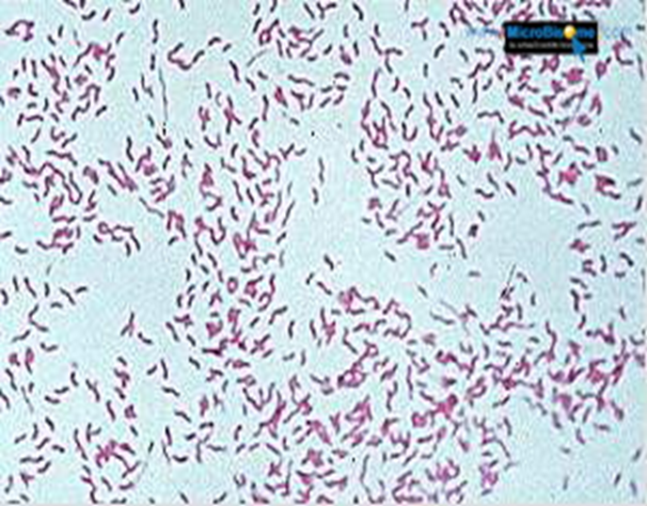
Campylobacter
Gram negative curved ( spiral or s-shape ) bacilli .
world wide infection ,more common among children
Common species : C.jejuni, C. coli, C fetus.
Source: dog , cat, birds, poultry ,water, milk, meat, person to person transmission can occur.

Slide 20
Clinical presentation
Incubation period: 2-6 days
Lower abdominal pain , watery or dysenteric diarrhea with pus and blood. fever in some patients . Nausea and vomiting are rare
Self limiting after 2-6 Day
Chronic carrier, outbreaks uncommon.
May lead to autoimmune disease like Guillain- Barrie’ syndrome and extra-intestinal infections eg. reactive arthritis ,bacteremia ,lung infection and others frequently preceded by C.jejuni infection.

Slide 21
Laboratory diagnosis and treatment
Laboratory diagnosis:
  Use transport media
  Culture on CAMPY BAP media containing antibiotics.
  Incubate in microaerophilic atmosphere (5%O₂ 10%CO₂ 85%N ) at 42°C except C.fetus 37°C
  Identification :Gram stain/culture biochemical/Serology.
Treatment:
  Only severe cases
  Erythromycin or Ciprofloxacin .

Slide 22
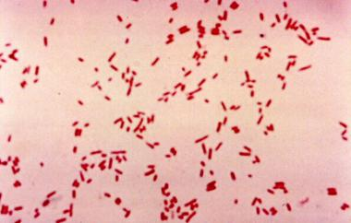
E.coli
About 10 -15% of strains of E. coli associated with diarrhea. Other strains associated with extra-intestinal diseases( septicaemia, meningitis & UTI).
Based on virulence factors, clinical manifestation, epidemiology and different O and H serotype.
Types of Diarrheagenic E. coli :
  Enterotoxigenic E. coli (E T E C)
  Enteropathogenic E. coli (E P E C)
  Enteroinvasive E. coli (E I E C)
  Enterohaemorrhagic E. coli (E H E C )
  Enteroaggregative E.coli (EAEC)

Slide 23
1. Enterotoxigenic E.coli (ETEC)
Major cause of Traveler's diarrhea in infant and adult in developing countries from contaminated food and water.
It has high infective dose 10⁶-10¹⁰
Has heat-labile toxin (LT) and heat-stable toxin (ST) each has two fragment (A and B) . No invasion or inflammation.
LT leads to accumulation of CGMP, which lead to hyper-secretion of fluid with no cellular injury
Symptoms watery diarrhea, abdominal cramps and some time vomiting .
Self limiting .No routine diagnostic method required.

Slide 24
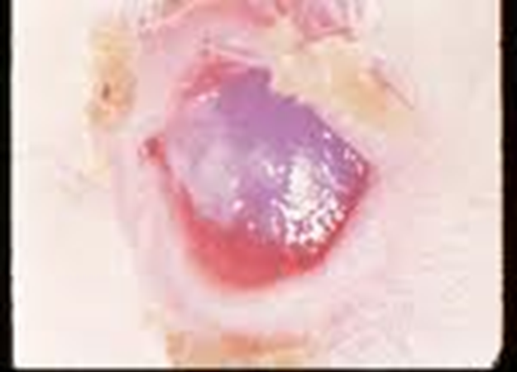
2. Enteroinvasive E.coli ( EIEC)
Produce dysentery (Penetration, invasion and destruction).Common in children.
Similar to Shigella spp. (non motile, LNF)
Transmission :Fecal oral route .
Fever, severe abdominal cramp, malaise and watery diarrhea
Infective dose 10⁶
Diagnosis Sereny test and DNA probes.

Slide 25
3-Enteropathogenic E.coli ( EPEC)
Cause infantile diarrhea ( bottle fed infants)
Disrupt microvilli and intestinal absorptive function.
Outbreak in hospital nurseries and day care centers
Low grade fever, malaise, vomiting and watery diarrhea
mucous in stool but no blood.

Slide 26
4-Enterohemorrhagic E.coli ( EHEC)
0157:H7 Hemorrhagic diarrhea, colitis and hemolytic uremic syndrome (HUS)=low Platelet count, hemolytic anemia and kidney failure
Bloody diarrhea, low grade fever and stool has no leucocytes
Fatal disease in young and elderly persons in nursing homes
Undercooked hamburgers, unpasteurized dairy products, Apple cider, cookie dough
Cytotoxin =vertoxin І and vertoxin ІІ Similar to Stx₁ (shiga-toxin I&II)
E.coli other than 0157:H7 can cause HUS.
Diagnosis by culture on SMAC(sorbitol MacConkey agar cefixime), Vertoxin detection by immunological test or PCR.

Slide 27
5. Enteroaggregative E.coli ( EAEC)
Pediatric diarrheal disease
Adhering to the surface of the intestinal mucosa. Produce aggregative stacked brick .
Produce mucoid ,watery diarrhea, vomiting, dehydration and abdominal pain
may resolve after two weeks or more .

Slide 28
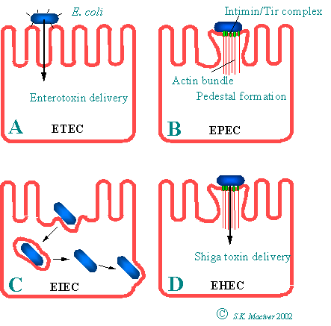

Slide 29
Yersinia enterocolitica
Mesenteric lymphadenitis in children and septicemia in immunocompromised hosts
Common in Europe, USA, Canada .Cat, dog, swine (chitterlings)
Survive cold temperatures and associated with transfusion of packed red blood cells.
Presented with enteritis, arthritis and erythema nodosum
Generalize infection in adult and children 1-5 yrs, usually mild but in old children adult mimic appendicitis
Growth at 25°-30°C media Cefsulodin-Igrasan-Novobiocin

Slide 30
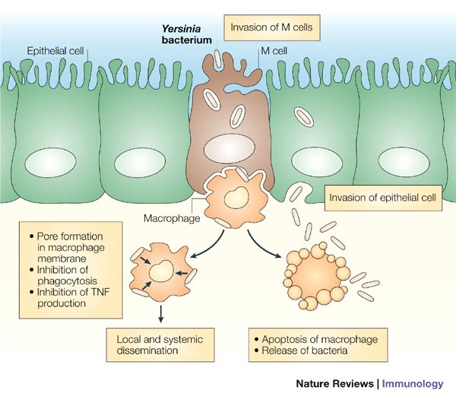

Slide 31
Clostridium difficile
Antibiotic associated diarrhea ( ampicillin, cephalosporins & clindamycin). Antibiotic use for the last 8 weeks ( community acquired) or hospital stay for at least 3 days ( hospital acquired).
Transmitted from person to person via fecal-oral route
Cultured from in animate hospital surfaces.
Disruption of the endogenous bacterial flora of the colon
Produce toxin A ( enterotoxic & cytotoxic effects ) and B ( cytotoxic ) that can bind to surface epithelial cell receptors leading to inflammation mucosal injury and diarrhea.

Slide 32
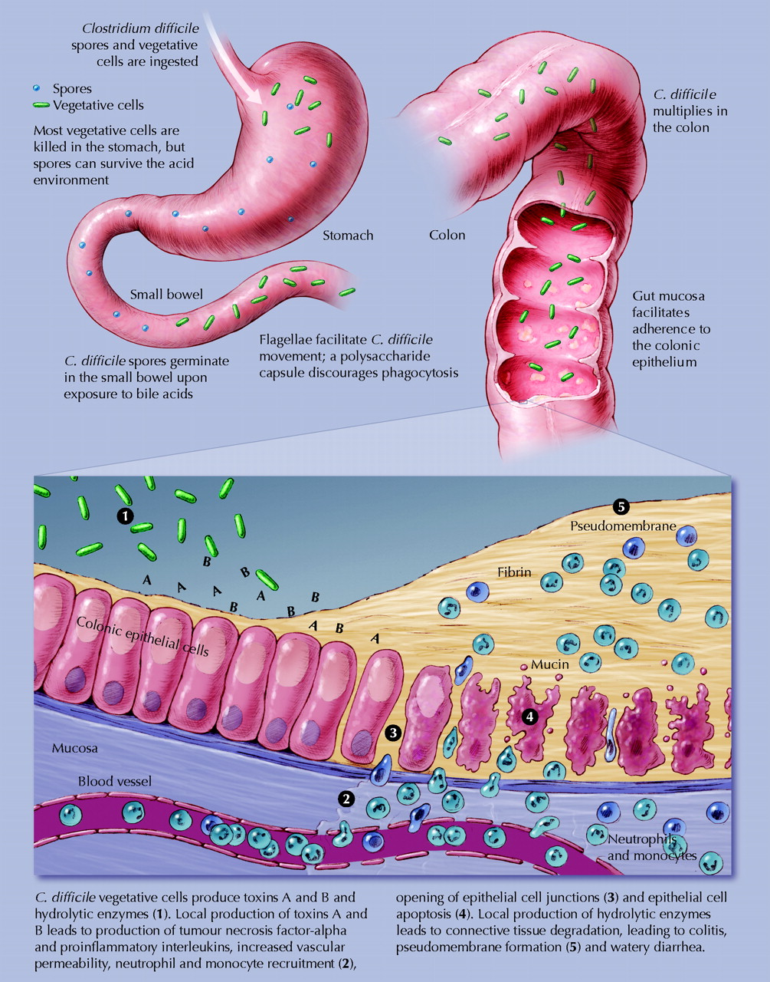

Slide 33
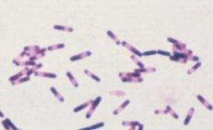


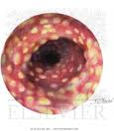
C.difficile & pseudomembraneous colitis

Slide 34
Clostridium difficile
Patient presents with fever, leukocytosis, abdominal pain and diarrhea
Pseudomembrane can result (neutrophils, fibrin, and cellular debris in the colonic mucosa) and toxic megacolon
Diagnosis: direct toxin detection from stool by enzyme immunoassay(EIA)
Treatment Metronidazole ± oral Vancomycin and supportive treatment

Slide 35
Selected Clinical and Epidemiologic Characteristics of Typical Illness Caused By Common Foodborne Pathogens*
Pathogen | Typical Incubation Period | Duration | Typical Clinical Presentation | Assorted Foods
Bacterial
Salmonella species | 1-3 Days | 4-7 Days | Gastroenteritis | Undercooked eggs or poultry, produce
Campylobacter jejuni | 2-5 Days | 2-10 Days | Gastroenteritis | Undercooked poultry, unpasteurized dairy products
E. coli, Enterotoxigenic | 1-3 Days | 3-7 Days | Gastroenteritis | Many foods
Shigella species | 1-2 Days | 4-7 Days | Gastroenteritis | Produce, egg salad

Slide 36
Listeria monocytogenes | 2-6 weeks | Variable | Gastroenteritis, meningitis abortion | Deli meat, hotdogs, unpasteurized dairy products
Bacillus cereus | 1-6 hour | <24 hour | Vomiting, Gastroenteritis | Fried rice, meats
Clostridium botulinum | 12-72 hour | Days-months | Blurred vision, paralysis | Home-canned foods, fermented fish
Staphylococcus aureus | 1-6 hour | 1-2 Days | Gastroenteritis, particularly nausea | Meats, potato & pork, unpasteurized dairy products.
Yersinia enterocolitica | 1-2 Days | 1-3 weeks | Gastroenteritis, appendicitis-like syndrome | Undercooked pork, unpasteurized dairy products.

Slide 37
Lab diagnosis of diarrheal diseases due to bacterial causes
Stool specimen:
Microscopy: for the presence of polymorphs or blood may help .
Culture :on selective media for Salmonella, Shigella & Campylobacter.
Culture for Vibreo cholerae, EHEC or Yersinia if suspected.
Toxin assay: if C.difficile toxins is suspected.

