Slide 1
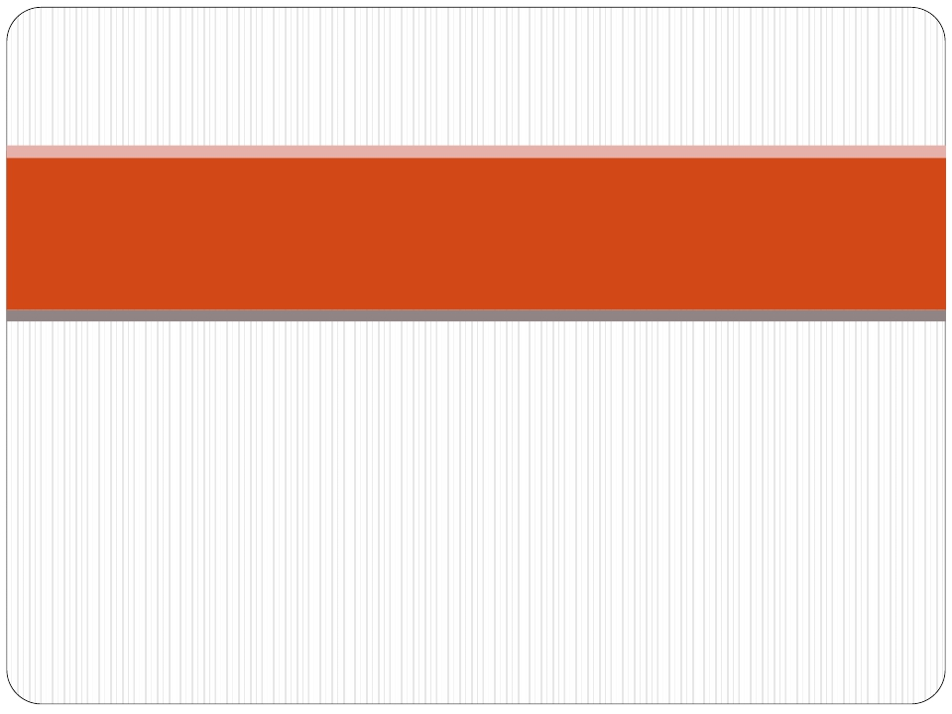
Liver Cirrhosis
pathology

Slide 2
Liver cirrhosis
Objectives:
 Define Cirrhosis.
 Recognize the types of cirrhosis.
 Recognize the causes and the pathogenetic mechanisms
leading to cirrhosis.
 Describe the pathological findings in cirrhotic livers.

Slide 3
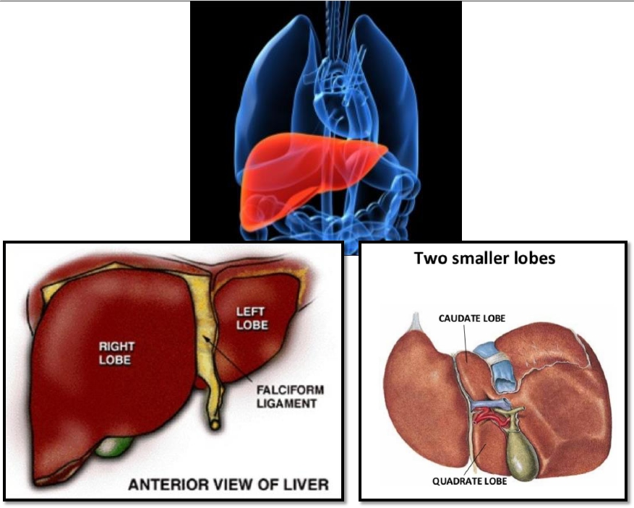
weighs 1400 to 1600 gm

Slide 4
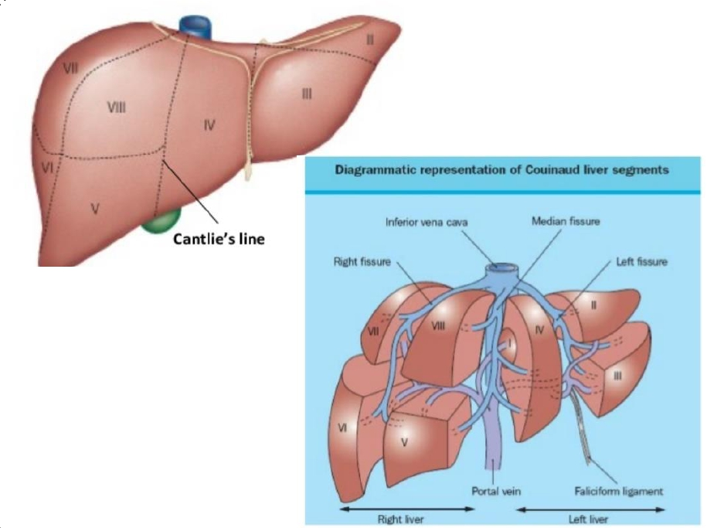

Slide 6
Cirrhosis
 Cirrhosis refers to the diffuse transformation of the liver
into regenerative parenchymal nodules surrounded by
fibrous bands
 It is among the top 10 causes of death in theWestern
world.
 It is the end-stage of chronic liver disease
 The chief worldwide causes are:
I.
II.
alcohol abuse
viral hepatitis
 Other causes include:
1.
2.
biliary disease
iron overload

Slide 7
Cirrhosis
Cirrhosis is defined by three characteristics
1)Fibrosis in the form of delicate bands or
broad scars/septa
2)Nodules containing regenerating hepatocytes
encircled by fibrosis,with diameters varying
from very small (<3 mm,micronodules) to
large (several centimeters, macronodules)
3)Disruption of the architecture of the entire liver

Slide 8
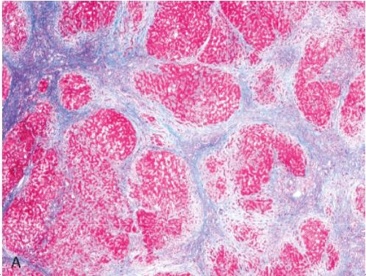
Features of cirrhosis
 Vascular architecture is reorganized by the parenchymal
damage and scarring,with the formation of abnormal
interconnections between vascular inflow and hepatic vein
outflow channels
 Fibrosis is the key feature of progressive damage to the liver.
Once cirrhosis has developed,reversal is thought to be rare

Slide 9
Classifiation of cirrhosis
 The classification is based on the underlying
etiology.
 Many forms of cirrhosis (particularly alcoholic
cirrhosis) are initially micronodular,but there is
a tendency for nodules to increase in size with
time.

Slide 10
Classifiation of cirrhosis based on
causes
 Alcoholic liver disease
 Viral hepatitis
 Biliary diseases
 Primary hemochromatosis
 Wilson disease
 α1-Antitrypsin deficiency
 Cryptogenic cirrhosis
60% to 70%
10%
5% to 10%
5%
Rare
Rare
10% to 15%

Slide 11
Classifiation of cirrhosis
Other infrequent types of cirrhosis :
 the cirrhosis developing in infants and children
with galactosemia and tyrosinosis
 drug-induced cirrhosis.
 Severe fibrosis can occur in the setting of
cardiac disease;called "cardiac cirrhosis"
 In some cases there is no cause and these are
referred to as cryptogenic cirrhosis
 Once cirrhosis is established,it is usually impossible
to establish an etiologic diagnosis on morphologic
grounds alone

Slide 12
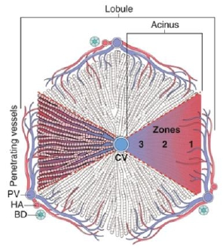
Pathogenesis of cirrhosis
 The pathogenetic processes in cirrhosis are
progressive fibrosis and reorganization of the
vascular microarchitecture of the liver
In the normal liver,interstitial collagens
(types I and III) are concentrated in
portal tracts and around central veins.
The type IV collagen(reticulin) is in the
space of Disse.

Slide 13
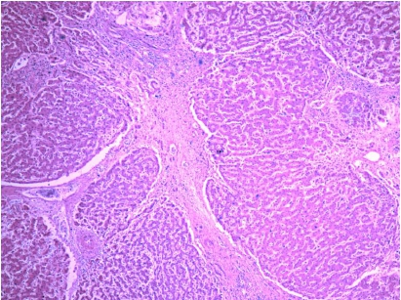
Pathogenesis of cirrhosis
 In cirrhosis,types I and III collagen are
deposited in the lobule,creating delicate or
broad septal tracts.
There is loss of fenestrations in the sinusoidal endothelial cells
(capillarization of sinusoids,that is the sinusoidal space comes to
resemble a capillary rather than a channel for exchange of solutes
between hepatocytes and plasma)

Slide 14
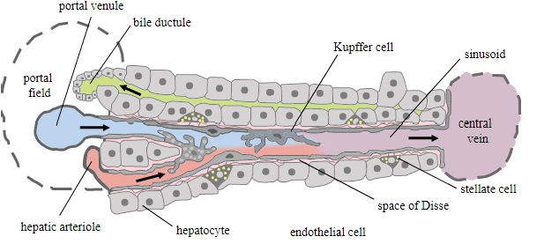
Pathogenesis of cirrhosis
 The major source of excess collagen in cirrhosis is the
perisinusoidal stellate cells ( Ito cells),which lie in the space
of Disse.
 Although Ito cells normally function is a vitaminA fat-
storing cells, during the development of cirrhosis they
become activated and transform into myofibroblast-like cells.

Slide 15
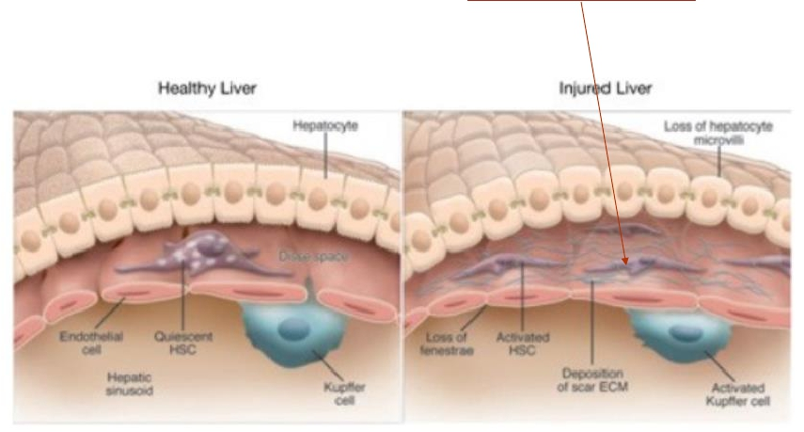
Ito cells produce collagen

Slide 16
Pathogenesis of cirrhosis
Collagen synthesis is stimulated by:
1) Chronic inflammation,with production of
inflammatory cytokines.
2) Cytokine production by activated endogenous
cells (Kupffer cells,endothelial cells,
hepatocytes,and bile duct epithelial cells).
3) Disruption of the normal extracellular matrix.
4) Direct stimulation of stellate cells by toxins

Slide 17
The cirrhotic patient may develop
jaundice and even hepatic failure’


Slide 18
Clinical Features

All forms of cirrhosis may be clinically silent.
 When symptomatic they lead to nonspecific
clinical manifestations:anorexia,weight loss,
weakness,osteoporosis,and,in advanced
disease,frank debilitation.
 Incipient or overt hepatic failure may develop.

Slide 19
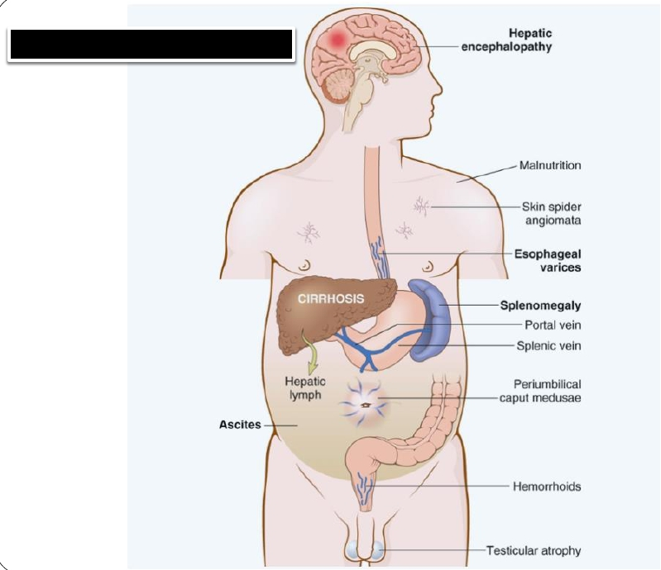
Clinical Featuresof Liver Cirrhiosis
Jaundice

Slide 20
Clinical Features
The ultimate mechanism of most
cirrhotic deaths is
(1) progressive liver failure
(2) a complication related to portal
hypertension
(3) the development of hepatocellular
carcinoma

Slide 21
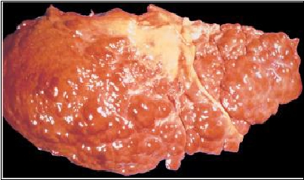
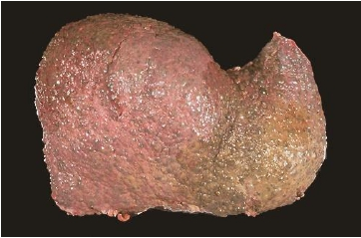
Gross Features
Macronodular cirrhosis
Micronodular cirrhosis

Slide 22
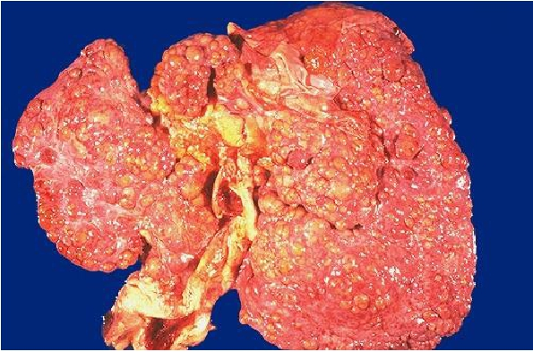
Gross Features:
 The nodules seen here are larger than 3
mm and,hence,this is an example of
"macronodular" cirrhosis.

Slide 23
Micronodular cirrhosis : The regenerative nodules
are quite small, averaging less than 3 mm in size.
The most common cause for this is chronic
alcoholism.

Slide 24
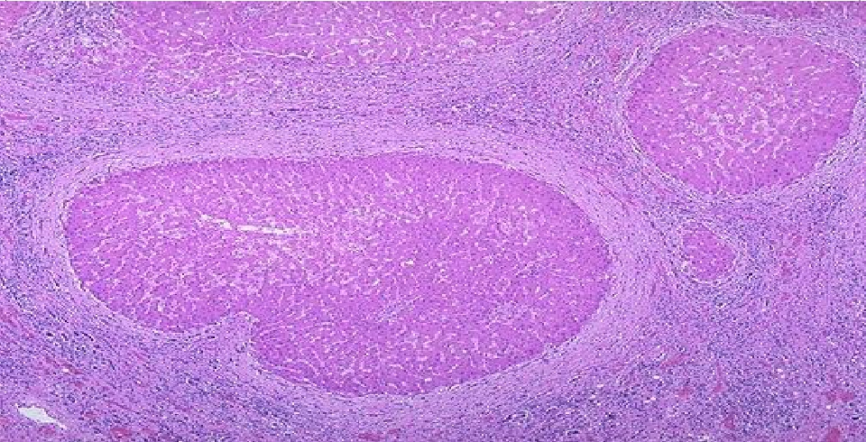
Regenerative nodules of hepatocytes are surrounded by fibrous
connective tissue that bridges between portal tracts. Within this
collagenous tissue are scattered lymphocytes as well as a
proliferation of bile ducts.

Slide 25
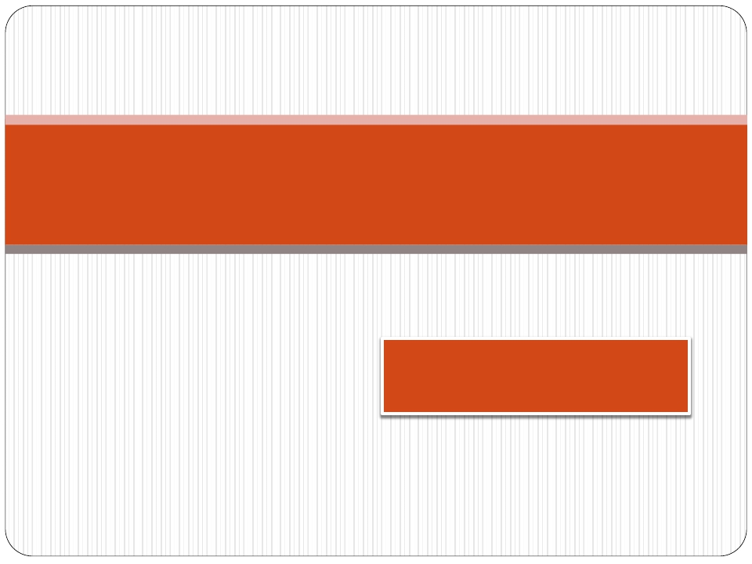
Caused of liver cirrrhosis
Chronic Hepatitis (hepatitis B and C virus)
Autoimmune hepatitis
Alcoholic liver disease
(secondary biliary cirrhosis
primary biliary cirrhosis
primary sclerosing cholangitis )

Slide 26
Chronic Hepatitis: morphology
Some changes are shared with acute hepatitis.
 Hepatocyte injury,necrosis,and regeneration
 Sinusoidal cell reactive changes
 Portal tract Inflammation:
-Confined to portal tracts or
-Spillover into adjacent parenchyma,with necrosis of
hepatocytes ("interface hepatitis") or
-Bridging inflammation and necrosis
 Fibrosis:
-continued loss of hepatocytes results in fibrous septa
formation which ultimately leads to cirrhosis
 HBV:"ground-glass" hepatocytes,"sanded" nuclei
 HCV:bile duct damage,lymphoid aggregate formation
 Cirrhosis:The end-stage outcome

Slide 27
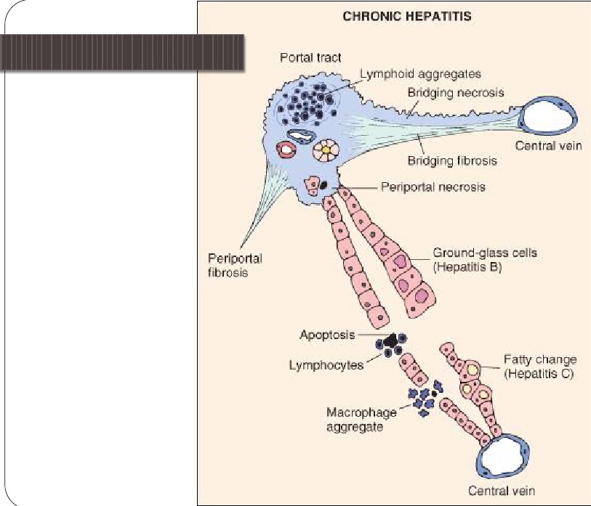
Chronic Hepatitis,morphology

Slide 28
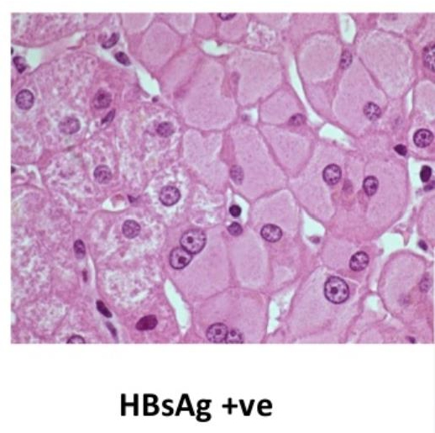

Slide 29
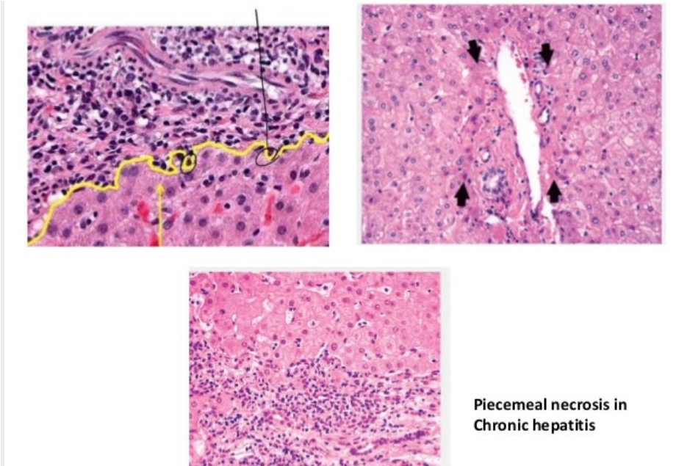
Spillover into
adjacent parenchyma,
with necrosis of
hepatocytes
"interface hepatitis"

Slide 30
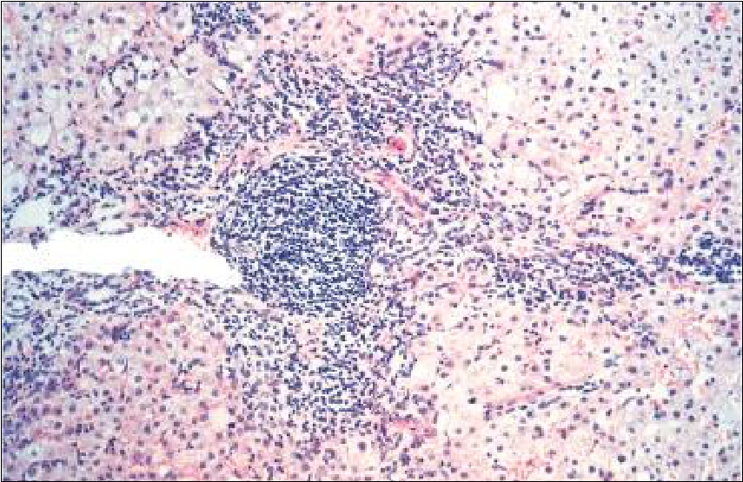
Chronic hepatitis ,morphology

Slide 31
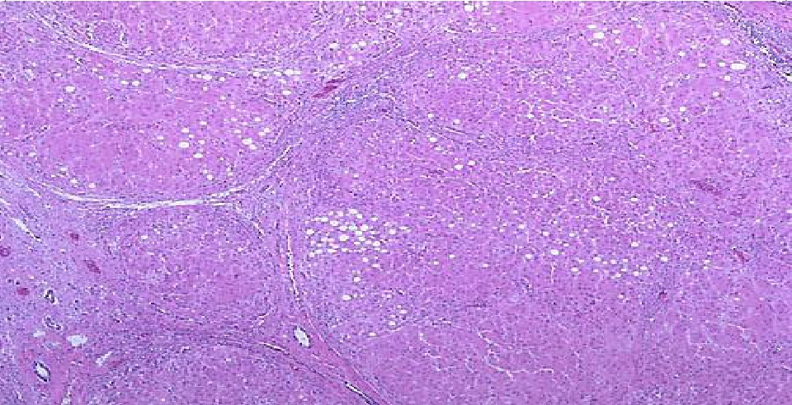
Viral hepatitis C which is at a high stage with extensive
fibrosis and progression to macronodular cirrhosis, as
evidenced by the large regenerative nodule at the
center right.

Slide 32
Autoimmune hepatitis
 is a chronic hepatitis with histologic features
like that of chronic viral hepatitis.This disease
may run an indolent or severe course.
 Features include the following:
 Female predominance,particularly in young and
perimenopausal women.
 The absence of viral serologic markers
 Elevated serum IgG and γ-globulin levels (>1.5 times
normal)
 High serum titers of autoantibodies in 80% of cases,
including antinuclear (ANA),antismooth muscle
(SMA),anti-mitochondrial antibodies

Slide 33
Autoimmune hepatitis
 In untreated severe disease,as many as 40% of patients
die within 6 months of diagnosis,and cirrhosis develops
in at least 40% of survivors.
 Treatment include immunosuppressive therapy,and liver
transplantation.
 Associated with other autoimmune diseases eg.
Rheumatoid arthritis,Sjogren’s syndrome etc.

Slide 34
Intrahepatic Biliary Tract Disease
Three disorders of intrahepatic bile ducts:
 Secondary biliary cirrhosis
 Primary biliary cirrhosis
 Primary sclerosing cholangitis

Slide 35
Secondary biliary cirrhosis
 Prolonged obstruction of the extrahepatic
biliary tree results in profound alteration of
the liver itself.
 The most common cause of obstruction in
adults is extrahepatic cholelithiasis
(gallstones),followed by malignancies of the
biliary tree or head of the pancreas and
strictures resulting from previous surgical
procedures
 Obstructive conditions in children include
biliary atresia,cystic fibrosis,choledochal
cysts (a cystic anomaly of the extrahepatic biliary tree)

Slide 36
Secondary biliary cirrhosis: morphology
 Secondary inflammation resulting from biliary
obstruction initiates periportal fibrosis,which
eventually leads to hepatic scarring and
nodule formation,generating secondary
biliary cirrhosis.
 Subtotal obstruction may promote secondary
bacterial infection of the biliary tree
(ascending cholangitis),which aggravates the
inflammatory injury.Enteric organisms such
as coliforms and enterococci are common
cause.

Slide 37
Secondary biliary cirrhosis
Etiology | Extrahepaticbileductobstruction:biliary atresia,gallstones,stricture,carcinomaof pancreatichead
Sexpredilection Symptomsandsigns | None. Pruritus,jaundice,malaise,darkurine,light stools,hepatosplenomegaly
Laboratoryfindings | Conjugatedhyperbilirubinemia,increased serumalkalinephosphatase,bileacids, cholesterol
Importantpathologic findingsbeforecirrhosis develops | Prominentbilestasisinbileducts,bile ductularproliferationwithsurrounding neutrophils,portaltractedema

Slide 38
Primary biliary cirrhosis
 Primary biliary cirrhosis is a chronic,progressive,and
often fatal cholestatic liver disease,characterized by the
destruction of intrahepatic bile ducts,portal
inflammation and scarring,and the eventual
development of cirrhosis and liver failure.
 The primary feature of this disease is a nonsuppurative,
inflammatory destruction of medium-sized intrahepatic bile
ducts.
 Cirrhosis develops only after many years.

Slide 39
Primary biliary cirrhosis
 middle-aged women,
 female:male predominance (6:1).
 Pathogenesis: autoimmune etiology,90% of patients have
circulating "antimitochrondrial antibodies."

Slide 40
Primary biliary cirrhosis
Clinical features:
 pruritus,jaundice,hepatomegaly.Xanthomas and
xanthelasmas arise owing to cholesterol retention.
 Over a period of time patients develop portal hypertension
and hepatic encephalopathy.
 Serum alkaline phosphatase and cholesterol are elevated;
hyperbilirubinemia is a late development.
 90% of patients have circulating "antimitochrondrial
antibodies."

Slide 41
Primary biliary cirrhosis
Morphology:
 During the precirrhotic stage,portal tracts
and bile ducts are infiltrated by lymphocytes
and may exhibit noncaseating
granulomatous inflammation.There is bile
duct destruction.
 With time,there is bile ductular
proliferation,inflammation,and necrosis of
the adjacent periportal hepatic parenchyma.
 Over years to decades,relentless portal tract
scarring and bridging fibrosis lead to
cirrhosis.

Slide 42
Primary biliary cirrhosis
 In most cases,the end-stage picture is
indistinguishable from secondary biliary
cirrhosis or the cirrhosis that follows chronic
hepatitis from other causes

Slide 43
Primary biliary cirrhosis
Etiology |  | Possiblyautoimmune
SexpredilectionSymptomsand signs |  | Femaletomale:6:1Sameas secondarybiliarycirrhosis
Laboratoryfindings |  | Sameassecondarybiliarycirrhosis, pluselevatedserumautoantibodies (especiallyantimitochondrialantibody- AMA)
Importantpathologicfindings beforecirrhosisdevelops |  | Denselymphocyticinfiltrateinportal tractswithgranulomatousdestruction ofbileducts

Slide 44
Primary sclerosing cholangitis
 Primary sclerosing cholangitis is characterized by inflammation
and obliterative fibrosis of intrahepatic and extrahepatic bile
ducts,with dilation of preserved segments.




Characteristic "beading" of a barium column in
radiographs of the intrahepatic and extrahepatic biliary
tree is attributable to the irregular strictures and
dilations of affected bile ducts.
It is commonly seen in association with inflammatory bowel
disease ,particularly chronic ulcerative colitis
Males predominate 2:1
Pathogenesis:unknown.

Slide 45
Primary sclerosing cholangitis: Morphology
 Primary sclerosing cholangitis is a fibrosing
cholangitis of bile ducts,with a lymphocytic
infiltrate,progressive atrophy of the bile duct
epithelium,and obliteration of the lumen.
 The concentric periductal fibrosis around affected ducts
("onion-skin fibrosis") is followed by their
disappearance,leaving behind a solid,cordlike fibrous
scar.
 As the disease progresses,the liver becomes cirrhotic
like that seen with primary and secondary biliary
cirrhosis

Slide 46
Primary sclerosing cholangitis
Etiology
Sex predilection Symptoms and signs
Laboratory findings
Important pathologic findings before
cirrhosis develops
Unknown, possibly autoimmune; 50-
70% associated with inflammatory
bowel disease
Female to male: 1:2 Same as
secondary biliary cirrhosis; insidious
onset
Same as secondary biliary cirrhosis,
plus elevated serum IgM,
hypergammaglobulinemia
Periductal portal tract fibrosis,
segmental stenosis of extrahepatic
and intrahepatic bile ducts

Slide 47
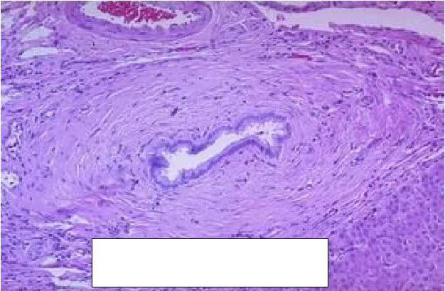
Primary sclerosing cholangitis
Periductal portal tract fibrosis
(onion-skin fibrosis)

Slide 48
Alcoholic liver disease
Three features:
1.
2.
Steatosis (fatty change)
Hepatitis (steatohepatitis)
3.
Fibrosis

Slide 49
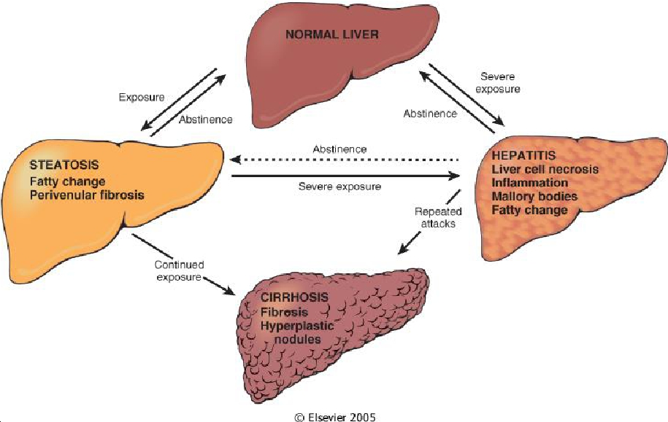
Alcoholic liver disease

Slide 50
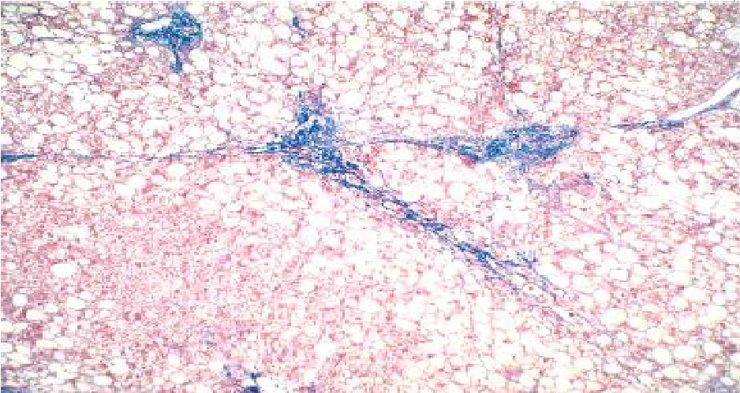
Alcoholic liver disease

Slide 51
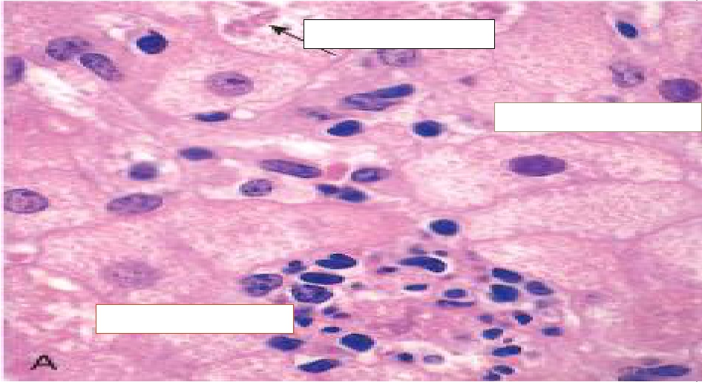
Alcoholic liver disease
Mallory-Denk bodies
Hepatocyte ballooning
Neutrophil infiltration

Slide 52
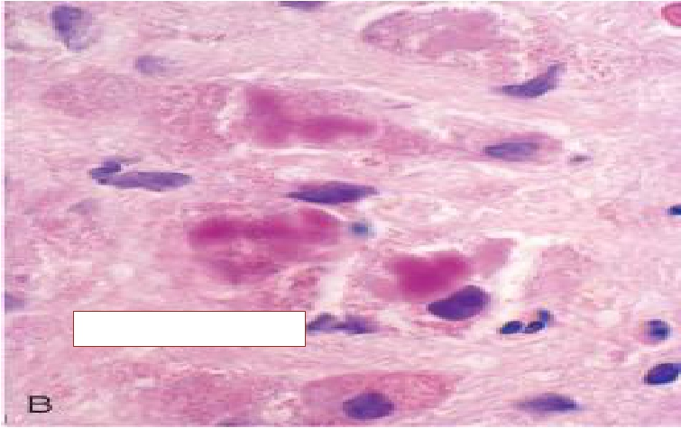
Alcoholic liver disease
Mallory-Denk bodies

Slide 53
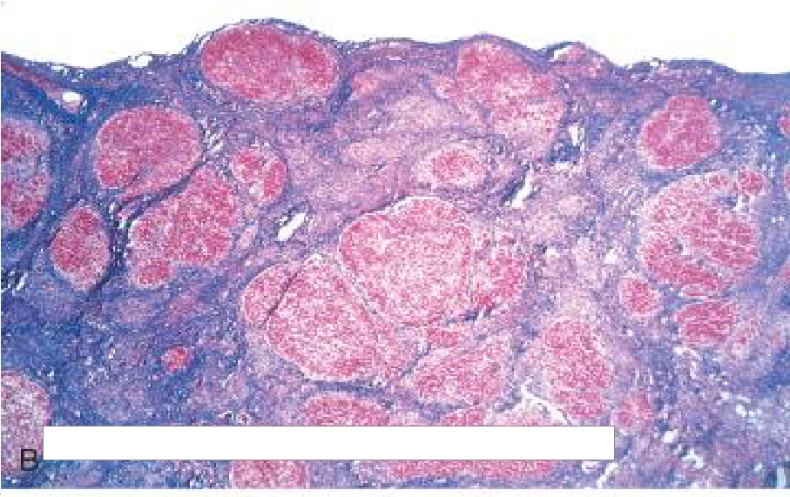
Alcoholic liver disease
Cirrhosis
diffuse nodules of varying sizes entrapped in blue-staining fibrous tissue

Slide 54
Alcoholic liver disease
 The causes of death are:
 Hepatic failure
 Massive gastrointestinal hemorrhage
 Intercurrent infection (to which affected individuals are
predisposed)
 Hepatorenal syndrome
 Hepatocellular carcinoma (3%–6% of cases)

