Slide 1
Complications of liver cirrhosis

Slide 2
Complications of liver cirrhosis
 Recognize the major complications of cirrhosis
 Understand the pathogenetic mechanisms
underlying the occurrence of the complications
 Recognize the clinical features inherent to the
above mentioned complications
 Describe the pathological findings of the
different complications

Slide 3
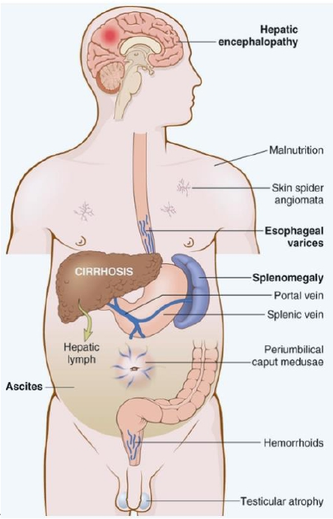
.
Complications of
liver cirrhosis
 Portal hypertension
 Variceal bleeding
 Splenomegaly
 Ascites
 Spontaneous bacterial peritonitis
 Jaundice and cholestasis
 Coagulopathy
 Hepatic encephalopathy
 Hepatorenal syndrome
 Hepatocellular carcinoma

Slide 4
Complications of liver cirrhosis
PORTAL HYPERTENSION :

Slide 5
Complications of liver cirrhosis
PORTAL HYPERTENSION :
 Resistance to blood flow
prehepatic,intrahepatic,and posthepatic
 The dominant intrahepatic cause is cirrhosis
(This is accounting for most cases of
portal hypertension)
 Portosystemic shunts develop when blood flow is
reversed from the portal to systemic circulation.

Slide 6
Complications of liver cirrhosis
ESOPHAGEAL VARICES

Slide 7
Complications of liver cirrhosis
ESOPHAGEAL VARICES:
Instead of returning directly to the heart,
venous blood from the GI tract is delivered to
the liver via the portal vein before reaching
the inferior vena cava.
 This circulatory pattern is responsible for the first-
pass effect in which drugs and other materials
absorbed in the intestines are processed by the liver
before entering the systemic circulation..

Slide 8
Complications of liver cirrhosis
ESOPHAGEAL VARICES:
 Diseases that impede this flow cause portal
hypertension and can lead to the development
of esophageal varices,an important cause of
esophageal bleeding

Slide 9
Complications of liver cirrhosis
Portal hypertention
Portosystemic Shunt
Portosystemic Shunt
Portal
Rectum ( hemorrhoids)
Abdominal wall collaterals (caput medusae)
Cardioesophageal junction ( esophagogastric varices)

Slide 10
Complications of liver cirrhosis
ESOPHAGEAL VARICES:
Pathogenesis
 Portal hypertension results in the development of
collateral channels at sites where the portal and
caval systems communicate.Although these
collateral veins allow some drainage to occur,they
lead to development of a congested subepithelial
and submucosal venous plexus within the distal
esophagus.(varices):90% of cirrhotic patients
 Alcohol - Hepatic schistosomiasis

Slide 11
Complications of liver cirrhosis
ESOPHAGEAL VARICES
Morphology:
 Varices can be detected by venogram:tortuous dilated veins lying
primarily within the submucosa of the distal esophagus and
proximal stomach.Venous channels directly beneath the
esophageal epithelium may also become massively dilated.
 Varices may not be grossly obvious in surgical or postmortem
specimens,because they collapse in the absence of blood flow .
 Variceal rupture results in hemorrhage into the lumen or
esophageal wall,in which case the overlying mucosa appears
ulcerated and necrotic.If rupture has occurred in the past,venous
thrombosis,inflammation,and evidence of prior therapy may also
be present.

Slide 12
Complications of liver cirrhosis
ESOPHAGEAL VARICES:
Clinical features:
 Asymptomatic or rupture-→ massive hematemesis.
 Inflammatory erosion of thinned overlying mucosa
 Increased tension in progressively dilated veins
 Increased vascular hydrostatic pressure associated with
vomiting are likely to contribute to medical emergency that
is treated by any of several methods:
1.
2.
3.
Sclerotherapy
Endoscopic balloon tamponade
Endoscopic rubber band ligation

Slide 13
Complications of liver cirrhosis
ESOPHAGEAL VARICES:
 Half of patients die from the first bleeding episode either as a
direct consequence of hemorrhage or following hepatic coma
triggered by hypovolemic shock.
 Additional 50% within 1 year.
 Each episode has a similar rate of mortality.
 Over half of deaths among individuals with advanced
cirrhosis result from variceal rupture.

Slide 14
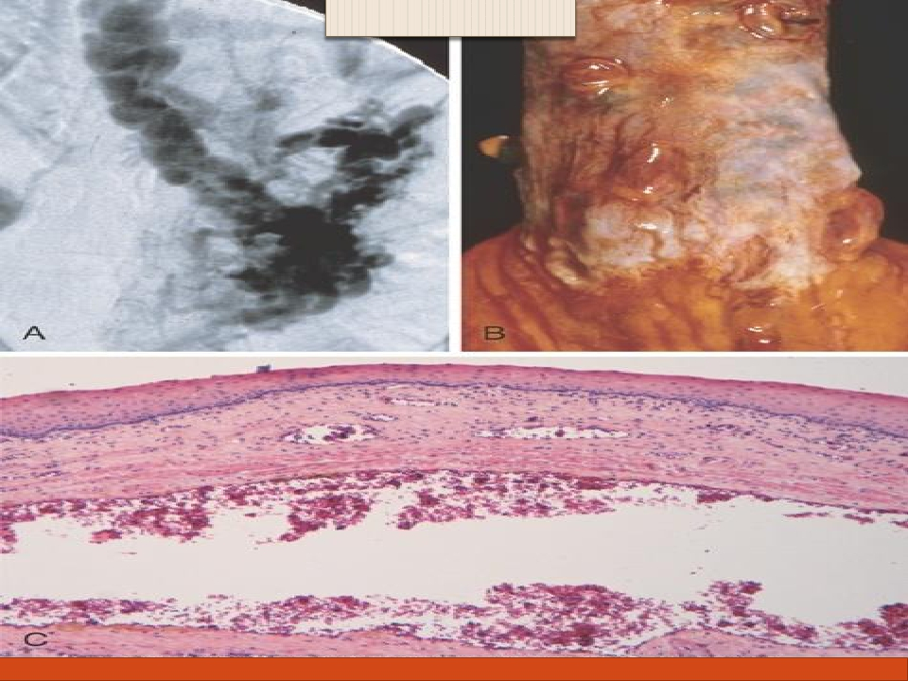
ESOPHAGEALVARICES:
Complications of liver cirrhosis

Slide 15
Complications of liver cirrhosis
 Splenomegaly:Long-standing congestion
may cause congestive splenomegaly
(spleen weight may reach up to 1000 gm)
The massive splenomegaly may induce
hematologic abnormalities attributable to
hypersplenism,such as thrombocytopenia
or pancytopenia

Slide 16
Complications of liver cirrhosis
 Ascites is the accumulation of excess fluid in
the peritoneal cavity:85%
 Serous:less than 3 gm/dL of protein

Slide 17
Complications of liver cirrhosis
 Spontaneous bacterial peritonitis

Slide 18
Complications of liver cirrhosis
JAUNDICE AND CHOLESTASIS

Slide 19
Complications of liver cirrhosis
JAUNDICE AND CHOLESTASIS:
 Jaundice and icterus: a yellowish or greenish
pigmentation of the skin and sclera of the eyes
respectively due to high bilirubin levels.
 Cholestasis,characterized by systemic retention
of not only bilirubin but also other solutes
eliminated in bile.

Slide 20
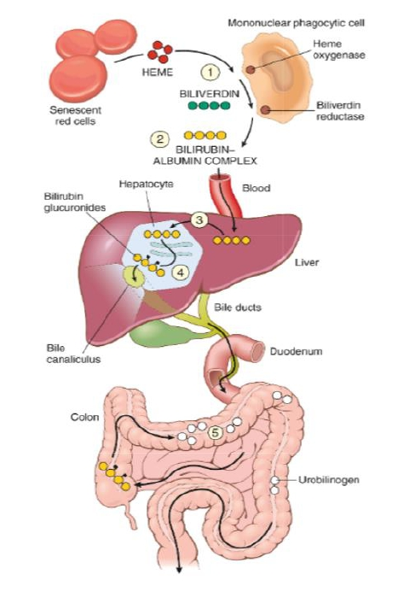
 Bilirubin metabolism
and elimination

Slide 21
Complications of liver cirrhosis
Cause of Jaundice
1. Prehepatic causes of jaundice: Bilirubin overproduction
due to hemolysis and hematoma resorption, lead to elevated
levels of unconjugated (indirect) bilirubin.
2. Intrahepatic disorders
can lead to unconjugated or conjugated hyperbilirubinemia.The
conjugated (direct) bilirubin level is often elevated by alcohol,
infectious hepatitis,drug reactions,and autoimmune disorders.
3. Posthepatic disorders (Obstruction of the flow of bile)
also can cause conjugated hyperbilirubinemia.Gallstone
formation is the most common posthepatic process that causes
jaundice; however,the differential diagnosis also includes
serious conditions such as biliary tract infection,pancreatitis,
and malignancies

Slide 22
Complications of liver cirrhosis
Coagulopathy

Slide 23
Coagulopathy
 The liver is the source of a number of coagulation factors that
decline in the face of liver failure,leading to easy bruising
and bleeding

Slide 24
Complications of liver cirrhosis
Hepatic encephalopathy

Slide 25
Complications of liver cirrhosis
Hepatic encephalopathy
 spectrum of disturbances in consciousness ranging from
subtle behavioral abnormalities,to confusion and stupor,to
coma and death.
 may develop over days,weeks,or a few months
 Due to elevated ammonia levels in blood and the central
nervous system and brain edema.

Slide 26
Complications of liver cirrhosis
Hepatorenal syndrome:

Slide 27
Complications of liver cirrhosis
Hepatorenal syndrome:
 Appearance of renal failure in individuals with
severe chronic liver disease --- no intrinsic
morphologic or functional causes for the renal
failure.
 The incidence of this syndrome is about 8% per
year among patients who have cirrhosis and
ascites

Slide 28
Complications of liver cirrhosis
Hepatorenal syndrome:
 Decreased renal perfusion pressure due to
systemic vasodilation
 Activation of the renal sympathetic nervous
system with vasoconstriction of the afferent
renal arterioles
 Increased synthesis of renal vasoactive
mediators, that decrease glomerular filtration.

Slide 29
Complications of liver cirrhosis
 Hepatocellular Carcinoma

Slide 30
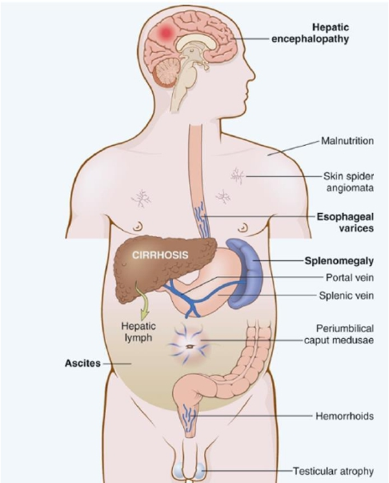
Complications of liver cirrhosis
 Conclusion

