Slide 1
Gastrointestinal Block Pathology lecture Dec, 2017
Inflammatory bowel disease
Dr. Maha Arafah
Dr. Ahmed Al Humaidi

Slide 2
Learning Objectives
Know the two forms of idiopathic inflammatory bowel disease (IBD).
Compare and contrast Crohn’s disease and Ulcerative Colitis with respect to:
a. clinical features and extraintestinal manifestations
b. pathogenesis
c. pathology (gross and microscopic features)
d. complications (especially adenocarcinoma preceded by dysplasia)

Slide 3
Inflammatory Bowel Diseases
Inflammatory bowel disease (IBD) is a chronic condition resulting from inappropriate mucosal immune activation
Crohn's disease (CD) and ulcerative colitis (UC)
Ulcerative colitis is the common inflammatory bowel disease
Although their causes are still not clear, the two diseases probably have an immunologic hypersensitivity basis.

Slide 4
Epidemiology
Both Crohn’s disease (CD) and ulcerative colitis (UC) are more common in females and in young adults
Ulcerative colitis
More common in whites than blacks
Occurs between 14 and 38 years of age
Lower incidence in smokers and other nicotine users
Lower incidence if previous appendectomy <20 years
Crohn’s disease
More common in whites than blacks, in Jews than non-Jews. More common in children than adults.
Smoking is a risk factor
Majority (>75%) of cases occur between 11 and 35 years of age

Slide 5
Epidemiology
The geographic distribution of IBD is highly variable, but it is most prevalent in North America, northern Europe, and Australia.
IBD incidence worldwide is on the rise and is becoming more common in regions in which the prevalence was historically low.

Slide 6
Epidemiology
The hygiene hypothesis suggests that these changes in incidence are related to:
improved food storage conditions and decreased food contamination.
improved hygiene has resulted in inadequate development of regulatory processes that limit mucosal immune responses early in life.
As a result, exposure of susceptible individuals to normally innocuous microbes later in life triggers inappropriate immune responses due to loss of intestinal epithelial barrier function.

Slide 7
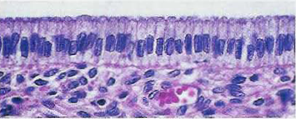
Pathophysiology
luminal bacteria

Slide 8
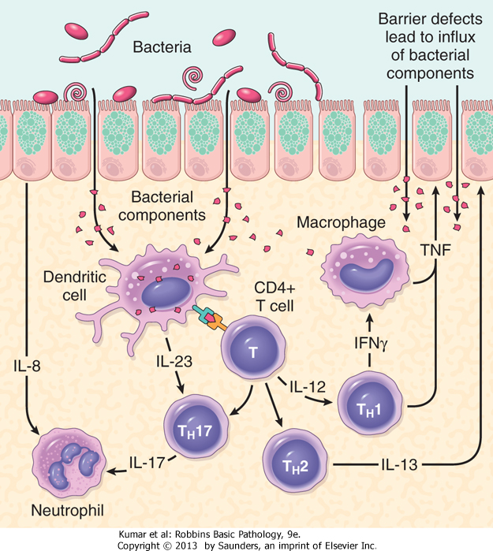
Pathophysiology
Defects in host interactions with intestinal microbes
Intestinal epithelial dysfunction
Aberrant mucosal immune responses.
For unclear reasons, research suggests that smoking increases the risk of Crohn’s disease but reduces the likelihood of ulcerative colitis.
UC

Slide 9
Pathophysiology
Genetics: mutation in Nucleotide-binding oligomerization domain-containing protein 1 (encodes a protein that binds to intracellular bacterial peptidoglycans)
NOD2……. susceptibility gene in Crohn disease.
…………. Abnormal recognition and response to intracellular pathogens
THEORY
Less effective at recognizing and combating luminal microbes
Mucosal immune responses.
Abnormal intestinal epithelial tight junction barrier function
Immunosuppression is the mainstay of IBD therapy.
Transepithelial flux of luminal bacterial components activates immune responses
Inflammation

Slide 10
Clinical
The manifestations of IBD generally depend on the area of the intestinal tract involved.
Colon
Small intestine
Extraintestinal manifestations
Bloody diarrhea,
Tenesmus
Abdominal pain
Intestinal obstruction.
Steatorrhea
Arthritis
Eye manifestation
Skin manifestation

Slide 11
Crohn's disease
is a chronic inflammatory disorder that most commonly affects the ileum and colon but has the potential to involve any part of the gastrointestinal tract from the mouth to the anus.

Slide 12
Crohn's disease
Clinical Features
Any age but has its highest incidence in young adults
Extremely variable clinical feature.
Acute phase: fever, diarrhea, and right lower quadrant pain may mimic acute appendicitis.
Chronic disease: remissions and relapses over a long period of time.
Thickening of the intestine may produce an ill-defined mass in the abdomen.

Slide 13
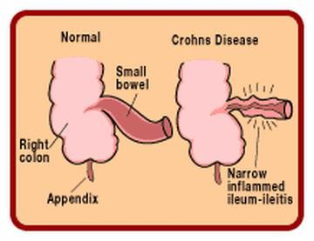
Crohn's disease
Sites of Involvement:
Any part of the GIT from the mouth to the anus.
ileum (30%) colon (20%).
most commonly terminal ileum
Commonly (75%) have perianal lesions such as abscesses, fistulas, and skin tags.

Slide 14
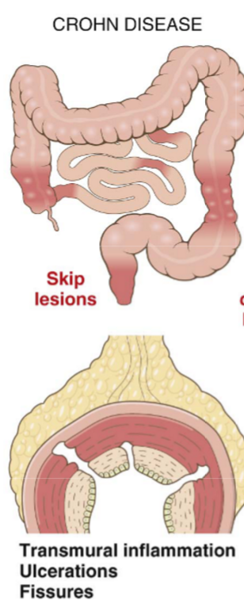
Crohn's disease
Gross Appearance:
Involvement is typically segmental, with skip areas of normal intestine between areas of involved bowel.
Marked fibrosis causing luminal narrowing with intestinal obstruction.
Fissures (deep and narrow ulcers that look like stabs with a knife that penetrate deeply into the wall of the affected intestine)
fistulas (communications with other viscera).

Slide 15
Mucosa: longitudinal serpiginous ulcers separated by irregular islands of edematous mucosa. This results in the typical cobblestone effect.
cobblestone effect.

Slide 16
FAT : In involved ileal segments, the mesenteric fat creeps from the mesentery to surround the bowel wall (creeping fat)

Slide 17
Crohn's disease
Microscopic Features
Distortion of mucosal crypt architecture with mucosal inflammation
Transmural inflammation
Epithelioid granulomas [60%]
Fissure-ulcers and fistulas can
be seen microscopically

Slide 18
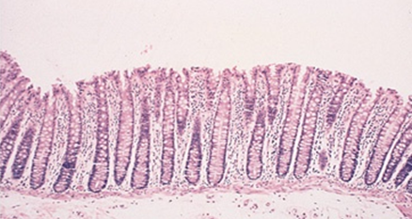
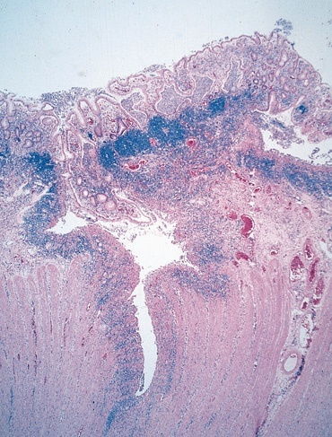
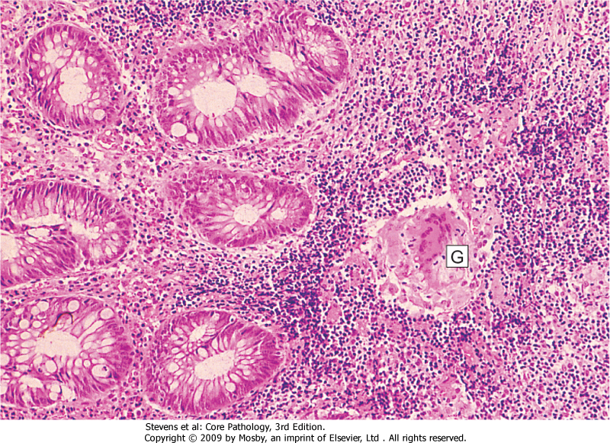
Normal
Crohn’s Disease
FISSURE
GRANULOMA

Slide 19
Crohn's disease Clinical findings
Recurrent right lower quadrant colicky pain (obstruction) with diarrhea and weight loss
Bleeding occurs only with colon or anal involvement (fistulas; abscesses)
Aphthous ulcers in mouth
Extragastrointestinal: erythema nodosum, sacroiliitis (HLA-B27 association), pyoderma gangrenosum, iritis (CD > UC), primary sclerosing cholangitis (UC > CD)

Slide 20
Crohn's disease
Complications
Intestinal obstruction
Fistula formation
between the ileum and the colon result in malabsorption
Enterovesical fistulas lead to urinary infections and passage of gas and feces with urine.
Enterovaginal fistulas produce a fecal vaginal discharge.
Extraintestinal manifestations (arthritis and uveitis)
Slight increased risk of development of carcinoma of the colon—much less than in ulcerative colitis.

Slide 21
Crohn's disease
Summary
Involvement of discontinuous segments of intestine (skip areas
Can involve any part of GIT.
Noncaseating epithelioid cell granulomas
Transmural (full-thickness) inflammation of the affected parts

Slide 23
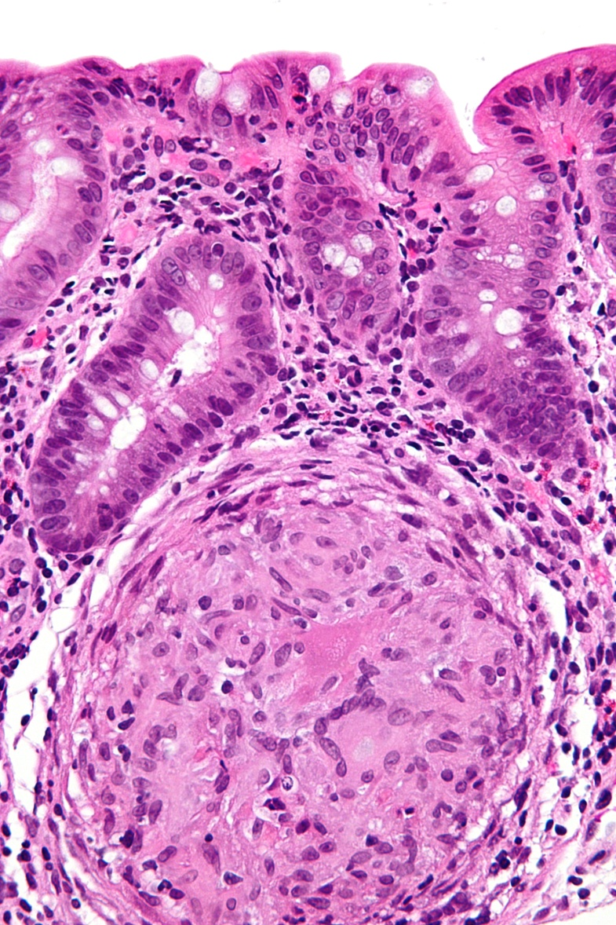
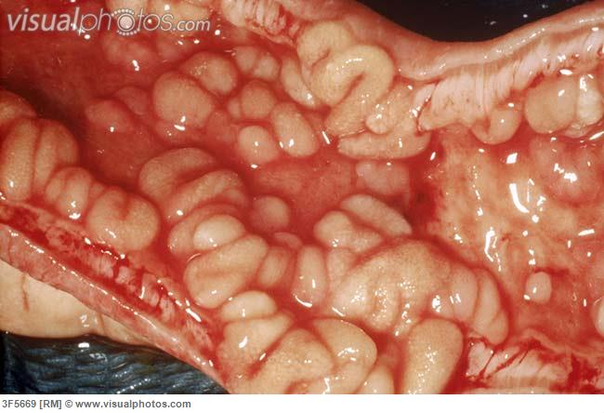

Slide 24
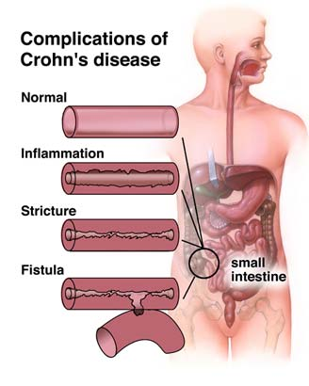
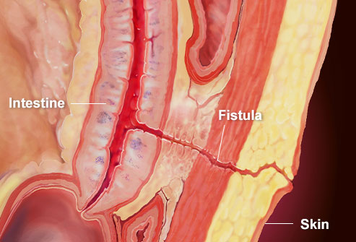
Crohn's disease

Slide 25
Ulcerative Colitis
Definition—chronic relapsing ulceroinflammatory disease of undetermined etiology
20- to 30-year age group but may occur at any age
Most common inflammatory bowel disease
Ulcerations are in continuity

Slide 26
Ulcerative Colitis
Etiology
The cause is unknown
Antibodies that cross-react with intestinal epithelial cells and certain serotypes of Escherichia coli have been demonstrated in the serum of some patients with ulcerative colitis.

Slide 27
Ulcerative Colitis
Clinical Features
In the acute phase and during relapse, the patient has fever, leukocytosis, lower abdominal pain, bloody diarrhea and mucus in the stool.
The disease usually has a chronic course, with remissions and exacerbations.

Slide 28
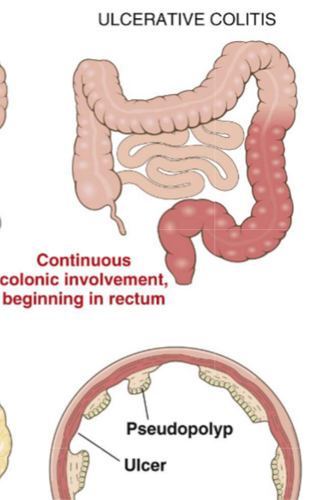
Ulcerative Colitis
Sites of Involvement
Ulcerative colitis is a disease of the rectum, and the colon.
Rectum is involved in almost all cases
The disease extends proximally from the rectum in a continuous manner without skip areas.
The ileum is not involved as a rule

Slide 29
Ulcerative Colitis
Gross Appearance
Involves mainly the mucosa (diffuse hyperemia with numerous superficial ulcerations in the acute phase.
The regenerated or nonulcerated mucosa may appear polypoid (inflammatory pseudopolyps) in contrast with the atrophic areas or ulcers.

Slide 30
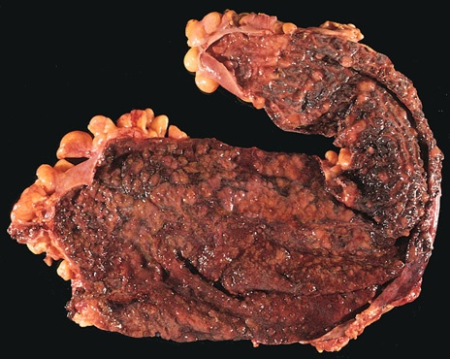
diffuse hyperemia with numerous superficial ulcerations
NO skip lesion

Slide 31
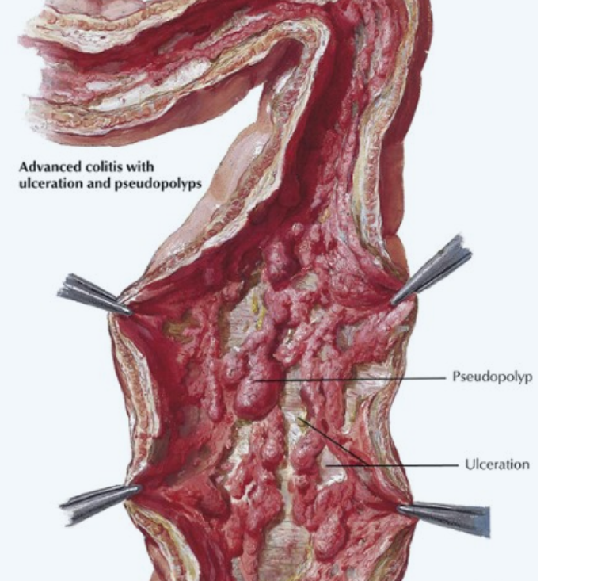

Slide 32
Ulcerative Colitis
Microscopic Appearance
The inflammation is usually restricted to the mucosa.
In the active phase….neutrophils (Cryptits, crypt abscess)
In the chronic phase…..crypt atrophy and distortion
Active inflammation correlates well with the severity of symptoms.

Slide 33
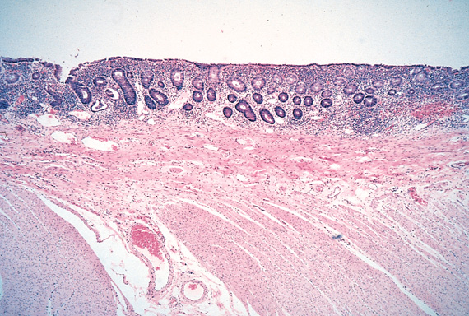
The inflammation is usually restricted only to the mucosa.
inflammation
No inflammation

Slide 34
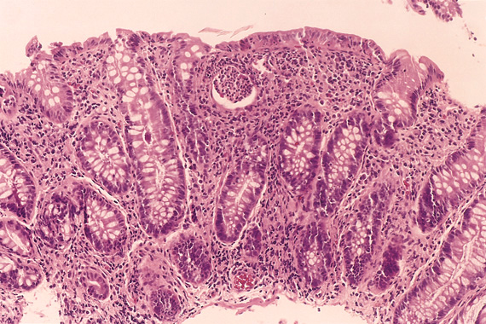
Crypt abscess
dysplasia

Slide 35
Ulcerative Colitis Clinical findings
Recurrent left-sided abdominal cramping with bloody diarrhea and mucus
Fever, tenesmus, weight loss
Toxic megacolon (up to 10% of patients). Mortality rate 50%.
Extra-gastrointestinal: primary sclerosing cholangitis (UC > CD), erythema nodosum, iritis/uveitis (CD > UC), pyoderma gangrenosum, HLA-B27 positive arthritis.
p-ANCA antibodies >45% of cases

Slide 36
Ulcerative Colitis
Extraintestinal manifestations
Arthritis
Uveitis
Skin lesions (pyoderma gangrenosum),
Sclerosing cholangitis (fibrosis around bile ducts), leading to obstructive jaundice.

Slide 37
Ulcerative Colitis
Complications
Acute phase
Severe bleeding
Toxic megacolon ( dilation of the colon, with functional obstruction)
Chronic ulcerative colitis
Increase risk of developing colon carcinoma.
The presence of high-grade dysplasia in a mucosal biopsy imposes a high risk of cancer and is an indication for colectomy.

Slide 38
Ulcerative Colitis | Crohn's disease
Colon only | Any part of the GIT | Site
Diffuse involvement of mucosa | Skip areas of normal mucosa | Pattern
Superficial ulcers | Deep ulcers ( fissure ) | Depth of the ulcer
Mucosal inflammation only | Transmural inflammation | Extent of inflammation
No | Yes | Fistula formation
No | Yes | Creeping mesenteric fat
No | Yes | Fibrous thickening of wall
No | Yes | Granulomas
Common | rare | Dysplasia
more common (10%) | rare | Carcinoma
Pseudopolyps | Cobblestone | Mucosal appearances
Thin wall Dilated lumen | Thickened wall Narrow lumen | Bowel wall
Moderate | Marked | Lymphoid reaction
Haemorrhage Electrolyte loss Toxic megacolon Systemic effects | Short gut syndrome Fistula formation Bowel perforation Stricture formation | Complications

Slide 39
Ulcerative Colitis | Crohn's disease
Colon only | Any part of the GIT | Site
Diffuse involvement of mucosa | Skip areas of normal mucosa | Pattern
Superficial ulcers | Deep ulcers ( fissure ) | Depth of the ulcer
Mucosal inflammation only | Transmural inflammation | Extent of inflammation
No | Yes | Fistula formation
No | Yes | Creeping mesenteric fat
No | Yes | Fibrous thickening of wall
No | Yes | Granulomas
Common | rare | Dysplasia
more common (10%) | rare | Carcinoma
Pseudopolyps | Cobblestone | Mucosal appearances
Thin wall Dilated lumen | Thickened wall Narrow lumen | Bowel wall
Moderate | Marked | Lymphoid reaction
Haemorrhage Electrolyte loss Toxic megacolon Systemic effects | Short gut syndrome Fistula formation Bowel perforation Stricture formation | Complications
No | Common | Recurrence after surgery

Slide 40
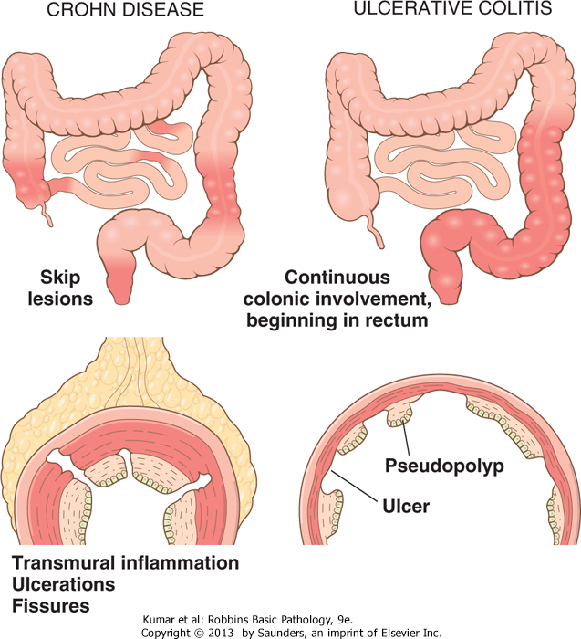

Slide 42
Inflammatory bowel diseases MATCH
Colon only
Diffuse involvement of mucosa
Superficial ulcers
Any part of the GIT
Skip areas of normal mucosa
Mucosal inflammation only
Fistula formation
Transmural inflammation
Granulomas
Deep ulcers ( fissure )
Dysplasia is common
Carcinoma is more common (10%)
Crohn's disease
Ulcerative Colitis

