Slide 1
Ultrasound of Liver and Gall Stone (Lecture 2)
Radiology

Slide 2
Objectives:
Introduction to US.
Indications of liver and gall bladder US.
Normal anatomy and radiological appearance.
Pathology of liver and gall bladder.
Common pathological cases.

Slide 3
Introduction to US

Slide 4
Definition:
a diagnostic technique in which ULTRA=high-frequency sound waves penetrate the body, bounce around, and produce multiple echoes; these echo patterns can be viewed as an image on a computer screen.
Frequency ranges used in medical Ultrasound imaging are 2 - 20 MHz

Slide 5
US machine
PROBES
MACHINE

Slide 6
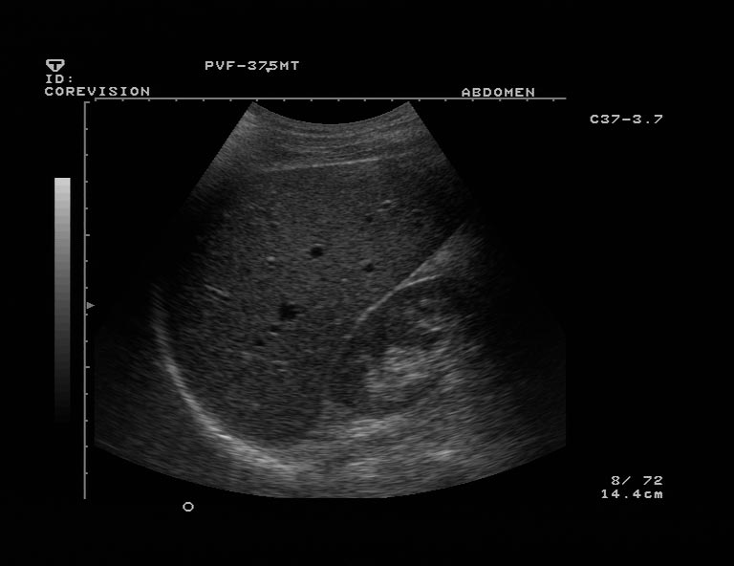
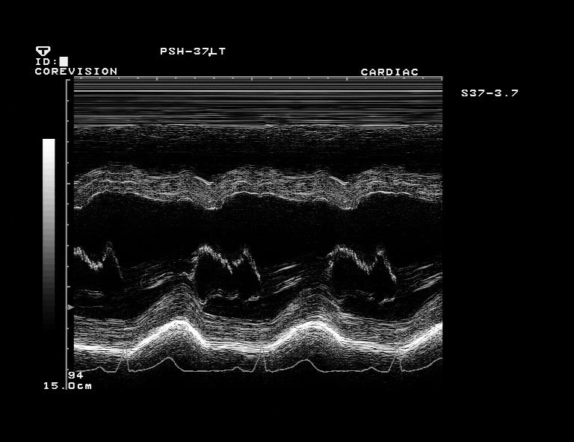
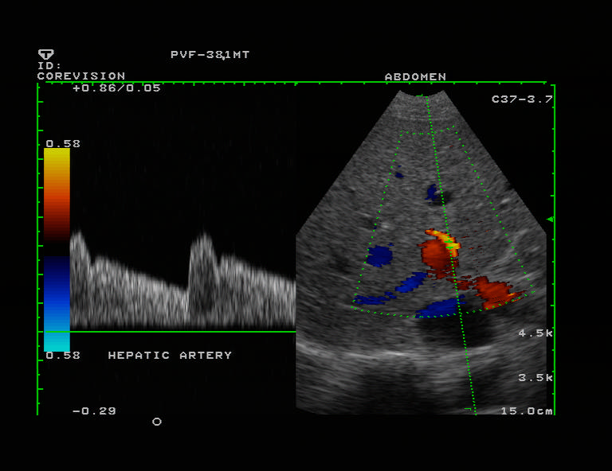
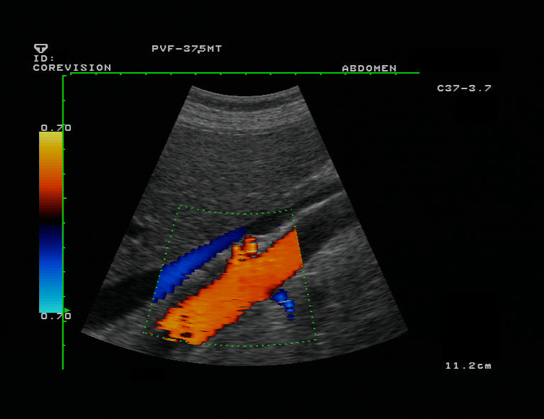
B- MODE.
M- MODE.
COLOR DOPPLER
DUPLEX

Slide 7
Advantages of US
noninvasive
inexpensive.
Easy and available.
Safe and non-ionizing.

Slide 8
Disadvantages of US
Inability to penetrate gas or bone.
Operator dependant.
Less sensitive in some situations.

Slide 9
Indications of liver and gall bladder US
Right upper quadrant pain.
Jaundice.
High liver function test.
Fever work up.
Screening for metastasis.

Slide 10
Normal anatomy and radiological appearance

Slide 11
Cont.

Slide 12
Pathology of the liver:
Size.
Diffuse liver disease.
Focal liver disease.
Hepatic vascularity.
Biliary system obstruction/pathology.

Slide 13
Size abnormality
Normal liver size:
15 cm at MCL.
Hepatomegaly:
Infective eg viral hepatitis.
Neoplastic eg. Metastasis.
Degenerative eg. early cirrhosis.
Raised venous pressure eg. Congestive cardiac failure.
Storage disorder eg. Amyloidosis.
Myeloproliferative disorder eg. Polycythaemia rubra vera.
NORMAL

Slide 14
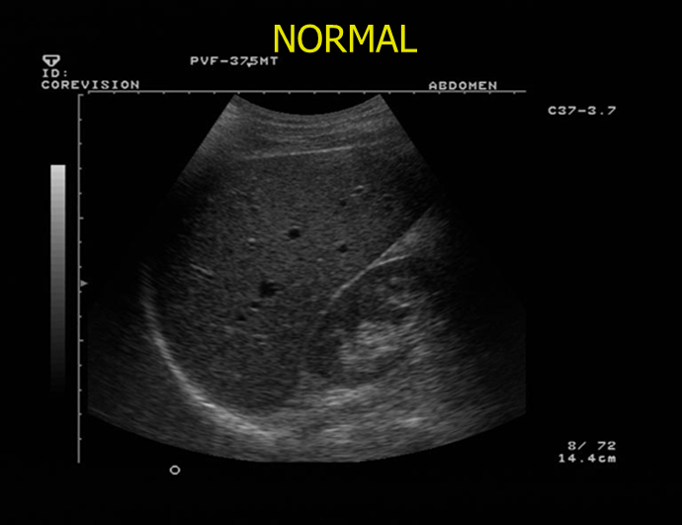
Cont.
Small shrunken liver:
Late cirrhosis:
Shrunken liver with irregular outline
Ascites
Portal hypertension.
+- focal lesion.

Slide 15
Diffuse abnormality
Diffuse increase parenchymal echogensity
(whiter than normal)
Diffuse fatty infiltration.
Other infiltrative:
Malignant
Infectious
Glycogen storage disease

Slide 16
Cont.
Diffuse decrease in parenchymal echogensity.
(darker than normal)
Acute hepatitis.
Other:
Malignant infiltration.

Slide 17
Focal liver lesions
Benign tumor:
Hemangioma.
Malignant tumor:
Primary eg. Hepatocellular carcinoma.
Secondary metastasis eg. Colon breast.
Infective:
Abscess
hydated cyst.
Congenital:
Hepatic cyst.

Slide 18
Cont.
Liver abscess
hemangiomas
metastasis
HCC

Slide 19
Cont.
NO CONTENT SHARP THIN OUTLINES
Hydatid cyst

Slide 20
Vascular abnormality
Portal venous system:
thrombosis.
Portal hypertension.
Hepatic venous system:
Thrombosis
(Budd Chiari syndrome).

Slide 21
Cont.
PV thrombosis
Hepatic vein thrombosis

Slide 22
Biliary abnormality
Intra-hepatic biliary radicals.
Less than 3mm
Extra-hepatic “CBD”
Less than 8mm
Causes of dilatation & obstruction:
Intra-luminal:
Stone & mass.
Mural:
stricture (benign & malignant)
Extrinsic:
Compression mass & Lymph node

Slide 23
Pathology of gall bladder
Intra-luminal pathology.
Mural pathology.

Slide 24
Intra-luminal pathology
Gall stone:
Acoustic shadowing
Polyps
No acoustic shadowing.

Slide 25
Cont.
Intraluminal:
Mass lesion
+- invasion
Gall bladder carcinoma.

Slide 26
Mural pathology
Mural thickening:
Primary:
Cholecystitis.
Secondary:
Cardiac failure.
Cirrhosis.
ascites
Hypoalbuminaemia
Renal failure.

Slide 27
Common pathological cases

Slide 28
Case one
Middle age women presented to ED with fever, RUQ pain
On exam
She looks ill, febrile and on pain
Abdomen: RUQ tenderness
Lab high LFTs & WBC.

Slide 29
Cont.
Thickening of GB wall >3mm.
Distended GB
Pericholecystic fluid.
Hyperemia.
Gall stone
Acute calcular cholecystitis.

Slide 30
Case two
Middle age women presented to surgical out patient clinic with 2 years history of recurrent RUQ pain mild to moderate in severity radiated to the right shoulder aggravated by fatty meal.
On exam:
obese lady well not distressed, febrile or jaundiced.
Lab LFTs normal.

Slide 31
Cont.
Multiple oval shaped echogenic structures seen within GB causing acoustic shadowing
GB stones

Slide 32
Case three
Middle age man presented to ER with severe RUQ pain and yellowish discoloration of skin and sclera.
On exam:
he looks ill, jaundiced and on pain but not febrile
Lab high LFTs.

Slide 33
Cont.
Dilated intra-hepatic and extra-hepatic biliary system
Echogenic structure seen within CBD
CBD stone causing biliary obstruction.

Slide 34
Case four
Old man recently discovered to have colonic cancer presented to primary health care clinic with vague upper abdominal pain
On exam:
he was thin, ill not febrile or jaundiced.
Mild abdominal tenderness enlarged liver with irregular outline.
Lab mildly elevated LFTs.

Slide 35
Cont.
Multiple hypoechoic focal hepatic lesions
Metastatic liver lesions.

Slide 36
Case five
Middle age man known case of HCV+ for 10 years presented to GI out patient clinic with history of weight loss, indigestion and mild abdominal pain. No fever.
On exam:
he was ill, slim ,mildly jaundice not febrile.
Abdomen: bulging flanks, dilated tortuous vessels around umbilicus. Mild diffuse abdominal tenderness.
Lab high LFTs.

Slide 37
Cont.
Shrunken liver with irregular outline.
Heterogeneous appearance.
Focal hypoechoic lesion.
Cirrhotic liver with HCC.

Slide 38
Case six
Young man known IV drug addict presented to ER with high fever, chills, upper abdominal pain and vomiting
On exam:
He looks very ill, febrile and on pain.
Abdomen: RUQ tenderness.
Lab high LFTs & WBC.

Slide 39
Cont.
Focal hypoechoic liver lesion with ill defined outline.
Liver abscess.

Slide 40
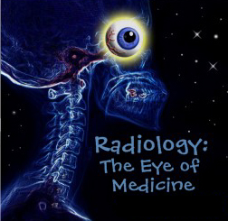
thank you

