Slide 1
RADIOLOGY OF ESOPHAGUS AND STOMACH
Practical Session (1)
Radiology

Slide 2
ESOPHAGUS ANATOMY

Slide 3
What are the modalities can be used in imaging the esophagus?
CT scan
MRI
Fluoroscopy
US
X-ray
Nuclear medicine

Slide 4
What are the modalities can be used in imaging the esophagus?
CT scan
MRI
Fluoroscopy
US
X-ray
Nuclear medicine

Slide 5
CT scan

Slide 6
5
2
4
1
3
1

Slide 7
5
2
4
1
3
1
Esophagus
Trachea
Aorta
Lung
Pulmonary artery

Slide 8
Fluoroscopy

Slide 9
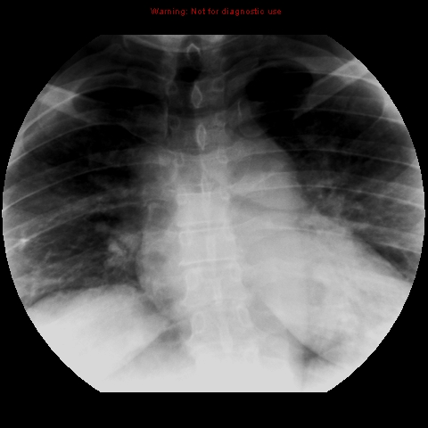

Slide 10
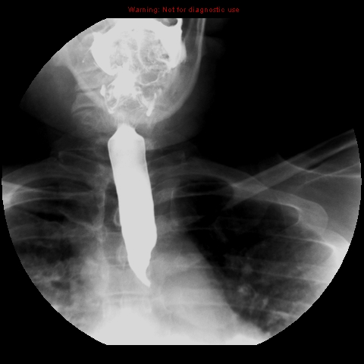

Slide 11
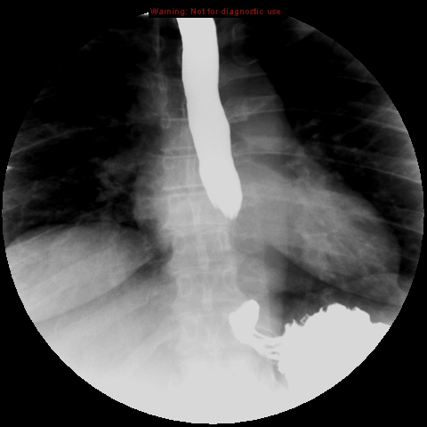

Slide 12
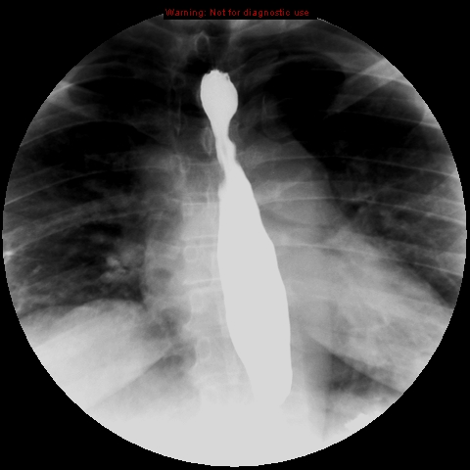

Slide 13
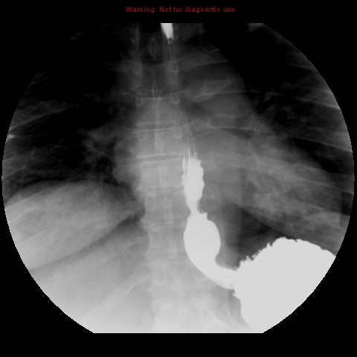
2
1
4
3

Slide 14
1-esophageal vestibule (ampulla).
2- B ring.
3- gastroesophageal junction.
4- stomach (gastric fundus).
2
1
4
3

Slide 15
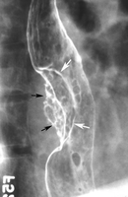
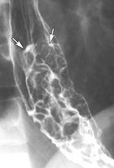
Abnormal esophagus (masses)

Slide 16
STOMACH ANATOMY
X RAY

Slide 17
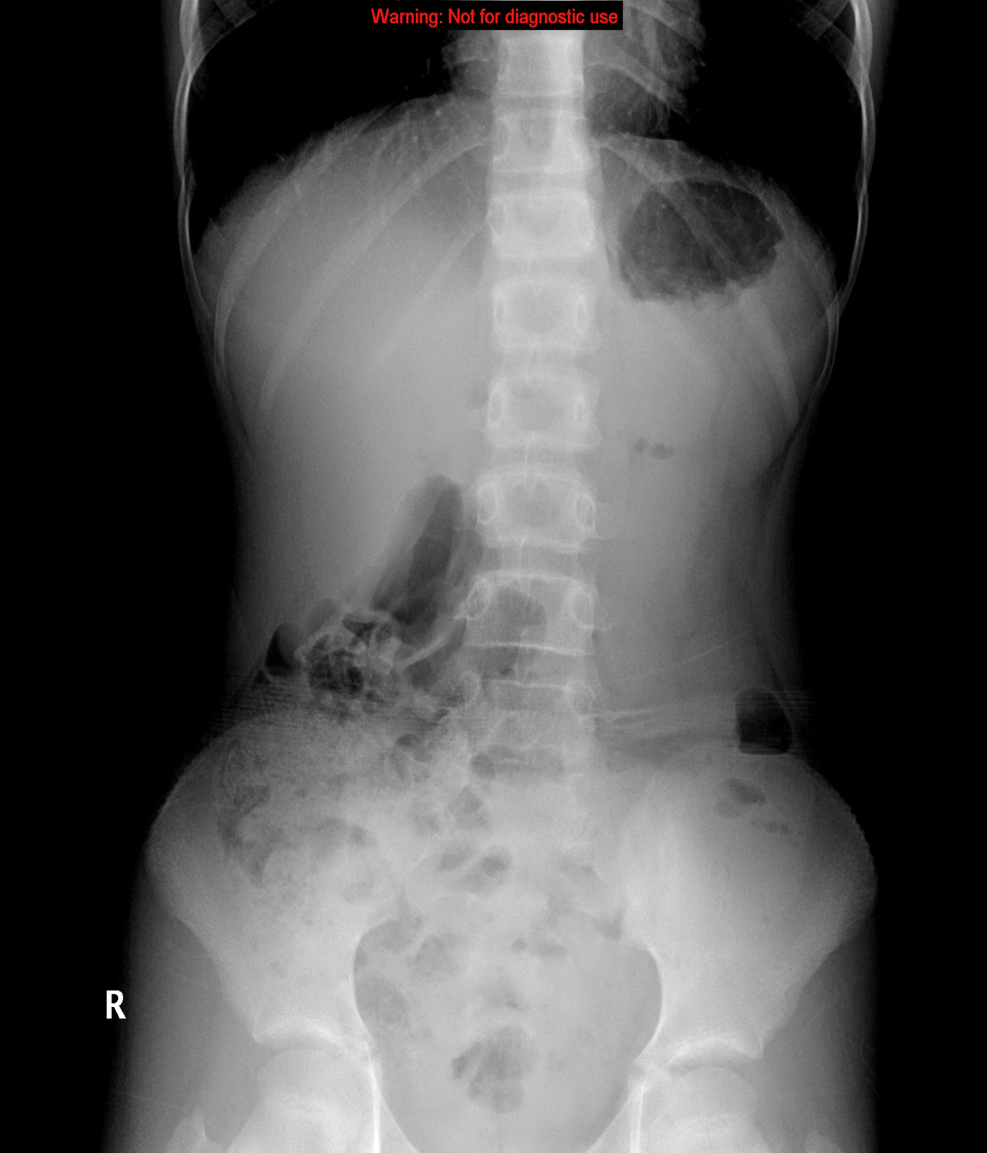
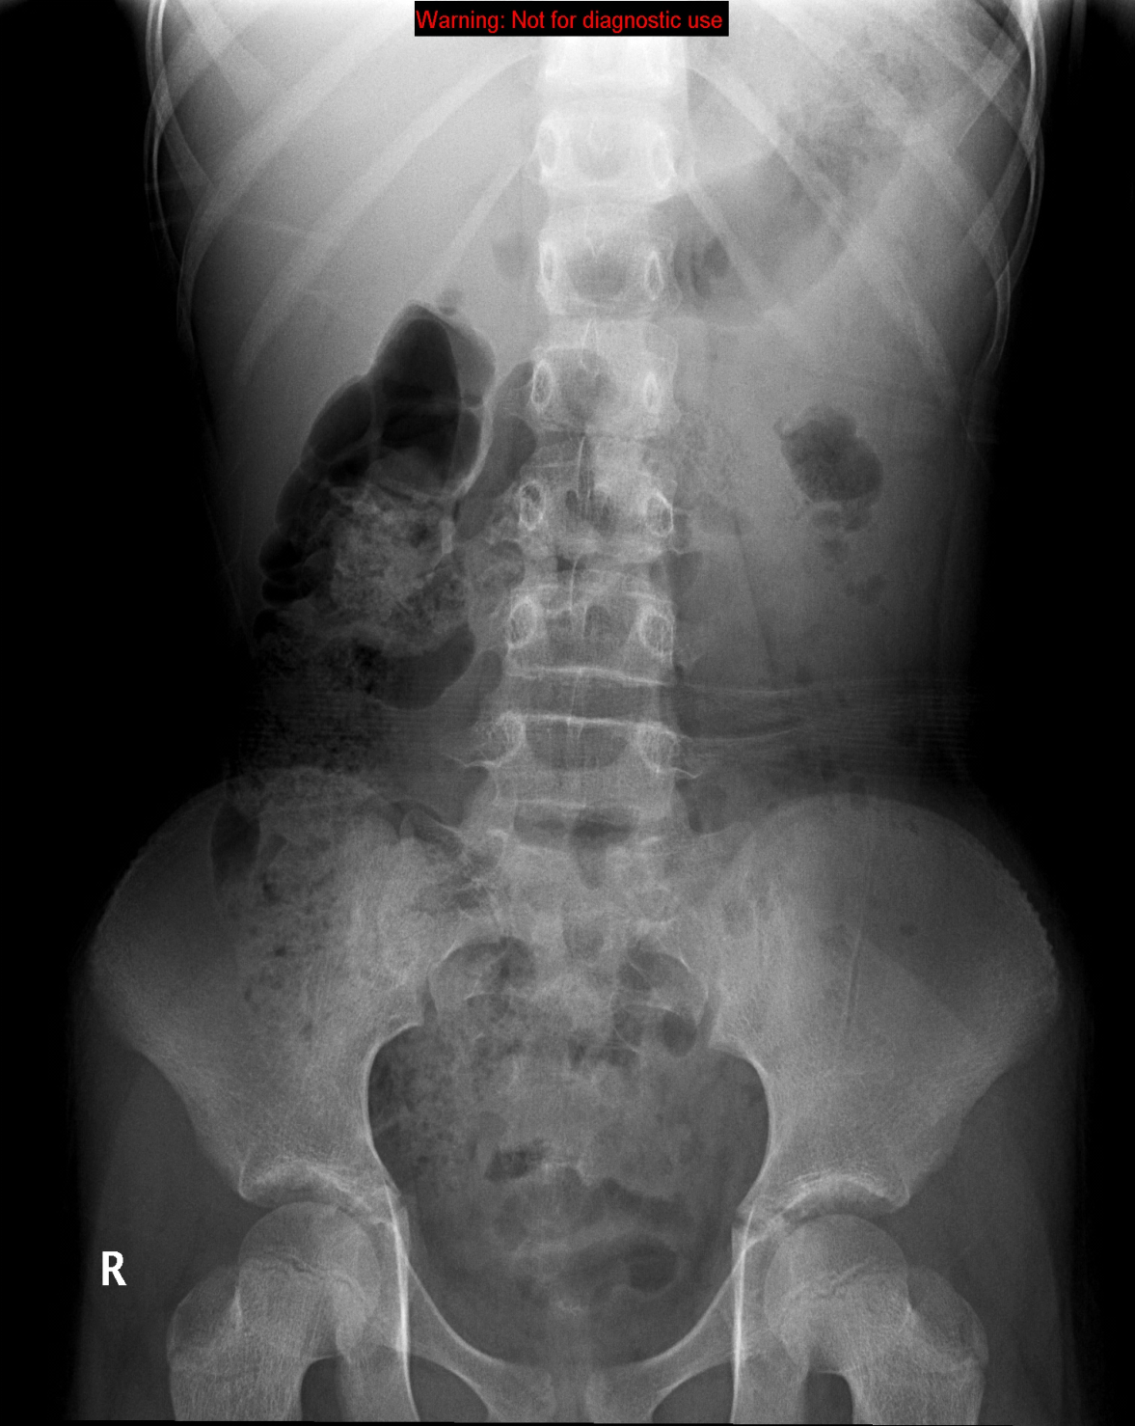

Slide 18
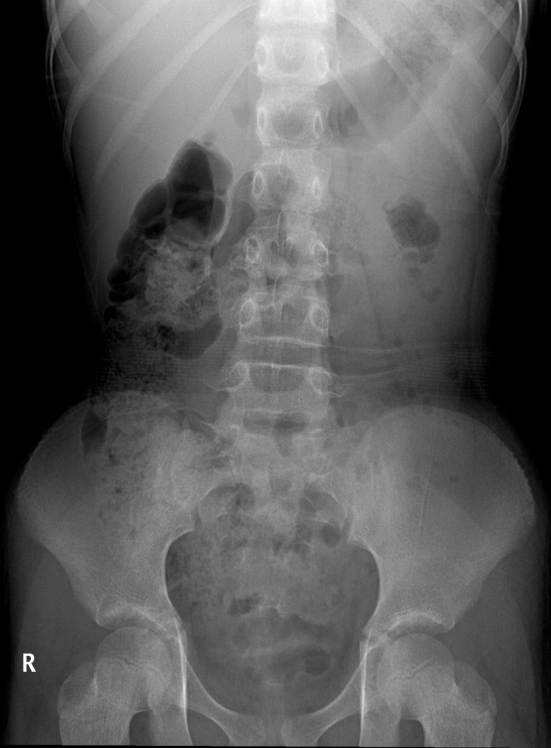

Slide 19
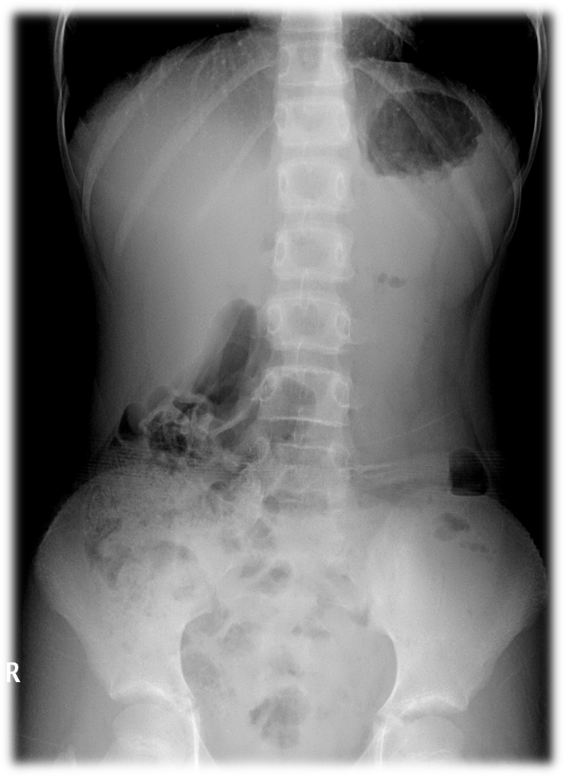

Slide 20
Fluoroscopy

Slide 21
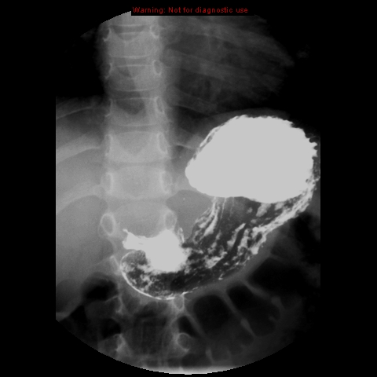
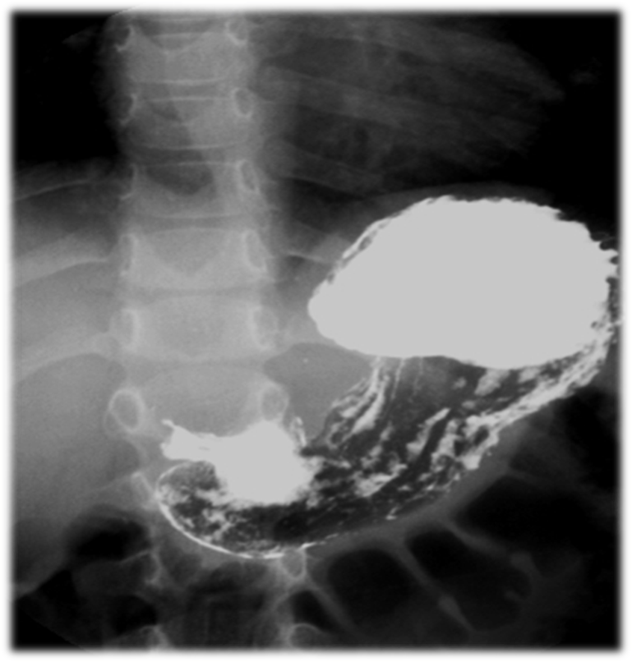
1
3
5
2
4
6

Slide 22
1
Stomach fundus
Greater curvature
Lesser curvature
Antrum
Pylorus
Mucosal folds
3
5
2
4
6

Slide 23
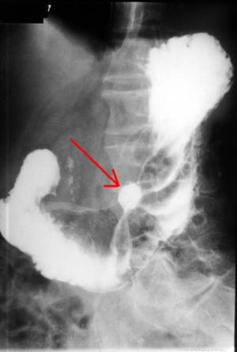
Gastric ulcer

Slide 24
CT Scan vs MRI

Slide 25
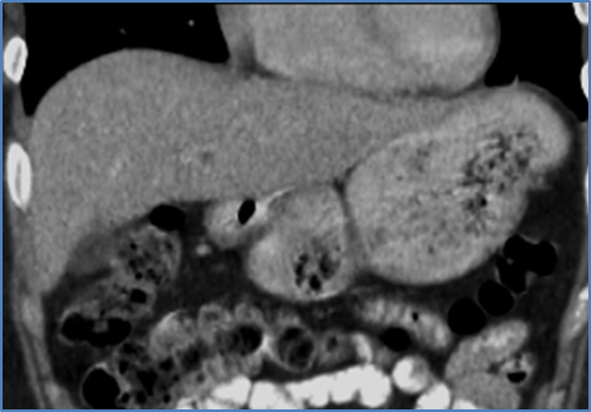
CT SCAN
MRI

Slide 26
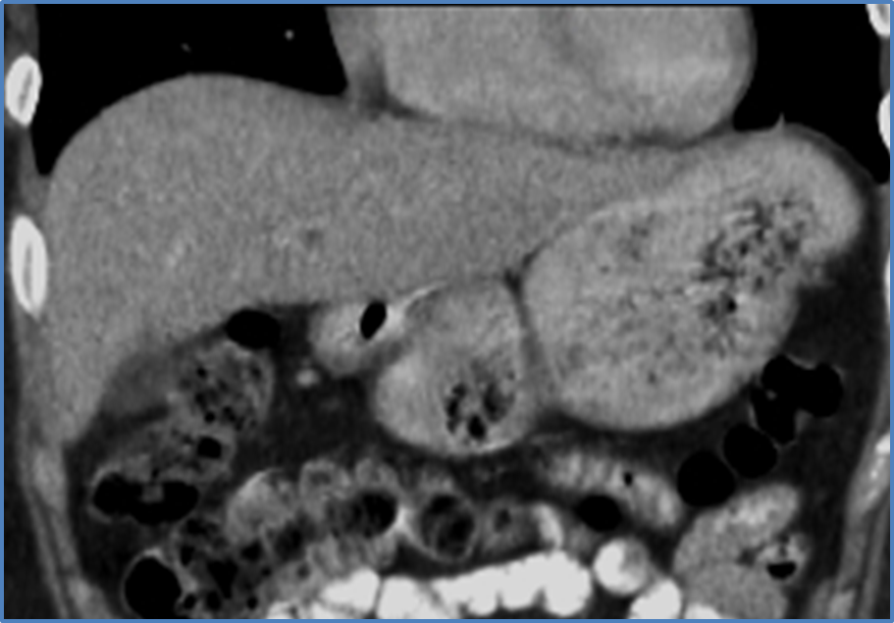
2
3
5
4
1

Slide 27
2
3
5
4
1
1-Greater curvature
2-Lesser curvature
3-Stomach fundus
4-Antrum
5-Pylorus

Slide 28
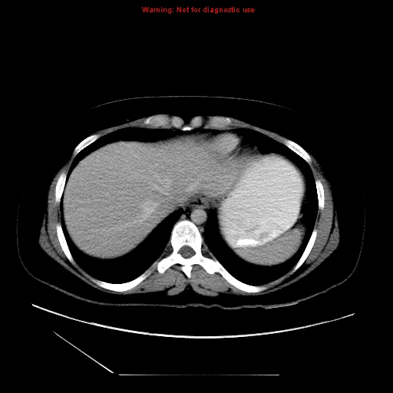
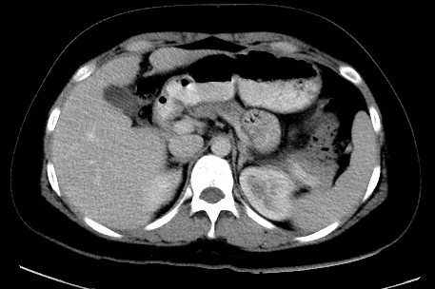
2
1
3
4
6
5

Slide 29
Stomach
Liver
Antrum
Pylorus
Spleen
Kidney
2
1
3
4
6
5

Slide 30
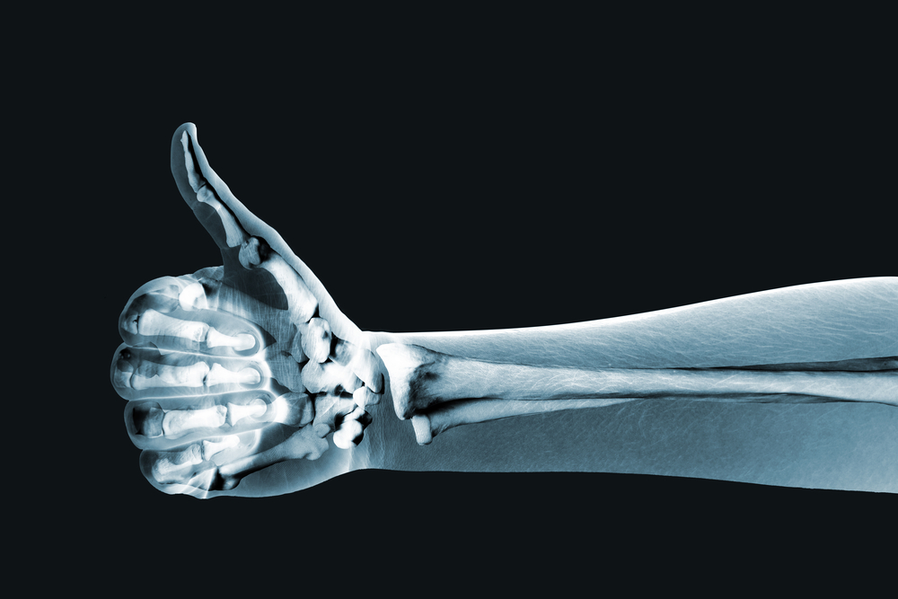
Thank you

