Slide 1
Introuduction to Pluripotent Stem Cells
Prof. Abdullah Aldahmash

Slide 2
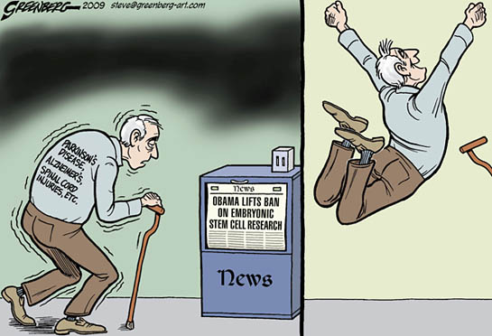
Notes:
The reason I am testifying before you today is that this cartoon tells the truth: it’s not possible to discuss stem cells without creating an ethical dilemma or bogging down in an ethical quagmire. I hope to show you a way out of the swamp without getting our feet too muddy.

Slide 3
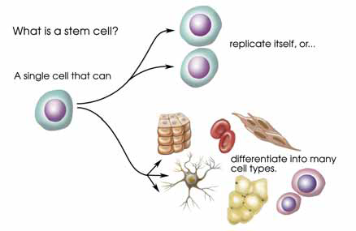
Stem Cell – Definition
A cell that has the ability to continuously divide and differentiate into various other kinds of cells
Self-renewal
A stem cell
Differentiation
Stem Cell – main function within the body
Continuous Repair of defective cell types and regeneration of tissues.

Slide 4
Classifications of stem cells (1)
Potency based
Description | Potency
1-3 days, differentiate into embryonic and extraembryonic cell types | Totipotent
Descendants of totipotent cells and differentiate into cells of 3 germ layers | Pluripotent
Produce cells of a closely related family (of cells (e.g. hematopoietic stem cells | Multipotent
Differentiate into ONLY a few cells, such as lymphoid or myeloid stem cells | Oligopotent
Produce ONLY one cell type (e.g. muscle stem cells) | Unipotent
The terminal cell | Nullpotent

Slide 5
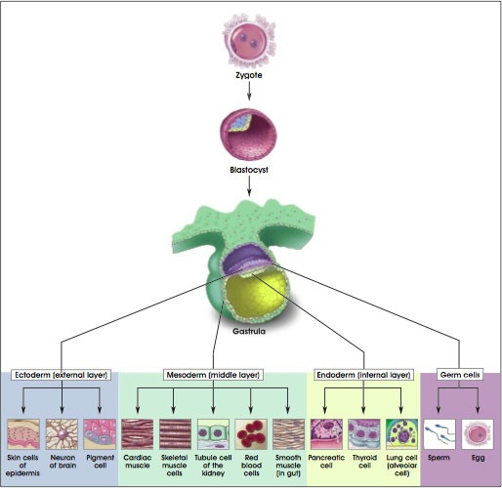
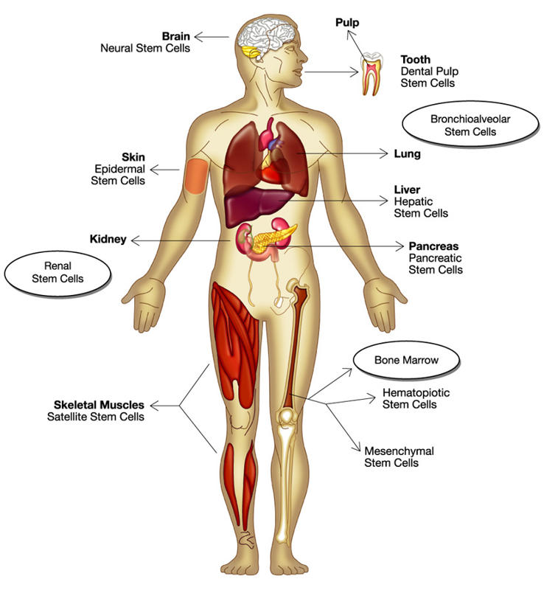
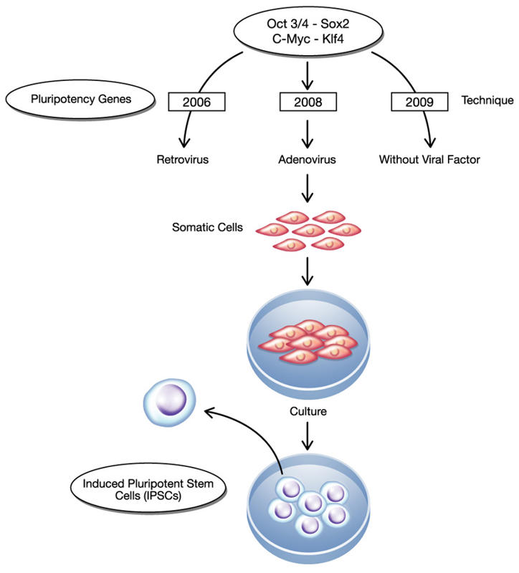
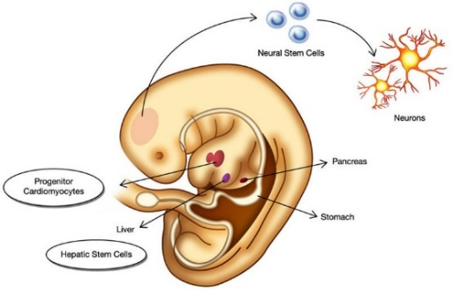
Classifications of stem cells (2)
Sourced based
Embryonic
Adult
(Tissue Specific)
Induced

Slide 6
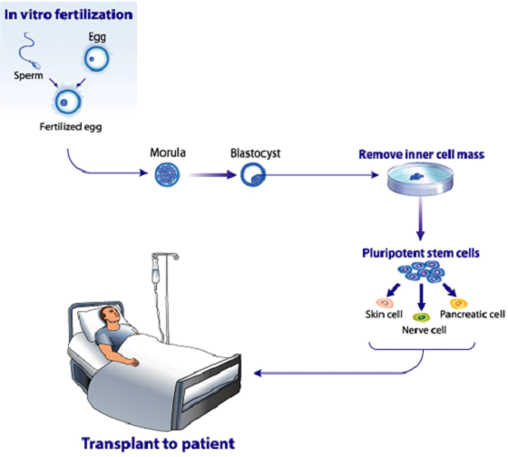
Embryonic Stem Cell
Embryonic human stem cells were first isolated in 1995 by Dr. James Thomson.
Source of ESC is Blastocysts (IVF, SCNT)

Slide 7
Generation of Embryonic Stem Cells

Slide 8
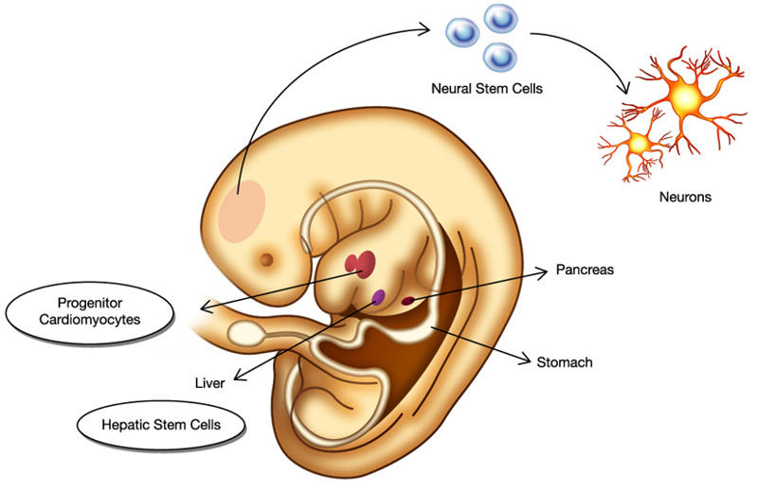
Adult stem cells (Tissue Specific Stem Cell)
Found in specific mature body tissues as well as the umbilical cord and placenta after birth.
They also can be isolated of developing embryos’ different tissues

Slide 9
Induced Pluripotent Stem Cell (iPS) cells
The method was described by Yamanaka and Takahashi in which the skin cells of laboratory mice were genetically manipulated and returned back to their embryonic state.
iPS are somatic cells that have been reprogrammed to a pluripotent state (embryonic stem cell like state).
Several difficulties are to be overcome before iPS cells can be considered as a potential patient-specific cell therapy. It will be crucial to characterize the development potential of human iPS cell line in the future.

Slide 10
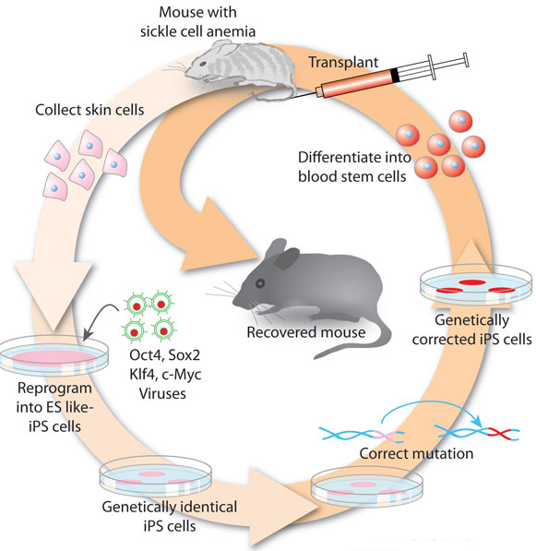
iPS
Skin cells were taken from the tail tip of a sickle-cell model mouse.
The cells were differentiated into hematopoietic cells.
The produced cells were transfused back into the sick mouse
Hanna J. et.al., 2007

Slide 11
Different Approaches for isolation of Pluripotent stem cells

Slide 12
Different Approaches for isolation of Pluripotent stem cells

Slide 13
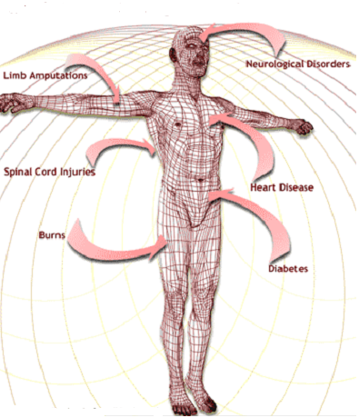
The Promises of Stem Cell Technology
Replacement of tissues/organs
Study cell differentiation
Toxicity testing.
Understanding prevention and treatment of birth defects.
Study of development and gene control.
Study of drugs therapeutic potential.

Slide 14
Characterization of Human Pluripotent Stem cells (ESCs)

Slide 15
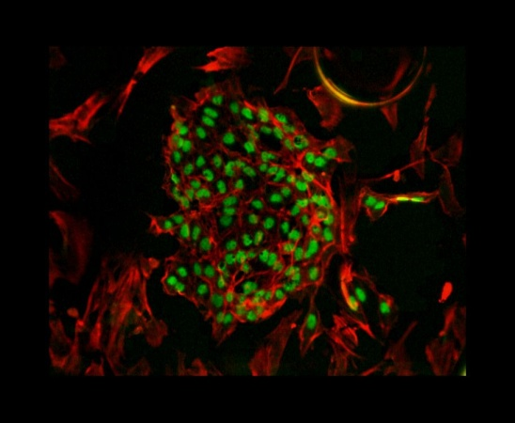
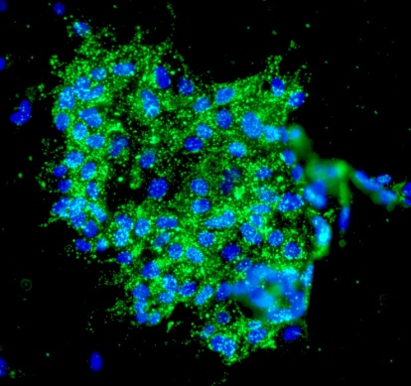
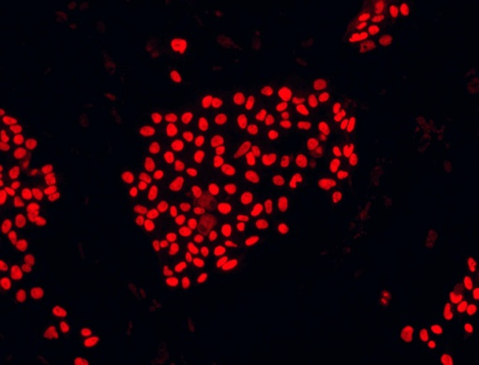
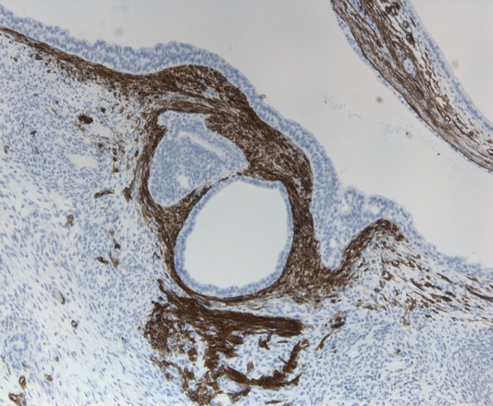
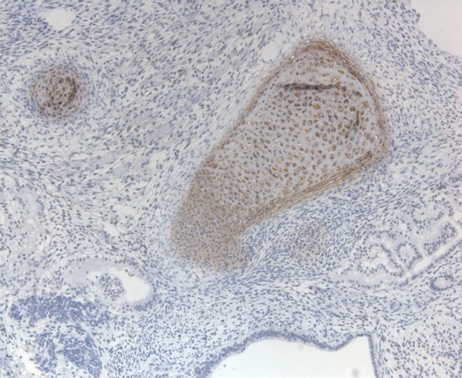
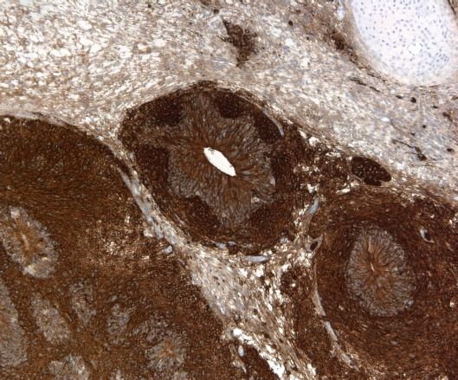
SSEA-4
Sox-2
Oct-4
Endoderm
Mesoderm
Ectoderm
Sox17
Sox9
Beta-III tubulin

Slide 16
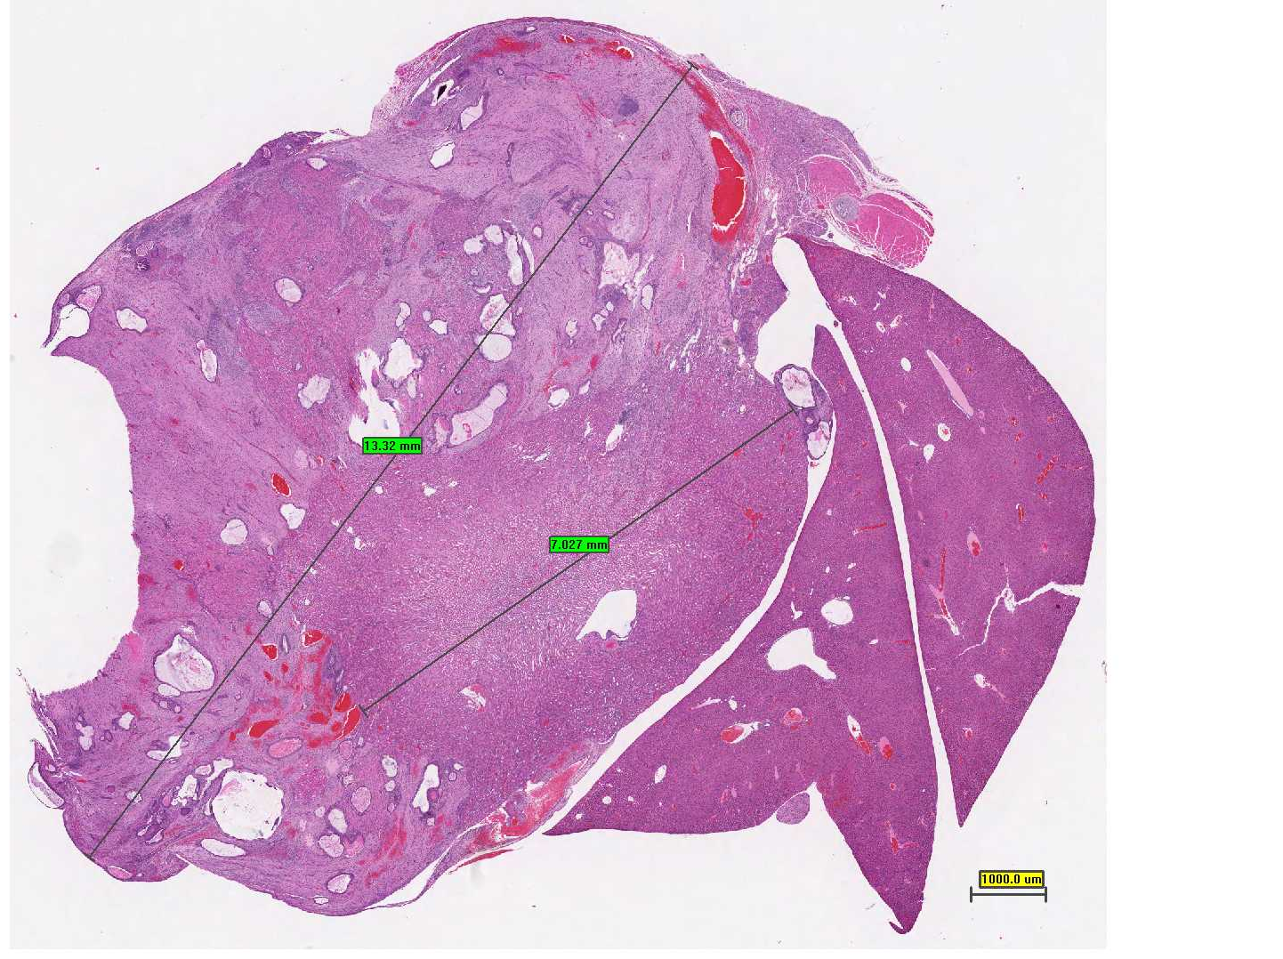
Teratoma
Kidney
Liver
A large tumor mass measuring twice as the kidney is compressing it.

Slide 17
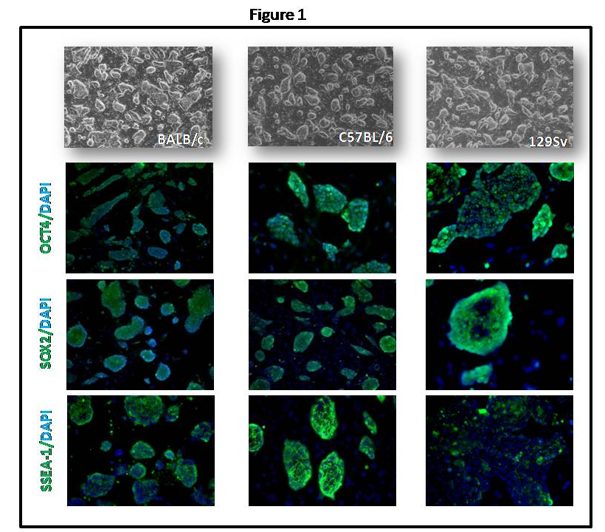

Slide 18
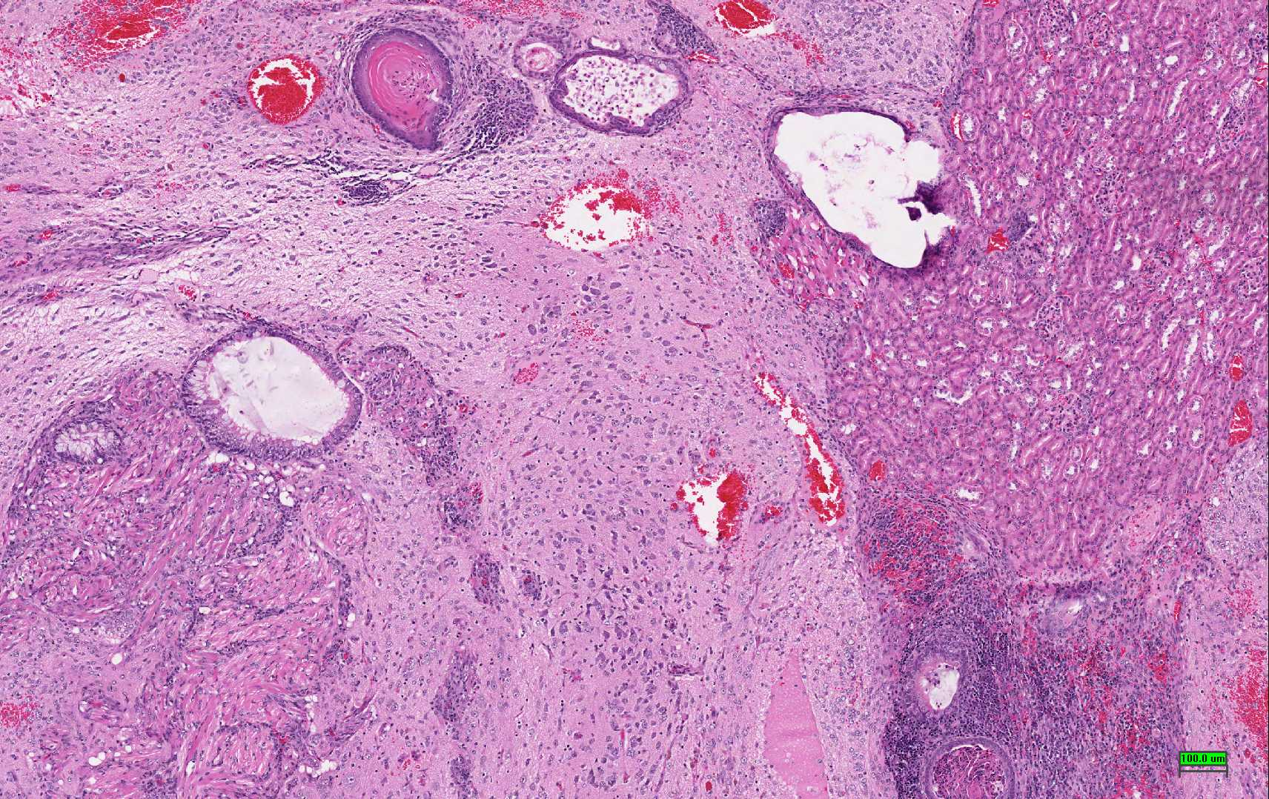
Skin
Brain
Lymphoid
Muscle
The teratoma was composed of mixed tissue patterns: skin with keratin, brain tissue, striated and smooth muscle, lymphoid tissue ……..

Slide 19
Challenges to Stem Cell Research
Stem cells need to be differentiated to the appropriate cell types before they can be used clinically.
Recently, abnormalities in chromosome number and structure were found in three human ESC lines.
Stem cell development or proliferation must be controlled once placed into patients.
Possibility of rejection of stem cell transplants as foreign tissues is very high.
The use of mouse “feeder” cells to grow ESC could result in problems due to xenotransplantation.

