Slide 1
Urea Cycle
Clinical Biochemistry Unit, Path. Dept.
College of Medicine, King Saud University

Slide 2
Objectives:
Understand the reactions for removal of α-amino group of amino acids and formation of ammonia
Identify the importance of blood transport of ammonia to the liver in the form of glutamine/alanine
Understand the importance of conversion of ammonia into urea by the liver through urea cycle
Identify urea as the major form for the disposal of amino groups derived from amino acids
Identify the causes (hereditary & acquired), clinical manifestations and management of hyperammonemia

Slide 3
Background:
Unlike glucose and fatty acids, amino acids are not stored by the body.
Amino acids in excess of biosynthetic needs are degraded.
Degradation of amino acids involves:
Removal of α-amino group Ammonia (NH₃)
Remaining carbon skeleton Energy metabolism

Slide 4
Removal of α-amino group, formation of ammonia and its transport to liver
A: Removal of α-amino group of amino acids and formation of ammonia:
Transamination to glutamate
Oxidative deamination of glutamate
B: Blood transport of ammonia into liver:
in the form of glutamine (most tissue)
in the form of alanine (muscle)

Slide 5
A: Removal of α-amino group & formation of ammonia
Amino groups of amino acids are funneled to glutamate (Why?) by transamination reactions with α-ketoglutarate
Glutamate is unique. It is the only amino acid that undergoes rapid oxidative deamination
Oxidative deamination of glutamate will release NH₃ and re-generate α-ketoglutarate

Slide 6
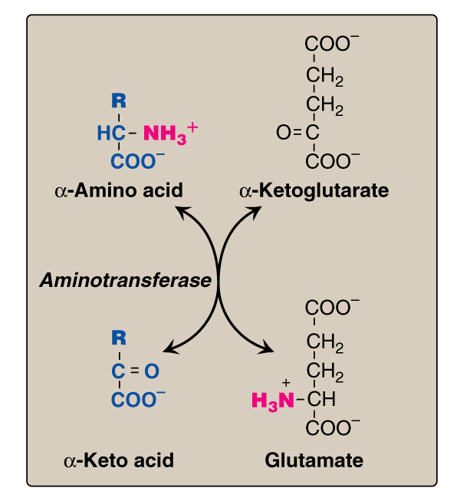
Transamination
& PLP
PLP: Pyridoxal phosphate, a co-enzyme that is derived from vitamin B6

Slide 7
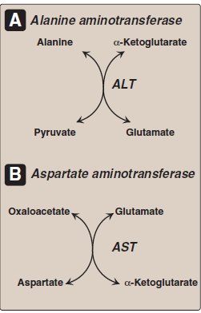
Transamination by ALT & AST
& PLP
ALT
& PLP
& PLP

Slide 8
Oxidative Deamination
Glutamate α-ketoglutarate
Glutamate
Dehydrogenase
NAD NADH
NH₃

Slide 9
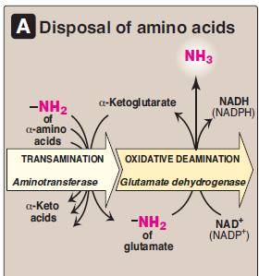
Summary: Removal of α-amino group of amino acid & formation of ammonia

Slide 10
B: Transport of NH₃ from peripheral tissues into the liver
Ammonia is produced by all tissues and the main disposal is via formation of urea in liver
Blood level of NH₃ must be kept very low, otherwise, hyperammonemia and CNS toxicity will occur (NH₃ is toxic to CNS)
To solve this problem, NH₃ is transported from peripheral tissues to the liver via formation of:
Glutamine (most tissues)
Alanine (muscle)

Slide 11
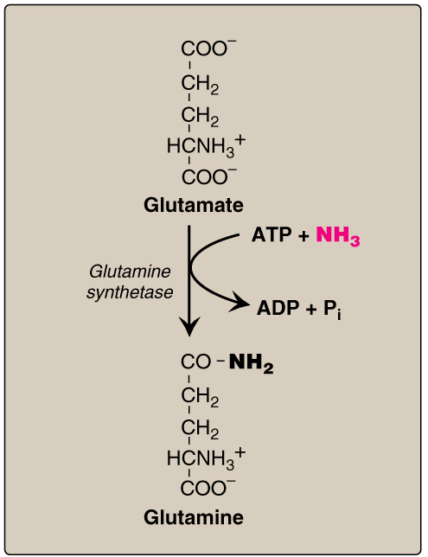
Transport of NH₃ from peripheral tissues into the liver
Cont’D
From most peripheral tissues:
NH₃ is transported Into
the liver through forming
glutamine by glutamine synthetase

Slide 12
Transport of NH₃ from peripheral tissues into the liver
Cont’D
From the muscle:
First, NH₃ will be transferred
into α-ketoglutarate to form
glutamate
Then, glutamate will give its
amino group to pyruvate
to form alanine by ALT
Therefore, NH₃ is transported
from muscle into the liver
through forming alanine

Slide 13
Release of ammonia from glutamine and alanine in the liver
In the Liver:
1. Glutamine is converted into
glutamate by glutaminase.
2. Alanine will give its amino group
to α-ketoglutarate to form glutamate by
ALT.
1
3
3. Glutamate is converted into
α-ketoglutarate and releasing NH₃
by glutamate dehydrogenase.
2

Slide 14
Summary Blood transport of NH₃ from peripheral tissues (in the form of glutamine and alanine) into the liver and the release of NH₃ back in the liver to start the urea cycle

Slide 15
Urea Cycle
Urea is the major form for disposal of amino groups derived from amino acids
Urea cycle occurs in the liver
One nitrogen of urea is from NH₃ and the other nitrogen from aspartate
Urea is transported in the blood to the kidneys for excretion in urine

Slide 16
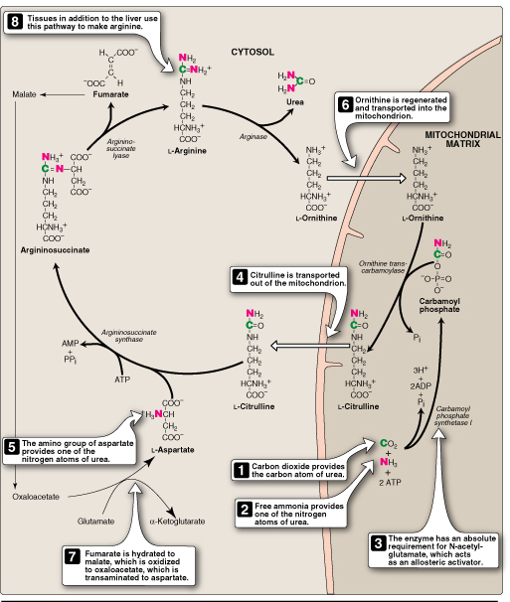
Urea Cycle
CONT’D
ASL
Arginase
The five enzymes of urea cycle:
Carbamoyl phosphate synthetase I
Ornithine transcarbamoylase (OCT)
Argininosuccinate synthase
Argininosuccinate lyase
Arginase
OCT
ASS
CPSI

Slide 17
Urea Cycle: Regulation
Rate-limiting enzyme of urea cycle:
Carbamoyl phosphate synthetase I
(CPSI)
Allosteric activator of CPSI:
N-Acetylglutamate
N-Acetylglutamate is synthesized by:
N-Acetylglutamate synthetase
(NAGS) in presence of arginine
NAGS deficiency is efficiently treated
with Carbaglue, a CPS1 activator
Glutamate
NAGS
N-Acetylglutamate

Slide 18
Fate of Urea
Urea Kidneys and excreted in urine
Intestine NH₃ + CO₂
Blood
Urease
Lost in feces
Reabsorbed
into blood
The action of intestinal urease to form NH₃
is clinically significant in renal failure:
Renal failure Blood urea Urea to intestine NH₃ blood level
Urease
(Acquired hyperammonemia)

Slide 19
Sources and Fates of Ammonia
Normal blood level of ammonia: 5 – 50 µmol/L

Slide 20
Hyperammonemia
Acquired hyperammonemia:
1. Liver diseases: Acute: Viral hepatitis or hepatotoxic Chronic: Cirrhosis by hepatitis or alcoholism
2. Renal failure
Inherited hyperammonemia:
Genetic deficiencies of any of the 5 enzymes of urea cycle or the activator enzyme for CPSI:
CPSI, OTC, ASS, ASL, arginase or NAGS

Slide 21
Inherited Hyperammonemia
Ornithine transcarbamoylase deficency: X-linked recessive Most common of congenital hyperammonemia Marked decrease of citrulline and arginine
Others: Autosomal recessive

Slide 22
Clinical Presentation of Hyperammonemia
Lethargy and somnolence
Tremors
Vomiting and cerebral edema
Convulsions
Coma and death

Slide 23
Management of Hyperammonemia
Protein restriction
Volume repletion to maintain renal function Use 10% dextrose in water but limit the use of normal saline
Ammonia removal by hemodialysis &/or drugs
Avoid drugs that increase protein catabolism (eg, glucocorticoids) or inhibit urea synthesis (eg, valproic acid), or have direct hepatotoxicity

Slide 24
Drug Treatment of Hyperammonemia
Drugs that scavenge ammonia by creating an alternate pathway to excrete N₂- precursors:
I.V. Sodium phenylacetate & sodium benzoate (Ammonul)
Oral sodium phenyl butyrate (Buphenyl)
I.V. Arginine: for all UCDs except UCD due to arginase deficiency (argininemia)
B. Activators to CPSI (Carglumic acid “Carbaglu”): For hyperammoniemia due to NAGS deficiency

Slide 25
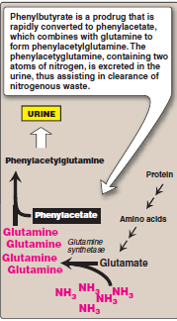
Sodium phenyl butyrate (Buphenyl)
Sodium phenyl butyrate (Buphenyl):
Prodrug that is converted to
phenylacetate.
Phenylacetate condenses with
glutamine forming phenylacetylglutamine
that is excreted in urine

Slide 26
Thank You

