Slide 1
HAEMOGLOBINOPATHIES
DR. SHIHAB AL-MASHHADANI
Consultant Haematologist
Head of Haematology Division
Department of Pathology

Slide 2
HAEMOGLOBINOPATHIES
A - THALASSAEMIAS
B - ABNORMAL HAEMOGLOBINS

Slide 3
LEARNING OBJECTIVES
To understand the normal structure and function of haemoglobin
To understand how the globin components of haemoglobin change during development, and postnatally
To understand the mechanisms by which the thalassaemias arise
To appreciate the clinical presentations and complications of thalassaemia
To appreciate the contribution of haemolysis and ineffective erythropoiesis to the pathophysiology of thalassaemia

Slide 4
cont’d…
To understand the pathophysiology of sickle cell anaemia
To be able to describe the clinical presentation and complications of sickle cell anaemia
To understand the role of haemoglobin electrophoresis and high performance liquid chromatography in the investigation of globin disorders
To appreciate the many other haemoglobin variants associated with disease

Slide 6
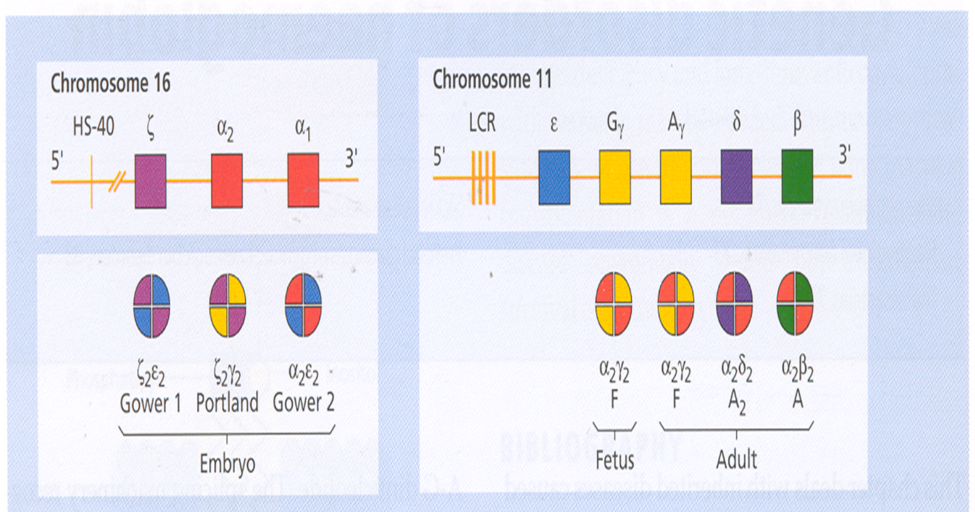

Slide 9
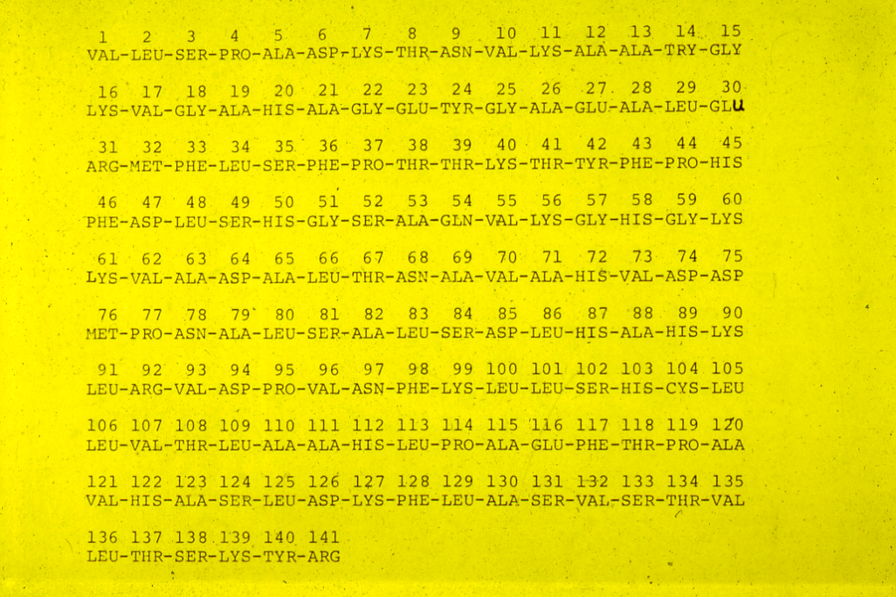

Slide 10
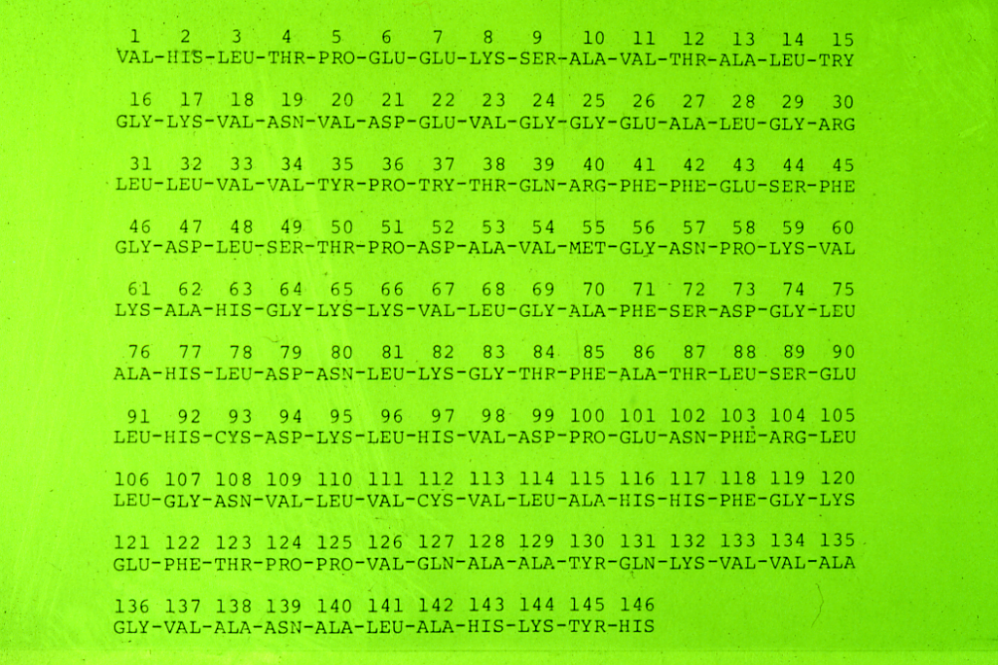

Slide 11
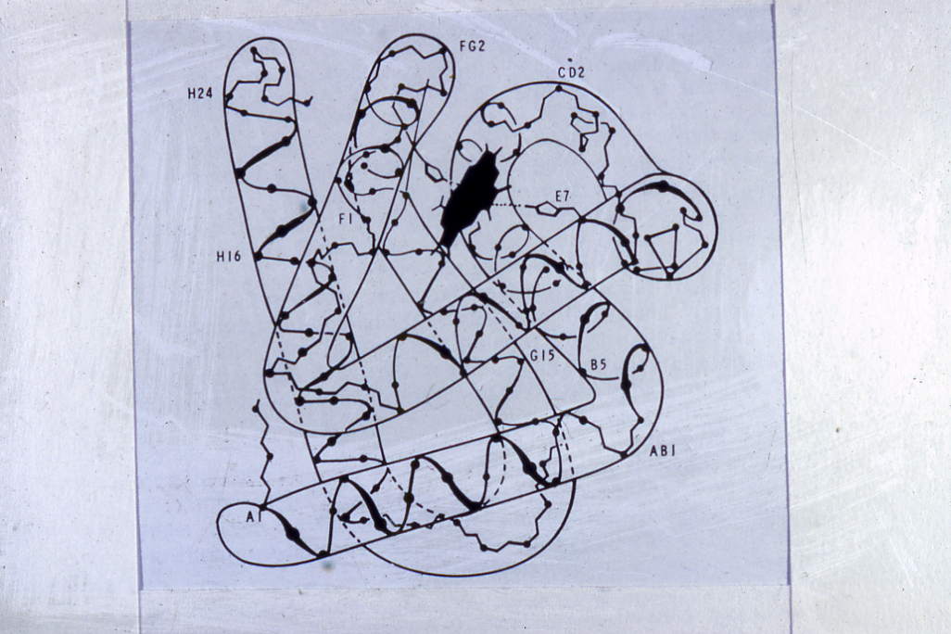

Slide 12
NAME | Chains
Haemoglobin A | α2 | β2
Haemoglobin A2 | α2 | δ2
Haemoglobin F | α2 | γ2
Haemoglobin H | - | β4
Haemoglobin Bart’s | - | γ4
Haemoglobin Gower I | ζ2 | Є2
Haemoglobin Gower II | α2 | Є2
Haemoglobin portland | ζ2 | γ2
Haemoglobin Lepore | α2 | (δβ)2

Slide 13
THE HAEMOGLOBINS PRESENT AT BIRTH IN NORMAL NEWBORN
NAME %
HbA 15 – 40
HbA₂ < 0.3
HbF 60 – 85
Hb Bart’s < 0.5

Slide 14
THE NORMAL HUMAN HAEMOGLOBINS
EMBRYONIC
(Upto 8 Weeks gestation) ζ₂ Є ₂ Hb Gower I
ζ ₂ γ₂ Hb Portland
α₂ Є ₂ Hb Gower II
FETAL α₂ γ₂ HbF 60 - 85%
α₂β₂ HbA 15 – 40 %
Caucasian Saudi
ADULT α₂ β₂ HbA 97.0% 95.0%
α₂δ₂ HbA₂ 2.5% 3.5%
α₂ γ₂ HbF 0.5% 1.5%

Slide 15
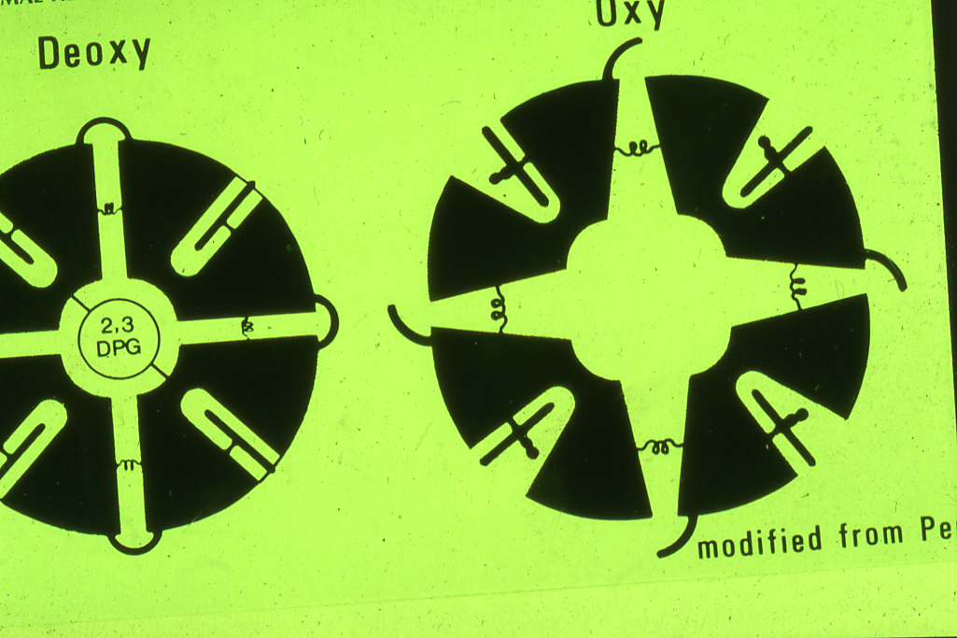

Slide 16
α and β THALASSAEMIA
The thalassaemias are divided into two main groups, the α-thalassaemias and the β-thalassaemias, depending on whether the defect lies in the synthesis of α- or β-globin chains respectively.
The pathophysiology reflects the impact of an imbalance in the expression of α and β globin chains.

Slide 17
cont’d…
The chains which are present in excess will precipitate in the precursor red cells, leading to their premature death prior to release from the bone marrow (ineffective erythropoiesis).
The resulting anaemia leads to an increased erythroid drive.

Slide 18
cont’d…
There is further expansion of the marrow into bones not typically used for haemopoiesis, and into the spleen.
The long-term consequences of thalassaemia therefore include splenomegaly, bony deformities and iron excess as well as chronic anaemia.

Slide 20
α - THALASSAEMIA
HETEROZYGOUS
HOMOZYGOUS

Slide 22
α⁺-Thalassaemia trait (deletion of one or two α globin genes)
This is seen when an individual inherits the α⁺-thalassaemia allele from one parent or two parents and a normal chromosome 16 from one or two parents (i.e. heterozygotes for the α⁺ determinant or homozygous α⁺ trait). Affected individuals are asymptomatic, although they have minor haematological changes such as slight reductions in mean cell volume (MCV) and mean cell haemoglobin (MCH).

Slide 23
α⁰-Thalassaemia trait (deletion of both α-globin genes on one chromosome 16)
The Hb is either normal or slightly reduced and the MCV and MCH are low.

Slide 24
Haemoglobin H disease (deletion of three α-globin genes)
This chronic haemolytic anaemia results from the inheritance of both the α⁺- and α⁰-thalassaemia alleles, leaving one functioning α-globin gene per cell. α-globin chains are produced at very low rates, leaving a considerable excess of β-chains, which combine to form tetramers (β₄). This tetramer is known as HbH.
HbH is unstable and precipitates as the erythrocytes age, forming rigid membrane-bound inclusions that are removed during the passage of affected red cells through the spleen. The damage to the membrane brought about by this removal results in a shortened red cell lifespan.

Slide 25
cont’d…
Most patients are moderately affected, with anaemia of 7-11g/dl and markedly hypochromic, microcytic indices.
Supravital staining of the blood film demonstrates cells with many HbH inclusions, giving a characteristic ‘golf-ball’ appearance.
Most patients will be transfusion independent.
Splenomegaly is seen in most patients.

Slide 27
Hb Bart’s hydrops fetalis syndrome (deletion of all four α-globin genes)
No α-chains can be formed, and the fetal β-like chain γ-globin forms tetramers known as Hb Bart’s. This haemoglobin is not useful for oxygen transport and, despite the persistence of the embryonic haemoglobin Hb Portland (ζ₂γ₂), there is intrauterine or neonatal death due to hydrops.

Slide 30
LABORATORY DIAGNOSIS OF ALPHA THALASSEMIA SYNDROME
High red cell count in the trait
Hypochromic microcytic red cells & target cells
Normal serum iron or low in children
Normal total iron binding capacity or high in children
Positive Hb H inclusion bodies in the blood film preparation & positive Heinz bodies with vital stains
Hemoglobin electrophoresis show presence of hemoglobin H (Hb H disease)
Hemoglobin electrophoresis show low Hb A2 level
Genetic study to confirm the diagnosis

Slide 31
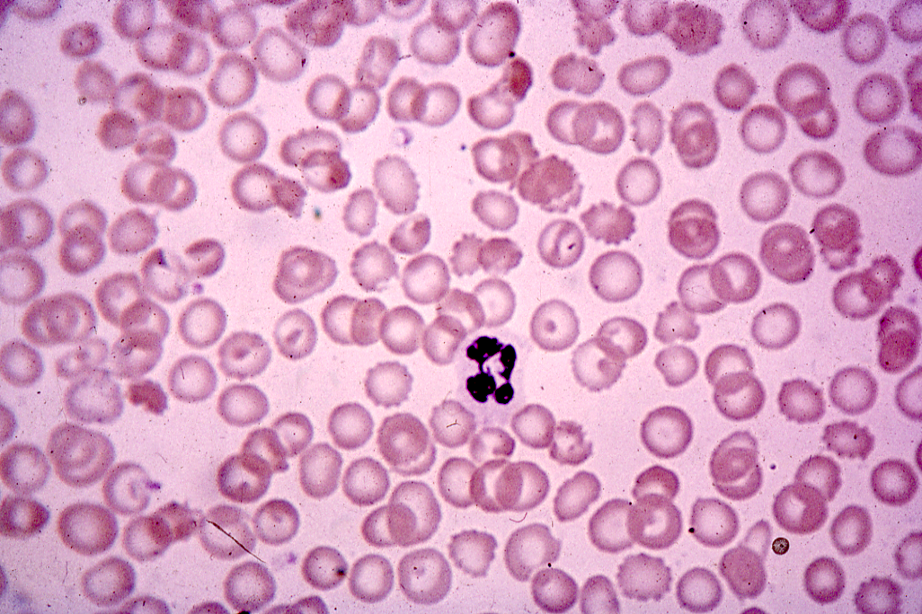

Slide 32
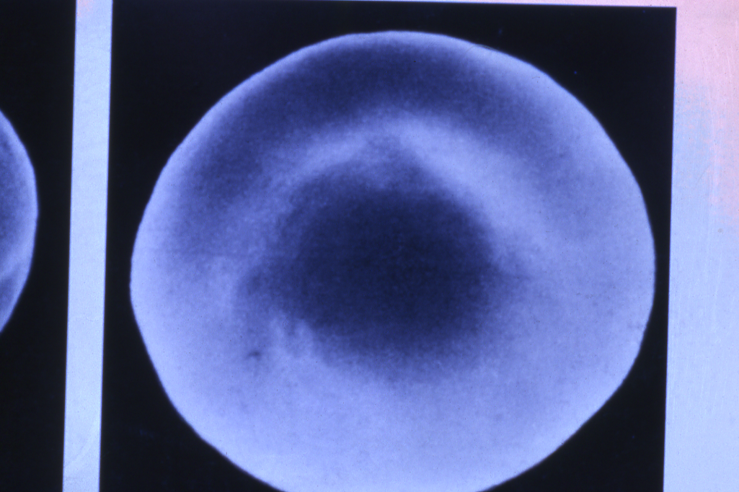

Slide 33
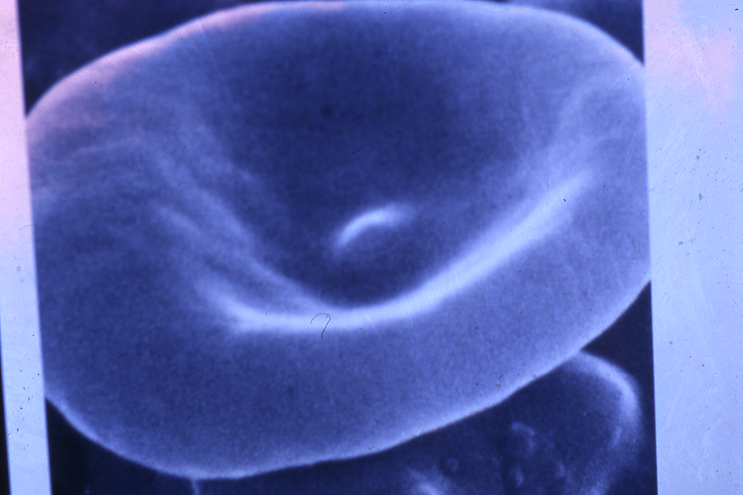

Slide 35
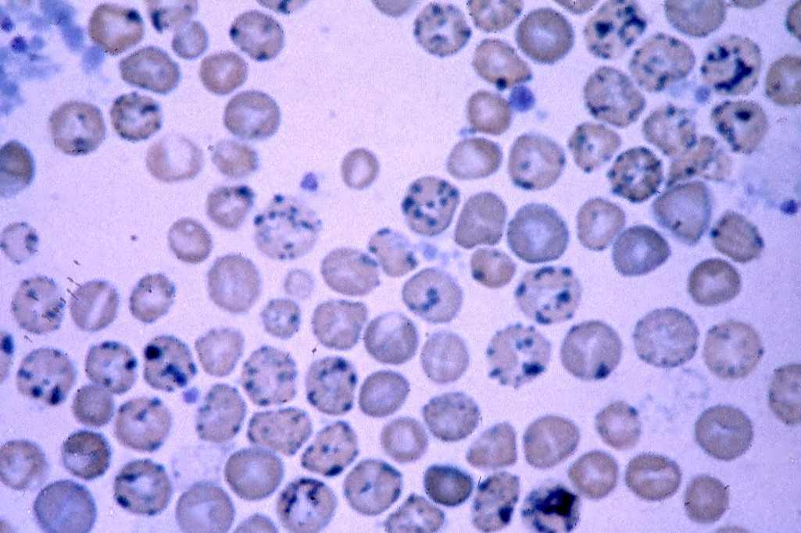

Slide 36
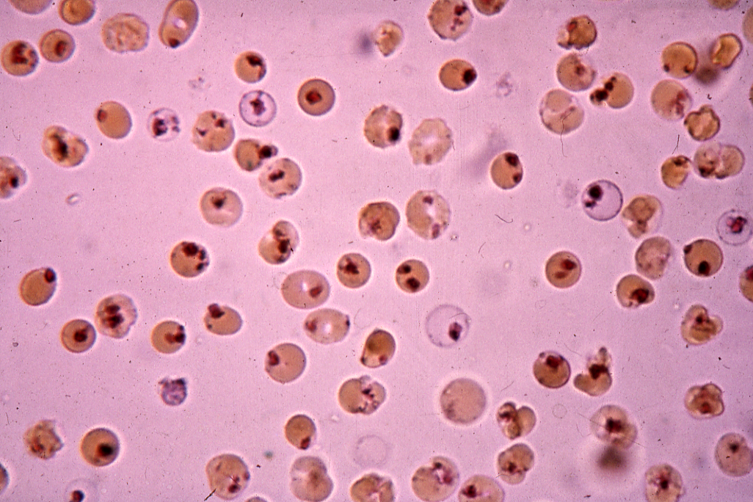

Slide 37
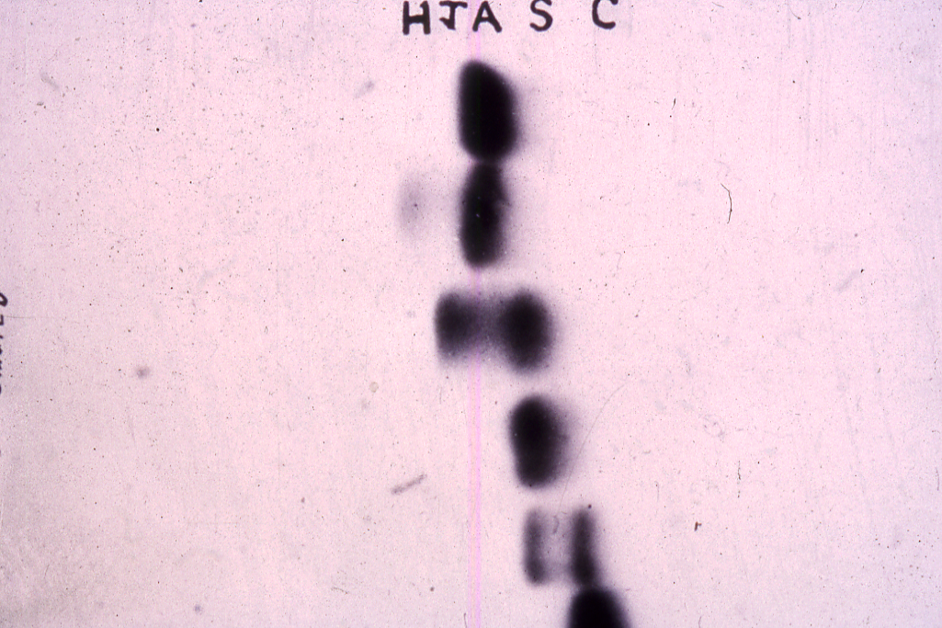

Slide 38
β-THALASSAEMIA
DR. SHIHAB AL-MASHHADANI

Slide 39
5’ ε Gγ Aγ uη δ β 3
Hc Hd Hd Hc A B
The –globin gene cluster showing the position of various common restriction endonuclease polymorphic sites. (Hc, Hinc II; Hd, Hind III; A, Ava II; B, Bam H1).

Slide 40
β-Thalassaemia
The World Health Organization estimates that 1.5% of the world’s population are carriers of β-thalassaemia. The prevalence of the β-thalassaemia trait is particularly high in southern Europe (10-30%) and south-east Asia (5%), common in Africa, the Middle East, India, Pakistan and southern China.
α-thalassaemia typically arises from gene deletions.
β-thalassaemia usually results from a multiplicity of different single nucleotide substitutions, insertions or small deletions affecting the β-gene itself.

Slide 41
Heterozygous β-thalassaemia (Beta-thalassaemia trait)
Most affected subjects with beta thalassaemia trait are asymptomatic.
The Hb concentration is either normal or slightly reduced, hypochromic and microcytic red cell indices are seen.
Examination of peripheral blood film may show red cell abnormalities such as target cells and poikilocytes.
HbA2 levels will be raised above the normal range to 3.5-7.0%.
Slightly increased HbF levels, in the range of 1-5%.

Slide 42
Homozygous β-Thalassaemia
Defects of β-globin on both copies of chromosome 11
Marked anaemia
Transfusion dependent

Slide 43
Clinical classification of the thalassaemias
Thalassaemia minima describes the presence of a thalassaemia mutation that is without clinical consequences.
Thalassaemia minor describes patients with microcytosis and hypochromic red cells secondary to thalassaemia mutations, but with only mild anaemia or a normal haemoglobin. Patients who inherit a single affected allele are usually in this category.

Slide 44
cont’d…
Thalassaemia intermedia patients will also have a microcytic hypochromic anaemia, increased erythroid drive to maintain their haemoglobin, packed bone marrow with a decreased myeloid:erythroid ratio, and extramedullary haematopoiesis, giving splenomegaly. Transfusion may be required to maintain the haemoglobin at times of additional physiological stress.

Slide 45
cont’d…
Thalassaemia major have severe anaemia and are transfusion dependent. Their increased erythroid drive leads to a packed erythroid marrow and splenomegaly, development of bony abnormalities secondary to unchecked marrow expansion. Patients in this category are those with complete loss of β-globin expression from both copies of chromosome 11.

Slide 46
Molecular Defects in the β-Thalassaemia Syndrome
 | β-Globin synthesis | β⁻mRNA | β-Globin Gene | δ-Globin Synthesis | γ-Globin Synthesis
1. β⁺-Thalassemia 2. β⁰-Thalassemia | Decreased Absent | Decreased Absent | Present Present | Present Present | Present Present
Ferrara Variant Indian Variant | Absent Absent | Inactive Absent | Present Partially Deleted | Present Present | Present Present
3. δβ-Thalassaemia 4. HPFH | Absent Absent | Absent Absent | Deleted Deleted | Absent Absent | Increased increased

Slide 47
Hemoglobin Fractions in the Genotypic Variants
of the β-Thalassaemia Syndromes
Genotype | HbA | HbA₂ | HbF (%) | Other Hemoglobins
Normal β/β | 97 | 2.5 – 3.2 | <1 | None
Thalassaemia major β⁰/β⁰ β+/β⁺ Mediterranean β⁰/β⁺ (δβ) Lepore/ (δβ) Lepore | 0 Present Present 0 | 1.0 – 5.9 2.4 – 8.7 0.6 – 3.4 0 | >94 20 – 90 >75 70 – 92 | Free α-chains Free α-chains None Hb Lepore (8-30%)
Thalassaemia intermedia β+/β⁺, black β⁰/ (δβ)⁰ β⁺/ (δβ)⁰ β⁰/ (δβ)⁰ Lapore β⁺/ (δβ)⁰ Lepore β⁰/β (δβ)⁰ / (δβ)⁰ (δβ)⁰/ (δβ)Lepore α/β | Present 0 20 – 30 0 Present Present 0 0 Present | 5.4 – 10.0 0.3 – 2.4 Decreased Decreased Decreased >3.2 0 0 Increased | 30 – 73 60 – 99 Increased Increased Increased 1.5 – 12 100 92 Normal or increased | None None None Hb Lepore (10%) Hb Lepore (10%) None None Hb Lepore (8%) ± Hb H

Slide 48
Hemoglobin Fractions in the Genotypic Variants
of the β-Thalassaemia Syndromes (Continued)
Genotype | HbA | HbA₂ | HbF (%) | Other Hemoglobins
Thalassaemia minor β ⁺/β β⁰/β (δβ)⁰/β (δβ) Lepore/ β (γδβ)⁰/β | >90 >90 >90 Present Present | 3.5 – 8.0 3.5 – 8.0 2.5 – 8.0 1.2 – 2.6 2.5 – 3.2 | 1 – 2 1 – 2 5 – 20 1 – 3 < 1 – 2 | None None None Hb Lepore ( 5 – 15%) None
Thalassaemia minima β^{silent}/β | 97 | <3.2 | <1 | None

Slide 49
Clinical Manifestations in Thalassaemias
Pallor
Jaundice
Apathy and Anorexia
Failure to Thrive
Hepato-splenomegaly
Skeletal Deformity
Iron Overload mainfestations

Slide 50
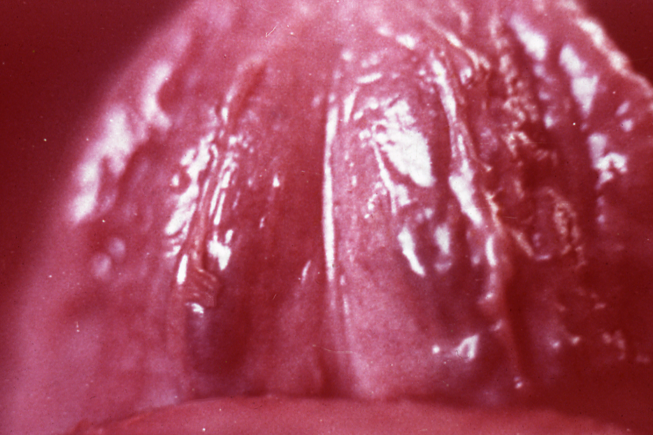
.

Slide 51
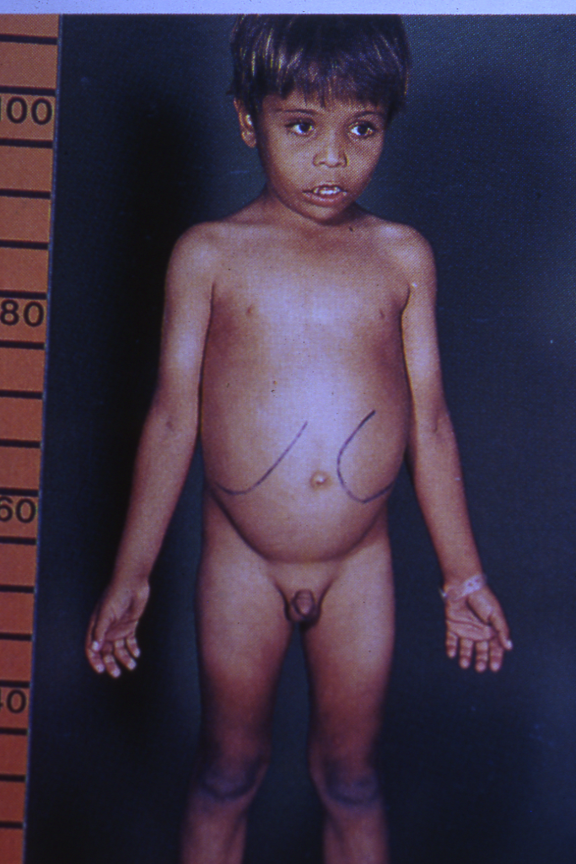
.

Slide 52
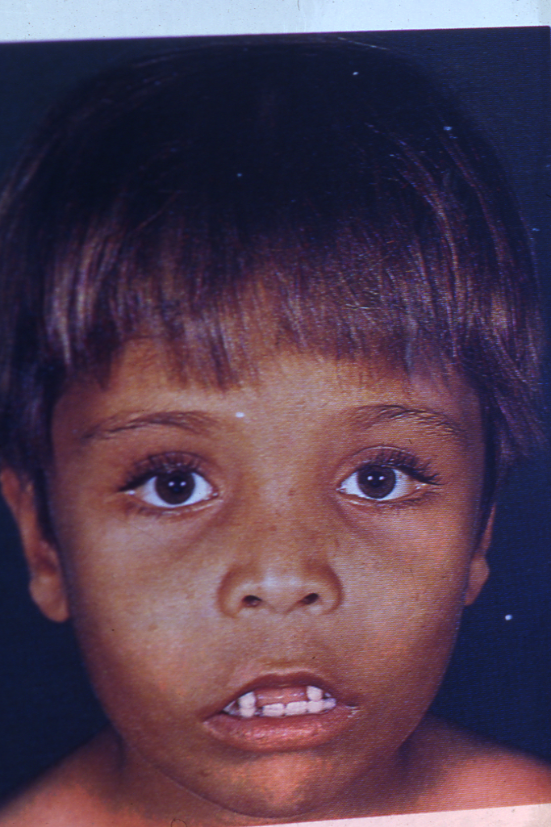
.

Slide 53
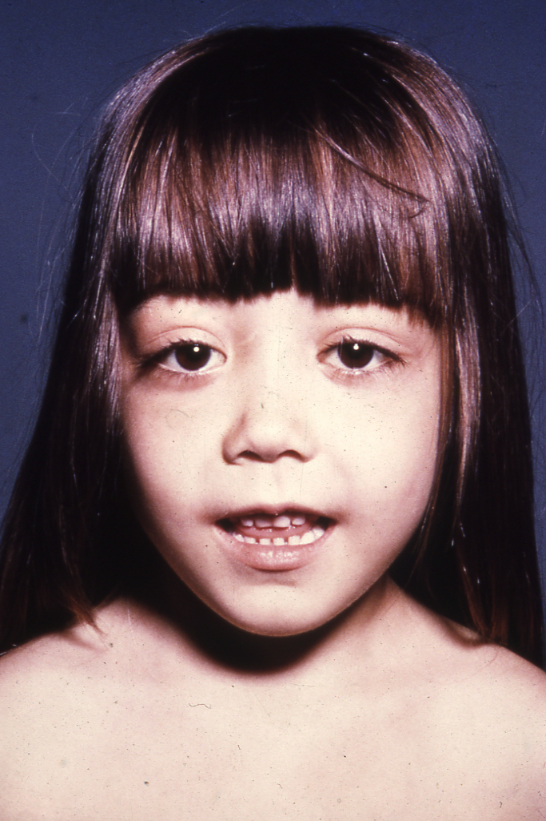
.

Slide 56
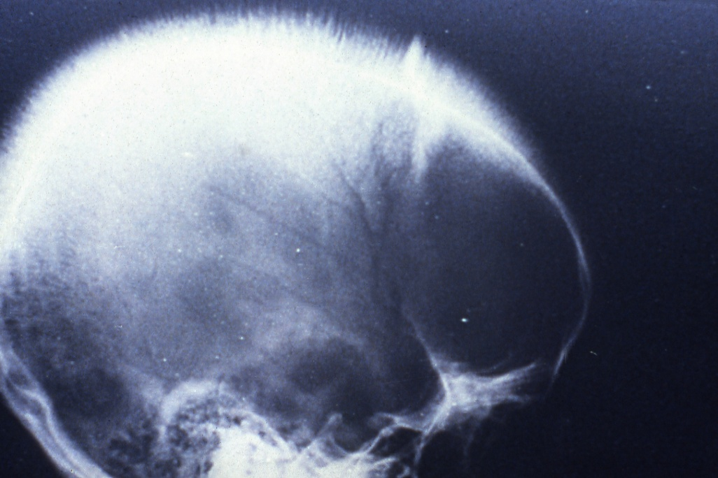
.

Slide 57
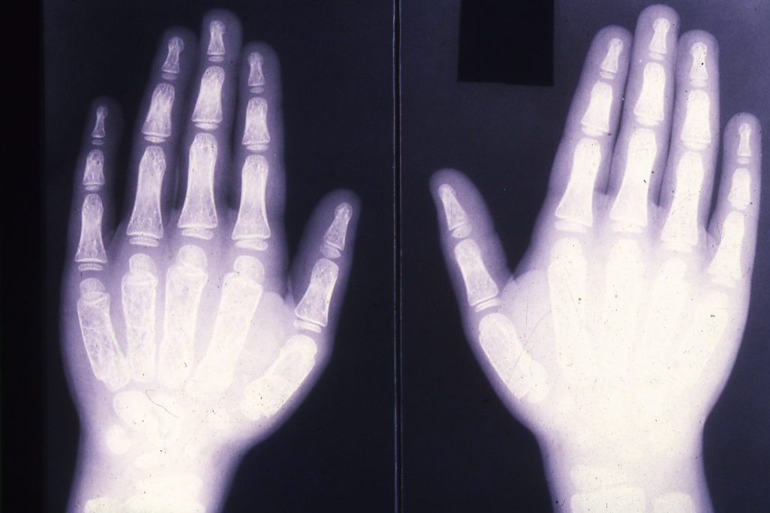
.

Slide 58
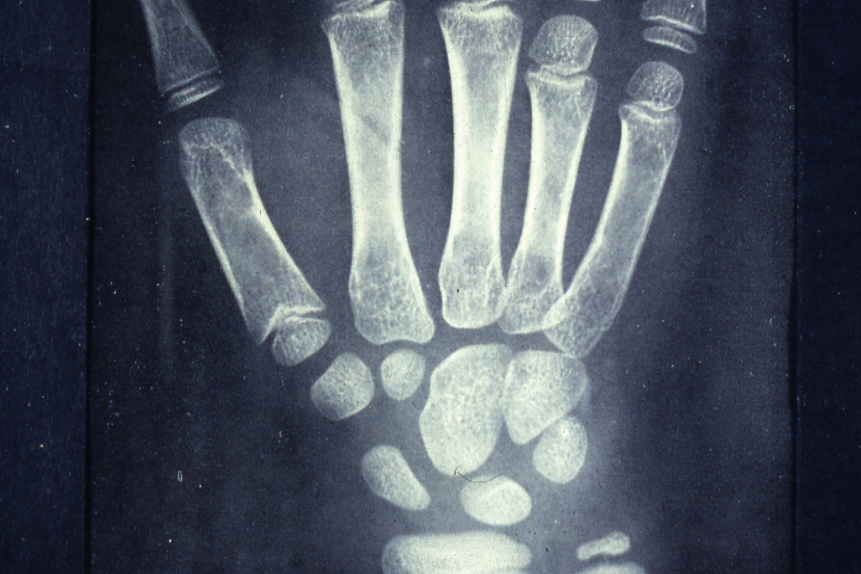
.

Slide 59
Clinical and Hematological Features
of the β-Thalassemia Syndrome
 | Major | Intermedia | Minor | Minima
Severity of mainfestations | ++++ | ++ | +, ± | ±, 0
Genetics | Homozygotes, double heterozygotes | Homozygotes, double heterozygotes, rarely heterozygotes | Heterozygotes | Heterozygotes
Splenomegaly | ++++ | ++,+++ | +,0 | 0
Jaundice | +++ | ++,+ | 0 | 0
Skeletal changes | ++++,++ | +,0 | +,0 | 0
Anemia (Hb, g/dl) | <7 | 7 – 10 | >10 | Normal

Slide 60
Clinical and Hematologic Features
of the β-Thalassemia Syndrome (Continued)
 | Major | Intermedia | Minor | Minima
Hypochromia | ++++ | +++ | ++ | +
Microcytosis | +++ | ++ | + | 0
Target cells | 10 – 35% | ++ | + | ±
Basophilic stippling | ++ | + | + | 0, +
Reticulocytes (%) | 5 – 15 | 3 – 10 | 2 – 5 | 1 – 2
Nucleated red cells | +++ | +, 0 | 0 | 0
±, little or no abnormality; +, mild abnormality; ++++, prominent abnormality

Slide 62
Diagnosis of Haemoglobinopathies including Thalassaemias
Personal & Family History
Physical Examination
Laboratory Investigation
1. Haematological Tests – CBC, Red cell indices, blood film Morphology, reticulocyte count.
2. Sickling Tests – Sickle cell test, Sickle cell solubility test.
3. Hb Electrophoresis at alkaline/acidic pH and quantitation.
4. Quantitation of HbA2 and HbF
5. Serum iron total iron binding capacity and ferritin level
6. Biochemical tests:
Liver functions tests, renal function tests, blood gases and acid-base status, bone profile and urine analysis.
7. Special Tests
A. Family studies (Laboratory Investigations)
B. Measurement of Alpha/Non-Alpha chain ratio
C. Gene Studies

Slide 63
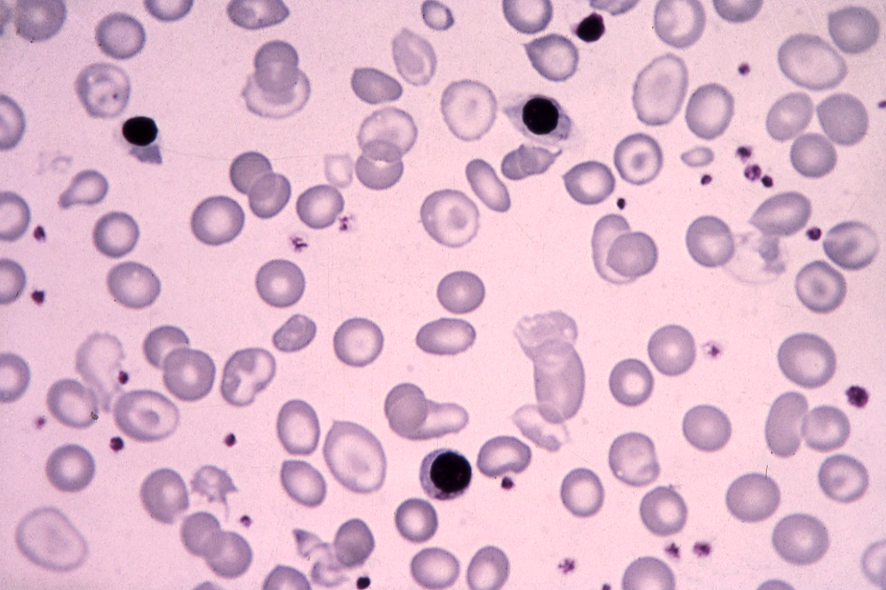
.

Slide 64
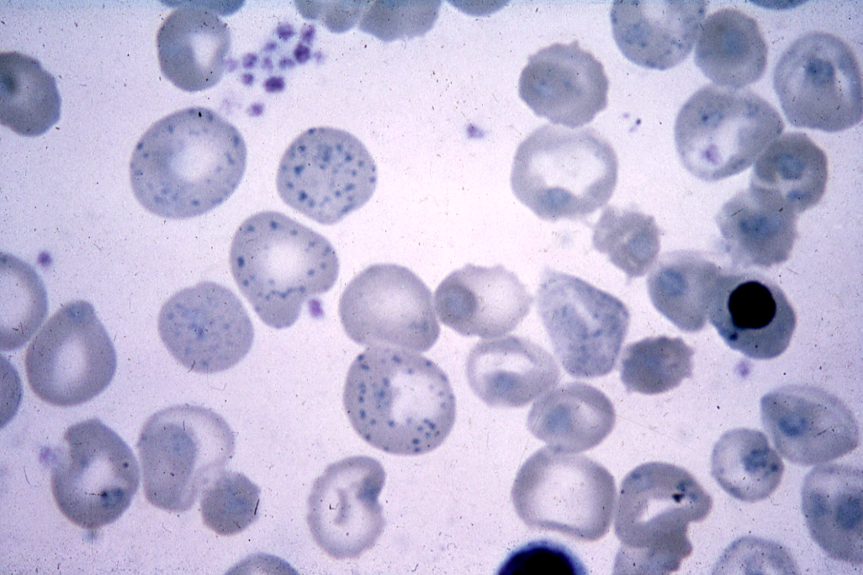
.

Slide 65
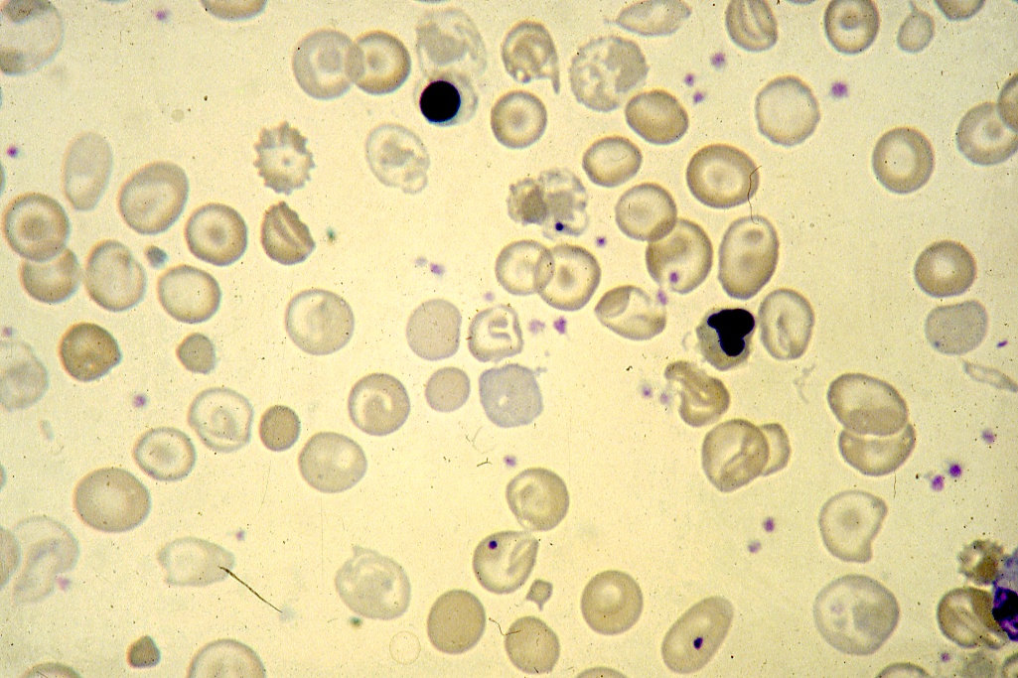
.

Slide 73
Prenatal diagnosis of the haemoglobinopathies (Including thalassaemia)
DNA Analysis
Chorionic villus sampling
Transcervical approach (9 – 11 weeks of pregnancy)
Transabdominal approach (up to 15 weeks of pregnancy)
Amniotic fluid cell analysis (16 – 20 weeks gestation)
Fetal blood sampling (> 20 weeks gestation)
DNA analysis
Haematological parameters
Biochemical analysis
Globin chain synthesis
α/β Ratio
α/ɣ Ratio
α/δ Ratio

Slide 75
DNA ANALYSIS
Gene mapping
2. RFLPs linkage analysis
(Restriction fragment length polymorphisms)
Oligonucleotide probes
(Using short gene probes 17 – 19 Nucleotide)
Gene amplification
(Enzymatic amplification of DNA sequences)
DNA polymerase chain reaction technique.

Slide 76
MANAGEMENT OF THE THALASSEMIAS
Blood Transfusion
Iron chelation therapy
Splenectomy
Hormone replacement
Bone marrow transplantation
Gene therapy

Slide 77
SUMMARY OF RECOMMENDATIONS FOR THE
TREATMENT OF THALASSEMIA MAJOR
TRANSFUSION
Transfusion, in the absence of cardiopathy:
Blood-type the patient completely;
Vaccinate hepatitis B negative patients against hepatitis;
Transfuse when the Hb remains consistently below 8 g/dL, or earlier if there are other indications;
Keep the pretransfusion Hb between 10.5 and 11 g/dL;
Give 10-15 mL/kg of blood preparation in 2 h;
Do not raise the posttransfusion Hb above 16 g/dL;
Choose a 3-4 week transfusion interval.

Slide 78
SUMMARY OF RECOMMENDATIONS FOR THE TREATMENT OF THALASSEMIA MAJOR (Continued)
TRANSFUSION
Transfusion in the presence of cardiopathy, or when the Hb is less than 5 g/dL:
Inject furosemide 1-2 mg/kg;
Preferably use fresh blood;
Do not transfuse more than 5 mL/kg of blood;
Do not transfuse faster than 2 mL/kg, or for more than 4 h;
If necessary, divide the blood among 2 or more bags;
Use very short intertransfusion intervals.

Slide 79
IRON CHELATION THERAPY
Desferrioxamine S.C. 20-60 mg/kg/day in 8 h (average 40 mg/kg/day, or 280 mg/kg/ week).
In selected subjects, give desferrioxamine i.v. in high dose, maximum 100 mg/kg over 8 h, only on the days of transfusion.
SPLENECTOMY
Is indicated when the blood consumption is more than 1.5 times normal.
Give anti-pneumococcal vaccine to children more than 2 years old prior to splenectomy.
Inform the patients and their family doctors of increased risk of serious infections.
Give prophylactic penicillin, and a platelet anti-aggregant when there is thrombocytosis.

Slide 83
ORAL IRON CHELATION THERAPY
-----------------------------------------------------------------------------------------
Deferiprone [ Ferriprox ]
Oral Tablet or Syrup 5 to 10 mg /kg /day divided in 3 doses.
More effective than desferoxamine in chelating cardiac iron.
Total iron excretion with deferiprone is less than with desferoxamine.
Major adverse effect especially in children include - Gastrointestinal symptoms, joint pain, liver disfunction, neuropenia in 27% of patients.

Slide 84
ORAL IRON CHELATION THERAPY (CONTINUE)
-----------------------------------------------------------------------------------------
Deferasirox (EXJADE, NOVARTIS)
The dose is 20-30 mg/kg/day once daily.
Approved by FDA.
Reduction of liver iron to 50%, reduction of serum ferritin to 70% after 1 year treatment.
Side effects:
Nausea, vomiting, diarrhea, abdominal pain, skin rash.
Mid increase in serum cratinine in 30% of patients as with
Desferoxamine ocular and auditory disturbance have been reported.
Increase in serum transaminases in 10% of patients.
Reduction of the dose in steps 5-10mg/kg/day every 3-6 months depending on serum ferritin level.

Slide 85
Assessment of Iron Stores
Serum ferritin
Serum iron and percentage saturation of transferrin (iron-binding capacity)
Bone marrow biopsy (Perl’s stain) for reticuloendothelial stores
DNA test for mutation resulting in Cys282 Tyr in the HFE gene
Liver biopsy (parenchymal and reticuloendothelial stores)
Liver CT scan or MRI
Cardiac MRI
Desferrioxamine iron excretion test (chelatable iron)
Repeated phelobotomy until iron deficiency occurs

Slide 86
Assessment of tissue damage caused by
iron overload
Cardiac Clinical; chest X-ray; ECG; 24-h monitor;
echocardiography; radionuclide (MUGA scan to check left ventricular ejection fraction at rest and with stress
Liver Liver function tests; liver biopsy; CT scan
Endocrine Clinical examination (growth and sexual development) glucose tolerance test; pituitary gonadotrophin release tests; thyroid, parathyroid, gonadal, adrenal function, growth hormone assays; radiology for bone age; isotopic bone density study
-----------------------------------------------------------------------------------------
CT, computed tomography; ECG, electrocardiography; MRI, magnetic resonance imaging; MUGA, multiple gated acquisition.

Slide 87
INVESTIGATIONS AND FOLLOW-UP
Prior to treatment: | Study the case, and do complete red cell typing.
Before each transfusion: | Hb, cross-match and red cell antibody detection, serum transminases (in areas with a high incidence of hepatitis). Record the date of transfusion, net weight and mean hematocrit of the blood preparation, and the Hb of the patient
After each transfusion: | Measure the posttansfusion Hb.
Every 3 months: | Measure height and weight
Every 6 months: | Ferritin estimation.
Every year: | Evaluate growth and development. Calculate the transfusion indices. Evaluate iron balance. Complete evaluation of the case.
Variable intervals: | Cardiac and endocrinological investigations according to the clinical state of the patient.

Slide 88
Thank you !!!

