Slide 1
Polycythemia
Dr. Osamah T. Khojah,
MBBS, Ms. Med (Sydney), M.Sc. (Oxford), IFCAP
KSUF (Hematopathology and Blood Transfusion)
Assistant Professor, Faculty of Medicine
King Saud University Medical City
King Saud University
asd@ksu.edu.sa, 0555485892
many slide were adapted from Dr Mansor Al-Jabry

Slide 2
Learning Objectives
To understand the meaning of myeloproliferative neoplasm (MPN) and its clinical presentation.
To differentiate between primary and secondary polycythemia.
To obtain an overview about primary myelofibrosis and essential thrombocythemia.
To appreciate the importance of genetic abnormalities (clonality) in these hematological neoplasms and the idea of targeted therapy.

Slide 3
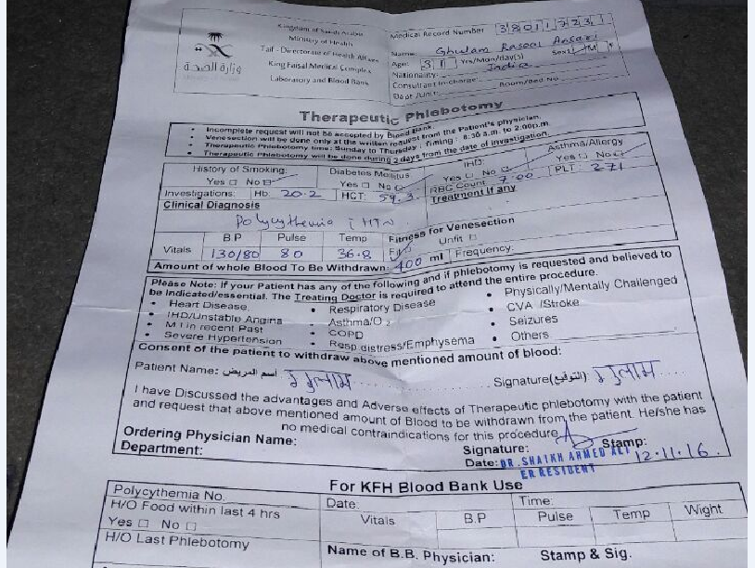




Slide 4
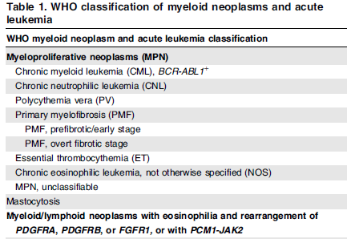




WHO Updated 2016

Slide 5
MPN features
Cytosis.
Organomegaly (mainly splenomegaly).
High uric acid.
Hypercellular bone marrow.
Clonal evolution.
Progression to acute leukaemia (mainly AML).

Slide 6
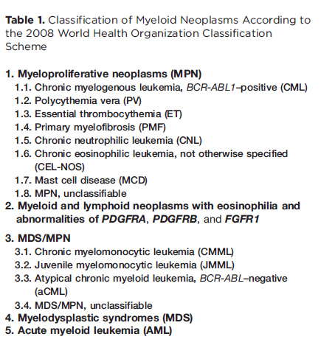


BCR-ABL must be
negative
For reading

Slide 7
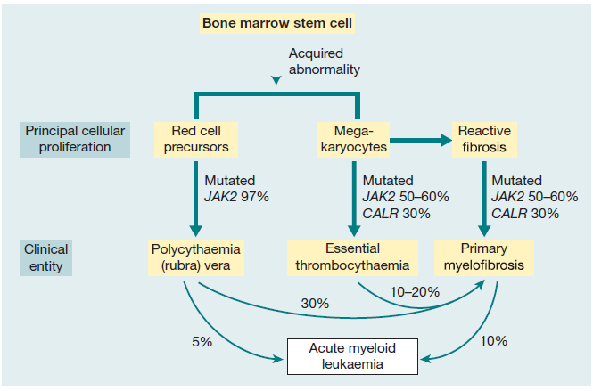
Notes:
Figure 15.1 Relationship between the three myeloproliferative diseases. They may all arise by somatic mutation in the pluripotential stem
and progenitor cells. Many transitional cases occur showing features of two conditions and, in other cases, the disease transforms during
its course from one of these diseases to another or to acute myeloid leukaemia. The three diseases, polycythaemia rubra vera, essential
thrombocythaemia and primary myelofibrosis, are characterized by JAK2 or CALR mutation in a varying proportion of cases.

Slide 8
Polycythemia
In Greek, “too many cells in the blood.”.
Absolute increase in total body red cell volume (or mass).
Manifests itself as a raised hemoglobin or packed cell volume (PCV), maybe masked by other disorders like iron deficiency.
Almost always, accompanied with JAK2 mutation.
.

Slide 9
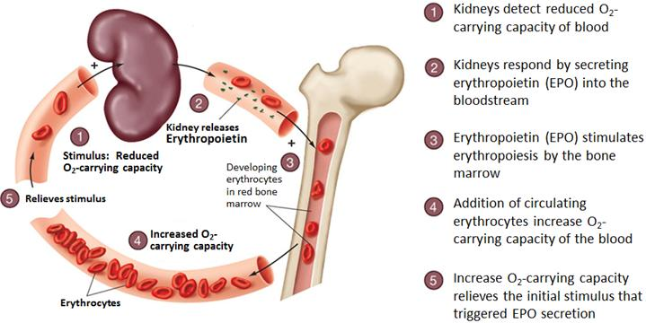
Regulation of Erythropoiesis

Slide 10
Classification of Polycythemia
normal
normal
normal
Relative
Polycythemia
2nd Polycythemia
Polycythemia Vera
Decreased plasma volume due to severe dehydration
Increased RBC mass due to high EPO:
1-COPD, Sleep apnea, smoking..
2-High altitude
3-High affinity HB
4-Renal disease
5-Epo secreting tumor (Parathyroid adenoma …)
Increased RBC mass due to malignant proliferation

Slide 11
For reading

Slide 12
Polycythemia Vera
It is a type of MPN characterized by increased red blood cell production independent of the mechanisms that normally regulate erythropoiesis (intrinsic proliferation and anti-apoptotic).
Diagnostic Features:
HB >16.5g/dl in men, 16.0g/dl in women.
Hypercellular bone marrow (pan-myelosis).
JAK2 mutation in >95% of cases
No increase in serum erythropoietin level

Slide 13
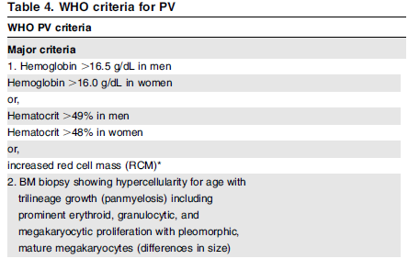
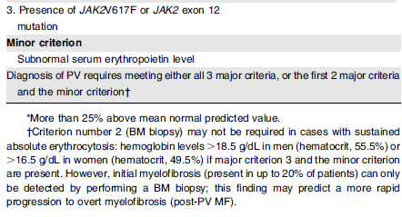
Polycythemia Vera
For reading
Updated WHO 2016

Slide 14
Clinical features of PV
1-Increased blood viscosity
Hypertension, pruritus.
Headache, dizziness, visual disturbances & paresthesia.
2- Thrombosis
Deep vein thrombosis
Myocardial infarction
Mesenteric, portal or splenic vein thrombosis
3-Splenomegaly in 70%
4-Hepatomegaly in 40%
Dr. Mansour Aljabry

Slide 15
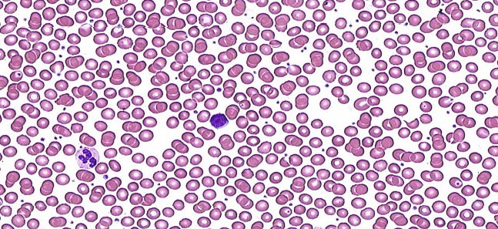
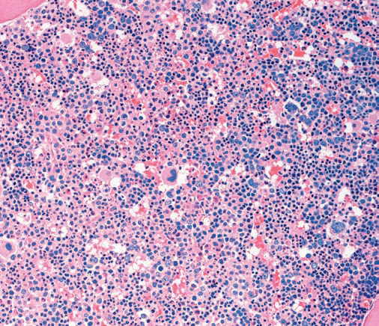
Investigations
CBC:
*RBC: increased *Hb: increased
*WBC & PLT :mildly increased (usually).
Blood smear:
Excess of normocytic normochromic RBC.
± Leukocytosis &thrombocytosis.
Bone marrow
Hypercellular.
Predominant erythroid precursors.
± Increased megakaryocytes & myeloid precursors.
Blasts AL transformation

Slide 16
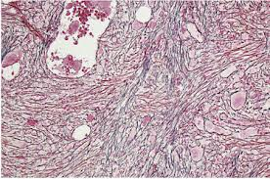
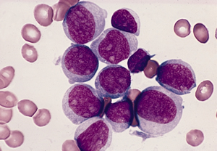
Complication &treatment
Diagnosis of Polycythemia Vera
Treatment:
Venesection + Aspirin
± Myelo-suppressive drugs (hydroxyurea)
10-15 years
20-30%
5-10%
Myelofibrosis
Acute leukemia

Slide 17
Notes:
Figure 15.1 Relationship between the three myeloproliferative diseases. They may all arise by somatic mutation in the pluripotential stem
and progenitor cells. Many transitional cases occur showing features of two conditions and, in other cases, the disease transforms during
its course from one of these diseases to another or to acute myeloid leukaemia. The three diseases, polycythaemia rubra vera, essential
thrombocythaemia and primary myelofibrosis, are characterized by JAK2 or CALR mutation in a varying proportion of cases.

Slide 18
Primary Myelofibrosis
It is a clonal MPN characterized by a proliferation of megakaryocytes & granulocytes in the bone marrow that associated with deposition of fibrous connective tissue and extramedullary haematopoiesis.
Clinical features
Anemia
Leukoerythroblastic blood picture.
Massive splenomegaly.
Fibrotic bone marrow.
JAK2 mutation (50%-60%).
Risk of AML transformation (10-20%).

Slide 19
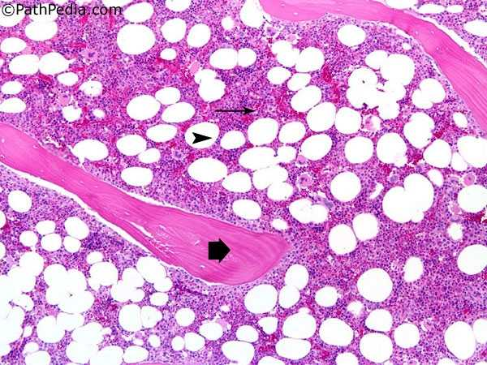
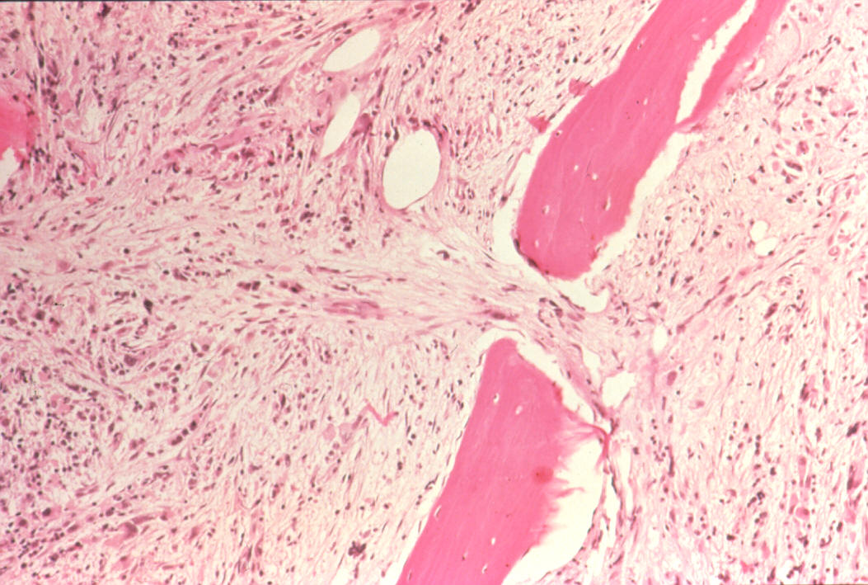
Bone marrow in Myelofibrosis
Normal BM
Fibrotic BM

Slide 20
Stages of PMF
7-10 years survival
Proliferation of megakaryocytes & granulocytes
- Leukocytosis
- Thrombocytosis
Pre-fibrotic stage
3-7 years survival
Fibrotic stage
Anemia
Leukopenia
Thrombocytopenia
Extramedullary hematopoiesis
≤1
year survival
AML transformation

Slide 21
Notes:
Figure 15.1 Relationship between the three myeloproliferative diseases. They may all arise by somatic mutation in the pluripotential stem
and progenitor cells. Many transitional cases occur showing features of two conditions and, in other cases, the disease transforms during
its course from one of these diseases to another or to acute myeloid leukaemia. The three diseases, polycythaemia rubra vera, essential
thrombocythaemia and primary myelofibrosis, are characterized by JAK2 or CALR mutation in a varying proportion of cases.

Slide 22
Essential Thrombocythemia
It is a MPN that involves primarily the megakaryocytic lineage and characterized by sustained thrombocytosis .
Diagnostic Features
Sustained thrombocytosis ≥45O×10⁹/L.
Hypercellular BM with megakaryocytic proliferation.
Exclusion of: CML, MDS, PV &PMF.
JAK2 V617F mutation (50-60%), CARL or MPL mutations If negative; no evidence of reactive thrombocytosis:
Iron def. ,splenectomy, surgery, infection ,autoimmune disease….

Slide 23
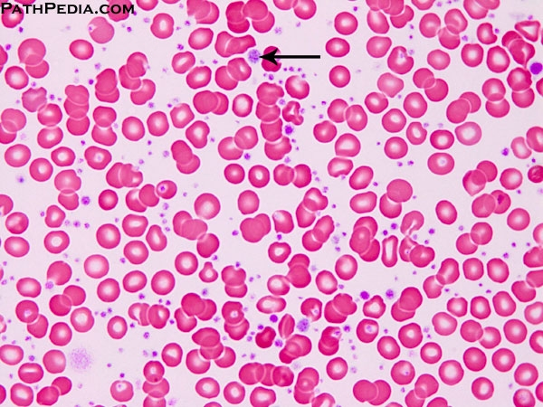

Slide 24
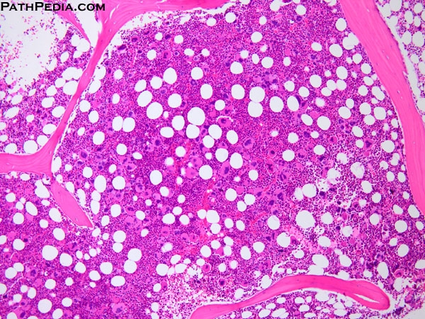

Slide 25
Essential Thrombocythemia
Clinical Presentation
Asymptomatic (50%)
Thrombosis
Bleeding
Mild splenomegaly (50%)
Mild hepatomegaly (20%)
Very indolent
(5% risk of AML transformation )
Treatment
Aspirin ± Hydroxyurea

Slide 26
JAK2 Mutation
JAK2: (Ch 9p with 26 exons), a non-receptor protein tyrosine kinase involved in signal transduction pathway.
JAK2 kinase domains structure
JH6
JH5
JH4
JH3
JH2
JH1
Negative feed back
JAK2 mutation :
Point mutation (at codon 617 in JH2) leads to loss of auto inhibitory control over JAK2.
The mutated JAK2 is in a constitutively active state.

Slide 27
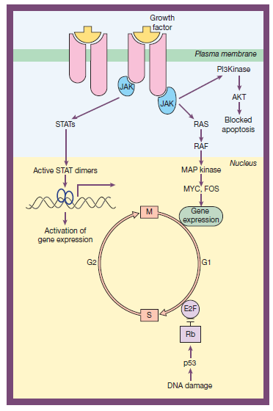
For reading

Slide 28
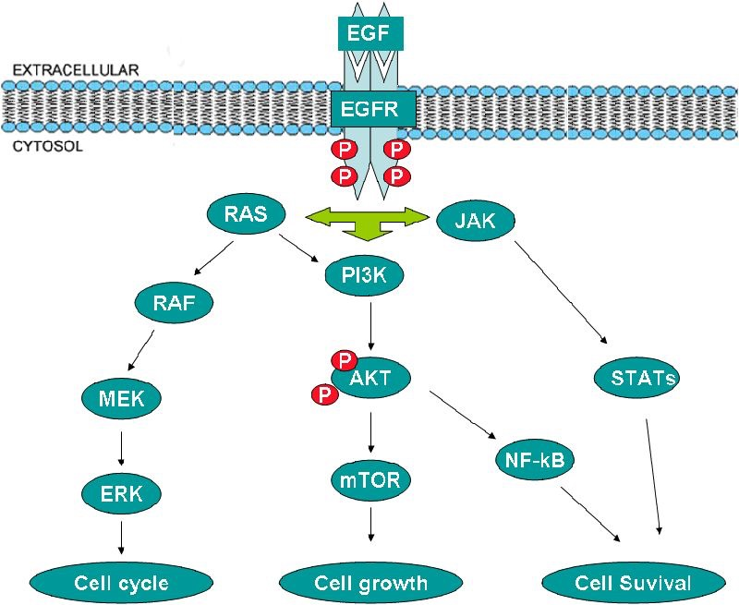
For reading

Slide 29
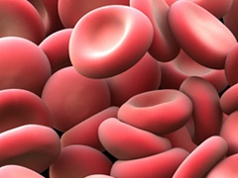
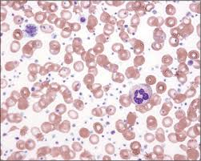
JAK2 Mutation
EPO
JAK2
JH2
JH1
P
-ve
P
RAS
P
95%
STAT
JAK2 (V617) mutation
P
MAPK
+ve
+ve
60%
Transcriptional factors
Increased proliferation
Decreased apoptosis
60%
Dr.Aljabry

Slide 30
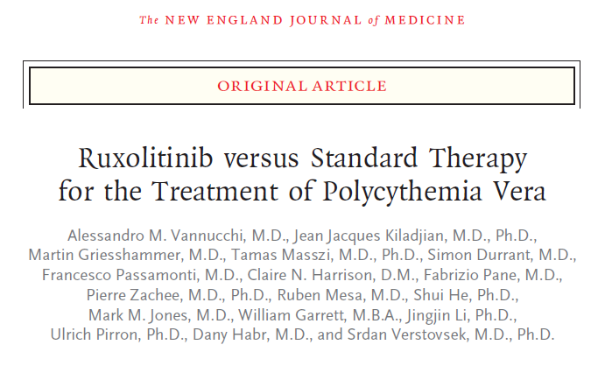
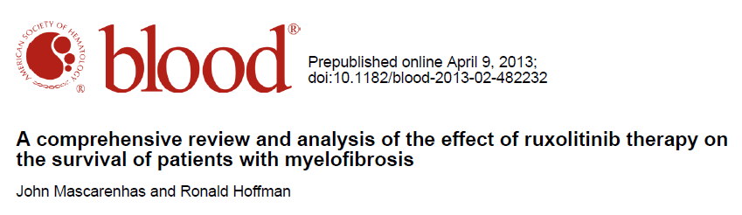
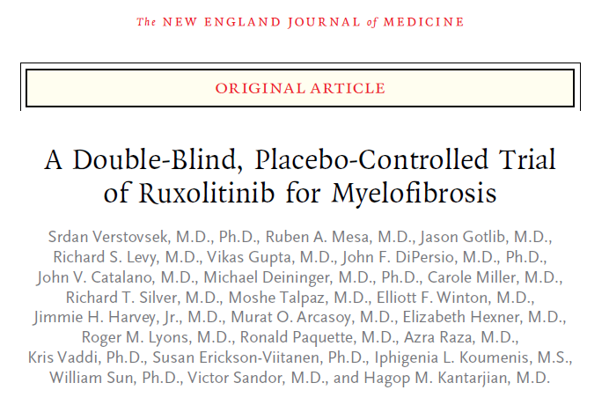
??

Slide 31


Slide 32
Q1)
Which ONE of the following is NOT a cause of polycythemia?
A) Mutation of JAK‐2.
B) Renal disease.
C) Congenital heart disease.
D) Hemoglobin abnormality.
E) Iron overload.

Slide 33
Q2)
Which ONE of these statements is TRUE about pseudo (stress) polycythemia?
A) It is caused by a raised red cell mass.
B) It is associated with a large spleen.
C) It is treated with hydroxycarbamide (hydroxyurea).
D) It is most common in young male adults.

Slide 34
Q3)
What is the approximate frequency of the Val617Phe mutation in JAK2 in myeloproliferative neoplasms?
A) 99% in polycythemia vera (PV) and 50% in essential thrombocythemia (ET) and primary myelofibrosis (PM).
B) Approximately 50% in PV, ET and PM.
C) 50% in PV and 25% in ET and PM.
D) 90% in PV, rare in ET and PM.

Slide 35
Thank You!!!

