Slide 1
Normal flora & introduction to infectious diarrhea
Prof. Ali M. Somily, MD
Prof. Hanan A. Habib, MD

Slide 2
Objectives
By the end of this lecture the student should be able to:
Define and recognize the various types of acute diarrheal illness.
Describe the epidemiology the host defenses in preventing the gastrointestinal infection.
Explain pathogenesis by which Escherichia coli campylobacter and yersinia and their management.
Discuss the microbiological methods used for diagnosis of each of the bacterial agents including microscopy, selective media for maximal recovery.
Describe the pathogens, risk factors, clinical presentation and prevention of food poisoning travelers and antibiotic associated diarrhea.
Name the etiological agents causing food poisoning and their clinical presentation .

Slide 3
Background
Acute diarrheal illness is one of the most common problems evaluated by clinicians.
A major cause of morbidity and mortality world wide.
Most of healthy people have mild illness but other might develop serious squeals so it is important to identify those individuals who require early treatment.

Slide 4
Normal flora - Gastrointestinal tract
Ecology
Birth: sterile
Breast-fed Bifidobacteria species
Switch to cow’s milk Enteric, bacteroides, enterococci, lactobacilli and clostridia
Switch to solid food
Microflora similar to parents
Notes:
Ecology
Birth: sterile
Breast-fed
Bifidobacteria species (>90% of intestinal flora)
Switch to cow’s milk
Bifidobacteria joined by enteric, bacteroides, enterococci, lactobacilli and clostridia
Human milk contains, on average, 1.1% protein, 4.2% fat, 7.0% lactose (a sugar), and supplies 72 kcal of energy per 100 grams.▪ Cow's milk contains, on average, 3.4% protein, 3.6% fat, and 4.6% lactose, and supplies 66 kcal of energy per 100 grams. http://en.wikipedia.org/wiki/Milk
Switch to solid food
Microflora similar to parents
▪ Human milk contains, on average, 1.1% protein, 4.2% fat, 7.0% lactose (a sugar), and supplies 72 kcal of energy per 100 grams.▪ Cow's milk contains, on average, 3.4% protein, 3.6% fat, and 4.6% lactose, and supplies 66 kcal of energy per 100 grams. http://en.wikipedia.org/wiki/Milk

Slide 5
Normal flora - Gastrointestinal tract
GI ecology varies
Esophagus saliva, food
Stomach harsh 10
Small intestine (10³ -10⁸)
Large intestine
10⁹-10¹¹/ml
>350 species
E. coli = 0.1% of total population
Primarily anaerobic
Facultative aerobes deplete oxygen
Adult excretes 3x10¹³ bacteria/day
25%-35% of fecal mass = bacteria
Notes:
GI ecology
Varies along the tract (longitudinal levels)
Varies along horizontal level: lumen vs. epithelium
Esophagus
Microbes associated with saliva and food
Stomach
Low pH limits population numbers (10 bacteria/ml)
Helicobacter pylori, acid-tolerant lactobacilli
Reduction of acidity (increase alkalinity)
Increases population of resident flora
Populated by flora of intestine (reflux)
Small intestine
Proximal small intestine (duodenum and jejunum)
Sparse (<10³ bacteria/ml fluid) due to acid from stomach, bile and pancreatic secretions
Lactobacilli, Enterococcus faecalis
Distal small intestine (ileum)
Increases (10⁸ bacteria/ml) due to pH change
Lactobacilli, Enterococcus faecalis, coliforms, Bacteroides, bifidobacteria
More like colon microbiota
Bile: Alkaline solution containing cholesterol, phospholipids, bile pigments, bile salts, bicarbonate ions. Acts as emulsifier of fats. Produced by hepatocytes. Drains through many bile ducts throughout liver
Pancreatic secretions: digestive enzymes (trypsin, chymotrypsin, pancreatic lipase, pancreatic amylase) and alkaline-salt fluid secreted into small intestine

Slide 6
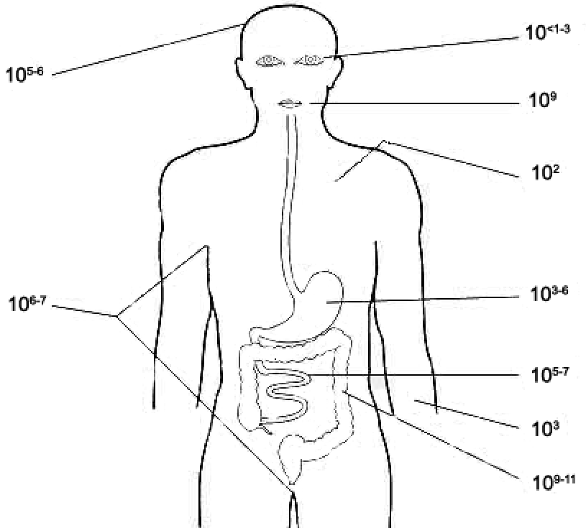
Normal flora - Gastrointestinal tract
Location (adult) | Bacteria/gram contents
duodenum | 10³-10⁶
jejunum and ileum | 10⁵-10⁸
cecum and transverse colon | 10⁸-10¹⁰
sigmoid colon and rectum | 10¹¹
Notes:
In the normal adult colon, 96–99% of the resident bacterial flora consists of anaerobes: bacteroides species, especially B fragilis; fusobacterium species; anaerobic lactobacilli, e.g., bifidobacteria; clostridia (C perfringens); and anaerobic gram-positive cocci (Peptostreptococcus species).

Slide 7
Definition
Stool weight in excess of 200 gm/day
3 or more loose or watery stools/day
Acute < 14 days
Alteration in normal bowel movement characterized by decreased consistency and increased frequency
Less than 14 days in duration

Slide 8
Etiology
Viral: 70-80% of infectious diarrhea in developed countries
Bacterial: 10-20% of infectious diarrhea but responsible for most cases of severe diarrhea
Protozoan: less than 10%

Slide 9
Epidemiology
1.4 million deaths in study in 2010
1.2-1.9 episodes per person annually in the general population
2.4 episodes per child >3 years old annually
5 episodes per year for children <3 years old and in daycare
Seasonal peak in the winter

Slide 10
Risk Factors
Food from restaurants.
Family member with Gastrointestinal symptoms.
Recent travel to developing countries.
Patient underlying illness and mediation(↓Stomach acidity cyst, spores)
Abnormal peristalsis.
Low Immunoglobulin IgA.
Antibiotics decrease the normal flora to less 10¹²
Median infective dose (ID₅₀)

Slide 11
Classifications
Infectious diarrhea- viral Bacterial organism. Campylobcator, Shigella, Solmnella, Yersinea, Cholera and E. coli.
Food poisoning:S taphylococcus, Clostridium perfringens, Bacillus.
Traveler diarrhea - Enterotoxogenic E-coli IP >1 day last 3
Antibiotic associated diarrhea-Clostridium difficile.

Slide 12
Clinical Presentation and Pathogenic Mechanism I
Enterotoxin mediated
Lack of pus in the stool (no invasion)
Lack of fever
Rapid onset preformed toxin<12 hr
Small intestine
Vomiting ,non-bloody diarrhea, abdominal cramp
Vibreo cholero, Staphylococcus aureus, Clostridium perfringens and Bacillus cereus
Other viral and some parasitic infection

Slide 13
Clinical Presentation and Pathogenic Mechanism II
Invasive:-
Pus and blood in the stool
Fever due to inflammation
Shigella, and Endameba histolytica
Affect colonic mucosal surface of the bowel
Sometime Solmonella spp, EHEC, Yersinia and Clostridium difficile
Extension to lymph nodes
Incubation period 1-3 days
E. histolytica 1-3 weeks
Dysentery syndrome- gross blood and mucous

Slide 14
TOXIN TYPE | TOXIN-PRODUCING BACTERIA | TOXIN NAME, IF RELEVANT
Neurotoxin Central autonomic Nervous system Food poisoning | Staphylococcus aureus | Enterotoxin B
 | Bacillus cereus | Emetic toxin
 | Clostridium botulinum | Botulinum toxin
Enterotoxin | Vibrio cholerae | Cholera toxin
 | Enterotoxigenic Escherichia coli | Heat-labile toxin, heat-stable toxin
 | Clostridium perfringens | Enterotoxin
Cytotoxin | Shigella dysenteriae type I | Shiga toxin
 | Enterohemorrhagic E. coli | Shiga toxins 1 and 2 Globotriaosylceramide (Gb3) 23 S r RNA in 60 Subunit
 | Vibrio parahaemolyticus | Thermostable direct hemolysin
 | Campylobacter jejuni | Cytolethal distending toxin
 | Clostridium difficile | Toxin A, toxin B
 | Clostridium perfringens type A | Cpe, Alpha toxin
 | E. histolytica | protozoal phospholipase A and pore-forming peptides

Slide 15
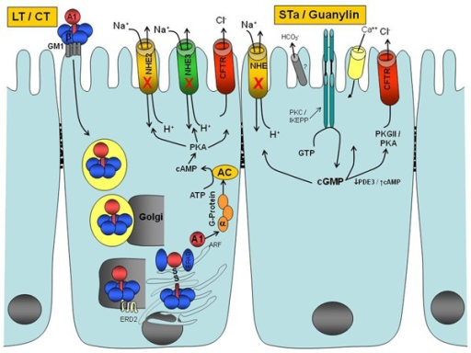
A1-B5 protein enterotoxin that is exported out of the bacterial cell by a type II protein secretion system
Monosialoganglioside
GM1 receptor
A1 subunit
ADP ribosylating factor
G protein
Adenylate Cyclase AC
ATP to cAMP
Prevent CL absorption
Notes:
Enterotoxins
A number of pathogenic bacteria produce enterotoxins that act directly on gastrointestinal mucosal cells to stimulate net fluid secretion. The prototypical example of this class is cholera toxin, which is an A₁-B₅ protein enterotoxin that is exported out of the bacterial cell by a type II protein secretion system.⁹⁶ The B pentamer binds to the enterocyte surface receptor GM1 monosialoganglioside. The A subunit is then nicked by a protease and reduced, and a portion of the A subunit enters the eukaryotic cell cytoplasm, where it catalyzes adenosine diphosphate ribosylation of an arginine residue on the Gsα subunit of adenylate cyclase, leading to increased intracellular cyclic adenosine monophosphate and net fluid secretion through the apical chloride channels of the epithelial cell.⁹⁷ The genes for the A and B subunits of cholera toxin are encoded together on a bacteriophage that inserts itself into the chromosome of pathogenic strains of V. cholerae.⁹⁸
ETEC produces a heat-labile enterotoxin that is very similar to cholera toxin, both in protein sequence as well as in mechanism of action.⁷⁵ Strains of ETEC may also produce a heat-stable enterotoxin that is secreted extracellularly and binds and activates intestinal guanylate cyclase in the cell membrane of intestinal epithelial cells. Heat-stable enterotoxin acts as a homologue of the peptide guanylin, an endogenous peptide made by small intestinal villus cells that regulates normal intestinal secretion by stimulating intracellular cyclic guanosine monophosphate production.⁹⁹

Slide 16
Shigella and Salmonella
Salmonella enterica is the common cause of food poisoning in Saudi Arabia.
Salmonella typhi transmitted through human faeces.
Shigella causes local Gastrointestinal invasion and bacteremia less common in normal host.

Slide 17
Campylobacter
Family Campylobacteraceae
Genus arcobacter
Epidemiology
Source: poultry, birds, dog , cat, →water, milk, meat, person to person can occurs

Slide 18
Clinically
IP 2-6 days
Abdominal cramp, bloody diarrhea, nausea and vomiting are rare
Self limiting 2-6 Day
Chronic carrier
GB and Reactive arthritis

Slide 19
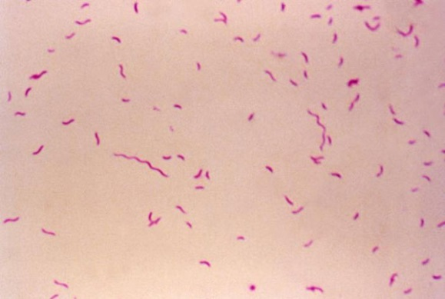
Laboratory diagnosis and treatment
Laboratory
Transport media Cary Blair
CAMPY BAP contain antibiotics
Incubate in 5%O₂ 10%CO₂ 85%N @ 42°C except C.fetus 37°C
Gram stain/culture biochemical/Serology
Treatment:
Ciprofloxacin, Erythromycin or Tetracycline

Slide 20
E. Coli
Only about 10 -15% of strains of E. coli associated with diarrhea.
Based on virulence factors, clinical manifestation, epidemiology and different O and H serotype.
There are five major categories of diarrheagenic E.coli:
Types of E. coli diarrhea
Enterotoxigenic E. coli (E T E C)
Enteropathogenic E. coli (E P E C)
Enteroinvasive E. coli (E I E C)
Enterohaemorrhagic E. coli (E H E C )
Enteroadherent E.coli (EAEC)

Slide 21
1. Enterotoxigenic E. coli
Major cause of traveler's diarrhea in infant and adult in developing countries from contaminated food and water.
It has ↑infective dose 10⁶-10^{10.}
Has heat-labile toxin (LT) and heat-stable toxin (ST) each has two fragment (A and B) LT leads to accumulation of CGMP, which lead to hyper secretion.
Symptoms watery diarrhea, abdominal cramps and some time vomiting.
No routine diagnostic method.

Slide 22
2. Enteroinvasive E. coli
Produce dysentery (Penetration, invasion and distraction)
Similar to Shigella spp (Non motile, LNF)
Fecal oral route
Fever, severe abd. cramp, malaise and watery diarrhea
Infective dose10⁶
Diagnosis Sereny test and DNA probes.

Slide 23
3. Enteropathogenic E. coli
Infantile diarrhea
Outbreak in hospital nurseries and day- care centers
Low grade fever, malaise, vomiting and diarrhea
Stool mucous but no blood.

Slide 24
4. Entero hemorrhagic E. coli
O157H7 and Non O157H7 Hemorrhagic diarrhea, colitis and hemolytic uremic syndrome (HUS)=↓Platelet count, hemolytic anemia and kidney failure.
Undercooked hamburgers, unpasteurized dairy products, apple cider, cookie dough.
Bloody diarrhea, low grade fever and stool has no leucocytes.
Fetal disease in young and elderly persons in nursing homes.
Cytotoxin =vertoxin І and vertoxin ІІ Similar to Stx₁ (shigotoxin I&II).
E.coli other than 0157H7 can cause HUS.
Diagnosis by culture on SMAC, MUG test , Vertoxin detection by immunological test or PCR.
Notes:
براعم الفاصوليا الخام

Slide 25
5. Enteroadherent E. coli
Pediatric Diarrheal Disease.
Adhering to the surface of the intestinal mucosa.
Aggregative stacked brick.
Watery diarrhea, vomiting, dehydration and abdominal pain.
Two or more weeks.

Slide 26
Yersinia enterocolitica
Mesenteric lymphadenitis in children and septicemia in immunocompramised hosts
Common in Europe, USA, Canada and cat, dog, swine (chitterlings)
Survive cold temperatures and associated with transfusion of packed red blood cells.
Presented with enteritis, arthritis and erythema nodosum
Generalize infection in 1'C adult children 1-5 yrs usually mild but in old children adult mimic appendicitis
Growth at 25°c-30°c media Cefsulodin-Igrasan-Novabiacin (CIN)

Slide 27
Clostridium difficile
Antibiotic associated diarrhea.
Transmit from person to person via Fecal-Oral route.
Have been cultured from in animate hospital surfaces.
Disruption of the indigenous bacterial flora of the colon.
Produce toxin A and B that can bind to surface epithelial cell receptors leading to inflammation mucosal injury and diarrhea.

Slide 28
Clostridium difficile
Patient Presents with fever, leukocytosis, abdominal pain and diarrhea.
Pseudomembrane can result (neutrophils, fibrin, and cellular debris in the colonic mucosa) and toxic megacolon.
Diagnosis, toxin detection by EIA.
Treatment Metronidazole ± Vancomycin and supportive treatment.

Slide 29
Diagnostic Approach
Duration
Chronic vs acute
Symptoms
Fever, bloody, weight loss and dehydration
Risk factor
Travel , immunocompromised , diet, medications, outbreak
Fever and blood do culture
Watery no fever symptomatic treatment
Hospital acquire think about C. difficle
Chronic diarrhea think about
Protozoa (giardia, crypto, cyclo, microsporidia, MAC
Other malabsorption, lactase defic. Or bacterial overgrowth

Slide 30
Type | Organism | Incubation Period | Source Risk factors | Clinical | Diagnosis | Treatment
Infectious diarrhea Invasive Dysentery Blood+mucous | Shigella gram-negative rods | 1-3 Days | Contaminated Food or water with human excreta | Small amount of stool with blood and mucous and lower abdominal pain ( trismus) | Culture on selective media | Ciprofloxacin
 | Entamoeba histolytica | 1-3 wks |  |  | Microscopy | Metronidazole
 | EIEC gram-negative rods | 1-3 Days |  |  | Culture and toxin detection | Ciprofloxacin

Slide 31
Type | Organism | Incubation Period | Source Risk factors | Clinical | Diagnosis | Treatment
Infectious diarrhea Non-invasive Watery +/-blood | Salmonella gram-negative rods | 1-3 Days | S.typhi and S.para Human Others reptiles and snakes | Watery+/-Blood | S.typhi and S.para typhi→ typhoid Others watery diarrhea | Ampicillin or ciprofluxaci or metronidazole or trimethoprim sulfa
 | campylobacter jejuni small, curved, gram-negative rods | 1-3 Days | poultry | Watery+/-Blood | Special media at 42 º C at microaerophilic condition | Erythromycin
 | EHEC | 1-3 Days | beef | Watery then bloody diarrhea Renal failure | Culture and toxin detection
 | Vibrio cholera Comma-shape gram-negative rods | 1-3 Days | Salt water | Rice water |  | Ciprofloxacin Doxycycline
 | Yersinia Gram Neg bacilli | 1-3 Days | Pork intestine | Pseudo appendicitis | Cold enrichment 25-30ºC CIN (Yersinia) | Gentamycin
 | Listeria Monocytogenes Gram pos bacilli | 2-3 wks | unpasteurized dairy products | Meningitis in neonate and old Abortion |  | Ampicillin

Slide 32
Type | Organism | Incubation Period | Source Risk factors | Clinical | Diagnosis | Treatment
Food Poisoning Watery (preformed toxin) | Staphylococcus aureus | 1-6 hour | Contaminated food from human flora | Vomiting then watery diarrhea | Culture and toxin detection | Observation and supportive treatment
 | Clostridium perfringens | 8 to 16 hours | Food contaminated with Soil
 | bacillus cereus spore forming aerobic Gram pos bacilli | 8 to 16 hours | 8 to 16 hours
Travelers | ETEC | 1-3 Days | Travel | Watery diarrhea | Culture Toxin detection | ciprofloxacin
Antibiotics Associated | Clostridium Difficile | 1-3 Days | Antibiotics use patient→ patient | Bloody diarrhea Toxin A and B | Toxin detection PCR | Metronidazole +/- Vancomycin

