Slide 1
Vibrio cholera
Ali M Somily MD

Slide 2
Objectives
Know the epidemiology of cholera and history of cholera Know the microbiological characteristic of cholera
Describe the pathogenesis of cholera
Describe the clinical features of cholera
Describe the methods for laboratory diagnosis
Know the management of cholera and control of outbreak

Slide 3
Introduction
A water born live threatening diarrheal disease.
Caused by vibrio cholera which is a comma- shaped gram-negative rods.
Found in salt and fresh water.
Has many serotypes based on O-antigen.
O 1 and O 139.
Produce a non-invasive enterotoxin.
leads to outbreak and epidemic.
Can be prevented by good sanitation system.

Slide 4
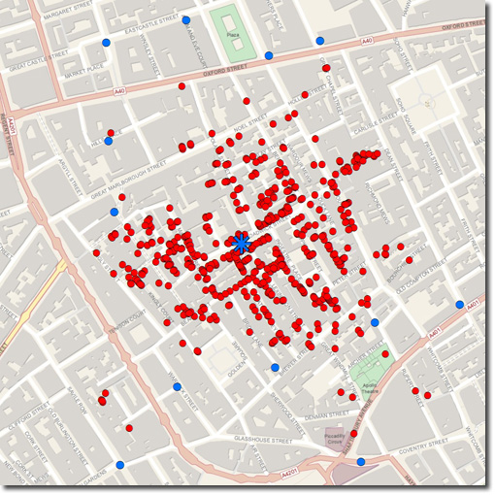
Discovery
John Snow discovered an outbreak in London 1854
It was related to broad street pump sewage contamination.
Removal of the pump handle → end of the outbreak.

Slide 5
Epidemiology
V. cholera O1 and O139 serogroup organisms are the causes of epidemic cholera.
O1 ( from1817 till now)
Classical: 1 case per 30-100 infections
El Tor: 1 case per 2-4 infections (Seventh pandemic)
O139 ( recently in 1992 in Asia only)
Contained in India, Bangladesh.
Seven major outbreaks.
Majority in India, Sub-Saharan Africa, Southern Asia.
Endemic in > 50 countries.
Each year 3-5 millions cases result in 100,000 deaths.

Slide 6
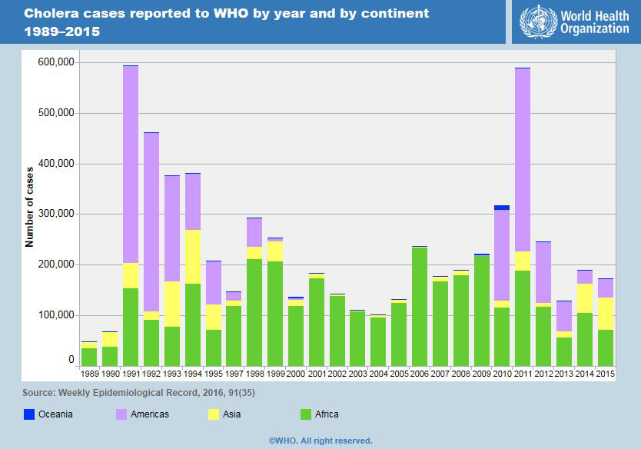
Epidemiology
In 2016 in Haiti after Hurricane Matthew, in South Soudan and Yemen and many other African countries

Slide 7
Transmission
Fecal- oral transmission through contaminated food or water.
Common in summer grows in brackish estuaries and coastal seawaters, often in close association with copepods or other zooplankton.
Sewage or infected person contaminate water supply.
Not well established sewage system and water treatment.
Under-cooked shellfish.
Children, elderly and people with less gastric acidity are at higher risk then others
Blood group O>> B > A > AB

Slide 8
Infectivity
Period of infectivity during acute stage till recovery ( end one to three wks)
Infected person can produce up to 20 L of 10⁹ CFU/ml /day
Has high infectious dose NOT like Shigella
Infectious dose 10⁶-10¹¹ colony-forming units
Due to harsh environment of the intestine ie temperature and stomach acidity and Bile salts, organic acids in the intestine

Slide 9
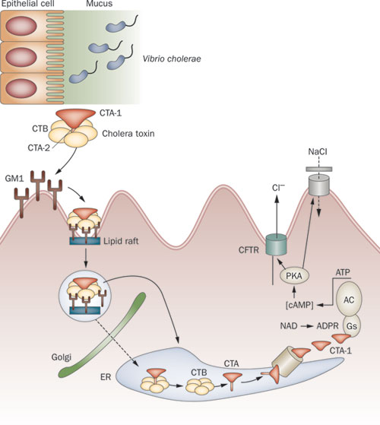
Pathogenesis (previous lecture)
Vibrio cholerae uses toxin-coregulated pili (TCP) to colonize the human intestine.
Cholera results from secretory diarrhea caused by the actions of cholera toxin (CT) on intestinal epithelial cells.
CT is an adenosine diphosphate–ribosylating enzyme that leads to chloride, sodium, and water loss from intestinal epithelial cells.
GM1, a glycosphingolipid on the surface of epithelial cells
enzymatic A subunit of cholera toxin mediates
Nicotinamide adenine dinucleotide (NAD)
→Adenosine diphosphate (ADP)-ribose
→G protein
→Regulates adenylyl (adenylate) cyclase activity (AC)
→elevation in the intracellular cyclic adenine monophosphate
(cAMP) concentration
Monosialoganglioside (GM1) receptor

Slide 10
Clinical Manifestations
Ranges from a few hours to 5 days( range 1-3 days).
Depending on gastric acidity and initial infectious dose.
Majority have mild, or no symptoms at all
75% asymptomatic
20% mild disease
2-5% severe
Vomiting, Cramps and Watery diarrhea (1L/hour) with flecks of white mucus (rice water stool) with a fishy odor
Death occurred in 18 hours-several days if not treated due dehydration.
↓ Ca⁺⁺ and K can lead to ileus, muscle pain and spasm, and even tetany

Slide 11
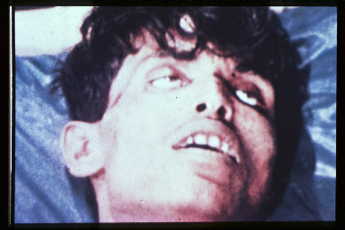
Clinical Manifestations
Cholera gravis:
More severe symptoms due to Rapid loss of body fluids
6 liters/hour
10⁷⁻⁹ vibrios CFU/mL
Rapidly lose more than 10% of bodyweight
Dehydration and shock
Sunken eyes, and ↓skin turgor ( tenting), cold and clammy.
Anuric and lactic acidosis ( Kussmual breathing).
Hypoglycemia leads to seizure or comma.
Cardiac and Renal failure.
Aspiration pneumonia
Death within 2-12 hours or less.
Mortality 50-60% without treatment
Mortality <1% with redehydration

Slide 12
Diagnosis
Suspect in sever diarrhea with dehydration.
Other non-invasive bacterial, ETEC and viral gastroenteritis might have similar presentation.
Complete history and physical examination.
Insert central line for IV fluid, collect blood for basic routine tests ( chemistry and hematology).
Send stool for smear and culture on special media.
Culture not routinely performed, you have to request it.
Dark field microscopy (shooting stars)
Gram stain (curve Gram Negative bacilli)
Culture on thiosulfate citrate bile sucrose (TCBS) agar-yellow colonies
Recovery of organisms can be enhanced by enrichment of stool in alkaline peptone water. (60-100%)

Slide 13
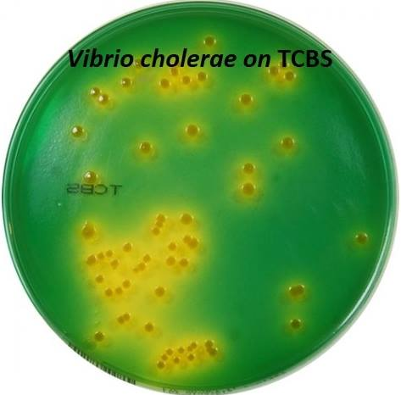
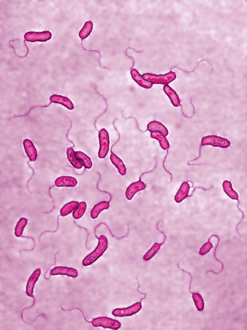
Microbiology
VIBRIO CHOLERAE MUST SEE !!
In U tube

Slide 14
Diagnosis/ microbiology
Vibrio cholera is highly motile, gram-negative, curved or comma-shaped rods with a single polar flagellum.
Biotype O 1 antigen | Serotype | Antigen
Classical | Ogawa | A,B
 | Inaba | A,C
 | Hikojima | A,B,C
El Tor | Ogawa | A,B
 | Inaba | A,C
 | Hikojima | A,B,C
O 139 serogroup appeared in Bangladesh 1992
Has poly saccharide capsule but does not have O1 antigen
Non-O1, Non-O139 Serogroup
Most are CT (cholera toxin) negative and are not associated with epidemic disease.

Slide 15
Treatment
Basically rehydration and antimicrobial therapy.
Rehydration should be started immediately before confirming the diagnosis.
Either oral rehydration if the patient can tolerate it ( not vomiting or start IV rehydration.
Decrease mortality from 50% to 1 %.
Give 1.5 time the amount lost.
Start when 10% of total body weight lost.
Patients recovered within 3-6 days.
Oral Rehydration Salt (ORS) by WHO and UNICEF
One pack in 1 liter contain NaCl, KCl, NaHCO3, glucose
IV use either Ringer’s lactate, Saline or Sugar and water

Slide 16
Antibiotics
Reduce the recovery time to 2-3 days.
Decrease infectivity
Azithromycin single-dose is often the preferred therapy especially in children.
Or
Ciprofloxacin
Or
Tetracycline, Doxycycline

Slide 17
Can be a bioterrorism agents
Ease of procurement
Simplicity of production in large quantities at minimal expense
Ease of dissemination with low technology
Silent dissemination

Slide 18
Prevention
Wash your hand frequently
Boil water and chlorination.
Cook all types of food very well.
Avoid salad, ice and iced food
Water Sanitation
Water treatment
Disrupt fecal-oral transmission if present
 | Killed Whole-cell Vaccines | Live Attenuated Vaccines
Adult | 50% protection for 6 months | 60% protection for 2 years
children aged 2-5 | < 25% protection | protection rapidly declines after 6 months
Doses | Multiple doses | 3 dose
Side effects | -------------------- | Mild diarrhea, abdominal cramping
Notes:
50% protection for 6 months to adults

Slide 19
International Efforts
WHO: Global Task Force on Cholera Control
Reduce mortality and morbidity
Provide aid for social and economic consequences of Cholera
CDC
U.N.: GEMS/Water
Global Water Quality Monitoring Project
Addresses global issues of water quality with monitoring stations on all continents

