Slide 1
SALMONELLA

Slide 2
INTRODUCTION
Gram negative facultative anaerobic bacilli
Non lactose fermenting colonies
highest during the rainy season in tropical climates and during the warmer months in temperate climates.

Slide 3
CLASSIFICATION -Has two species s.enterica (six subspecies I, II, III, IV, V, VI) s.borgori (rare) -Cold blooded animal, birds, rodents, turtles, snake and fish
Has two species S.enterica (six subspecies I, II, III, IV, V, VI) S.borgori (rare)
Cold blooded animal, birds, rodents, turtles, snake and fish

Slide 4
SALMONELLA SPECIES AND SUBSPECIES | NO. OF SEROTYPES WITHIN SUBSPECIES | USUAL HABITAT
S. enterica subsp. enterica (I) | 1504 | Warm-blooded animals
S. enterica subsp. salmae(II) | 502 | Cold-blooded animals and the environment*
S. enterica subsp. arizonae (IIIa) | 95 | Cold-blooded animals and the environment*
S. enterica subsp. diarizonae (IIIb) | 333 | Cold-blooded animals and the environment*
S. enterica subsp. houtenae (IV) | 72 | Cold-blooded animals and the environment*
S. enterica subsp. indica(VI) | 13 | Cold-blooded animals and the environment*
S. bongori (V) | 22 | Cold-blooded animals and the environment*
Total | 2541

Slide 5
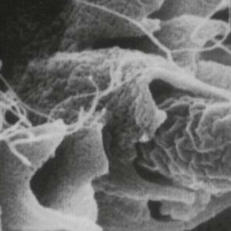
VIRULENCE FACTORS
Fimbria - Adherence
Endocytosis
SPI 1 T3SS
TLR
Replication in microphage
Enterotoxin

Slide 6
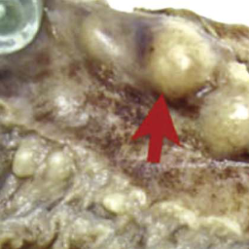
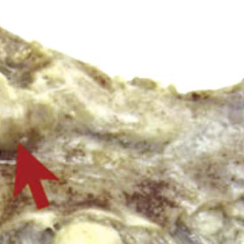
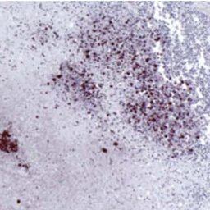
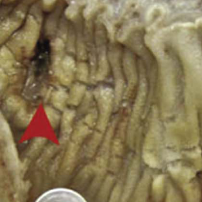
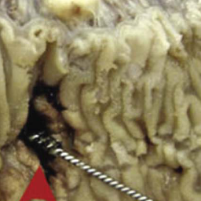
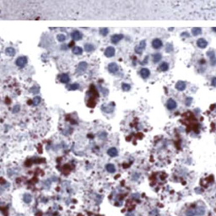
Histopathology
Notes:
A, The visualized mucosal surface of a surgically resected area demonstrates two perforations (arrowheads); the visualized serosal surface demonstrates significant enlargement of lymph nodes (arrows). B and C, Lower and higher magnification views demonstrate immunohistochemical staining for the Salmonella O:9 antigen in a necrotic lymph node.(From Neil KP, Sodha SV, Lukwago L, et al. A large outbreak of typhoid fever associated with a high rate of intestinal perforation in Kasese District, Uganda, 2008-2009. Clin Infect Dis. 2012;54:1096.)

Slide 7
Antigenic structures
O. somatic antigen
H. Flagellar antigen
K. capsular antigen

Slide 8
V_{I} in Salmonella serotype typhi (virulence heat-labile capsular homopolymer of N-acetyl-galactosamino-uronic acid) vs phagocytosis
O Antigen (Heat – stable) is lipopolysaccharide in the outer membrane A,B,C1,C2,D,E
H₋antigen (Heat labile)

Slide 9
CLINICAL FEATURES
Acute gastroenteritis
Typhoid fever
Nontyphoidal bacteremia
Carrier state following Salmonella infection

Slide 10
Source
Water food and milk contaminated with human or animal excreta
Salmonella typhi and S. paratyphi the source is human

Slide 11
GASTROENTERITIS
Food poisoning through contaminated food
S. enterica subsp. enterica
Source poultry, milk, egg & egg products and handling pets
Infective dose 10⁶ bacteria
IP 8 – 36 hrs.
fever, chills, watery diarrhea and abdominal pain, self limiting
In sickle cell, hemolytic disorder and ulcerative colitis, elderly or very young patient the infection may be very severe.
At high risk for dissemination & antimicrobial indicated

Slide 12
ENTERIC FEVER
Prolonged fever
Bacteremia
Involvement of the reticulo endothelial system (liver, spleen, intestines and mesentery)
Dissemination to multiple organs
Ingestion of contaminated food by infected or carrier individual
By salmonella serotype typhi or S. paratyphi A, B and C (less severe)
Tropical ,subtropical, Traveler (sewage, poor sanitation)
IP : 9 – 14 days.

Slide 13
First week fever, malaise, anorexia, myalgia and a continuous dull frontal headache then,
Patient develops constipation
Mesenteric lymph node → blood stream liver, spleen and bone marrow
Engulfment of salmonella by mononuclear phagocytes (multiply intercellularly)
Released into the blood stream again that can lead to high fever (blood culture positive)

Slide 14
2nd and 3rd week
Sustain fever prolonged bacteremia
Invade gallbladder and payer's patches
Rose spots 2nd week of fever
Billiary tract →GIT
Organism isolated from stool in large number

Slide 15
ANTIBIOTIC& management
Ceftriaxone
Ciprofloxacin
Trimelhoprim – Sulfamethoxazole
Ampicillin
Azithromycin or Ceftriaxone from patients from India and SE Asia due to resistance of strains. and Ciprofloxacin from patients from other areas.
Salmonella gastroenteritis uncomplicated cases require fluid and electrolyte replacement only.

Slide 16
COMPLICATION
Necrotizing cholecystitis
Bowel hemorrhage and perforation
Pneumonia and thrombophlebitis
Meningitis, osteomyelitis, endocarditis and abscesses.

Slide 17
SHIGELLA

Slide 18
CLINICAL INFECTION
S.sonnei (group D1) most predominant in USA ( fever, watery diarrhea)
S.flexneri (group B15) 2nd most common
Young adult ( man who have sex with man)
S. dysenteriae (group A 6 )and S. boydii (group C 20) are most common isolates in developing countries
S. dysenteriae type 1 associated with morbidity and mortality.
Human is the only reservoir

Slide 19
Cause bacillary dysentery ( blood, mucus and pus in the stool)
Non lactose fermenter

Slide 20
ANTIGENIC STRUCTURE
Has 4 species and 4 major O antigen groups
All have O antigens some serotype has K antigen ( heat labile removed by boiling)
Shigella are non motile, lack H antigen

Slide 21
Person to person through fecal –oral route
Flies, fingers
Food and water
Young children in daycare, people in crowded area and anal oral sex in developed countries
Low infective dose < 200 bacilli
Penetrate epithelial cells leads to local inflammation, shedding of intestinal lining and ulcer formation

Slide 22
SYMPTOMS
High fever, chill, abdominal cramp and pain accompanied by tenesmus of bloody stool with mucus & WBC
IP 24 - 48 hrs
Can lead to rectal prolapsed in children
Complication ileus, obstruction dilatation and toxic mega colon
Bacteremia in 4 % of severely ill patient
Seizures, HUS

Slide 23
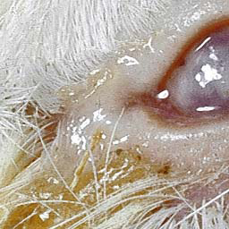
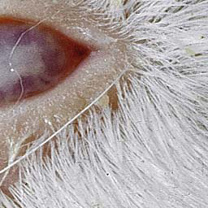
Diagnosis
Stool culture on selective selenite enrichment broth media MAC, SS and XLD,HEA BS
Sero-grouping based on O and H antigen
Sereny test

Slide 24
TREATMENT
Antibiotic s used to reduce duration of illness
IV ceftriaxone and ampicillin , oral TMP-SMX or
ciprofloxacin or doxycycline.

