Slide 1
Haemoflagellates
Trypanosomiasis
Dr. Ibrahim Alkhalife

Slide 2
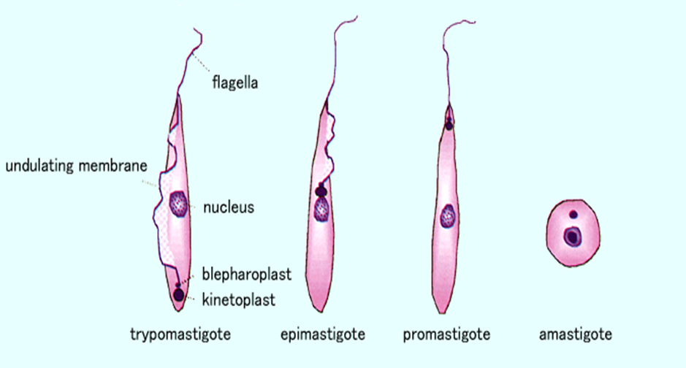
Different stages of Haemoflagellates

Slide 3
Trypanosomiasis
There are two types of trypanosomiasis that affect humans
They are divided according to their geographical location:
African trypanosomiasis (sleeping sickness) is caused by Trypanosoma brucei parasites in Africa and is transmitted by the tsetse fly.
American trypanosomiasis (Chagas disease) is caused by Trypanosoma cruzi parasites in Latin America and is transmitted by the ‘kissing’ bugs.

Slide 4
1-African sleeping sickness
Trypanosoma brucei rhodesiense: East Africa, wild and domestic animal reservoirs
Trypanosoma brucei gambiense: West and Central Africa, mainly human infection
2-Chaga’s disease (American trypanosomiasis)
Chaga’s disease in Central and South America
Trypanosma cruzi cause Chaga’s disease.

Slide 5
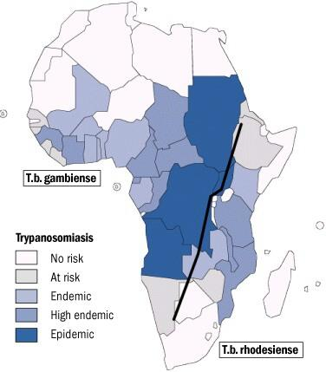
African sleeping sickness

Slide 6
What is African sleeping sickness?
African trypanosomiasis is a parasitic disease transmitted by the tsetse fly. It gets its nickname ‘sleeping sickness’ because symptoms can include a disturbed sleep pattern.
Infection occurs through the bite of infected tsetse flies (intermediate host). Humans, domestic cattle and wild animals are the main reservoir host for Trypanosoma (definitive host).
T. gambiense causes a chronic illness.
T. rhodesiense causes a more acute illness.

Slide 7
Animal reservoir hosts for African sleeping sickness

Slide 8
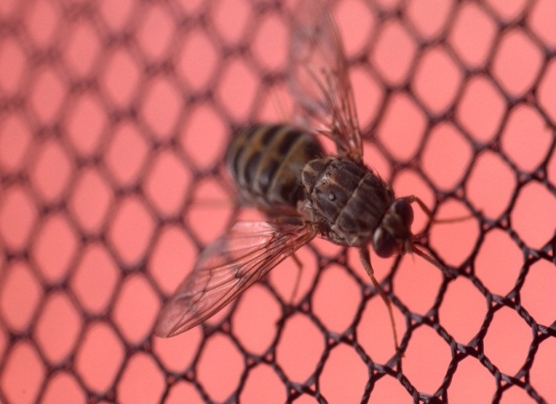
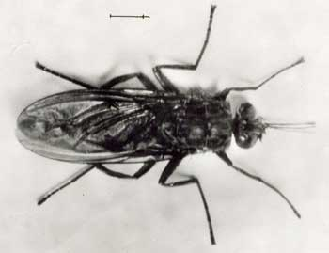
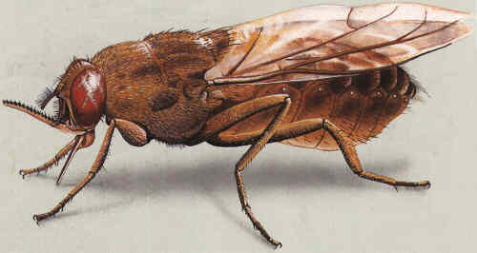
How is African trypanosomiasis transmitted ?
Trypanosoma are transmitted from human to human through the bite of the tsetse fly which is only found in rural parts of Africa.
However, trypanosomes can also be transmitted from mother to child as the parasite can cross the placenta? in the blood and infect the baby while it is still in the womb?.
Contaminated needles can also contribute to the spread of trypanosomes, but this is rare.

Slide 9
Trypanosoma life cycle
The trypanosome parasite is first introduced into the mammalian host as trypomastigotes when a tsetse fly takes a blood meal and secretes parasite-filled saliva into the host’s skin.
Once in the bloodstream the trypomastigotes multiply in the blood, lymph or spinal fluid.

Slide 10
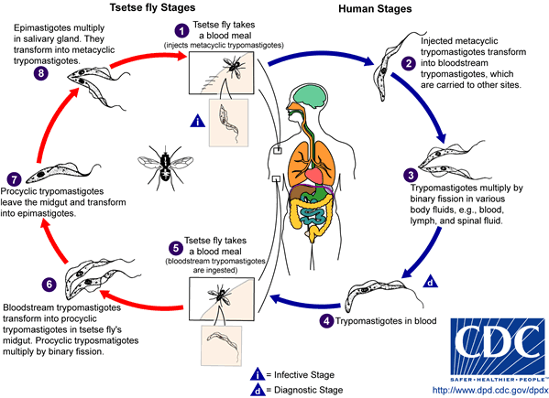
African Trypanosomiasis
Life cycle of Trypanosoma
brucei gambiense & T. b. rhodesiense

Slide 11
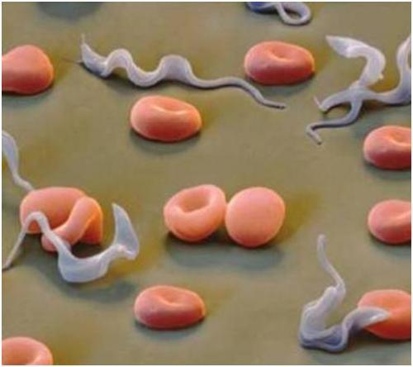
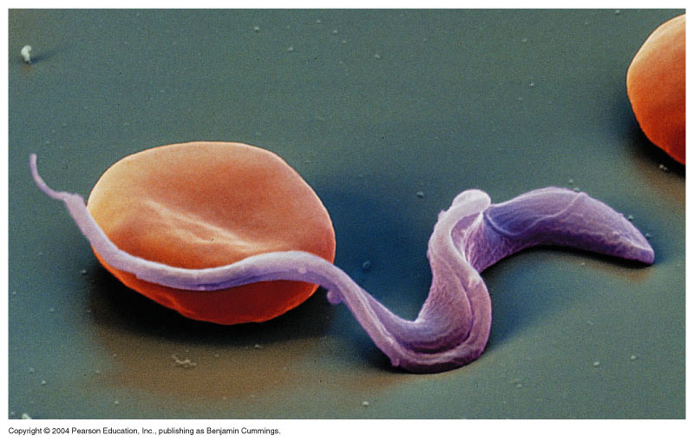
Trypanosomiases

Slide 12
Tsetse fly intermediate host

Slide 13
Pathology and clinical picture
Skin stage: A primary reaction occurs at the site of inoculation of trypomastigotes, chancre which resolve in 2-3 weeks.
Haematolymphatic stage: intermittent fever, headache and generalized lymphadenopathy mainly in the cervical and sub occipital region (Winterbottom’ sign), anemia.
Central nervous system stage (CNS): This stage begins when the trypanosome parasites cross from the blood-brain barrier into the spinal fluid, infecting the CNS including the brain, result in change in behavior, confusion, poor coordination, difficulties with speech and disturbance of sleep (Meningoencephalitis).
(Development of the disease more rapid in Trypanosoma brucei rhodesiense)

Slide 14
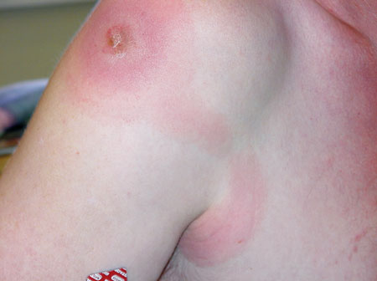
Chancre skin stage

Slide 15
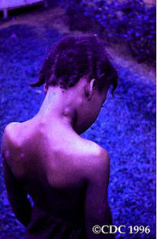
Winterbottom’s stage

Slide 16
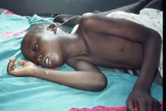
3rd stage CNS: CNS involvement in typical case there is daytime sleeping, psychological changes, tremors, convulsions and finally coma without treatment, the disease is invariably fatal.

Slide 17
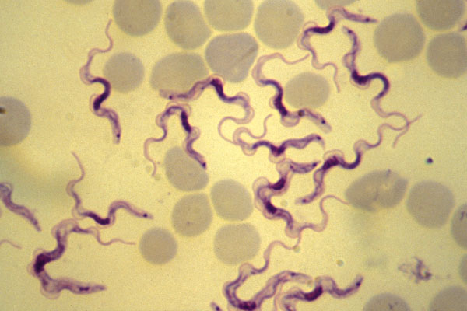
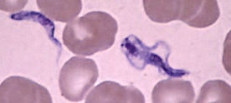
Diagnosis of African trypanosomiasis
Diagnosis relies on recognition of the trypomastigote in peripheral blood during fever, sternal bone marrow, lymph node aspirates and CSF. Motile organisms may be visible in the buffy coat.
Serological testing is also common as IF and ELIZA.

Slide 18
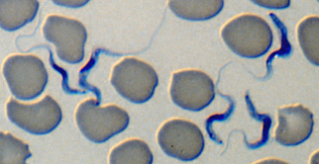
trypanosoma

Slide 19
Lymph node aspirate

Slide 20
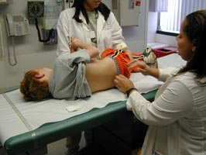
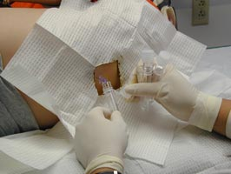
CSF lumbar puncture

Slide 21
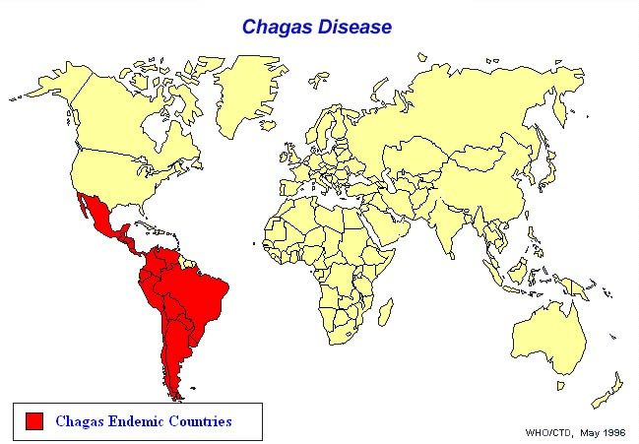

Slide 22
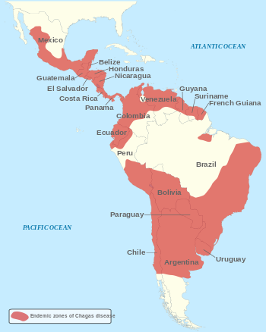

Slide 23
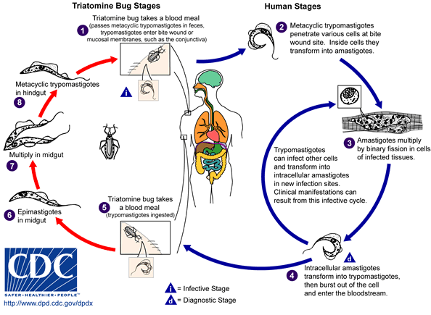
AMERICAN TRYPANOSOMIASIS
LIFE CYCLE OF Trypanosoma cruzi

Slide 24
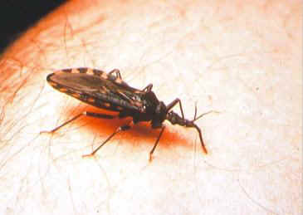
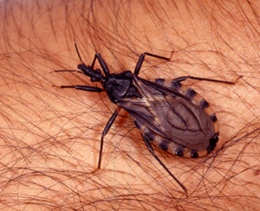
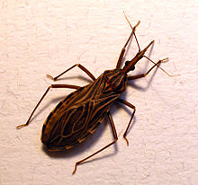
Reduviid (Triatomine) bug

Slide 25
American trypanosomes (Chaga’s disease)
The parasites produce focal lymphangitis and oedema at the site of parasites entry (Chagoma) after that parasites (trypomastigote) enter the blood stream and find there way, mainly on the face near the eyelids, it produces a swelling of the eye and temporal region with conjunctivitis (Romana’s sign), and also find their way mainly the cardiac muscles cells. The most constant feature of the cardiac disease is cardiomyopathy, in severe cases can lead to partial or complete heart block which may lead to cardiac failure.
NOTE: Parasite when free in blood stream in form (trypomastigote), but in the tissue it become in form of (Amastigote).

Slide 26
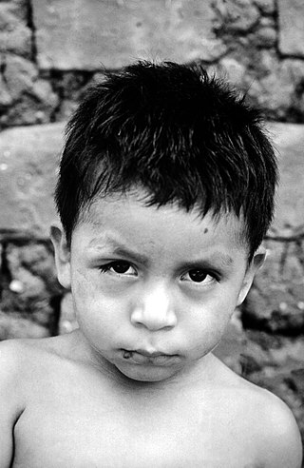
American trypanosomiasis (Chaga’s disease)
American trypanosomiasis, is a tropical parasitic disease caused by the Trypanosoma cruzi. It is spread mostly by insects known as "kissing bugs.
The human disease occurs in two stages: an acute stage and chronic stage. In the early stage, symptoms are typically either not present or mild, and may include fever, swollen lymph nodes, headaches, or local swelling at the site of the bite (chagoma). The most recognized marker of acute Chagas disease is called Romaña's sign, which includes swelling of the eyelids on the side of the face near the bite wound or where the bug feces were deposited or accidentally rubbed into the eye.

Slide 27
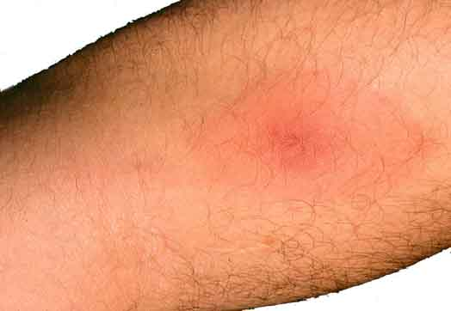
T. cruzi causes cutaneous stage (chagoma)

Slide 28
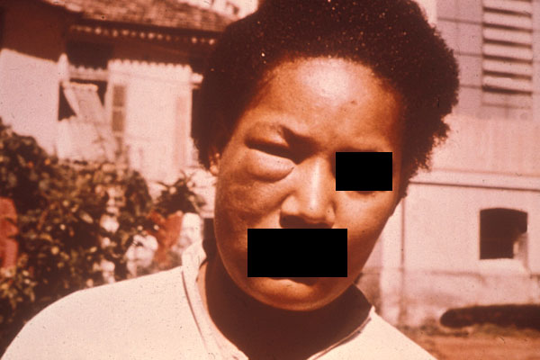
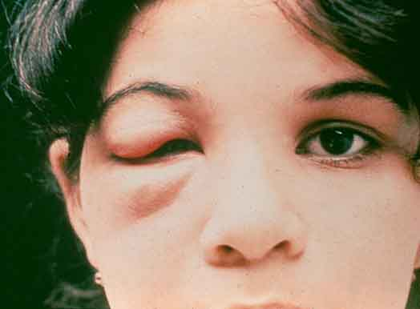
Ocular lesion (Romana’ sign)

Slide 29
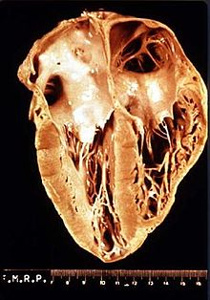
American trypanosomes (Chaga’s disease)
T. cruzi causes a chronic illness with progressive myocardial damage leading to cardiac arrhythmias and cardiac dilatation, and gastrointestinal involvement leading to mega-oesophagus and megacolon. T. cruzi causes acute illness in children, which is followed by chronic manifestations later in life. intracellular amastigotes destroy the intramural neurons of the autonomic nervous system in the intestine and heart, leading to megaintestine and heart aneurysms, If left untreated, Chagas disease can be fatal, in most cases due to heart muscle damage.

Slide 30
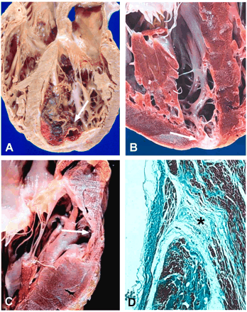
Heart damage due to American trypanosomiasis
About two-thirds of people with chronic symptoms have cardiac damage, including dilated cardiomyopathy, which causes heart rhythm abnormalities and may result in sudden death.

Slide 31
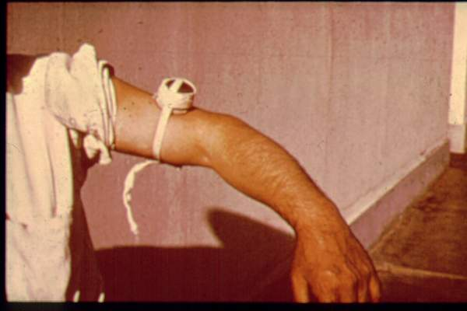
Diagnosis
Microscopical examination of Giemsa–stained blood film.
Serology: IFAT
Xenodiagnosis: feeding bugs on a suspected cases.
PCR used to detect trypomastigotes.

Slide 32
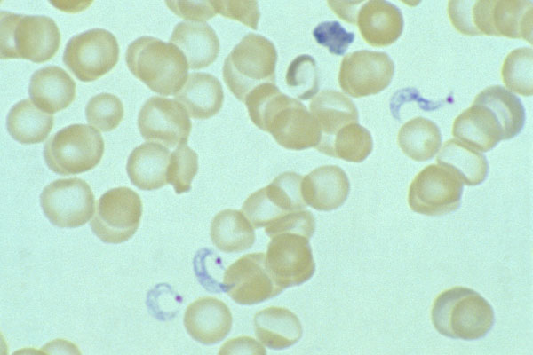
C-shape

Slide 33
TREATMENT OF TRYPANOSOMIASIS
African trypanosomiasis
For early infection
pentamidine
suramin
For late infection
Diflouromethylornithine- (DFMO)
American trypanosomiasis (Chaga’s disease)
benznidazole
Nifurtimox

