Slide 1
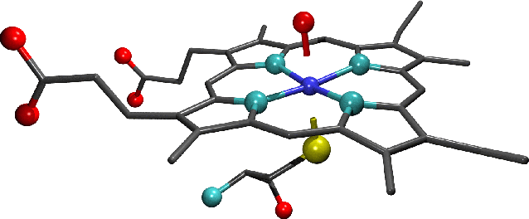
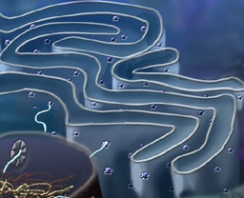
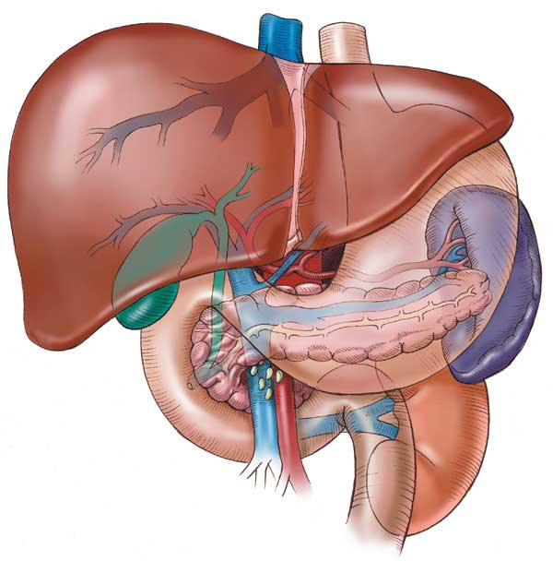
CYTOCHROME SYSTEM
&
DRUG METABOLISM

Slide 2
CYTOCHROME SYSTEM
&
DRUG METABOLISM
Revise the aim & phases of drug metabolism
Define the role of cytochrome system in relation to drug metabolism
Expand on the nature, location, nomenclature, structure, distribution & function of CYT P450
Focus on its regulation; directly & indirectly, its induction & inhibition its relevance to drug interactions
Interpret the molecular mechanism of interactions by CYT P450
Classify its different isoforms, their substrates, inducers & inhibitors
Delineate some of its genetic variations.

Slide 3
Where do drug biotransformations occur ?
RENAL Elimination
Being mostly lipophylic ➔ The liver subjects them to chemical transformation (METABOLISM) ➔ to become inactive & easily EXCRETED.
Polar product
Non-Polar product
Identified as foreign substances that body must get rid of
BILIARY Elimination
?
DRUG METABOLISM
Occurs mainly in the
“METABOLIC CLEARING HOUSE"
Notes:
the liver is the principal organ of drug metabolism. Other tissues that display considerable activity include the gastrointestinal tract, the lungs, the skin, the kidneys, and the brain.

Slide 4
Inactive product
Active metabolite;
Similar to parent
More active than parent
A product with different effect
Toxic metabolite
“ Cytochrome P450“ “ CYT 450” Superfamily is the terminal rate limiting oxidase of this system
?
Phase II
Conjugation
Create a conjugation site
Phase I
OXIDATION /Reduction/Hydrolysis
Its enzymes are part of a cascade
➔ transfers electrons from molecular oxygen to oxidize the drugs
CYTOCHROME SYSTEM
DRUG METABOLISM

Slide 5
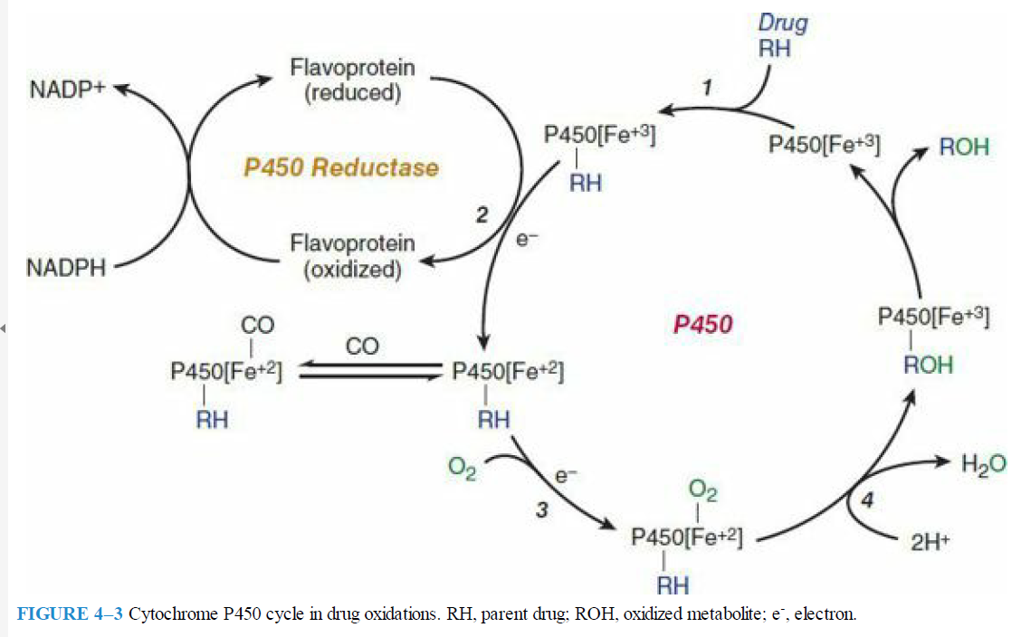

Slide 6
Cytochrome P450 cycle in drug oxidations

Slide 7
The smooth microsomes rich in enzyme responsible for oxidative drug metabolism in particular they contain the enzyme known as mixed function oxidases or monooxygenases. The activity of these enzymes requires both a reducing agent NADPH and molecular oxygen; in a typical reaction, one molecule of oxygen is consumed(reduced) per substrate molecule, with one oxygen atom appearing in the product and other in the form of water

Slide 8
In this oxidation – reduction process, two microsomal enzymes play a key role. The first of these is a flavoprotein, NADPH-cytochrome P450 reductase (Flavin mono nucleotide and Flavin dinucleotide)
The second mirosomal enzyme is a hemoprotein called cytochrome P450 which serves as a terminal oxidase

Slide 9
Microsomal drug oxidations require P450,P450 reductase,NADPH, and molecular oxygen
Briefly , oxidized(Fe3+) P450 combines with a drug substrate to form a binary complex(step 1). NADPH donates an electron to the flavoprotein P450 reductase,which inturn reduces the oxidized P450 drug complex(step 2).

Slide 10
A second electron is introduced from NADPH via the same P450 reductase, which serves to reduce molecular oxygen and to form an activated oxygen – P450-substrate complex(step 3).
This complex in turn transfers activated oxygen to the drug substrate to form the oxidized product(step 4)

Slide 11
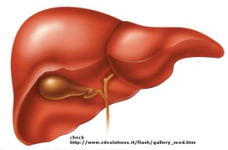
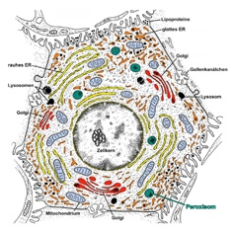
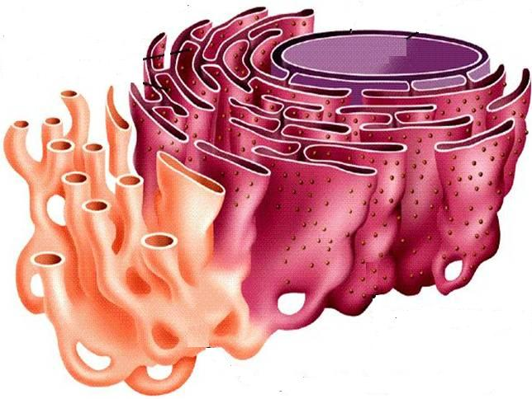
CYTOCHROME P450 FAMILY OF ENZYMES
They are located mainly attached to the smooth endoplasmic reticulum (SER) of hepatocytes.
“Cytochrome" = colored cells
They color the liver cells dark red as they contain iron
"P450“ absorbs a very characteristic wavelength (450 nm) of UV light when it is exposed to carbon monoxide.
They are isolated in the subcellular fraction termed the MICROSOMES
➔ Liver microsomal enzymes

Slide 12
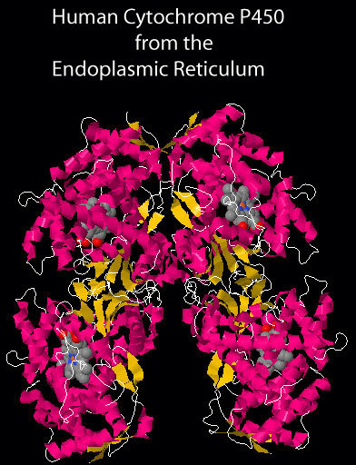
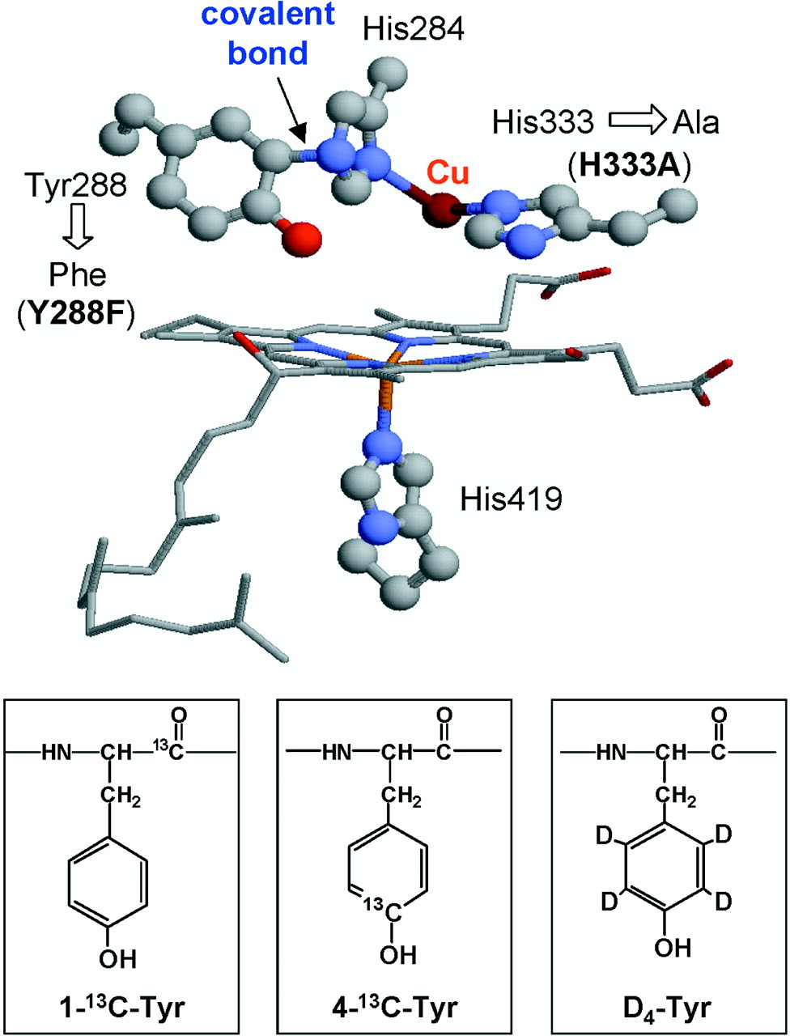
STRUCTURE
They are heme-containing isoenzymes
O₂
N₃
Su
Fe
haem
DISTRIBUTION
Highly concentrated in hepatocytes
Enterocytes of the small intestine present their principal extra-hepatic source
Very small quantities in kidneys, lungs, & brain.

Slide 13
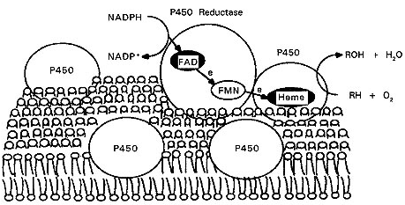
Function
Responsible for most of the OXIDATIVE METABOLISM of:
Endogenous substances: steroid hormones, prostaglandins, lipids, & fatty acids
Exogenous compounds: diet (food & beverages) / Drugs/ environmental xenobiotics.
Substrates
P450 Reductase
CYT P450 Oxidase
Notes:
Synthetic chemicals foreign to a particular ecological system & has a biological activity can be called xenobiotic compounds.

Slide 14
Regulation
Activation or Inactivation of the CYT P450 can be achieved either
A: Directly
B : Indirectly by expression or repression of its relevant genes by
activation or inhibition of the
responsible transcription factors
Activation or Inactivation can be
processed be any food, intrinsic products or extrinsic xenobiotics as drugs (usually the lipophylic) that have to be metabolized.

Slide 15
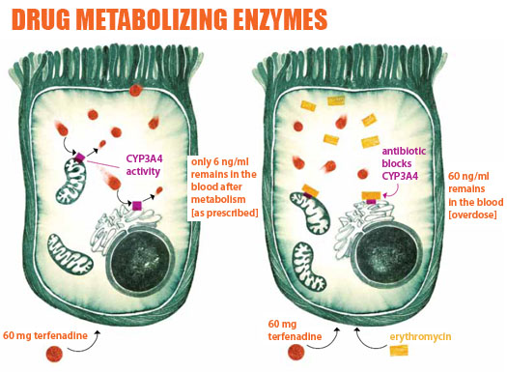
Regulation
When drugs play a role in regulation of the CYT P450 they are termed
Enzyme Inducers if Activate the enzyme
Enzyme Inhibitors if Inactivate the enzyme
PHARMACOKINETIC DRUG-DRUG INTERACTION
?

Slide 16
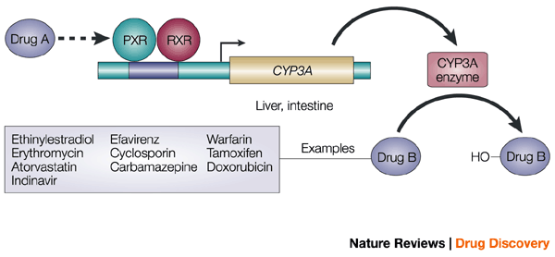
Molecular Basis Of Drug–drug Interaction
Regulation
The orphan nuclear receptor PXR is a TRANSCRIPTION FACTOR that regulates the expression of the CYP P450 genes.
If Drug A is INDUCER  it binds & activates PXR  which translocates in nucleus dimerize with RXR  the heterodiamer PXR / RXR will induce EXPRESSION of CYT P450 isoenzymes to metabolism of Drug B
If Drug A is an INHIBITOR, its binding will prevent activation  REPRESSION of CYT P450 isoenzymes to metabolism of Drug B
PXR, pregnane X receptor
RXR, retinoid X receptor.

Slide 17
Outcome Of Drug-drug Interactions Mediated By CYT P450
Regulation
IN RELATION TO ENZ INDUCERS
metabolism of the inducer +  its pharmacological action.
Tolerance or complete nullification
 metabolism of co-administered drugs
◉ EFFICACY
IN RELATION TO ENZ INHIBITORS
/ Retard metabolism & excretion of inhibitor & co-administered drugs
 / prolong action of the inhibitor & co-administered drugs.
TOXCICITY

Slide 18
Classification
CYT P450 has been classified into
Families designated by Numbers
Sub families designated by Letters
Distribution of
different CYP isoforms
in the liver.

Slide 19
Major Contributor to Phase I Metabolism

Slide 20
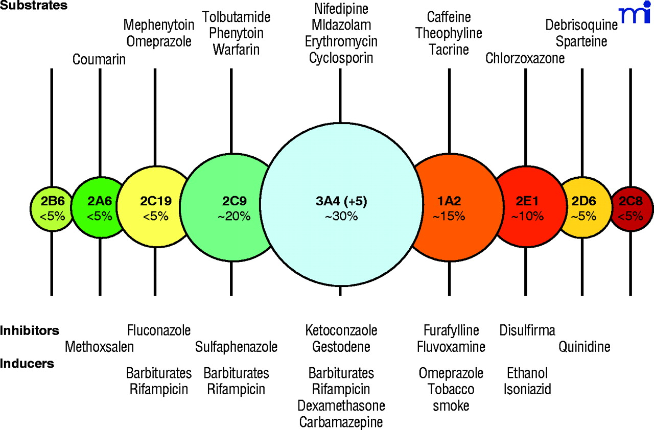
Substrate
Inhibitors
Inducers

Slide 21
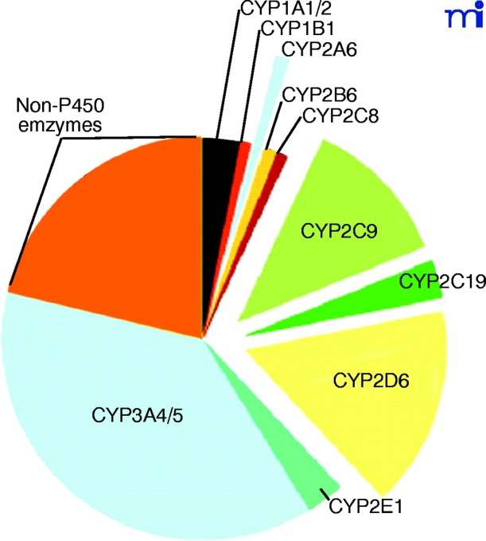
Cytochrome P450 3A4

Slide 22
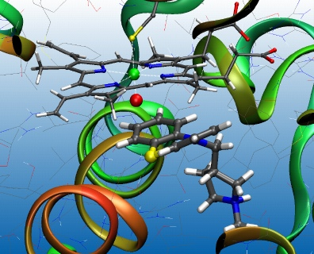
Cytochrome P450 2D6

Slide 23
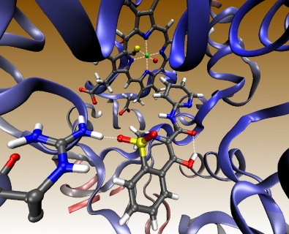
Cytochrome P450 2C9

Slide 24
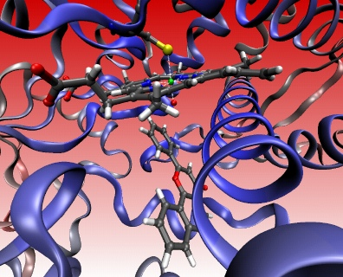
Cytochrome P450 1A2

Slide 25
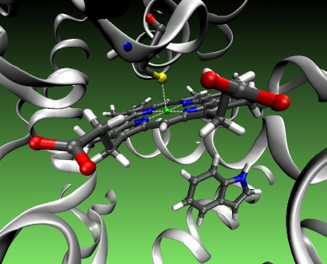
Cytochrome P450 2C 19

Slide 26
CYT P450 3A4
Substrates
Immunosuppressants (Cyclosporine)
Azole Antifungals (Fluconazole)
Antibiotics (Erythromycin, Clarithromycin)
Ca channel blockers (Amlodepine, Verapamil)
Statins (Atorvastatin, Amidarone???)
Cancer Chemotherapy
(Cyclophosphamide, Tamoxifen)
Non-Sedating Antihistamines (Astamizole)
Benzodiazipines (Midazolam, Clonazepam).
Inhibitors
Protease Inhibitors
Ritonavir
Cimetidine
Chloramphenicol
Nefazadone
Grape Fruits
Inducers
Phenytoin
Carbamazepine
Barbiturates
Rifampicin
Dexamethazone
Progestins

Slide 27
“A 50 years old, patient was treated for the last 3 years by the hypocholestrolemic agent; atorvastatin. Yesterday he began to complain of severe muscle pains, weakness & reddish discoloration of urine
He receives daily multivitamins & his lab results last week, proved that he has become diabetic, for which he was prescribed metformin. He was also started on a course of fluconazole for a concomitant fungal infection.
From drug history, the diagnosis of his current state was likely rhabdo-myositis (severe muscloskeletal toxicity) & was verified by the lab finding of severe elevation in creatinine phosphokinase. “
Which one of the following drug-drug interaction on CYT 3A4 is the likely cause of his current state?
Metformin + Atrovastatin
Atrovastatin + Fluconazole
Metformin + Fluconazole
Fluconazole+ Multivitamins

Slide 28
Genetic Variation
Genetic polymorphisms in CYT P450 isoenzymes have been observed & are reasons behind the ALTERED RESPONSE to drug therapy
CYP2D6
This isoenzyme has the most frequent polymorphisms in all CYT P450
When polymorphism occurs   metabolizing capacity of CYP2D6
i.e those who exhibit the polymorphism become poor metabolizers:
1. Metabolism of some neuroleptics, tricyclic antidepressants, antianginals agent ( perihexiline), antiarrhythmics (propafenone & metoprolol) is suppressed  so side effects & toxicity develop. i.e.
Neuropathy after therapeutic doses of perihexiline
Bradycardias & arrhythmias on therapeutic dose of propafenone or metaprolol
2. The pro-drugs cannot be converted to their therapeutically active metabolite; e.g poor analgesia with codeine & tramadol because they are not transformed into active forms

Slide 29
Genetic Variation
CYP2C9.
Warfarin, phenytoin, & tolbutamide are examples of drugs with narrow therapeutic index that are metabolized by CYP2C9.
Clearance of these drugs is impaired in genetic variation of the enzyme
CYP2C19
Polymorphism in CYP2C19 shows increased & prolonged action of its substrates as omeprazole
This has been an advantage as in those variants   cure rates in peptic ulcer patient with Helicobacter pylori.
Benefit

Slide 30
G
O
O
D
L
U
C
K
CYTOCHROME SYSTEM
&
DRUG METABOLISM

