Slide 1
Swallowing (Deglutition)
Chapter 64: 807-809
Mohammed Alzoghaibi, PhD.
zzoghaibi@gmail.com
Cell Phone: 0506338400

Slide 2
Learning Objectives
Swallowing process and stages.
Ingestion of Food.
Nervous initiation of pharyngeal stage of swallowing.
Effect of pharyngeal stage on respiration.
Function of lower esophageal sphincter.
Prevention of esophageal reflux by valve like mechanism.

Slide 3
Stages of Swallowing (Deglutition)
Swallowing is the ordered sequence of events that propel food from the mouth to the stomach
Swallowing is initiated voluntarily in the mouth, but thereafter is under involuntary or reflex control. The reflex portion is controlled by the swallowing center in the medulla.
Stages of Swallowing:
Oral stage (voluntary)
Pharyngeal stage (involuntary)
Esophageal stage (involuntary)

Slide 4
Stages of Swallowing (Deglutition)
Oral stage: is initiated voluntarily when the tongue forces a bolus of food (upward and backward against the palate) toward the pharynx which contains high density of somatosensory receptors. The activation of these receptors initiates the involuntary swallowing reflex in the medulla. From here on, swallowing becomes entirely automatic and can not be stopped.
Pharyngeal stage: Four Steps
1. Soft palate is pulled upward 2. the epiglottis moves to cover opening of larynx 3. the upper esophageal sphincter relaxes allowing food to move from pharynx to esophagus and 4. peristalsis wave of contraction initiated in the pharynx moves food from pharynx through the upper esophageal sphincter. Breathing is inhibited during the pharyngeal stage of swallowing.

Slide 5
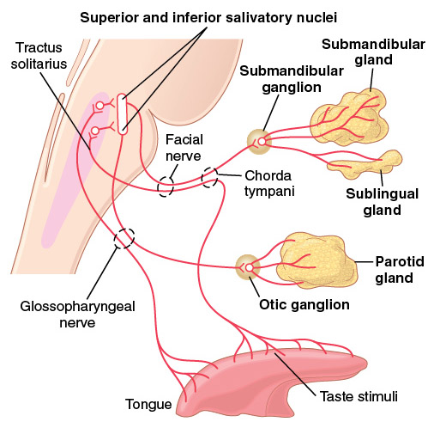
Ingestion of Food
Swallowing (deglutition): The pharynx plays a role in respiration as well as swallowing. Generally swallowing can be divided into (a) an oral stage (voluntary), (b) a pharyngeal stage (involuntary), and (c) an esophageal stage (involuntary) that transports food from the pharynx to the stomach.
(I) Voluntary Stage of Swallowing. The first stage of swallowing involves the voluntary rolling of the chewed food posteriorly into the pharynx by the upward and backward pressure applied by the tongue against the palate.
Swallowing
mechanism.
Figure 65-3.
Copyright 2000, WB Saunders Company, All Rights Reserved

Slide 6
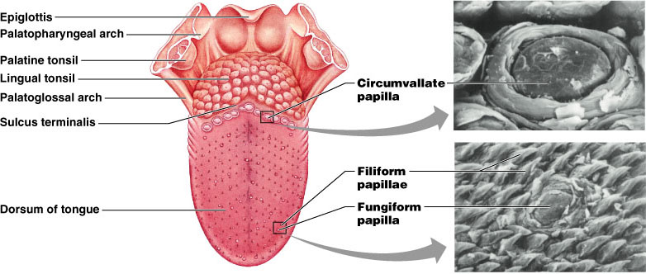
Ingestion of Food (continued)
(II) Pharyngeal stage of Swallowing (involuntary): At the pharynx, the bolus of food stimulates epithelial swallowing receptor areas all around the pharynx opening and impulses from this area pass to the brain stem (swallowing center) and accordingly initiate a series of autonomic pharyngeal muscle contractions as follows:
(1) The soft palate is pulled upward to close the posterior nares which prevents the food from entering the nasal cavities.
(2) The palatopharyngeal folds on each side of the pharynx are pulled medially to approximate each other. These folds form a sagittal slit through which food must pass into the posterior pharynx.

Slide 7
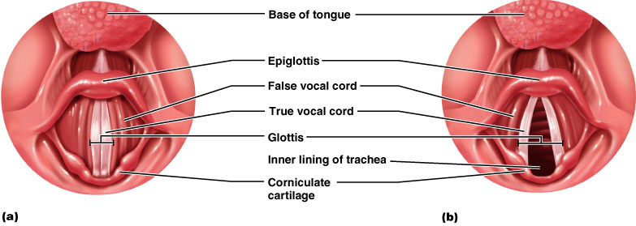
Ingestion of Food (continued)
(3) The vocal cords of the larynx are strongly approximated and the larynx is pulled upward and anteriorly by the neck muscles. These actions and the ligaments that prevent the epiglottis from moving upward, cause the epiglottis to swing backward over the opening of the larynx. All these effects prevent food from going into the nose and trachea. Destruction of the vocal cords or the muscle that approximate them can cause strangulation.
(4) The upward movement of the larynx pulls up and enlarges the opening to the esophagus. The upper esophageal sphincter (or the pharyngoesophageal sphincter) relaxes and allows food to move freely from the posterior pharynx into the upper esophagus.

Slide 8
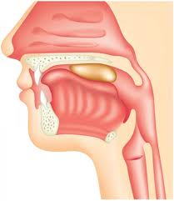
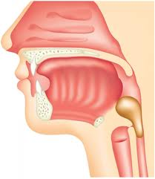
Ingestion of Food (continued)

Slide 9
Ingestion of Food (continued)
(5) Once the larynx is raised and the pharyngoesophageal sphincter relaxes, the entire muscular wall of the pharynx contracts (superior, middle, then inferior parts) propelling the food by peristalsis into the esophagus.
Summary of pharyngeal stage of swallowing: The trachea is closed, the esophagus is opened, and a fast peristaltic wave initiated by the nervous system of the pharynx forces the bolus of food into the upper esophagus (time of process is < 2 seconds).
Figure 65-3.
Copyright 2000, WB Saunders Company, All Rights Reserved

Slide 10
● Nervous initiation of the pharyngeal stage of swallowing. Sensory impulses from the mouth are received by the nucleus tractus solitarius (NTS) via the medulla oblongata through the trigeminal and glossopharyngeal nerves. The most sensitive areas of the posterior mouth and pharynx for initiating the pharyngeal stage of swallowing are located in a ring around the pharyngeal opening including the tonsillar pillars. The successive stages of swallowing are then automatically initiated by neuronal areas of the reticular substance of the medulla and lower portion of the pons (collectively called the deglutition or swallowing center). The motor impulses to the pharynx and upper esophagus are transmitted from the swallowing center by the 5th, 9th, 10th, and 12th cranial nerves and few of the superior cervical nerves.

Slide 11
Ingestion of Food (continued)
● Effect of the Pharyngeal Stage of Swallowing on Respiration. The entire pharyngeal stage of swallowing occurs in < 6 sec, during which time the swallowing center inhibits the respiratory center in the medulla which stops respiration during the swallowing cycle.
In summary, the pharyngeal stage of swallowing is a reflex act initiated by the voluntary movement of food into the back of the mouth which stimulates involuntary pharyngeal sensory receptors to elicit the swallowing reflex.

Slide 12
Stages of Swallowing (Deglutition)
(III) Esophageal stage:
The esophagus is a conduit to move food rapidly from the pharynx to the stomach. The esophageal stage is controlled partly by the swallowing reflex and partly by the enteric nervous system (ENS). When bolus of food passes through the upper esophageal sphincter, the swallowing reflex closes the sphincter so food cannot reflux into the pharynx.
The musculature of the pharyngeal wall and upper 1/3 of esophagus (striated muscles) are innervated by vagus (10th cranial) & glossopharyngeal nerves (9th cranial), while the musculature of the lower two thirds of the esophagus is smooth muscle (controlled by the vagus through connections with the esophageal myenteric nervous system).
In case of vagotomy enteric nervous system takes over.

Slide 13
Ingestion of Food (continued)
(III) Esophageal Stage (cont.):
It exhibits two types of peristaltic movements, primary and secondary peristalsis. The primary peristalsis is simply a continuation of the peristaltic wave that begins in the pharynx and spreads into the esophagus during the pharyngeal stage of swallowing. This wave passes from the pharynx to the stomach in 8-10 sec. If this primary peristaltic wave fails to move the food to the stomach, then the distention in the esophagus caused by the food will initiate secondary peristaltic wave which will continue until all the food is emptied into the stomach.

Slide 14
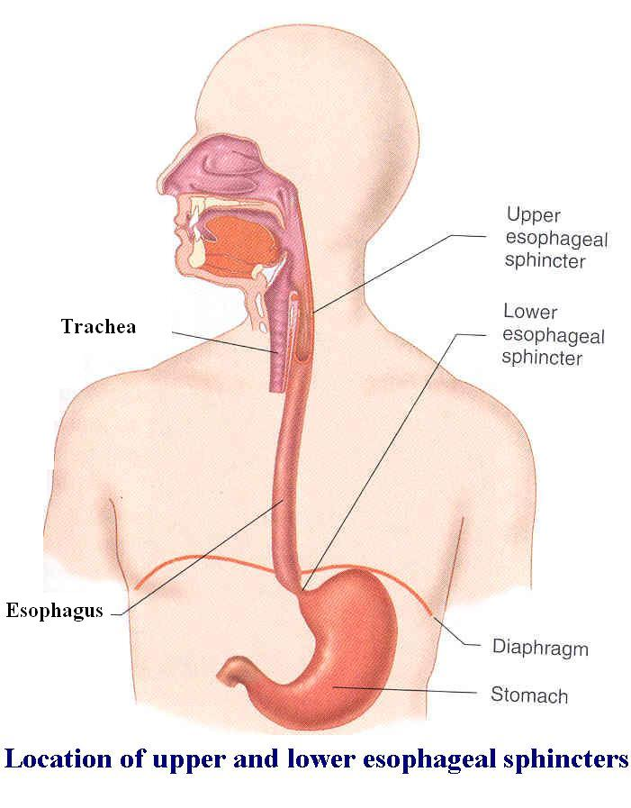
Esophageal Stage of Swallowing

Slide 15
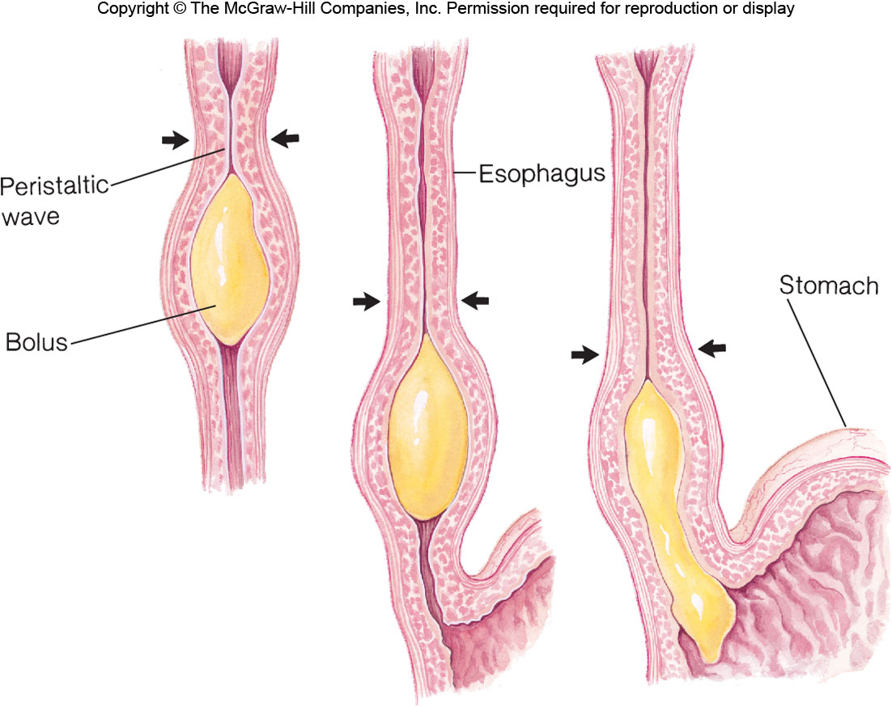
Esophageal Stage of Swallowing

Slide 16
Function of Gastroesophageal Sphincter
● Receptive Relaxation of the Stomach. When the esophageal peristaltic waves reaches the stomach, the stomach relaxes through inhibition of myenteric neurons which prepares the stomach to receive the food that is propelled into the esophagus during swallowing.
● Function of the Lower Esophageal Sphincter (Gastroesophageal Sphincter). The esophageal sphincter is formed by the esophageal circular muscle located in an area of ~ 3 cm upward of the junction with the stomach. This sphincter remains tonically constricted (protects the esophagus from the stomach acidic juices) until the peristaltic swallowing wave passes down the esophagus and causes a “receptive relaxation” of the sphincter and the emptying of the propelled food into the stomach.
Failure of the sphincter to relax will result in achalasia.

Slide 17
Function of Gastroesophageal Sphincter
● Additional Prevention of Esophageal Reflux by Valve-like Closure of the Distal End of the Esophagus. This is another protective mechanism (safety factor) that prevents reflux of gastric secretions into the lower portion of the esophagus. This mechanism involves a short portion of the esophagus that extends slightly into the stomach and that caves the esophagus inward in response to increased intra-abdominal pressure.

Slide 18
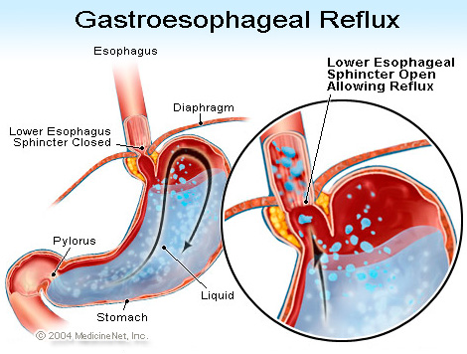
Function of Gastroesophageal Sphincter

Slide 19
Function of Gastroesophageal Sphincter (continued)
Resting pressure (15-30 mmHg).
A valve like mechanism of the distal end of the esophagus that lies immediately beneath the diaphragm and is exposed to +ve intra-abdominal pressure. This flutter-valve closure of the lower esophagus by the increased intra-abdominal pressure prevents the high pressure in the stomach from forcing its contents into the esophagus.
The diaphragm wraps around the esophagus at the level of lower esophageal sphincter (LES), contraction of the diaphragm helps to increase the pressure at the LES during inspiration.

Slide 20
Function of Gastroesophageal Sphincter (continued)
Contraction of the circular musculature of the sphincter is regulated by nerves, (extrinsic & intrinsic), hormones and neurotransmitter.
Between swallows, tonic vagal cholinergic impulses maintain contraction to keep the sphincter closed.

Slide 21
Function of Gastroesophageal Sphincter (continued)
During swallowing, efferent inhibitory impulses from vagus nerve cause the sphincter to relax. The transmitter probably being nitric oxide (NO) or vasoactive intestinal peptide (VIP).
The gastrin hormone, released from the stomach by food, contracts LES.
Secretin and cholecystokinine (CCK), are released from the upper small intestine, relax the LES.

Slide 22
Achalasia
A condition due to high resting pressure at the LES that fails to relax during swallowing. As a result, food transmission from the esophagus into the stomach is prevented.
Physiological basis of this condition is either pathology of or absence of the myenteric plexus containing VIP & NO in the lower third of esophagus.
The musculature of the lower esophagus instead remains contracted and the myenteric plexus has lost the ability to transmit a signal to cause relaxation of the LES.

Slide 23
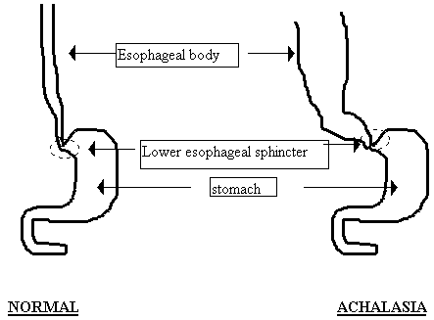
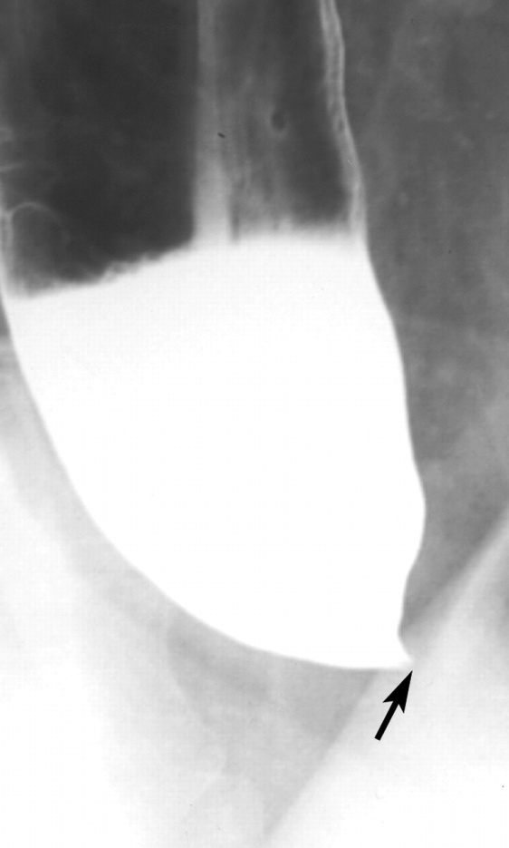
Achalasia

Slide 24
The End

