Slide 1
RADIOLOGY OF THE ABDOMEN (Lecture 1)
Radiology

Slide 2
OBJECTIVES
To know radiology modalities used in abdomen imaging mainly GI tract.
To know advantages and disadvantages of each modality.
To know indications and contraindications of each modality.
Overview on normal abdomen appearance and common pathologies including:
Pneumoperitomium
Peptic ulcer
Bowell obstruction
Inflammatory bowel disease
Large bowel masses/malignancies

Slide 3
What radiological modalities are GOOD in imaging the abdomen mainly the GI tract?

Slide 4
What radiological modalities are GOOD in imaging the abdomen mainly the STOMACH and BOWEL LOOPS?
X-ray
Fluoroscopy
CT scan
MRI
?? US

Slide 5
X-Ray

Slide 6
Abdominal x-ray
X-ray is a form of radiation, that are focused into a beam
X-ray can pass through most objects including the human body.
When X-rays strike a piece of photographic film, they make a picture.

Slide 7
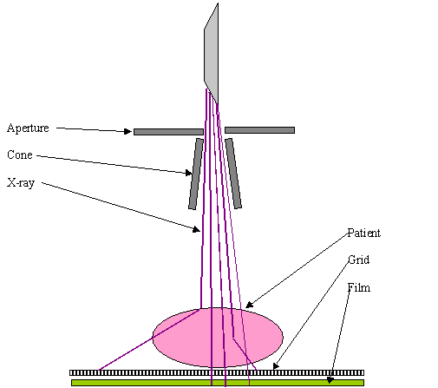

Slide 8
ABDOMINAL X-RAY
White ----- bone and calcification
Grey ------ soft tissue
Black ----- air

Slide 9
ADVANTAGES:
Widely available
Cheap
Excellent in diagnosing free air in the abdomen
Good in diagnosing bowel obstruction & stones/calcifications
DISADVANTAGES:
Radiation
Poor soft tissue details

Slide 10
INDICATIONS
Abdominal pain
Bowel obstruction
Stones
Masses
Trauma
Others, foreign body, supportive lines.. Etc
CONTRAINDICATIONS:
pregnancy

Slide 11
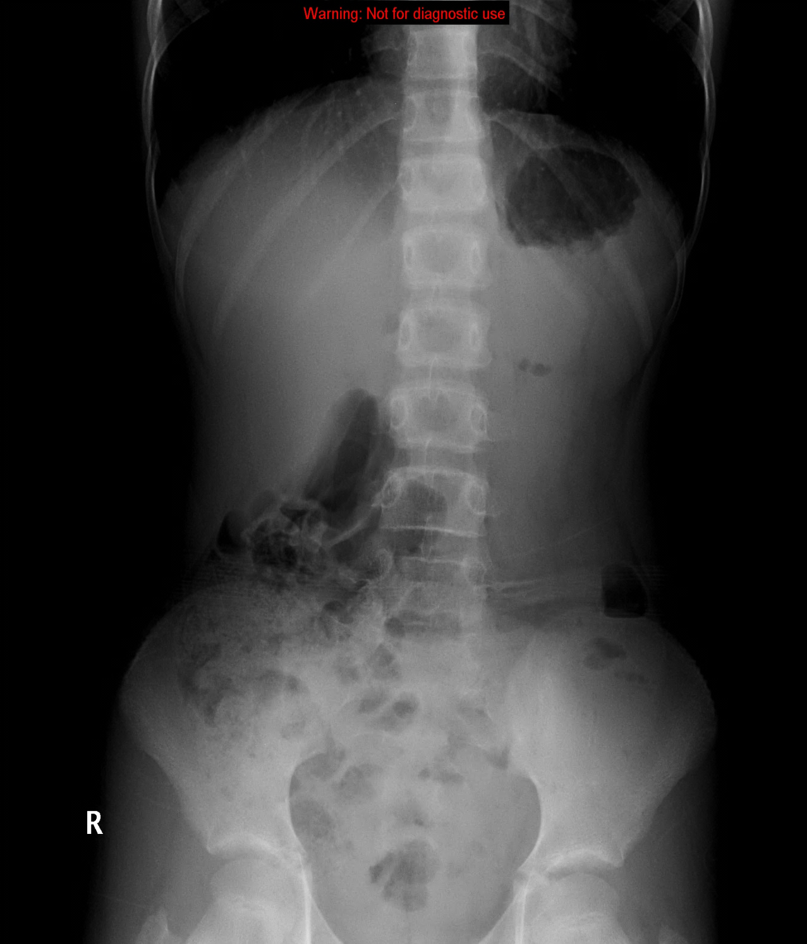
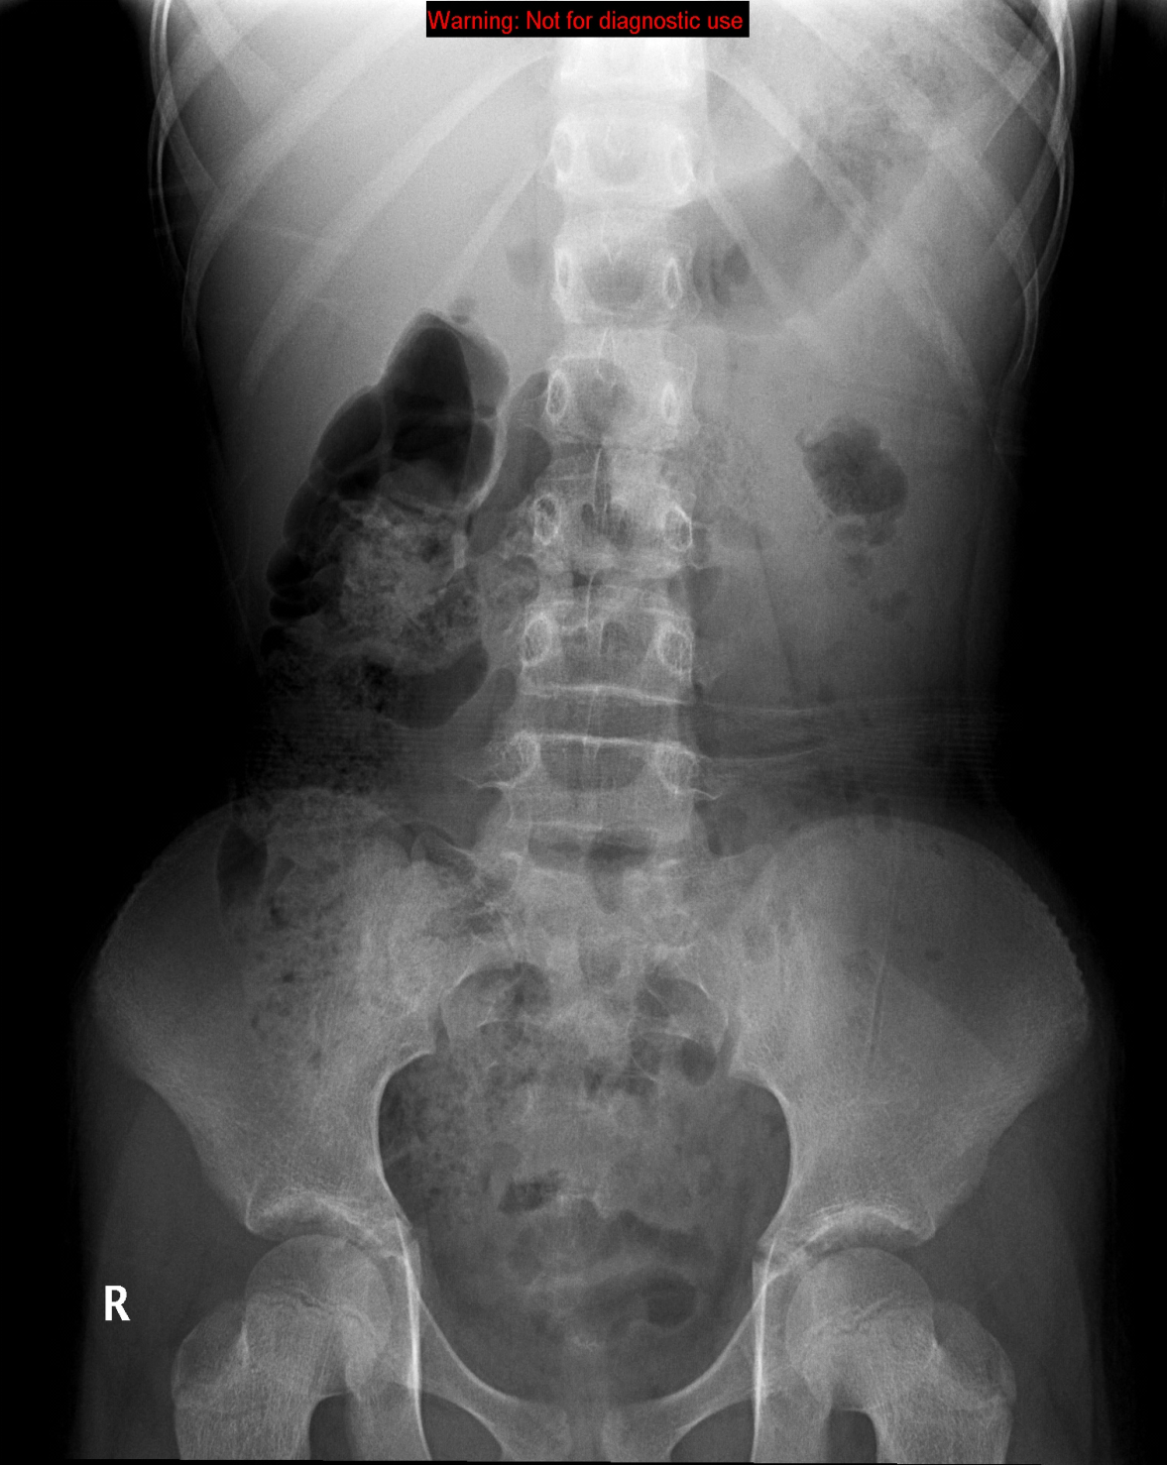
NORMAL ABDOMEN X-RAY
Standing
Supine

Slide 12
STOMACH
SMALL BOWEL
LARGE BOWEL
RECTUM

Slide 13
Soft tissues
2
1
3
4

Slide 14
Soft tissues
Liver
Spleen
Kidneys
Psoas muscles

Slide 15
Soft tissues
Liver
Spleen
Kidneys
Psoas muscles

Slide 16
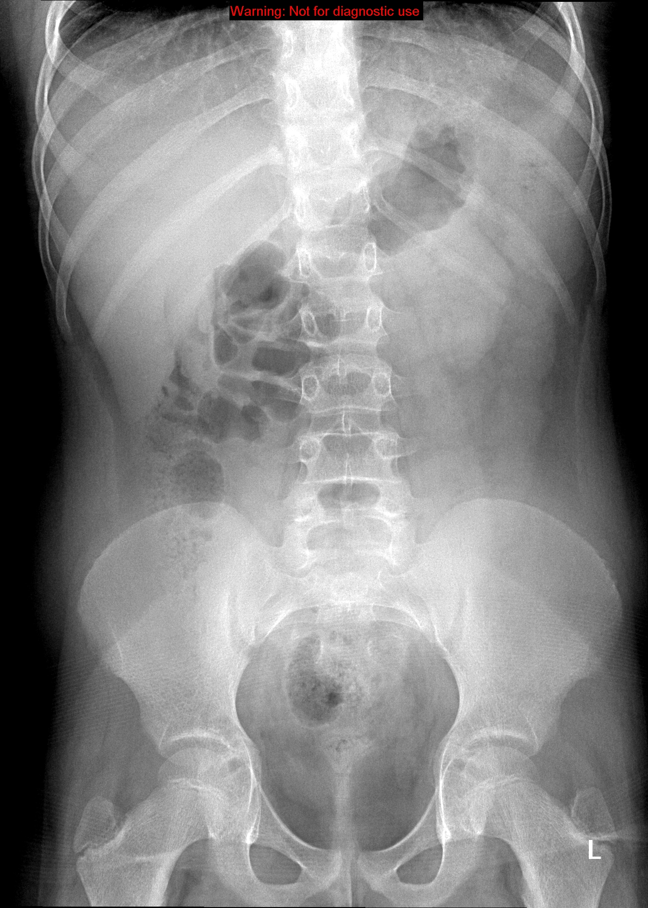
Liver
Spleen
Kidneys
Psoas muscles

Slide 17
Liver
Spleen
Kidney
Psoas muscles

Slide 18
Liver
Spleen
Kidneys
Psoas muscles

Slide 19
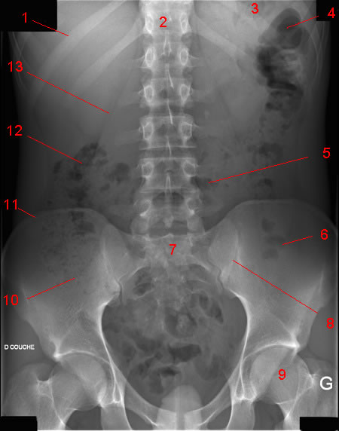
Normal AXR
Liver
Gas in stomach
T12
Splenic flexure
11th rib
Psoas margin
Left kidney
Hepatic flexure
Transverse colon
Iliac crest
Gas in sigmoid
Sacrum
Gas in caecum
SI joint
Bladder
Femoral head

Slide 20
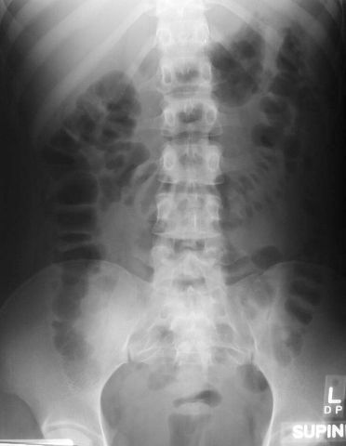
Gas pattern
What is normal?
Stomach
Almost always air in stomach
Small bowel
Usually small amount of air in
2 or 3 loops
Large bowel
Almost always air in rectum
and sigmoid
Varying amount of gas in rest of large bowel

Slide 21
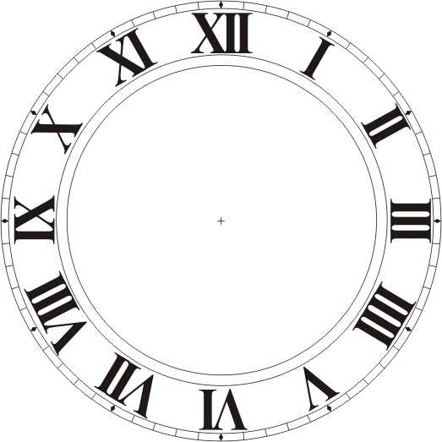
3, 6, 9 RULE
Maximum Normal Diameter of bowel
Small bowel 3cm
Large bowel 6cm
Caecum 9cm

Slide 22
Is this X ray normal or abnormal ? and Why?

Slide 23
It is ABNORMAL
BOWEL OBSTRUCTION
Dilated bowel loops
Air fluid levels

Slide 24
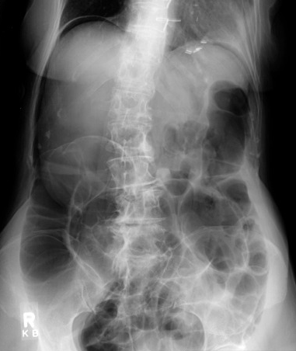
Is the air inside or outside the bowel loops?

Slide 25
It is outside
(pneumoperitonium)

Slide 26
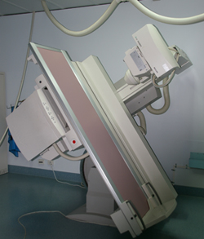
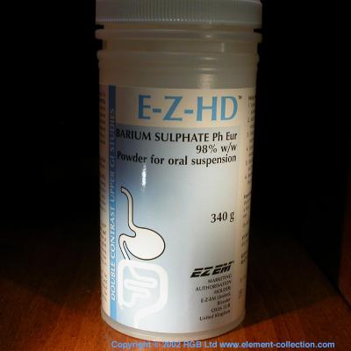
Fluoroscopy
+
ORAL
CONTRAST
X-RAY

Slide 27
Barium swallow --------------> Esophagus
Barium meal ------------------> Stomach
Barium follow through -----> Small bowel
Barium enema ----------------> Large bowel

Slide 28
ADVANTAGES:
Available
Relatively cheap
Excellent in evaluation the bowel lumen and mucosa
DISADVANTAGES:
Radiation
Poor in evaluating extra luminal pathologies

Slide 29
INDICATIONS
Assessing the mucosal outline
Abdominal pain
Gastro esophageal reflux
Masses
Inflammatory bowel diseases
Post surgical, leak
CONTRAINDICATIONS:
Pregnancy
Bowel obstruction
Bowel perforation (with barium type of contrast)

Slide 30
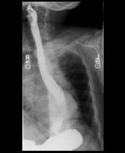
BARIUM SWALLOW

Slide 31
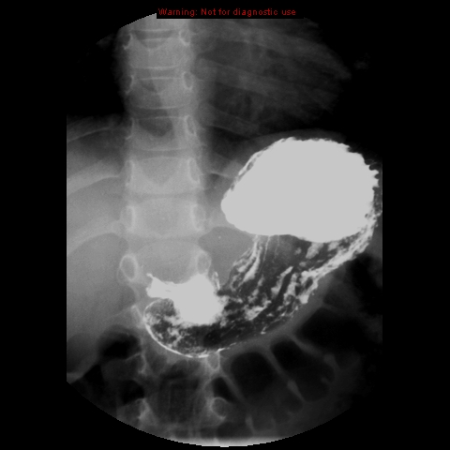
BARIUM MEAL

Slide 32
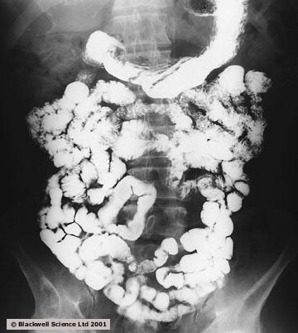
BARIUM FOLLOW THROUGH

Slide 33
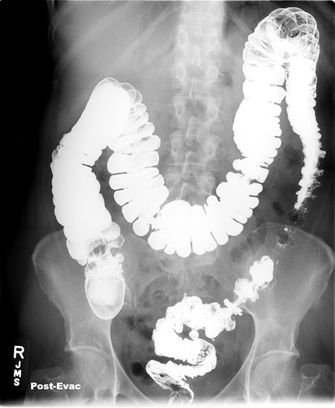
BARIUM ENEMA

Slide 34
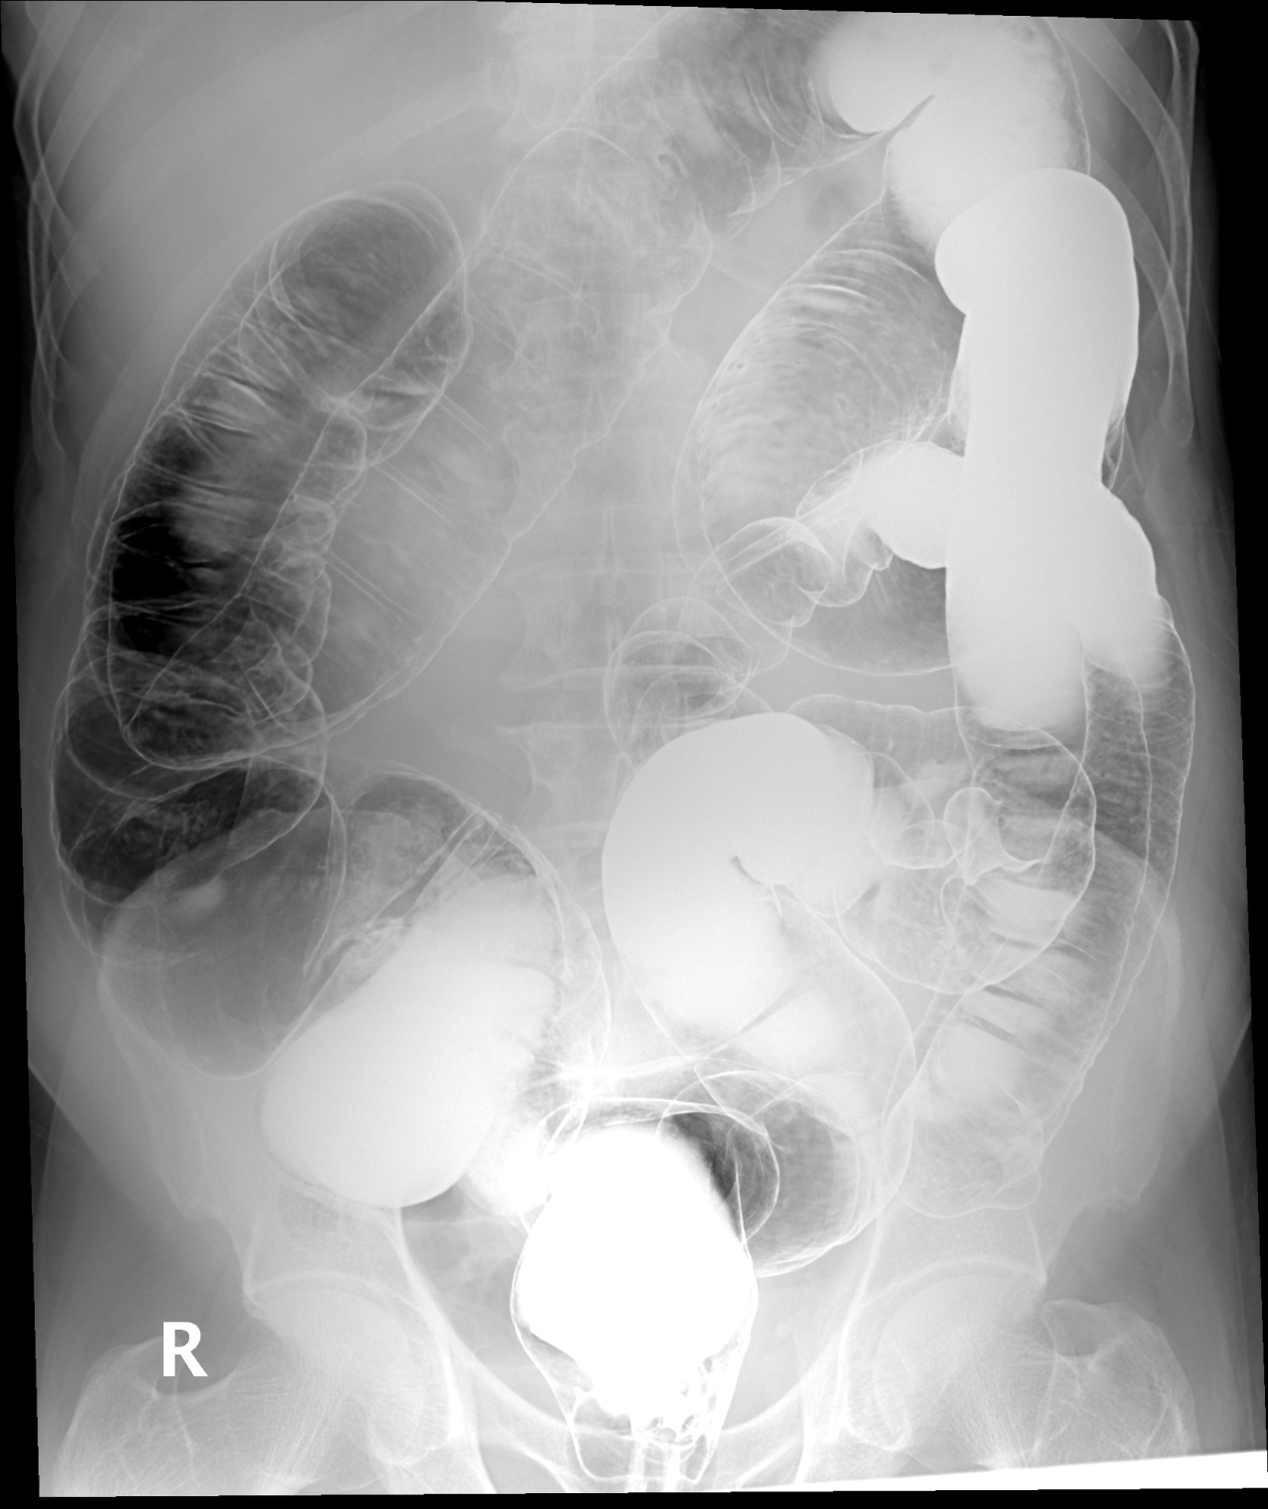
What type of this study?
5
4
6
3
7
2
8
1

Slide 35
4
5
6
Rectum
Sigmoid colon
Descending colon
Splenic flexure
Transverse colon
Hepatic flexure
Ascending colon
cecum
3
7
2
8
1

Slide 36
What is abnormal here?

Slide 37
Peptic ulcer disease

Slide 38
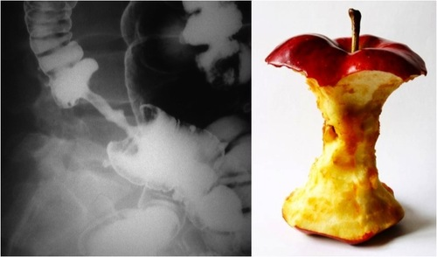
What is abnormal in this barium enema?

Slide 39
Colon mass/malignancy (Apple core appearance)

Slide 40
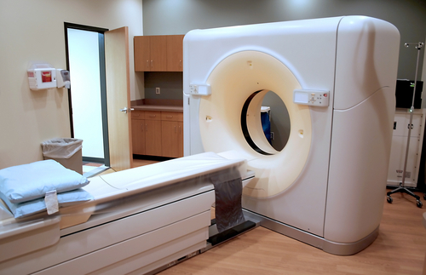
CT scan

Slide 41
ADVANTAGES:
Available
Short scan time
Much more soft tissue and bone details
Excellent in diagnosing extra-luminal lesions
Excellent in diagnosing the cause of bowel obstruction
DISADVANTAGES:
Radiation
Some times need intra venous contrast (renal disease)
Relatively expensive

Slide 42
INDICATIONS
Abdominal pain
To look for bowel obstruction cause
To diagnose intra-abdominal masses
Trauma
CONTRAINDICATIONS:
Pregnancy
No IV contrast in renal failure
Unstable patients (severe trauma/ICU)

Slide 43
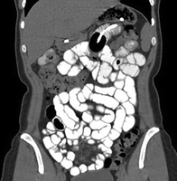

Slide 45
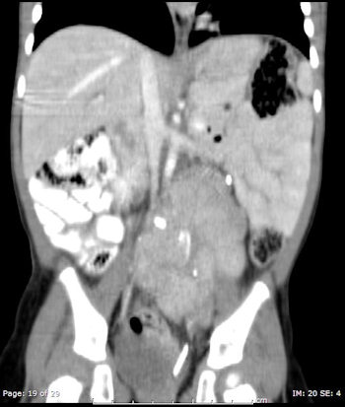
Where is this mass ? Inside or outside the bowel loops?

Slide 46
It is OUTSIDE the bowel and causing mass effect.

Slide 47
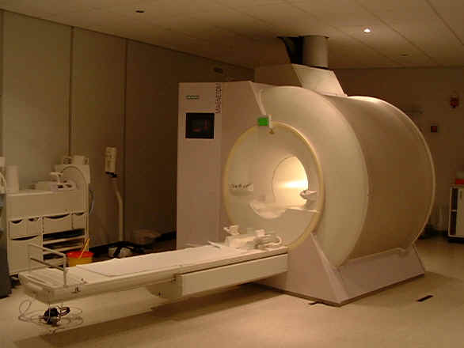
MRI

Slide 48
ADVANTAGES:
Relatively safe in pregnancy (no radiation)
Give much more soft tissue details
Excellent in diagnosing abdominal solid organ lesion: liver, spleen, kidneys
DISADVANTAGES:
Expensive
Long scanning time
Sensitive to motion

Slide 49
INDICATIONS
Abdominal solid organ masses
Inflammatory bowel disease
CONTRAINDICATIONS:
uncooperative patients
Early pregnancy (relative contraindication)
No IV contrast renal failure (relative contraindication)

Slide 51
CT scan
MRI

Slide 52
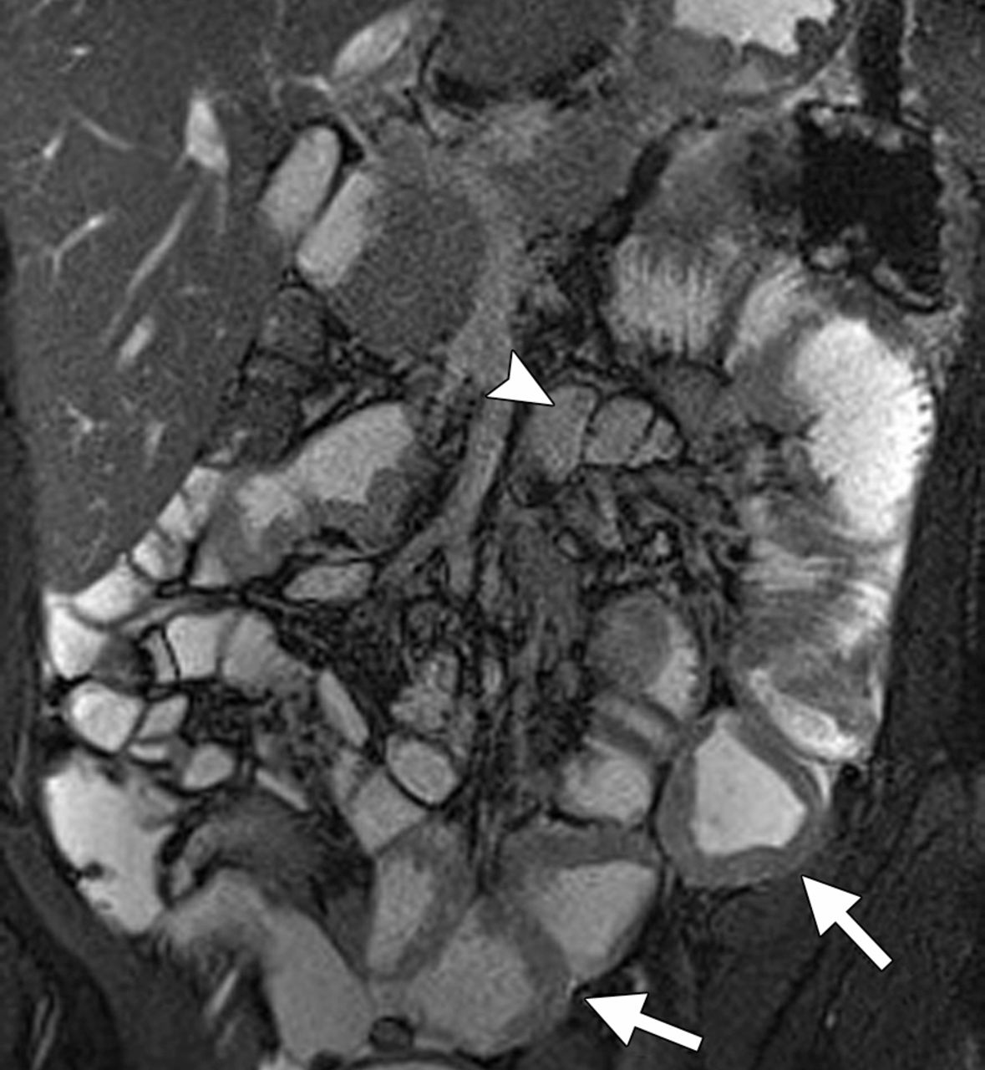
Can you identify what is abnormal ?

Slide 53
Bowel wall thickening
Separation of bowel loops

Slide 54
Inflammatory bowel disease
Bowel wall thickening

Slide 55
Thank you

