Slide 1

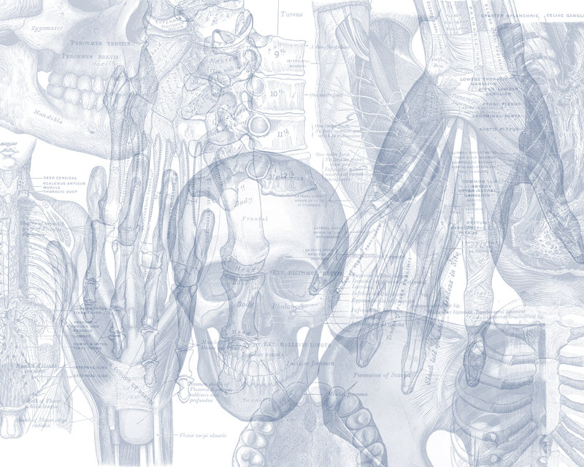
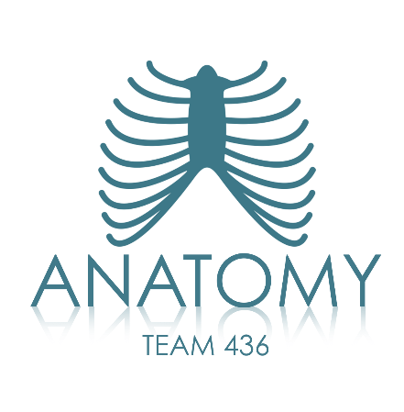

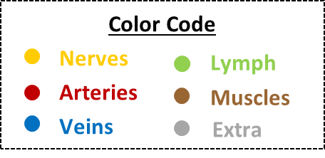
OSPE
GASTRONUTRITIONAL BLOCK

Slide 2
اللهم لا سهل إلا ما جعلته سهل وأنت تجعل الحزن إذا شئت سهل
Important Points
Read the questions carefully.
Make sure your write the FULL name of the structures with the correct spelling.
Example: IVC ✕→ Inferior Vena Cava ✓
Thoracic aorta ✕→ Descending thoracic aorta ✓
3. There is NO guarantee whether or not the exam will go out of this file.
Good luck!

Slide 3
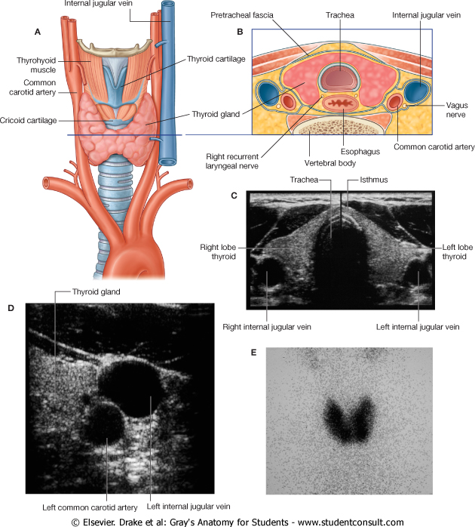
Case 1
Write the relations of the esophagus.
Cervical part:
Anteriorly:
Trachea
Recurrent laryngeal nerves (vagus nerve)
Posteriorly:
Vertebral column
Laterally:
Lobes of thyroid gland

Slide 4
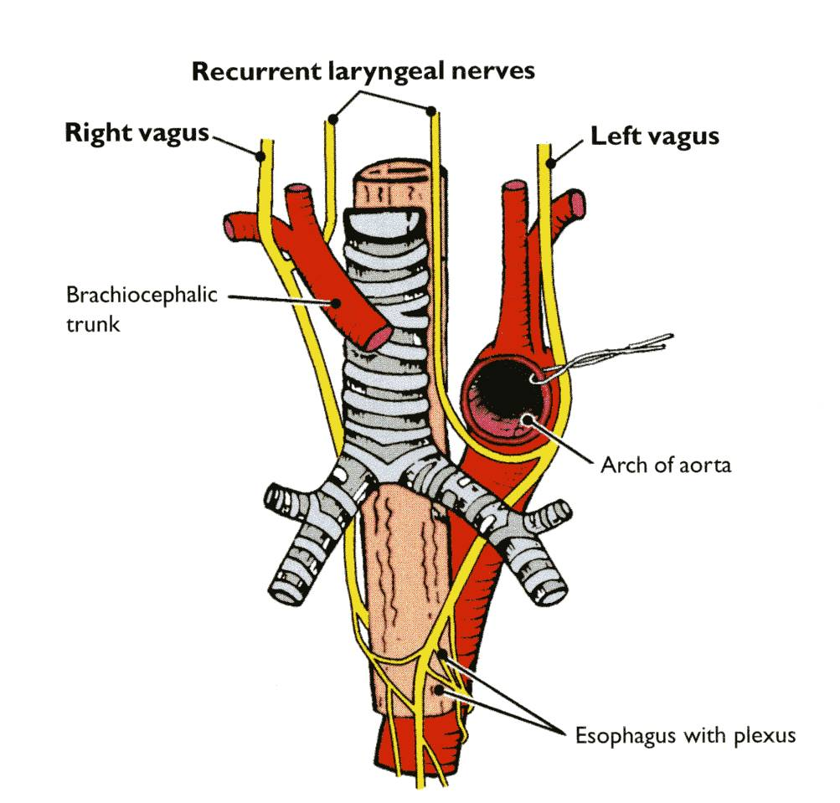
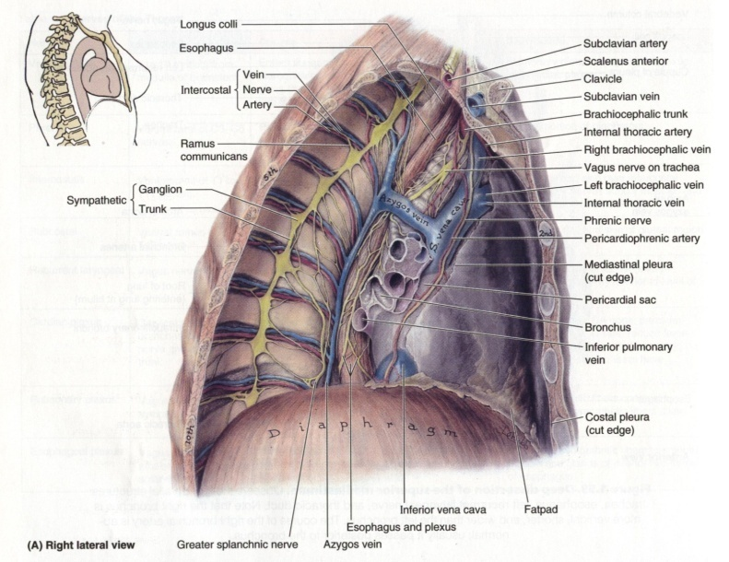
Case 1
Write the relations of the esophagus.
Thoracic part:
Anteriorly:
Trachea
Left recurrent laryngeal nerve
Left principal bronchus
Pericardium
Left atrium
Posteriorly:
Bodies of the thoracic vertebrae
Thoracic duct
Azygos vein
Right posterior intercostal arteries
Descending thoracic aorta (at the lower end)

Slide 5
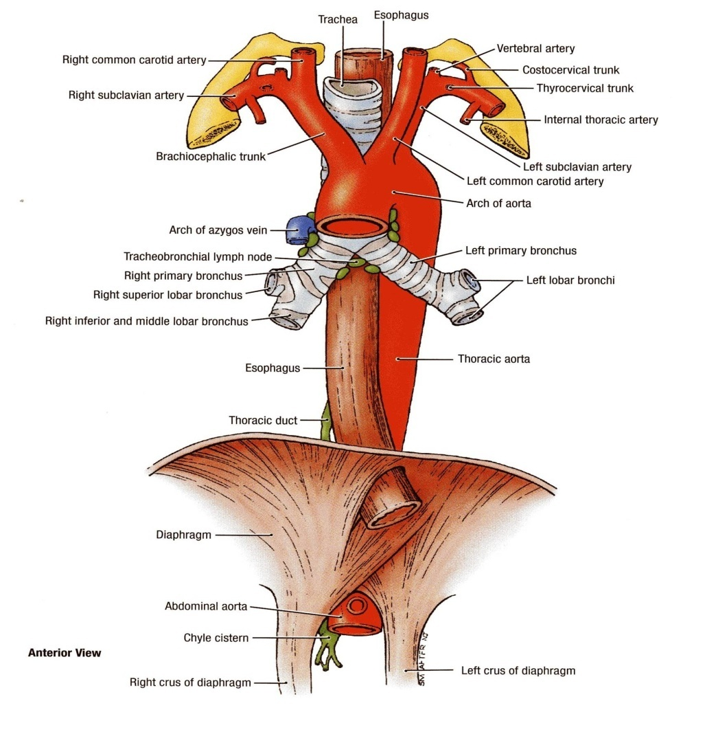
Case 1
Write the relations of the esophagus.
Thoracic part:
Laterally - Right:
Mediastinal pleura
Terminal part of the azygos vein.
Laterally - Left:
Mediastinal pleura.
Left subclavian artery.
Aortic arch.
Thoracic duct.
Abdominal Part
Anteriorly:
Left lobe of liver
Posteriorly:
Left crus of diaphragm

Slide 6
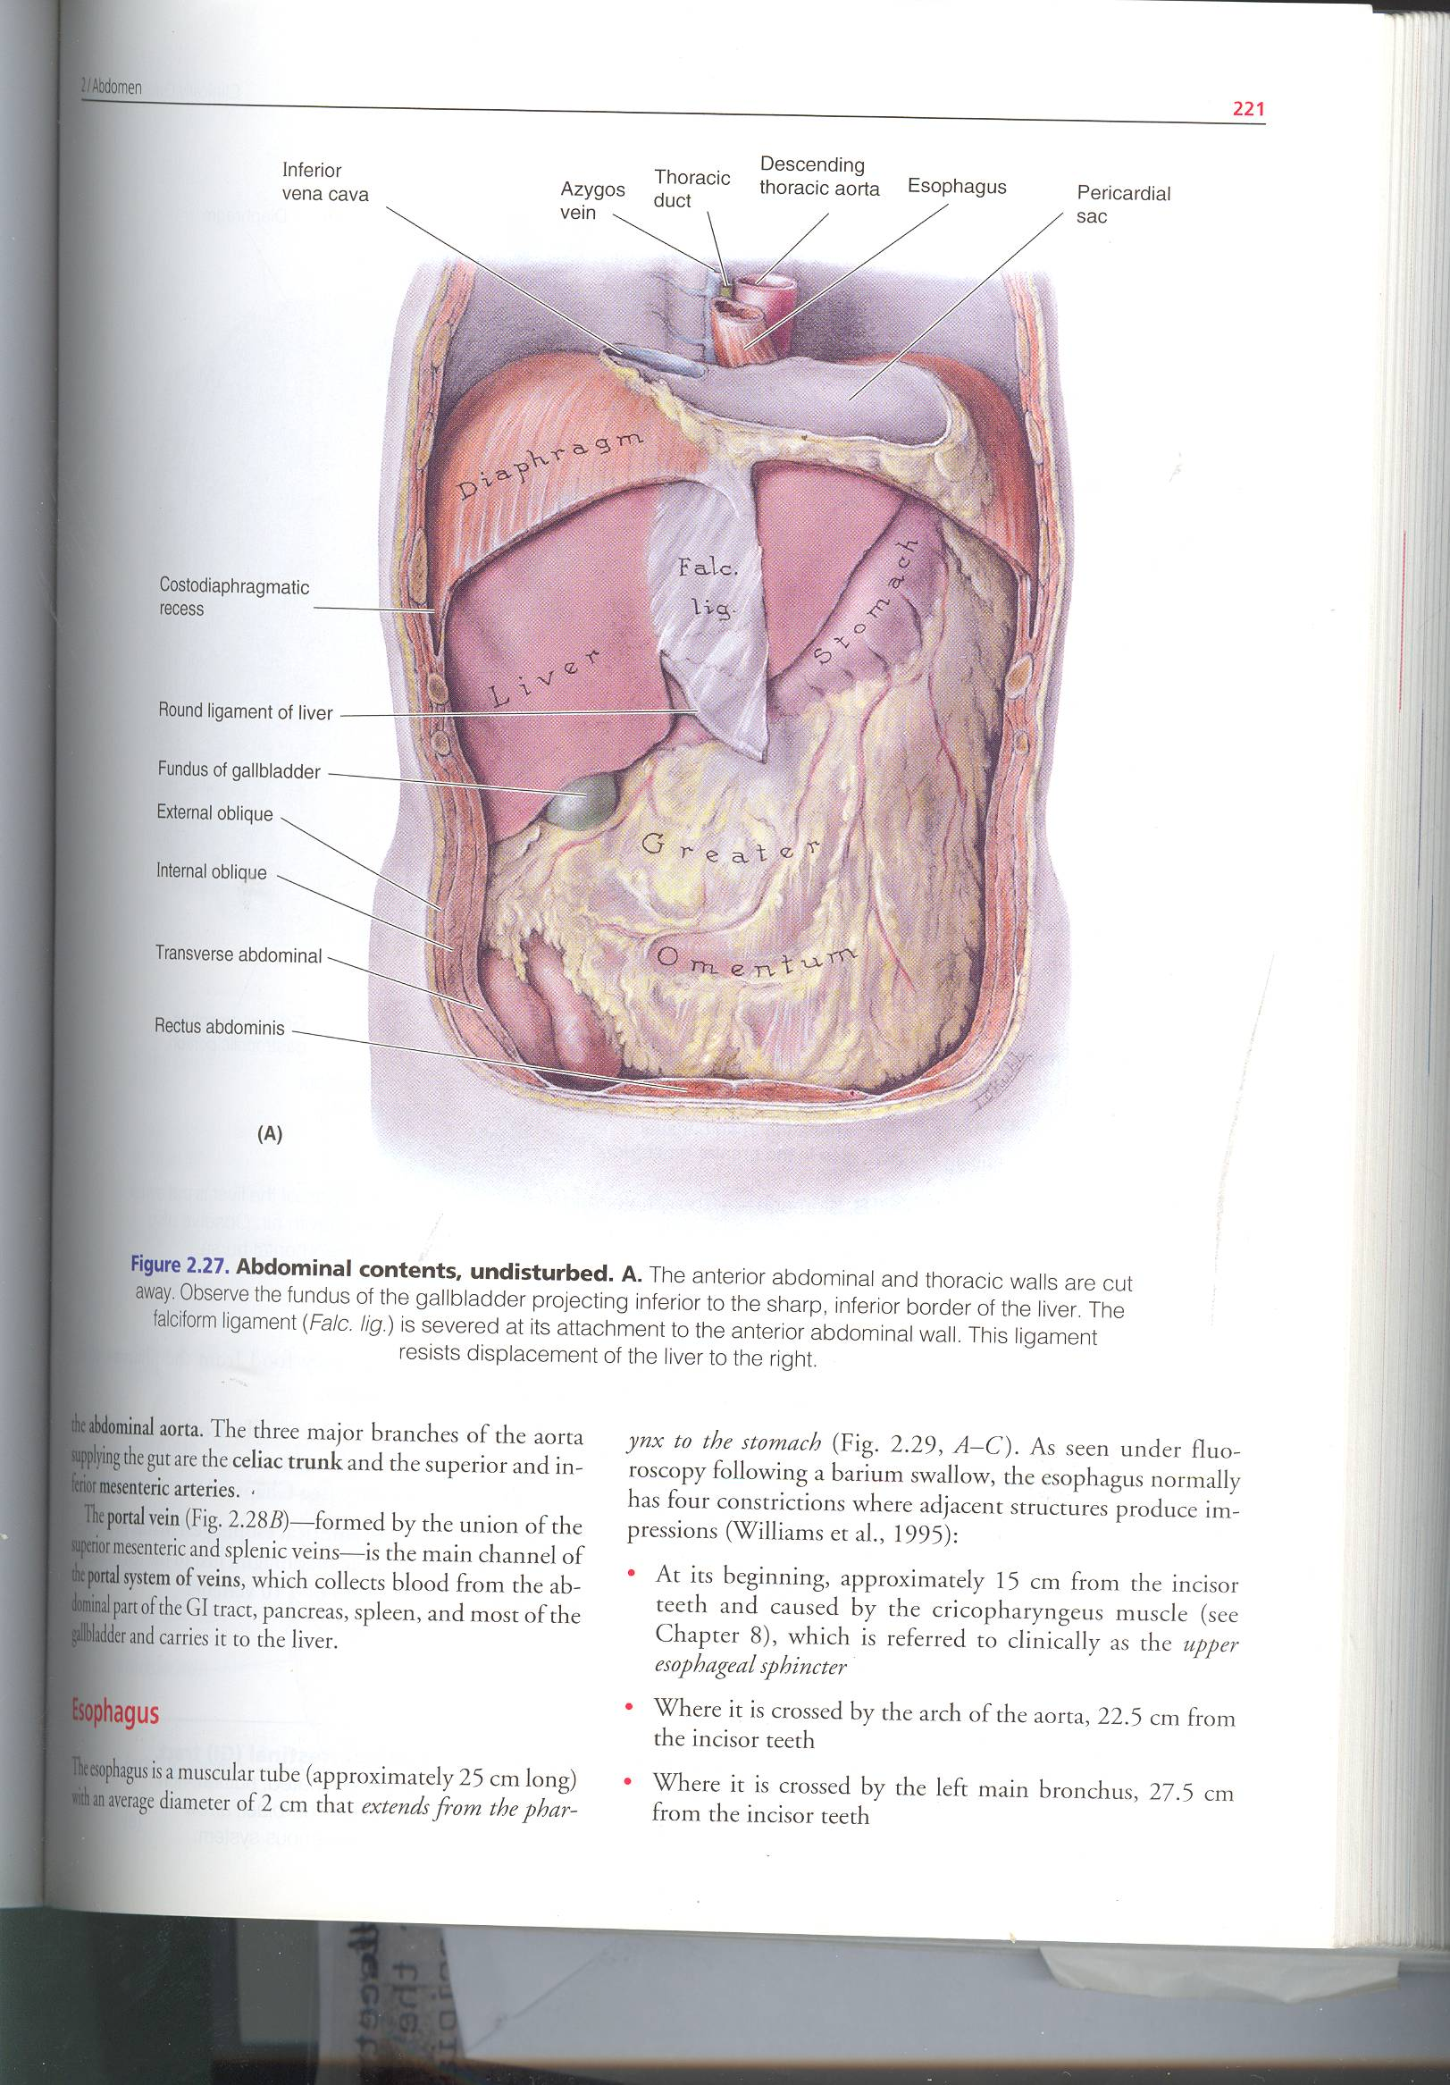
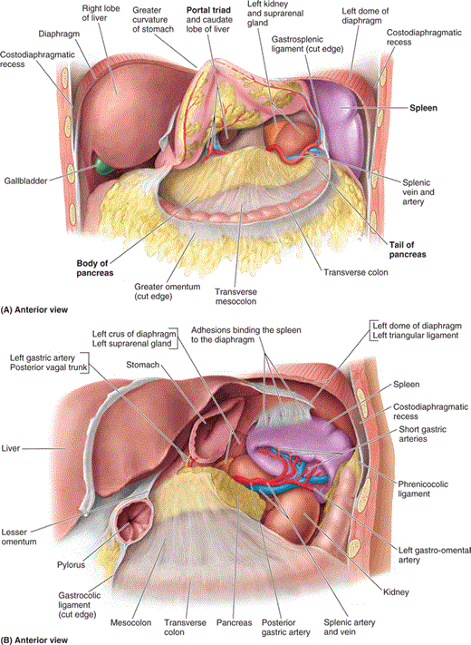
Case 2
Write 3 structures passing anteriorly and 3 structures passing posteriorly to the stomach.
Anteriorly:
Anterior abdominal wall.
Left pleura & lung.
Diaphragm.
Left lobe of the liver.
Left costal margin.
Posteriorly:
Lesser sac
Splenic artery
Pancreas
Transverse mesocolon.
Transverse colon.
Left crus of diaphragm.
Left suprarenal gland.
Part of left kidney
Spleen

Slide 7
Case 3
A 55-year- old woman develops a hiatal hernia in which the fundus of the stomach protrudes through the esophageal hiatus of the diaphragm into the thorax.
What is the level of the esophageal opening of the diaphragm?
Thoracic 10.
What structure is at great risk of injury during surgical repair in this case?
Vagus nerve.
More accurate to say: anterior gastric (left vagus) and posterior gastric (right vagus)
Enumerate 2 other structure that pass through the esophageal opening of the diaphragm?
Branches of left gastric vessels.
lymph vessels.
Notes:
Lecture: stomach/esophagus

Slide 8
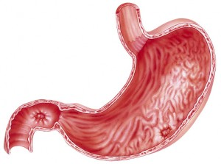
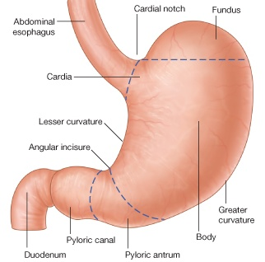
Case 4
A heavy smoker 50-year old man has an upper abdominal pain and heartburn that on and off for several months. 2 weeks ago he vomited dark blood. Gastroscopy examination revealed peptic ulcer.
Identify
Cardiac orifice.
Pylorus.
Fundus.
List 4 arteries supplying the stomach.
Left gastric.
Right gastric.
Left gastroepiploic.
Right gastroepiploic.
Short gastric
C
A
B

Slide 9
This slide was added by Dr. Jameela
Enumerate the structures posterior to the head of pancreas.
  Bile duct and portal vein
What are the arteries supplying the transverse colon & their origin.
  Superior mesenteric artery (from midgut) and inferior mesenteric artery (from hind gut)
What are the sites of the esophageal constrictions?
  The first (pharyngo-esophageal) is at the junction with the pharynx.
  The second (aortobronchial) is at the crossing with the aortic arch and the left main bronchus.
  The third (diaphragmatic) is at the junction with the stomach.
Describe the relations of the spleen.
  Anteriorly: Stomach, tail of pancreas, left colic flexure & left kidney
  Posteriorly: Diaphragm, that separates it from the left pleura (left costo-diaphragmatic recess), left lung & 9, 10 & 11 ribs.
  Inferiorly: left colic flexure
  Medially: left kidney
Level | Surface Anatomy
5th Intercostal Space | Stomach fundus
Tip of 9th costal cartilage | Gallbladder Fundus comes in contact with anterior abdominal wall
T10 | (7th Costal Cartilage) - Cardiac orifice
T12 | Pancreas (tail)
L1 | Transpyloric plane – Stomach pylorus - Pancreas (head, neck, body) Duodenum 1st part (superior)
L1 → L3 | Duodenum 2nd part (descending)
L3 | Subcostal plane - Duodenum 3rd part (horizontal)
L3 → L2 | Duodenum 4th part (ascending)

Slide 10
Case 5
A 57-year-old male brought to the ER where he diagnosed with perforated duodenal ulcer in the posterior wall of the first part of the duodenum.
Which artery lies behind the ulcer in his case?
Gastroduodenal artery
Enumerate 3 different organs supplied by this artery.
Stomach (pylorus)
Duodenum
Head of pancreas
Identify:
Accessory pancreatic duct
Minor duodenal papilla
Major duodenal papilla
Hepatopancreatic ampulla
Main pancreatic duct
Bile duct
6

Slide 11
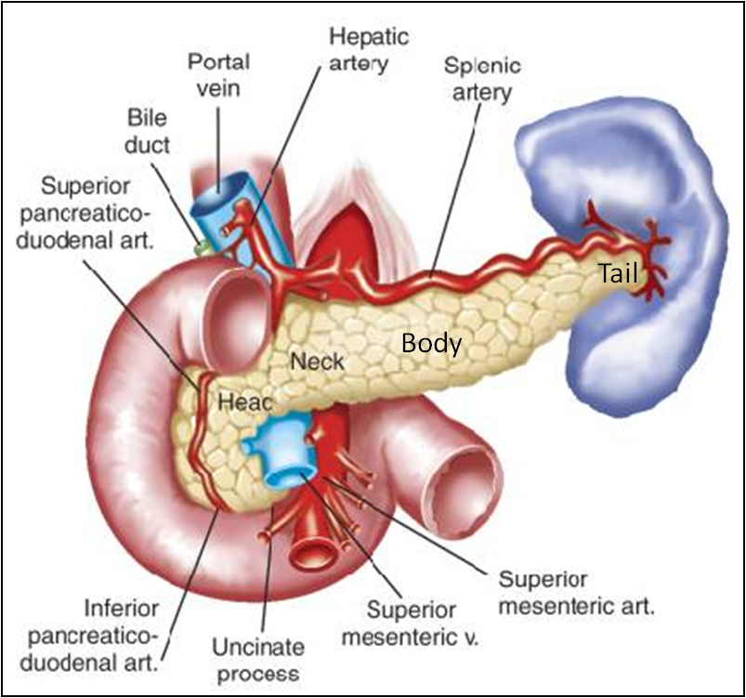
Case 6
A 48-year-old man has lost 10 kilos over the last 3 months and presented with upper abdominal pain that radiates to the back between the scapulae. During examination the doctor noticed jaundice. CT scan reveals tumor of the head of the pancreas.
List the arterial supply of the pancreas.
Superior pancreaticoduodenal artery
Inferior pancreaticoduodenal artery
Splenic artery
Where does the main pancreatic duct open?
Major duodenal papilla in the 2nd part of the duodenum
From where do the arteries supplying the pancreas originate?
Superior pancreaticoduodenal artery originates from gastroduodenal branch of hepatic artery of celiac
Inferior pancreaticoduodenal artery from superior mesenteric artery
What is the cause of jaundice in this case?
  Posthepatic: the tumor will obstruct the bile duct and block the flow of bile from the gallbladder to the small intestine (duodenum)
Notes:
Lecture: pancreas

Slide 12
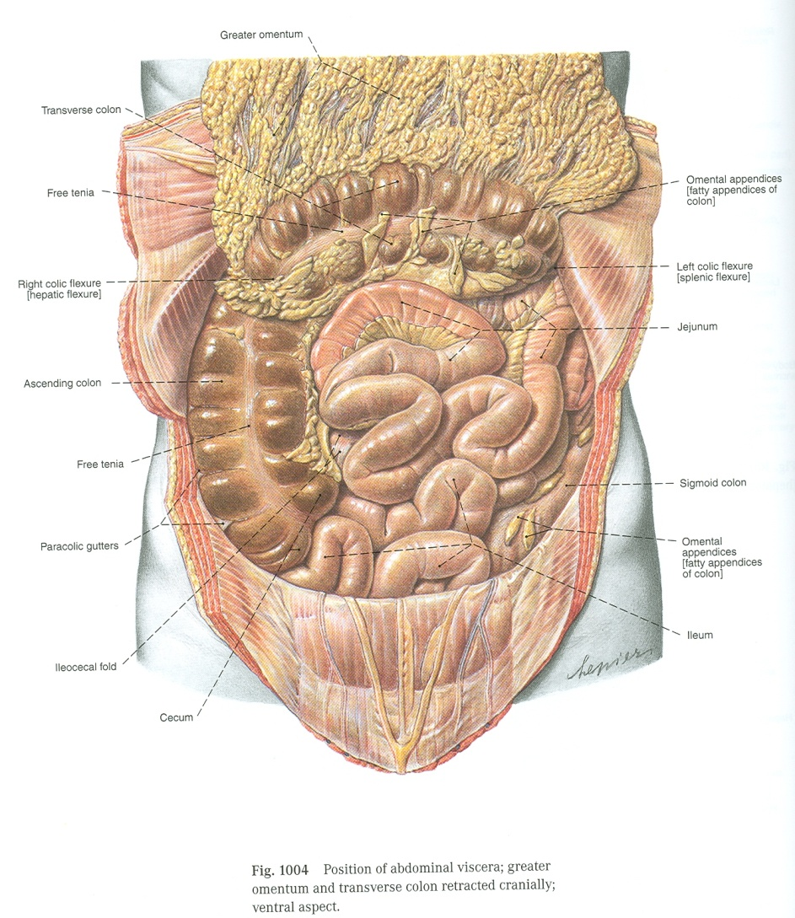
Case 7
Write 3 differences between jejunum and ileum.
 | Jejunum | Ileum
Length | Shorter (proximal 2/5) of SI | Longer (distal 3/5) of SI
Diameter | Wider | Narrower
Wall | Thicker (more plicae circulares) | Thinner (less plicae circulares)
Appearance | Dark red (more vascular) | Light red (less vascular)
Vessels | High & Less arcades (long terminal branches) | Low & More arcades (short terminal branches
Mesenteric Fat | Small amount & away from intestinal border | Large amount & close to intestinal border
Lymphoid Tissue | Few aggregations | Numerous aggregations (Peyer’s patches)

Slide 13
Case 8
3
5
1
4
1
6
7
3
5
2
2
7
6
Identify:
Stomach
Spleen
Opening into lesser sac (epiploic foramen)
Bile duct
Hepatic artery
Portal vein
Liver
Identify
Stomach
Descending colon
Gallbladder
Root of mesentery
Ascending colon
Sigmoid colon
Teniae coli

Slide 14
Case 9
A 52 year old man has been feeling unwell, he always feels tired. The doctor noticed that he is jaundiced. Abdominal examination showed splenomegaly, ascites, caput medusa, and increased abdominal girth. Investigations revealed chronic liver cell failure.
In which abdominal regions lies the liver?
Right and left hypochondrium and epigastrium
Enumerate the contents of porta hepatis in order (from anterior to posterior).
From anterior to posterior
2 hepatic ducts
2 hepatic arteries
2 branches of portal vein
Autonomic nerve fibers
Hepatic lymph nodes
From where does the liver receive its blood supply?
Hepatic artery (30%) and portal vein (70%)
Where do the hepatic veins terminate?
In the inferior vena cava.

Slide 15
Case 10
During cholecystectomy a resident damaged the cystic artery before the clamp was properly placed. The assistant surgeon applied pressure on top of the free margin of the lesser omentum to stop the bleeding.
Which artery runs in the free margin of the lesser omentum?
Hepatic artery
From which artery the cystic artery usually arises?
Right hepatic artery
What are the other structures that runs in the free margin of the lesser omentum?
Common bile duct
Portal vein
Hepatic plexus of nerves
Lymphatics
Enumerate 2 other structures that run in the lesser omentum along the lesser curvature of the stomach.
Right gastric vessels
Left gastric vessels

Slide 16
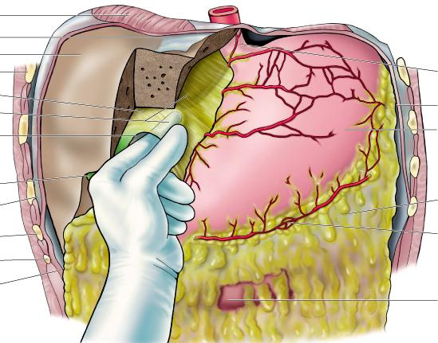
Case 11
A 52-year-old woman undergoes an open abdominal cholecystectomy. During surgery her doctor inserts his index finger into the epiploic foramen.
Enumerate the 4 boundaries of the epiploic foramen?
Superior: peritoneum caudate process of caudate lobe of liver.
Inferior: peritoneum covering 1st part of duodenum and hepatic artery
Anterior: free margin of lesser omentum, hepatic artery, common bile duct & portal vein.
Posterior: Peritoneum covering the inferior vena cava.
Notes:
Lecture: omentum

Slide 17
Case 12
Identify:
Transverse colon.
Left colic (splenic) flexure.
Teniae coli.
Sigmoid or pelvic colon.
Appendix.
Ascending colon.
Right colic (hepatic) flexure.
Epiploic Appendices .
What is the level of the beginning of the rectum?
S3 (in front of 3rd sacral vertebra).
Where does the rectum terminate?
One inch below & in front of tip of coccyx.
1
2
7
6
3
8
4
Notes:
Parts with mesentry

Slide 18
Case 13
A 12 year old boy is brought to the ER with a fever, nausea, and abdominal pain. Investigation revealed leucocytosis. The case is diagnosed as acute appendicitis.
Identify the position of the appendix according to the numbers :
Retrocecal
Subcecal
Pelvic
Postileal
Preileal
What is the most common site?
Retrocecal
What artery will need to be ligated during appendectomy operation?
Appendicular artery
From where does this artery arise?
Ileocolic branch of superior mesenteric artery
Teniae coli
Epiploic Appendices
Terminal ileum
Describe the surface anatomy of the appendix.
  The base of appendix is marked by McBurney’s point: A point at the junction of lateral 1/3 & medial 2/3 of a line traced from right anterior superior iliac spine to umbilicus.
Notes:
Lecture: large intestine

Slide 19
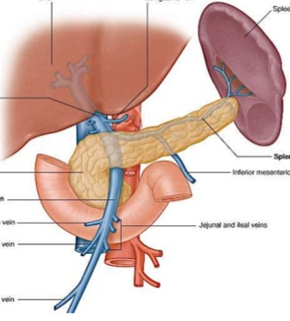
Case 14
A 46-year-old male brought to ER with hematemesis. Investigation revealed liver cirrhosis and portal hypertension.
How the portal vein is formed?
Union of superior mesenteric and splenic veins
What structure lies in front of the beginning of the portal vein?
Neck of the pancreas.
What structure lies behind the beginning of the portal vein?
Inferior vena cava.
What is the cause of bleeding in this case?
Esophageal varices.
List 2 other site of portosystemic anastomosis.
1) Upper part of anal canal.
2) Paraumbilical region.
Portal vein
Splenic vein
Superior mesenteric vein
Full list:
3) Esophagus
4) intrahepatic
5) retroperitoneal
Notes:
Lecture: liver

Slide 20
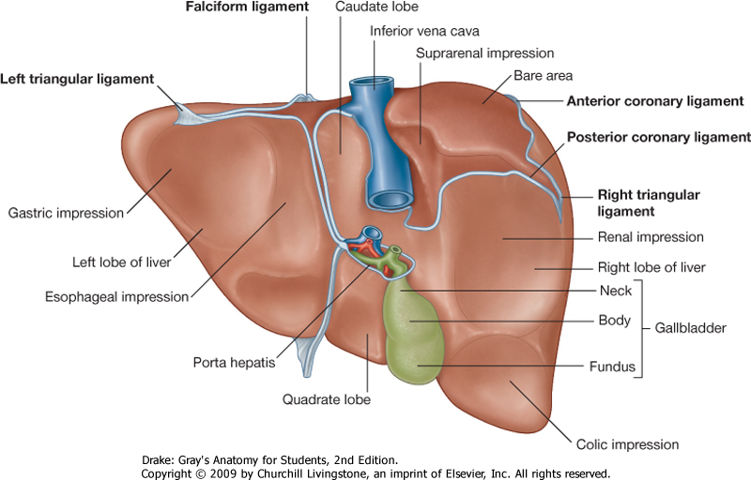
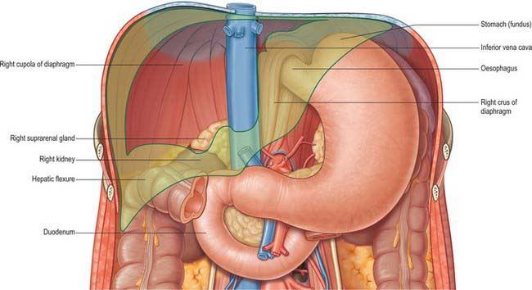
Case 15
Identify the structures related to the marked impressions :
stomach and duodenum
esophagus
gallbladder
right colic flexure
right kidney and right suprarenal gland
lesser omentum
bare area
7
1
2
5
6
3
4
Notes:
Lecture: liver

Slide 22





Done by:
Jawaher Abanumy
Nada Aldakheel
Mohammed Ghandour
Mohammed Alyousef
Khalid Aleedan
Practice Test
Extra Pictures For Practice
Feedback
Editing File
References:
1- Team 435
2- Greys Anatomy for Students
anatomyteam436@gmail.com
@anatomy436

