Slide 1
OSPE FILE (HAEMATOLOGY)

Slide 2
Notes:
Each single word in this file is important especially the findings You have to write them all even the normal!
You have to write the word DISEASE in the cases of sickle cells anemia to differentiate it from sickle cell trait
There are some RED Color in the file this indicate that don’t ignore these informations and you have to write it in the Exam

Slide 3
Hemoglobin | Normal Values
Hb A | 96.8 – 97.8
Hb F | < 2.0
Hb A2 | α-thal < 1.5 – 3.5 < β-thal
Any other Hb = ABNORMAL

Slide 4
What is the name of test performed?
Hemoglobin electrophoresis
What are the findings?
Hb A: normal
Hb F: normal
Hb A2: normal
What is the most likely diagnosis?
Normal electrophoresis
What further investigations will you order?
NONE

Slide 5
What is the name of test performed?
Hemoglobin electrophoresis
What are the findings?
Hb A: absent
Hb F: very high
Hb A2: normal
What is the most likely diagnosis?
High persistent HB F disease OR Normal fetus
What further investigations will you order?
Blood smear
Genetic study
Family study

Slide 6
What is the name of test performed?
Hemoglobin electrophoresis
What are the findings?
Hb A: absent
Hb F: high
Hb A2: high
Abnormal Hb: Hb S high → sickle cell disease
What is the most likely diagnosis?
Sickle cell anemia disease with beta thalassemia
What further investigations will you order?
Solubility test
Blood smear
Genetic study
Family study

Slide 7
What is the name of test performed?
Hemoglobin electrophoresis
What are the findings?
Hb A: very low
Hb F: high
Hb A2: high
Abnormal Hb: Hb S high → sickle cell disease
What is the most likely diagnosis?
Sickle cell anemia disease with beta thalassemia
(with Hb A from blood transfusions)
What further investigations will you order?
Solubility test
Blood smear
Genetic study
Family study

Slide 8
What is the name of test performed?
Hemoglobin electrophoresis
What are the findings?
Hb A: very low
Hb F: high
Hb A2: high
Abnormal Hb: Hb S high → sickle cell disease
What is the most likely diagnosis?
Sickle cell anemia disease with beta thalassemia
(with Hb A from blood transfusions)
What further investigations will you order?
Solubility test
Blood smear
Genetic study
Family study

Slide 9
What is the name of test performed?
Hemoglobin electrophoresis
What are the findings?
Hb A: absent
Hb F: high
Hb A2: normal
Abnormal Hb: Hb S high → sickle cell disease
What is the most likely diagnosis?
Sickle cell anemia disease
What further investigations will you order?
Solubility test
Blood smear
Genetic study
Family study

Slide 10
What is the name of test performed?
Hemoglobin electrophoresis
What are the findings?
Hb A: absent
Hb F: high
Hb A2: low
Abnormal Hb: Hb S high → sickle cell disease
What is the most likely diagnosis?
Sickle cell anemia disease with alpha thalassemia
with high Hb F
What further investigations will you order?
Solubility test
Blood smear
Genetic study
Family study

Slide 11
What is the name of test performed?
Hemoglobin electrophoresis
What are the findings?
Hb A: normal
Hb F: absent
Hb A2: normal
What is the most likely diagnosis?
Normal electrophoresis (even with HbF absence)
What further investigations will you order?
NONE

Slide 12
What is the name of test performed?
Hemoglobin electrophoresis
What are the findings?
Hb A: absent
Hb F: high
Hb A2: normal
Abnormal Hb: Hb S high → sickle cell disease
What is the most likely diagnosis?
Sickle cell anemia disease, with high Hb F
What further investigations will you order?
Solubility test
Blood smear
Genetic study
Family study

Slide 13
What is the name of test performed?
Blood smear/film
What are the findings?
Sickled cells
Target cells
Basophil
Lymphocyte
What is the most likely diagnosis?
Sickle cell anemia disease
What further investigations will you order?
Solubility test
Hemoglobin electrophoresis
Genetic study
Family study

Slide 14
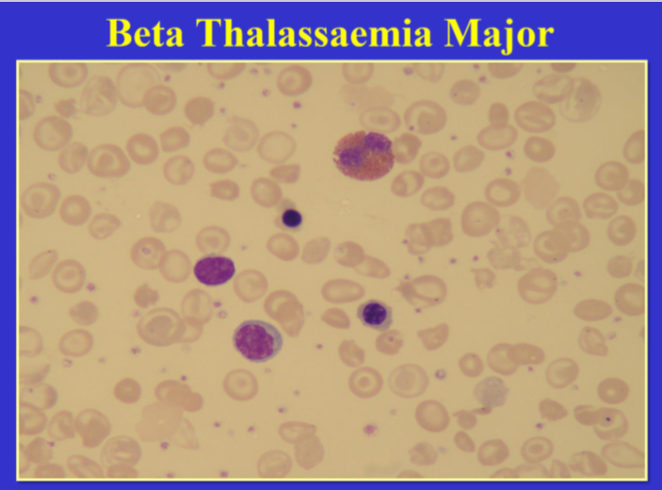
What is the name of test performed?
Blood smear/film
What are the findings?
Nucleated RBCs
Hypochromsia
Microcytosis
Esinophils - lymphocytes
Anisocytosis (variation in size)
Poikilocytosis (variation in shape).
Target cells
What is the most likely diagnosis?
Beta thalassemia major
What further investigations will you order?
Iron profile
Hemoglobin electrophoresis
Genetic study
Family study

Slide 15
What is the name of test performed?
Blood smear/film
What are the findings?
Hypochromsia
Microcytosis
Monocytes
Anisocytosis (variation in size)
Poikilocytosis (variation in shape).
Target cells
What is the most likely diagnosis?
Alpha thalassemia
What further investigations will you order?
Iron profile
Hemoglobin electrophoresis
Genetic study
Family study

Slide 16
What is the name of test performed?
Peripheral blood smear/film with supravital stain
What are the findings?
RBCs with dark granules (golf ball appearance)
What is the most likely diagnosis?
Hemoglobin H (alpha thalassemia with 3 gene deletions)
What further investigations will you order?
Iron profile
Hemoglobin electrophoresis
Genetic study
Family study
golf ball appearance

Slide 17
What is the name of test performed?
Peripheral blood smear/film
What are the findings?
Target cells
Rhomboidal / crystal RBC
What is the most likely diagnosis?
Hemoglobin C disease
What further investigations will you order?
Hemoglobin electrophoresis
Genetic study
Family study

Slide 18
Finished ? Examine your self : HERE
Good Luck!
Done by: Jawaher Abanumy
Revised by:
Abdulaziz Al-Hussainy
Safa Al-Osaimi

