Slide 1
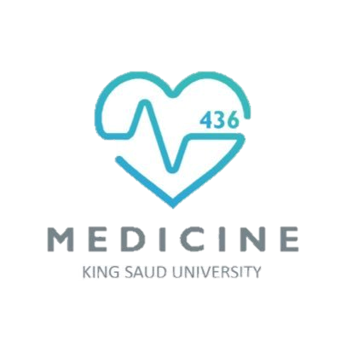
Oral Cavity, Esophagus And Stomach
Color Code
Important
Doctors Notes
Notes/Extra explanation
Please view our Editing File before studying this lecture to check for any changes.

Slide 2
Objectives
By the end of the lecture you should be able to:
Describe the anatomy the oral cavity, (boundaries, parts, nerve supply).
Describe the anatomy of the palate, (parts, muscles, nerve & blood supply).
Describe the anatomy of the tongue, (structure, muscles, motor and sensory nerve supply, blood supply , lymph drainage).
Describe the anatomical view of the esophagus; extent, length, parts, strictures, relations, blood & nerve supply and lymphatic.
Describe the anatomical view of the stomach; location, shape, parts, relations, blood & nerve supply and lymphatic

Slide 3
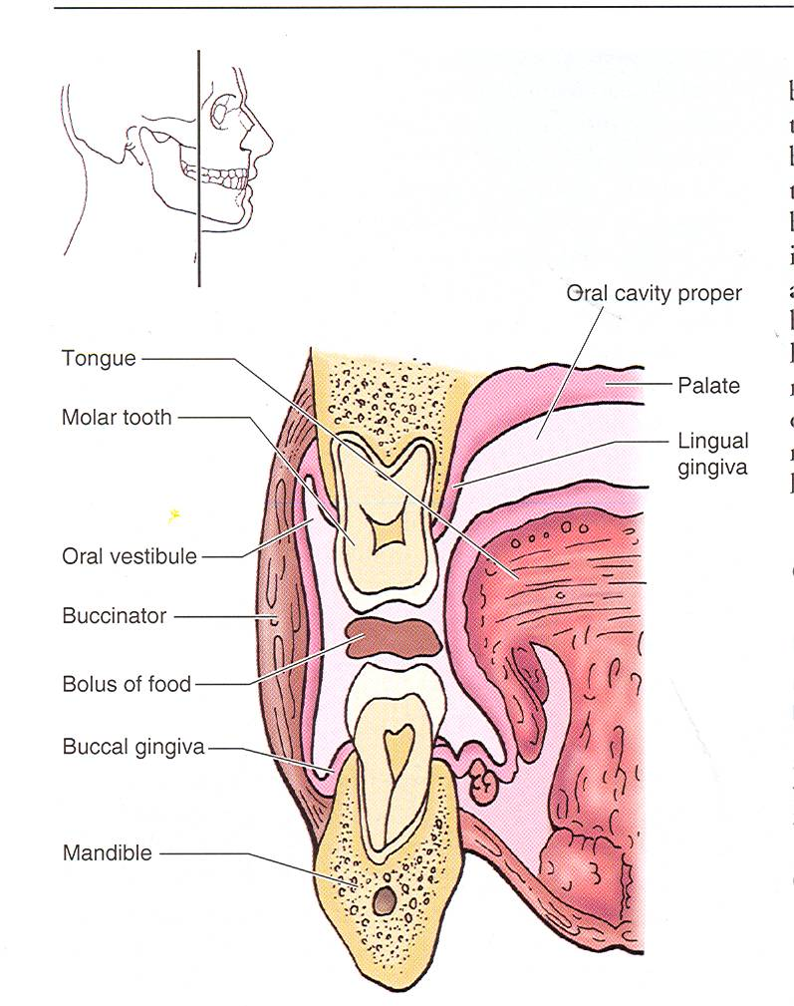
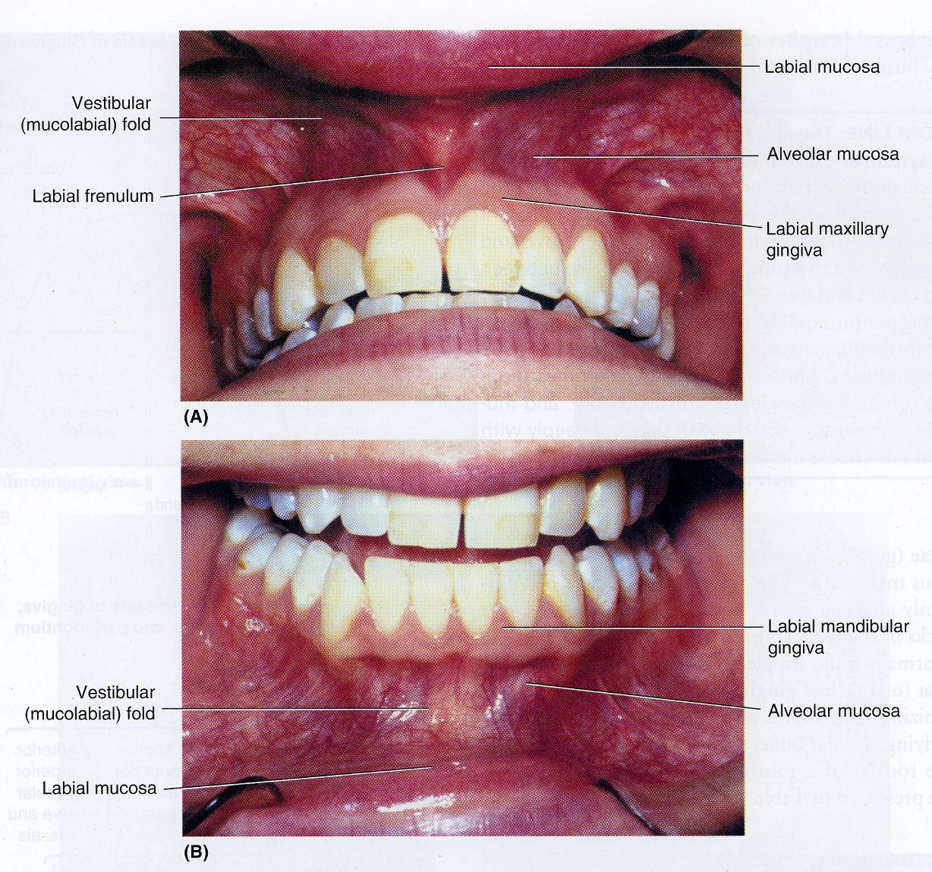
Oral Cavity
The mouth extends from lips anteriorly to the oropharyngeal isthmus posteriorly (the junction between mouth & the pharynx).
It is divided into : 1- Vestibule 2- Mouth cavity proper
Vestibule
Which lies between teeth & gums internally and lips & cheeks externally
The vestibule receives the opening of the parotid duct opposite the upper 2nd molar tooth
Mouth cavity proper
Lies within the alveolar arches, gums, and teeth
Roof: Formed by the hard & soft palate.
Floor: Formed by the anterior 2/3 of the tongue
It communicates with the vestibule behind the 3rd molar tooth, when you close your lips.
Mouth Proper

Slide 4
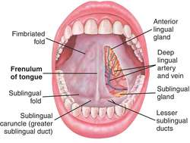
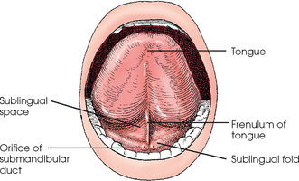
Oral Cavity
Under Surface Of The Tongue:
Frenulum lingulae in the midline. It connects the under surface of the tongue to the floor of the mouth.
Orifice of the Submandibular Duct* opens on each side of the frenulum.
Sublingual Fold (formed by the underlying sublingual salivary gland*).
Extra
Extra
*we will discuss the salivary glands in more detail in the next lecture.

Slide 5
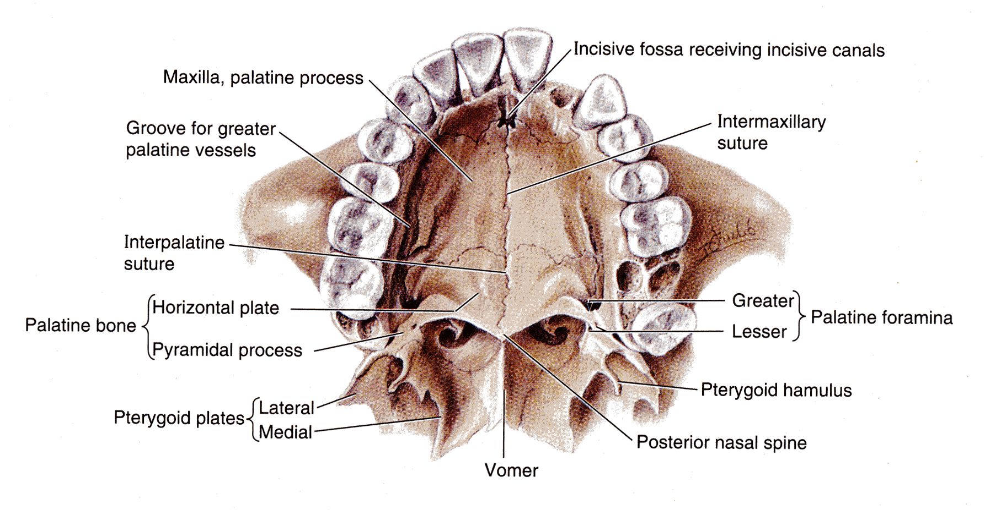
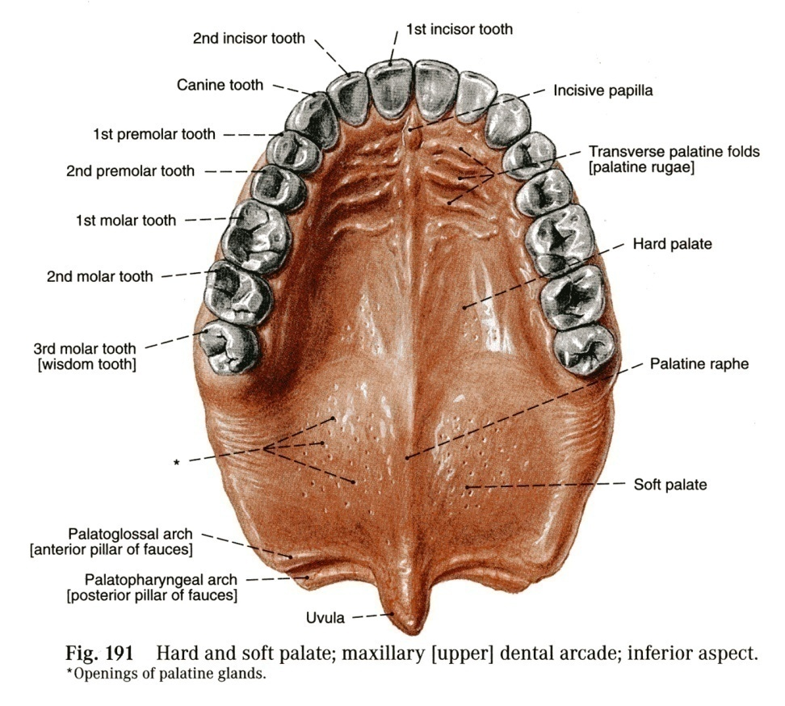
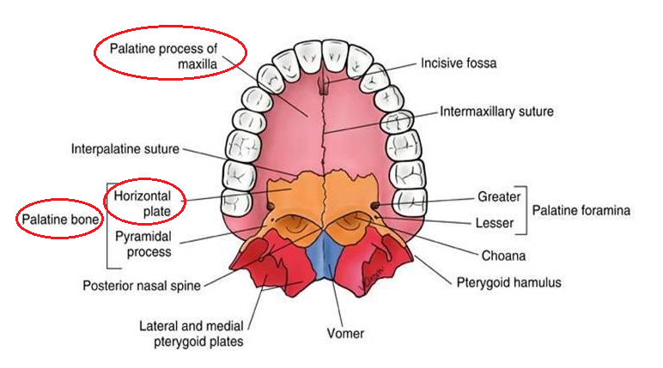
Oral Cavity
The Palate forms the roof of the mouth and it is divided into two parts:
The Hard (Bony) palate in front & The Soft palate behind.
The Hard Palate | The Soft Palate
The hard palate is formed by (4 bones): 2 Palatine processes of the maxillae 2 Horizontal plates of palatine bones posteriorly. It is Bounded Laterally by the alveolar arches of the maxilla. Behind it is continuous with the soft palate. The hard palate forms the floor of the nasal cavities. | It is a mobile fold formed of a bag of mucous membrane filled with striated muscles. It is attached to the posterior border of the hard palate. Its free posterior border is a conical projection called the uvula.
Extra
The tongue is composed of two parts 1) oral (palatine) part forms the anterior two thirds 2) pharyngeal part forms the posterior one third.

Slide 6
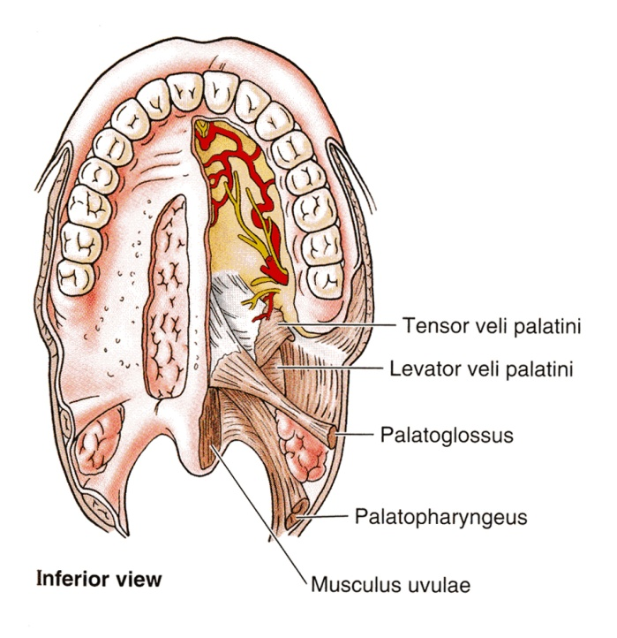
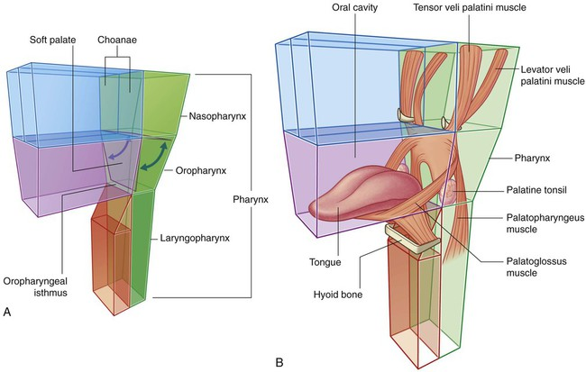
Oral Cavity
Soft Palate (Muscles)
Five pairs (one on each side) of muscles:
1. Tensor veli palatini*
Tenses the soft palate
2. Levator veli palatini*
Elevates the soft palate
3. Palatoglossus
Pulls palatoglossal fold toward midline
4. Palatopharyngeus
5. Musculus uvulae
Moves palatopharyngeal fold toward midline
Elevates uvula
*A shorter name:
Tensor palatine
Levator palatine
Extra diagram

Slide 7
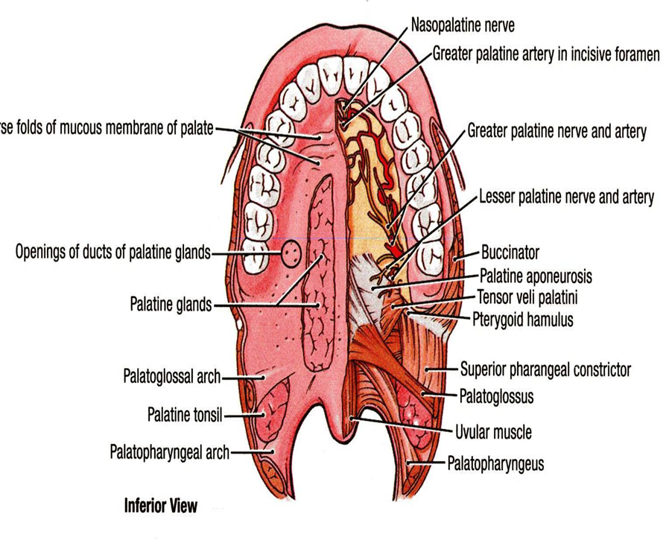
Oral Cavity
Soft Palate (Innervation)
Motor | Sensory
All muscles of the palate are supplied by pharyngeal plexus* of nerves EXCEPT tensor veli palatini (by mandibular nerve). | Maxillary nerve through: Greater palatine nerve Lesser palatine nerve Nasopalatine nerve
Motor innervation of soft palate can be tested by saying ‘Ah’, normally soft palate rises upward and the uvula moves backward in the middle line. | 2. Glossopharyngeal nerve.
*pharyngeal plexus: made up from cranial nerves 9, 10, cranial part of 11, and superior cervical sympathetic ganglion.
Motor part: from 10 and cranial part of 11
Sensory part: from 9
Sympathetic part: from superior cervical sympathetic ganglion

Slide 8
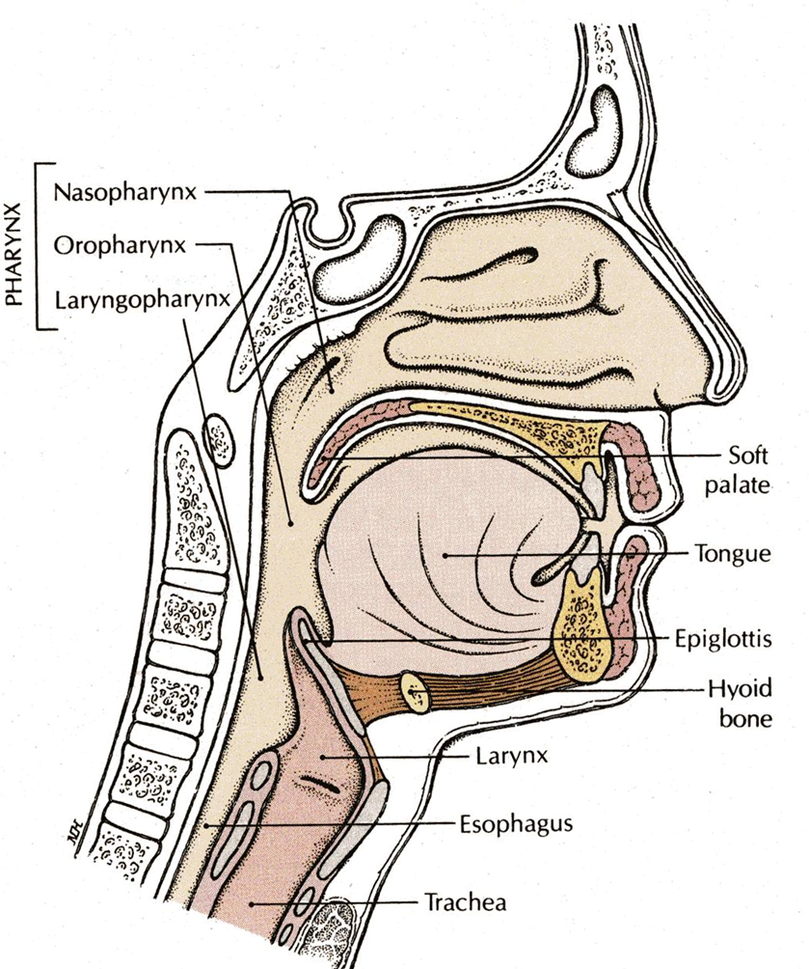
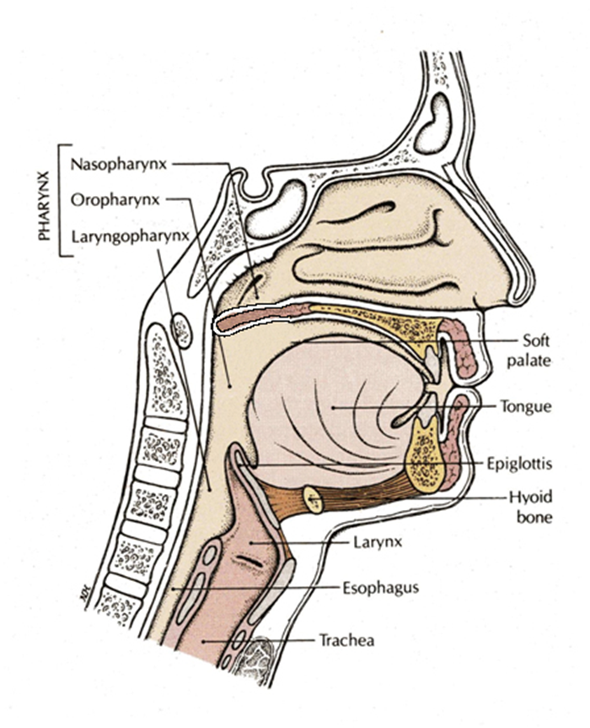
Oral Cavity
Soft Palate (Movement)
*Different form the oropharyngeal isthmus.
Pharyngeal isthmus*: (It is the communication between the nasal and oral parts of the pharynx).
Closure occurs during:
the production of explosive consonants in speech.
swallowing.
It is closed by raising the soft palate upward:
By this means the nasal part of the pharynx is closed off from its oral part.
1. Soft palate is raised by the contraction of the levator veli palatini and Palatopharyngeus.
2. At the same time, the posterior wall of the pharynx is pulled forward (by superior constrictor).
3. The palatopharyngeus muscles on both sides also contract so that the palatopharyngeal arches are pulled medially, like side curtains.

Slide 9
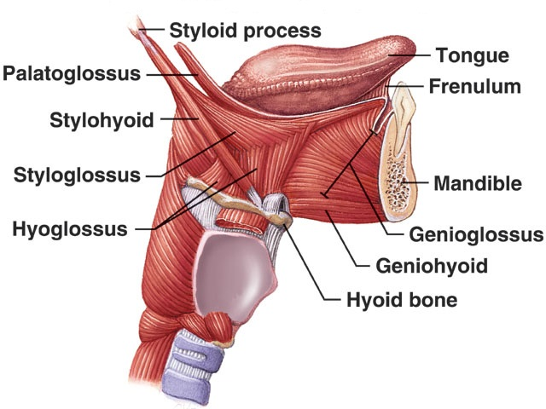
Oral Cavity
Tongue
The tongue is a mass of striated muscle covered with mucous membrane.
Its anterior 2/3 lies in the mouth (oral part).
Its posterior 1/3 lies in the pharynx (pharyngeal part).
It is attached by muscles:
Above to → styloid process & soft palate
Below to → mandible and hyoid bone
The tongue is essential for several Important Functions:
Normal articulation of the jaw,
Manipulation of food,
Swallowing,
Taste.
Production of normal Speech.
Extra

Slide 10
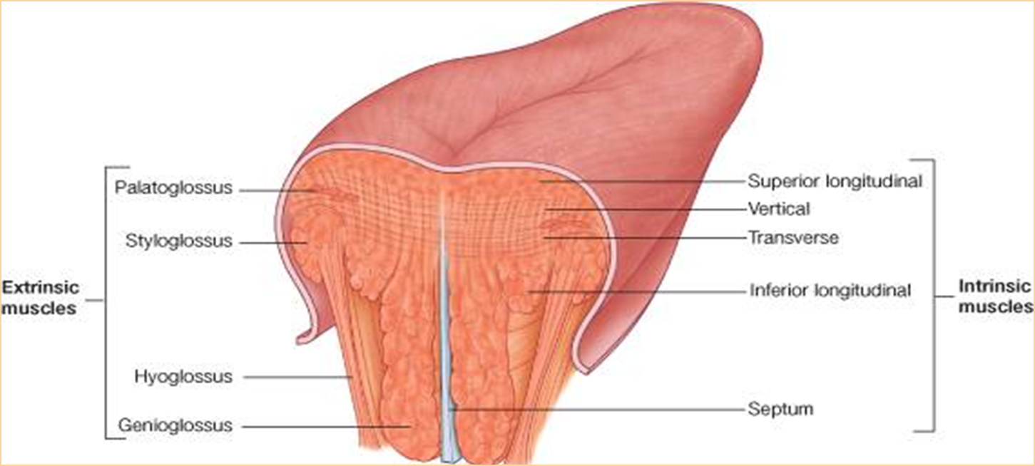
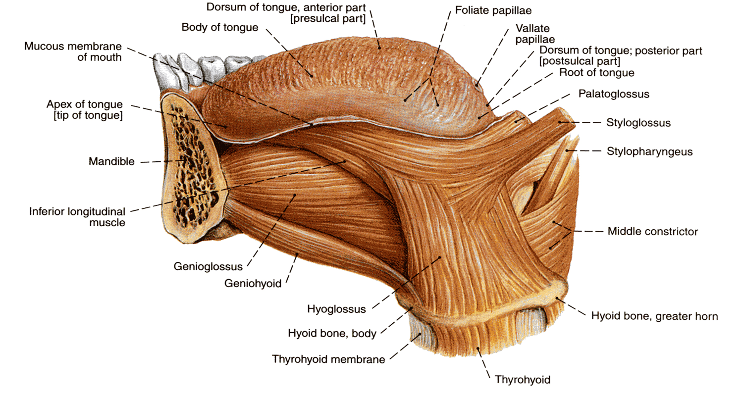
Oral Cavity
Tongue (Muscles)
Muscles of the tongue are divided into two types:
Intrinsic muscles | Extrinsic muscles
The intrinsic muscles are restricted to the tongue and are not attached to bone. | Attached to bones and the soft palate.
They consist of : Longitudinal fibers (superior & inferior) Transverse fibers Vertical fibers | There are 4 pairs: Palatoglossus (from the soft palate) Styloglossus (from the styloid process) Genioglossus (from the mandible) Hyoglossus (from the hyoid bone)
Action: Alter the shape of the tongue while it lies in the mouth cavity. | Action: protrude, retract, depress, and elevate the tongue.

Slide 11
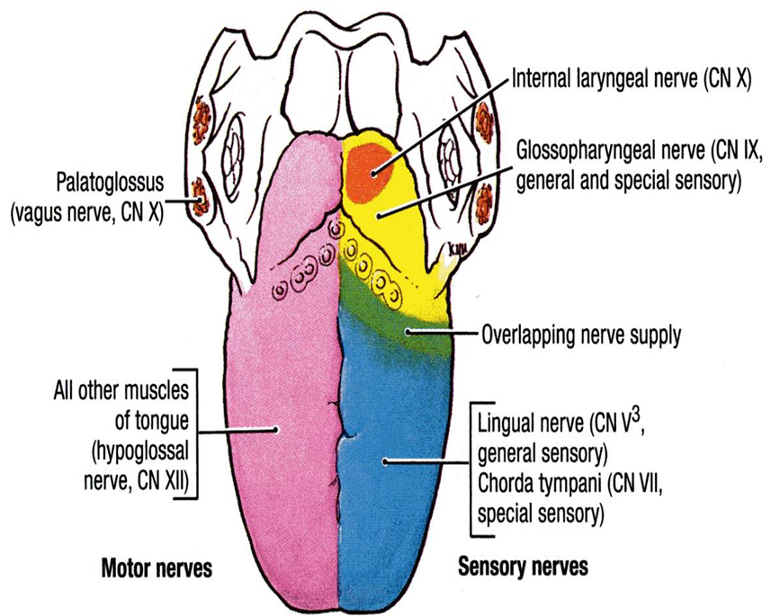
Oral Cavity
Tongue (Innervation)
Motor | Sensory
All muscles of the tongue are supplied by the Hypoglossal nerve. EXCEPT Palatoglossus which is supplied by the Pharyngeal plexus. | Anterior 2/3: General sensations: Lingual nerve (from trigeminal). Taste: through Chorda Tympani of the Facial nerve, EXCEPT the vallate papillae. Posterior 1/3: (including the vallate papillae): General & taste sensations: Glossopharyngeal nerve. Root of the tongue and Epiglottis: General & taste sensations are carried by the Vagus nerve.

Slide 12
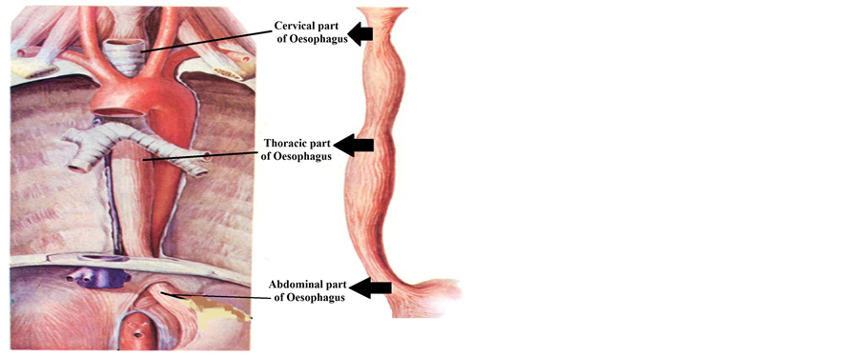
Esophagus
It is a tubular structure about 25 cm long.
It begins as the continuation of the pharynx at the level of the 6th cervical vertebra.
It pierces the diaphragm at the level of the 10th thoracic vertebra to join the stomach.
It terminates at the level of 11TH thoracic vertebra
It is formed of 3 parts:
Cervical
Thoracic
Abdominal

Slide 13
Esophagus
I. Cervical Part
Relations
Anterior | Trachea Recurrent laryngeal nerves
Laterally | Lobes of the thyroid gland.
Posterior | Vertebral column.

Slide 14
Esophagus
II. Thoracic Part
In the thorax, it passes downward and to the left through superior and then to posterior mediastinum
At the level of the sternal angle (T4), the aortic arch and left main bronchus push the esophagus again to the midline.
Relations:
Anterior | Posterior | Lateral
 |  | Right Side | Left Side
Trachea. Left recurrent laryngeal nerve. Left principal bronchus. Pericardium. Left atrium. | Bodies of the thoracic vertebrae. Thoracic duct. Azygos vein. Right posterior intercostal arteries. Descending thoracic aorta (at the lower end). | Right pleura. Terminal part of the azygos vein. | Left pleura. Left subclavian artery. Aortic arch. Thoracic duct.
remember that both recurrent laryngeal nerves are found in the cervical portion of the esophagus, while only the left recurrent laryngeal is found in the thoracic part of the esophagus

Slide 15
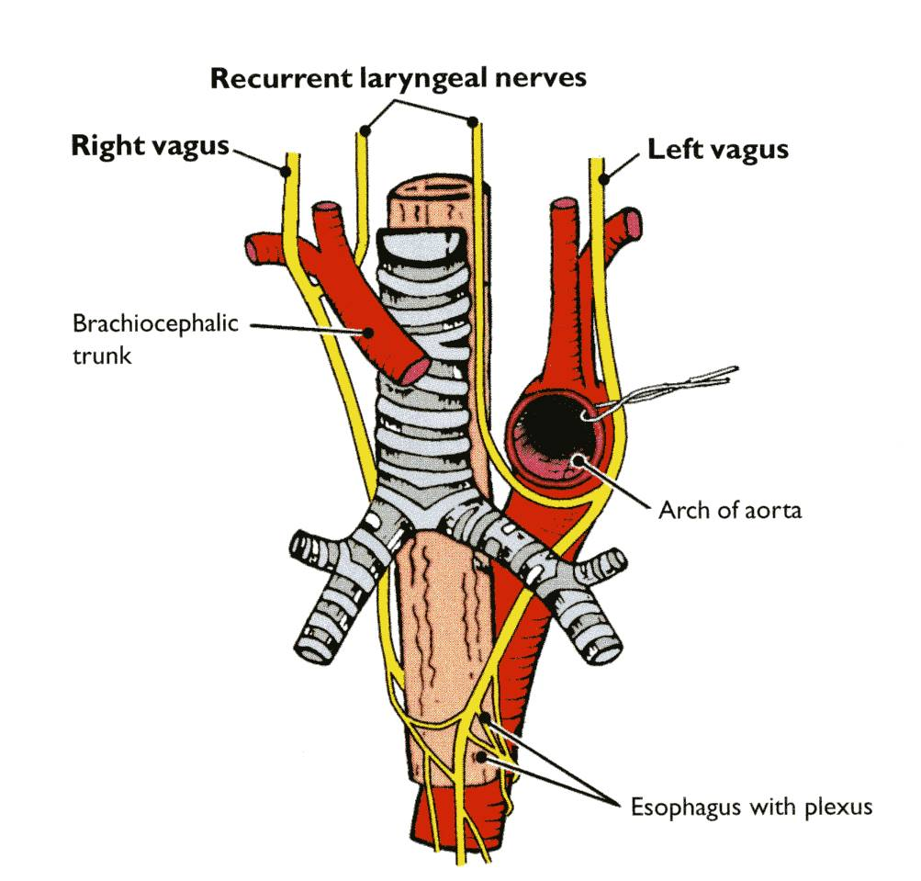
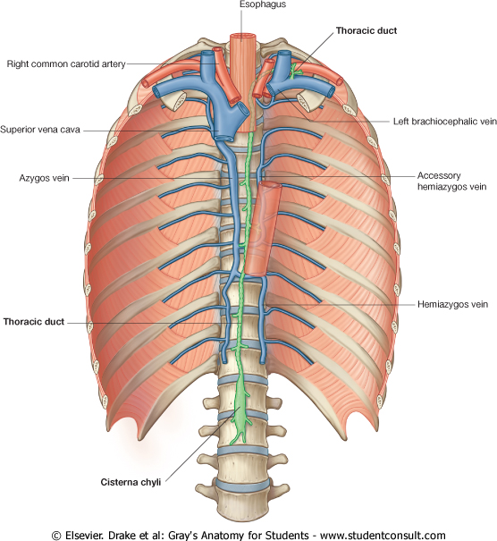
ANTERIOR
POSTERIOR
LATERAL

Slide 16
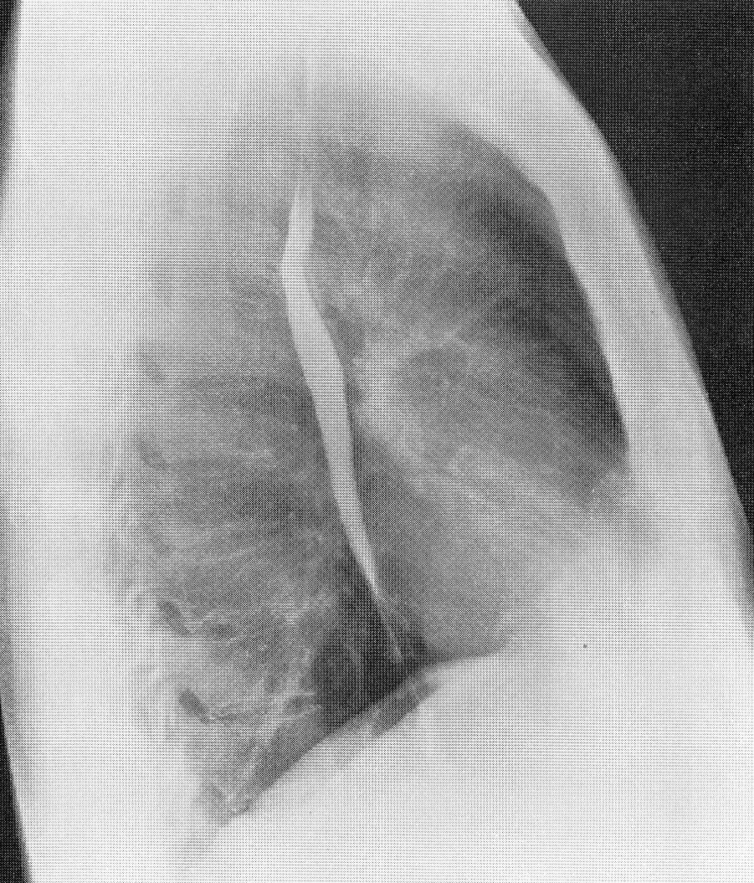
Esophagus
Left Atrium
There is a close relationship between the left atrium of the heart and the esophagus.
What is the clinical application?
A barium swallow will help the physician to assess the size of the left atrium, (Dilation) as in case of a heart failure, or long standing mitral stenosis.

Slide 17
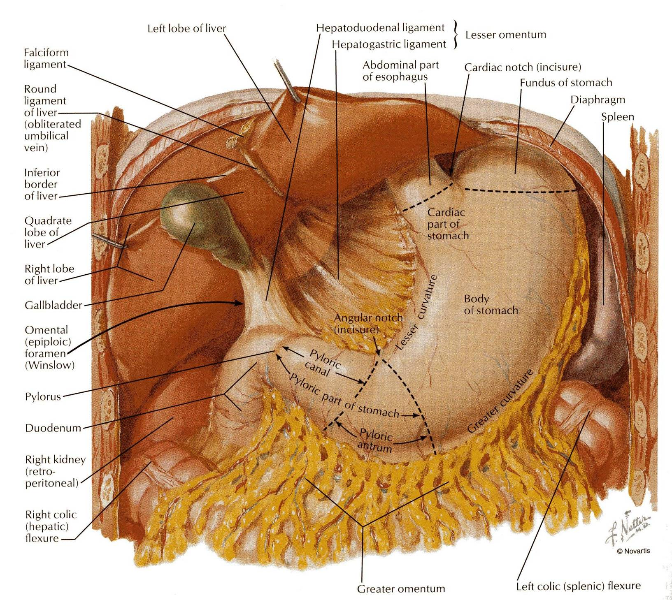
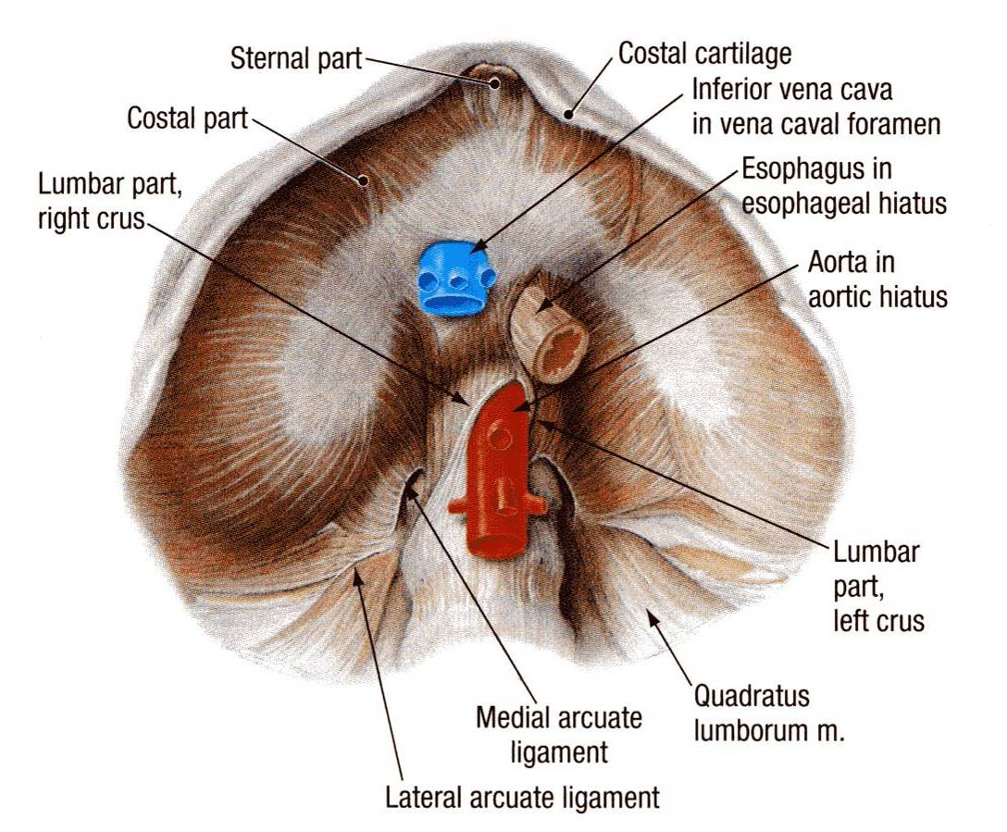
Esophagus
III. Abdominal Part
In the abdomen, the esophagus descends for 1.3 cm and joins the stomach.
Relations:
Anteriorly, it is related to the left lobe of the liver.
Posteriorly, it is related to the left crus of the diaphragm.
Fibers from the right crus of the diaphragm form a sling around the esophagus.
At the opening of the diaphragm, the esophagus is accompanied by:
The two vagi
Branches of the left gastric vessels
Lymphatic vessels.

Slide 18
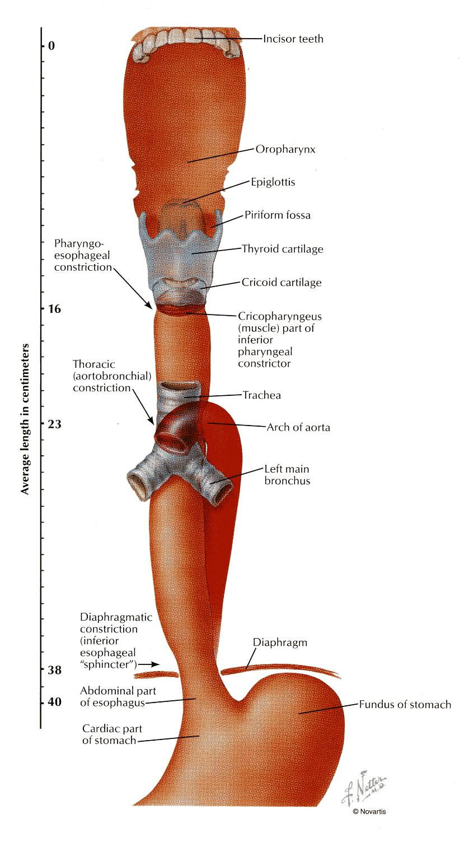
Esophagus
Constriction
The esophagus has 3 anatomic constrictions.
The first (pharyngo-esophageal) is at the junction with the pharynx.
The second (aortobronchial) is at the crossing with the aortic arch and the left main bronchus.
The third (diaphragmatic) is at the junction with the stomach.
They have a considerable clinical importance.
Why? explained on next slide

Slide 19
Esophagus
Strictures
They may cause difficulties in passing an esophagoscope.
In case of swallowing of caustic liquids (mostly in children), this is where the burning is the worst and strictures develop.
The esophageal strictures are a common place of the development of esophageal carcinoma.
In this picture what is the importance of the scale?
Ans: to know where and when you have resistance on passing esophagoscope.
Or 21

Slide 20
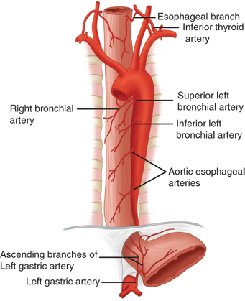
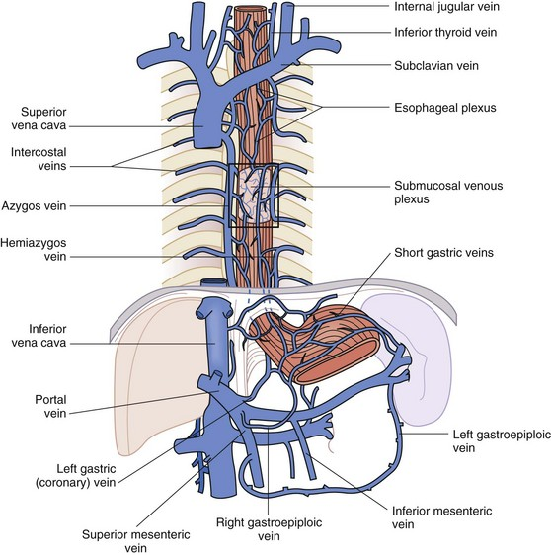
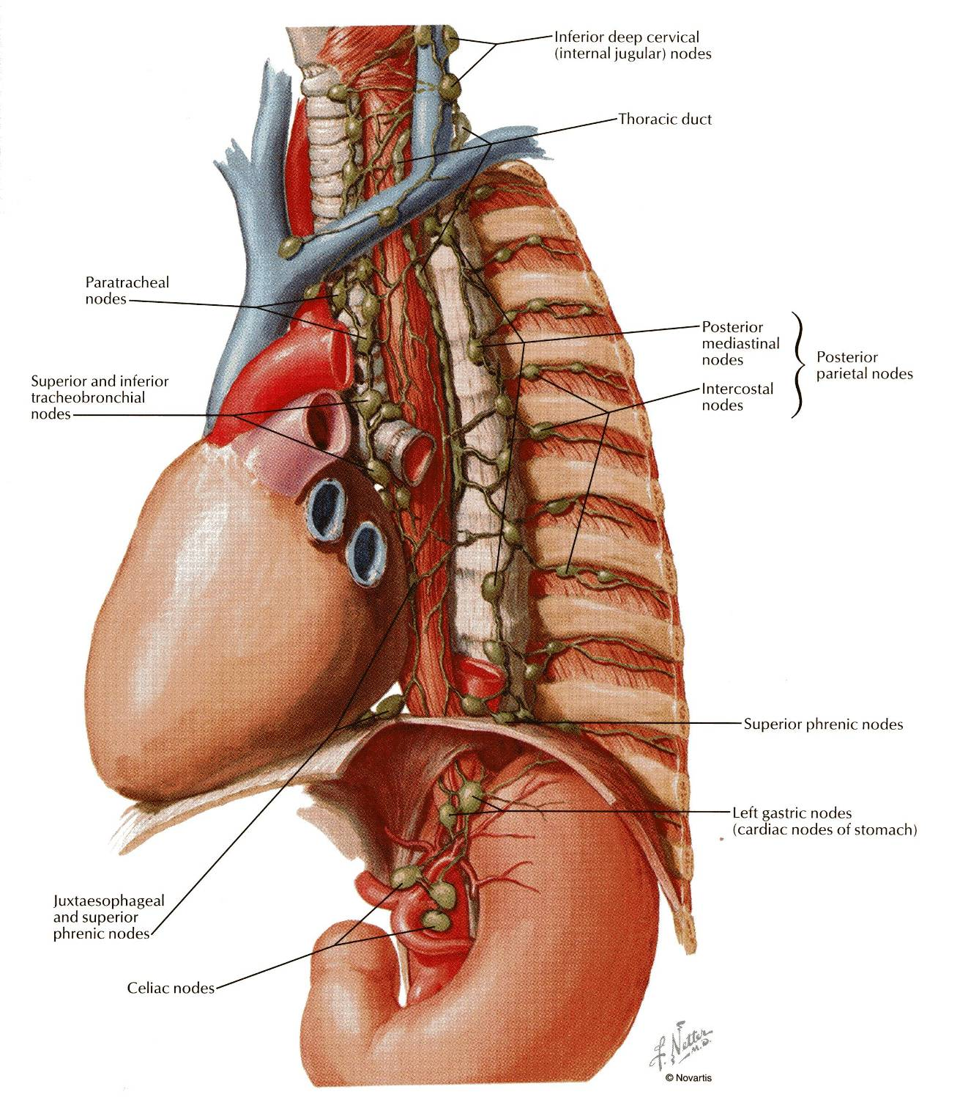
Esophagus
Supply
Part | Arterial supply | Venous Drainage | Lymphatic Drainage
Upper third | inferior thyroid artery | inferior thyroid veins | deep cervical nodes
Middle third | thoracic aorta | azygos veins | superior and inferior mediastinal nodes
Lower third | left gastric artery | left gastric vein (tributary of the portal vein) | celiac lymph nodes (in the abdomen)

Slide 21
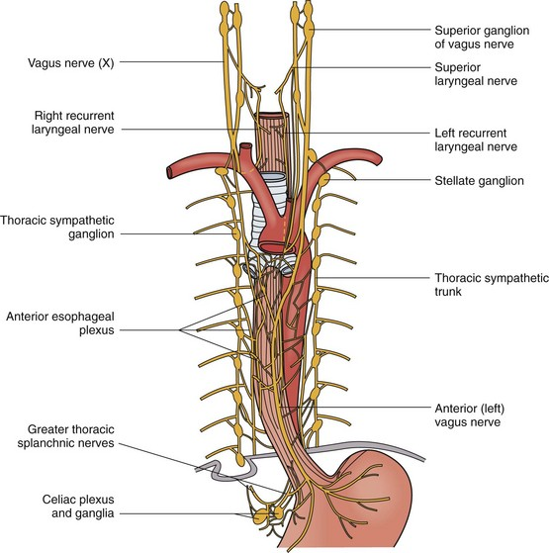
Esophagus
Supply
Sympathetic | Parasympathetic
It is supplied by sympathetic fibers from the sympathetic trunks. | The parasympathetic supply comes form the vagus nerves. Inferior to the roots of the lungs, the vagus nerves join the sympathetic nerves to form the esophageal plexus. The left vagus lies anterior to the esophagus. The right vagus lies posterior to it.

Slide 22
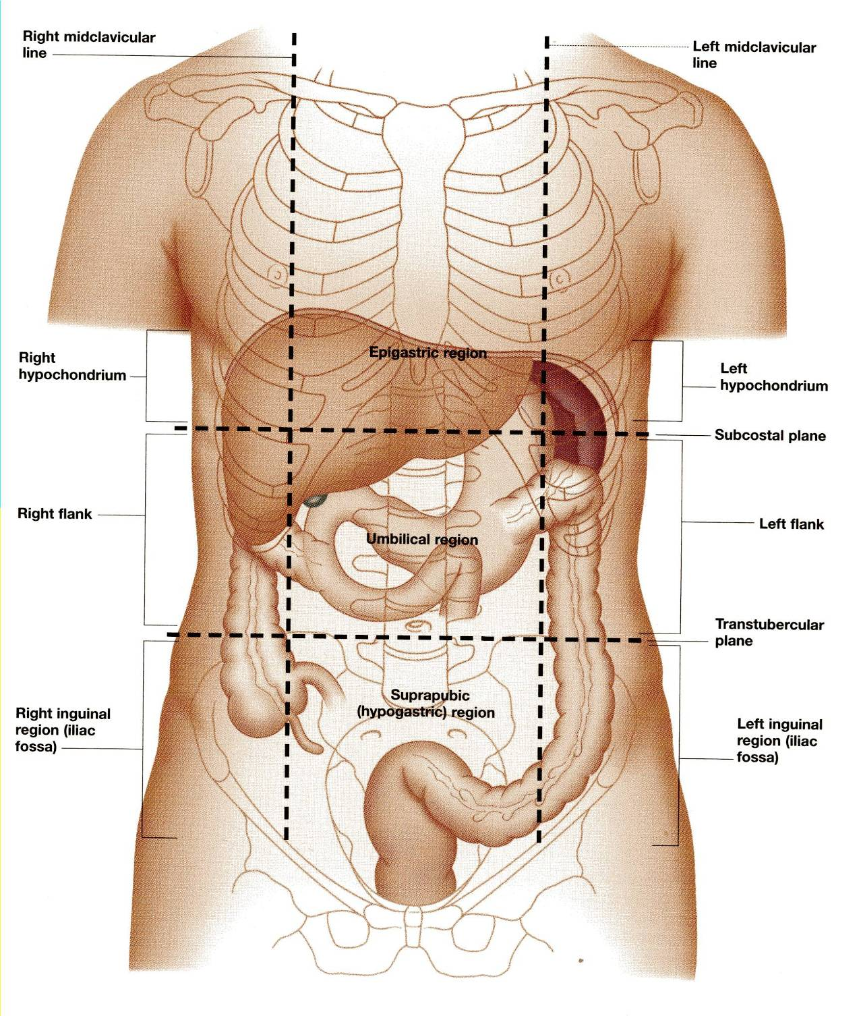
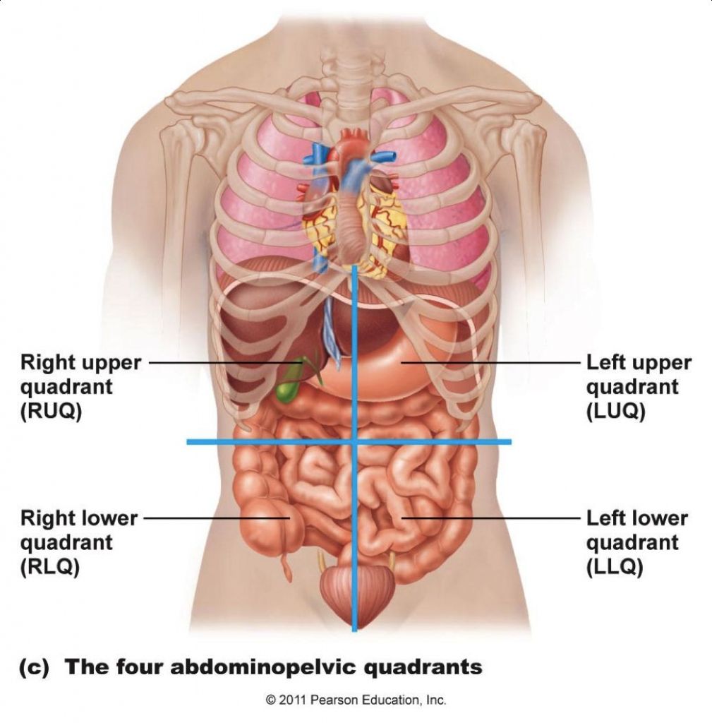
Stomach
Location :
The stomach is a dilated part of the alimentary canal.
It is located in the upper part of the abdomen
It extends from beneath the left costal region into the epigastric and umbilical regions.
Much of the stomach is protected by the lower ribs.
It is roughly J-shaped.

Slide 23
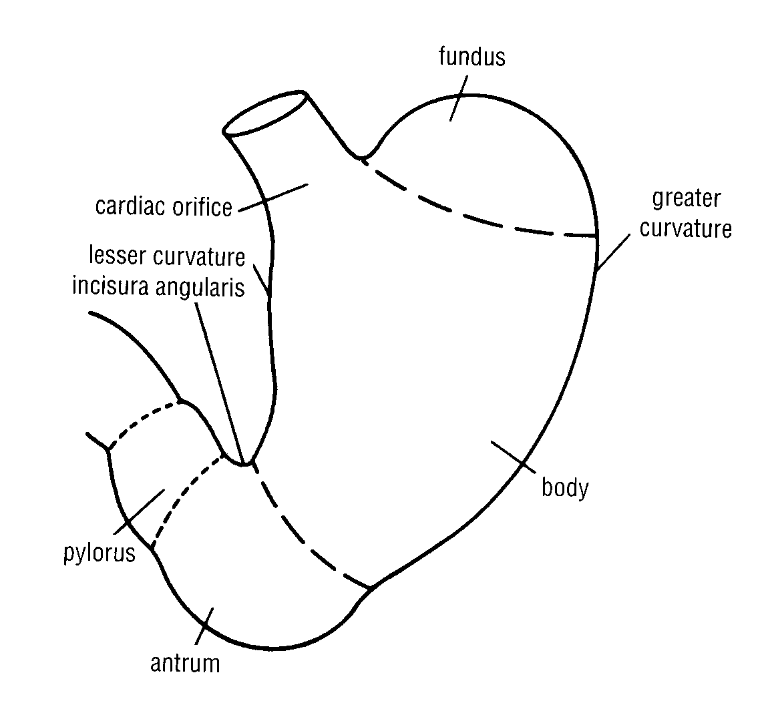
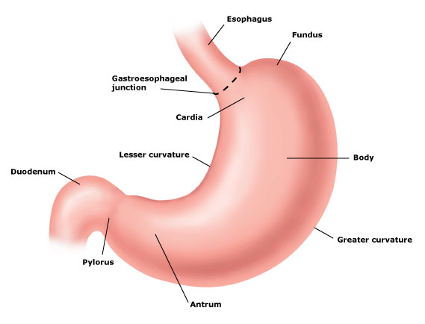
Stomach Parts
2 orifices | Cardiac orifice.
 | Pyloric orifice
2 borders | Lesser curvature
 | Greater curvature
2 surfaces | Anterior surface
 | Posterior surface
3 parts | Fundus
 | Body
 | Pylorus
Pylorus is formed of 3 parts | Pyloric antrum
 | Pyloric canal
 | Pyloric sphincter

Slide 24
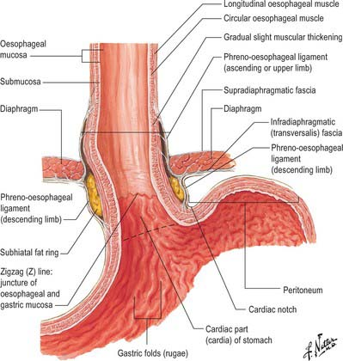
Stomach Cardiac Orifice
It is the site of the gastro- esophageal sphincter.
It is a physiological sphincter rather than an anatomical sphincter.
Consists of circular layer of smooth muscle (under vagal and hormonal control).
Lies opposite left seventh costal cartilage 2.5 cm from the sternum T10.
Function: Prevents esophageal regurgitation (reflux) حرقان.

Slide 25
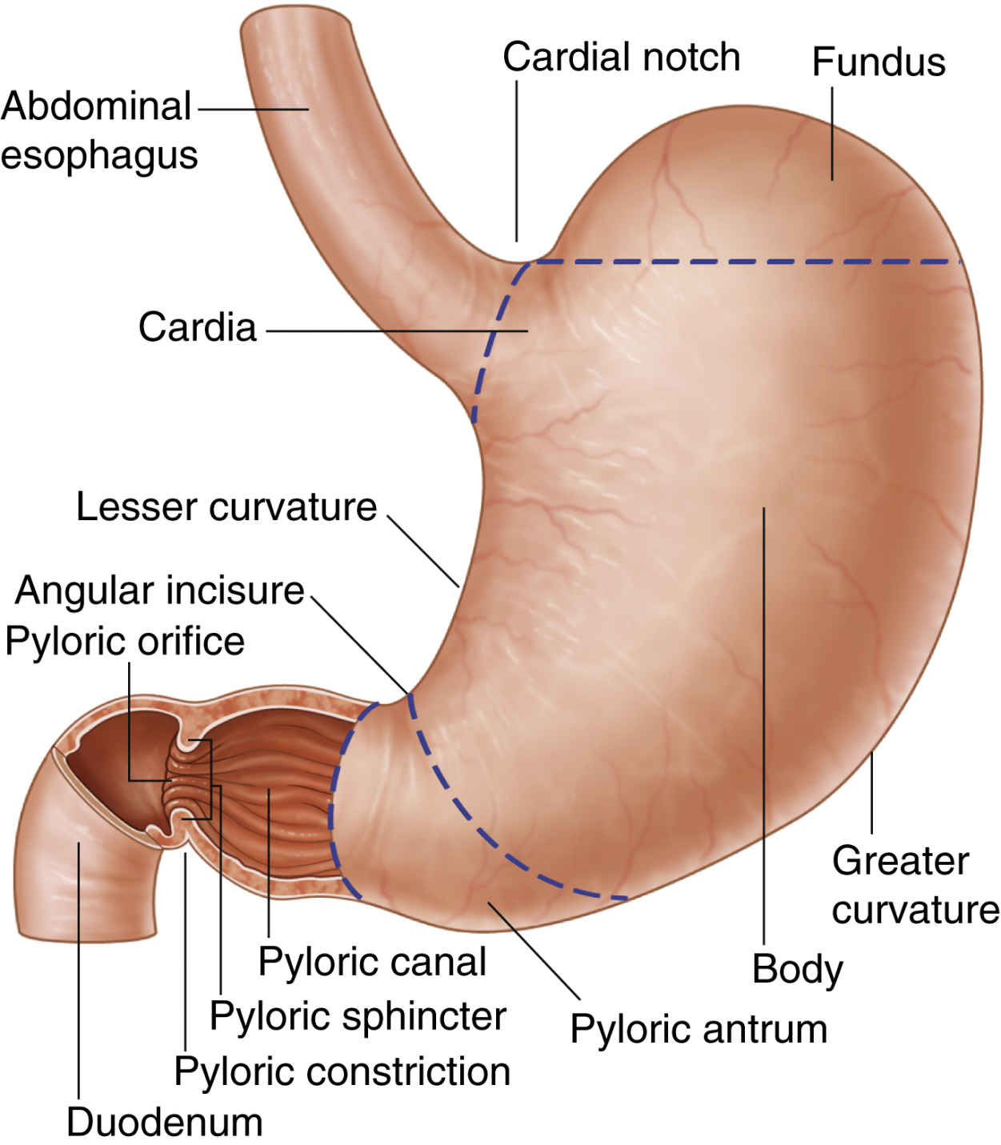
Fundus
Stomach
Body
• Dome-shaped.
• Located to the left of
the cardiac orifice.
• Usually full of gazes.
• It reaches to the left
fifth intercostal space
a little below the
apex of the heart.
• Extends from:
– The level of the
fundus, to
– The level of
Incisura angularis. (This is a constant notch on the
lesser curvature)
the fundus of the stomach is separated from the heart by the diaphragm

Slide 26
Stomach
Lesser curvature
Forms the right border of the stomach.
Extends from the cardiac orifice to the pylorus.
Attached to the liver by the lesser omentum, (gasrtohepatic ligament)
Pyloric antrum
The pyloric antrum extends from Incisura angularis to the pylorus.
Pylorus
The pylorus is a tubular part of the stomach.
It lies in the transpyloric plane (L1), 1 cm. to the right of the middle line.
It has a thick muscular end called pyloric sphincter.
The cavity of the pylorus is the pyloric canal.
Greater curvature
Forms the left border of the stomach.
Extends from the cardiac orifice to the pylorus.
Its upper part is attached to the spleen by gastrosplenic ligament.
Its lower part is attached to the transverse colon by the greater omentum.

Slide 27
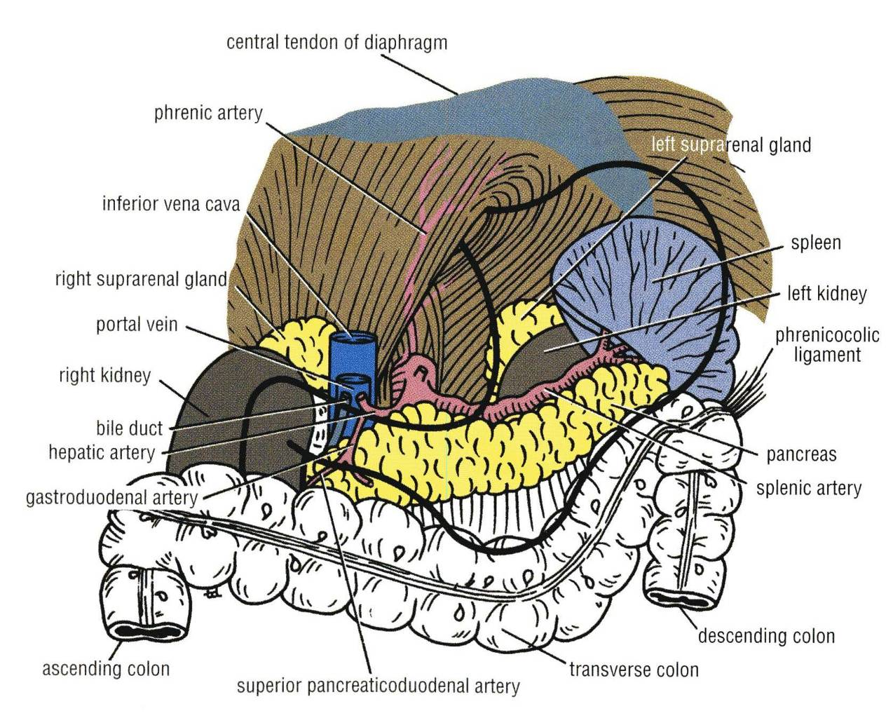
Stomach
Relations
Anterior | Posterior (stomach bed)
Anterior abdominal wall. Left costal margin. Left pleura & lung. Diaphragm. Left lobe of the liver. | 1. Left crus of diaphragm 2. Left suprarenal gland 3. Part of left kidney 4. Spleen 5. Splenic artery 6. Pancreas 7. Transverse mesocolon 8. Transverse colon 9. Lesser sac All these structures form the stomach bed. All are separated from the stomach by peritoneum of lesser sac except the spleen by greater sac.

Slide 28
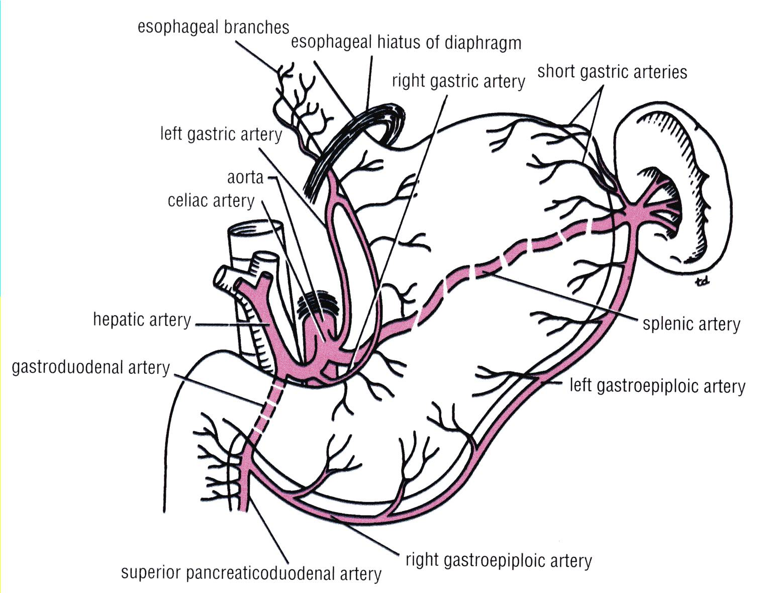
Stomach
Supply (Arterial)
1- Left gastric artery | branch of celiac artery 1st branch of Abdominal Aorta | Runs along the lesser curvature.
2- Right gastric artery | a branch of hepatic artery of celiac | Runs to the left along the lesser curvature
3- Short gastric arteries | a branch of splenic artery | Pass in the gastrosplenic ligament.
4- Left gastroepiploic artery | a branch of splenic artery | Pass in the gastrosplenic ligament.
5- Right gastroepiploic artery | a branch of gastroduodenal artery of hepatic | Passes to the left along the greater curvature.

Slide 29
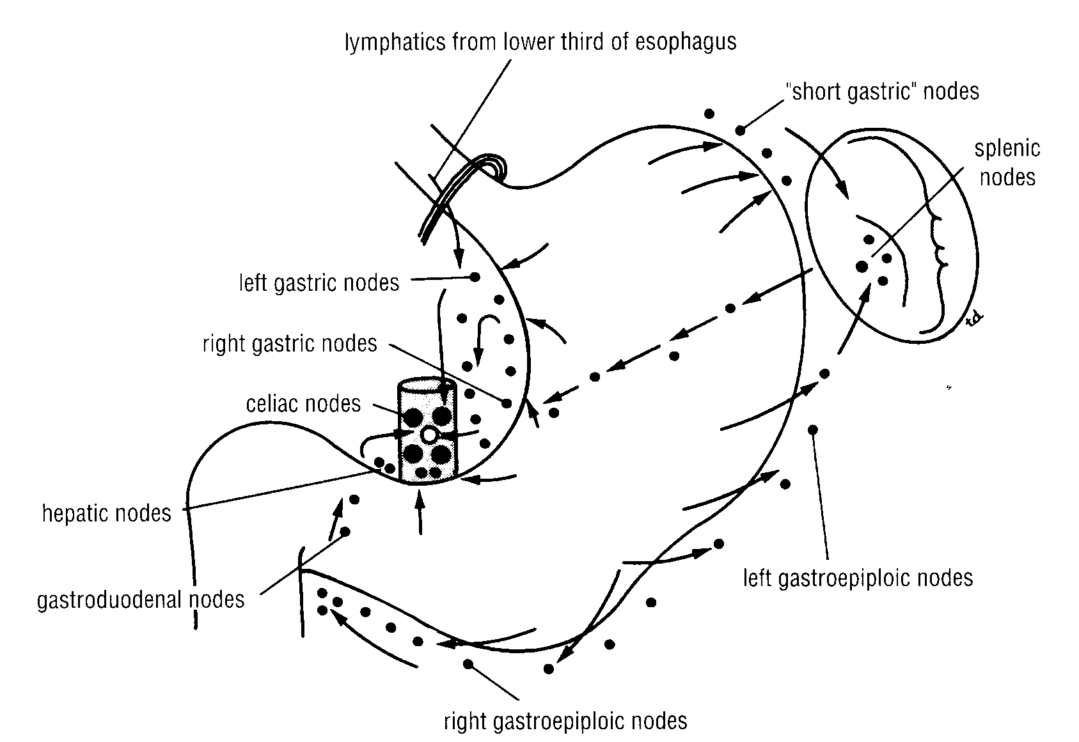
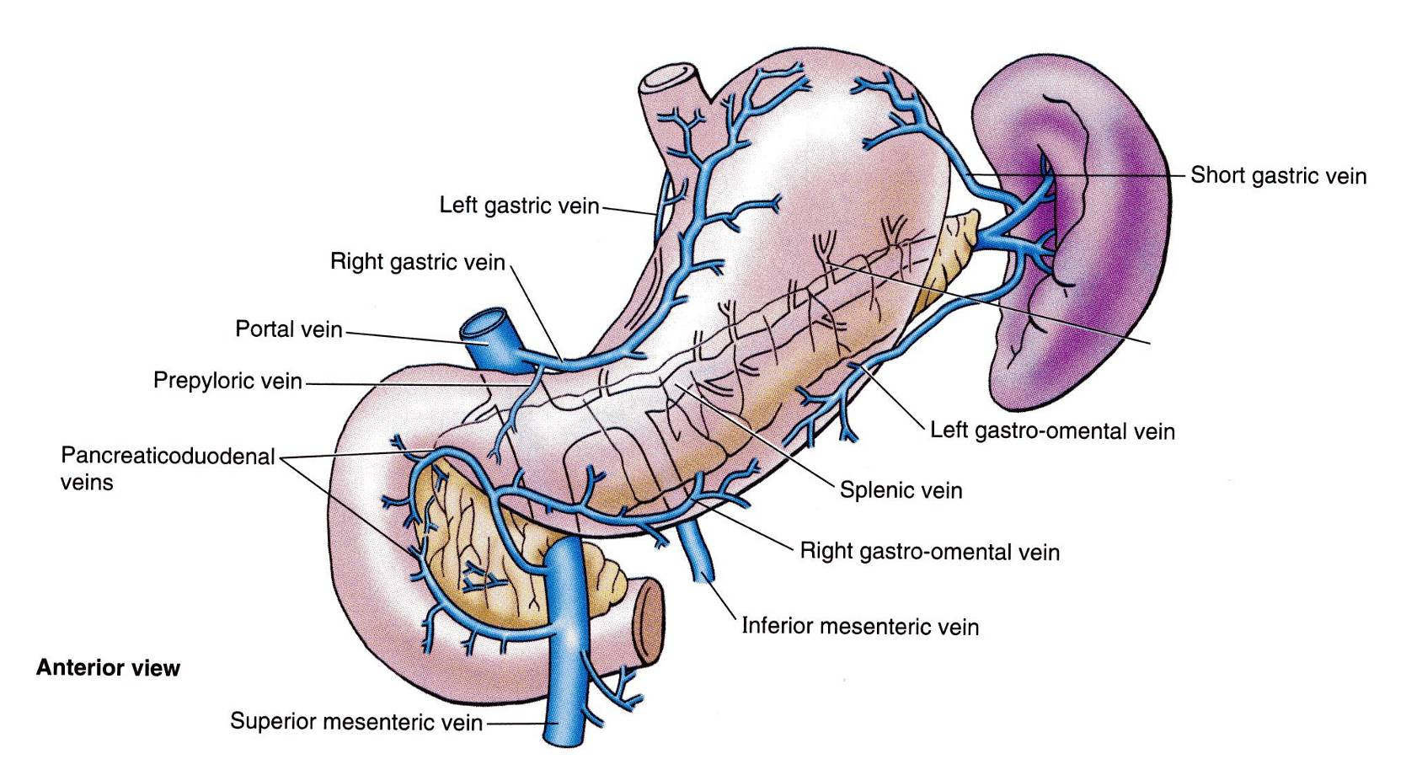
Stomach
Supply
Venous drainage
All of the veins drain into the portal circulation.
The right and left gastric veins drain directly in the portal vein.
The short gastric veins and the left gastroepiploic vein join the splenic vein.
The right gastroepiploic vein drain in the superior mesenteric vein.
Lymphatic drainage
The lymph vessels follow the arteries.
They first drain to the:
Left and right gastric nodes.
Left and right gastroepiploic nodes and
Short gastric nodes.
Ultimately, all the lymph from the stomach is collected at the celiac nodes.

Slide 30
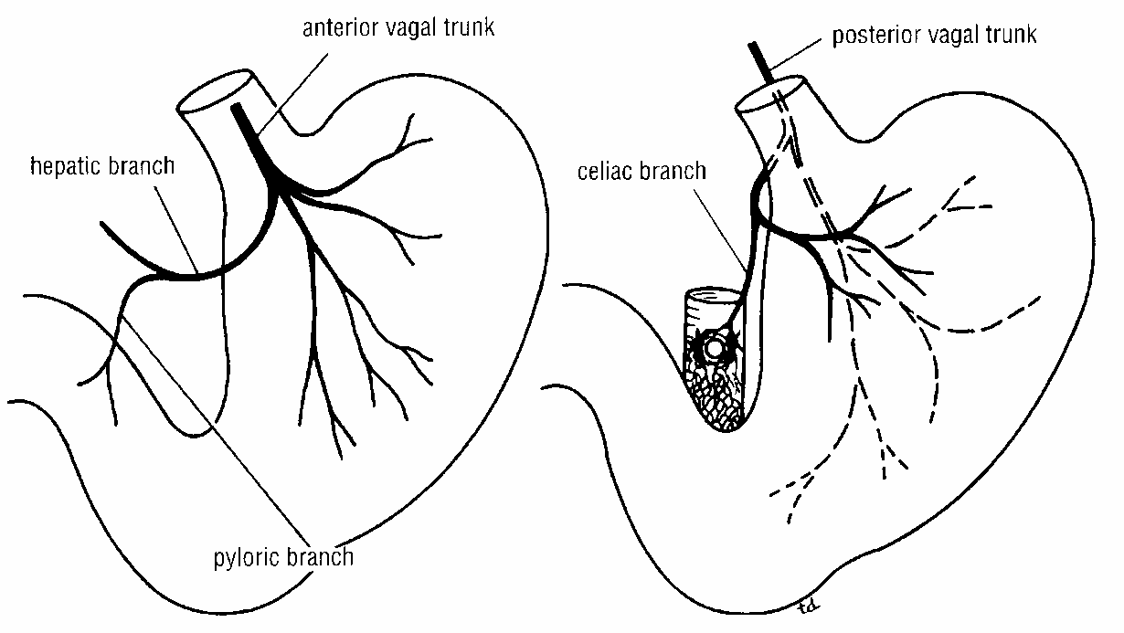
Stomach
Supply (Innervation)
Sympathetic fibers are derived from the celiac plexus
Parasympathetic fibers from both vagi.
Anterior vagal trunk:
Formed from the left vagus
Supply the anterior surface of the stomach
Gives off a hepatic branch and from it - a branch to the pylorus.
Posterior vagal trunk:
Formed from the right vagus
Supply the posterior surface of the stomach
Gives off a large branch to the celiac and the superior mesenteric plexuses.

Slide 31
Oral Cavity
Hard palate | Formed by (4 bones): 2 Palatine processes of the maxillae, and 2 Horizontal plates of palatine bones posteriorly.
Soft palate | Muscles: 1. Tensor veli palatini, 2. Levator veli palatini, 3. Palatoglossus, 4. Palatopharyngeus, 5. Musculus uvulae. Nerve supply: Motor: All by pharyngeal plexus EXCEPT tensor veli palatini by mandibular nerve. Sensory: Maxillary nerve (Greater palatine, Lesser palatine, and Nasopalatine nerves) and Glossopharyngeal nerve.
Tongue | Attached to: Above (styloid process & soft palate) below (mandible & hyoid bone) Muscles: Intrinsic & extrinsic (palatoglossus, styloglossus, genioglossus, and hyoglossus) Nerve supply: Motor: all by hypoglossal nerve EXCEPT palatoglossus by pharyngeal plexus.
Esophagus
Cervical | Anterior: Trachea & Recurrent laryngeal nerves Lateral: Lobes of the thyroid gland. Posterior: Vertebral column
Thoracic | Barium swallow allows assessment of size of left atrium
Abdominal | Anterior: left lobe of liver Posterior: left crus of diaphragm Opening of diaphragm: The two vagi, branches of the left gastric vessels, and lymph.
Constrictions | Junction with pharynx Crossing of aortic arch and left main bronchus Junction with stomach
Supply | Upper third: inferior thyroid. Middle third: aorta + azygos Lower third: left gastric Parasympathetic: vagus
Stomach
Cardiac orifice | Left seventh costal cartilage (T10)
Fundus | Left fifth intercostal space
Pylorus | Transpyloric plane (L1)
Curvature | Lesser curvature: Attached to the liver by the lesser omentum, (gasrtohepatic ligament) Greater curvature: Upper part → attached to spleen by gastrosplenic ligament. Lower part → attached to transverse colon by the greater omentum.
Supply | Arterial: Right & left gastric, short gastric , right & left gastroepiploic arteries. Venous: Right & left gastric → portal. Short gastric & left gastroepiploic → splenic → portal. Right gastroepiploic → superior mesenteric → portal Lymph: celiac lymph nodes Sympathetic: celiac plexus Parasympathetic: vagus nerve

Slide 32
MCQs
1) Which of the following is a posterior relation of the stomach ?
A. Anterior abdominal wall.
B. Left costal margin.
C. Left pleura & lung.
D. Splenic artery.
2) Which of the following is a branch of the celiac artery ?
A. Left gastric artery.
B. Right gastric artery.
C. Short gastric artery.
D. Right gastroepiploic artery.
5) The Left gastroepiploic is a branch of which artery
A. Splenic
B. Abdominal Aorta
C. Gastroduodenal
D. Hepatic
6) Where does the right gastroepiploic vein drain?
A. Portal
B. Superior mesenteric
C. Left gastroepiploic
D. Left gastric
3) The vestibule receive the opening of the parotid gland at the upper side of seconded molar tooth at the same side :
A. Ture
B. False
4) The vestibule lie between :
A. the teeth and gum externaliy and the tounge posteriorly
B. the space in behind the tounge
C. the 2nd molar tooth and the cheeks
D. the teeth & gums internally and lips and cheeks externally
7) What is the level of the cardiac orifice?
A. T7
B. T8
C. T10
D. T12
8) Barium swallow asses which of the following?
A. Right atrium
B. Left atrium
C. Right ventricle
D. Left ventricle
Answers: 1- D, 2- A, 3- B, 4- D, 5- A, 6- B, 7-C, 8- B

Slide 33
Leaders:
Nawaf AlKhudairy
Jawaher Abanumy
Members:
Abdulmalki alhadlaq
Abdullah jammah
Abdulmohsen alkhalaf
Abdulmohsen alghannam
Abdulrahman almalki
Abdulrahman alrajhi
Abdullah alhashem
Feedback
References:
1- Girls’ & Boys’ Slides
2- Greys Anatomy for Students
3- TeachMeAnatomy.com
anatomyteam436@gmail.com
@anatomy436

