Slide 1
Anatomy of Salivary Glands
Color Code
Important
Doctors Notes
Notes/Extra explanation
Please view our Editing File before studying this lecture to check for any changes.

Slide 2
Objectives
By the end of this lecture the student should be able to:
Describe the anatomy of the parotid gland: position, shape, structures within it , innervation and parotid duct.
Describe the anatomy of the submandibular and sublingual salivary glands: location, shape, parts, ducts and innervation of the glands.
المحاضرة فيها اختلاف كبير بين محتوى الطلاب والطالبات وبعد ما استفسرنا من د.جميلة ود. وليد قالوا لنا نعتمد نسخة الطالبات والمعلومات اللي فيها.التيم شامل كل المحتوى وسوينا نسخه بس فيها محتوى الطالبات موجود هنا

Slide 3
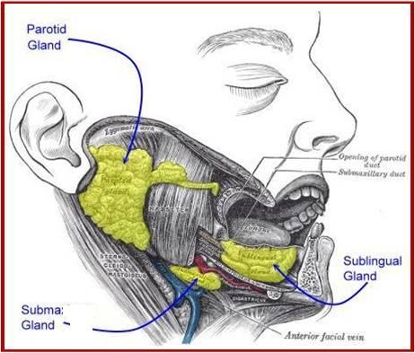
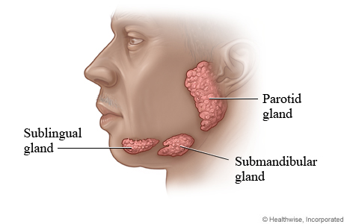
Salivary glands
Only on the girls’ slides
Are exocrine glands, that produce saliva.
There are 3 large named pairs of salivary glands and multiple minute unnamed glands in the submucosa of the oral cavity (lips, palate & under surface of the tongue).
The three NAMED PAIRS are:
Parotid: | produces a serous watery secretion.
Submandibular: | produces a mixed serous & mucous secretion.
Sublingual: | secretes saliva that is predominantly mucous in character.
EXTRA

Slide 4
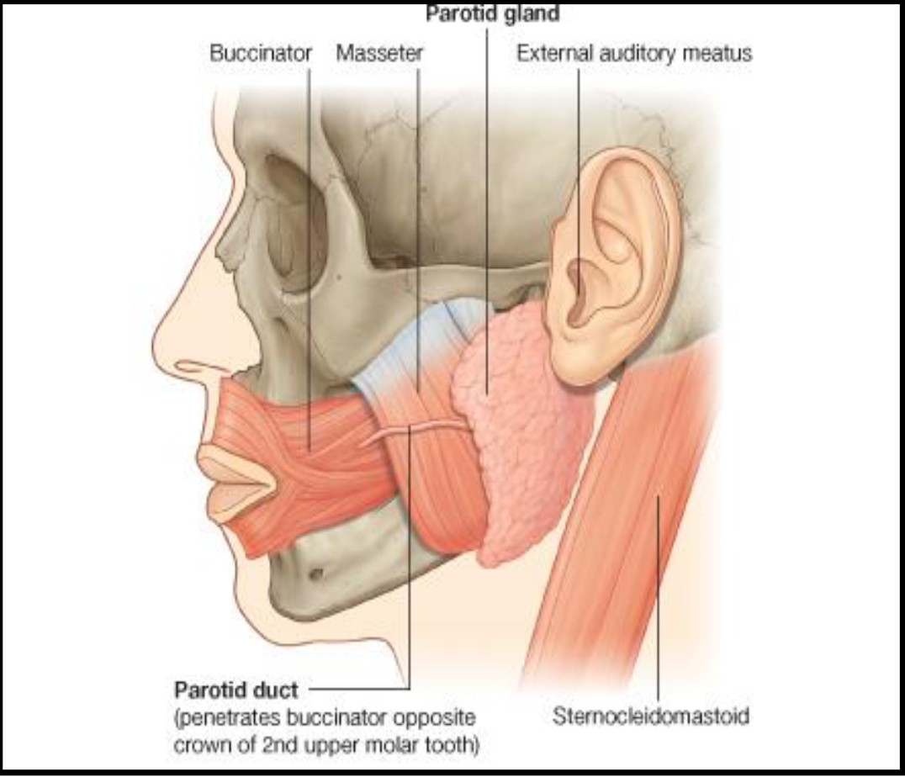
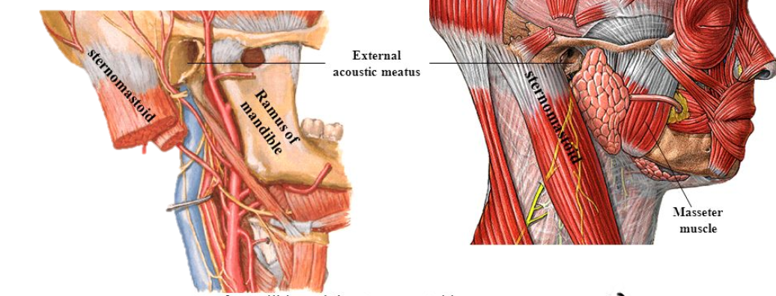
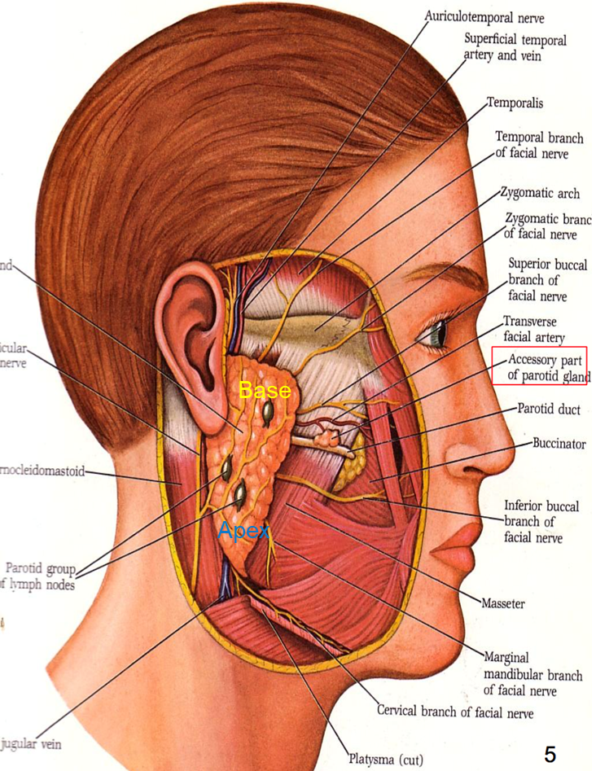
Parotid gland
Parotid Gland
It is the largest salivary gland formed entirely of serous acini.
It has 2 borders: anterior convex, and straight posterior border.
Position: located in a deep space and is wedged between
Anteriorly: mandibular ramus & masseter (the parotid gland is behind them)
Posteriorly: Mastoid process & sternomastoid muscle (the parotid gland is in front of them)
هي تكون في الوسط وفوقها شيء وتحتها شيء زي السندويتس
Shape: triangular/wedged, and has:
Apex (lower end): below & behind angle of the mandible
Base (concave upper end): lies above and related to cartilaginous part of external auditory meatus, the zygomatic arch, & TMJ (temporomandibular joint).

Slide 5
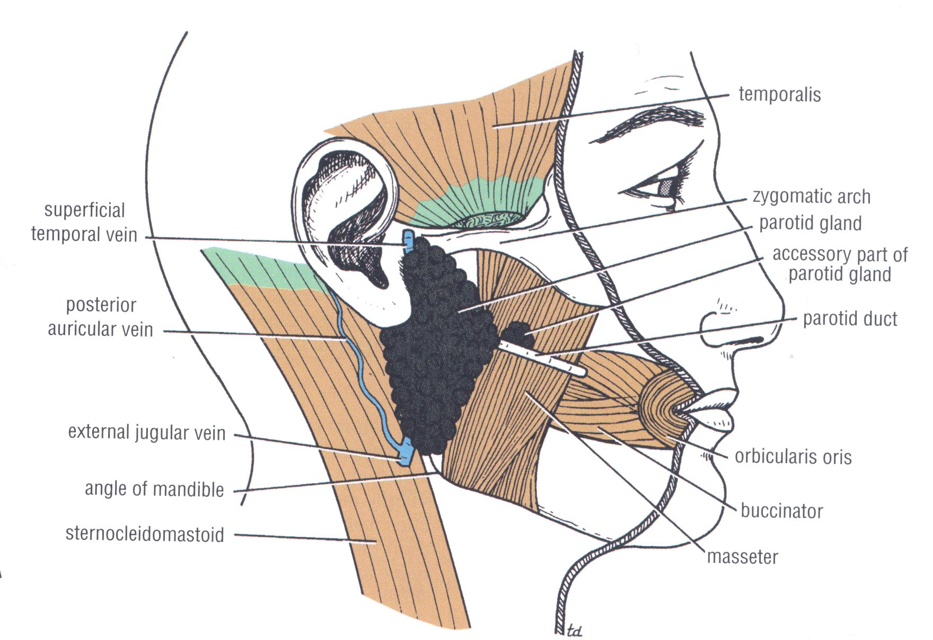
Parotid Gland Processes
Only on the boys’ slides
It has 4 processes:
Superior margin of the gland extends upward behind temporo-mandibular joint into mandibular fossa of skull ….. Glenoid process.
Anterior margin of the gland extends forward superficial to masseter … facial process.
A small part of facial process may be separate from main gland… accessory part of gland, that lies superficial to masseter. (also in girls’ slides)
Deep part of gland may extend between medial pterygoid & ramus of mandible … pterygoid process.

Slide 6
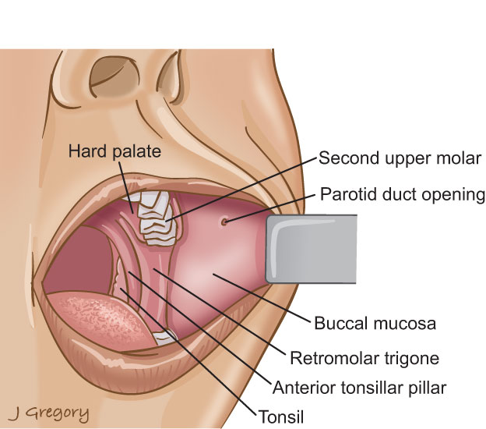
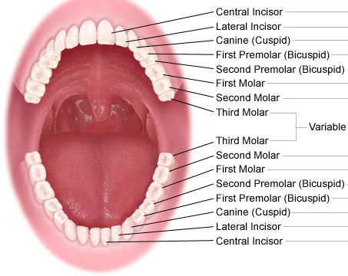
Parotid Gland Parotid Duct
Only on the boys’ slides
It opens into the vestibule of the mouth on a small papilla, opposite the upper second molar (maxillary) tooth.
Parotid duct 5 cm long, passes from anterior border of gland , superficial to masseter one fingerbreadth, below zygomatic arch, then it pierces buccal pad of fat & buccinator muscle.
It passes obliquely between buccinator & m.m.of mouth (serves as valve-like mechanism to prevent inflation of duct during violent blowing) and finally opens into vestibule of mouth ,opposite upper 2nd molar tooth.
Extra

Slide 7
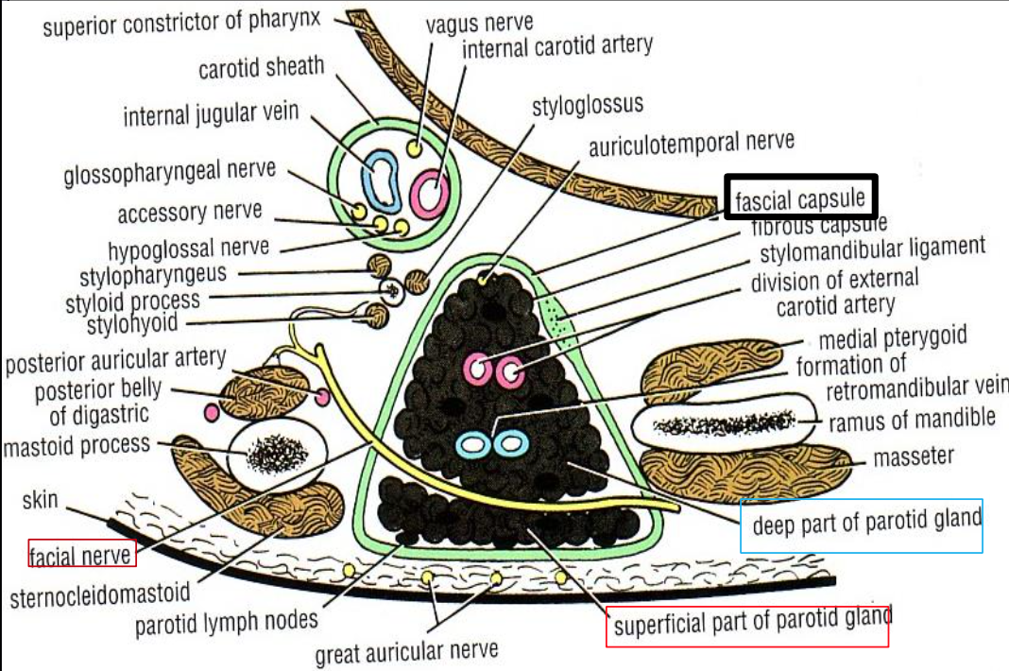
Parotid Gland Capsule
It is surrounded by 2 tight capsules:
the first is C.T. (connective tissue) capsule,
the second is the dense fascial capsule of investing layer derived from deep cervical fascia of the neck, (part of it is thickened to form stylomandibular ligament).
The gland is divided into superficial & deep parts, by the facial nerve fibers.

Slide 8
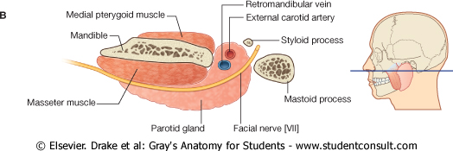
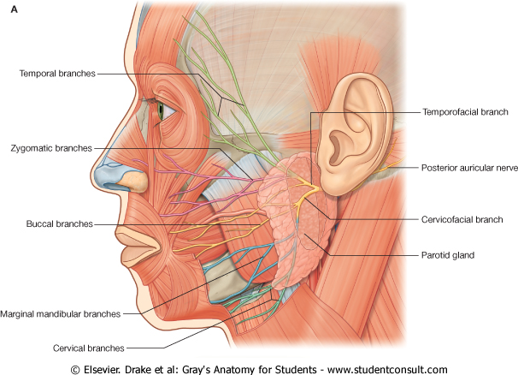
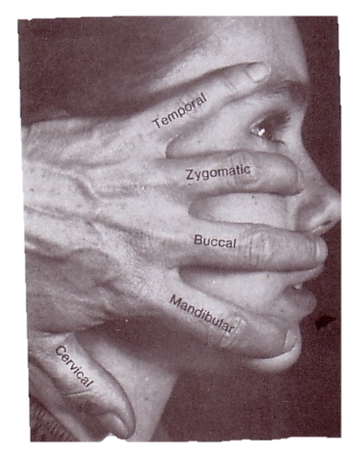
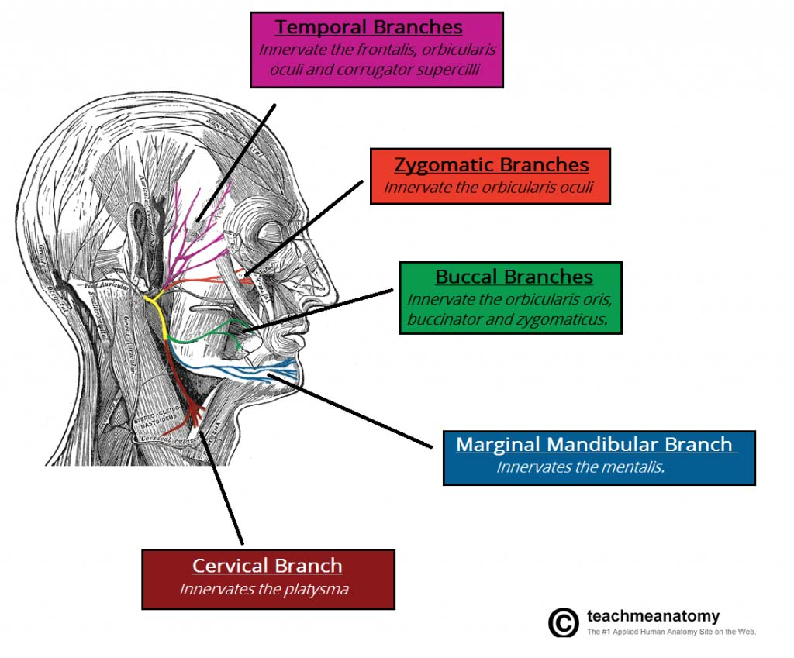
Structures within Parotid Gland
From superficial to deep OR lateral to medial (horizontal section)
(you have to know both)
1. Facial Nerve
most superficial structure
2. Retromandibular vein
intermediate in position
3. External Carotid artery
Most deep
4. Parotid group of lymph nodes
The facial nerve it divides the gland into superficial & deep parts.
It emerges from stylomastoid foramen to enter the gland at its posteromedial surface.
It gives:
TWO Branches before it enters the gland
FIVE Branches within the parotid which leave anteromedial suface of the gland:
1- Temporal
2- Zygomatic
3- Buccal
4- Mandibular
5- Cervical.
Extra

Slide 9
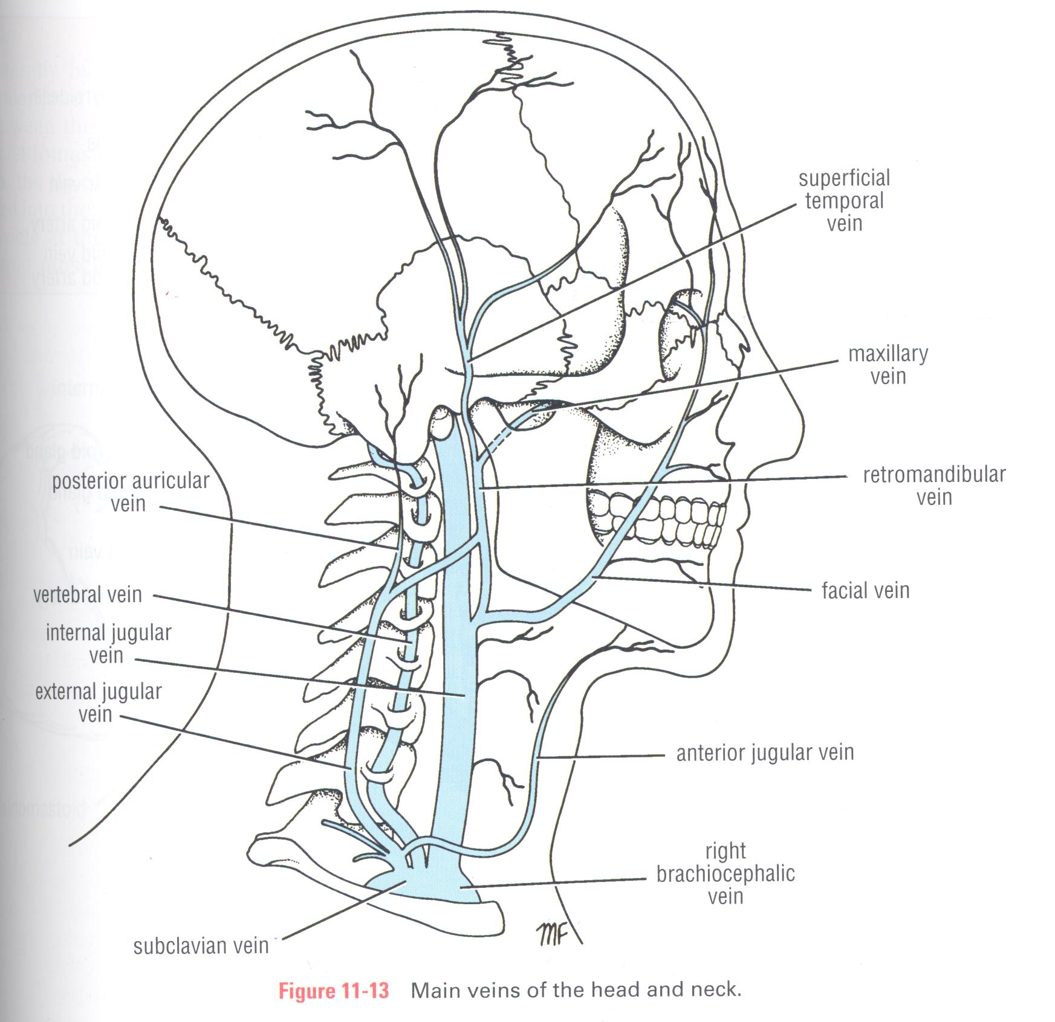
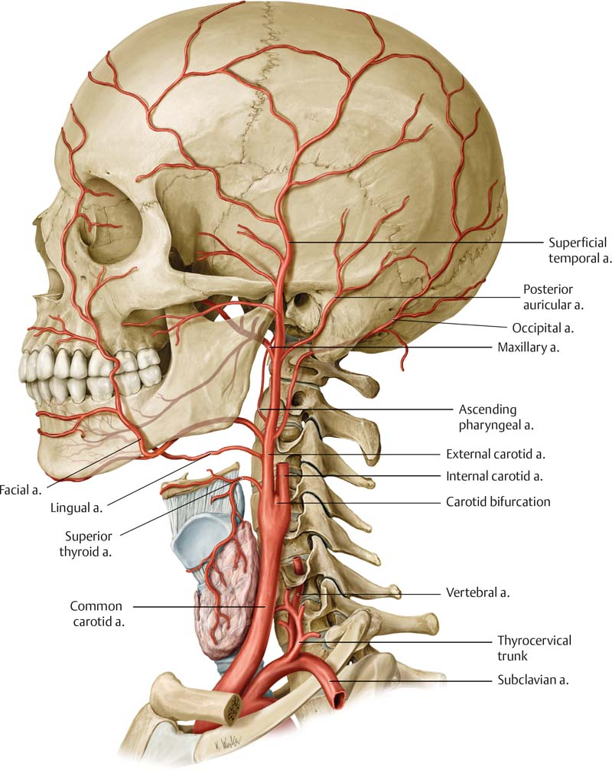
Structures within Parotid Gland
From superficial to deep OR lateral to medial (horizontal section)
(you have to know both)
1. Facial Nerve
most superficial structure
2. Retromandibular vein
intermediate in position
3. External Carotid artery
Most deep
4. Parotid group of lymph nodes
Formed within the gland by the union of maxillary & superficial temporal veins.
It leaves lower end of the gland.
Before it leaves the gland it is divided into 2 division/branches:
anterior (joins facial vein) &
posterior (joins posterior auricular vein to form external jugular vein).
It is divided into its 2-terminal branches maxillary and superficial temporal arteries at neck of mandible, which they leave upper end & anteriomedial surface of gland.
Extra

Slide 10
Structures which enter & leave Parotid Gland
Only on the boys’ slides
 | enter | Leave
Upper end | superficial temporal vein | 1- superficial temporal artery. 2- auriculotemporal nerve 3- temporal branch of facial nerve
Lower end | - | 1- cervical branch of facial nerve 2- retromandibular (posterior facial) vein & its 2 division.
Posteromedial surface | 1-external carotid artery. 2-facial nerve | -
Anteromedial surface | maxillary vein | maxillary artery
Anterior border | - | 1- zygomatic branch of facial nerve 2- buccal branch of facial nerve 3- mandibular branch of facial nerve 4- parotid duct. 5- transverse facial artery (branch of external carotid artery)

Slide 11
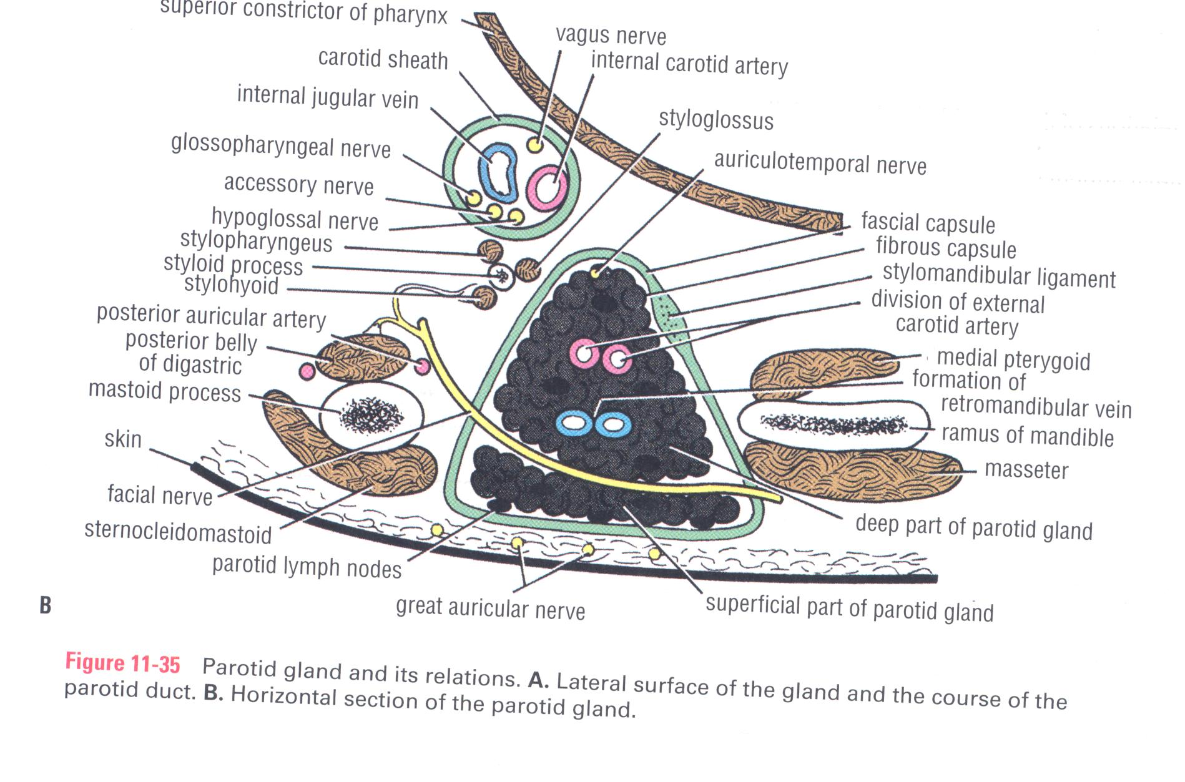
Parotid Gland Relations
Only on the boys’ slides
Antero-medial relations | Postero-medial relations | Superficial (lateral) relations | Superior relations
Ramus of mandible Temporomandibular joint Medial pterygoid Masseter. | mastoid process & attached muscles styloid process & its attached muscles carotid sheath & its contents Facial nerve enters gland from its postero-medial surface External carotid artery grooves gland at its posteromedial surface, then passes inside it. | Skin, Superficial fascia containing platysma & great auricular nerve Deep fascia (parotid fascial capsule) Parotid lymph nodes | External auditory meatus & posterior surface of temporo-mandibular joint.

Slide 12
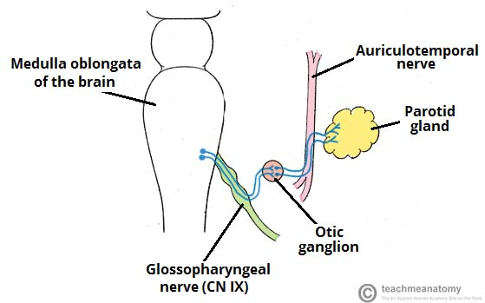
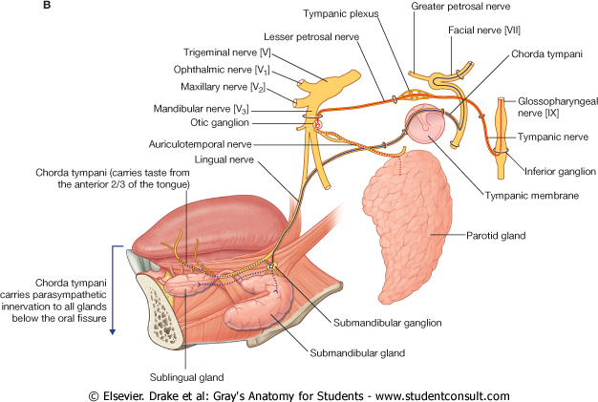
Parotid Gland Nerve supply
Extra
Parasympathetic (secretomotor):
from inferior salivary nucleus (of 9th cranial nerve “glossopharyngeal nerve” in medulla oblongata) → via its branch: tympanic nerve → forms tympanic plexus in middle ear → then via lesser petrosal nerve (preganglionic fibers) to otic ganglion
The postganglionic fibers running in auriculotemporal nerve supply the parotid gland.
Otic ganglion: is a small parasympathetic ganglion that is functionally associated with glossopharyngeal nerve it is located in the infratemporal fossa, just below foramen ovale, medial to mandibular nerve.

Slide 13
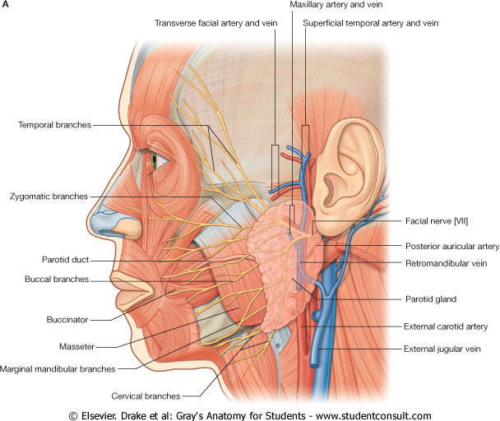
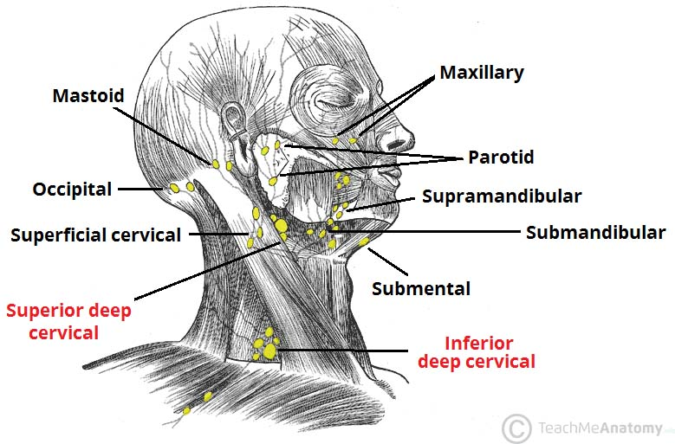
Parotid Gland Nerve + Blood supply
Sympathetic:
from plexus around external carotid artery.
Sensory supply:
Auriculo-temporal nerve (a branch of posterior division of mandibular nerve) ascends from upper end of parotid gland to supply skin of scalp above auricle + Great auricular nerve. (C2,3 ).
Arterial supply:
external carotid artery + its 2-terminal branches (maxillary artery + superficial temporal artery)
Venous drainage:
The 2-veins (maxillary & superficial temporal veins) drain into the retromandibular vein.
Lymphatic:
parotid lymph nodes which finally drain into deep cervical lymph nodes.
Extra

Slide 14
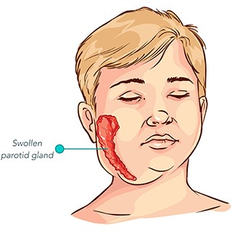
Parotid Gland Clinical Notes
Only on the boys’ slides
1- Parotid gland infection: Mumps
Gland becomes swollen, painful because fascial capsule derived from investing layer of deep cervical fascia is strong and limits the swelling of gland.
2-Frey’s Syndrome :
it is an interesting complication that sometimes occurs after penetrating wounds of parotid gland.
When patient eats, beads of perspiration (sweat) appear on the skin of parotid.
It is caused by damage to auriculotemporal & great auricular nerves.
During healing, parasympathetic secretory fibers in auriculotemporal nerve grow out and join distal end of great auricular nerve (C2,3) supplying skin over parotid. These fibers reach the sweat glands in skin of face so, there is sweating on skin covering parotid, instead of salivation during eating.
Extra

Slide 15
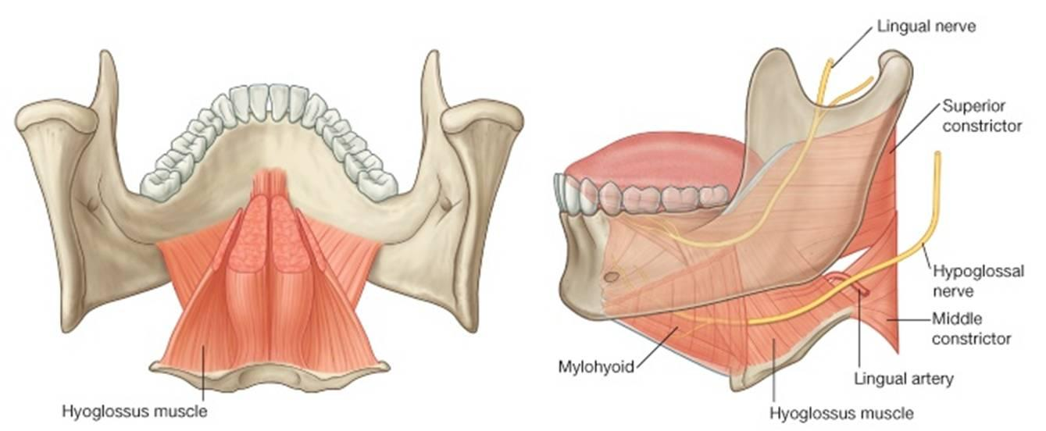
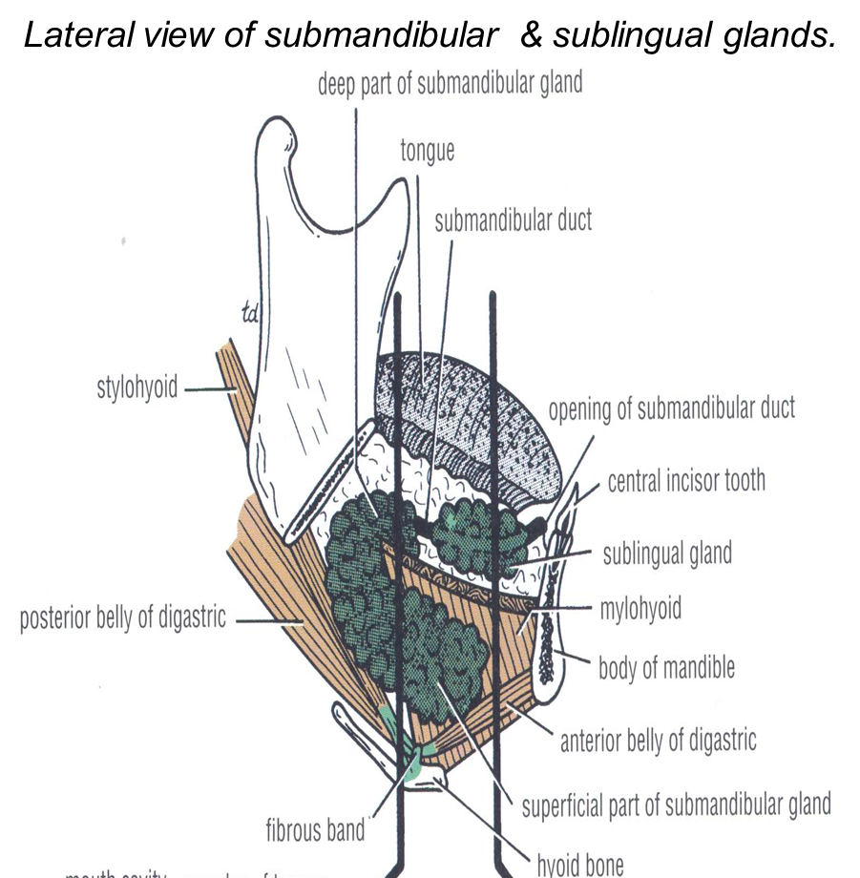
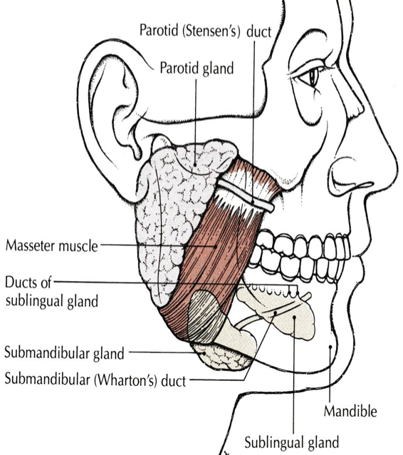
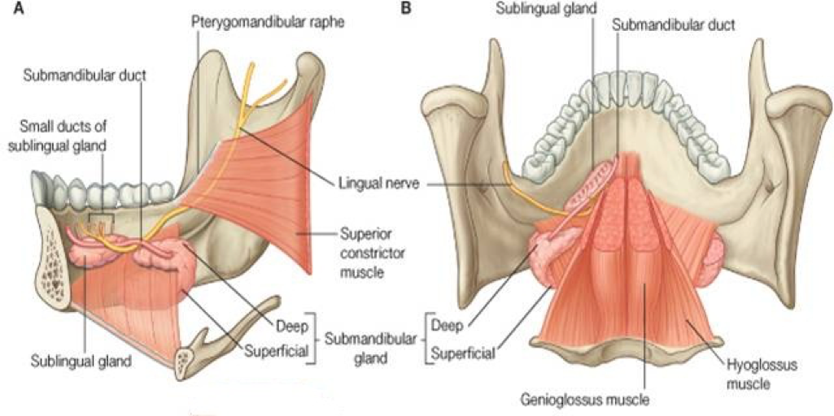
Submandibular Gland
It is a lobulated mass, composed of serous & mucous acini, located deep to the body of the mandible.
It is surrounded by C-T capsule + dense fascial capsule derived from investing layer of deep cervical fascia.
Formed of two parts:
Large Superficial Part: lies in digastric triangle between mylohyoid & body of mandible (superficial to mylohyoid).
Small Deep Part: lies deep to mylohyoid and superficial to hyoglossus.
Its deep part is continuous with superficial part around posterior border of mylohyoid muscle.
Extra

Slide 16
Submandibular Gland Relations
Only on the boys’ slides
 | Superficial part
Anteriorly | anterior belly of digastric
Posteriorly | posterior belly of digastric + stylohyoid muscle.
Medially (deep) | mylohyoid
Laterally | it lies in contact with submandibular fossa on medial surface of mandible.
Inferolaterally (superficial) | -skin, superficial fascia, platysma & investing layer of deep cervical fascia + submandibular lymph nodes -it is crossed by facial vein & cervical branch of facial nerve. -facial artery ascends into digastric triangle, it deeply grooves posterior end of the gland, then passes between lateral surface of gland & the bone to reach base of mandible where it pierces deep fascia to ascend to face.

Slide 17
Submandibular Gland Relations
Only on the boys’ slides
 | Deep part
Medially (deep) | hyoglossus & styloglossus.
Laterally (superficial) | mylohyoid & superficial part of gland.
Superiorly | lingual nerve & submandibular ganglion.
Inferiorly | hypoglossal nerve.

Slide 18
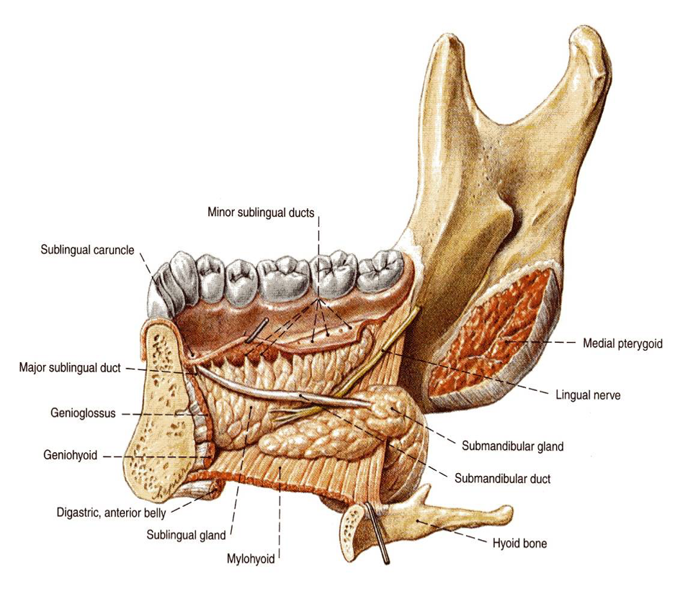
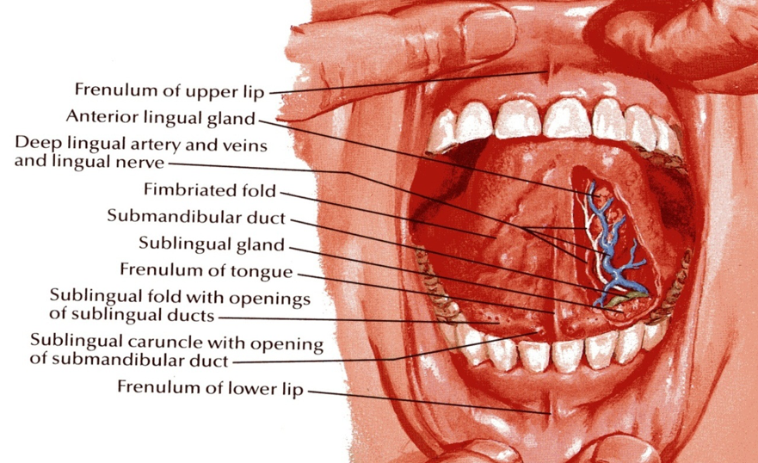
Submandibular Gland Submandibular Duct
The duct emerges from the anterior end of the deep part of the gland.
It passes forward along the side of the tongue, under the mucous membrane of the floor of the mouth.
It is crossed laterally by the lingual nerve, then lies between sublingual gland & genioglossus muscle.
It opens into floor of mouth on the summit (highest point) of a small sublingual papilla (the sublingual caruncle*), which lies at the side of the frenulum of the tongue.
Clinically, it is important to remember that the submandibular duct can be palpated through the floor of the mouth alongside the tongue.
Saliva can usually be seen emerging from the orifice of the duct.
* Sublingual caruncle: an eminence on either side of the frenulum of the tongue, on which the major duct of the sublingual gland and the duct of the submandibular gland open.

Slide 19
Submandibular Gland Submandibular Duct
Only on the boys’ slides
Note the frenulum of the tongue in midline = it is a fold of mucous membrane connects undersurface of tongue to the floor of mouth.
Note, opening of submandibular duct into floor of mouth at the side of frenulum of tongue.

Slide 20
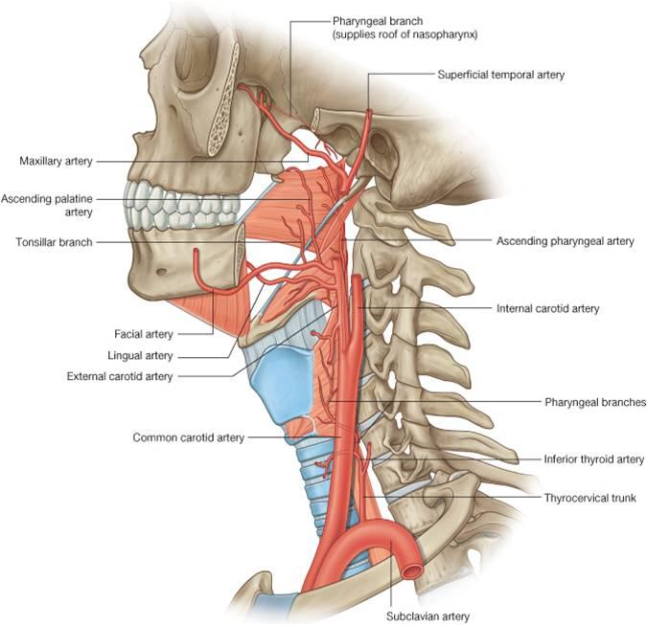
Submandibular Gland Supply
Only on the boys’ slides
Blood Supply :
branches of facial & lingual arteries.
Lymph drainage :
submandibular + deep cervical lymph nodes
Nerve supply :
1- Parasympathetic: secretomotor fibers from superior salivary nucleus of 7th C.N. (facial nerve) → via chorda tympani nerve → to join lingual nerve and pass into submandibular ganglion, then postganglionic parasympathetic secretory fibers from ganglion via lingual nerve into gland.
2- Sympathetic fibers: from plexus of nerves around Facial + Lingual arteries.
3- Sensory: lingual nerve
Extra

Slide 21
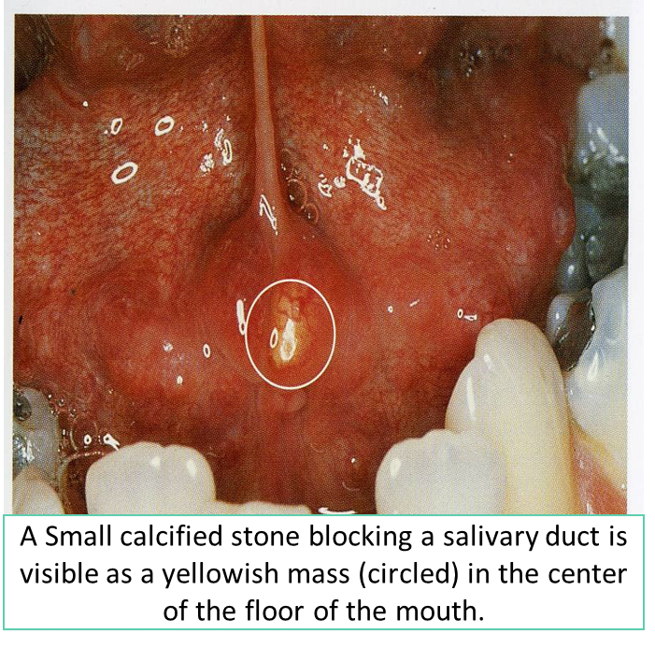
Submandibular Duct
Clinical Note
1. Calcus Formation
The submandibular duct is a common site of calculus formation.
The presence of a tense swelling below the body of the mandible, which is greatest before or during a meal and is reduced in size or absent between meals, is diagnostic of the condition.
Clinically: examination of the floor of the mouth will reveal absence of ejection of saliva from the orifice of the duct of the affected gland + Frequently, the stone can be palpated in the duct, which lies below the mucous membrane of the floor of the mouth.
2. Enlargement of Submandibular Lymph Nodes
are commonly due to :
1- Pathologic condition of scalp, face, maxillary sinus, or mouth cavity.
2- Acute infection of teeth (most common cause of painful enlargement these nodes)
Only on the boys’ slides

Slide 22
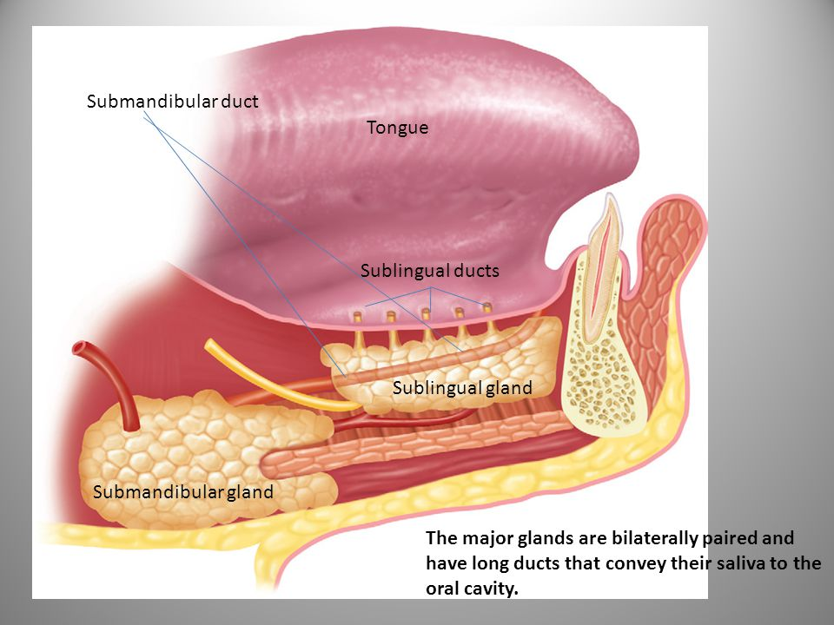
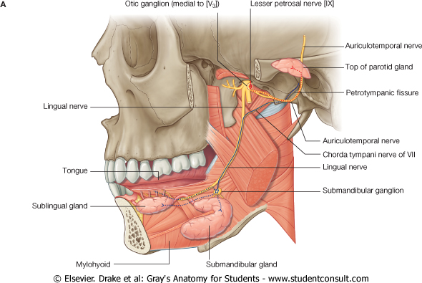
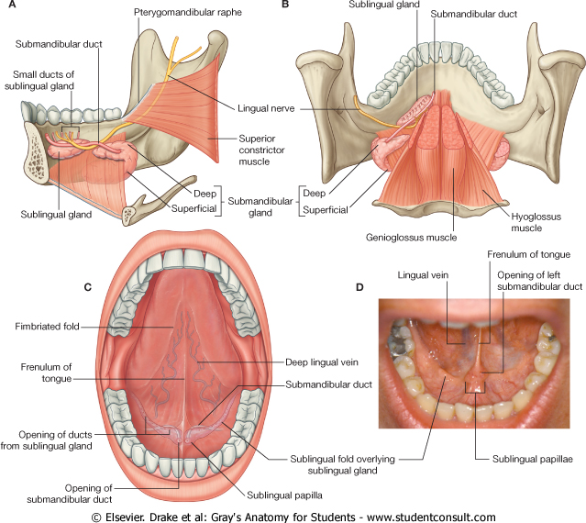
Sublingual Gland
Extra
Location
The smallest of the three main salivary glands.
It contains both serous & mucous acini.
It lies below the mucous membrane of the floor of mouth, within sublingual fold, close to the midline.
Sublingual Ducts
The sublingual ducts are 8 to 20 in number.
Most open into floor of mouth on the summit of the sublingual fold, but a few may open into the submandibular duct.

Slide 23
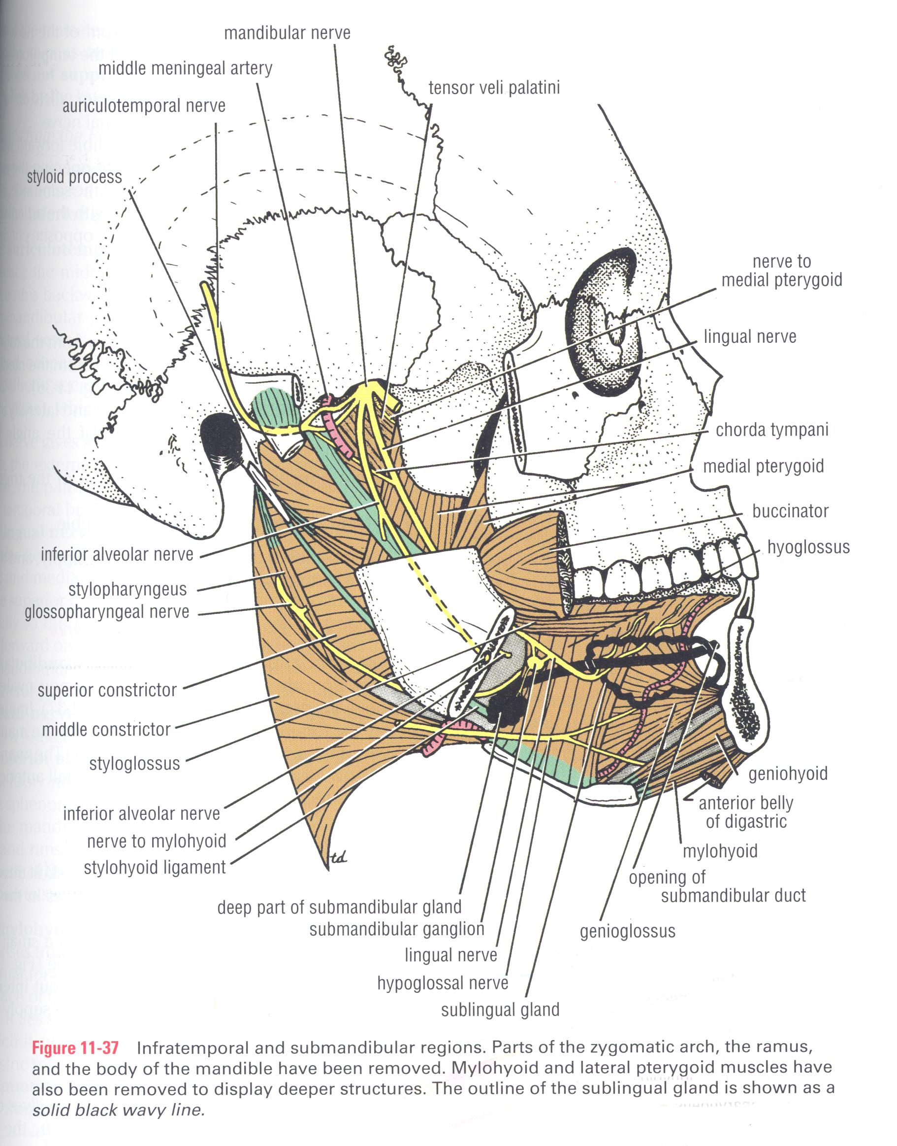
Sublingual Gland
Relations
Only on the boys’ slides
Posteriorly | deep part of submandibular gland
Medially (deep) | genioglossus + lingual nerve + submandibular duct.
Laterally (superficial) | sublingual fossa of medial surface of mandible.
Superiorly | Mucous membrane of floor of mouth, forming sublingual fold.
Inferiorly | it is supported by mylohyoid muscle.

Slide 24
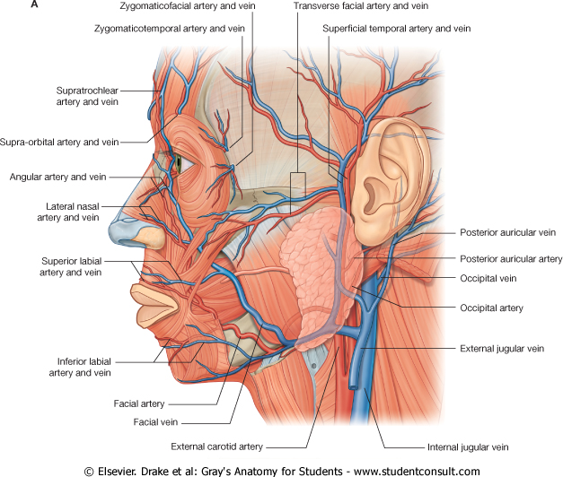
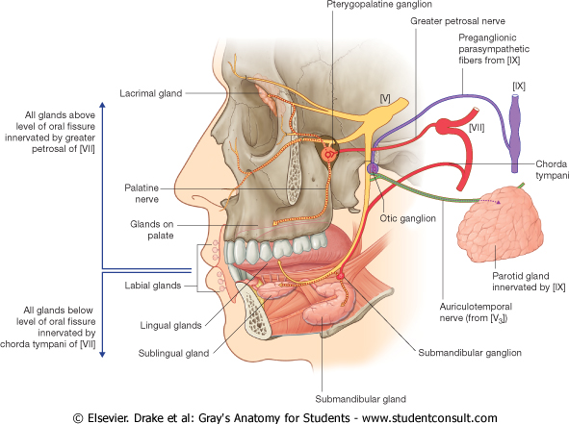
Sublingual Gland
Supply
Arterial supply:
Facial artery.
Lymph drainage:
Submandibular lymph nodes.
Nerve Supply
Parasympathetic secretomotor supply is from superior salivary nucleus of the facial (7th) nerve → The fibers pass to the submandibular ganglion via the chorda tympani nerve and the lingual nerve.
Postganglionic parasympathetic fibers reach the submandibular & sublingual glands either directly or along the duct.
Venous drainage:
Facial vein.

Slide 25
Structures within the gland \Clinical application | NERVE\BLOOD SUPPLY | DUCT | GENERAL NOTES | GLANDS
Structures within the gland: 1- Facial nerve: -TWO Branches before it enters the gland -FIVE Branches within the parotid 2- Retromandibular vein. 3- External carotid artery. | Parasympathetic from inferior salivary nucleus via auriculotemporal nerve Sympathetic: from plexus around external carotid artery. Arterial: ECA & its branches. Venous drainage: retromandibular vein. Lymphatic: parotid & deep cervical lymph nodes. | It opens into the vestibule of the mouth on a small papilla, opposite the upper second molar (maxillary) tooth. | Largest Formed entirely of serous acini Triangular in shape accessory part: A small part that is separated from the main gland. Capsule: Tight, derived from deep cervical fascia of the neck.
Clinical application: -the submandibular duct can be palpated through the floor of the mouth alongside the tongue. Saliva can usually be seen emerging from the orifice of the duct. -common site of calculus formation. The presence of a tense swelling below the body of the mandible. | Arterial supply: Facial + lingual artery. Lymph drainage: Submandibular + deep cervical lymph nodes Parasympathetic secretomotor supply is from superior salivary nucleus via lingual nerve | The duct emerges from the deep part of the gland. It is crossed laterally by the lingual nerve It opens on the summit of a small sublingual papilla, which lies at the side of the frenulum of the tongue. | deep to the body of the mandible Formed of 2 parts: Large superficial part Small deep part
- | Arterial supply: Facial artery. Venous drainage: Facial vein. Lymph drainage: Submandibular lymph nodes Parasympathetic secretomotor supply is from superior salivary nucleus via lingual nerve | sublingual ducts are 8 to 20 in number. Most open into the summit of the sublingual fold, but a few may open into the submandibular duct. | The smallest
PAROTID
SUBMANDIBULAR
SUBLINGUAL

Slide 26
MCQs
5. Which of the salivary is the largest?
A.Sublingual
B.submandibular
C.Parotid
D.Buccal
6. Parotid produces a
A. mixed serous & mucous secretion.
B. serous secretion
C. mucous secretion
D. nothing
7. Structures within the Parotid gland?
A. Facial nerve
B. Retromandibular vein
C. External carotid artery
D. All of the above
1. The submandibular duct emerge from which part of the gland ? A- The superficial part
B- The deep part
C- The anterior part
D- The posterior part
2. The submandibular duct crossed laterally by which structure ?
A- The lingual nerve
B- The facial nerve C- The parotid duct
D- retromandibular vein
3. Which of the following duct is a common site for calculus formation ?
A- The thoracic duct
B- The parotid duct
C- The sublingual duct
D- The submandibular duct
4. What’s the blood supply for the sublingual gland? A- Sublingual artery
B- Facial Artery
C- External carotid artery
D- Submental Artery
8.How many branches the facial nerve gives before it enters the parotid?
A.5 B.2 C.3 D.4
9.Which of the salivary glands is capsulated by the deep cervical faciae?
A.Sublingual
B.submandibular
C.Parotid
D.Buccal
Answers: 1. B, 2. A, 3. D, 4. B, 5. C, 6. B, 7. D, 8. B, 9. C

Slide 27
SAQ
A\ What are the structures within the parotid gland ?
1-Facial nerve – most superficial structure
2- retromandibular vine - intermediate in position
3- External carotid artery – most deep structure
B\ Qhat’s the nerve supply for the parotid gland ?
Sympathetic from plexus around External carotid artery
Parasympathetic from ( inferior salivary nucleus- tympanic nerve ) through the glossopharyngeal nerve to tympanic plexus –lesser petrosal to otic ganglion which is postganglionic fiber running in auriculotemporal nerve

Slide 28
Leaders:
Nawaf AlKhudairy
Jawaher Abanumy
Members:
Alanoud Abuhaimed
Anwar Alajmi
Do'aa abdulfattah
Ghada Alothaim
Lama Alfawzan
Lama AlTamimi
Rawan AlWadee
Reema Alshayie
Reema Alotaibi
Safa Al-Osaimi
Wejdan alzaid
Shatha Alghaihb
Feedback
References:
1- Girls’ & Boys’ Slides
2- Greys Anatomy for Students
3- TeachMeAnatomy.com
anatomyteam436@gmail.com
@anatomy436

