Slide 1

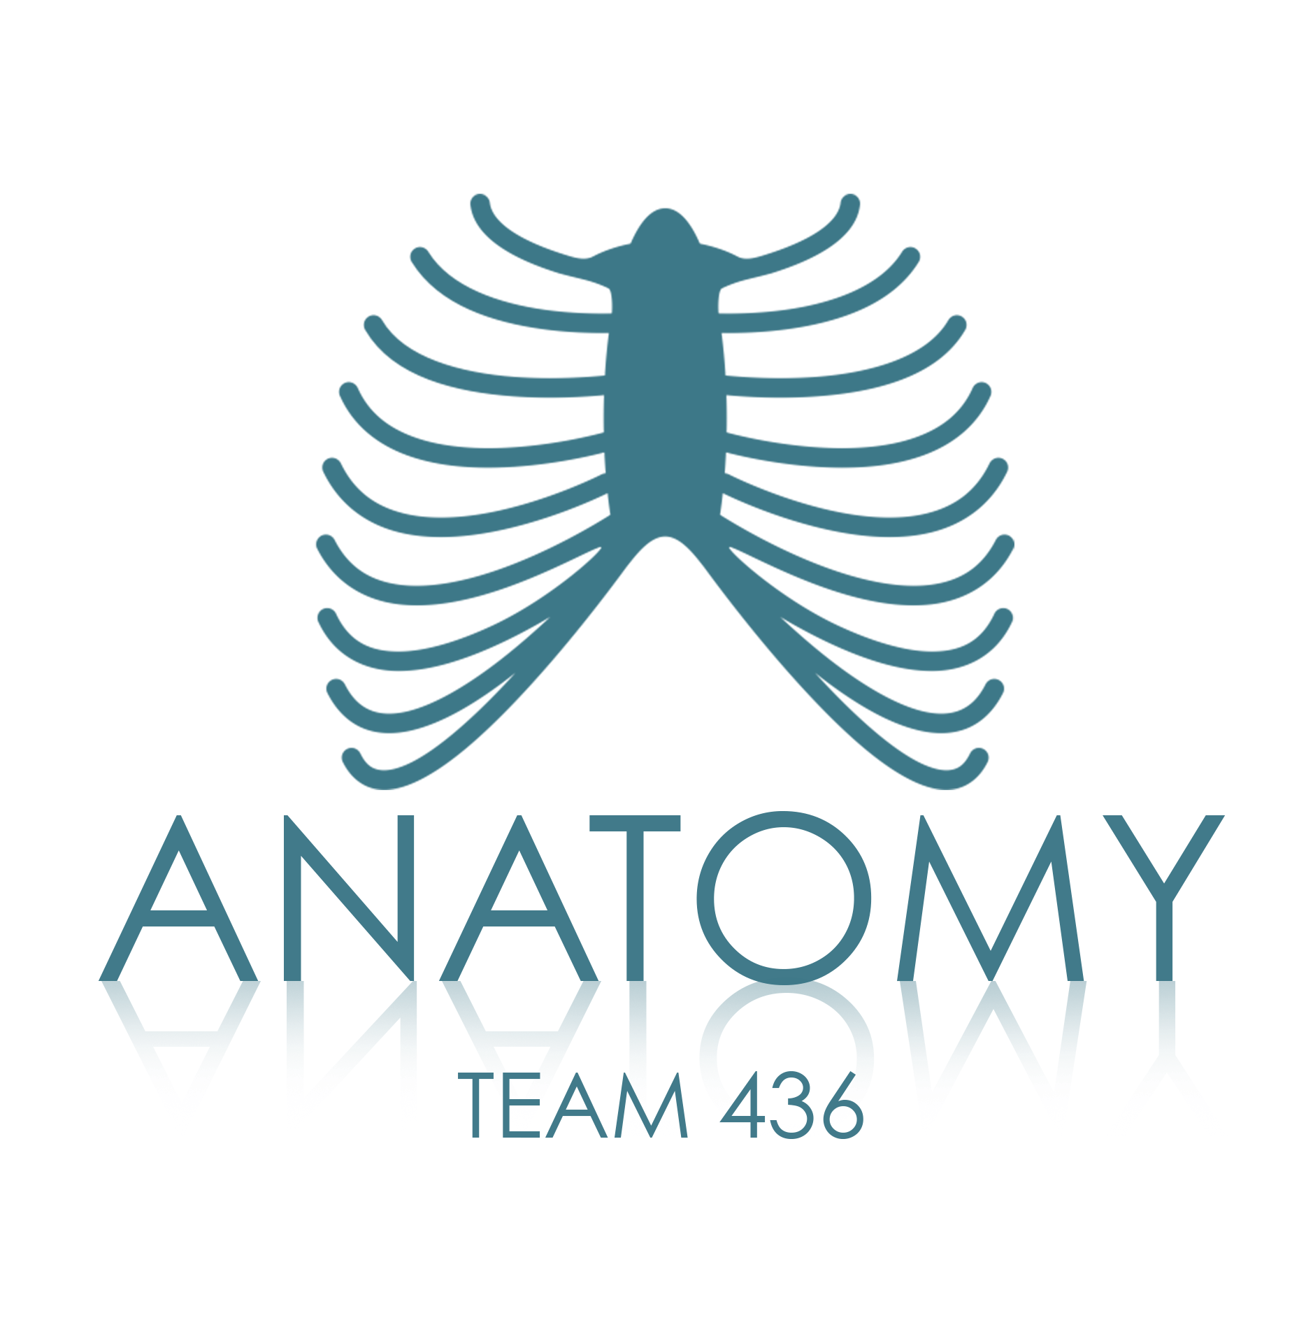
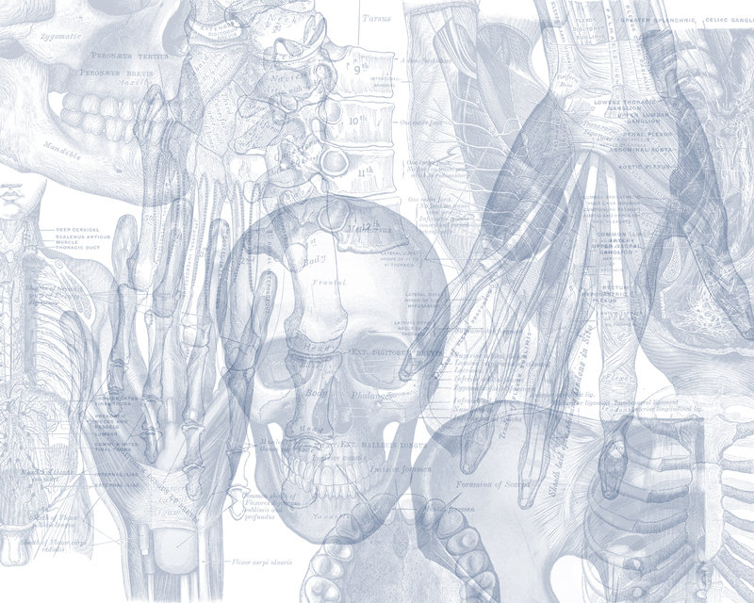


Pancreas and Biliary System
Color Code
Important
Doctors Notes
Notes/Extra explanation
Please view our Editing File before studying this lecture to check for any changes.

Slide 2
Objectives
At the end of the lecture, the student should be able to describe the:
Location, surface anatomy, parts, relations & peritoneal reflection of the pancreas and gall bladder.
Blood supply, nerve supply and lymphatic drainage of pancreas and gall bladder.
Course of each of common hepatic, cystic and common bile duct and pancreatic ducts

Slide 3
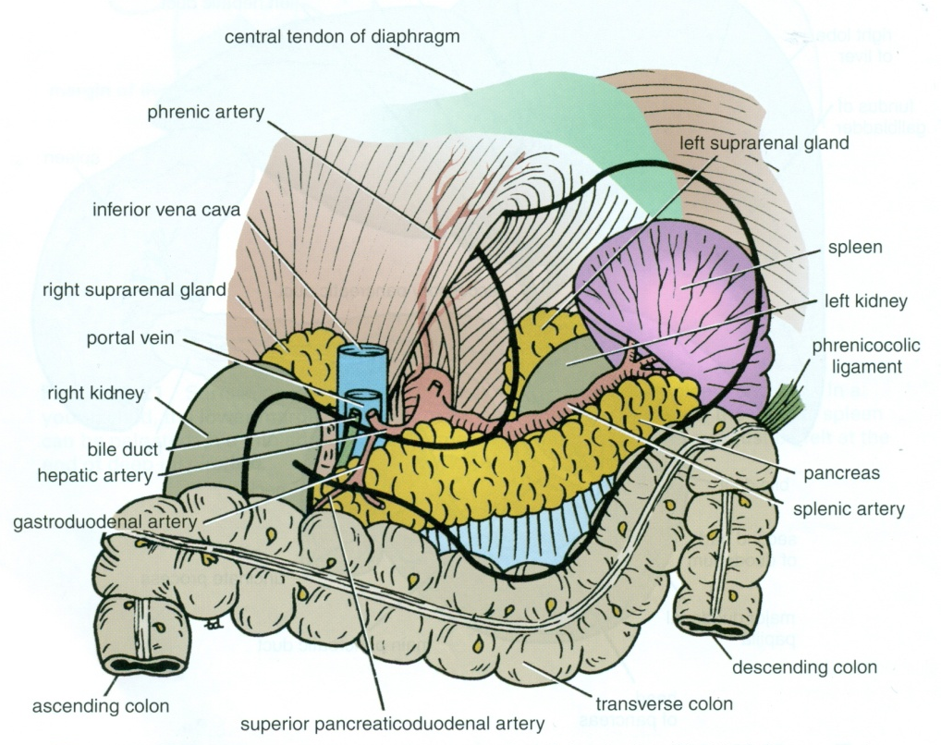
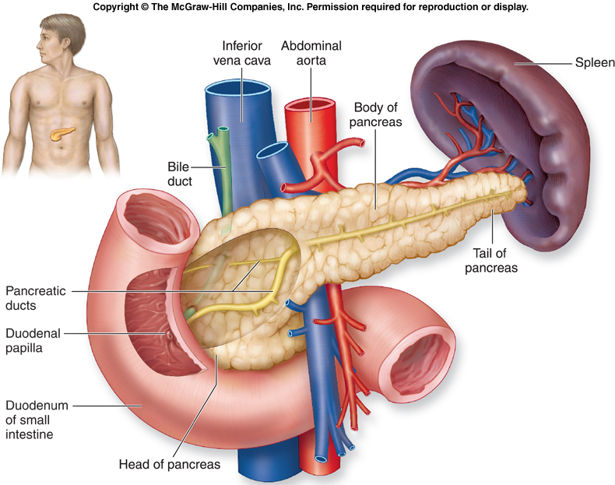
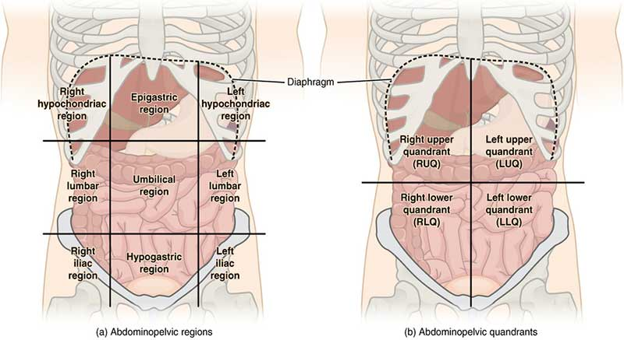
Pancreas
Location
Located in Epigastrium* & Left upper quadrant of abdomen.
Pancreas is a soft, lobulated elongated gland with both exocrine (secretes pancreatic juice) and endocrine (secretes insulin) functions.
6-10 inch in length and 60-100 gram in weight.
Retro-peritoneal** in position.
Lies across the posterior abdominal wall in an oblique directions at the transpyloric plane (L1 vertebra) but the tail is at T12.
Epigastrium* :upper central region of the abdomen.
Retro-peritoneal** : Behind the peritoneum (only covers anterior surface), more fixed (less movement) .
Extra

Slide 4
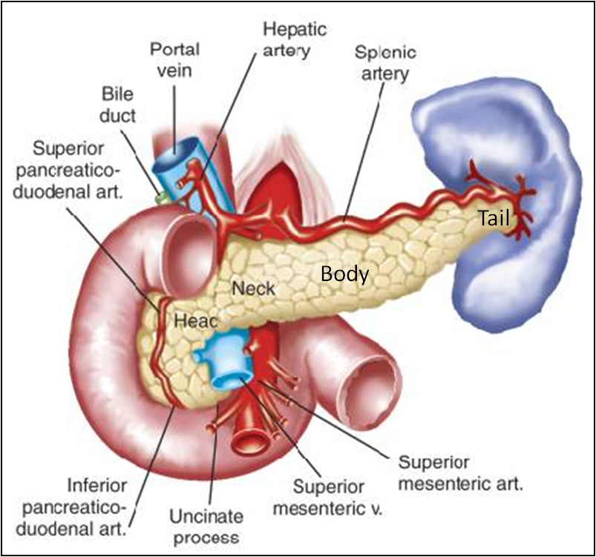
Pancreas
Head
Neck
Body
Tail
PARTS:
It is divided into:
Tail
Neck
Body
Head
uncinate process
Head
Disc shaped, lies within the concavity of the duodenum.
Related to the 2nd and 3rd portions of the duodenum on the right & continues with the neck on the left.
Includes uncinate process (part extending to the left behind the superior mesenteric vessels which descend anterior to it).
Neck
The constricted portion connecting the head & body.
Lies in front of origin of superior mesenteric artery and the confluence (the formation) of the portal vein.
Its antero-superior surface supports (يكون تحتها) the pylorus of the stomach .
The superior mesenteric vessels emerge from its inferior border.

Slide 5
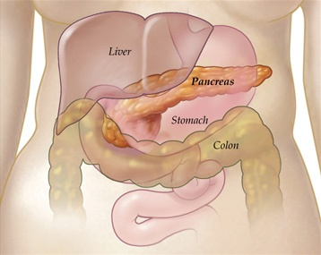
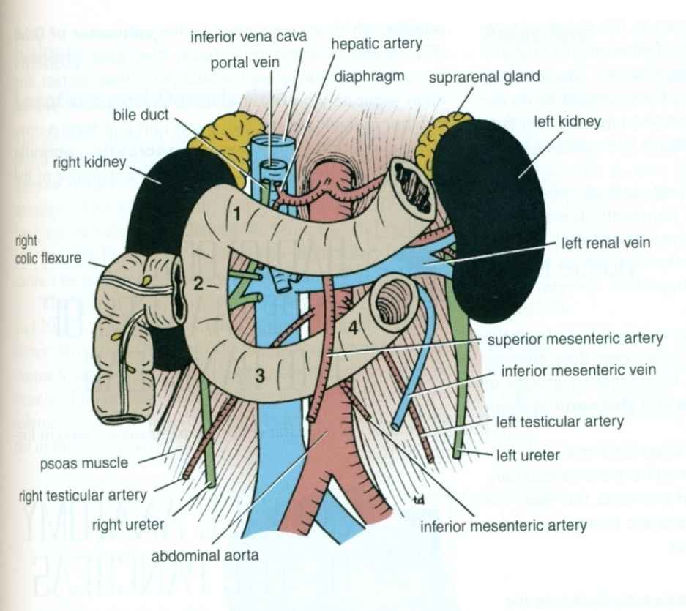
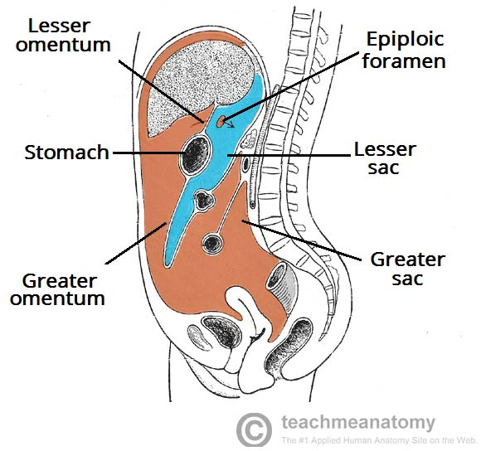
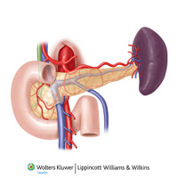
Pancreas
Body
It runs upward and to the left.
It is triangular in cross section.
The splenic vein is embedded in its posterior surface
Tail
Narrow, short segment, ending at the splenic hilum
Lies in the splenicorenal ligament (may get injured during splenectomy), at the level of the T12 vertebra
Anteriorly, related to splenic flexure of colon.
Anterior relations | Posterior relations:
Stomach separated by lesser sac Transverse colon & transverse mesocolon | Bile duct, portal & splenic veins, inferior vena cava, aorta & origin of superior mesenteric artery Left psoas muscle, left adrenal gland, left renal vessels & upper 1/3rd of left kidney Hilum of the spleen.
Extra

Slide 6
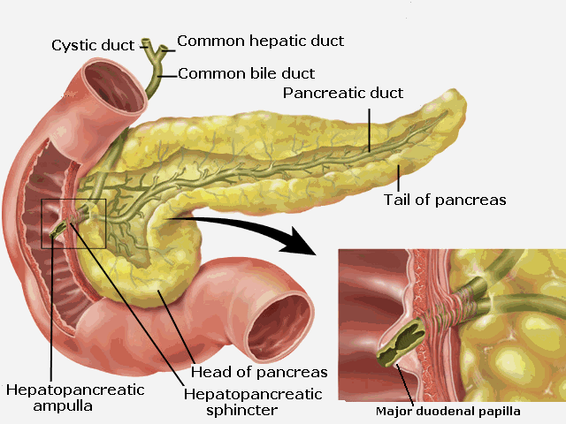
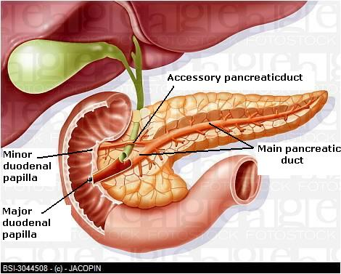
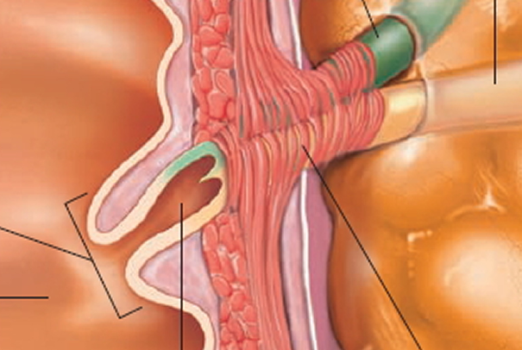
Pancreas
Pancreatic Duct
Major duodenal papilla
Tail
Hepato-pancreatic ampulla
Main duct (of Wirsung): runs the entire length of pancreas beginning from the tail.
  It receives many tributaries from tail, body, neck, inferior portion of head (except superior portion) & uncinate process.
  Joins common bile duct & together they open into a small hepatopancreatic ampulla (Ampulla of Vater) in the duodenal wall
  The ampulla opens into the lumen of the duodenum by means of a small Papilla, (Major duodenal papilla).
Accessory duct (of Santorini) drains superior portion of the head
  It empties separately into 2nd portion of duodenum at (minor duodenal papilla)

Slide 7
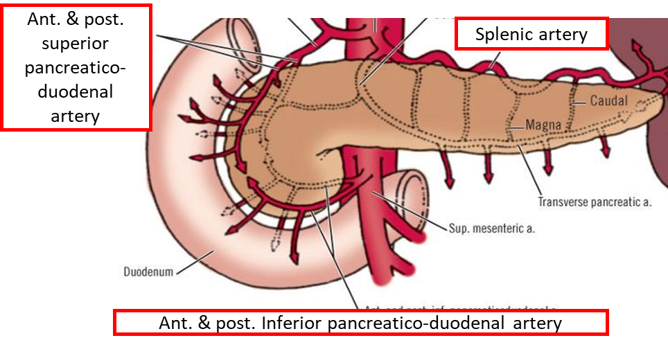
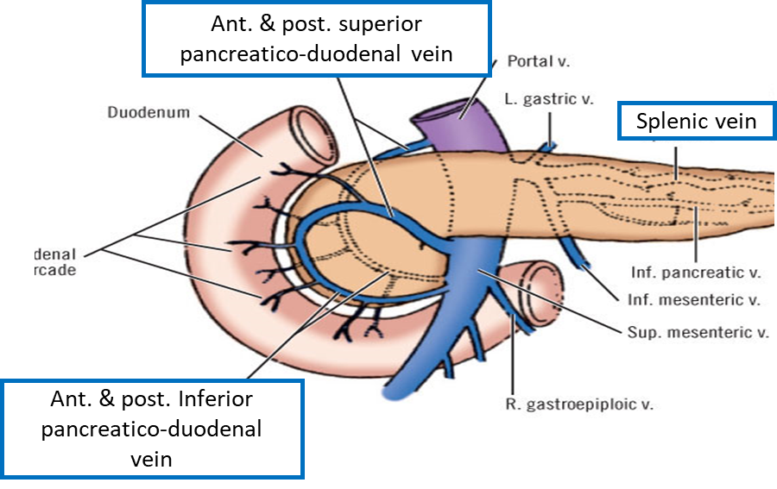
Pancreas
Blood Supply
Arteries
Head & neck: Supplied by branches from:
  Celiac trunk through Superior pancreatico-duodenal artery
  Superior mesenteric artery through Inferior pancreatico-duodenal artery
Body and tail: Supplied by Splenic artery through 8-10 branches
Veins
Head & neck: Drained by anterior and posterior venous arcades that form the superior & inferior pancreaticoduodenal veins which follow the corresponding arteries.
Body and tail: Drained by splenic vein, which is a tributary of portal vein
The superior and inferio pancreatico-duodenal arteries anastomose

Slide 8
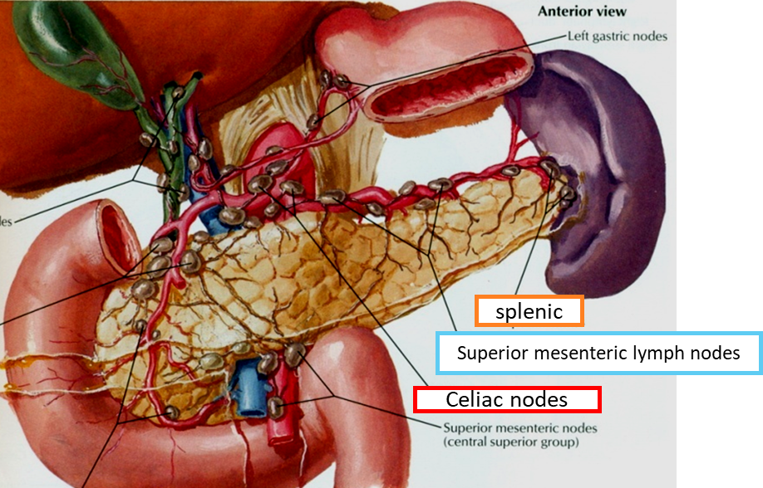
Pancreas
Lymphatic Drainage:
Rich network that drains into pyloric, hepatic and splenic nodes
Ultimately the efferent vessels drain into the celiac & superior mesenteric lymph nodes.
Extra
Innervation:
Sympathetic fibers from the thoracic splanchnic nerves. (Sympathetic fibers have a predominantly inhibitory effect.)
Parasympathetic fibers from the vagus. (Parasympathetic fibers stimulate both exocrine and endocrine secretions)

Slide 9
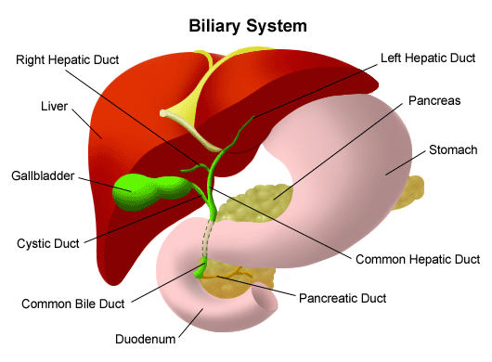
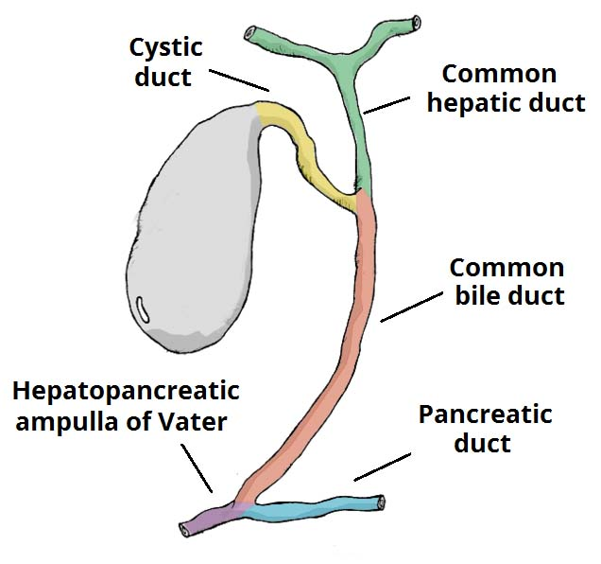
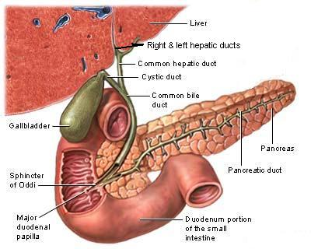
Biliary system
The biliary system consists of the ducts and organs (liver, gallbladder, & bile ducts) that are involved in the production, storage & transportation of bile respectively.
Bile is secreted by the liver cells at a constant rate of about 40 ml/hour. When digestion is not taking place, the bile is stored and concentrated in the gallbladder; later, it is delivered to the duodenum.
The bile ducts consist of
Bile canaliculi (between the liver sacs)
Interlobular ducts
Intrahepatic ducts
Right and left hepatic ducts
Common hepatic duct
Cystic duct (From GB)
Common bile duct (Bile duct)
Join and form larger ducts
Extra

Slide 10
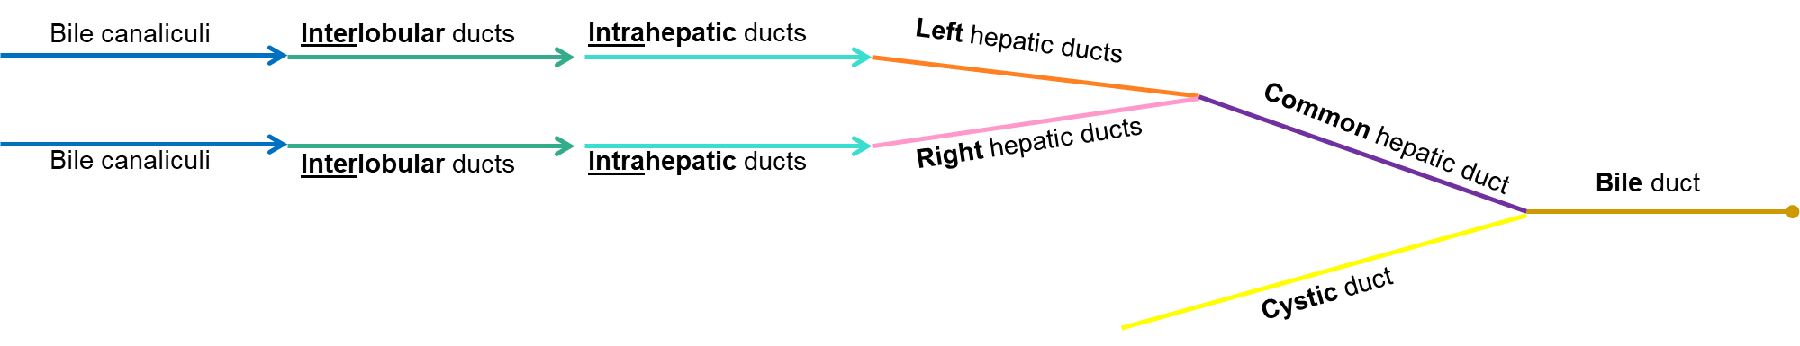
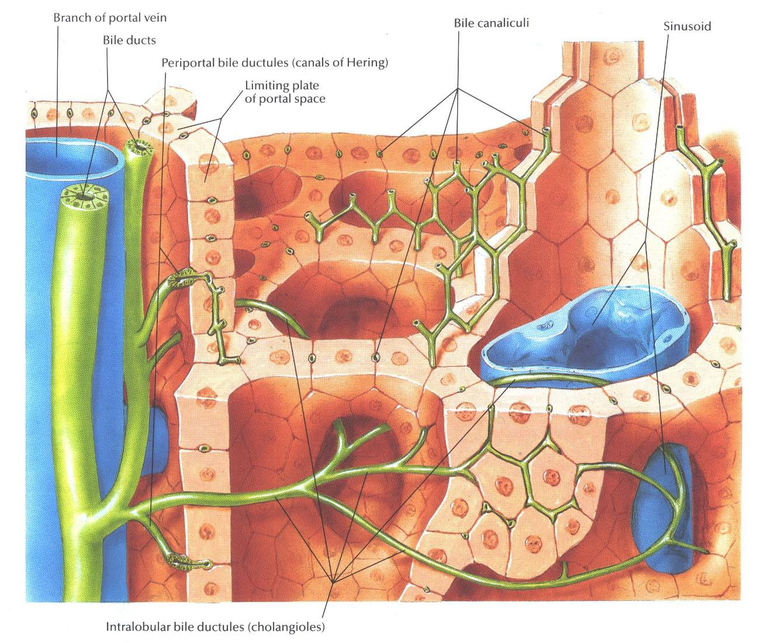
Biliary system
Bile ducts
  The smallest interlobular tributaries of the bile ducts are situated in the portal canals of the liver; they receive the bile canaliculi.
  The interlobular ducts join one another to form progressively larger ducts and, eventually, at the porta hepatis, form the right and left hepatic ducts.
  The right hepatic duct drains the right lobe of the liver and the left duct drains the left lobe, the caudate lobe, & quadrate lobe.
  After a short course, the hepatic ducts unite to form the common hepatic duct.
  The common hepatic duct is about 1.5 in. (4 cm) long and descends within the free margin of the lesser omentum. It is joined on the right side by the cystic duct from the gallbladder to form the common bile duct.
Bile canaliculi
Interlobular tributaries

Slide 11
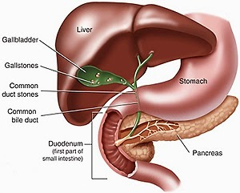
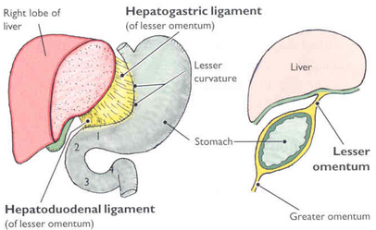
Biliary system
Common Bile Duct
Extra
The common bile duct is about 3 inches (8 cm: 4 → cystic and 4 → common hepatic) long.
Course:
  First it lies in the right free margin of the lesser omentum (will be discussed in a separate lecture).
  Then it runs behind the first part of the duodenum.
  Lastly it lies in a groove on the posterior surface of the head of the pancreas. Here, the bile duct comes into contact with the main pancreatic duct. (cancer of the head of the pancreas will lead to obstructive jaundice due to obstruction of the bile duct)

Slide 12
Biliary system
Common Bile Duct
The bile duct ends below by piercing the medial wall of the second part of the duodenum about halfway down its length.
It is usually joined by the main pancreatic duct, and together they open into a small ampulla in the duodenal wall, called the hepatopancreatic ampulla (ampulla of Vater).
The ampulla opens into the lumen of the duodenum by means of a small papilla, the major duodenal papilla.
The terminal parts of both ducts and the ampulla are surrounded by circular muscle, known as the sphincter of the hepatopancreatic ampulla (sphincter of Oddi). (this sphincter is constricted when we're not eating. so the bile goes back to the gallbladder)
Occasionally, the bile and pancreatic ducts open separately into the duodenum.

Slide 13
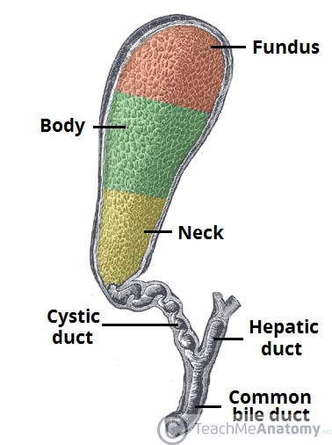
Gallbladder
A pear-shaped sac lying on the undersurface of the liver.
It has a capacity of 30 to 50 ml , it stores bile, which is concentrated by absorbing water.
The gallbladder is divided into: the fundus, body, and neck.
The fundus is rounded and projects below the inferior margin of the liver, where it comes in contact with the anterior abdominal wall at the level of the tip of the ninth right costal cartilage.
The body lies in contact with the visceral surface of the liver and is directed upward, backward, and to the left.
The neck becomes continuous with the cystic duct, which turns into the lesser omentum, joins the common hepatic duct, to form the bile duct
Extra

Slide 14
Gallbladder
The peritoneum completely surrounds the fundus of the gallbladder and binds the body and neck to the visceral surface of the liver.
Relations
Anteriorly:
The anterior abdominal wall
the inferior surface of the liver
Posteriorly:
The transverse colon
the first and second parts of the duodenum
Function of the Gallbladder
When digestion is not taking place, the sphincter of Oddi remains closed and bile accumulates in the gallbladder.
The gallbladder concentrates & stores bile; selectively absorbs bile salts, keeps the bile acid; it excretes cholesterol; and secretes mucus.
To aid in these functions, the mucous membrane (mucosa) is thrown into permanent folds that unite with each other, giving the surface a honeycombed appearance.

Slide 15
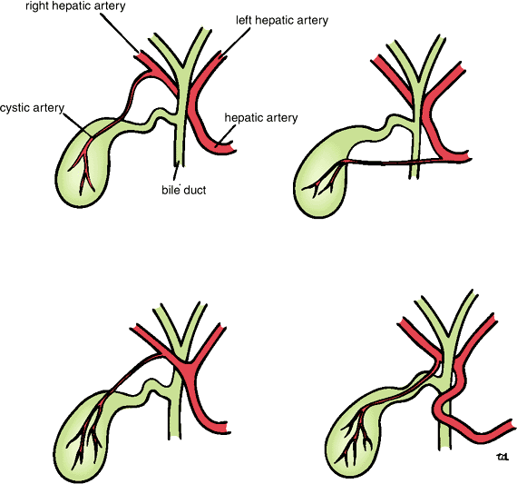
Gallbladder
Blood supply | The cystic artery, a branch of the right hepatic artery. The cystic vein drains directly into the portal vein. Several very small arteries and veins also run between the liver and gallbladder.
Lymph drainage | The lymph drains into a cystic lymph node situated near the neck of the gallbladder. From here, the lymph vessels pass to the hepatic nodes along the course of the hepatic artery and then to the celiac nodes.
Nerve supply | Sympathetic and parasympathetic vagal fibers form the celiac plexus. The gallbladder contracts in response to the hormone cholecystokinin, which is produced by the mucous membrane of the duodenum on the arrival of fatty food from the stomach
Right hepatic artery
Cystic artery

Slide 16
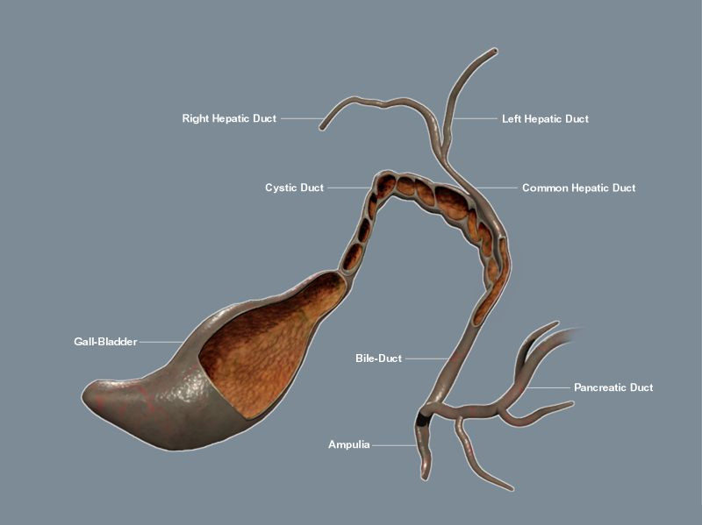
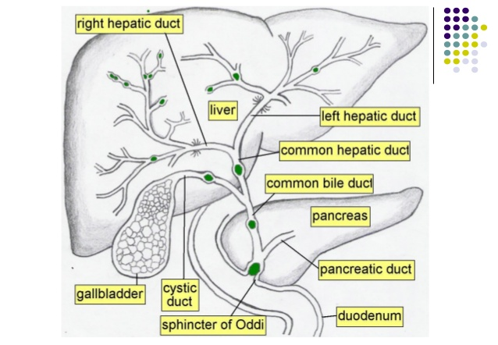
Cystic Duct
The cystic duct is about 1.5 in. (3.8 cm) long and connects the neck of the gallbladder to the common hepatic duct to form the bile duct.
It is usually somewhat S-shaped and descends for a variable distance in the right free margin of the lesser omentum.
The mucous membrane of the cystic duct is raised to form a spiral fold that is continuous with a similar fold in the neck of the gallbladder.
The fold is commonly known as the “spiral valve.” The function of the spiral valve is to keep the lumen constantly open.
Extra

Slide 17
SUMMARY
 |  | Pancreas | Gallbladder
Parts |  | Head, neck, body → L1 Tail → T12 | Fundus, body, and neck
Relations | Anteriorly | Stomach separated by lesser sac Transverse colon & transverse mesocolon | Anterior abdominal wall Inferior surface of the liver
 | Posteriorly | Bile duct, portal & splenic veins, inferior vena cava, aorta & origin of superior mesenteric artery Left psoas muscle, left adrenal gland, left renal vessels & upper 1/3rd of left kidney Hilum of the spleen. | Transverse colon First and second part of duodenum
Duct |  | Main Duct (of Wirsung): Joins common bile duct & together they open into a small hepatopancreatic ampulla (Ampulla of Vater) Accessory Duct (of Santorini) drains superior portion of the head | Cystic duct connects the neck of the gallbladder to the common hepatic duct to form the bile duct
Arterial supply |  | Head and neck: superior pancreatico-duodenal artery (celiac) and inferior pancreatico-duodenal artery (superior mesenteric) Body and tail: splenic artery (celiac) | Cystic artery (right hepatic artery)
Venous drainage |  | Head and neck: superior and inferior pancreatico-duodenal veins Body and tail: splenic vein → portal vein | Cystic vein → portal vein
Lymphatic drainage |  | Pyloric, hepatic and splenic nodes → celiac and superior mesenteric nodes | Cystic lymph node → hepatic nodes → celiac nodes
Nerve supply |  | Sympathetic: thoracic splanchnic nerves (inhibitory) Parasympathetic: vagus nerve (excitatory) | Sympathetic and parasympathetic vagal fibers form celiac plexus

Slide 18
MCQS
1-Which of the following is part of the Bile Ducts?
A-Interhepatic duct
B-Intralobular duct
C-Interlobular duct
D-non of the them
6-The gallbladder contracts in response to which hormone ?
A- secretin
B- gastrin
C- cholecystokinin
7- cystic duct connects the neck of the gallbladder to the common hepatic duct to form ?
A pancreatic duct
B right hepatic duct
C left hepatic duct
D bile duct
2-The Bile Secretion Rate is:
A-20 ml/hour
B-40 ml/hour
C-60 ml/hour
D-80 ml/hour
3-Which of the following is responsible for STORAGE of bile?
A-Bile Ducts
B-Liver
C-Gallbladder
8-The right and left hepatic ducts are formed at:
A-porta hepatis
B-splenic flexure
C-second part of duodenum
D- fundus of gallbladder
9- The fundus of the gallbladder comes in contact with the anterior abdominal wall at the level of:
A-9th right rib
B-8th right rib
C-tip of the 9th right costal cartilage
D-tip of the 8th right costal cartilage
4-Which part of the pancreas includes the uncinate process ?
A-Head
B-Neck
C-Body
D-Tail
5-. The pancreas is related to the posterior abdominal wall at :
A-9th right costal cartilage
B-8th right costal cartilage
C-Transpyloric plane L1
D-Transpyloric plane C6
1. C, 2. B, 3. C, 4. A, 5. C, 6. C, 7. D, 8. A, 9. C

Slide 19



Leaders:
Nawaf AlKhudairy
Jawaher Abanumy
Members:
Talal alhuqayl
Khalid aldakheel
Mohammed habib
Hamad AlKhudairy
Majed alzain
Mohammed nuser
Abdulaziz alsalman
Anwar Alajmi
Feedback
References:
1- Girls’ & Boys’ Slides
2- Greys Anatomy for Students
3- TeachMeAnatomy.com
anatomyteam436@gmail.com
@anatomy436

