Slide 1


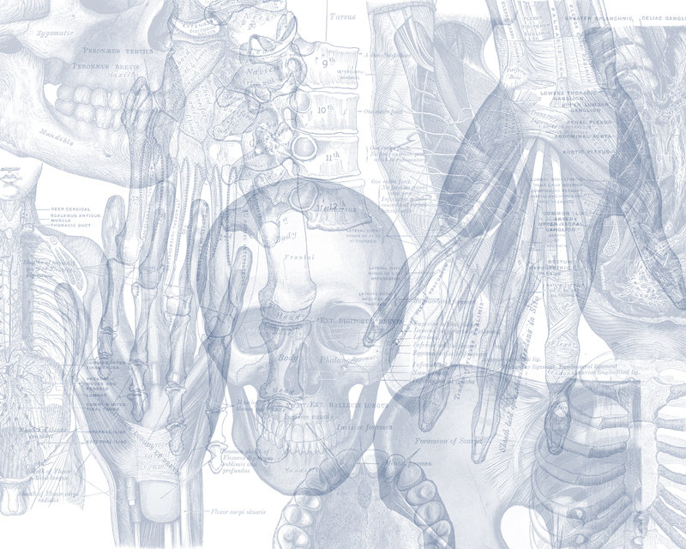


Introduction to Pluripotent Stem Cells
Color Code
Important
Doctors Notes
Notes/Extra explanation
Please view our Editing File before studying this lecture to check for any changes.

Slide 2
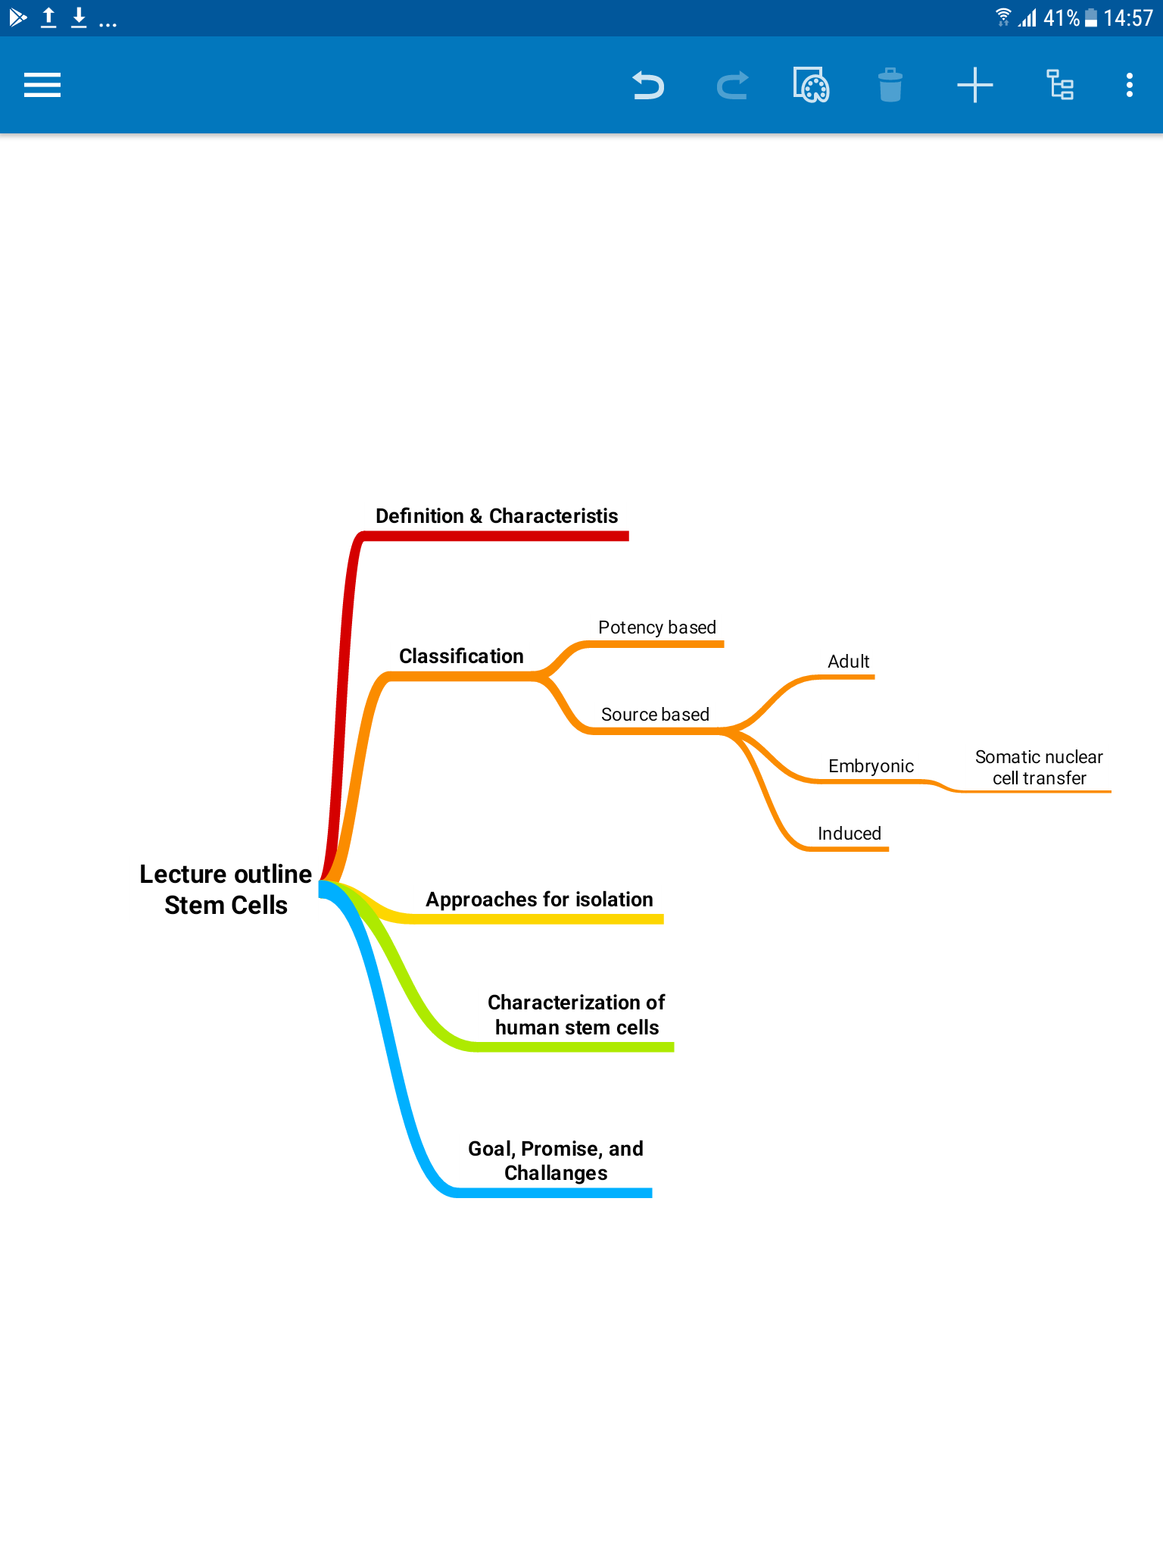
Objectives
By the end of the lecture you should be able to:
Stem Cell – Definition
Stem Cell – main function within the body
Where can we find Stem Cells?
Classifications of stem cells
Embryonic Stem Cell
Adult stem cells (Tissue Specific Stem Cell)
Induced Pluripotent Stem Cell (iPS) cells
Different approaches for isolation of pluripotent stem cells.
The Promise of Stem Cell Technology.

Slide 3
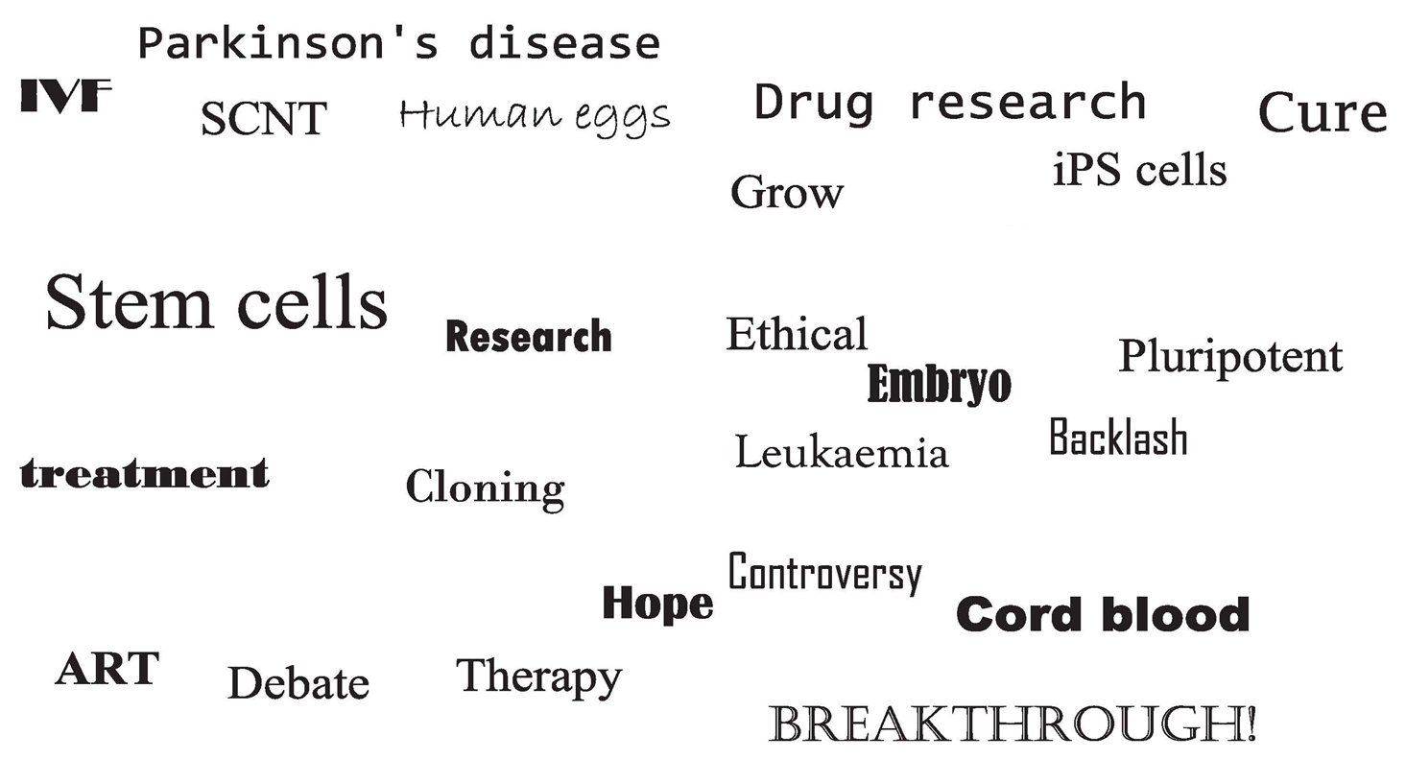
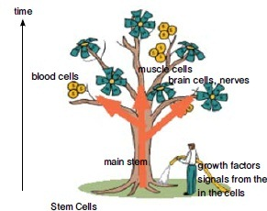
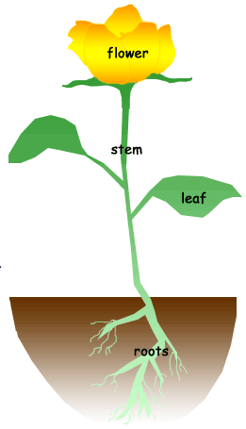

Stem Cells: Introduction
Only on the girls’ slides
When we hear stem cells all these words come to mind but in fact the main goal of stem cell is to provide a cure and regenerate cells which couldn’t regenerate
Here we can compare the stem cells to the roots of the plants. The root gives the stem which can give leaves and flowers, and in the same way stem cells can differentiate depending on the micro-environment factors into more than 200 types of cells, example muscle, nerve, blood, etc.

Slide 4
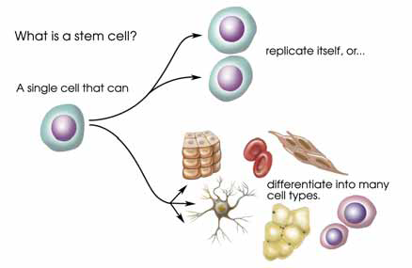
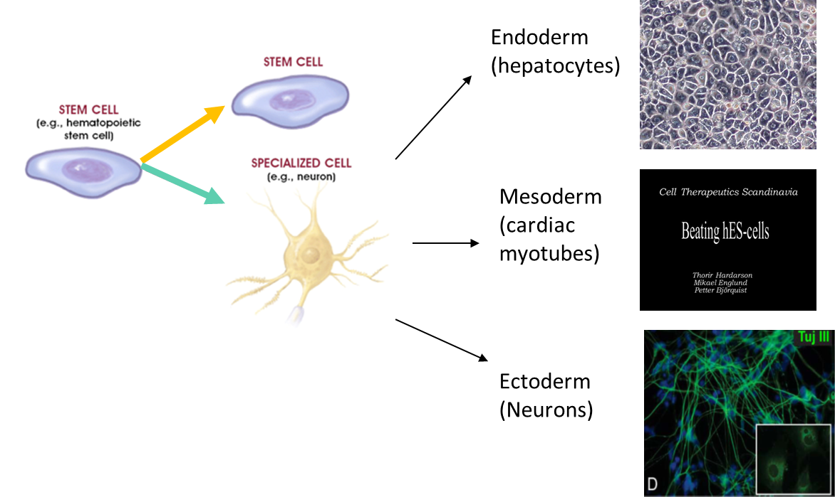
Stem Cells
Self-renewal
Definition
A cell that has the ability:
to continuously divide and give rise to new copy of itself (self-renew)
and other specialized ( differentiated ) cells/tissues.
Stem cells divide to new cell that has the potential to either remain a stem cell or become another type of cell with a more specialized function as cells of the blood, heart, bones, skin, muscles, brain etc, serving as a sort of repair system for the body.
Main function within the body:
Continuous Repair of defective cell types and regeneration of tissues.
A stem cell
Differentiation
Example: diabetes treatment were the cells differentiate into islets of langerhan (which produce insulin) then we transplant it into the human.
We classify stem cells in 2 ways:
According to potency: totipotent, pluripotent multipotent, unipotent, etc.
According to source: embryonic, adult

Slide 5
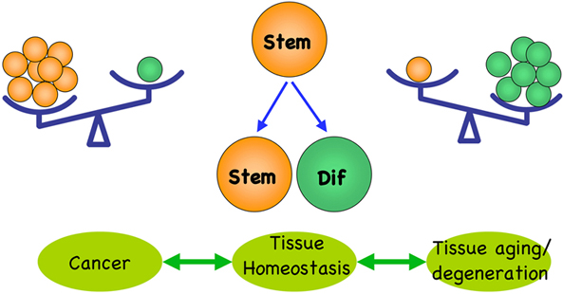
Stem Cells
Only on the girls’ slides
Unique Characteristics of Stem Cells
Unlimited self renewal (Regeneration) it divides to give copies of itself and this is the main idea behind treating degenerative disease.
Differentiation (eg. beating cells of the heart muscles) which depends on:
Internal signals (specific genes)
External signals (GF, cytokines) → they amplify the microenvironment around cells
For tissue homeostasis or health to be maintained there has to be a balance between these two characteristics. If there is imbalance:
Too much regeneration and unlimited dividing will result in cancer
Too much differentiation without enough regeneration will lead to aging and degeneration
A
B

Slide 6
The History of Stem Cells for your information
Only on the girls’ slides
Treatment
Great discovery
iPS: induced pluripotent stem cell
Gold stone
HSC = hematopoietic stem cell transplanted to leukaemia patient
*
HeLa cells can divide unlimitedly
* In vitro= Outside the body

Slide 7
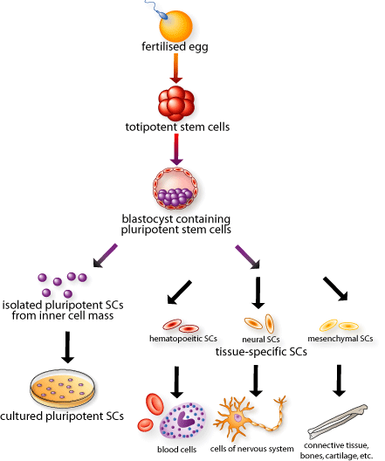
Classification of stem cells
(potency based)
Important
Potency = قدرة الخلية
This cell can form the Embryo and placenta
(morula)
Totipotent (Total)
    1-3 days, differentiate into (intra)embryonic and extraembryonic cell types.
Pluripotent (plural)
(blastocyst)
Most important one that we use
    Descendants of totipotent cells and differentiate into cells of 3 germ layers
Without placenta and extraembryonic cell types
This cell can just form the embryo
Multipotent (multiple)
Produce cells of closely related of cells (e.g. hematopoietic from bone marrow) family stem cells
Oligopotent
محدود
    Differentiate into ONLY a few cells, such as lymphoid or myeloid stem cells
Unipotent
    Produce ONLY one cell type (e.g. muscle stem cells & testes)
Nullpotent
Fully mature
    The terminal cells

Slide 8
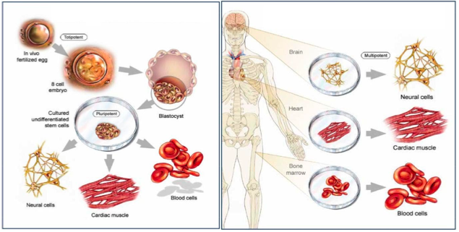
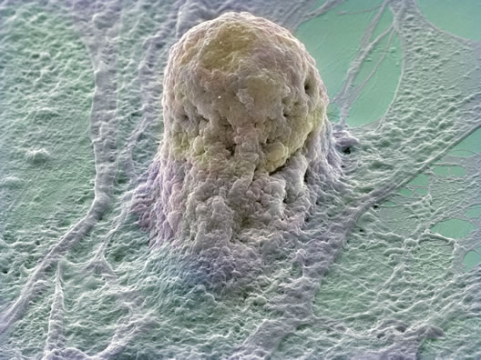
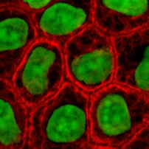
Classification of stem cells
(source based)
 | Embryonic Stem Cells (ESC) | Adult Stem Cells (ASC)
Source | IVF embryos Aborted embryos cloned embryos | Bone Marrow Placental Cord Mesenchymal Stem cells
Potency | Pluripotent large number can be harvested | Multipotent Limited numbers and more difficult to isolate
Note | May cause immune rejection Ethical concerns | No immune rejection (Because it comes form the patient to the same patient) No Ethical concerns
Picture
advantage
disadvantage
disadvantage
advantage
Now we will discuss each type in more detail

Slide 9
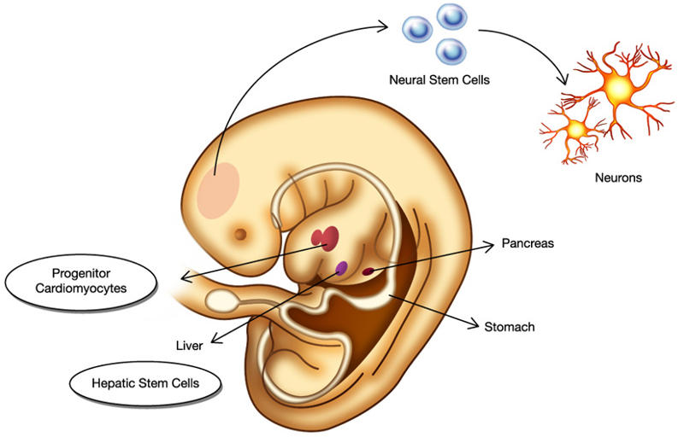
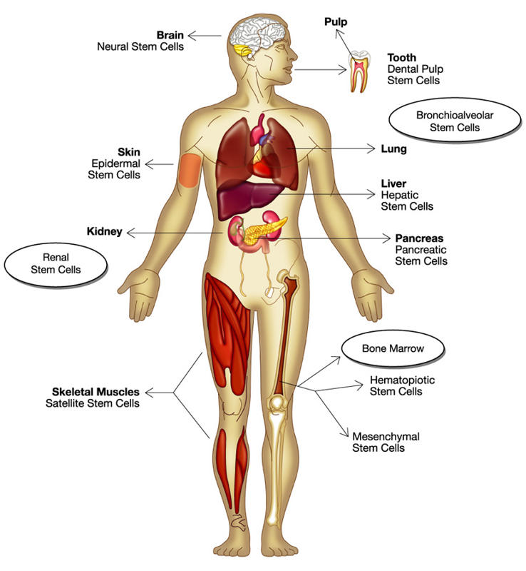
1- Adult* stem cells (Tissue Specific Stem Cell)
* Adult means any cell after day 14 when it becomes multipotent.
note that there is a difference between embryonic and fetus stem cells. Fetus stem cells are considered adult stem cells
A
B
Found in specific mature body tissues as well as the umbilical cord and placenta after birth.
They also can be isolated of developing embryos’ different tissues (after Day 14)
Can be derived from:
Bone marrow
Placental cord
Mesenchymal stem cells.
Menstrual blood may also contain stem cells
Mothers milk can also contain adult stem cells (which reminds us of القرابة بالرضاعة since some stem cells actually transfer from the mothers milk to the baby)

Slide 10
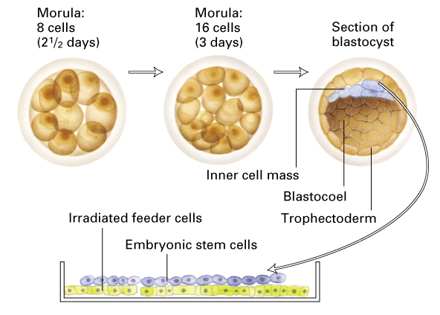
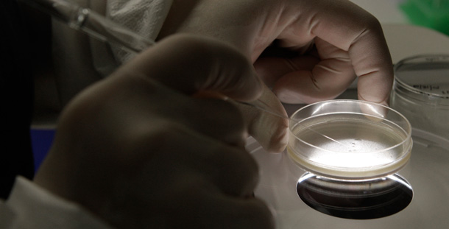
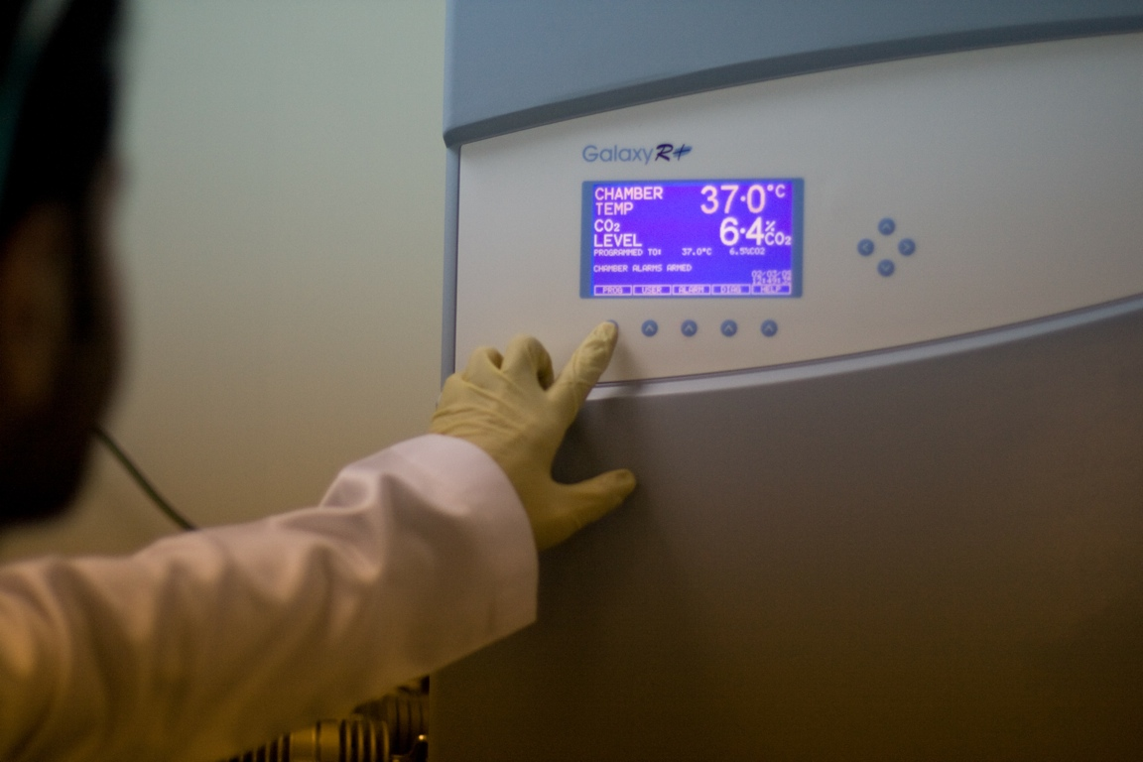
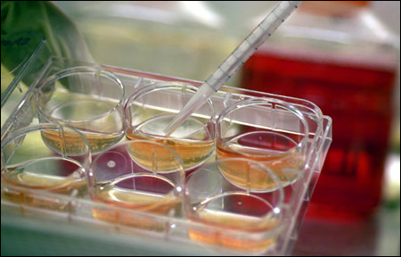
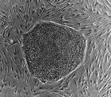
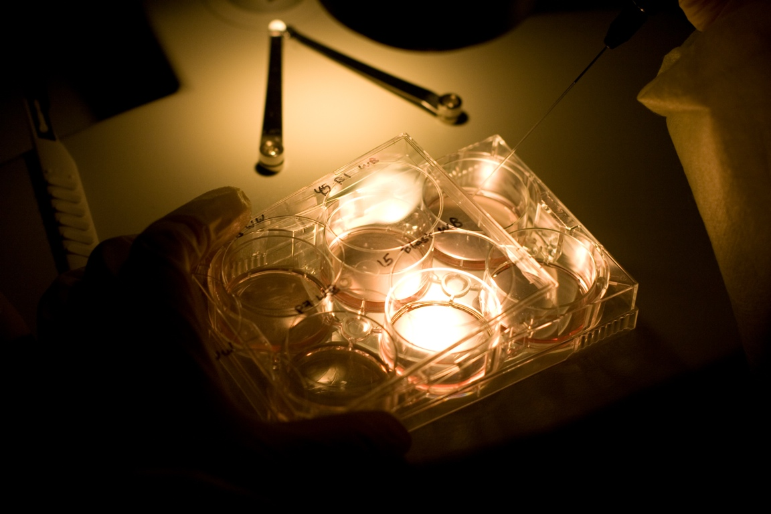
2- Embryonic Stem Cell (ESC)
Embryonic human stem cells were first isolated in 1995 by Dr. James Thomson.
Derived from 4-5 day old embryo (Blastocyst) (IVF*, SCNT**) which consists of:
Trophoblast
Blastocoel
Inner Cell Mass (ICS) this is the part we care about
*IVF: In Vitro Fertilization is a process of fertalization by extracting eggs and a sperm, manually combining them in a laboratory dish then transferring them to a uterus
**SCNT: Somatic Cell Nuclear Transfer (will be discussed later)
Isolate and transfer of ICS into culture dish in culture media
Culture at 37c and 5% CO2
Inner surface of culture dish is coated with inactivated MEF*s as a feeder layer: provides sticky surface for attachment and release nutrients
Cells divide and spread over the dish
ESCs are removed gently and plated into several different culture plates.
Generation of embryonic stem cells:
1
2
3
4
5
*MEF: mouse embryo fibroblast, they are used as a feeder layer to prevent differentiation of embryonic stem cells.
They stop the division but the cells are still alive

Slide 11
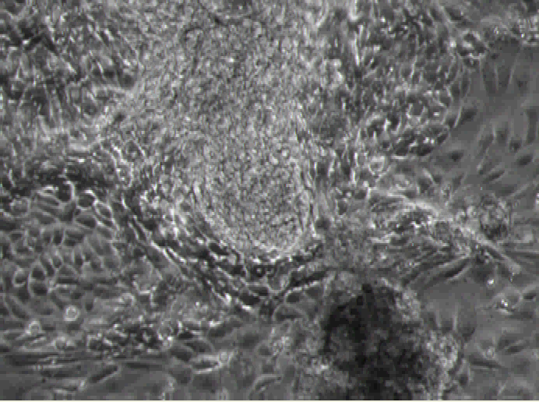
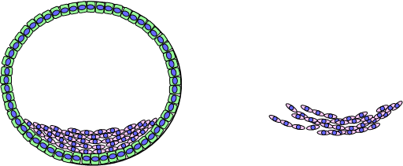
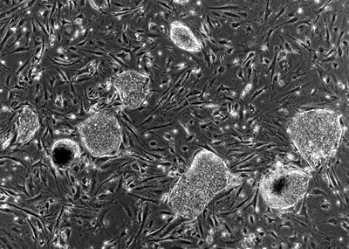
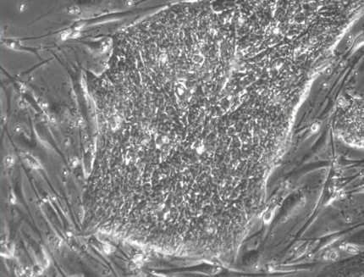
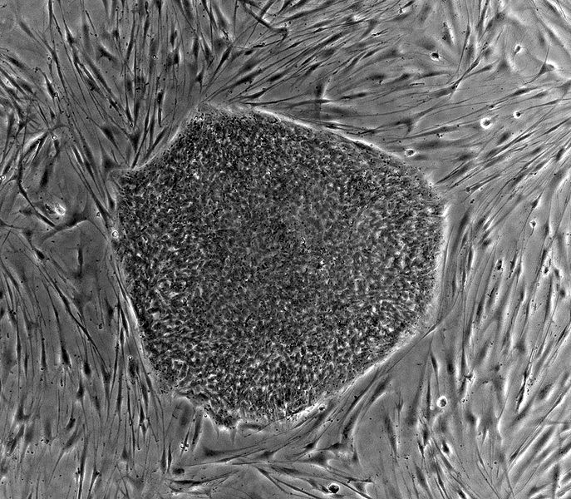
2- Embryonic Stem Cell (ESC)
Beating cardiomyocytes derived from hESCs
What do cultured ES cells look like?
This is a video showing cardiac cells beating. (to view it download the ppt version)
Mouse embryonic cells (feeder layer)
The lines around that surround ESC
Embryonic stem cell colony with distinct border
Embryonic stem cells in the dish

Slide 12
2- Embryonic Stem Cell (ESC)
Challenges with Embryonic Stem Cells
Recently, abnormalities in chromosome number and structure were found in some human ESC lines. (long term and long time culture lead to abnormal chromosomes)
Stem cell development or proliferation must be controlled once placed into patients. (to not cause cancer)
Stem cells need to be differentiated to the appropriate cell types before they can be used clinically. (if they are inserted before they are differentiated they might multiply and form cancer)
The use of mouse “feeder” cells to grow ESC could result in problems due to xenotransplantation*. (the feeder layer is supposed to be removed before we use the ESC but all isolation methods don’t guarantee not having feeder layer in the sample. Now there are medias to grow without feeder layer)
Possibility of rejection of stem cell transplants as foreign tissues is very high.
*xenotransplantation: process of transplanting tissues between organisms.

Slide 13
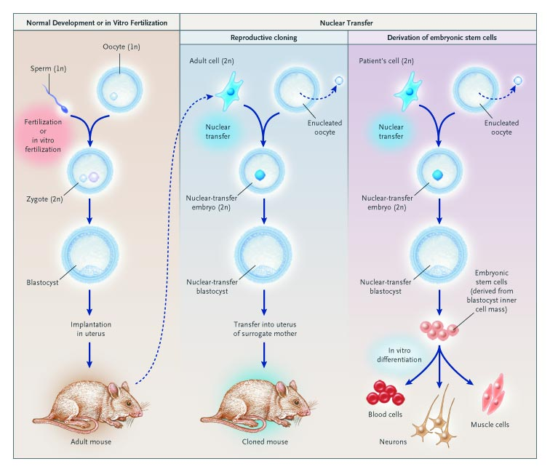
Somatic Cell Nuclear Transfer (SCNT)
Only on the girls’ slides
A new technique to prevent graft immuno-rejection
A
  B
In nuclear transfer we take an oocyte and remove its nucleus then take a nucleus from a somatic cell (which already has 46 chromosomes) and insert it.
Then it is exposed to electrical induction to divide and form blastocyst.
Then if we want (A) reproductive cloning we transfer it to a surrogate mother or (B) we take the inner cell layer from the blastocyst and grow a specific type of tissue
Note: because the DNA is derived from the same person there is no immunological reaction
Recall that all cells have 46 chromosomes except sex cells which have 23 chromosomes.
In normal fertilization a sperm (23 chromosomes) and an oocyte (23 chromosomes) fuse to make a zygote (46 chromosomes) which becomes a blastocyst then continues to develop into a full organism.

Slide 14
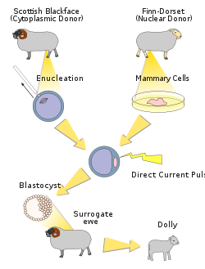
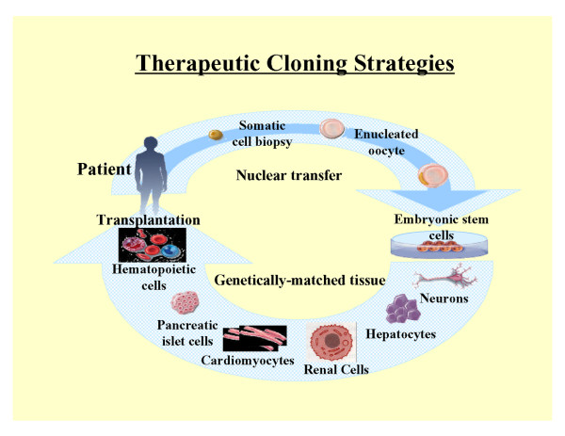

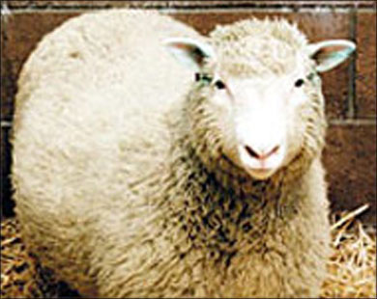
Somatic Cell Nuclear Transfer (SCNT)
Only on the girls’ slides
Nuclear transfer (cloning) can be used in 2 ways: reproductive (producing identical offspring) or therapeutic (which is the main goal)
Reproductive Cloning
Therapeutic Cloning
Dolly is a sheep that was cloned from another sheep using the same method we discussed before. An oocyte was deprived of its nucleus and a different nucleus was inserted and the blastocyst was reinserted into a surrogate mother.
To learn more about dolly →
Therapeutic cloning uses stem cells to correct diseases and other health problems that someone may encounter.
Therapeutic cloning does not cloned to make full humans but rather is used for the stem cells of embryo
02:24
(July 1996 – February 2003)
Notes:
To overcome the possibility of rejection of stem cell transplants as foreign tissues a new technology has been developed

Slide 15
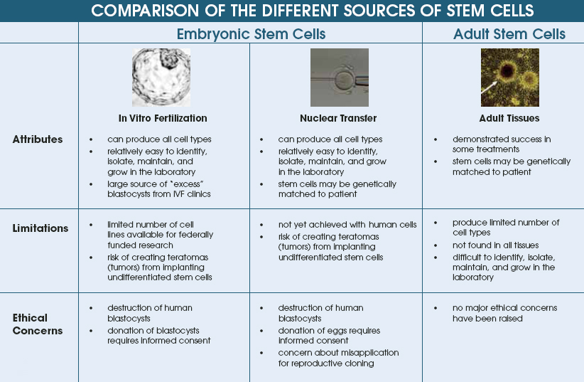
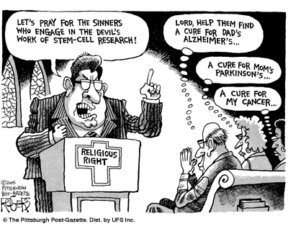
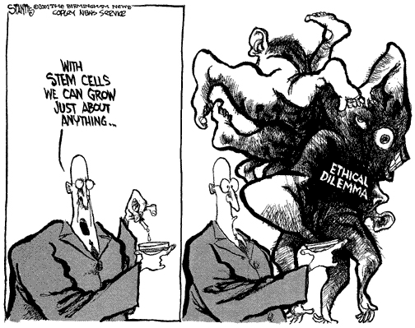
Only on the girls’ slides
some studies were successful
A BIG problem stem cell researchers faced was the ethical concerns

Slide 16
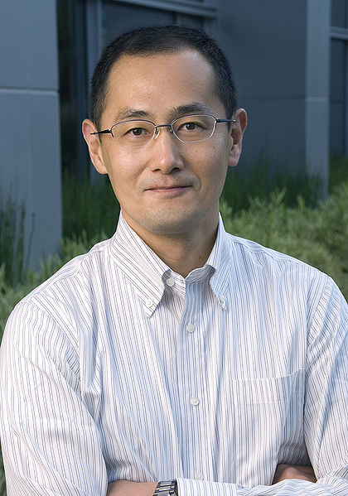
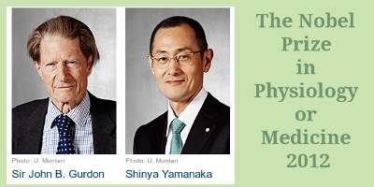
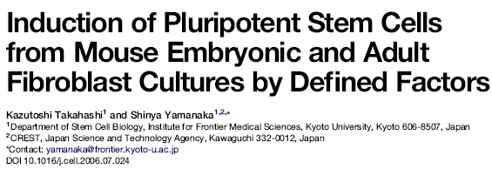

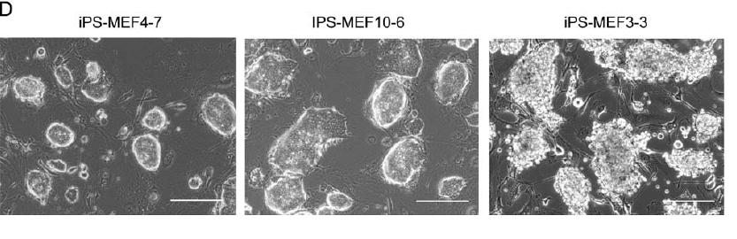
The First iPS
Only on the girls’ slides
In late 2006 the group of Takahashi and Yamanaka reported the stimulation of cells of adult and embryonic origin to pluripotent stem cells called induced pluripotent stem (iPS) cells.
This was a milestone because they found a solution to the ethical dilemma and immunological reaction. They took somatic cells and redirected them to pluripotent stem cells. Because they did not use embryos (this eliminated the ethical problem) and they used cells from the same person (so no immunological reaction) This was a medical breakthrough for which they won Nobel prizes.

Slide 17
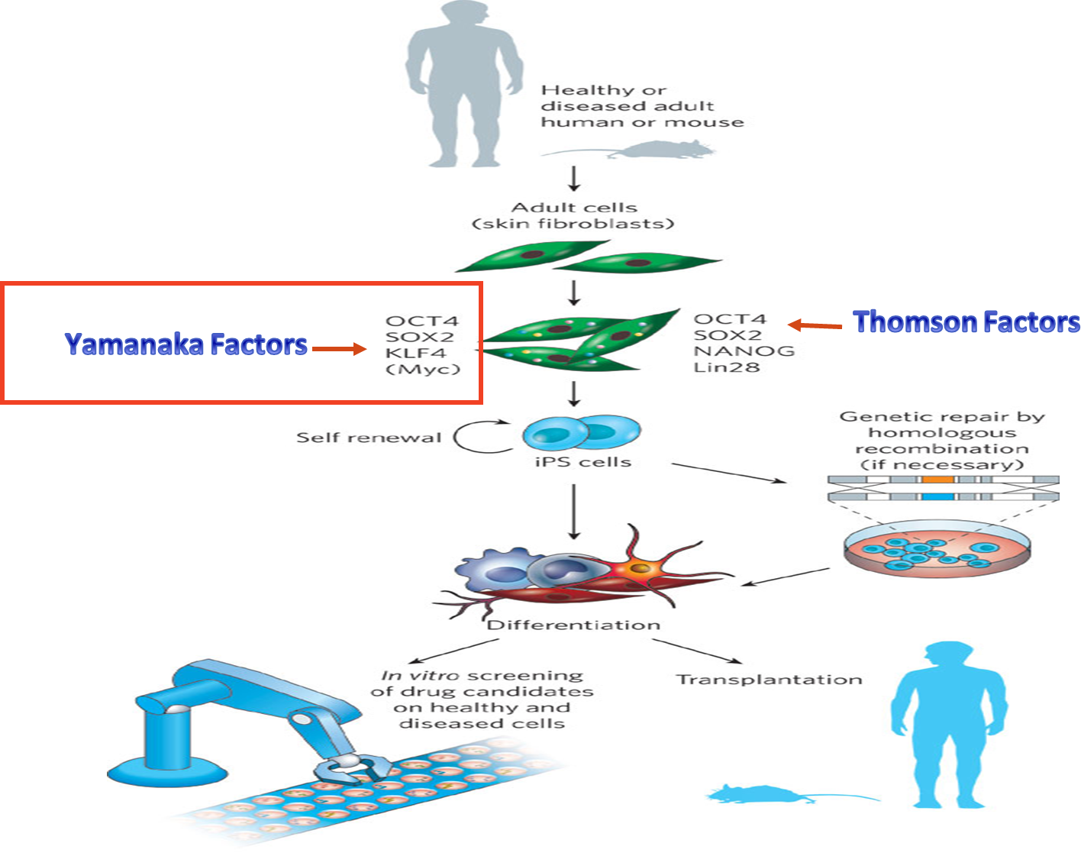
iPS Cells
Only on the girls’ slides
Yamanaka started with 24 pluripotent transcription factors and did a lot of trials then found that only four are the ones that can be used (now called Yamanaka factors OCT4, SOX2, KLF4 and Myc).
These factors reprogram somatic stem cells into pluripotent state. The transcription of the Yamanaka factors is done by viruses vectors (retrovirus and adenovirus and in 2009 they found it can be done without viruses).
Another researcher called Thomson also found his pluripotent factors (OCT4, SOX2, NANOG and Lin28).
After that the pluripotent stem cells can be differentiated in-vitro to the desired cell type.
If there are any mutations causing a disease it can be fixed by homologous recombination before transplanting into the body.

Slide 18
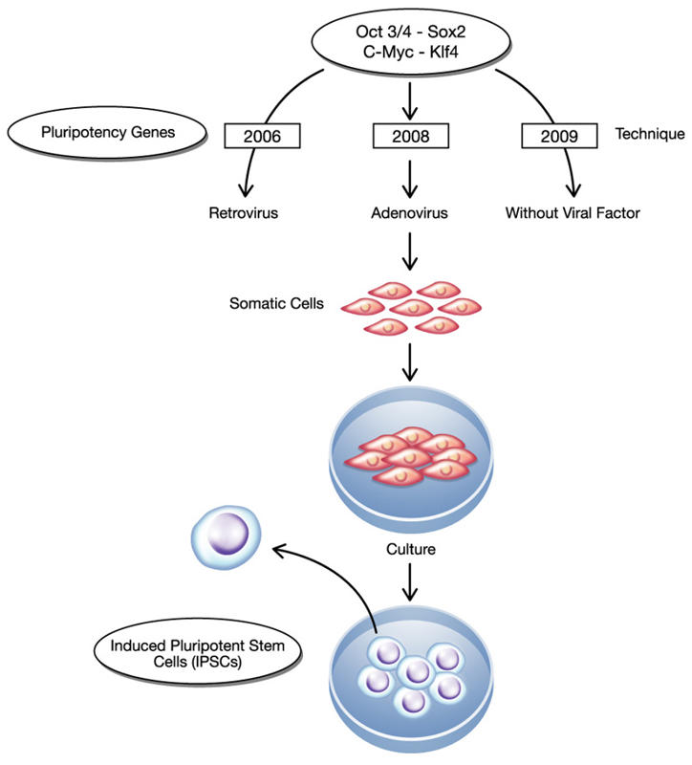
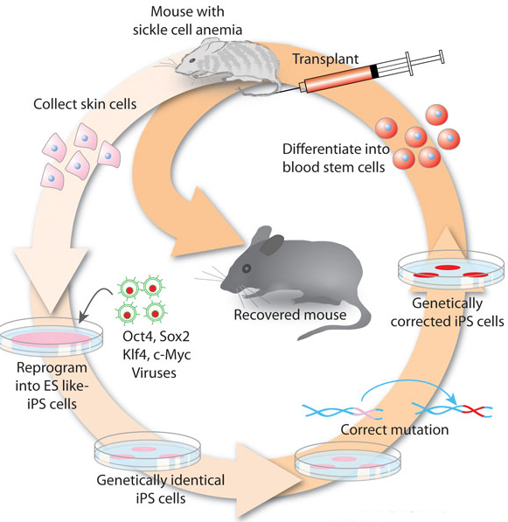
Induced Pluripotent Stem (iPS) Cells
The method was described by Yamanaka and Takahashi in which the skin cells of laboratory mice were genetically manipulated and returned back to their embryonic state.
iPS are somatic cells that have been reprogrammed to a pluripotent state (embryonic stem cell like state).
Several difficulties are to be overcome before iPS cells can be considered as a potential patient-specific cell therapy.
It will be crucial to characterize the development potential of human iPS cell line in the future.
Viruses were used to induce
The produced cells were transfused back into the sick mouse
Skin cells were taken from the tail tip of a sickle-cell model mouse.
The cells were differentiated into hematopoietic cells.

Slide 19
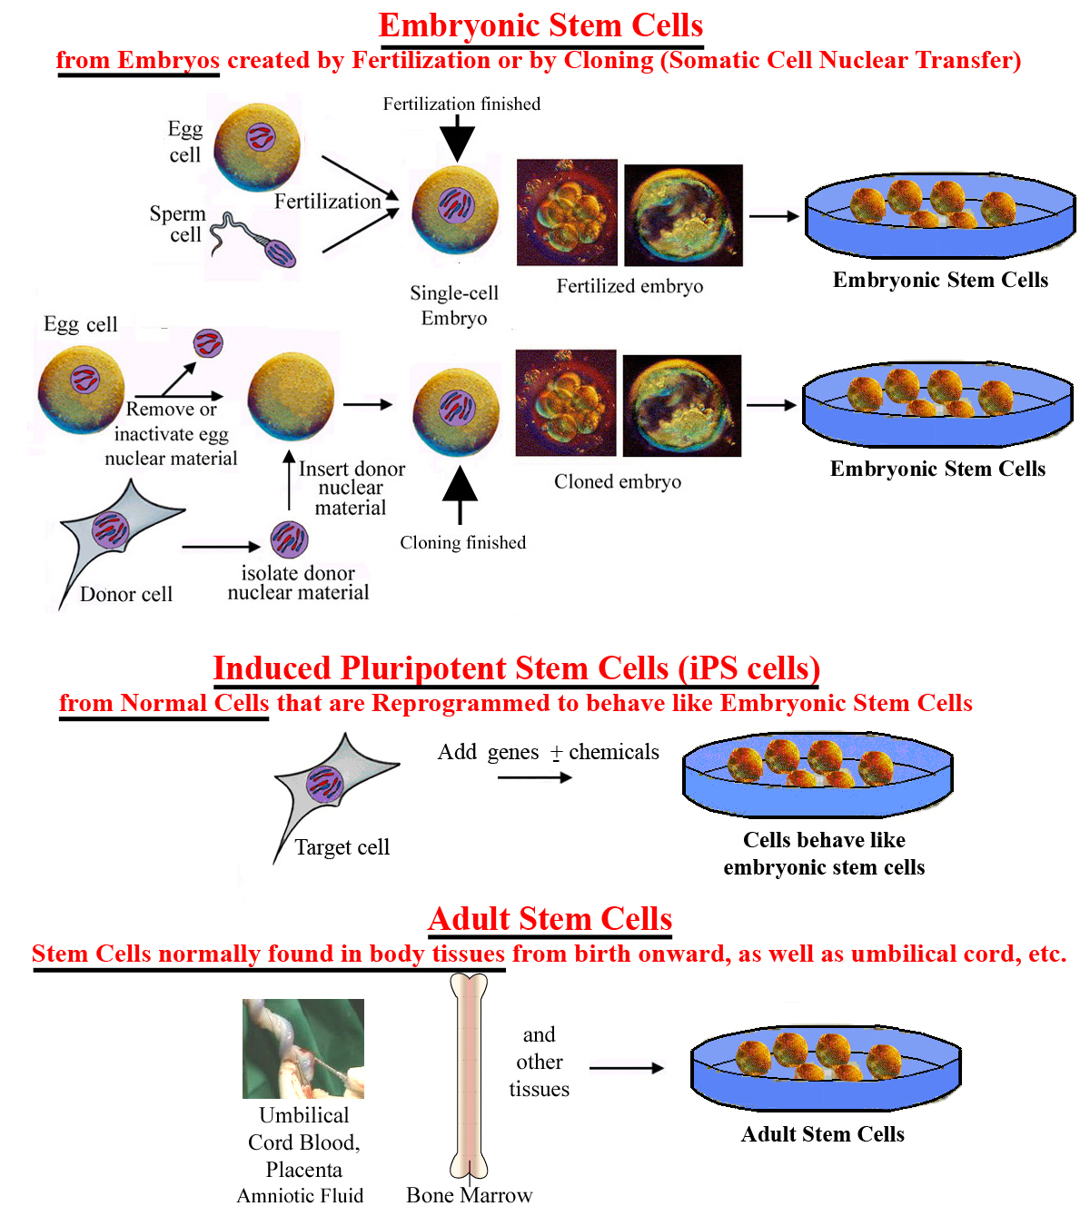
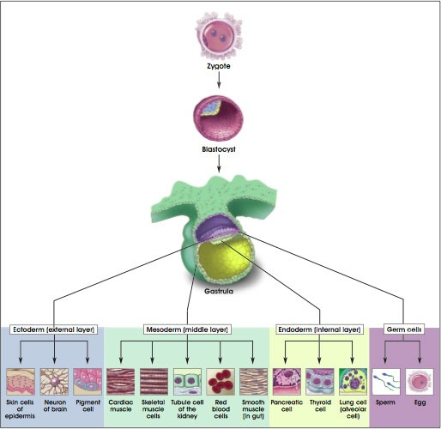
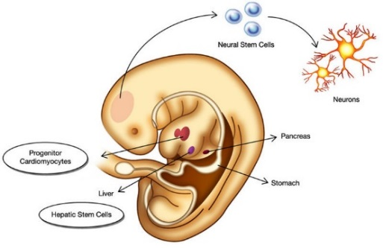
Classification of stem cells
(source based)
After this breakthrough we now have 3 classes
(this slide is a summary of everything we talked about before)
1- Embryonic
2- Adult (tissue specific)
3- Induced
(pluripotent + totipotent)
(multipotent + oligopotent + unipotent)

Slide 20
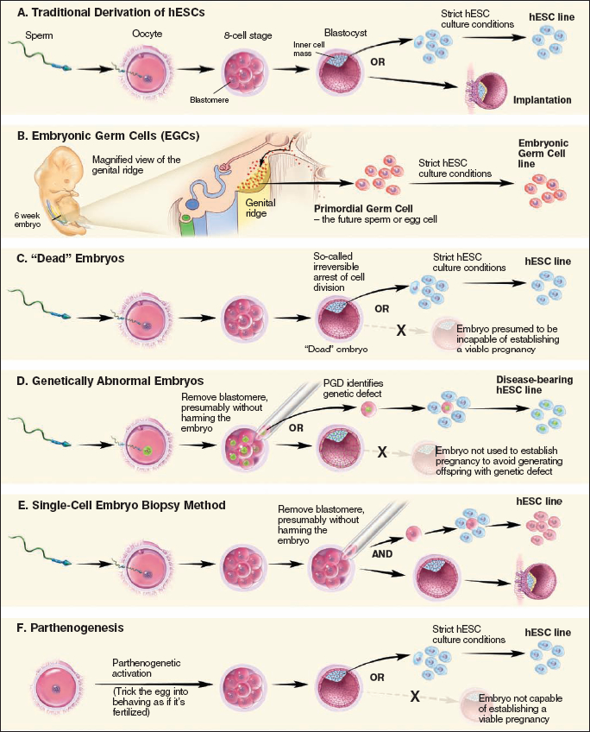
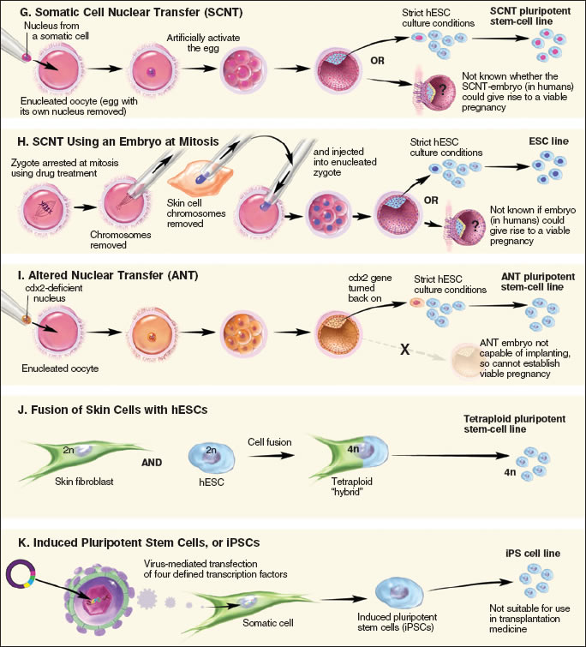
Different approaches for isolation of pluripotent stem cells
Normal fertilization
Very specific use
2n (46 chromosome) + 2n = 4n
At day 3 we remove the blastomere and culture it

Slide 21
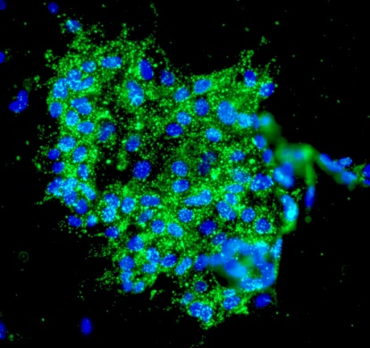
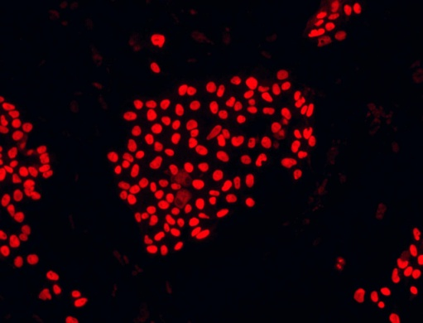
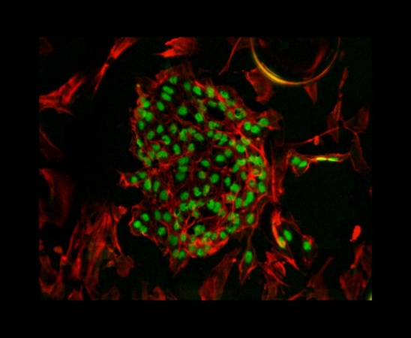
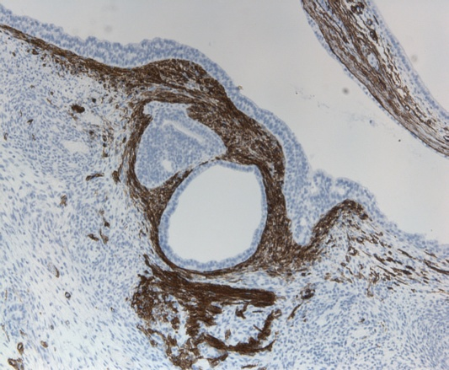
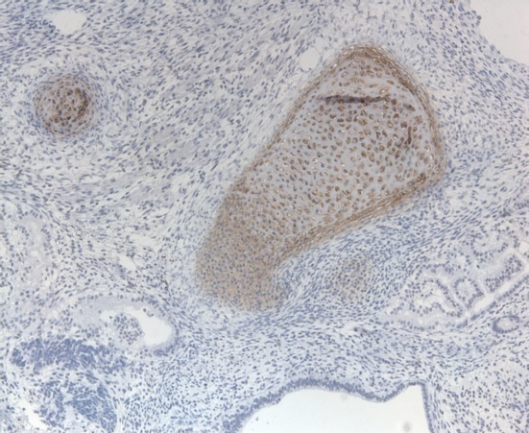
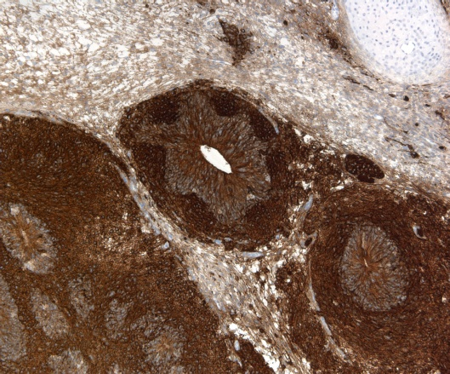
Characterization of human pluripotent stem cells (ESC)
SSEA-4
Sox-2
Oct-4
To check that the cell we have is a pluripotent stem cell we use special stains or markers (most common are SOX-2 and OCT-4)
Endoderm
Mesoderm
Ectoderm
Sox17
Sox9
Beta-III tubulin

Slide 22




Here we can see some pictures showing teratoma which is a serious complication of stem cells. Before it was believed that teratomas only developed in people who were immunocompromised but our lab did a study → and used 10 healthy (immunocompetent) samples. And in 9 out of 10 a teratoma developed. So we should always keep it in mind as a serious complication.
A large tumor mass measuring twice as the kidney is compressing it.
What is a teratoma? The teratoma was composed of mixed tissue patterns: skin with keratin, brain tissue, striated and smooth muscle, lymphoid tissue ……..

Slide 23


Only on the girls’ slides
Goal of Stem Cell Therapies
The goal of stem cell therapies is to promote cell replacement in organs that are damaged and do not have the ability for self repair (treat diseases)

Slide 24


The Promises of Stem Cell Technology
Obstacles of Stem Cell Research
Replacement of tissues/organs
Study cell differentiation
Toxicity testing.
Understanding prevention and treatment of birth defects.
Study of development and gene control.
Study of drugs therapeutic potential.
How to find the right type of stem cells?
How to completely differentiate Stem Cells to desired cell type?
How to put the stem cells into the right place?
Will the stem cells perform the desired function in the body?
Differentiation protocols for many cell types have not been developed.
Only on the girls’ slides

Slide 25
Summary
Stem cells
definition | Cells that have the ability to continuously divide and differentiate to other kinds of cells
function | Repair and regeneration of tissues
 | 1.potency based Totipotent : from embryonic and extra embryonic cells Pluripotent : form 3 germ layers Multipotent : form related cells Oligopotent : form few cells Unipotent : form one cell type Nullpotent : terminal cell 2.Sourced based Embryonic ( pluripotent ,may cause immune reaction ) Adult (multipotent , no immune reaction ) IPSCs (no immune reaction or ethical dilemma)
classification

Slide 26
1. The goal of stem cell therapies is to:
Reduce the Possibility of immune rejection
Promote cell replacement in organs that are damaged and do not have Ability for self-repair
To make full humans
2. Which of the following is The Promise of Stem Cell Technology:
Toxicity testing
Understanding prevention and treatment of birth defects
Study of drugs therapeutic potential
All are true
3. Mesenchymal stem cells are example of:
Pluripotent stem cells
Multipotent stem cells
Totipotent stem cells
Induced pluripotent stem cells (iPS cells)
4. What are yamanaka factors:
OCT3/4, SOX2, KLF4, c-Myc
Growth factors
Cytokines
OCT3/4, SOX2, Nanog
5. important limitation of using cloned ESCs (SCNT-ESCs) clinically:
Immune rejection
Produce limited number of cell types
Destruction of human embryos
Difficult to grow and culture in the laboratory
6. which of the following are pluripotent stem cells:
Cells has the potential to differentiate into any adult cell type forming an entire organism
Cells that has limited potential to form only multiple adult cell types
Cells that don’t have the ability for self-renewal
Cells has the Potential to form all differentiated cell types except placenta
7. Induced Pluripotent Stem Cell
(iPS) cells are:
Cells have limited potential to form only multiple adult cell types
Cells are Potential to form all differentiated cell types
somatic cells that have been reprogrammed to a pluripotent state
cells are potential to differentiate into any adult cell type
8. Stem cells need to be differentiated to the appropriate cell types before they can be used clinically because it may produce teratomas “undifferentiated cells”:
True
False
9. adults stem cells differ from embryonic stem cells in:
it’s can produced all cell types
have no major ethical concerns
risk of creating tumors
Answers:
1: B, 2: D, 3: B, 4: A, 5: C, 6: D, 7: C, 8: A, 9: B

Slide 27
10. If the stem cells differentiated into many stem cells and only few other types of cells this will lead to :
Homeostasis
Tissue aging
Tissue death
Carcinogenic tissue humans
11. Which of the following forms embryonic and extraembryonic cell types:
Unipotent
Multipotent
Oligopotent
Totipotent
12. All of the following are source of embryonic stem cells except:
IVF embryos
Cloned embryos
Placental cord
Aborted embryos
13. Which of the following is a feature of adult stem cells :
Large number can be harvested
Cause immune rejection
Ethical concerns
Multipotent
14. The Blastocyst is formed of each of the following except:
Trophoblast
Morula
Blastocoel
Inner Cell Mass (ICS)
15. Hematopotic stem cells gives:
Cells of the nervous system
Connective tissue
Cartilage
Blood cells
Answers:
10: D, 11: D, 12: C, 13: D, 14: B, 15: D
1-What are stem cells ?
2-What is the difference between oligopotent and unipotent stem cells?
Answer :
1-A cell that has the ability:
to continuously divide and give rise to new copy of itself (self-renew) and other specialized ( differentiated ) cells/tissues.
2-Oligopotent: differentiate into only few cells such as lymphoid or myeloid stem cells
Unipotent : differentiate into only one cell type such as muscle cell

Slide 28



Leaders:
Nawaf AlKhudairy
Jawaher Abanumy
Members:
Allulu Alsulayhim
Ashwaq Almajed
Ameera Niazi
Dania Alkelabi
Do'aa abdulfattah
Ghaida Alsaeed
Nada Aldakheel
Nourah Al Hogail
Nouf Aloqaili
Muneerah Alzayed
Sarah Alshamrani
Feedback
References:
1- Girls’ & Boys’ Slides
2- Greys Anatomy for Students
3- TeachMeAnatomy.com
anatomyteam436@gmail.com
@anatomy436

