Slide 1
Anatomy of Small Intestine
Color Code
Important
Doctors Notes
Notes/Extra explanation
Please view our Editing File before studying this lecture to check for any changes.

Slide 2
Objectives:
At the end of the lecture, students should:
List the different parts of small intestine.
Describe the anatomy of duodenum, jejunum & ileum regarding: the shape, length, site of beginning & termination, peritoneal covering, arterial supply & lymphatic drainage.
Differentiate between each part of duodenum regarding the length, level & relations.
Differentiate between the jejunum & ileum regarding the characteristic anatomical features of each of them.

Slide 3
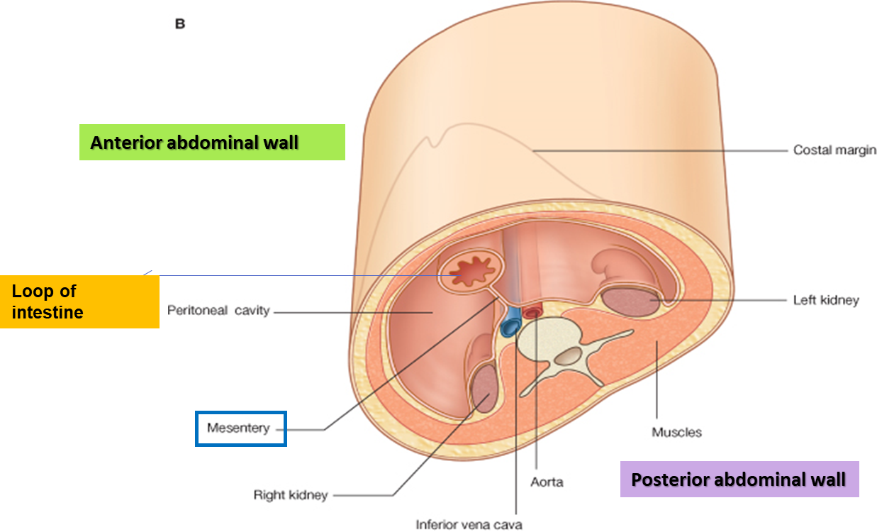
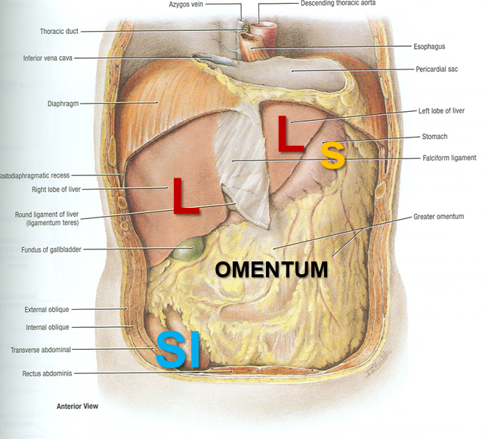
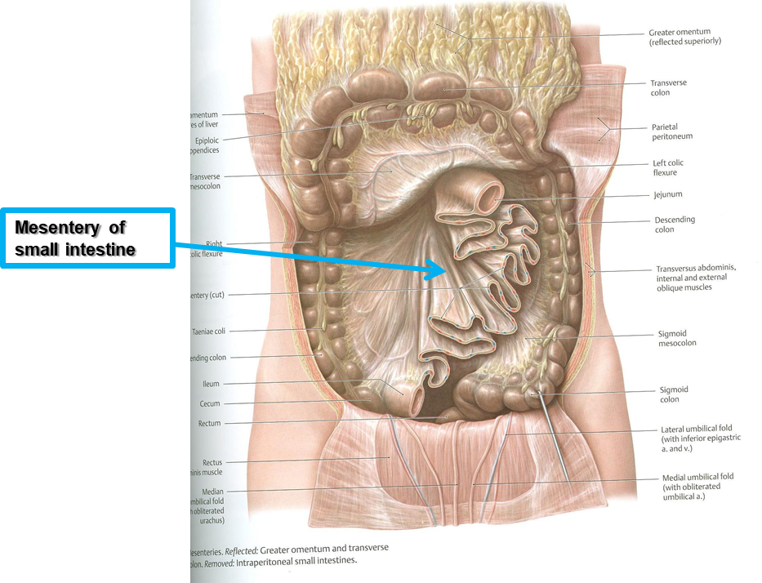
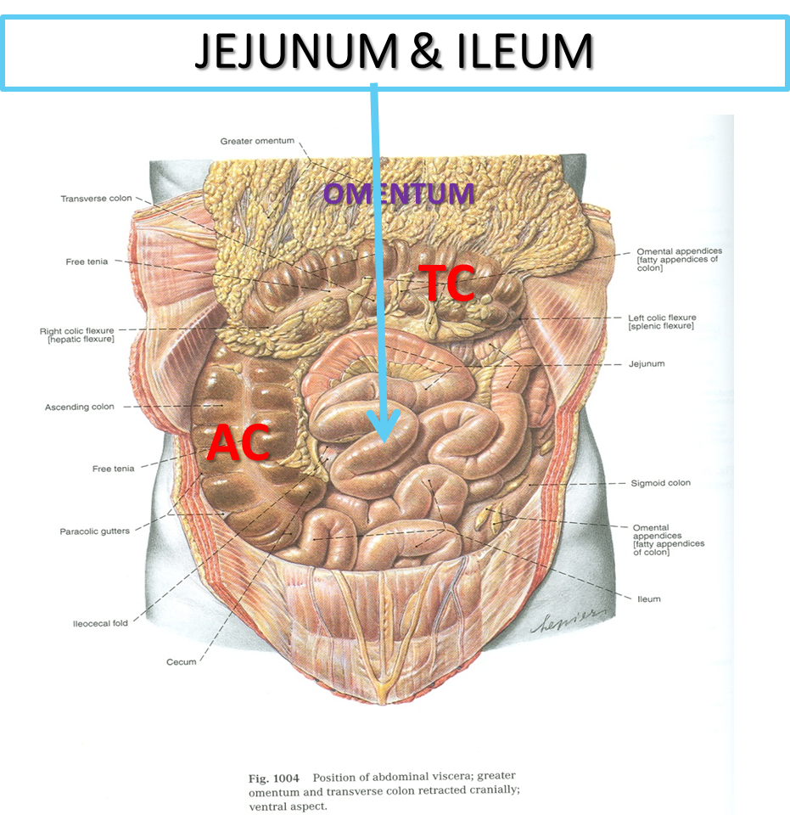
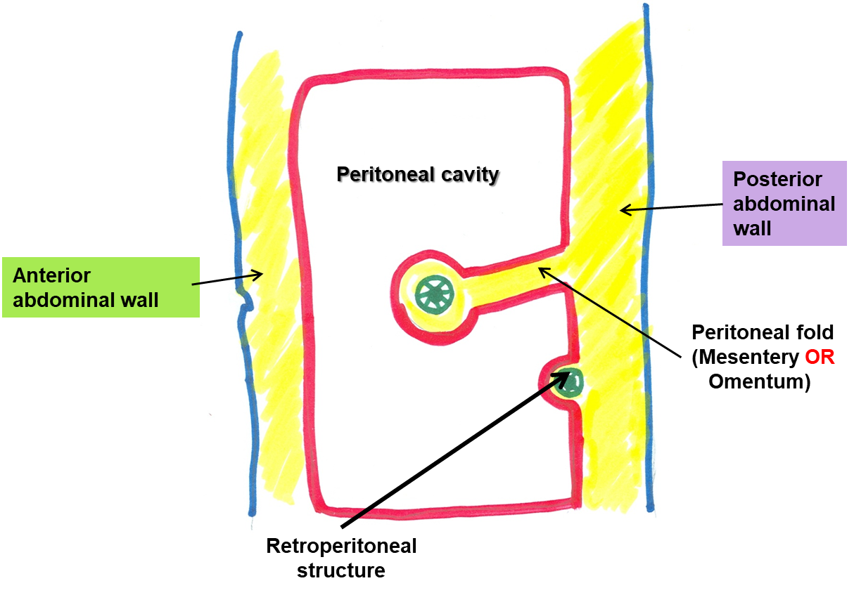
Abdomen
What is Mesentery?
It is a double layer attach the intestine to abdominal wall. If it has mesentery it is freely moveable.
L= liver, S=Spleen, SI=Small Intestine, AC=Ascending Colon, TC=Transverse Colon

Slide 4
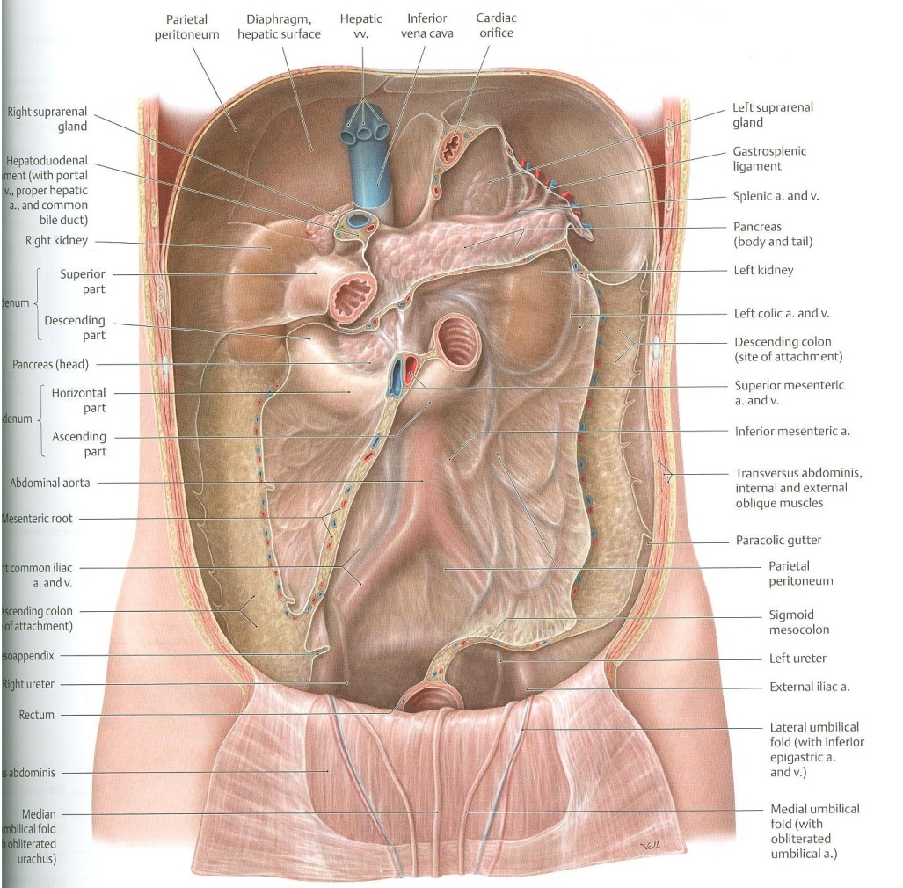
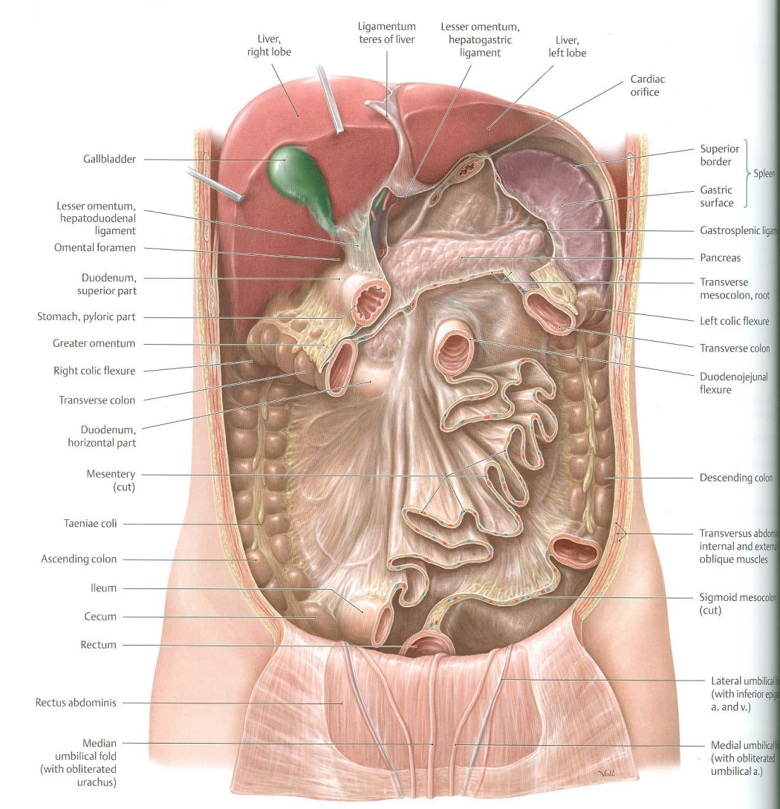
Abdomen
The small intestines consist of two parts:
1- fixed part (no mesentery) (retroperitoneal) : duodenum
2- free (movable) part (with mesentery) :jejunum & ileum

Slide 5
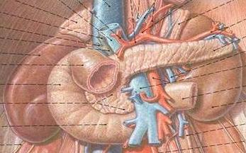
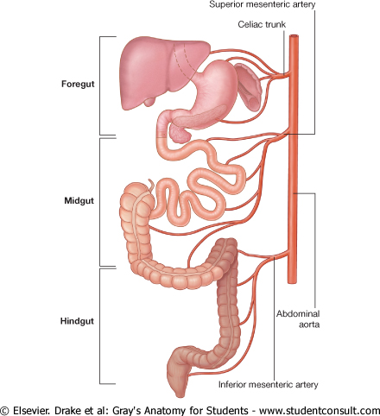
Only on the boys’ slides
RELATION BETWEEN EMBRYOLOGICAL ORIGIN & ARTERIAL SUPPLY
Extra: مهم
Arterial supply depends on the embryological origin :
Foregut → Coeliac trunk
Midgut → superior mesenteric
Hindgut → Inferior mesenteric
Duodenum:
Origin: foregut & midgut
Arterial supply:
Coeliac trunk (artery of foregut)
Superior mesenteric: (artery of midgut)
The duodenum has 2 arterial supply because of the double origin
The junction of foregut and midgut is at the second part of the duodenum
Jejunum & ileum:
Origin: midgut
Arterial supply:
Superior mesenteric: (artery of midgut)

Slide 6
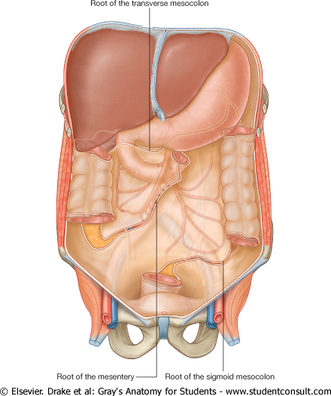
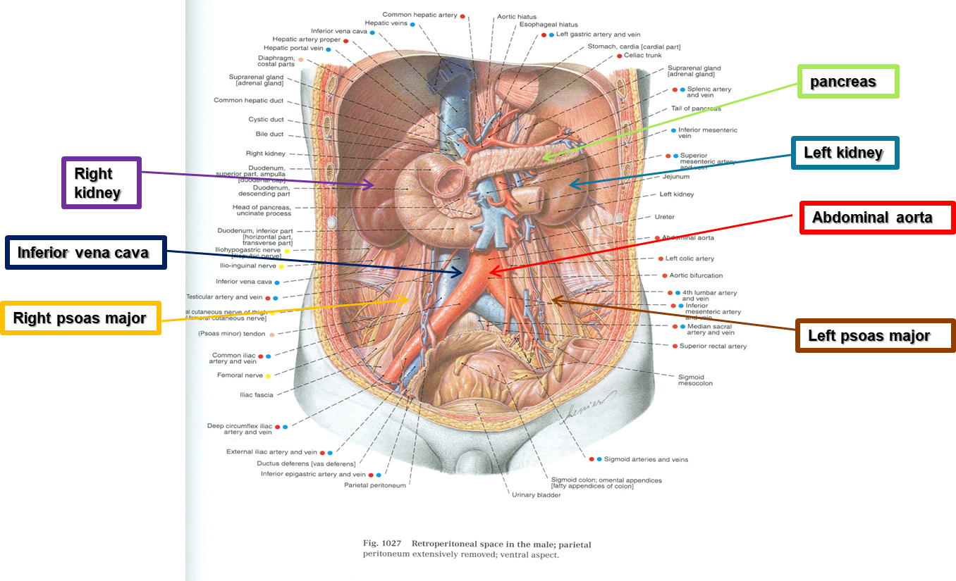
Duodenum
Duodenum
Shape | C-shaped loop
Length | 10 inches
Beginning | At pyloro-duodenal junction
Termination | At duodeno-jejunal flexure
Peritoneal covering | Retroperitoneal {fixed movement}
Divisions | 4 parts {superior-descending-horizontal-ascending} next slide
Embryological origin | Foregut & midgut
Arterial supply | Coeliac & superior mesenteric
Venous drainage | Superior mesenteric & portal veins
Lymphatic drainage | Coeliac & superior mesenteric lymph nodes

Slide 7
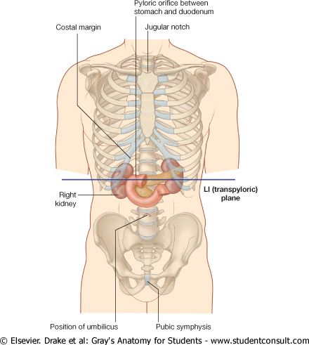
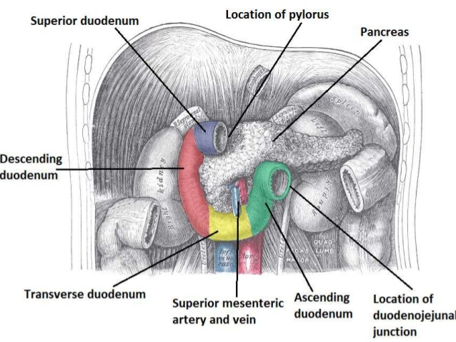
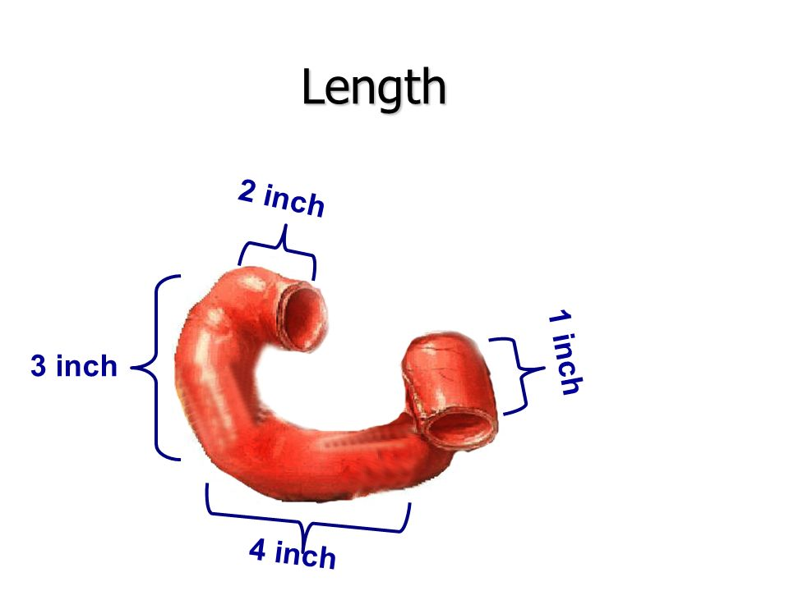
Duodenum Parts
Important
Part | Length | Level (surface anatomy)
FIRST PART (Superior) | 2 INCHES | L1 (Transpyloric Plane)
SECOND PART (Descending) | 3 INCHES | Descends From L1 TO L3
THIRD PART (Horizontal) | 4 INCHES | L3 (Subcotal Plane)
FOURTH PART (Ascending) | 1 INCHES | Ascends From L3 TO L2
Total = 10 inches
Extra

Slide 8
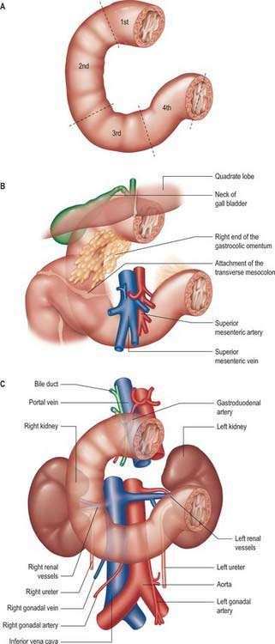
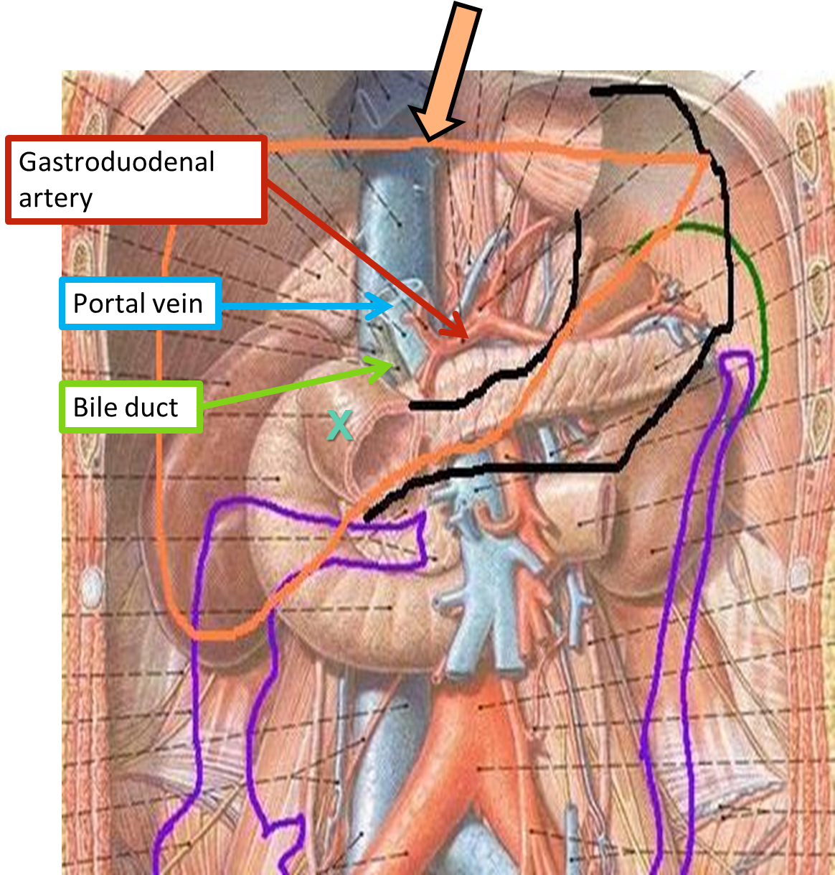
Relations of the first part:
Duodenum First Part
Anterior:
Liver
Posterior:
Gastroduodenal artery
Portal vein
Bile duct

Slide 9
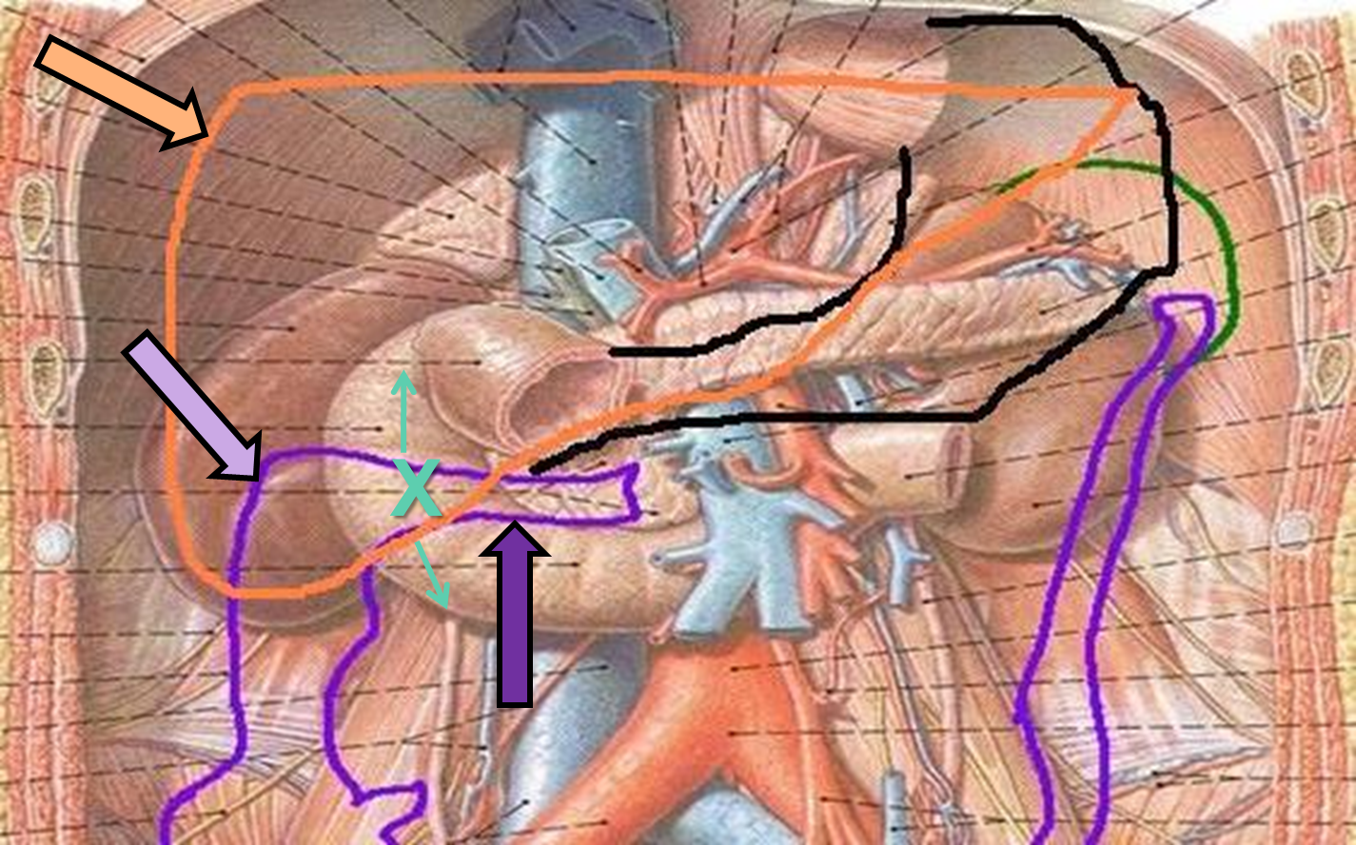
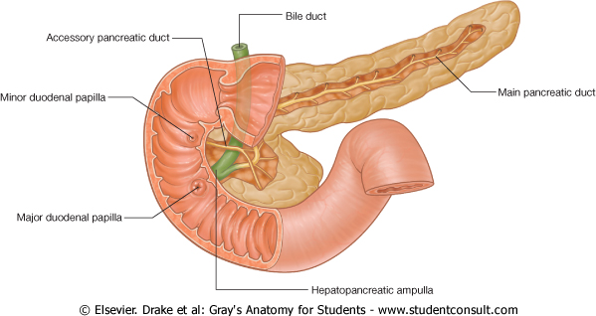
Duodenum Second Part
Openings of second part:
Common opening of bile duct & main pancreatic duct: on summit of major duodenal papilla.
Opening of accessory pancreatic duct (one inch higher): on summit of minor duodenal papilla.
Anterior | Posterior | Medial | Lateral
1. Liver 2. Transverse colon 3. Small intestine* | Right kidney | Pancreas | Right colic flexure
*we mean jejunum and ileum
Accessory pancreatic duct
Bile duct
Minor duodenal papilla
main pancreatic duct
Major duodenal papilla

Slide 10
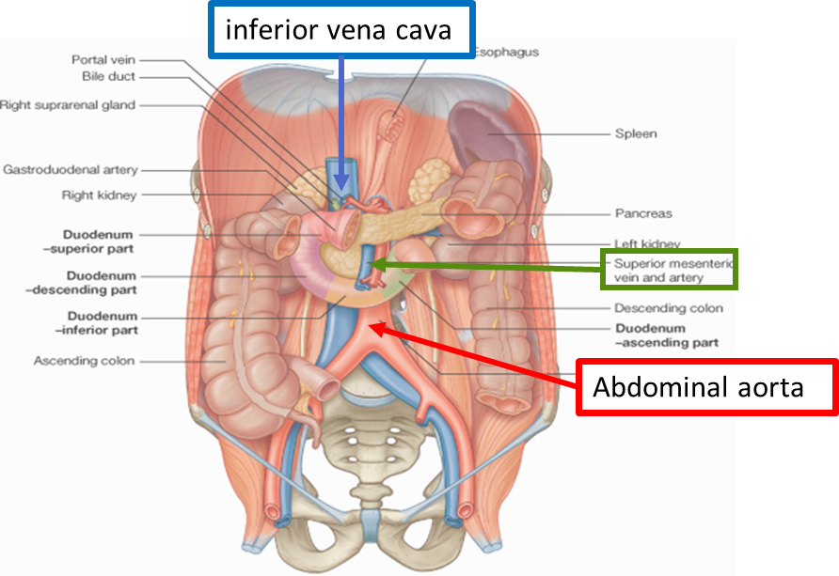
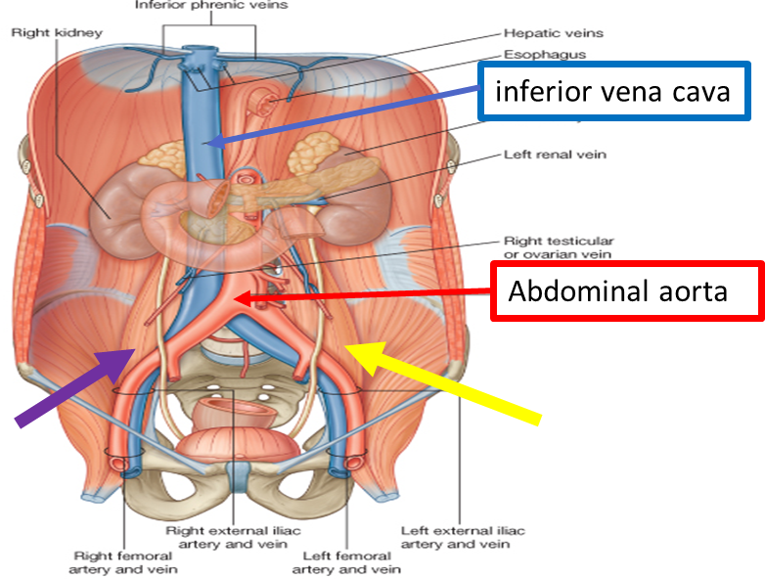
Duodenum Third & Fourth Part
Relations | Anteriorly | Posteriorly
3rd | 1- Small Intestine 2- Superior Mesenteric vessels | 1- Right psoas major 2- Inferior vena cava 3- Abdominal aorta 4- Inferior mesenteric vessels (originate at L3)
4th | Small Intestines | Left Psoas major

Slide 11
Duodenum Summary
This slide is extra and summarizes the slides before
Duodenum
Part |  | Superior (1st) | Descending (2nd) | Inferior (3rd) | Ascending (4th)
Length |  | 2 in. | 3 in. | 4 in. | 1 in.
Level |  | L1 – transpyloric plane | L1 → L3 | L3 – subcotal plane | L3 → L2
Relations | Anterior | Liver | Liver Transverse colon Small intestine (J & L) | Small intestine Superior mesenteric vessels | 1. Small intestine
 | Posterior | Bile duct Gastroduodenal artery Portal vein | Right kidney | Right psoas major Inferior vena cava Abdominal aorta Inferior mesenteric vessels | 1. Left psoas major
 | Medial |  | Pancreas
 | Lateral |  | Right colic flexure

Slide 12
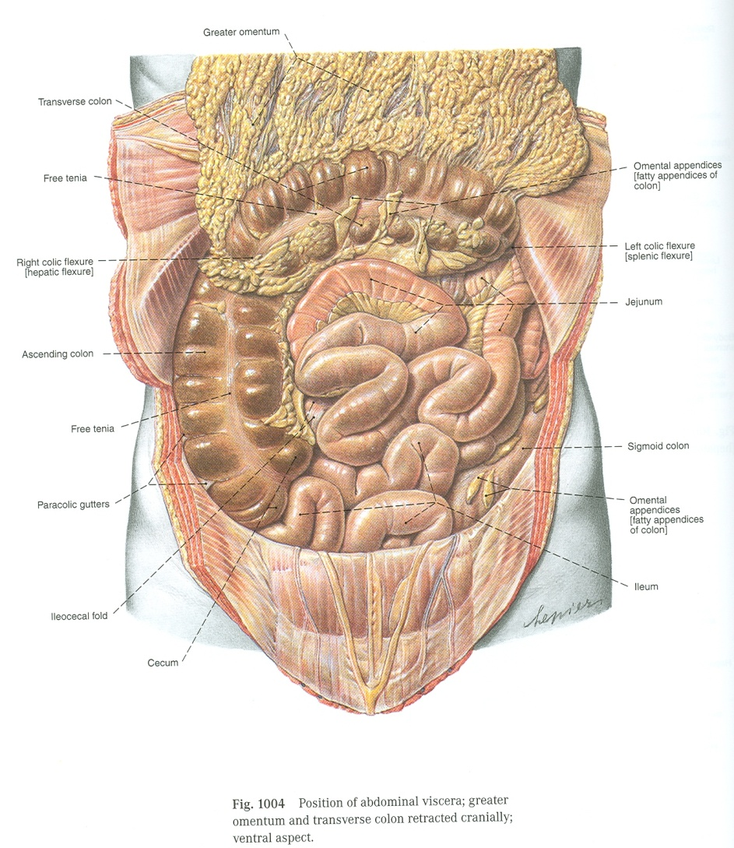
Jejunum & Ileum
Shape
Coiled tube
Superior mesenteric lymph nodes
Beginning
6 meters (20 feet)
Termination
Peritoneal fold
Embyological origin
Blood supply
Lypmphatic drainage
Length
At duodeno-jejunal flexure
At ileocecal junction
midgut
Mesentery of small intestine
Superior mesenteric Artery & Vein
Or valve/orifice
jejunum
ileum

Slide 13
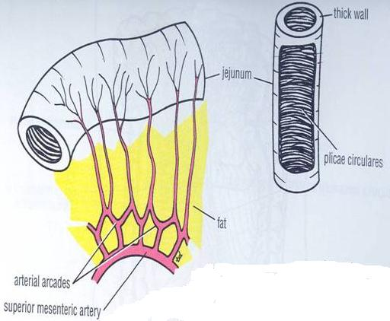
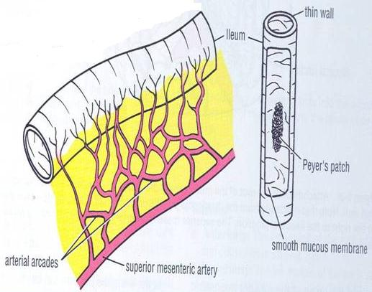
Jejunum & Ileum
Comparison
Plicae circulares: they are mucosal folds.
Arcades: Anastomosing arterial arches.
High: farther from the intestinal wall
Low: nearer intestinal wall
(Jejunum absorbs more than the ileum and needs more blood )
 | Jejunum | Ileum
Length* | Shorter (proximal 2/5) of SI | Longer (distal 3/5) of SI
Diameter | Wider | Narrower
Wall | Thicker (more plicae circulares) | Thinner (less plicae circulares)
Appearance | Dark red (more vascular) | Light red (less vascular)
Vessels? | High & less arcades Long terminal branches | Low & more arcades Short terminal branches
Mesenteric fat** | Small amount & Away from intestinal border | Large amount & Close to intestinal border
Lymphoid tissue | Few aggregations | Numerous aggregations (peyer’s patches)
*in regards to the total length of jejunum and ileum. (SI = Small Intestine)
**In general, the mesentery of the jejunum has less fat than the ileum. Also, the fat in the jejunum is not near the intestinal wall (the gap in the picture).

Slide 14
Summary
 | Duodenum | Ileum | Jejunum
Shape | C-shaped | Coiled tube
Peritoneal covering | Retroperitoneal | With mesentery
Length | 10 inch | 2/5 of SI | 3/5 of SI
Beginning | Pyloro-duodenal junction | Duodeno-jejunal flexure
End | Duodeno-jejunal flexure | Ilieo-caecal junction
Embryological origin | Foregut & midgut | Midgut
Arterial Supply | Celiac & superior mesenteric arteries | Superior mesenteric artery
Venous Drainage | Superior mesenteric → portal vein | Superior mesenteric vein
Lymphatic Drainage | Celiac & superior mesenteric lymph nodes | Superior mesenteric lymph node

Slide 15
MCQ
1-The origin of the duodenum is :
A- Foregut
B- Midgut
C- Hindgut
D- A and B
2-The lymphatic drainage of the duodenum is :
A- coeliac
B- superior mesenteric
C- A and B
D- Inferior mesenteric
5-the blood supply for the jejunum and ileum is from the:
A-Celiac trunk
B-Superior mesenteric artery
C-Inferior mesenteric artery
6-which of the following has a major contribution to the thickness of the jejunum?
A-Plicae circulares
B-Lymphoid tissue
C-Mesenteric fat
7- Which of the following lies anterior to the third part of duodenum?
A- Liver
B- Superior mesenteric vessels
C- Inferior mesenteric vessels
D- Abdominal aorta
8- Which one of the following structures can be injured in case of perforated duodenal ulcer?
A- Right kidney
B- Right colic flexure
C- Gastroduodenal artery
D- Inferior mesenteric vessels
3-Which level lies the third part of duodenum?
A-Transpyloric plane.
B-Subcotal plane
C-L1 to L3
D-L3 to L2
4-Which of the following lies anterior to the first part of duodenum?
A-liver.
B-Bile duct.
C-Portal vein.
D-Aorta.
1-D, 2-C, 3-B, 4-A, 5-B, 6-A, 7-B, 8-B

Slide 16
Leaders:
Nawaf AlKhudairy
Jawaher Abanumy
Members:
Abdulmalki alhadlaq
Abdullah jammah
Abdulmohsen alkhalaf
Abdulmohsen alghannam
Abdulrahman almalki
Abdulrahman alrajhi
Abdullah alhashem
Feedback
References:
1- Girls’ & Boys’ Slides
2- Greys Anatomy for Students
3- TeachMeAnatomy.com
anatomyteam436@gmail.com
@anatomy436

