Slide 1
Anatomy of Large Intestines
Color Code
Important
Doctors Notes
Notes/Extra explanation
Please view our Editing File before studying this lecture to check for any changes.

Slide 2
Objectives
By the end of this lecture the student should be able to:
List the different parts of large intestine.
List the characteristic features of colon.
Describe the anatomy of different parts of large intestine regarding: the surface anatomy, peritoneal covering, relations, arterial & nerve supply.

Slide 3
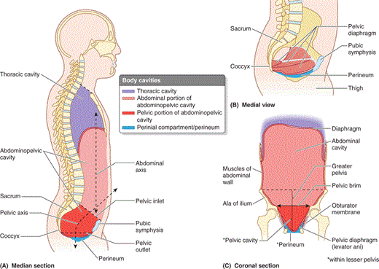
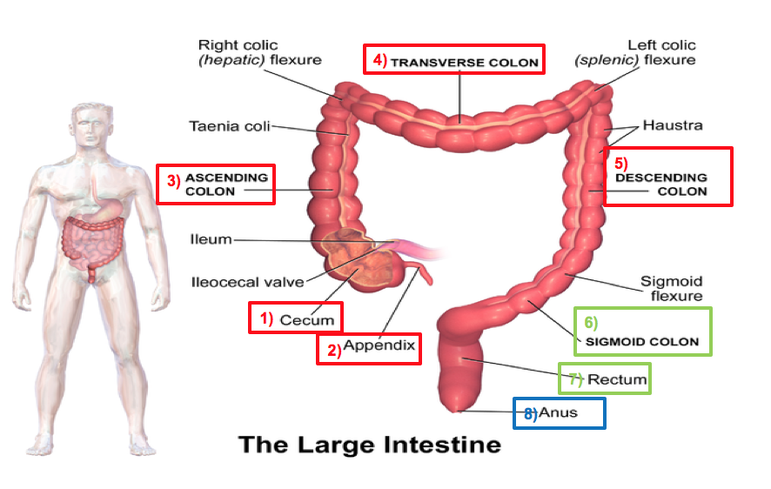
Parts of the Large Intestine
(1,2,3,4,5) are found in the abdomen
(6,7) are found in the pelvis
(8) is found in the perineum
Extra
Or anal canal

Slide 4
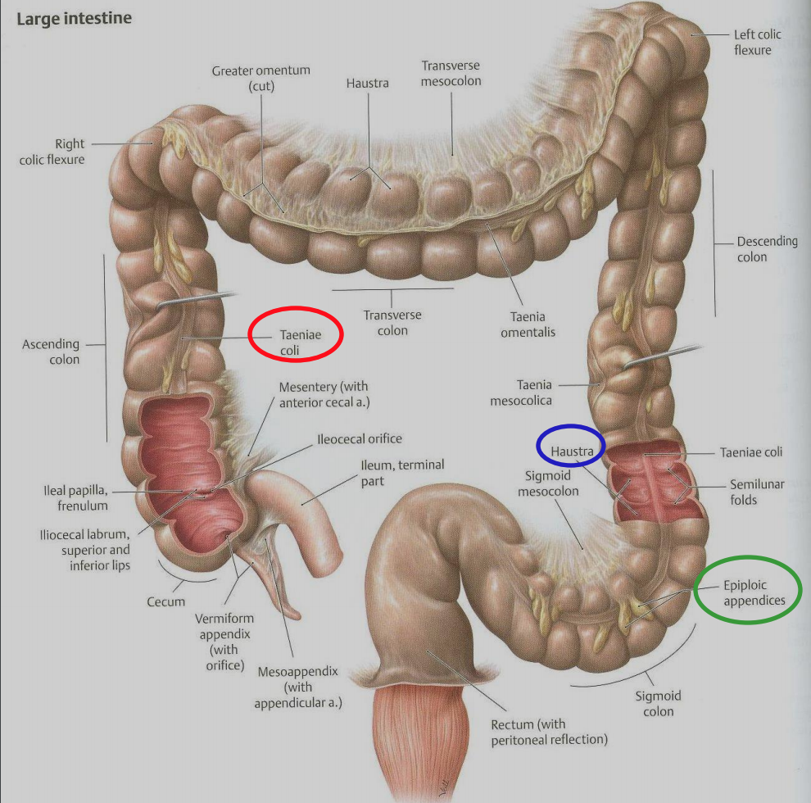
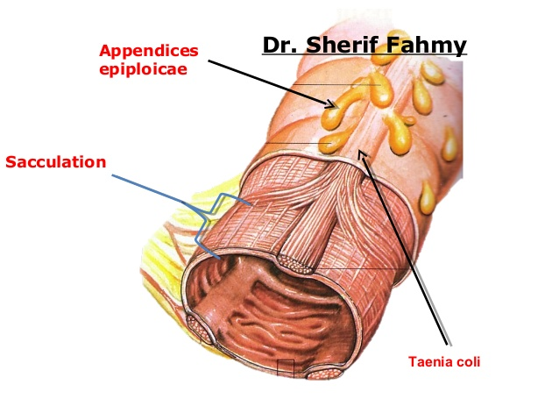
Characteristics of Colon (NOT found in rectum and anal canal)
Taeniae coli:
Three longitudinal muscle bands
Sacculations (Haustra):
Because the Taeniae coli are shorter than large intestine
Epiploic Appendices :
Short peritoneal folds filled with fat
Extra

Slide 5
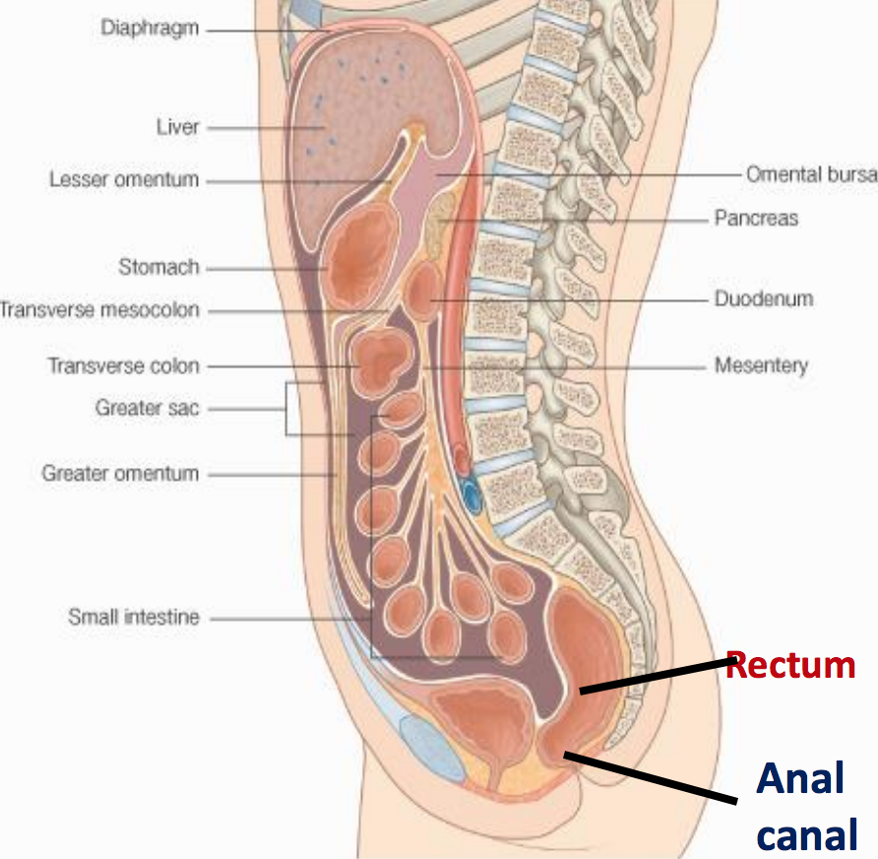
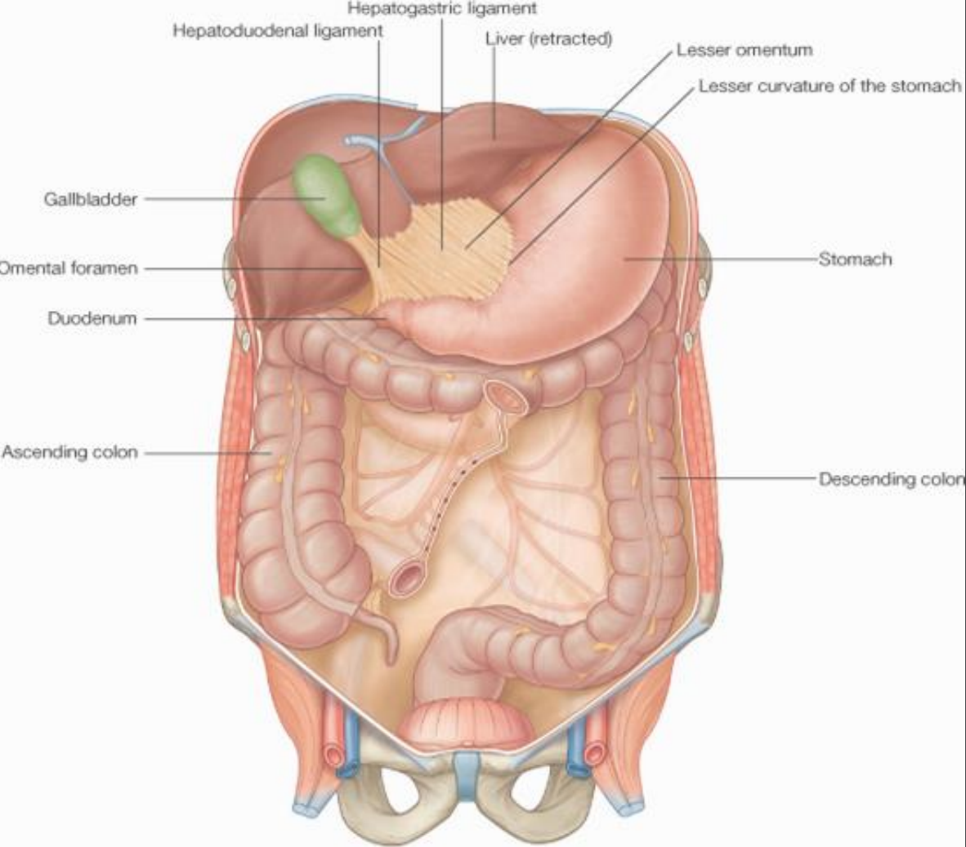
Peritoneal Covering
Parts with mesentery*:
Transverse colon
Sigmoid or pelvic colon
Appendix
Cecum
Retroperitoneal parts**:
Ascending colon
Descending colon
Upper 2/3 of rectum
Parts devoid (بدون) of peritoneal covering:
Lower 1/3 of rectum
Anal canal
* The peritoneum covers the anterior and posterior surfaces.
** The peritoneum only covers the anterior surface
Rectum
Anal canal

Slide 6
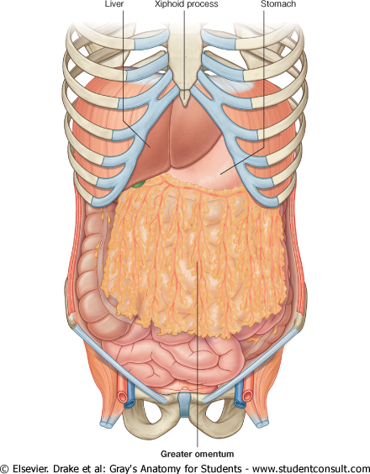
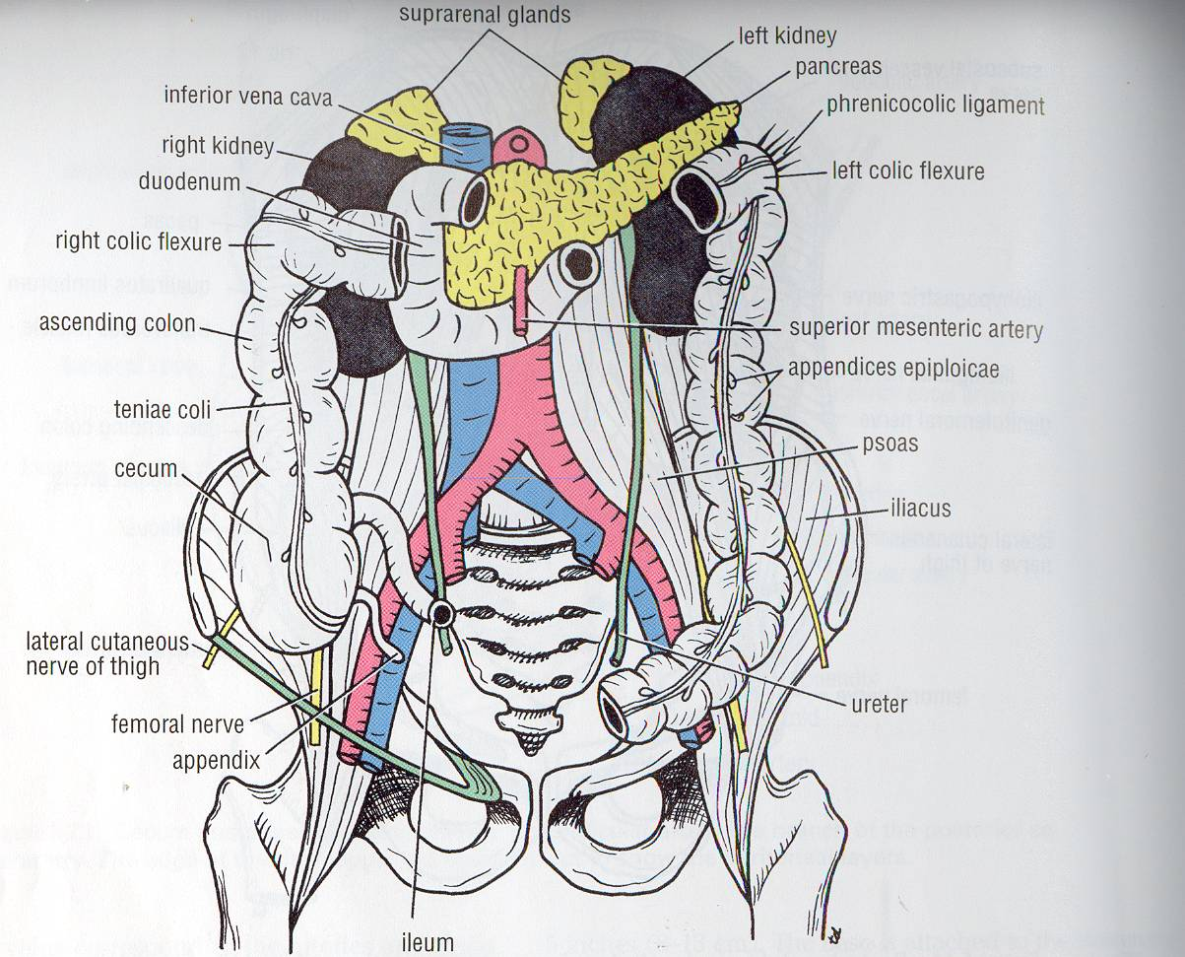
Relations of (CECUM – ASCENDING & DESCENDING COLONS)
Anterior:
Greater omentum
Coils of small intestine
Anterior abdominal wall
Posterior:
Cecum: Psoas major , Iliacus
Ascending colon: Iliacus ,Quadratus lumborum, Right kidney.
Descending colon: Left kidney, Quadratus lumborum ,Iliacus, psoas major
Quadratus lumborum
Anterior abdominal wall
Coils of small intestine

Slide 7
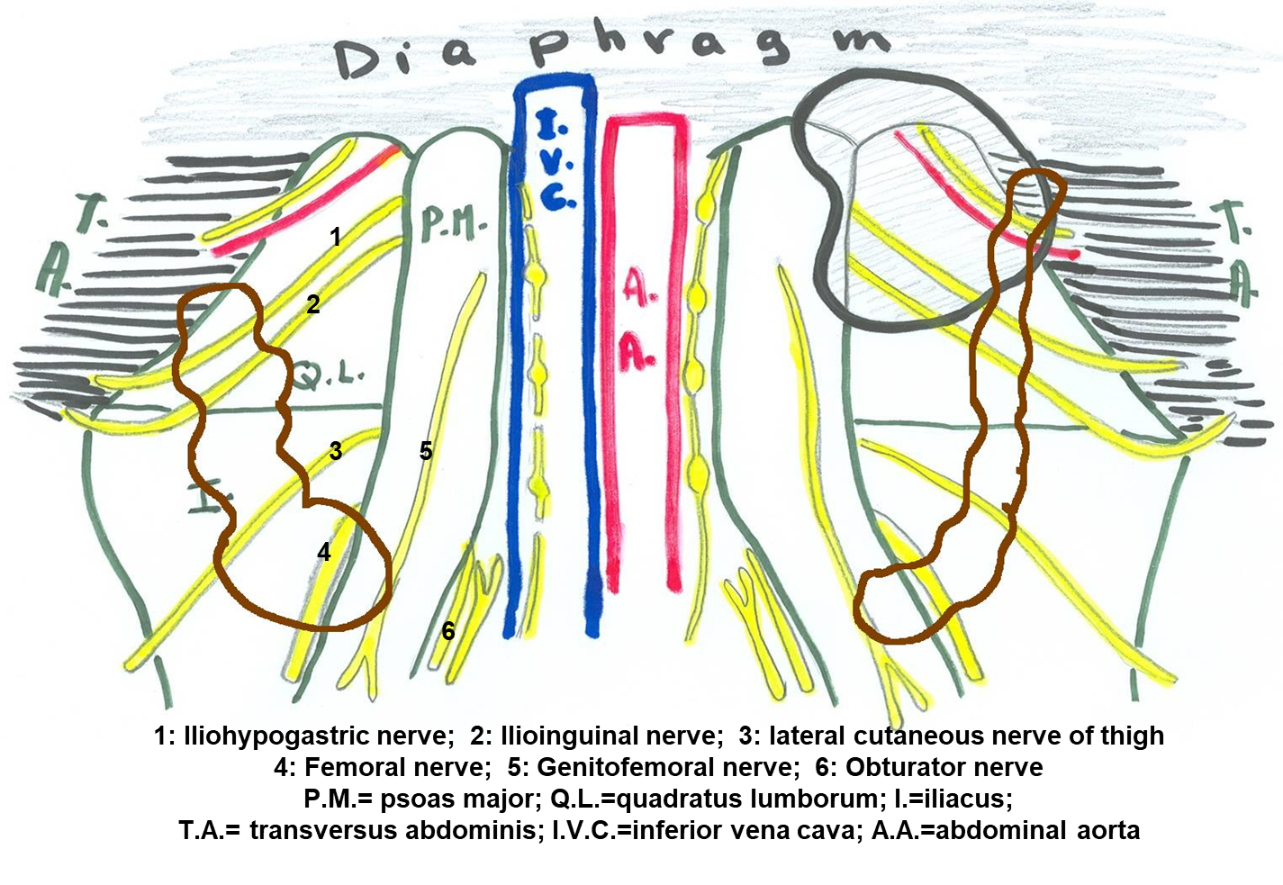
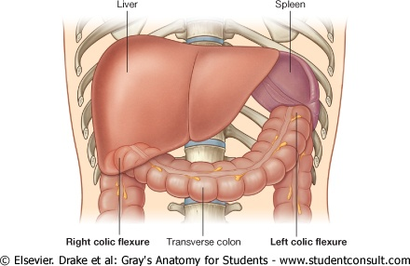
COLIC FLEXURES
Splenic flexure
Position: higher
Angle: more acute
Hepatic flexure

Slide 8
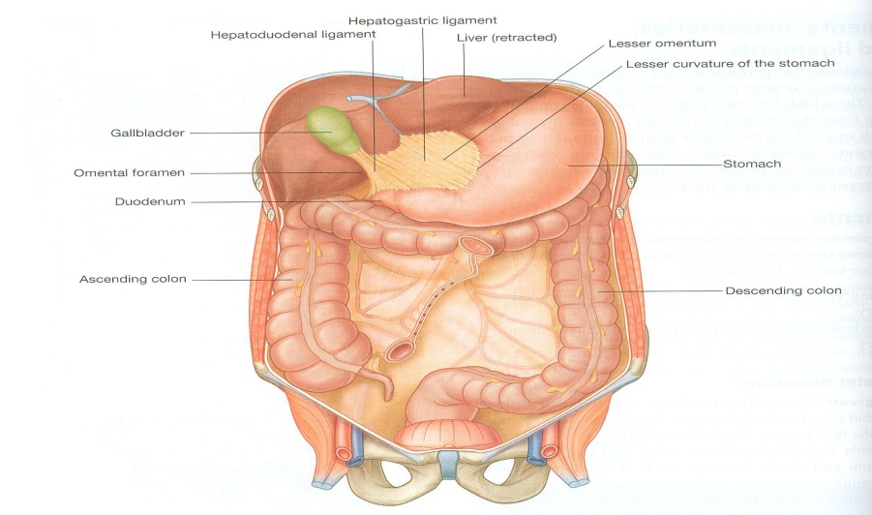
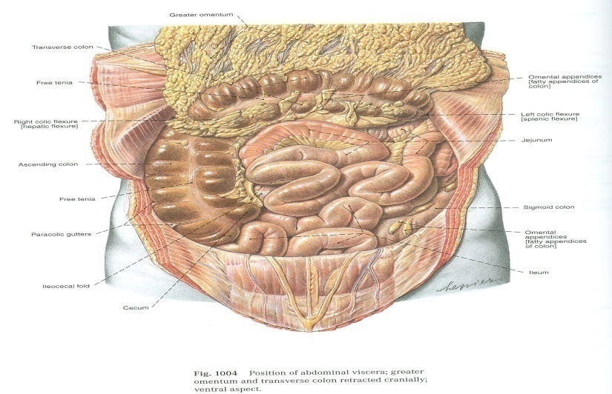
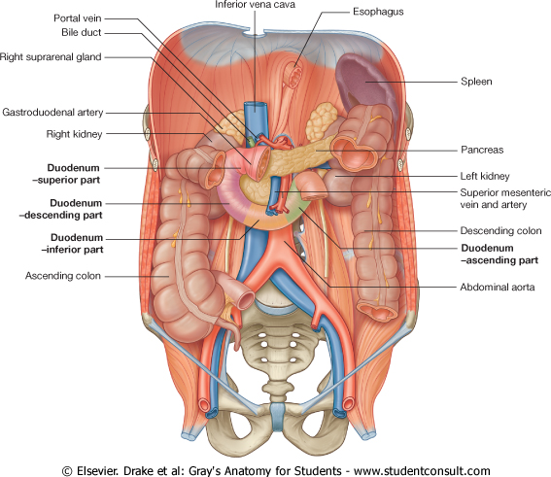
Relations of Transverse Colon
Anterior: greater omentum , anterior abdominal wall
Posterior: 2nd part of duodenum , pancreas & superior mesenteric vessels.
Superior: liver, gall bladder, stomach
Inferior: coils of small intestine
Anterior abdominal wall

Slide 9
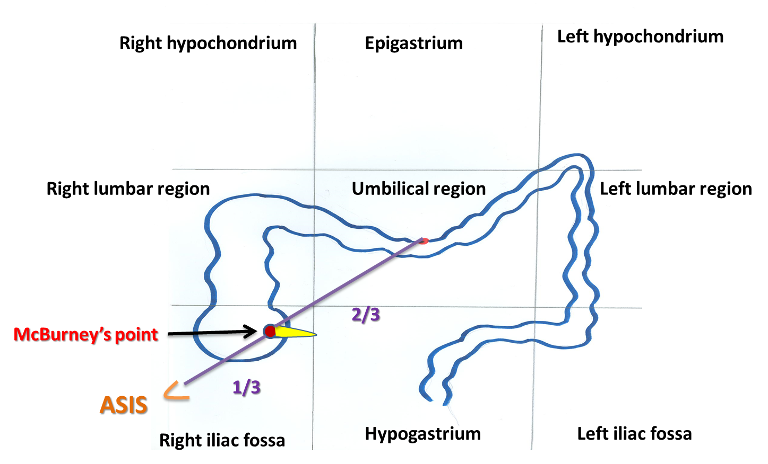
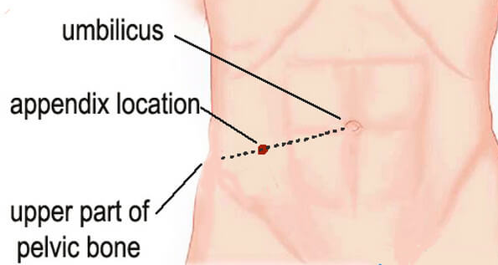
Appendix Surface Anatomy
Important
The appendix is a lymphoid tissue for immunity.
The base of appendix is marked by McBurney’s point:
A point at the junction of lateral 1/3 & medial 2/3 of a line traced from right anterior superior iliac spine to umbilicus.
(Its importance lies in the fact that tenderness and rebound at this point is suggestive of appendicitis)
لما الدكتور يفحص المريض يحط اصبعين على المكان واذا شالها بسرعه حيصرخ المريض من الالم اذا كانت ملتهبه
Extra

Slide 10
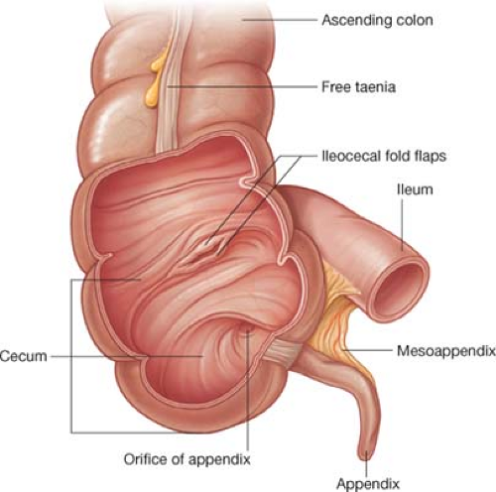
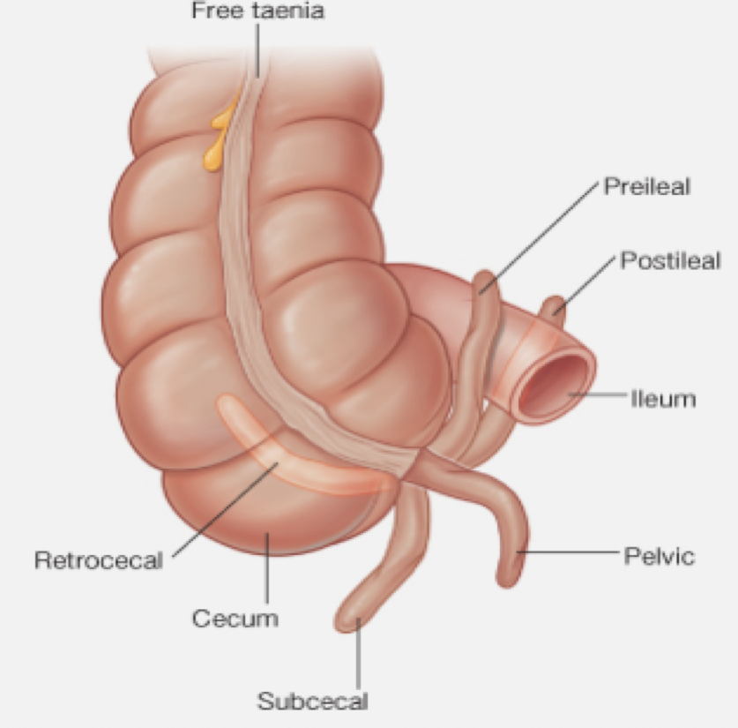
Appendix
Extra
Opening: (opens into cecum)
At posteromedial aspect of cecum, 1 inch below ileocecal junction.
Positions:
Retrocecal (most common)
Pelvic
Subcecal
Preilieal
Postileal (least common)
The free end is mobile so it moves and we may find it in the following positions:
(may be misdiagnosed with ovavitis)
(below)
مهم نعرفها عشان اذا كان عندنا التهاب في الزائدة وجئنا نبي نشيلها اول شيء لازم ندورها ورى السيكم اذا ما لقيناها نبدأ ندور في الاماكن الثانية

Slide 11
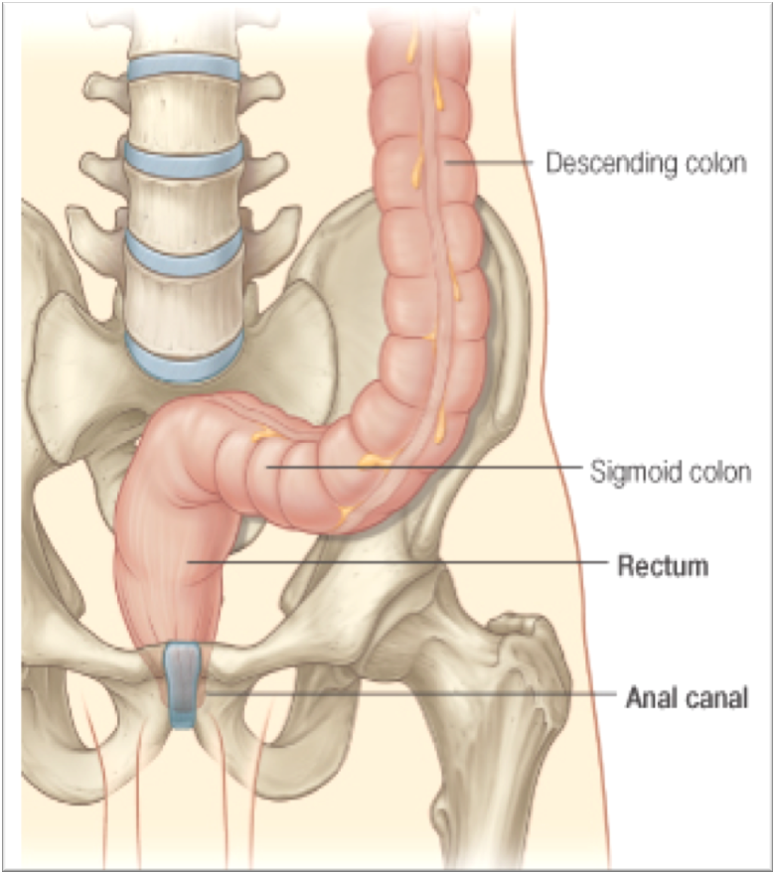
Rectum
Beginning: as a continuation of sigmoid colon at level of S3 in front.
Termination: continues as anal canal, one inch below & in front of tip of coccyx. Its end is dilated to form the rectal ampulla.
Length: 13 cm (5 inches)

Slide 12
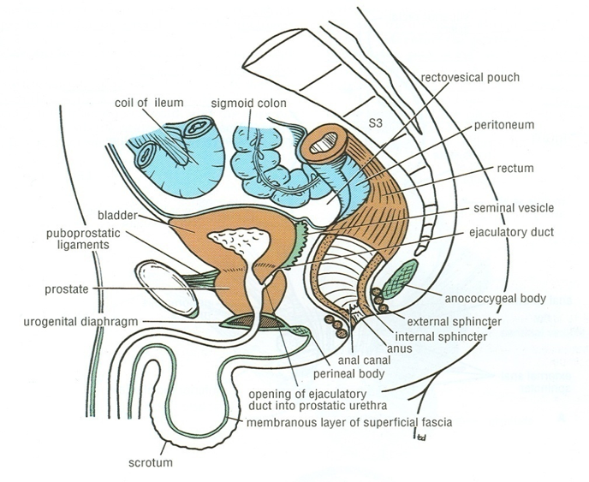
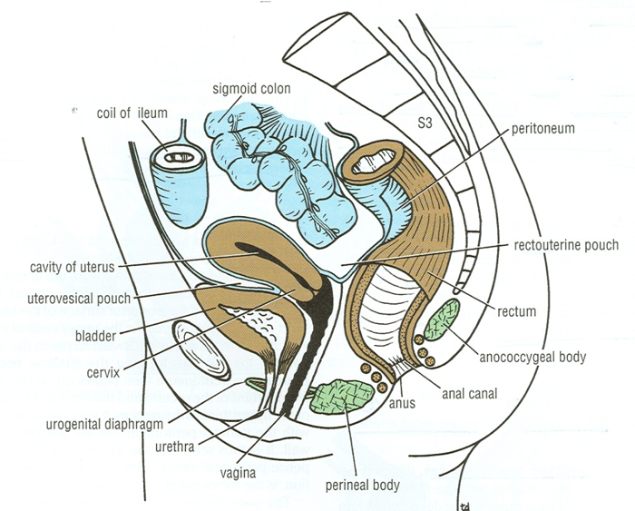
Relations of Rectum in Pelvis
* Due to its relation to the rectum, the easiest way to diagnose prostate enlargement is by examining it per rectal.
** Also prostate cancer may spread backwards and press on the sacral plexus causing symptoms of sciatica
Male Pelvis
Anterior: seminal vesicles, posterior surfaces of urinary bladder & prostate gland*
Posterior: sacrum, sacral plexus** & coccyx
Female Pelvis
Anterior: posterior wall of vagina
Posterior: sacrum, sacral plexus & coccyx
(posterior relations are the same in male and female)

Slide 13
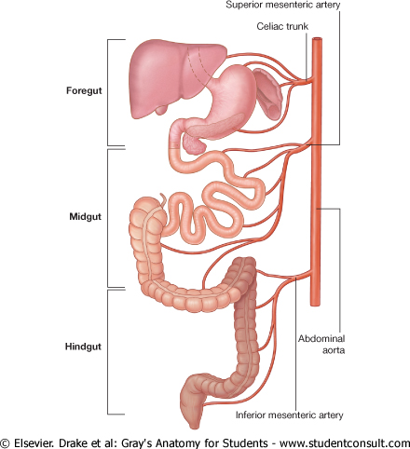
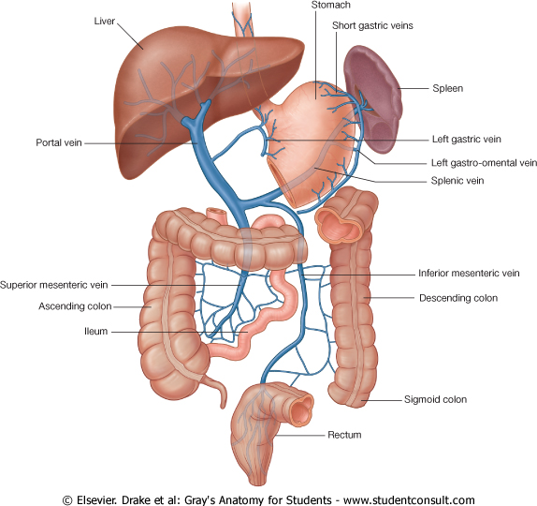
Relation Between Embryological Origin of GIT& its Arterial Supply
GIT is developed from foregut, midgut and hindgut. Each of which has its own blood supply:
Foregut | from esophagus → proximal duodenum at major duodenal papilla | Celiac trunk
Midgut | from distal duodenum after opening → right 2/3 of transvers colon | Superior mesenteric artery
Hindgut | from left 1/3 of transvers colon → anal canal | Inferior mesenteric artery
Venous Drainage Of GIT
The veins of the gut form the tributaries of the portal vein which enters the liver and drains into the portal circulation.

Slide 14
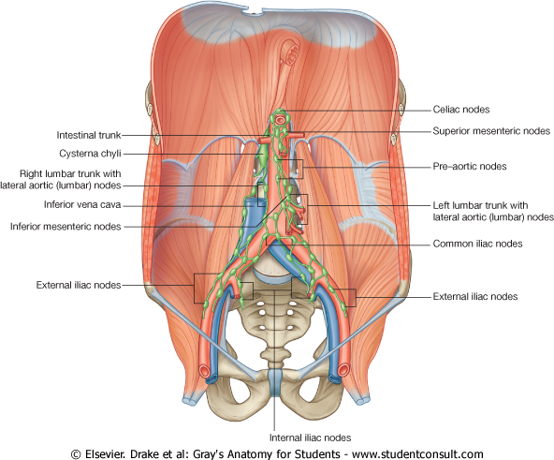
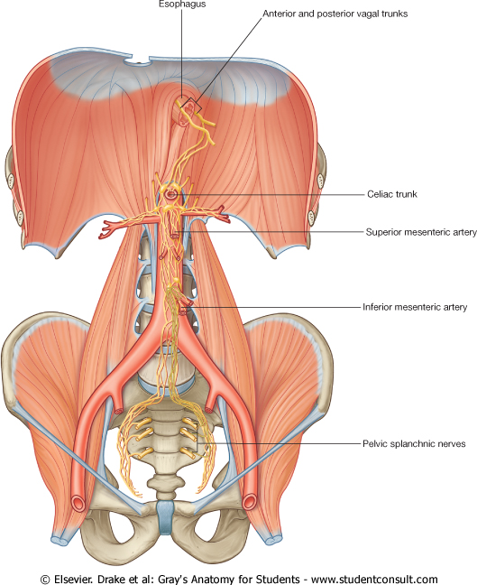
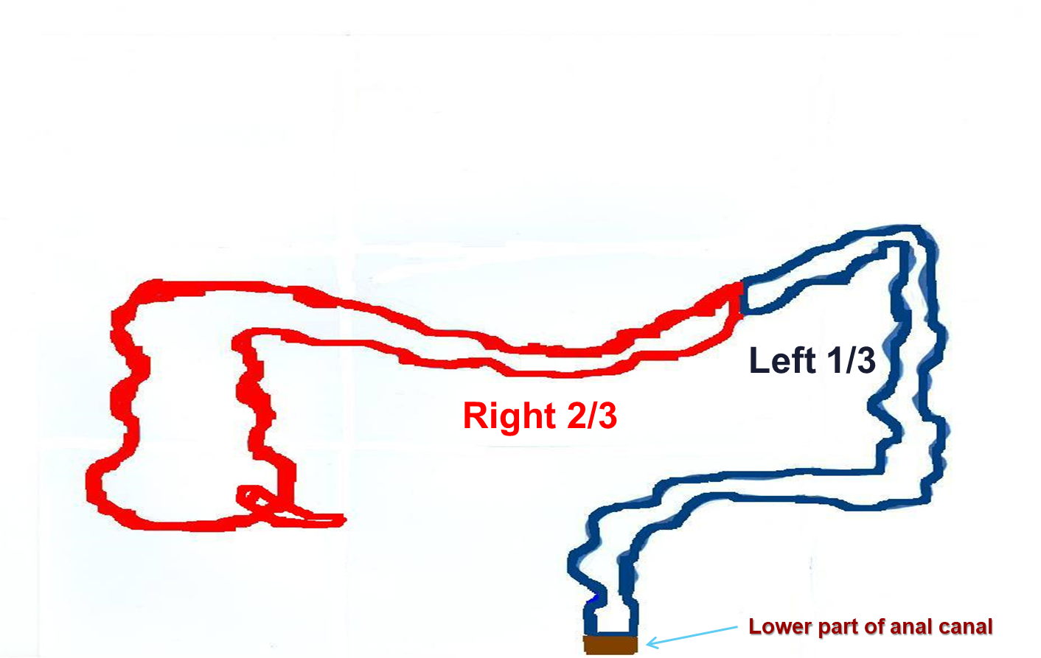
Lymph Drainage of GIT
Only on the girls’ slides
The lymph vessels follow the arteries.
Ultimately, all the lymph is collected at the Preaortic lymph nodes (Superior & Inferior mesenteric).
Relation Between Embryological Origin & Nerve Supply
Origin: Midgut (endoderm)
Nerve supply: (Autonomic): Sympathetic (celiac) + Vagus
Origin: Hindgut (endoderm)
Nerve supply: (Autonomic): Sympathetic + pelvic splanchnic nerves
Origin: ectoderm (lower 1/3 of anal canal)
Nerve Supply: Somatic (inferior rectal)

Slide 15
Peritoneal Covering | CECUM – ASCENDING & DESCENDING COLONS | Transverse Colon | APPENDIX | Rectum | Venous, lymph, nerve supply
PARTS with MESENTERY: 1. Transverse colon 2. Sigmoid colon 3. Appendix 4. Cecum RETROPERITONEALPARTS: 1. Ascending colon 2. Descending colon 3. Upper 2/3 of rectum PARTS DEVOID OF PERITONEAL COVERING: 1. Lower 1/3 of rectum 2. Anal canal | Anterior Relations: -Greater omentum -Coils of small intestine -Anterior abdominal wall Posterior Relations: Cecum: 1. Psoas major 2. Iliacus Ascending colon: 1. Iliacus 2. Quadratus lumborum 3. Right kidney. Descending colon: 1. Left kidney 2. Quadratus lumborum 3. Iliacus | COLIC FLEXURES: 1-Hepatic flexure 2-Splenic flexure: higher + more acute angle Relations: Anterior: -greater omentum, -anterior abdominal wall. Posterior: -2nd part of duodenum , -pancreas & -superior mesenteric vessels. Superior: -liver, - gall bladder, -stomach Inferior: -coils of small intestine | Surface anatomy: the base of appendix is marked by Mc’Burney’spoint. Opening:At posteromedial aspect of cecum. Positions: 1.Retrocecal most common 2.Pelvic 3.Subcecal 4.Preilieal 5.Postileal: least common | Beginning: at level of S3. Termination: continues as anal canal, one inch below & in front of tip of coccyx. Length: 13 cm(5 inches) Relations Posterior: sacrum , sacral plexus & coccyx Anterior: MALE PELVIS: seminal vesicles, posterior surfaces of urinary bladder & prostate gland. FEMALE PELVIS: posterior wall of vagina. | Venous drainage: Portal circulation. Lymph drainage: Preaortic lymph nodes. Nerve supply: Origin: Midgut Nerve supply: (Autonomic): Sympathetic + Vagus Origin: Hindgut Nerve supply: (Autonomic): Sympathetic + pelvic splanchnic nerves Origin: ectoderm (lower 1/3 of anal canal) Nerve Supply: Somatic (inferior rectal)

Slide 16
MCQs
1. The taeniae coli found in which of the following structure ?
A- Transverse colon B- Small intestine C- Rectum
D- Anal canal
2. Which of the following part is with mesentery ?
A- Lower 1/3 of rectum B- Appendix C- Ascending colon
D- Upper 2/3 of rectum
3. Which of the following structure is an anterior relation of cecum ?
A- Psoas major B- lliacus C- Quadratus lumborum
D- Coils of small intestine
4. The superior mesenteric vessels relate to Transverse colon ?
A- Anteriorly B- Posteriorly C- Superiorly
D- inferiorly
5. Which one of the following is the nerve supply of the Hindgut (endoderm):
A- Sympathetic + pelvic splanchnic nerves
B- Somatic (inferior rectal)
C- Sympathetic + Vagus
6. All the lymph in the GIT is collected at the:
A- Preaorticlymph nodes (Superior & Inferior mesenteric).
B- Preaorticlymph nodes (anterior & Inferior mesenteric).
C- postaorticlymph node
7. The termination of the rectum is:
A- as a continuation of sigmoid colon at level of S3.
B- continues as anal canal, one inch below & in front of tip of coccyx.
C- sacral plexus & coccyx
8. Which one of the following parts of large intestine is found in the pelvis?
A- Transverse colon
B- Anal canal
C- Rectum
D- Cecum
9. Its surface anatomy is marked by Mc’Burney’s point:
A- Rectum
B- Colon
C- Appendix
D- Pancreas
Answers:
1. A, 2. B, 3. D, 4. B 5.A 6.A
7.B 8.C 9.C

Slide 17
SAQ
1. What are the Characteristics of COLON ?
Taeniae coli
Sacculations
Epiploic appendices
2. What are the Anterior Relations of (CECUM – ASCENDING & DESCENDING COLONS)
Anterior abdominal wall
Coils of small intestine
Greater omentum
3. What are the Posterior Relations (CECUM – ASCENDING & DESCENDING COLONS)
Cecum: 1. Psoas major 2. Iliacus
Ascending colon: 1. Iliacus 2. Quadratus lumborum 3. Right kidney.
Descending colon: 1. Left kidney 2. Quadratus lumborum 3. Iliacus

Slide 18
Leaders:
Nawaf AlKhudairy
Jawaher Abanumy
Members:
Alanoud Abuhaimed
Anwar Alajmi
Ghada Alothaim
Lama Alfawzan
Lama AlTamimi
Rawan AlWadee
Reema Alshayie
Safa Al-Osaimi
Shatha Alghaihb
Wejdan alzaid
Feedback
References:
1- Girls’ & Boys’ Slides
2- Greys Anatomy for Students
3- TeachMeAnatomy.com
anatomyteam436@gmail.com
@anatomy436

