Slide 1


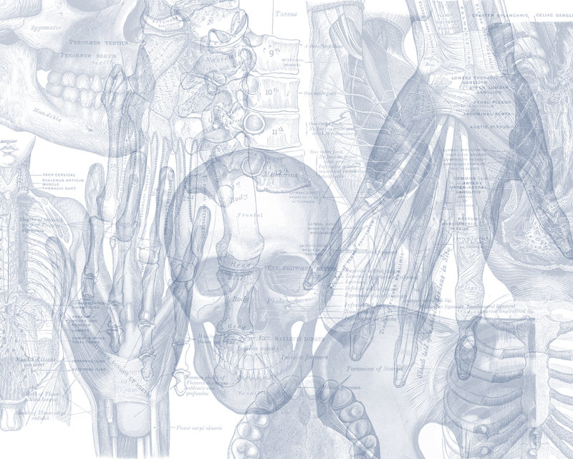


Omentum
Color Code
Important
Doctors Notes
Notes/Extra explanation
Please view our Editing File before studying this lecture to check for any changes.

Slide 2
Objectives
At the end of the lecture the students must know:
Brief knowledge about peritoneum as a thin serous membrane and its main parts; parietal and visceral.
The peritonial cavity and its parts the greater sac and the lesser sac (Omental bursa).
The omentum, as one of the peritonial folds
The greater omentum ,its extends, and contents.
The lesser omentum, its boundaries, and contents.
The Omental bursa, its boundaries.
The Epiploic foramen, its boundaries.
Mesentery of the small intestine, and ligaments of the liver.
Nerve supply of the peritoneum.
Clinical points.
These objectives are only on the Girls Slides BUT they were found in the Medical Education Guide

Slide 3

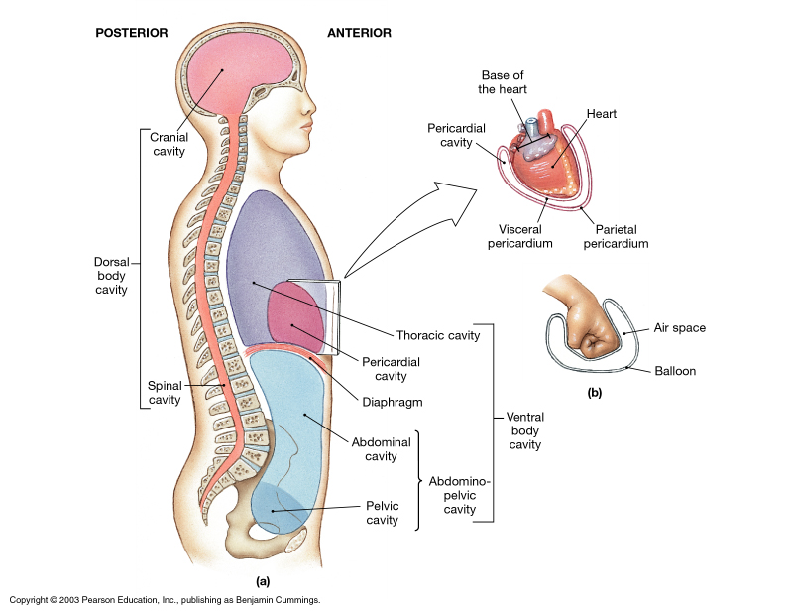
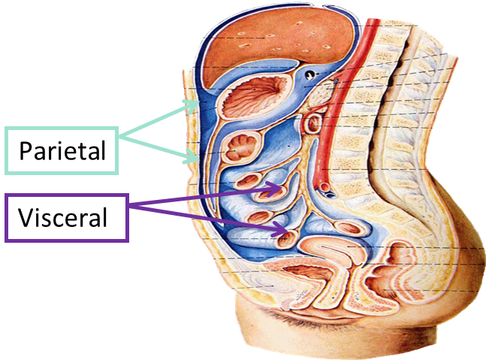
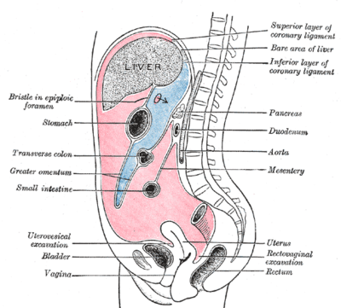
The Peritoneum
Highly recommended →
07:12
is a thin serous membrane,
Lining the wall of the abdominal and pelvic cavities, (the parietal peritoneum).
Covering the existing organs, (the visceral peritoneum).
The potential space between the two layers is the peritoneal cavity.
The peritoneal cavity is the largest one in the body.
Divisions of the peritoneal cavity :
Greater sac; extends from diaphragm down to the pelvis.
Lesser sac; lies behind the stomach.
Both cavities are interconnected through the epiploic foramen.
In male : the peritoneum is a closed sac .
In female : the sac is not completely closed because it communicates with the exterior through the uterine tubes, uterus and vagina.
Extra

Slide 4
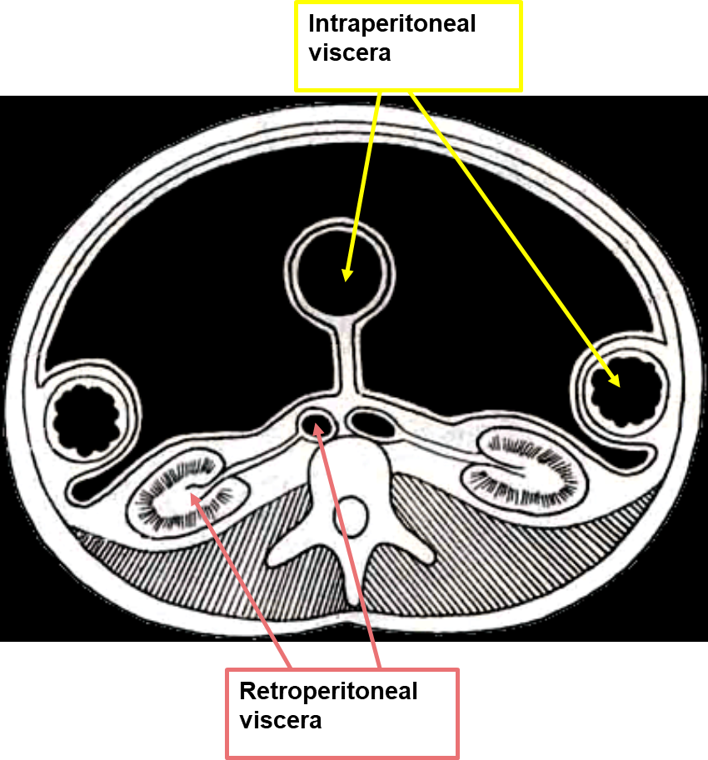
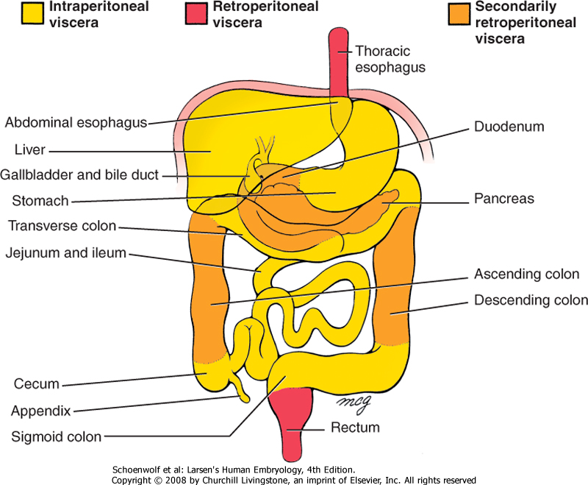
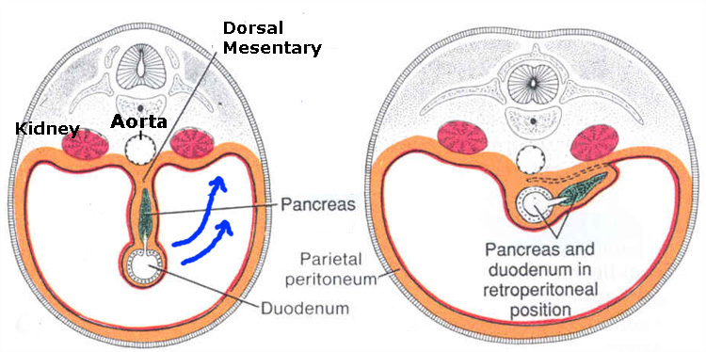
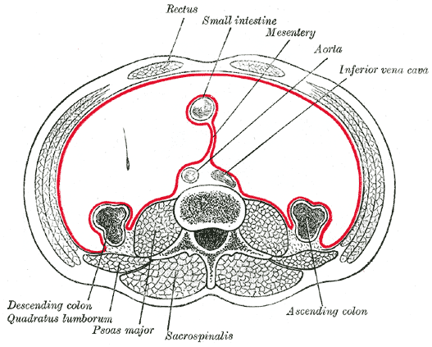
The Peritoneum
Intraperitoneal and retroperitoneal; describe the relationship between various organs and their peritoneal covering;
Intraperitoneal structure; which is nearly totally (entirely) covered by visceral peritoneum and has a supporting mesentery :
stomach & 1st part of duodenum,
liver,
gall bladder,
spleen,
jejunum, ileum,
transverse colon,
sigmoid colon,
uterus, and
ovaries.
Extraperitoneal or Retroperitoneal structure; lies behind the peritoneum, or partially covered by visceral peritoneum and has no supporting mesentery.
Primary retroperitoneal organs:
Aorta,
Inferior vena cava,
kidneys,
Suprarenal glands,
urinary bladder,
vagina, and
rectum.
Secondary retroperitoneal organs: develop in mesenteries, but get pushed against the body wall (parietal peritoneum) during growth so that only half of their surface is covered by peritoneum:
duodenum,
pancreas,
ascending and
descending colon.
The examples are only on the girls’ slides

Slide 5
Folds of the Peritoneum
The peritoneum is divided into (types of peritoneal folds):
Omenta.
Mesenteries.
Peritoneal ligaments.
08:27
The peritoneal ligaments, omenta, and mesenteries permit blood, lymph vessels, and nerves to reach the viscera
Only on the girls’ slides

Slide 6
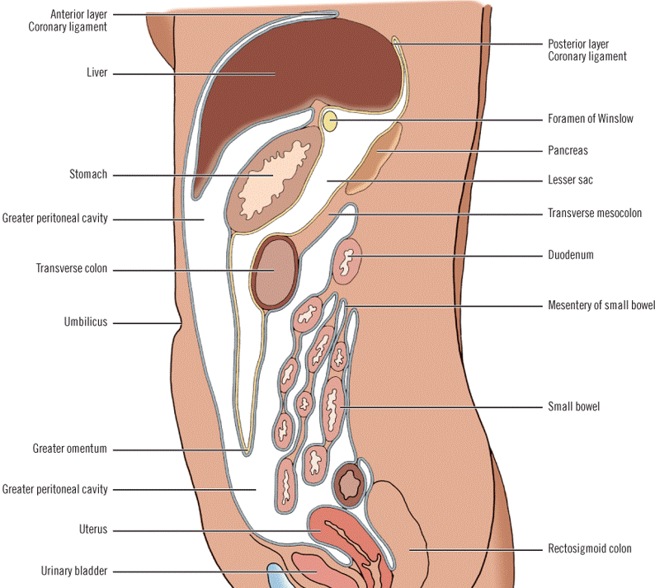
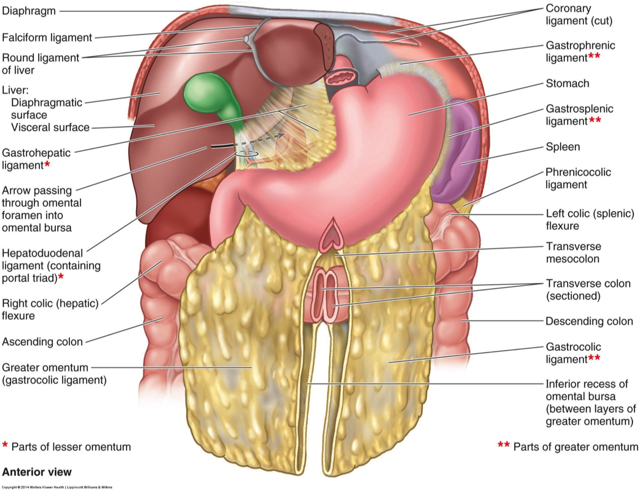
1. Omenta
Two layered fold of peritoneum connecting the stomach to another viscus.
The lesser omentum attaches the lesser curve of the stomach to the liver.
The greater omentum connects the greater curve of the stomach to the transverse colon.
Greater omentum = كرشة
Lesser omentum
Extra
Extra
Greater omentum

Slide 7
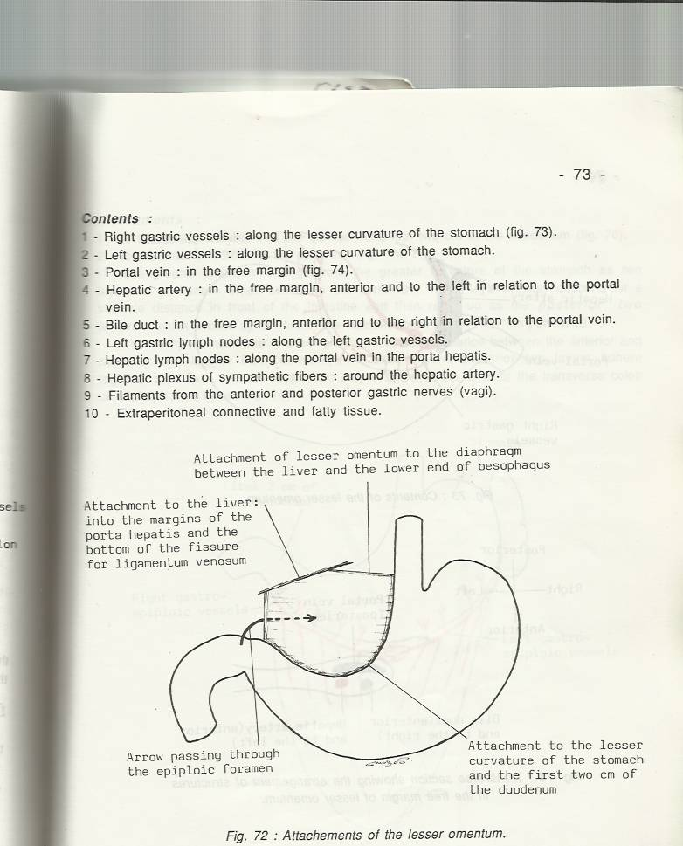
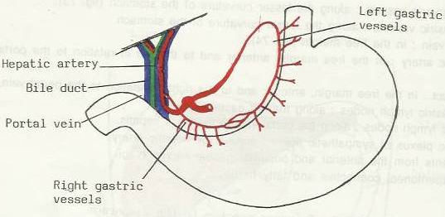
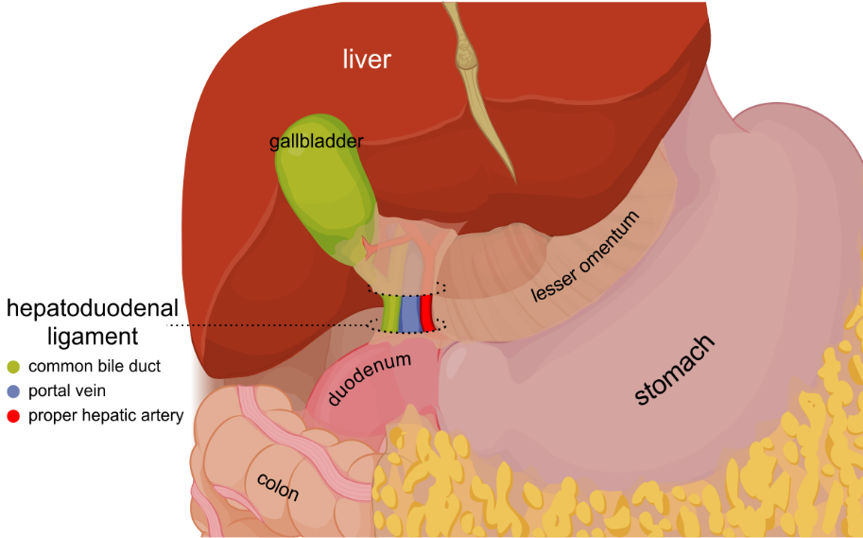
1. Omenta
Lesser omentum
Extends between the liver and the lesser curvature of the stomach + 1st part of the duodenum.
It is continuous with the two layers of peritoneum which cover the stomach and 1st part of the duodenum.
Ascend as a double fold to the porta hepatis of the liver, and fissure for ligamentum venosum.
To the left of porta hepatis it is carried to the diaphragm.
Its right border is a free margin; constitutes the anterior boundary of the epiploic foramen.
Contents between the two layers of the lesser omentum :
Close to the right free margin:
1. hepatic artery
2. common bile duct
3. portal vein
4.Lymphatics
5.hepatic plexus of nerves
At the attachment to the stomach :
run the right and left gastric vessels.
EXTRA
Important

Slide 8
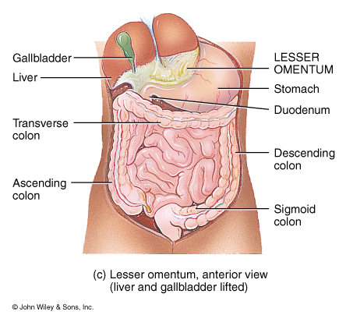
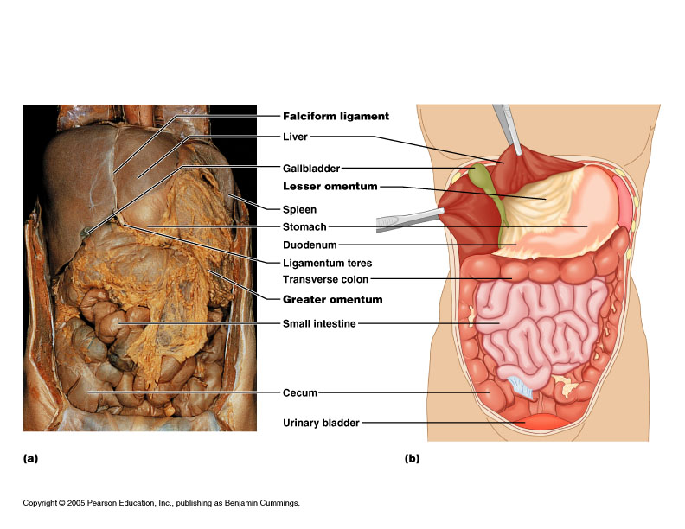
1. Omenta
Lesser omentum
These Pictures are only on the boys’ slides

Slide 9
1. Omenta
Greater omentum
Greater Omentum
connect | the greater curve of the stomach to the transverse colon.
Description and course | The largest peritoneal fold. cribriform appearance. contains some adipose tissue. It consists of a double sheet of peritoneum, folded on itself so that it is made up of four layers (anterior 2 layers + posterior 2 layers). The two layers which descend from the greater curve of the stomach and commencement of the duodenum, pass downward in front of the small intestines, then turn upon themselves, and ascend to the transverse colon, where they separate and enclose it.
borders | Right | Left
 | continuous with the gastrosplenic ligament. | extends as far as the commencement (beginning) of the duodenum.
Content between the 2 layers. | the anastomosis between the right and left gastroepiploic vessels.

Slide 10
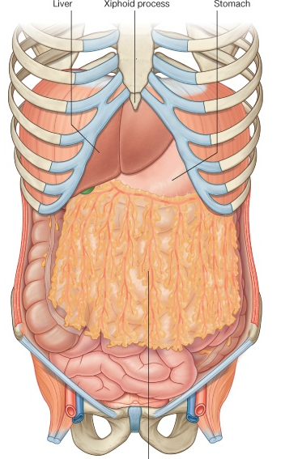
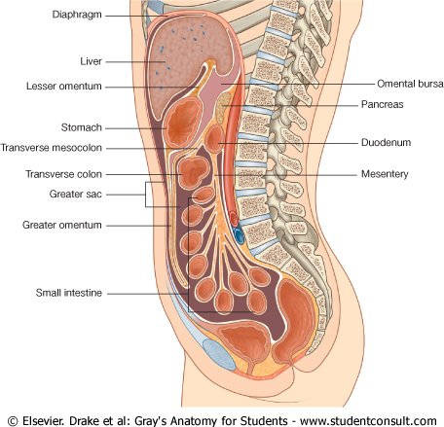
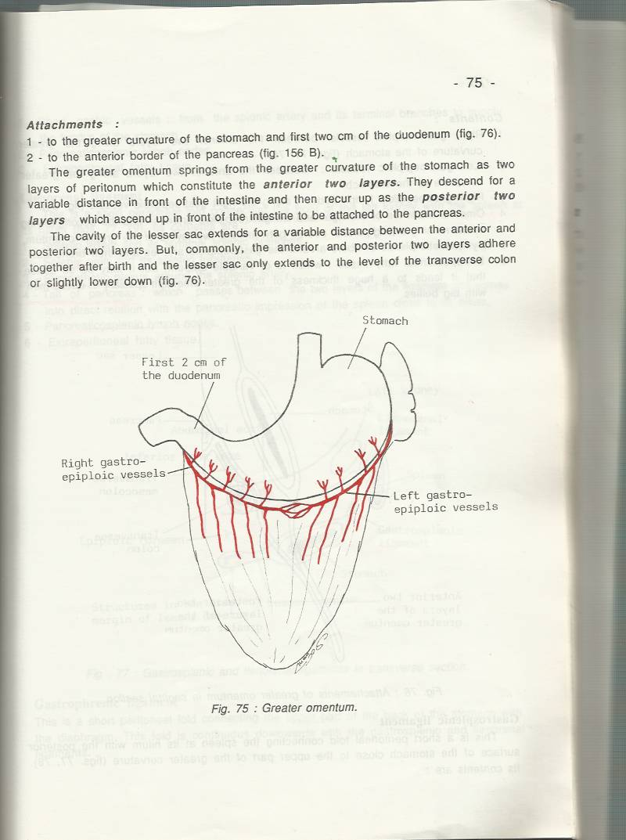
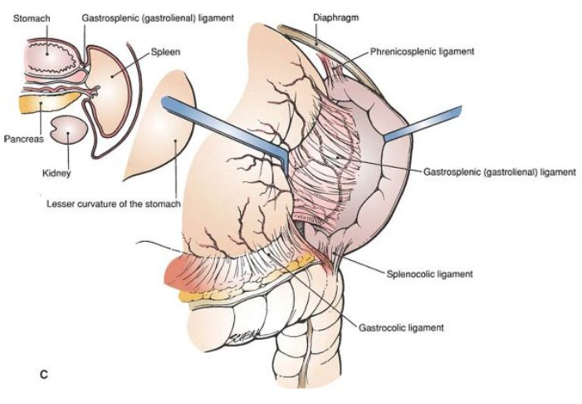
1. Omenta
Greater omentum
Greater omentum
Extra

Slide 11
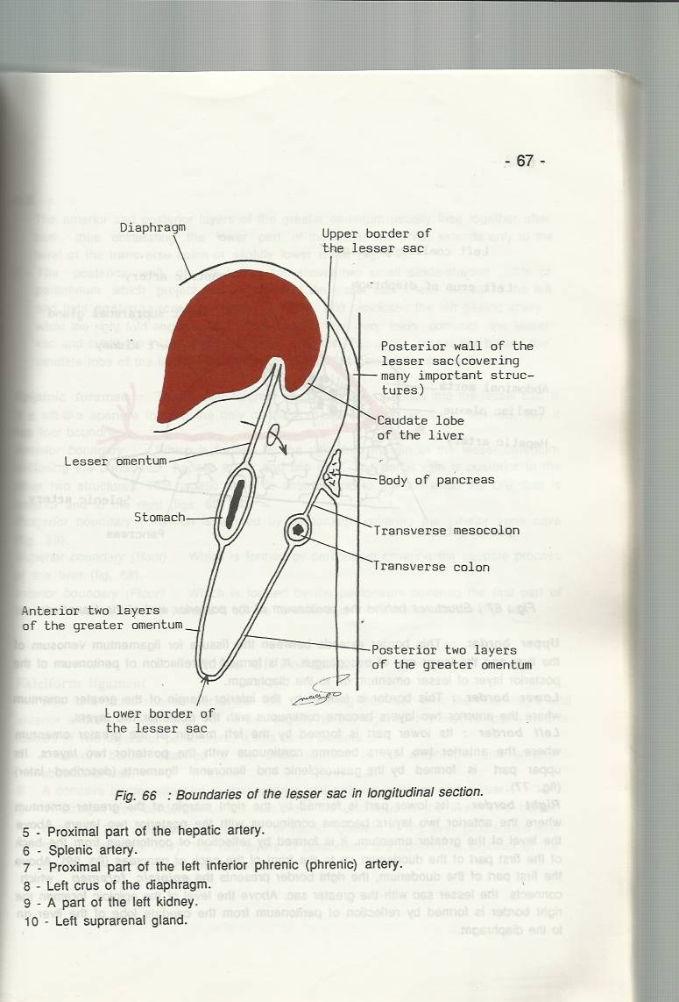
1. Omenta
Omental bursa (Lesser Sac)
Posterior wall
The omental bursa is a part of the peritoneal cavity behind the stomach.
Boundaries of the omental bursa:
Anterior wall: from above downward:
by the caudate lobe of the liver → the lesser omentum → back of the stomach → and the anterior two layers of the greater omentum
Posterior wall: from below upward,
by the posterior two layers of the greater omentum → the transverse colon → and the ascending layer of the transverse mesocolon → the upper surface of the pancreas → the left suprarenal gland →and the upper end of the left kidney.
Anterior wall
Sagittal section of abdominal cavity

Slide 12
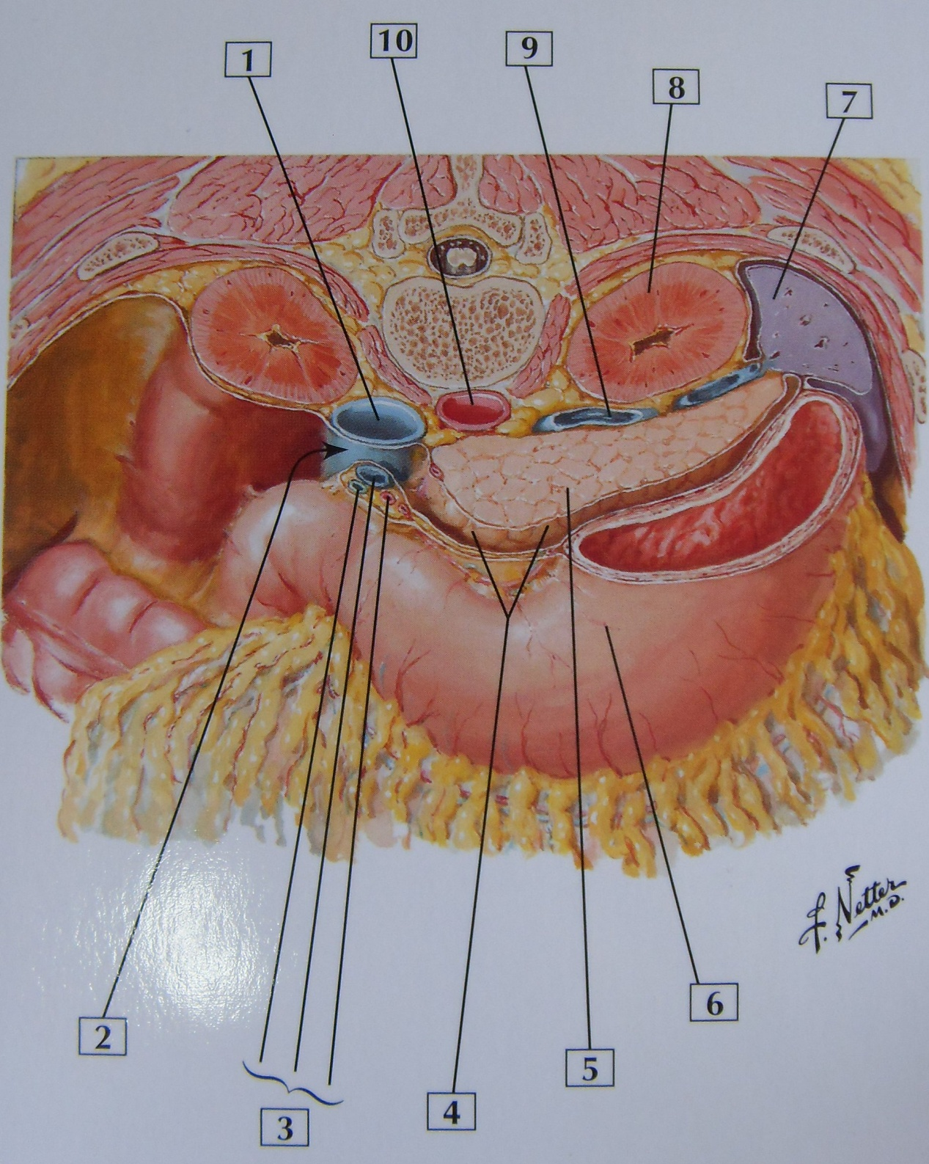
1. Omenta
Omental bursa (Lesser Sac)
Only on the boys’ slides
IVC (inferior vena cava)
Epiploic Foramen
Portal Triad
Lesser Sac
Pancreas
Stomach
Spleen
Kidney
Splenic Vein
Abdominal Aorta

Slide 13
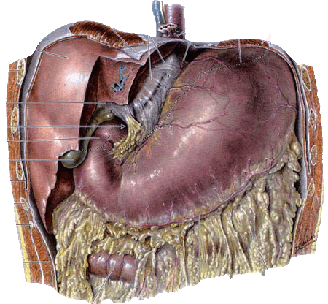
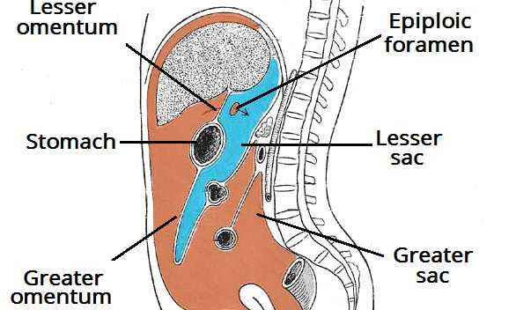
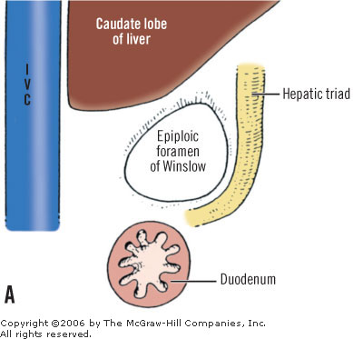
1. Omenta
Epiploic Foramen
The epiploic foramen is the communication between the greater and lesser sacs .
It is bounded by;
In front by the free border of the lesser omentum, with its contents : hepatic artery, common bile duct, and portal vein between its two layers.
Behind by the peritoneum covering the inferior vena cava.
Above (roof) by the peritoneum on the caudate process of the liver.
Below (floor) by the peritoneum covering the commencement of the duodenum and the hepatic artery, before ascending between the two layers of the lesser omentum.
Roof
Front
Behind
:
1)hepatic artery 2)common bile duct
3)portal vein
The floor part of hepatic artery
This is an extra picture to understand the relations
Floor

Slide 14
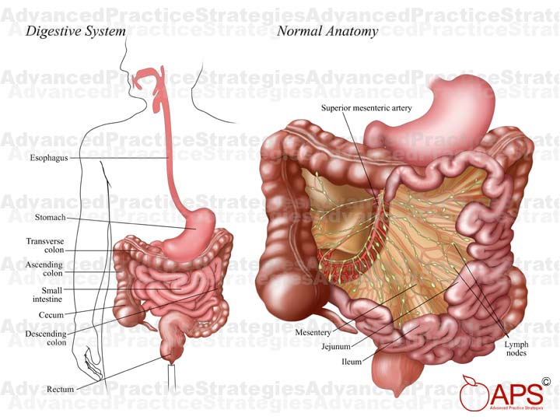
2. Mesentery
Only on the girls’ slides
Two-layered fold of peritoneum suspends the small intestine from the posterior abdominal wall. (it attaches the small intestines to the posterior abdominal wall)
Broad and a fan-shaped
Intestinal border－folded, 7 m long
Root of mesentery: Important
  15 cm long
  Directed obliquely from duodenojejunal flexure at the level of left side of L2
  to the ileocecal junction in the right iliac fossa at the level of right sacroiliac joint.

Slide 15
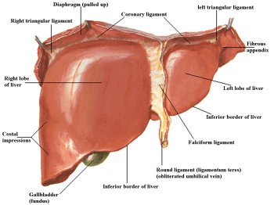
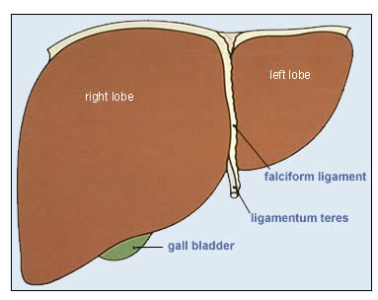
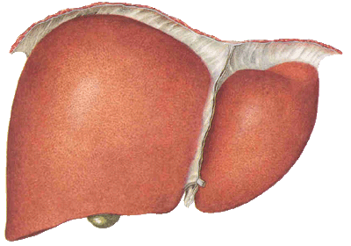
3. Ligaments
Only on the girls’ slides
Two-layered folds of peritoneum that attach solid viscera to the abdominal wall and diaphragm.
Ligaments of liver (will discuss them in more detail in the next lecture)
Falciform ligament of liver
Coronary ligament
Right & Left triangular ligaments
Ligamentum teres

Slide 16
The Peritoneum
Nerve supply
Only on the girls’ slides
Peritoneum | Parietal Peritoneum | Visceral Peritoneum
Sensitive to | Pain, temperature, touch, and pressure. | Only to stretch and tearing
Supplied by | Somatic spinal: Lining the anterior abdominal wall: lower six thoracic (lower 6 intercostal) and first lumbar nerves. The central part of the diaphragmatic peritoneum is supplied by the phrenic nerves (C3,4,5). | autonomic nerves that supply the viscera or traveling in the mesenteries.
Clinical Point: Peritoneal Pain (peritonitis) | Abdominal pain originating from the parietal peritoneum is therefore of the somatic type, it is usually severe, and can be accurately localized. | It is due to Stretch caused by over distension of a viscus and pulling on a mesentery that gives rise to the sensation of pain. Leading to abdominal pain; poorly localized, poorly characterized pain (dull ,unclear, cramping).

Slide 17
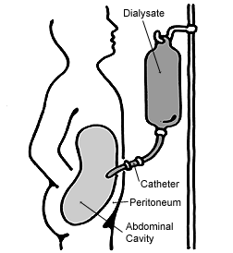
Clinical point
Only on the girls’ slides
Peritoneal Dialysis:
Because the peritoneum is a semi permeable membrane :
It allows transfer of substances (glucose solution)across itself to remove the waste products.
It has been used of in patients with acute renal insufficiency.
Summary
The peritoneum is divided into 2 layers :
1)Parietal layer, lines the abdominal and pelvic walls.
2)Visceral layer, covers the abdominal and pelvic organs.
Omenta are folds of peritoneum. 2 omenta :
1)lesser
2) greater
Lesser sac of peritoneum (Omental Bursa) :
Boundaries :
Anterior wall.
Posterior wall.
Opening to lesser sac (epiploic foramen) : It is a slit-like opening which connect lesser sac with greater sac. Lies behind the lesser omentum.
Epiploic foramen is bounded anteriorly by right free margin of lesser omentum.

Slide 18
Lesser omentum | Greater omentum
connects the stomach and 1st part of duodenum to the liver | connects the greater curvature of stomach with the transverse colon
Right border of lesser omentum is free and it forms the anterior boundary of epiploic foramen
Contents of lesser omentum : Along lesser curvature of stomach : right & left gastric vessels. At the right free border : 1)Hepatic artery 2)Bile duct 3)Portal vein 4)Nerves, lymph vessels& fat. | Contents of greater omentum : Along the greater curvature of stomach : Right & left gastroepiploic vessels. Lymph nodes, vessels & fats.
Mesentery: two-layered fold of peritoneum
suspends the small intestine from the posterior abdominal wall.
Ligaments: two-layered folds of peritoneum that attach solid viscera to the abdominal wall.
Function of peritonuem: The peritoneal ligaments, omenta, and mesenteries permit blood, lymph vessels, and nerves to reach the viscera.
Nerve Supply of the Peritoneum :
parietal peritoneum: lower six thoracic and first lumbar nerves and the phrenic nerves.
visceral peritoneum: autonomic nerves that supply the viscera.
Clinical aspects :
Peritoneal Pain.
Peritoneal Dialysis.
Hepatic (portal) Triad

Slide 19
MCQS
1- An organ covered by visceral peritoneum and has a supporting mesentery is described as:
A-Retroperitoneal
B-Extrapetironeal
C-Intraperitoneal
5-Which of the following is an anterior border of the omentum bursa?
A- transverse colon
B- left kidney
C- back of the stomach
6-Which of the following is part of the hepatic triad?
A- common bile duct
B- hepatic duct
C- portal artery
2- Which of the following connects the greater curve of the stomach to the transverse colon :
A-Lesser omentum
B-Greater omentum
C-Epiploic Foramen
7-The parietal peritoneum is supplied by:
A-lower 6 intercostal
B-lower 6 cervical
C-autonomic
8- A patient presented with abdominal pain that was dull and poorly localized, which part of the peritoneum is affected?
A- parietal peritoneum
B- visceral peritoneum
C- both A & B
3-Which of the following is a content of lesser omentum?
A-Hepatic duct
B-Hepatic vein
C-Hepatic artery
4-The right border of the greater omentum is continuous with:
A-Gastrosplenic ligament
B-Coronary ligament
C-Ligamentum teres
D-Falciform ligament
1. C, 2. B, 3. C, 4. A, 5. C, 6. A, 7. A, 8. B

Slide 20



Leaders:
Nawaf AlKhudairy
Jawaher Abanumy
Members:
Talal alhuqayl
Hamad alkhudairy
Khalid aldakheel
Majed alzain
Mohammed habib
Mohammed nasr
Feedback
References:
1- Girls’ & Boys’ Slides
2- Greys Anatomy for Students
3- TeachMeAnatomy.com
anatomyteam436@gmail.com
@anatomy436

