Slide 1
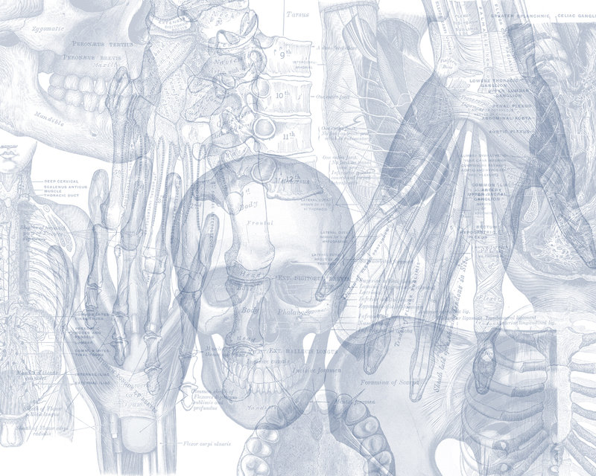
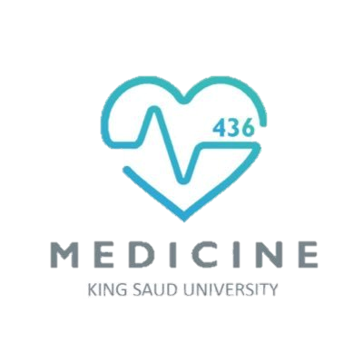
Anatomy of Liver and Spleen
Color Code
Important
Doctors Notes
Notes/Extra explanation
Please view our Editing File before studying this lecture to check for any changes.

Slide 2
Objectives
At the end of the lecture, the students should be able to:
Location, subdivisions ,relations and peritoneal reflection of liver.
Blood supply, nerve supply and lymphatic drainage of liver.
Location, subdivisions and relations and peritoneal reflection of spleen.
Blood supply, nerve supply and lymphatic drainage of spleen.

Slide 3
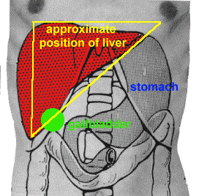
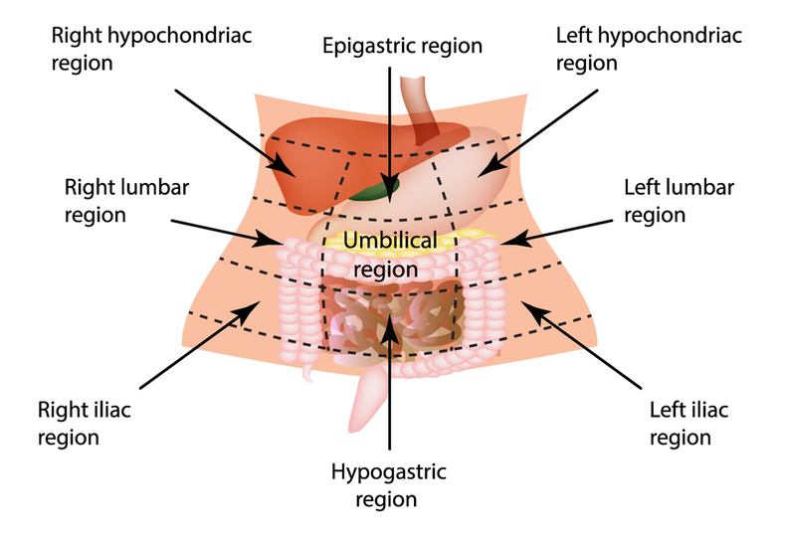
Liver
The largest gland in the body.
Weighs approximately 1500 g (approximately 2.5% of adult body weight).
Lies mainly in the right hypochondrium and epigastrium and extends into the left hypochondrium.
Protected by the thoracic cage and diaphragm, its greater part lies deep to ribs 7-11 on the right side and crosses the midline toward the left below the nipple.
Moves with the diaphragm and is located more inferiorly when on is erect (standing) because of gravity.

Slide 4
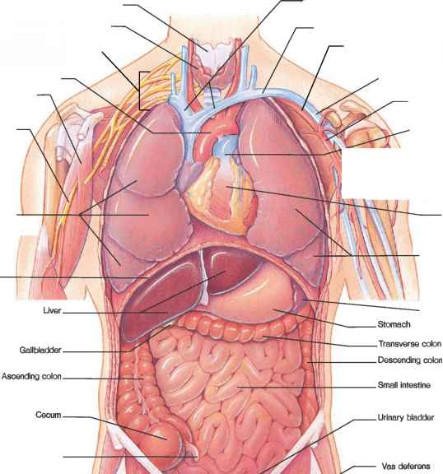
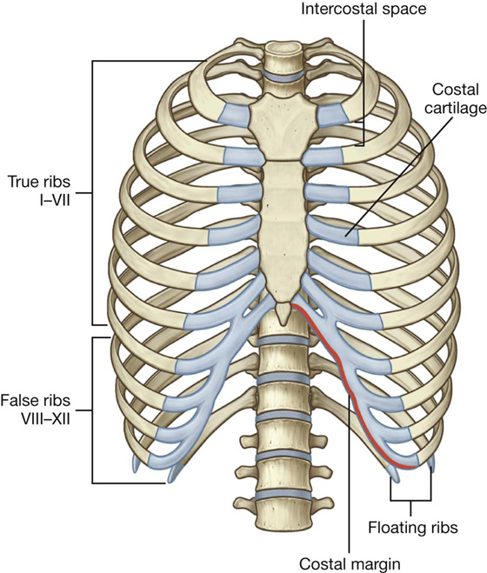
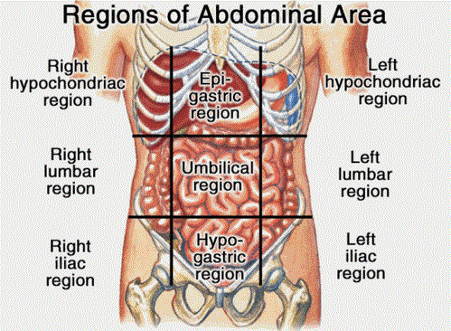
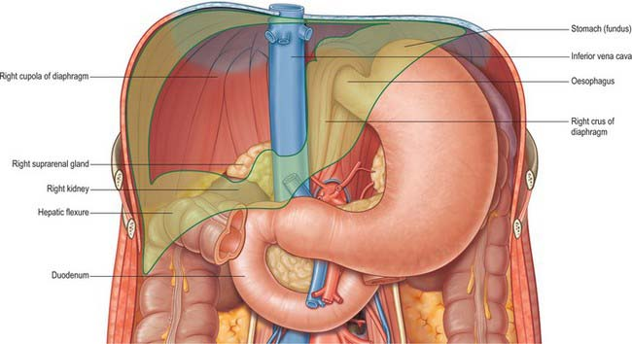
Liver
Relations
10:07
Anterior:
Diaphragm
Right & left pleura and lower margins of both lungs
Right and left costal margins
Xiphoid process
Anterior abdominal wall in the subcostal angle
Extra
Extra
Posterior:
Diaphragm
Inferior vena cava
Right kidney and right suprarenal gland
Hepatic flexure of the colon
Duodenum (beginning), gallbladder, esophagus and fundus of the stomach

Slide 5
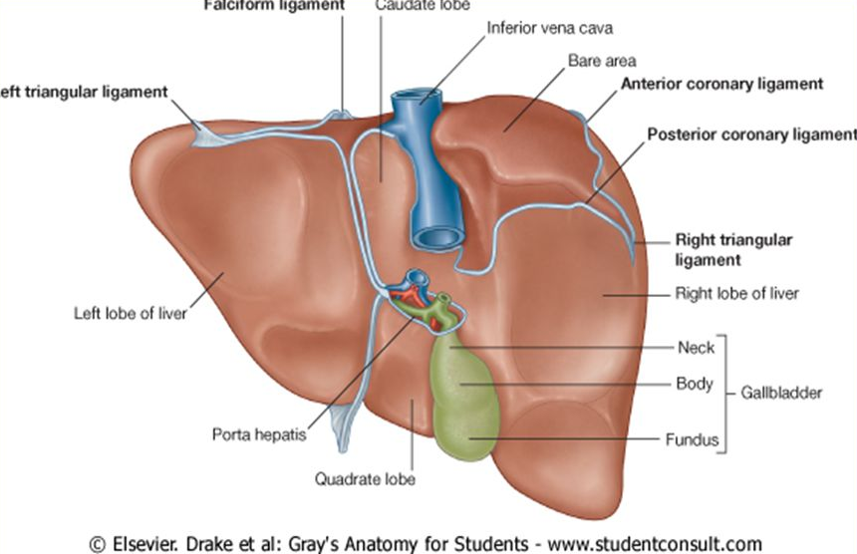
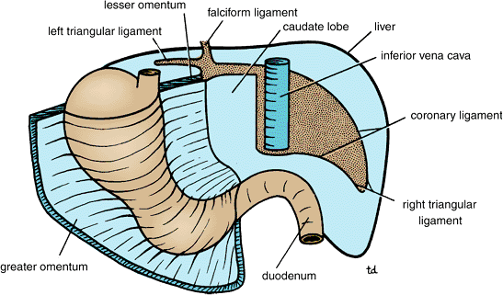
Liver
Peritoneal Reflection
Posterior surface of liver
The liver is completely surrounded by a fibrous capsule and completely covered by peritoneum (except the bare areas).
The bare area of the liver is a triangular area on the posterior (diaphragmatic) surface of right lobe where there is no intervening peritoneum between the liver and the diaphragm.
Boundaries of Bare area:
- Anterior: superior (anterior) layer of coronary ligament.
- Posterior: inferior (posterior) layer of coronary ligament.
- Laterally: right and left triangular ligaments.
Other bare areas include:
Porta hepatis, fossa for gall bladder, & grooves for IVC

Slide 6
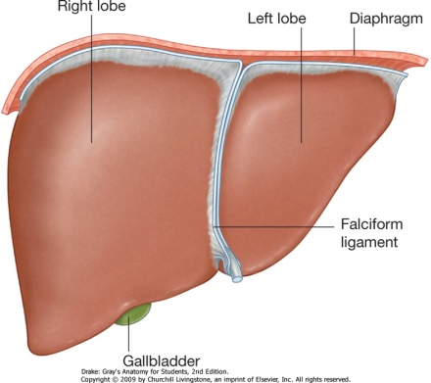
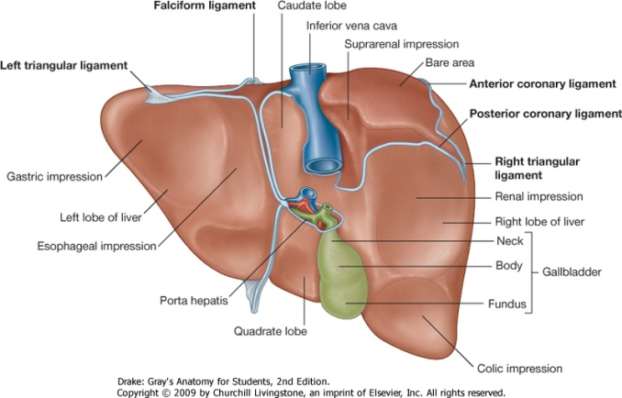
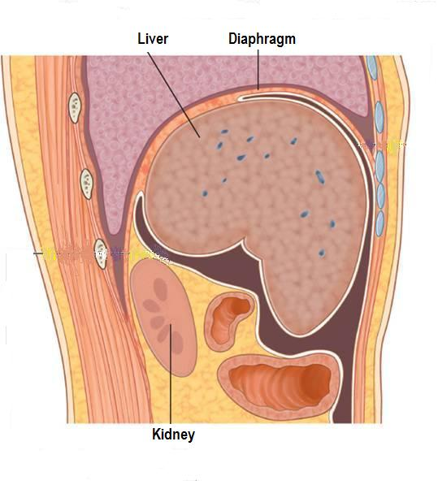
Liver
Surfaces
The liver has two surfaces:
A convex diaphragmatic surface (Antero-superior)
A relatively flat or even concave visceral surface (postero-inferior)
Diaphragmatic Surface
The convex upper surface is smooth and molded to the undersurface of the domes of the diaphragm which separates it from the pleurae, lungs, pericardium, and heart.
Covered with visceral peritoneum, except posteriorly in the bare area of the liver, where it lies in direct contact with the diaphragm.

Slide 7
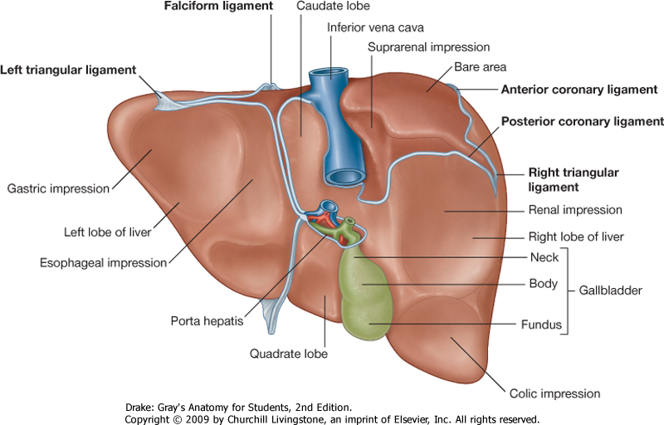
Relations of Visceral Surface of the Liver
Liver
Visceral Surface
It is the posteroinferior surface, related to abdominal viscera.
It is covered with peritoneum, except at the fossa for the gallbladder, the porta hepatis and IVC groove.
It bears multiple fissures and impressions for contact with other organs.
The visceral surface is related to the:
1. stomach and duodenum
2. Esophagus
3. lesser omentum
1
4. gallbladder
5. right colic flexure
right kidney and right
suprarenal gland
2
6
3
4
5
(along margin of porta hepatis)

Slide 8
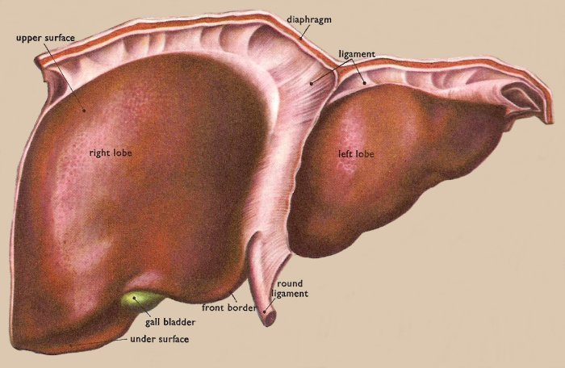
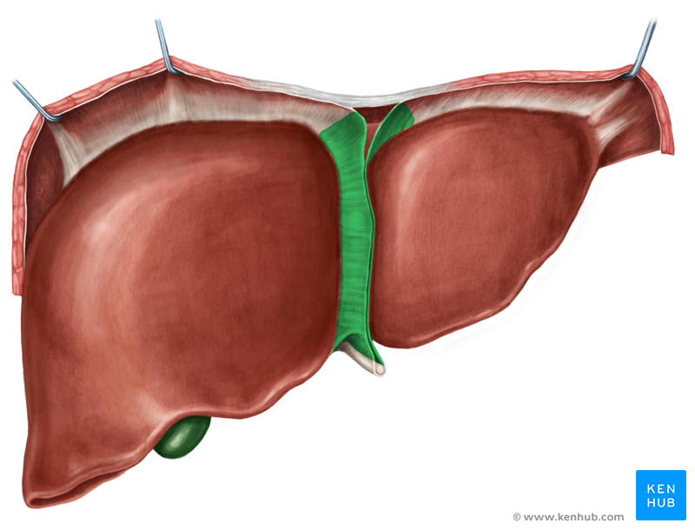
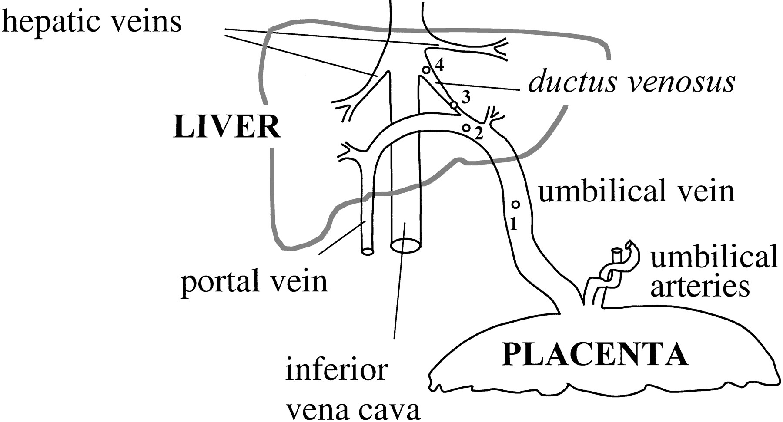
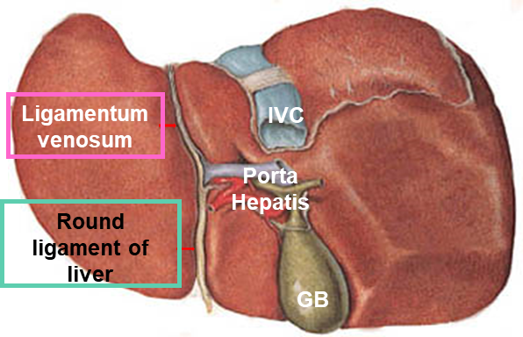
Liver
Ligaments
07:19
Falciform ligament
1. Falciform ligament
It is a two-layered fold of the peritoneum, ascends from the umbilicus to the liver.
It connects the liver with the diaphragm and anterior abdominal wall & umblicus.
Its sickle-shaped free margin contains the ligamentum teres (round Ligament) of liver, the remains of the umbilical vein (oblitrated umbilical vein) , which carried oxygenated blood from the placenta to the fetus.
Extra
2. Ligamentum venosum
It is the fibrous remnant of the fetal ductus venosus (oblitrated ductus venosus) , which shunted blood from the umbilical vein to the IVC, short circuiting the liver.
في الجنين كان حلقة الوصل بينهم

Slide 9
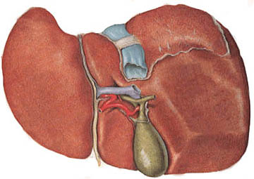
Liver
Lobes
The liver is divided into a large right lobe and a small left lobe by the attachment of the falciform ligament.
The right lobe is further divided into a quadrate lobe and a caudate lobe by the presence of (1) the gallbladder, (2) the fissure for the ligamentum teres, (3) the inferior vena cava, and (4) the fissure for the ligamentum venosum.
The caudate lobe is connected to the right lobe by the caudate process.
The quadrate and caudate lobes are a functional part of the left lobe of the liver.
The functional anatomy divides the liver into left and right lobes based on their relation to the division of common hepatic duct, hepatic portal vein, and hepatic artery proper into right & left branches, so the areas of the liver supplied by these branches constitute the functional left or right lobes. (Only on the girls’ slides)
Caudate process
Cauate lobe
Left lobe
Right lobe
Quadrate lobe
Extra

Slide 10
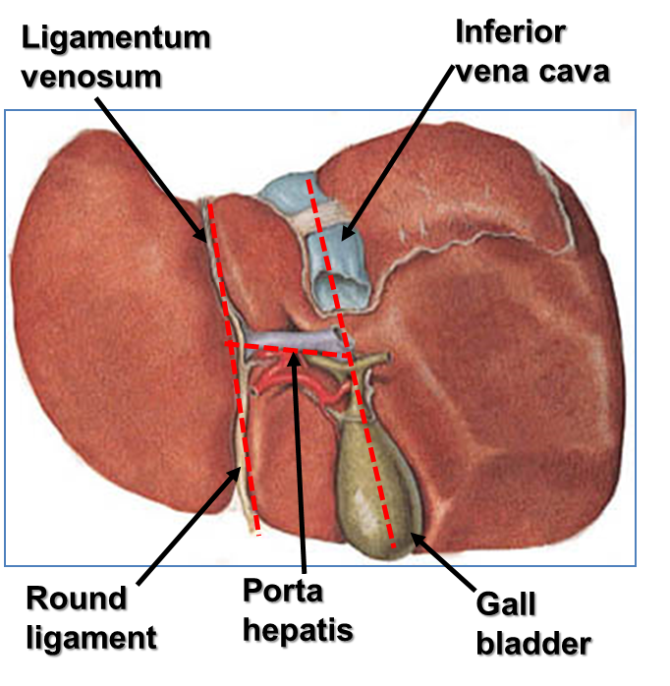
Fissures of The Liver
Two sagittally oriented fissures, linked centrally by the transverse porta hepatis, form the letter H on the visceral surface.
The Right Fissure , Formed :
Anteriorly : by the fossa for the gallbladder
The Left Fissure , formed :
Anteriorly: by the fissure for the round ligament (lig.teres*).
Posteriorly : by the fissure for the ligamentum venosum.
Posteriorly : by the groove for the inferior vena cava.
*ligamentum teres
Porta Hepatis (Hilum of the Liver)
A transverse fissure found on the posteroinferior surface and lies between the caudate and quadrate lobes.
The upper part of the lesser omentum is attached to its margins.
C
Structures passing through the porta hepatis include:
Right and left hepatic ducts.
Right and left branches of the hepatic artery
Right and left branches of the portal vein
Autonomic: Sympathetic and parasympathetic nerve fibers
A few hepatic lymph nodes lie here; they drain the liver and gallbladder and send their efferent vessels to the celiac lymph nodes.
Q
A useful mnemonic to help remember the order of structures in the porta hepatis from anterior to posterior is: DAVE
D: ducts (right and left hepatic duct branches)
A: arteries (right and left hepatic artery branches)
V: vein (portal vein)
E: epiploic foramen (of Winslow)

Slide 11
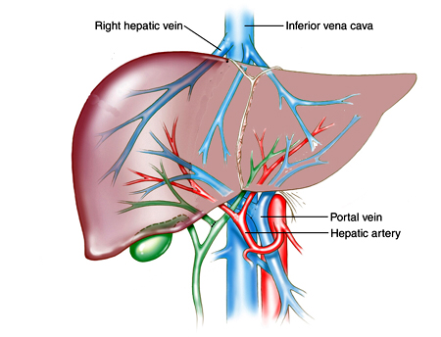
Liver
Blood Circulation
08:11
The blood vessels conveying blood to the liver are the hepatic artery (30%) a branch of celiac trunk, and portal vein (70%).
The hepatic artery brings oxygenated blood to the liver
The portal vein brings venous blood rich in the products of digestion, which have been absorbed from the gastrointestinal tract to the liver.
The venous blood is drained by right & left hepatic veins into the inferior vena cava
The liver has dual blood supply: from the hepatic artery and portal vein.
The venous drainage is into the hepatic vein.
Extra: the organs that are have dual supply are the liver, lungs, and liver.

Slide 12
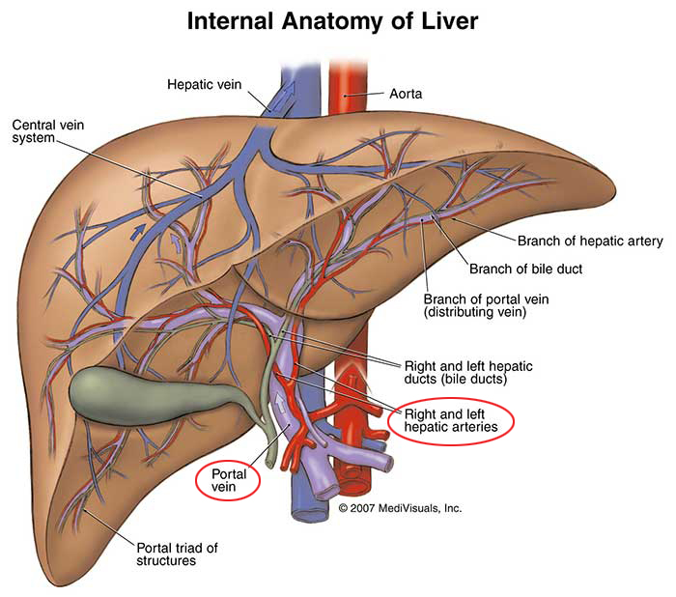
Liver
Blood circulation
At or close to the porta hepatis, the hepatic artery and portal vein terminate by dividing into right and left primary branches which supply the right and left parts of liver, respectively.
Within the liver, the primary branches divide to give secondary and tertiary to supply the hepatic segments independently.
The hepatic veins, are intersegmental in their distribution and function, draining parts of adjacent segments.
The attachment of these veins to the IVC helps hold the liver in position. (The peritoneal ligaments and the tone of the abdominal muscles play a minor role in the support of liver).
The liver is held in its position by 3 things:
Hepatic veins → main!
Peritoneal ligaments
Abdominal muscles
تثبتها في مكانها

Slide 13
Liver
Supply
Lymph Drainage
The liver produces a large amount of lymph—about one third to one half of all body lymph.
The lymph vessels leave the liver and enter several lymph nodes in the porta hepatis.
The efferent vessels pass to the celiac nodes mainly.
A few vessels pass from the bare area of the liver through the diaphragm to the posterior mediastinal lymph nodes.
Nerve supply
Sympathetic and parasympathetic nerves.
Sympathetic from the celiac plexus.
Parasympathetic nerves: The anterior vagal trunk gives rise to a large hepatic branch, which passes directly to the liver.

Slide 14
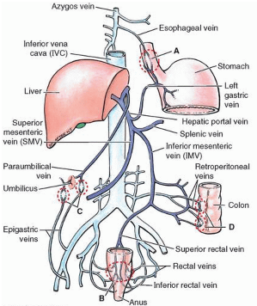
Liver
Portal-systemic (portacaval) anastomoses
It is a specific type of anastomosis that occurs between the veins of portal circulation and those of systemic circulation
In portal hypertion, these anastomosis open and form venous dilatation called varices (الدوالي).
Sites:
Esophagus (lower third part).
Upper Anal canal (immediately under rectum).
Paraumbilical region.
Retroperitoneal.
Intrahepatic (Patent ductus venosus) = rare.
In portal hypertension (as from cirrhosis or hepatitis) the anastomosis areas dilate causing variant effects depending on the site, for example:
Esophageal → causes esophageal varices and hematemesis (vomiting blood)
Paraumbilical → causes caput medusa
Upper anal canal → cause hemorrhoids (البواسير) when the dilation burst and bleed.

Slide 15
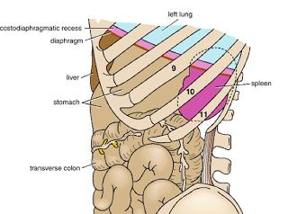
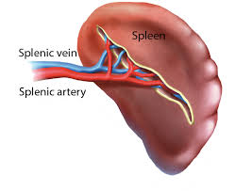
Spleen
Largest single mass of lymphoid tissue
Located in the left hypochondrium, deep to 9, 10 & 11 ribs. مهمة
Its Long axis lies along 10th rib.
It is separated from the ribs by the diaphragm and the costodiaphragmatic recess(space in pleural cavity).
Ovoid in shape with notched anterior border, while posterior border is round
Lower pole extends forward as far as the midaxillary line.
Normal size spleen can not be palpated on clinical examination. (A healthy spleen is not palpable).

Slide 16
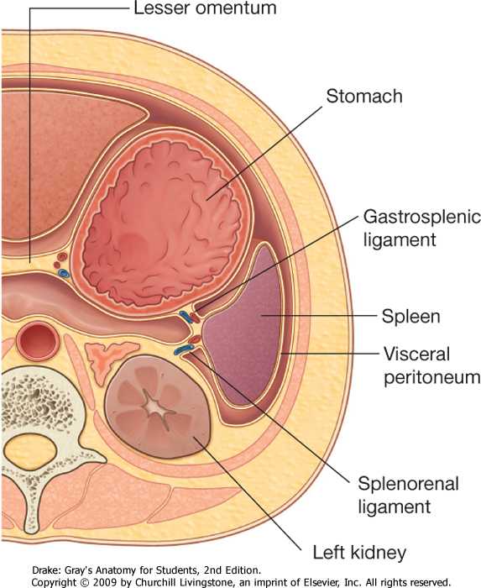
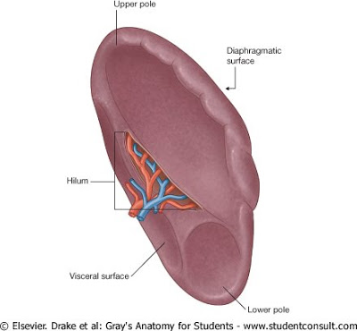
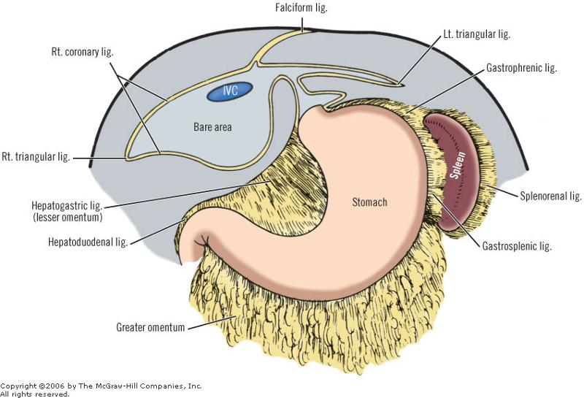
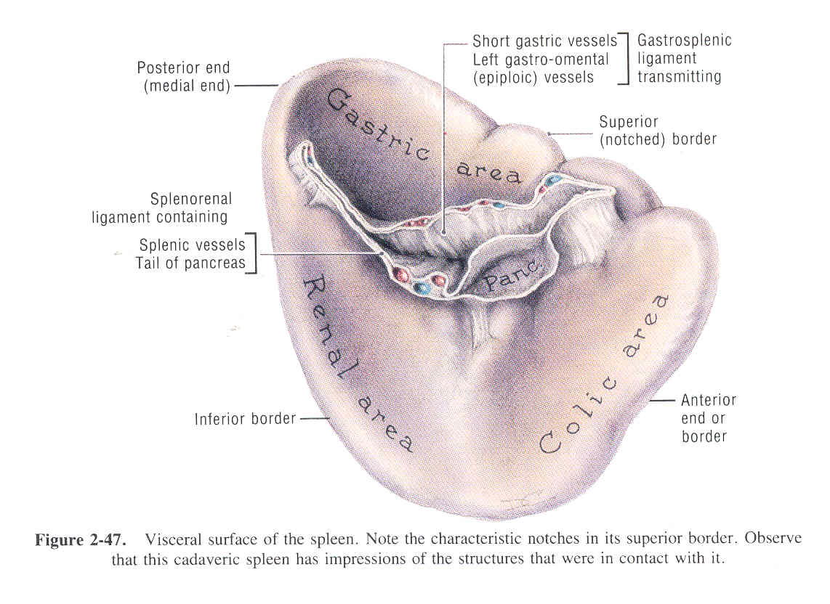
Spleen
14:28
Peritoneal Reflection / Ligaments
Spleen is completely surrounded by peritoneum
EXCEPT at the hilum where its margins give attachement to :
Gastrosplenic ligament to the greater curvature of stomach (carrying the short gastric and left gastroepiploic vessels)
Lienorenal (splenorenal) ligament to the left kidney (carrying the splenic vessels and the tail of pancreas).
Surfaces:
Diaphragmatic surface: is convexly curved to fit the concavity of the diaphragm and curved bodies of the adjacent ribs
Visceral surface: related to viscera.
Borders:
The superior and anterior borders are sharp.
Anterior border is notched.
The posterior (medial) and inferior borders are rounded.

Slide 17
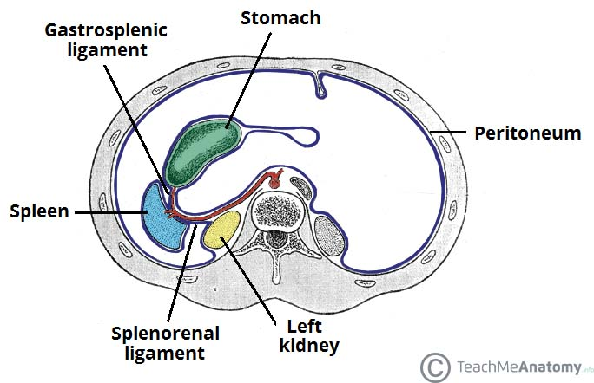
Spleen
Relations
Note:
Left colic flexure = splenic flexure
Right colic flexure = hepatic flexure
Anteriorly:
Stomach,
tail of pancreas,
left colic flexure &
left kidney
Posteriorly:
Diaphragm, that separates it from the left pleura (left costo-diaphragmatic recess),
left lung &
9, 10 & 11 ribs.
Inferiorly:
Left colic flexure.
Medially:
Left kidney.
Extra

Slide 18
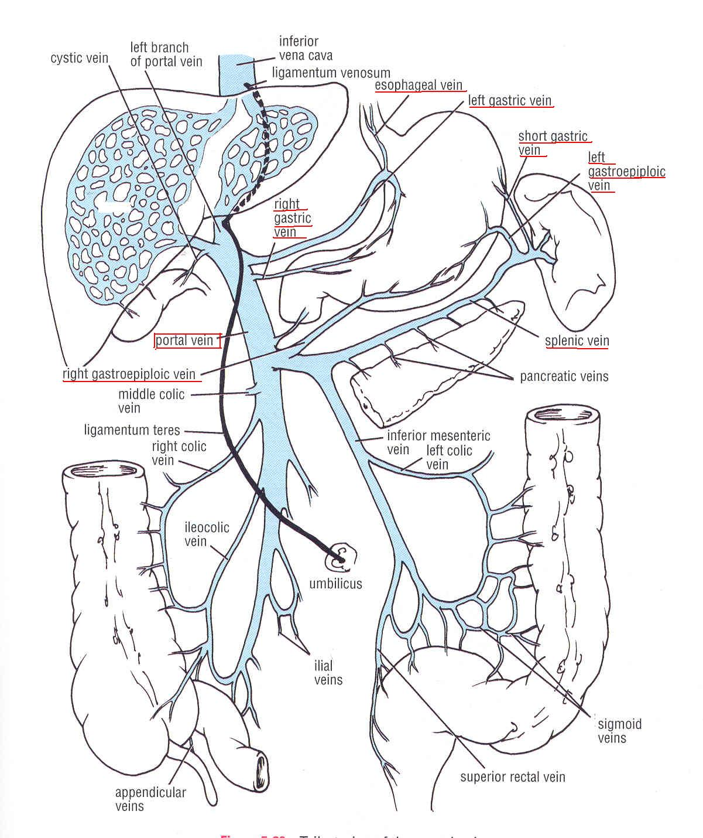
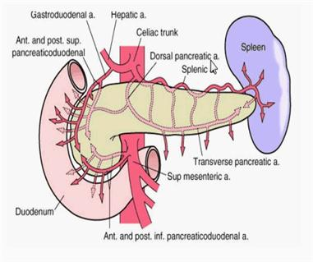
Spleen Supply
Sup.Mes.v.
Blood Supply : Splenic artery
Largest branch of the celiac artery
Runs a tortuous (متعرج) course* along the upper border of the pancreas
Passes within the lienorenal ligament
Divides into 4-5 terminal branches, which enter the spleen at the hilus .
The lack of anastomosis of these arterial vessels within the spleen results in the formation of vascular segments of the spleen with relatively avascular planes between them, enabling subtotal splenectomy**.
Venous Drainage: Splenic vein
Leaves the hilus
Runs behind the tail & body of the pancreas
Reaches behind the neck of pancreas, where it joins the superior mesenteric vein to form the portal vein
Tributaries:
Short gastric vein
left gastroepiploic vein
Pancreatic veins
Inferior mesenteric vein
*Extra: there are 3 arteries that have tortuous course in the body: uterine, splenic and facial
** كأنه في حددود بين كل قسم والثاني من حيث الشرايين فيسهل إزلة جزء لو احتاج الشخص لعملية

Slide 19
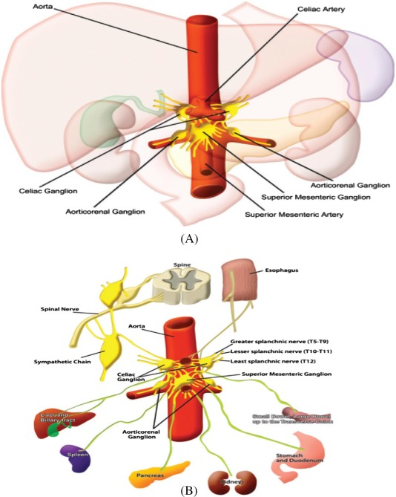
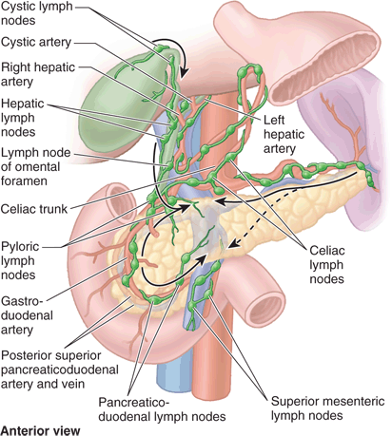
Spleen Supply
Lymph Drainage
Lymphatics emerge from the hilus and drain into several nodes lying at the hilum
Efferents from the hilar nodes pass along the course of splenic artery, and drain into the celiac lymph nodes
Nerve Supply
Derived from the celiac plexus (Innervation is purely sympathetic).
Are distributed mainly along branches of the splenic artery, and are vasomotor in function.
Extra
Extra

Slide 20
SUMMARY
 | Liver | Spleen
Location | Right & left hypochondrium and epigastrium | Left hypochondrium deep to 9&10&11ribs
Surfaces | Convex diaphragmatic Concave visceral | Diaphragmatic(convex) visceral
Borders | - | Superior & anterior borders → sharp Posterior & inferior → round
Blood supply | Hepatic artery(carry oxygenated blood) Portal vein (carry venous blood rich in nutrients) R&L hepatic vein drain venous blood into IVC | Splenic artery & vein (splenic v joins superior mesenteric v to form portal v)
Nerve supply | Sympathetic →celiac plexus parasympathetic→ anterior vagal trunk | Purely sympathetic →celiac plexus
Lymphatic drainage | Celiac nodes Few vessels to posterior mediastinal lymph nodes | Celiac nodes

Slide 21
MCQ
1. Which one of the following play a major role in supporting of liver?
Hepatic veins
Hepatic artery
Peritoneal ligament
Tone of abdominal muscle
5. The left colic flexure is related to the spleen :-
Anteriorly
Posteriorly
Medially
Inferiorly
2. The main final lymphatic drainage of liver is :-
Posterior mediastinal nodes
Celiac nodes
Superior mediastinal nodes
Superior mesenteric nodes
6. Which of the following artery has tortuous course :-
Hepatic artery
Splenic artery
Superior mesenteric
Inferior mesenteric
3. The spleen is located in the left side deep to :-
7,8 and 9 ribs
10 rib
9,10 and 11 ribs
None of above
7. The portal vein is form by joining of :-
Splenic vein and superior mesenteric artery
Splenic vein and superior mesenteric vein
Hepatic vein and superior mesenteric vein
Superior and inferior mesenteric veins
4. The ligament that attached the hilum of spleen to the greet curvature of stomach :-
Gastrosplenic ligament
Lienorenal ligament
Splenorenal ligament
Gastrohepatic ligament
Answers:
1: A, 2: B, 3: C, 4: A, 5: D, 6: B, 7: B

Slide 22
MCQ
8. The liver lies mainly in the :
Right lumber region
Left hypochondrium
Right hypogastrium
Right hypochondrium
11. The convex upper surface of the liver is covered with visceral peritoneum except :
Inferiorly in the fossa of the gallbladder
Anteriorly in the IVC
Superiorly in porta hepatis
Posteriorly in bare area
9. Which of the following lies posterior to the liver :
The body of the stomach
The hepatic flexure
The jejunum
The splenic flexure
12. Which of the following ligaments is a
remain of the umbilical vein :
Ligamentum venosum
Ligamentum hepatis
Ligamentum teres
A&C
10. The lateral boundaries of the Bare area include :
Superior triangular ligament
Left coronary ligament
Posterior triangular ligament
Right triangular ligament
13. The functional part of the left lobe of the liver include :
Caudate
A&C
Quadrate
None of the above
Answers:
8: D, 9: B, 10: D, 11:D, 12: C, 13: B

Slide 23
SAQ
52 years old male , emigrated from Southeast Asia about 10 years ago, and has no specific complaints except fatigue. On examination you find little of note except that his liver edge is firm, is easily felt, and extends about 6 cm below the costal margin across much of the right upper quadrant.
1) What is the liver ?
The largest gland in the body
2) where is it located ?
Lies mainly in the right hypochondrium and epigastrium and extend into the left hypochondrium. Its gather part lies deep to 7- 11 right side ribs and crosses the midline toward the left nipple
3) what protects it ?
It is protected by the thoracic cage and the diaphragm.
4) What is the site of portal-systemic anastomoses?
Esophagus (lower part).
Upper Anal canal.
Paraumbilical region.
Retroperitoneal.
Intrahepatic (Patent ductus venosus).
5) What is the feature that enable subtotal splenectomy?
Lack of arterial anastomoses

Slide 24
Leaders:
Nawaf AlKhudairy
Jawaher Abanumy
Members:
Ashwaq Almajed
Ameera Niazi
Dania Alkelabi
Do'aa abdulfattah
Ghaida Alsaeed
Nada Aldakheel
Nourah Al Hogail
Nouf Aloqaili
Muneerah Alzayed
Sarah Alshamrani
Feedback
References:
1- Girls’ & Boys’ Slides
2- Greys Anatomy for Students
3- TeachMeAnatomy.com
anatomyteam436@gmail.com
@anatomy436

