Slide 1
Biochemistry
Don’t watch the clock .
Do what it does
“KEEP GOING”
Role of Salivary Glands and Stomach in Digestion
Editing file

Slide 2
By the end of this lecture, the students should be able to know:
Understand the principle and importance of digestion of dietary foodstuffs
Understand the role of salivary glands indigestion
Understand the role of stomach indigestion

Slide 3
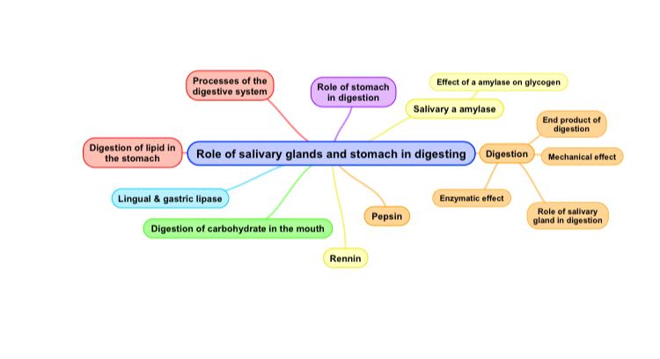
Key Principles:

Slide 4
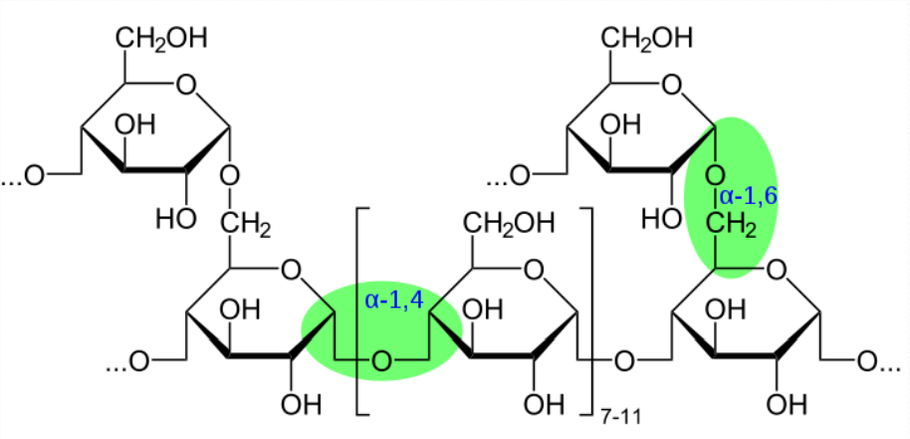
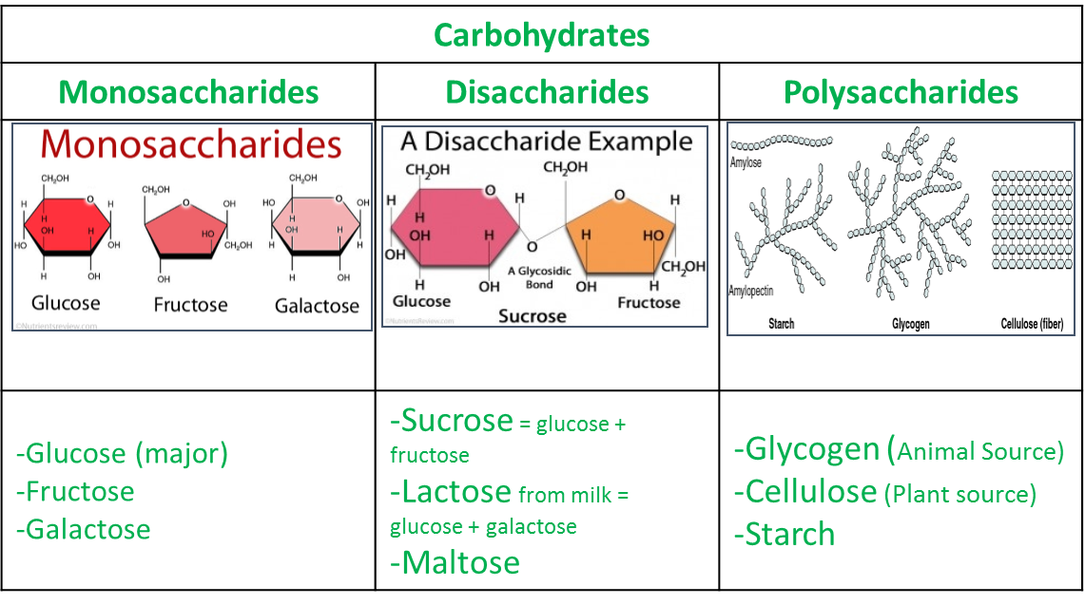
Background
The lecture talks about 2 aspects:
Role of salivary glands and stomach in digestion.
Most of dietary foodstuffs are ingested (ابتلاع) in the form that cannot be readily absorbed from the digestive tract.
Digestion: The breakdown of the naturally occurring foodstuffs (complex) such as fat ,glucose ,protein and carbohydrates into smaller, easily absorbable forms.
Major form of fat that we take is “triacylglycerol”

Slide 5
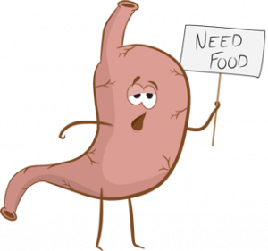
Processes of the digestive system
Motility
Secretion
Digestion of enzymes and other molecules.
Absorption of nutrients via blood
Elimination and excretion of the extra nutrients.
Processes of The Digestive System:
Food has to pass through the digestive tract completely starting from the esophagus to stomach then small intestine then it will be eliminated at the end.
The wall of the lumen contains epithelial lining that is involved in secretion of enzymes and other molecules.
After that it will go to the interstitial fluid and blood which is the ultimate absorber of the nutrients.

Slide 6
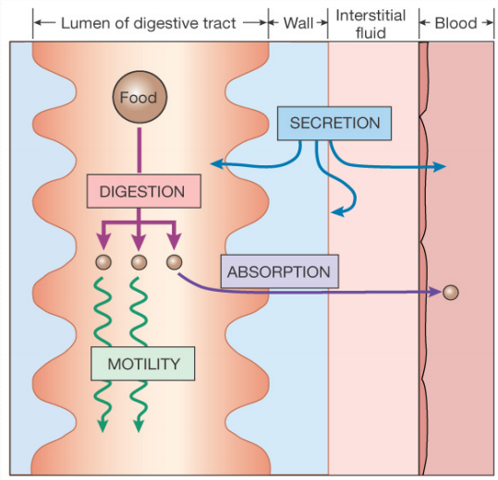
Processes of The Digestive System:
مجرد صورة توضيحية للكلام السابق ☺
افراز الانزيمات التي تساعد على الهضم والامتصاص
Breaking down of complex molecules into simple.
الامتصاص يتم في الدم والانترستيشيال فلويد
Facilitates the movement of food
Remember!
Secretion: release of a substance through normal body functions.
Excretion: expelling waste products from the body via biological functions.
Absorption: assimilating substances into cells or across the tissues and organs through diffusion or osmosis.

Slide 7
Processes of The Digestive System
Digestion: | - Mechanical Effect: E.g. Mastication (Chewing) Food should be physically broken down first, and then the enzymes and digestive juices will easily reach the food and will digest it faster due to increase surface area of the food .
 | - Enzymatic Effect: Digestive enzymes (hydrolases) digestion enzymes for fat, carbohydrates and protein but not all of them will be digested at the same time .
End Products of Digestion: | Carbohydrates broken down into → Monosaccharides
 | Triacylglycerol (3 fatty acids) (TAG) → Fatty acids (2 molecules) and monoacylglycerols (1 molecule)
 | Proteins → Amino Acids.

Slide 8
Processes of The Digestive System
Role of Salivary Glands in Digestion: | They secrete saliva. Saliva is composed of: enzymes, mucus, water and electrolytes. Saliva - Acts as lubricant it reduces the friction of dry food which may damage the mucosal lining of the esophagus (protection) - Contains salivary α-amylase digestion Enzyme , We have 3 sources of alpha amylase: 1-Stomach 2-Pancrease 3-Salivary glands. (acts on CHO) Contains lingual lipase. It is present in the saliva but it Starts acting when it reaches the stomach (acts on lipids). So, no lipid digestion in the mouth as well the protein . Only CHO starts the digestion in the mouth

Slide 9
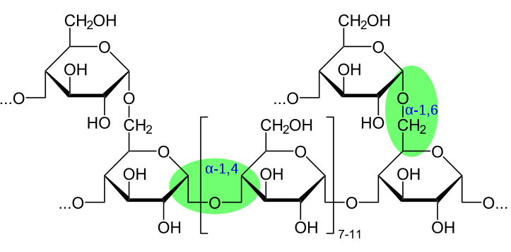
1-Salivary alpha-amylase
A-Salivary alpha-Amylase in Monosaccharide and disaccharide:
Secreted by: | Parotid glands
Optimum pH: | 6.6 – 6.8 Every enzyme has an optimum pH where is the maximum activity of the enzyme present Salivary amylase is inactivated by the acidity of stomach (The enzyme is inactivated at pH 4.0 or less). مثل ما ذكرنا يوجد اكثرمن مصدر للانزيم لذلك بمجرد ما يتوقف عن العمل بسبب حموضة الستوميك يبدأ يشتغل الانزيم الاخر الذي في الستوميك - Its digestive action on the polysaccharides is of little significance because of the short time during which the enzyme can act on the food in the mouth
Substrate: | Starch and glycogen
Starch and glycogen are polymers of glucose
And they contain alpha 1-4 linkage , when we break it down we will have maltose

Slide 10
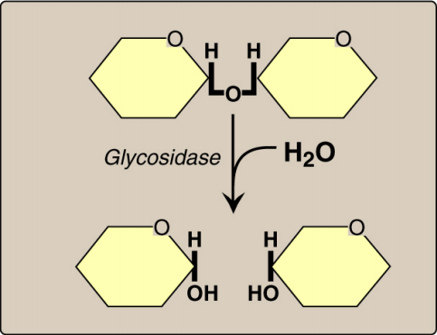
1-Salivary alpha-amylase
A-Salivary alpha-Amylase in monosaccharide and disaccharide:
Hydrolyzes : | α(1,4) glycosidic bonds Hydrolyzes means any enzyme that breaks the bond Bonds present in starch &Glycogen : Alpha(1,6) glycosidic bonds and beta (1,4) glycosidic bonds -Salivary ⍺-amylase doesn’t hydrolyze ⍺(1,6) glycosidic bonds. (the branch point of starch and glycogen) - Salivary ⍺-amylase cannot act on: β(1,4) glycosidic bonds of cellulose. That’s why we can’t digest it but animals can do - Salivary ⍺-amylase does not hydrolyze disaccharides .
Produces: | Short oligosaccharides
Simple sugar
Glycosidic linkage
Alpha Amylase that is secreted from saliva breaks down from polysaccharide to oligosaccharide. and it’s inactivated by the acidity of the stomach.
What is important to us is the pancreatic alpha amylase .
Disaccharides
Use water in hydrolysis

Slide 11
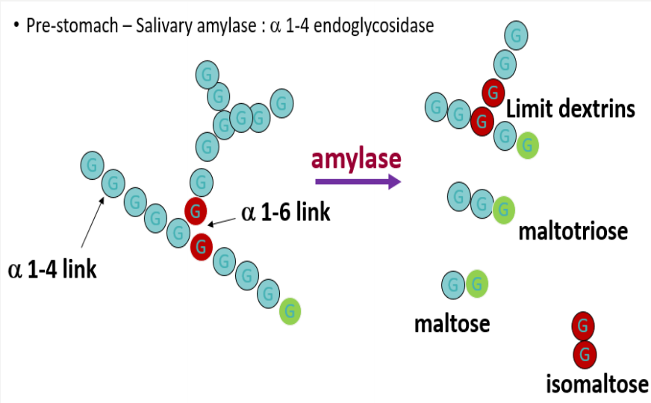
1-Salivary alpha-amylase
B-Effects of α-Amylase on glycogen:
Hydrolysis of: | α(1,4) glycosidic bonds.
Produces: | Mixture of short oligosaccharides (both branched and unbranched) Alpha 1,4 linkage
 | Disaccharides: maltose and isomaltose Alpha 1,6 linkage
Exoglycosidase means:
break up the bond at the terminus (end) will produce polysaccharide chain
Endoglycosidase means :
cutting in between will produce 2 oligosaccharides.
Amylase will cut in between alpha 1-4 linkage (polysaccharides only not disaccharides)
and will produce :
Limited dextrins (short oligosaccharides)
Maltotriose
Maltose : disaccharide of glucose with alpha 1-4 linkage
Isomaltose : disaccharide of glucose with alpha 1-6 linkage
Glucose Key:
Green: reducing end
Red: branched = alpha 1-6 linkage
Blue : alpha 1-4 linkage

Slide 12
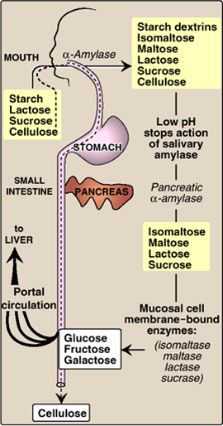
Digestion of Carbohydrates in the Mouth
The difference between starch and glycogen is the organization.
Glycogen has much less number of alpha 1,6 linkages and more 1,4 linkages
الانزيم الفا اميليز يستهدف هضم الكربوهيدرات لذلك يتم افرازه ابتداءً من الفم ومن هنا تبدأ عملية الهضم وعند وصوله للستوميك بسبب شدة الحموضة يقف عن العمل ويتم افراز انزيم اخر في الستوميك والبنكرياس لاستكمال العملية

Slide 13
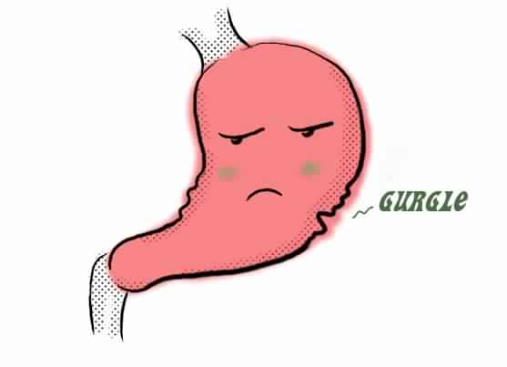
2-Lingual and gastric lipases
A-Lingual Lipase: (Present in Saliva)
Secreted by : | the dorsal surface of the tongue (Ebner’s glands) We have 3 types of lipase mainly for digestion lingual , gastric (which produced by stomach cells) and pancreatic lipase (major lipase enzyme)
Acts in: | the stomach for the digestion of TAG “Alpha amylase doesn’t work (inactivated) in the stomach due to the acidic pH”
Produces: | fatty acids and monoacylglycerols
Role: | Its role is of little significance in adult humans
Role of stomach in digestion:
No further digestion of carbohydrates.
Lipids digestion begins by lingual and gastric lipases
Proteins digestion begins by pepsin and rennin.
*Upper gastric muscles will relax so the food can get inside the stomach where the lower muscles will start doing all the movement to mix the food together
*Pancreatic ligases increases the surface area of the lipid by breaking it down

Slide 14
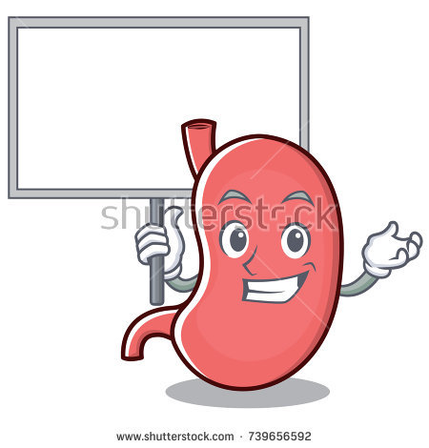
2-Lingual and gastric lipases
B-Lingual and Gastric Lipases (Acid-Stable Lipases):
Substrate: | TAG molecules, containing medium- and short-chain fatty acids; such as found in milk fat .
The end product: | 2-monoacylglycerols and fatty acids
Role: | both lipases in lipid digestion is of little significance in adult human (The lipids in the stomach is not yet emulsified. Emulsification occurs in duodenum)
Importance: | They are important in neonates and infants for the digestion of TAG of milk They are also important in patients with pancreatic insufficiency where there is absence of pancreatic lipase
My lipase
*TAG = Triacylglycerol
Emulsification : The breakdown of fat globules in the duodenum into tiny droplets

Slide 15
2-Lingual and gastric lipases
Target substrate for acid-stable lipases
is TAG containing:
R1 – C – O and R3 – C – O as
short- or medium-chain fatty acids
Lipase
Explanation
Glycerol group (backbone) & 3 R groups which are fatty acids
Fat →hydrophobic
Enzymes → hydrophilic (in watery environment)
The water has to interact with lipids and we call it lipid-water interphase
If we don’t modify lipids we will have lipids bolus and Only lipid which present on the surface will interact with enzymes so we need to emulsify the fat and this is will increase the surface area
It will be cleaved into 2 fatty acids, and the glycerol group will be attached to the third fatty acid group forming ONE molecule of 2-Monoacylglycerol (2 refers to the location of the bond and doesn’t mean 2 molecules )
*What kind of lipids are present in the stomach ? Cholesteryl aster, phospholipids, TAG , some short and medium chain fatty acid which haven’t been reduced by the action of lingual and gastric lipases and 2-monoacylglycrol

Slide 16
Digestion of lipids in the stomach
Digestion of Lipids in Stomach
In adults | In neonates and infants
no significant effects because of lack of emulsification that occurs in duodenum. | digestion of milk TAG and production of short and medium-chain fatty acids. Only the lipids that is present on the surface are interacted by enzymes.
CE: Cholesteryl ester.
PL: Phospholipids
TG: Triacylglycerol.

Slide 17
Digestion of lipids in the stomach
1-Pepsin
Secreted by: | chief cells of stomach as inactive proenzyme (enzymogen which is inactive enzyme that require modification) , pepsinogen
Activated by: | 1- HCl present in stomach 2- auto-catalytically (the enzyme is catalyzing it’s own molecule from the same type and make it active) by pepsin. Acid-stable, endopeptidase (it is cleaving in the middle of the chain)
Substrate: | denatured dietary proteins (by HCl)
End product: | Smaller polypeptides or oligopeptides
2-Rennin
Secreted by: | Chief cells of stomach in neonates and infants ONLY
Substrate: | Casein of milk (in the presence of calcium)
End product: | Paracasein with the formation of milk clot if the infant throw up the milk after a while you can notice it is la clot because of rennin
Effect: | It prevents rapid passage of milk from stomach, allowing more time for action of pepsin on milk proteins

Slide 18
Digestion of lipids in the stomach
Digestion of Dietary Proteins in Stomach:
HCL | Denatures proteins Activate Pepsin from pepsinogen
Pepsin | Cleaves proteins into polypeptides
Rennin | Formation of milk clot and increases the stay of milk in the stomach so that the pepsin can also act on it.
HCL have 2 main functions in the stomach:
1- denature dietary protein so they become accusable for digestion
2- activation of pepsinogen to pepsin
Don’t mix between rennin and renin they are totally different enzymes

Slide 19
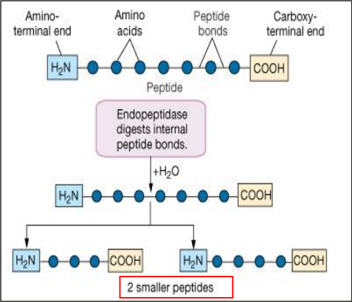
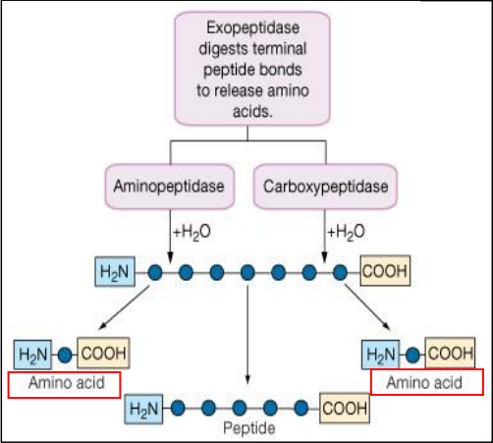
Endopeptidases and exopeptidases
“Will be explained better in the next lectures”
Key
Blue balls = amino acids
Straight lines= peptide bonds
Endopeptidase = Endoglycosidase=cut in the middle →2-smaller peptides or 2 short oligopeptides
Exopeptidase = Exoglycosidase = cleave at the end →
if it is aminopeptidase it will cut the N terminus
and if it is carboxyl-peptidase it will cut the C terminus it is and this will lead to formation of amino acids and peptide chains

Slide 20
Take home messages
Digestion involves both mechanical and enzymatic processes
Digestion makes dietary foodstuffs readily absorbable by the digestive tract
Salivary α-amylase is of limited, but initial effect on digestion of starch and glycogen in the mouth
Salivary α-amylase converts starch and glycogen into short, branched oligosaccharides
Limited digestion of TAG begins in the stomach by both lingual and gastric lipases producing 2-monoacylglycerols and fatty acids
Digestion of proteins begins in the stomach by pepsin producing smaller polypeptides
In neonates and infants, digestion of milk occurs in stomach by:
Acid-stable lipases for digestion of milk fat
Rennin and pepsin for digestion of milk proteins

Slide 21
Summary
Processes of the digestive system:
Motility |  |  | Secretion |  | Absorption |  |  |  | Elimination
Digestion:
Mechanical effect |  |  |  |  | Enzymatic effect
End products of digestion:
CHO |  |  |  | TAG |  |  |  | Proteins
Role of salivary glands:
Lubricant |  |  |  | Contains salivary enzymes, which are:
A- Alpha amylase
Secreted by: |  | Parotid gland. |  |  |  | Optimum pH: |  |  |  | 6.6 - 6.8
Substrate: |  | Starch and glycogen
Hydrolyzes: |  | Alpha (1,4) glyosidic bond which acts on: A- Monosaccharides and Disaccharides B-Glycogen.
B- Lingual Lipase
Secreted by: | Dorsal surface of the tongue |  |  |  | Acts in : |  | Stomach for the digestion of TAG
Produces: | Fatty acids and monoacyglycerol |  |  |  | Role: |  | Its role is little significance in the adults humans

Slide 22
Role of Stomach in digestion
No further digestion of carbohydrates. |  | Lipids digestion begins by lingual and gastric lipases |  | Proteins digestion begins by pepsin and renin.
C- Lingual and gastric lipases: (Acid- Stable lipases)
Substrate: | TAG molecules, containing medium- and short-chain fatty acids; such as found in milk fat .
The end product: | 2-monoacylglycerols and fatty acids
Role: | both lipases in lipid digestion is of little significance in adult human
Importance: | 1-They are important in neonates and infants for the digestion of TAG of milk 2-They are also important in patients with pancreatic insufficiency where there is absence of pancreatic lipase
Digestion of lipids in the stomach
In Adults: |  |  | In neonate and infants:
no significant effects because of lack of emulsification that occurs in duodenum. |  |  | digestion of milk TAG and production of short and medium-chain fatty acids.

Slide 23
Pepsin
Secreted by: | Chief cells of the stomach |  | Activated by: | HCl
 |  |  |  | Autocatlyictally
Substrate: | denatured dietary proteins (by HCl) |  | End product: | Smaller polypeptides
Renin
Secreted by: |  | chief cells of stomach in neonates and infants | Substrate: | Casein of milk
End product: |  | Paracasein with the formation of milk clot | Effect: | It prevents rapid passage of milk from stomach, allowing more time for action of pepsin on milk proteins

Slide 24
QUIZ
Q1 : Carbohydrates digestion starts in ?
A- Mouth
B- Stomach
C- Intestine
D- None of the above
Q2 : Proteins & lipids digestion starts in ?
A- Mouth
B- Stomach
C- Intestine
D- None of the above
Q3 : Enzyme important just for infants for milk clot ?
A- Renin
B- HCl
C- Pepsin
D- Rennin
Q4 : Which of the following enzymes get inactivated in the stomach ?
A- Renin
B- α-Amylase
C- Pepsin
D- Rennin
Q5 : Lipase acts on which type of fatty acids ?
A- Short
B- Short or medium
C- Long
D- All types
Q6 : Which of the following is responsible for Pepsinogen activation ?
A- HCl
B- Rennin
C- Lingual lipase
D- Gastric lipase

Slide 25
QUIZ
Q7 : Salivary α-amylase is able to hydrolyze which of the following
A- α(1,6) glycosidic bonds
B- β(1,4) glycosidic bonds of cellulose
C- α(1,4) glycosidic bonds
D- Disaccharide
Q10 : Lingual and gastric lipases are important for whom and why ?
They are important in neonates and infants for the digestion of TAG of milk and they are also important in patients with pancreatic insufficiency where there is absence of pancreatic lipase.
Q11 : Salivary α-amylase converts starch and glycogen into what ?
Short, branched oligosaccharides.
Q8 : What are the end products of digestion ?
1. Carbohydrate = monosaccharides.
2. TAG = fatty acid & monoacylglycerols.
3. Proteins = amino acid.
Q9 : What is the effect of rennin ?
It prevents rapid passage of milk from stomach to allow more time
for pepsin to break milk protein.
Suggestions and recommendations
1) A 2) B 3) D 4) B 5) B 6) A 7) C

Slide 26
Lama altamimi
Leen altamimi
Jawaher Alkhayal

Slide 27
Review the notes

