Slide 1

Biochemistry
Don’t wait for the perfect moment, take the moment and make it perfect!
Biochemical Aspects
of Bile Acids and Salts
Editing file

Slide 2
Upon completion of this lecture, the students should be able to :
Structure of primary bile acids and salts and secondary bile acids and salts
Functions of bile salts
Enterohepatic circulation
Malabsorption syndrome
Cholelithiasis

Slide 3
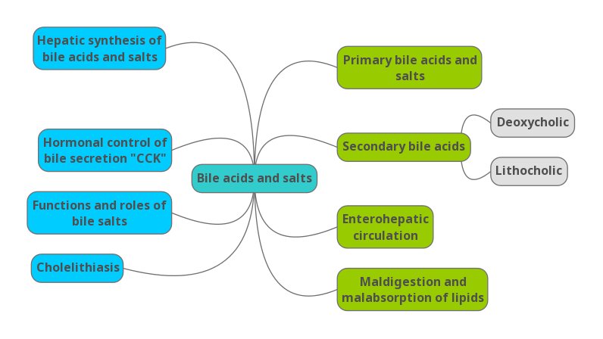
Overview

Slide 4
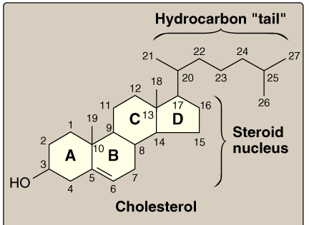
Overview
Cholesterol:
Bile salt is a watery mixture that’s secreted and produced by the liver, it has to go to the intestine ultimately but if not required, it will be stored in the gall bladder.
It’s stimulated by the hormone CCK. And CCK itself stimulated by undigested fats and proteins.
The parent molecule for the bile acid and salt is cholesterol which is hydrophobic in nature.
About 5% of bile salts are not reabsorbed but excreted which means that cholesterol is getting excreted .
The function of the bile is:
1- helping in digestion of fat by doing the Emulsification by increasing the surface area of fat so the enzyme can act.
2- formation of micelles which help in the absorption of the lipid and fat soluble vitamins.
3-helping in the excretion of cholesterol by solubilizing.
Cholesterol:
Number of carbons : 27 C
Parent steroid compound
Precursor of bile acids and salts

Slide 5
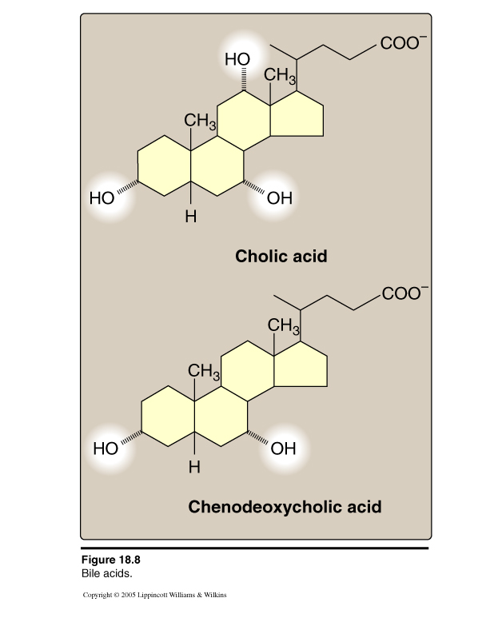
Overview
Primary Bile Acids:
When we make primary bile acid from the cholesterol what we usually do is removing 3 carbon now it becomes 24C molecule with the carboxyl group at the end. Then we add either one or two more hydroxyl group to It.
if we add:
One hydroxyl group it becomes chenodeoxycholic acid.
But if we add two hydroxyl group it becomes cholic acid.
So cholic acid has in total 3 hydroxyl group and chenodexycholic acid has 2 hydroxyl group and now these molecules are amphipathic.
Primary bile acids:
Number of carbons : 24 C
Amphipathic
COOH at side chain
Cholic acid: 3 OH
Chenodeoxycholic: 2 OH.
Those bile acids are ionized in nature shown as (COO-) at the end .. but in the body they are not ionized, so they will have (COOH) instead that’s why we call them bile acids
For example : ionized (COO-) pyruvate but non ionized (COOH) pyruvic acid

Slide 6
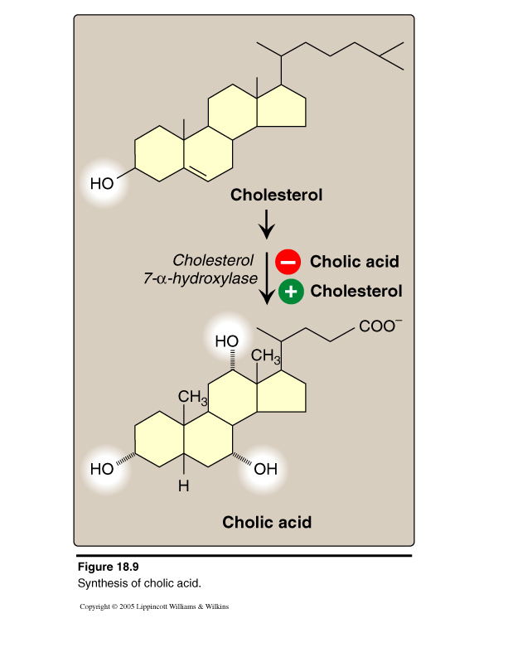
Hepatic Synthesis of Bile Acids:
REGULATION:
The rate-limiting step is catalyzed by:
Cholesterol 7-α-hydroxylase
Up-regulated by:
  End products (bile acids) “Enzyme repression” – cholic acid
  If we have a lot of primary bile acid so it will be inhibited
  Cholesterol
  “Enzyme induction”
  If we have a lot of cholesterol and less primary bile acid it will be up regulated
Making the cholic acid and Chenodeoxycholic acid is a multi step process and required multiple organs.
One of the most important steps is addition of this hydroxyl group at the carbon number 7.
This the rate limiting step from the synthesis of both primary bile acid.
This reaction is catalyzed by the enzyme : Cholesterol 7-α-hydroxylase.
The substrate is : cholesterol
The position is : 7 α
And we are doing here a hydroxylation
So this enzyme adds the hydroxyl group to the carbon No.7 of the cholesterol and it will make either cholic acids or Chenodeoxycholic acid.
Down-regulated by:

Slide 7
Primary Bile Acids and salts:
Bile acid
Bile acid
Cholic acid
glycine or taurine
Glycocholic
OR
Taurocholic
Chenodeo-xycholic acid
glycine or taurine
Glycochenodeoxycholic
OR
Taurochenodeoxycholic
Bile salts (Conjugated bile acids)
amide-linked with glycine or taurine
The ratio of glycine to taurine forms in the bile is 3:1
Now these bile acid (the cholic acid and Chenodeoxycholic acid) not stay as it’s, they interact with glycine or taurine to form the Conjugated bile acids.
When we add glycine to cholic acid it becomes Glycocholic or Taurocholic if taurine is added to cholic acid and so.. Now they known as the bile salt similarly if it was chenodeoxycholic acid ..
COOH of Cholic or chenodeoxycholic acids interact with amine group of glycine or taurine ..
The kind of linkage is amide. And majority of the molecules is glycine that’s why the ratio is 3:1

Slide 8
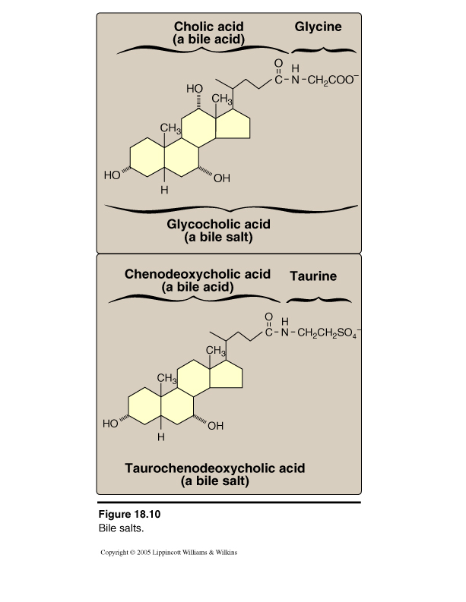
Primary Bile salts:
Addition of glycine or taurine results in the presence of fully ionized groups at pH 7.0 :
- COO- of glycine
- SO3- of taurine
(hence, its name as bile salts e.g., Sodium or potassium glycocholate)
More effective detergent (Emulsification) than bile acids
Only bile salts, but not acids, found in bile
Na or K Glycocholate
Na or K
Taurochenodeoxycholate

Slide 9
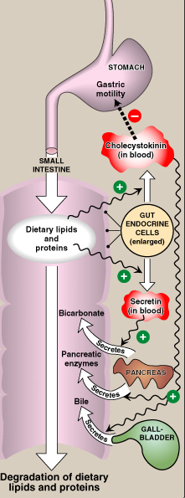
Hormonal Control of Bile Secretion:
Stimulus:
Undigested lipids and partially digested proteins in duodenum
Hormone from gut cells:
Cholecystokinin (CCK)
Responses:
Secretion of pancreatic enzymes
Bile secretion
Slow release of gastric contents
لو تلاحظون في الصورة الليبيدز والبروتينات الغيرمهضمومة تحفز انزيمين هم
CCK and Secretin
CCK Activates the release of bile in gall bladder and inhibits the release of gastric contents.
Secretin stimulates the release of bicarbonate

Slide 10
Hormonal Control of Bile Secretion:
As shown in the picture dietary lipids and proteins stimulates Gut endocrine cells .. (In this case I cells for CCK secretion and S cells for secretin secretion )
Cholecystokinin (CCK) has two functions: 1. Decreases Gastric motility
2. Stimulates Pancreatic enzymes and bile secretion and release into small intestine (relaxes sphincter of oddi)
Secretin Stimulates the release of bicarbonate into duodenum to utilize the acidity of the chyme that is coming from the stomach

Slide 11
Functions of Bile Salts:
Important for cholesterol excretion:
As metabolic products of cholesterol.
Solubilizer of cholesterol in bile.
Emulsifying factors for dietary lipids, a prerequisite step for efficient lipid digestion
What we require for Emulsification:
1- Has to be amphipathic
2- Need mechanical mixing which is done by the peristaltic movement
3- Need the bile salt to keep these small granules (fat globules)
Co-factor for pancreatic lipase and PLA2
Facilitate intestinal lipid absorption by formation of mixed micelle.
Mixed micelles help to absorbed the fat from the lumen of the intestine to the enterocyte after that it will go as chylomicrons

Slide 12
Roles of Bile Salts
Emulsification of dietary lipids
Absorption of dietary lipids
Mixed micelles:
Disc-shaped clusters of amphipathic lipids.
Arranged with their hydrophobic groups on the inside and their hydrophilic groups on the outside.
Micelle includes end products of lipid digestion, bile salts and fat-soluble vitamins. Micelle carrying the monoacylglycerol, fatty acid, cholesterol, fat soluble vitamin
Note: Short- and medium-chain fatty acids do not require mixed micelle for absorption by intestinal cells. They just diffuse inside
Emulsification increases the surface area of lipid droplets, therefore the digestive enzymes can effectively act.
Mechanisms:
1. Mechanical mixing by peristalsis
2. Detergent effect of bile salts:
Bile salts interact with lipid particles and aqueous duodenal contents, stabilizing the particles as they become smaller, and preventing them from coalescing.

Slide 13
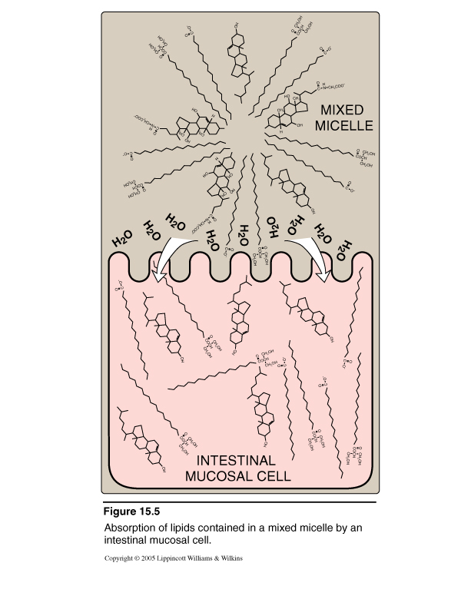
The Role of Bile Salts in Absorption of Lipids by Intestinal Cells
Mixed Micelle Formation:
Bile salts
End products of lipid digestion
Fat-soluble vitamins (A,K,D AND E)

Slide 14
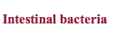
Secondary bile acids
The intestine has a bacteria which can act on the bile salt and remove the glycine and taurine when it’s removed we will left again with cholic or chenodexycholic acids.
The Cholic acid and Chenodeoxycholic is known as the primary bile acid which formed from the cholesterol. now this bile acid is in the intestine, intestinal bacteria can act on it .
When this bacteria acts on the bile acid it can removed the hydroxyl group from there (deoxy form) and that leads to production of another type of bile acid we call it secondary bile acid . These secondary bile acids goes to the liver because they can’t form bile salt in the intestine they have to go to the liver and add the glycine and taurine again but they become secondary bile salt

Slide 15
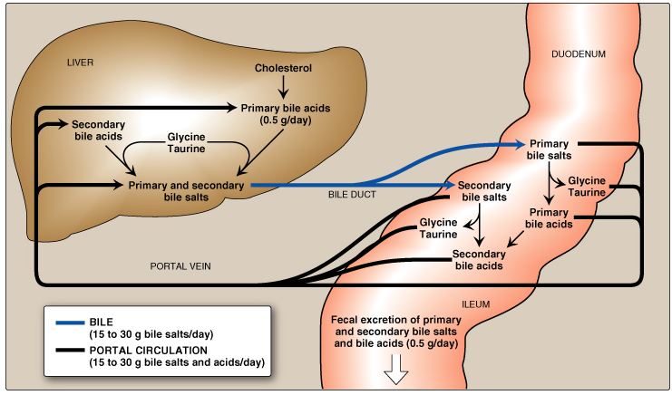
Enterohepatic Circulation
In the liver the primary bile acid is formed from the cholesterol. After the addition of glycine and taurine to the primary bile acid they become primary bile salt. This salt goes to the common bile duct directly to the intestine. The intestinal bacteria act on this primary salt and removes the of glycine and taurine and we left with primary bile acid again!
The intestinal bacteria act on this primary bile acid as well and removed the hydroxyl group which produce the secondary bile salt.
These secondary bile acid by the addition of glycine and taurine they become secondary bile salt.

Slide 16
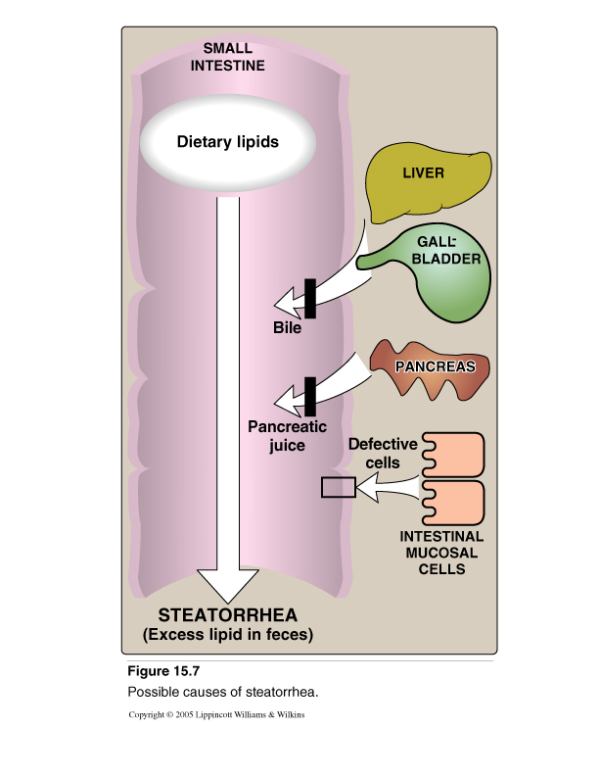
Maldigestion/Malabsorption of Lipids:
Decreased bile secretion by:
Liver diseases:
e.g., Hepatitis or cirrhosis
Gall bladder diseases:
e.g., Gall stones
Malabsorption of lipids
Less synthesis
obstruction

Slide 17
Cholelithiasis
Cholelithiasis means stone formation in the gall bladder
Causes
A. Decrease bile salts in bile:
1. Biliary tract obstruction
(interferes with enterohepatic circulation)
2. Hepatic dysfunction (synthesis)
B. Increase biliary cholesterol excretion
Treatment
Bile acid replacement therapy
Surgical

Slide 18
Summary

Slide 19
QUIZ
Q1 : Which ONE of the following molecules is more hydrophobic?
Cholic acid
Chenodeoxycholic acid
Cholesterol
Bile salts
Q2 : Mixed Micelles contain all the following EXCEPT?
Long Chain Fatty Acids
Bile acids
Vit. K
TAG
Q3 : Primary Bile Acids are?
Amphipathic
Hydrophobic
Hydrophilic
None of the Above
Q4 : Bile secretion is decreased by?
Gall Stones
Hepatitis
Adenocarcinoma in the tail of pancreases
Both A & B
Q5 : Primary bile salt found in the body associated with?
Cl
Na
K
B & C
Q6 : Which ONE of the following is the secondary bile acid derived from chenodeoxycholate?
Lithocholic acid
Deoxycholate
Taurocholate
Deoxycholic acid

Slide 20
QUIZ
Q7 : Mention a function of bile salts?
As metabolic products of cholesterol.
Solubilizer of cholesterol in bile.
Emulcification
Q8 : Can a person live without a gallbladder, why?
yes , because the liver can secrete the bile directly into the intestine, the gallbladder is only for storage and concentration.
Q9 : Mention how bile salts in bile get decreased?
1-Biliary tract obstruction (interferes with enterohepatic circulation)
2-Hepatic dysfunction (synthesis)
Q10 : A 26 year old male comes to the clinic with a yellowish tinge to the eyes and skin and complains of abdominal pain, fatigue and weakness, liver function tests only shows mildly elevated bilirubin (mostly unconjugated) and the rest of the parameters were all normal. Which ONE of the following is the most likely diagnosis ?
Gilbert's Syndrome
Suggestions and recommendations
1) C 2) D 3) A 4) D 5) D 6) A

Slide 21
Haneen alsubki
Rawan alwadee

Slide 22
Review the notes

