Slide 1

Biochemistry
Start where you are
Use what you have
Do what you can
Urea Cycle
Editing file

Slide 2
Upon completion of this lecture, the students should be able to :
Understand the reactions for removal of α-amino group of amino acids and formation of ammonia
Identify the importance of blood transport of ammonia to the liver in the form of glutamine/alanine
Understand the importance of conversion of ammonia into urea by the liver through urea cycle
Identify urea as the major form for the disposal of amino groups derived from amino acids
Identify the causes (hereditary & acquired), clinical manifestations and management of hyperammonemia

Slide 3
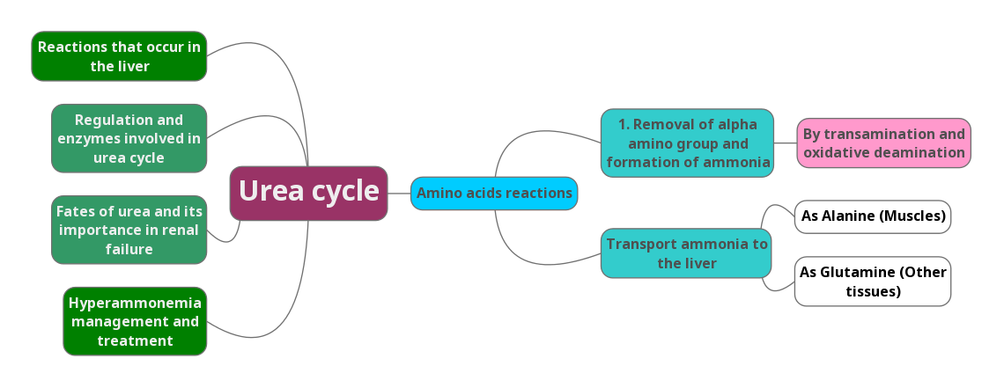
Overview

Slide 4
Background
Unlike glucose and fatty acids, amino acids are not stored by the body.
Amino acids in excess of biosynthetic needs are degraded.
Degradation of amino acids involves:
Removal of α-amino group Ammonia (NH3)
Remaining carbon skeleton Energy metabolism
Urea cycle happens only in the hepatocytes because we have unique enzyme such as Arginase that is present only in liver, that’s why pts with liver cirrhosis have high levels of ammonia
Urea cycle is basically the formation of urea from the Ammonia of the Amino acids (occurs in the liver)
So our main goal is to get the Ammonia (which is toxic) from amino acids of diﬀerent tissues to reach the liver where it will be converted to urea (which is not toxic)
First the amino acid undergoes transamination reaction and oxidative deamination to form this ammonia
Second, this toxic ammonia is transported to the liver in the form of glutamine and Alanine
Third, upon reaching the liver ,urea cycle can begin and we can convert ammonia to urea .

Slide 5
α-amino group
Removal of α-amino group, formation of ammonia and its transport to liver
A : Removal of α-amino group of amino acids and formation of ammonia
B : Blood transport of ammonia into liver
  Transamination to glutamate
  Oxidative deamination of glutamate
  in the form of glutamine (most tissue)
  in the form of alanine (muscle)
Removal of amino group make it active because its presence on the carbon skeleton (within the amino acid) stabilize it and make it not active.

Slide 6
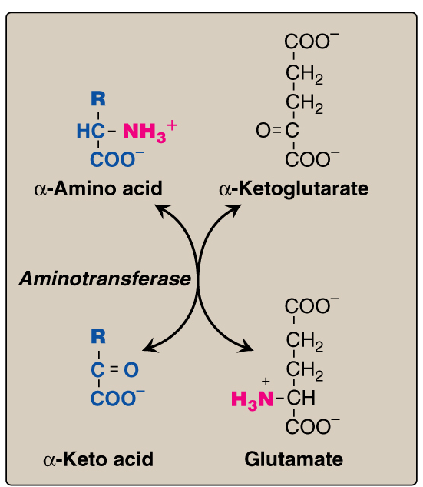
A: α-amino group removal & ammonia formation
Amino groups of amino acids are funneled to glutamate (Why?) by transamination reactions with α-ketoglutarate
Because Glutamate is unique. It is the only amino acid that undergoes rapid oxidative deamination
Oxidative deamination of glutamate will release NH3 and re-generate α-ketoglutarate
Transamination
Transamination in this picture where amino acids donate their amino group to alpha-ketoglutarate to become glutamate and therefore the amino acid become alpha keto acid (keto acid is a general term) each amino acid has its own keto acid
for example alanine’s keto acid is pyruvate
The reason why Amino groups of amino acids are funneled to glutamate is the unique feature that it has which is the rapid oxidative deamination
PLP: Pyridoxal phosphate, a co-enzyme that is derived from vitamin B6
Important
These reactions are bidirectional

Slide 7
Transamination
Here is an example to clarify
Glycine (amino acid) donates its amino group (NH3+) to alpha-ketoglutarate
Gives
Alpha-Keto acid
Glutamate
After the loss of the amino group the amino acids becomes an alpha - keto acid ( carbon skeleton)
Mainly:
The ketoglutarate here is the the receiver, it receives the (NH3) from amino acids by an enzyme called aminotransferase. The alpha ketoglutarate with the amino group is called (Glutamate).
The amino acid that lost it’s amino group is generally called (alpha keto acid)

Slide 8
A: α-amino group removal & ammonia formation
Important
Transamination by ALT & AST
Alanine is converted into pyruvate after the removal of an amino group by alanine aminotransferase enzyme
___________________________________________
The enzyme name consist of the name of the substrate that donate alanine and “aminotransferase” which is the function of the enzyme
___________________________________________
If we removed amino group :
Alanine becomes Pyruvate
Aspartate becomes Oxaloacetate
Normally all amino acids go through the formation of glutamate direction, except in this reaction the glutamate is the donator.
Pyruvate is the keto acid of Alanine.
Oxaloacetate is the keto acid of aspartate

Slide 9
A: α-amino group removal & ammonia formation
Oxidative Deamination
The purpose of this reaction is to produce free ammonia (NH3) and its really important to know the enzyme that mediate this reaction ( Glutamate dehydrogenase )
The amino groups( NH3+) from amino acids are funneled into glutamate and as we mentioned it is unique because it can be rapidly oxidative deaminated
The regeneration of alpha-ketoglutarate in this reaction because we need it as an recipient of amino group in the previous transamination reactions .
NH3 group that results is toxic because it is not positively nor negatively charged which means it's free and can diffuse freely in the blood and can cross the blood brain barrier which leads to CNS toxicity
By the action of glutamate dehydrogenase the glutamate gets oxidized into Alpha keto glutarate and NAD gets reduced to NADH

Slide 10
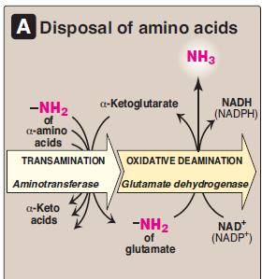
A: α-amino group removal & ammonia formation
Summary
This process occurs in 2 steps:
1- amino acids donate amino group to a- ketoglutarate to form glutamate (Transamination)
2- Glutamate by the action of Glutamate dehydrogenase will release Ammonia (NH3) and becomes a-ketoglutarate (Oxidative deamination)
Question: How can we remove the amino group from amino acid and form Ammonia ?
Answer : By Transamination and oxidative deamination

Slide 11
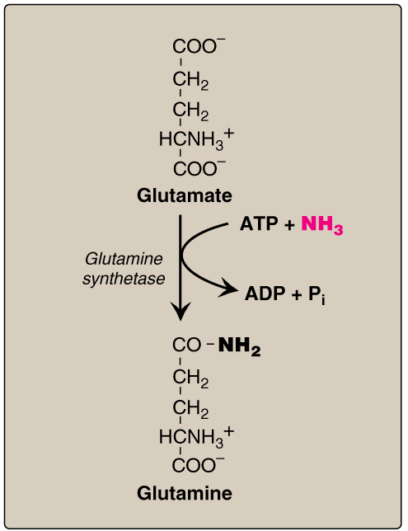
B: Transport of NH3 from peripheral tissues into the liver
NH3 needs to reach the liver because the liver contains the enzyme required to convert ammonia to urea
Ammonia is produced by all tissues and the main disposal is via formation of urea in liver
Blood level of NH3 must be kept very low, otherwise, hyperammonemia and CNS toxicity will occur (NH3 is toxic to CNS)
To solve this problem, NH3 is transported from peripheral tissues to the liver via formation of:
Glutamine (most tissues)
Alanine (muscle)
Transport of NH3 from
peripheral tissues into the liver
From most peripheral tissues NH3 is transported Into
the liver through forming glutamine by glutamine synthetase
Ammonia should not be left alone in the blood because it can cause CNS toxicity Therefore it is transported to the liver in the form of
Glutamine and alanine

Slide 12
Explanation
Transport of NH3 from
peripheral tissues into the liver
So now the ammonia is added to glutamate with the action of glutamine synthetase will form glutamine
Glutamate + NH3 (Glutamine synthetase) = Glutamine
Now it is safe to transport the ammonia to the liver
( this happens in most peripheral tissues)
هذه العملية تصيرعشان نخلي نقل الامونيا للكبد يتم بصورة آمنة

Slide 13
B: Transport of NH3 from peripheral tissues into the liver
From muscles to the liver
From just the muscles First, NH3 will be transferred
into α-ketoglutarate to form glutamate
Then, glutamate will give its amino group to pyruvate to form alanine by ALT
Therefore, NH3 is transported from muscle into the liver through forming alanine
Here we will package the ammonia into alanine in order for it to be safely transported from the muscles to the liver, but this requires 2 steps
1- this ammonia is combined to a-ketoglutarate to form glutamate
2- glutamate gives of its amino group to pyruvate and forms Alanine

Slide 14
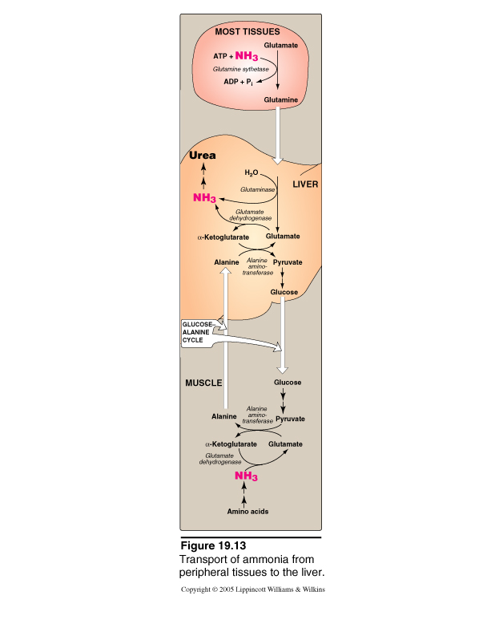
B: Transport of NH3 from peripheral tissues into the liver
In the liver
1. Glutamine is converted into
glutamate by glutaminase.
The liver is just interested in ammonia So now the Glutamine and Alanine will be broken down to release ammonia .
The action of glutaminase releases ammonia also .
In the third step ammonia is released from glutamate
by oxidative deamination ..
And now after ammonia reached the liver urea cycle begins
2. Alanine will give its amino group
to α-ketoglutarate to form glutamate by
ALT.
3. Glutamate is converted into
α-ketoglutarate and releasing NH3
by glutamate dehydrogenase.
Summary
Blood transport of NH3 from peripheral tissues (in the form of glutamine and alanine) into the liver and the release of NH3 back in the liver to start the urea cycle

Slide 15
Urea Cycle
Urea has two amino groups, one from the aspartate and the other from the ammonia
Urea is the major form for disposal of amino groups derived from amino acids
Urea cycle occurs in the liver
One nitrogen of urea is from NH3 and the other nitrogen from aspartate
Urea is transported in the blood to the kidneys for excretion in urine
The five enzymes involved in urea cycle are :
Carbamoyl phosphate synthetase I
Ornithine transcarbamoylase (OCT)
Argininosuccinate synthase
Argininosuccinate lyase
Arginase (Unique)
Enzyme 1 & 2 are present in the mitochondria while the rest in the cytosol

Slide 16
Urea Cycle : important explanation
It has several steps starting from ammonia presence in the liver
1-NH3 + CO2 + 2 ATP Carbamoyl phosphate
2-Carbamoyl phosphate + L-Ornithine L-Citrulline
3-L-Citrulline diffuses through mitochondrial wall to the cytosol
4-L-Citrulline combines with Aspartate to form Argininosuccinate by Argininosuccinate synthetase
5-Argininosuccinate by Argininosuccinate lyase gives L-Arginine
6-L-Arginine by Arginase gives urea

Slide 17
Urea Cycle
Rate-limiting enzyme of urea cycle:
Carbamoyl phosphate synthetase I
(CPSI)
Allosteric activator of CPSI:
N-Acetylglutamate
N-Acetylglutamate is synthesized by:
N-Acetylglutamate synthetase
(NAGS) in presence of arginine
Here it shows you how the N-Acetyl glutamate is formed which is an allosteric activator for CPSI
______________________________________________
Glutamate + Acetyl CoA in the presence of Arginine forms N-acetyl glutamate by the action of N-acetyl glutamate synthetase (NAGS)
NAGS deficiency is efficiently treated with Carbaglue, a CPS1 activator

Slide 18
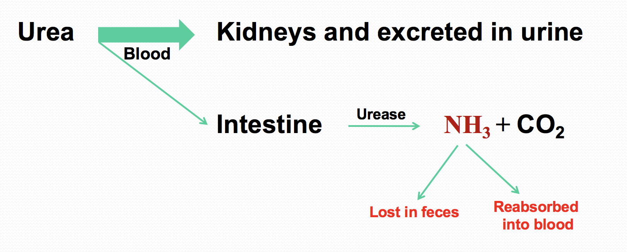
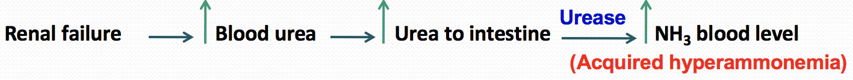
Fate of urea
In normal health conditions, the NH3 results which is in small amounts won't affect us
Major pathway
In renal failure , the major pathway to the kidneys will be inhibited and more urea will go to the intestine , this leads to large amounts of ammonia that are reabsorbed into the blood( acquired hyperammonemia). This NH3 can diffuse into BBB and cause CNS toxicity
Small amount goes to the intestine in the intestine the bacterial flora have urease activity which breaks urea into Ammonia (NH3) and CO2
The action of intestinal urease to form NH3 is clinically significant in renal failure:

Slide 19
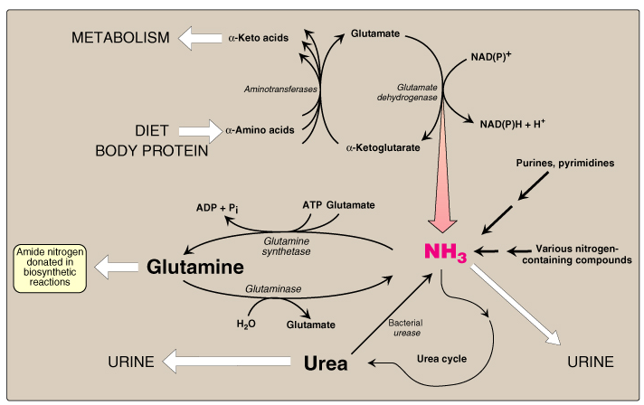
Sources and Fates of Ammonia
Normal blood level of ammonia: 5 – 50 µmol/L

Slide 20
Hyperammonemia
Acquired hyperammonemia:
1. Liver diseases:
Acute: Viral hepatitis or hepatotoxic
Chronic: Cirrhosis by hepatitis or alcoholism
2. Renal failure
Inherited hyperammonemia:
A. Genetic deficiencies of any of the 5 enzymes of urea cycle or the activator enzyme for CPSI :
CPSI, OTC, ASS, ASL, arginase or NAGS
Ornithine transcarbamoylase deficiency:
X-linked recessive
Most common of congenital hyperammonemia
Marked decrease of citrulline and arginine.
Others : Autosomal recessive
Clinical presentation of hyperammonemia
CNS problems mainly
Lethargy and somnolence
Tremors
Vomiting and cerebral edema
Convulsions
Coma and death
Urea cycle happens in the liver so if we have liver dysfunction for any reason , we won't be able to get rid of ammonia

Slide 21
Management & treatment of hyperammonemia
Management
Treatment
Protein restriction
Volume repletion to maintain renal function
Use 10% dextrose in water but limit the use of normal saline
Ammonia removal by hemodialysis &/or drugs
Avoid drugs that increase protein catabolism (eg, glucocorticoids) or inhibit urea synthesis (eg, valproic acid), or have direct hepatotoxicity
A. Drugs that scavenge ammonia by creating an alternate pathway to excrete N2- precursors:
1. I.V. Sodium phenylacetate & sodium benzoate (Ammonul)
2. Oral sodium phenyl butyrate (Buphenyl)
3. I.V. Arginine: for all UCDs except UCD due to arginase deficiency (argininemia)
B. Activators to CPSI (Carglumic acid “Carbaglu”):
For hyperammoniemia due to NAGS deficiency
If N-acetylglutamate synthetase (NAGS) is deficient , we can't form N- acetylglutamate (NAG)which is an allosteric activator of CPSI. We can give a medication called Carglumic acid(carbaglu) that can directly activate CPSI to enhance the urea cycle

Slide 22
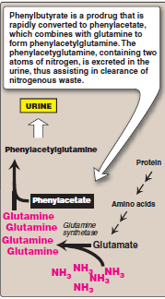
Sodium phenyl butyrate (Buphenyl)
Sodium phenyl butyrate (Buphenyl):
Pro-drug that is converted to
phenylacetate.
Phenylacetate condenses with
glutamine forming phenylacetylglutamine
that is excreted in urine
No urea formation here, there is direct excretion of ammonia into urine in the form of phenyl-acetyl-glutamine

Slide 23
Summary

Slide 24
Summary

Slide 25
QUIZ
Q1 : NH3 is transported from muscles to liver by ?
Glutamate
Glutamine
Alanine
B & C
Q2 : Glutamine is converted into glutamate by ?
Alanine aminotransferase ( ALT )
Glutamate dehydrogenase
Arginase
Glutaminase
Q3 : One of this enzymes are not included in urea cycle ?
Ornithine transcarbamoylase (OCT)
Glutaminase
Argininosuccinate synthase
Carbamoyl phosphate synthetase I
Q4 : The most common enzyme deficient and cause congenital hyperammonemia is ?
Argininosuccinate lyase
Carbamoyl phosphate synthetase I
Ornithine transcarbamoylase
Glutaminase
Q5 : Carbaglue is a treatment of which of the following ?
Hyperammonemia secondary to renal failure.
Hyperammonemia secondary to CPS1 deficiency.
Hyperammonemia secondary to OCT deficiency
Hyperammonemia secondary to NAGS deficiency.
Q6 : Amino Group of Amino Acids are funneled to Glutamine by ?
Transamination
Oxidative Deamination
Decarboxylation
Hydrolysis

Slide 26
QUIZ
Q7 : Mention the conditions which can cause Hyperammonemia ?
Inherited: Ornithine transcarbamoylase deficiency and others Autosomal dominant Acquired: Liver disease like Viral Hepatitis, Hepatotoxic ex Alcohol, Cirrhosis Renal Failure
Q8 : What is the normal blood level of Ammonia?
5 – 50 μmol/L
Q9 : Interpret signs and symptoms of hyperammonemia ?
Ammonia is a toxic product and it can cross the Blood brain barrier, causing:
Lethargy and somnolence, Tremors, Vomiting and cerebral edema, Convulsions, Coma and death
Q10 : What is the enzyme required for the oxidative deamination of glutamate ?
Glutamate dehydrogenase
Suggestions and recommendations
1) C 2) D 3) B 4) C 5) D 6) A

Slide 27
Rana almanea
Rehab Alanazi

Slide 28
Review the notes

