Slide 1
Biochemistry
Be like stem cells, differentiate yourself from others!
Structure and function of hemoglobin
Editing file

Slide 2
By the end of this lecture, the students should be able to know:
The structure and function of hemoglobin.
The factors affecting oxygen binding to hemoglobin.
Examples of normal and abnormal hemoglobin structures.

Slide 3
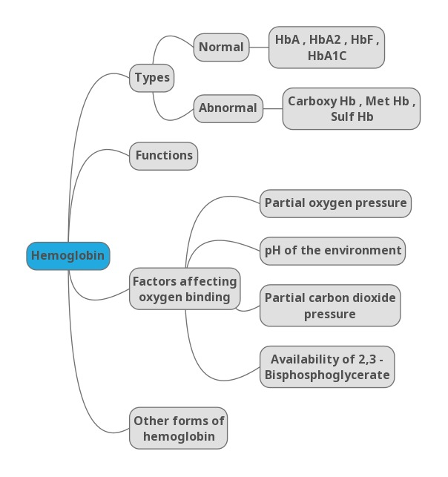
Lecture overview
* Hemoglobin has 2 parts
1- non protein part
2- protein part (heme)
* Myoglobin found in muscles and gives the red color
Recommended video 8:54 mins
Please watch this video before studying the lecture
*BPG = Bisphosphoglycerate

Slide 4
Hemoglobin
Hemoglobin (Hb)
A hemeprotein (heme + protein) found only in red blood cells.
Oxygen transport function.
Contains heme as prosthetic group.
Prosthetic means it acts as a co-factor
(it doesn’t consume the oxygen itself but it delivers O₂ to the tissues).
Heme reversibly (not permanent) binds to oxygen.
Prosthetic (it is a co factor that is required, when we talk about the enzymes which are not active and required non protein part to become active we call it Apo enzyme. And then when the non protein part become attached to it we call it holoenzyme so it is not an enzyme it is protein but it required a non protein part which is heme and it act as prosthetic group which is permanently attached to the protein
Attached temporarily → co enzyme
Attached permanently → prosthetic group
Enjoy studying me

Slide 5
Hemoglobin
The heme group :
A complex of protoporphyrin IX and ferrous iron (Fe²⁺).
Fe²⁺ is present in the center of the heme.
Fe²⁺ binds to four nitrogen atoms of the porphyrin ring.
Forms two additional bonds with:
Histidine residue of globin chain.
Oxygen molecule not atom.
*Heme group has iron in the center in ferrous state , if it is in ferric state it will not bind to oxygen
*in ferrous state it can have 6 bonds
4 with nitrogen we call it
porphyrin ring
1 bond with molecular O2 (molecule(O2) NOTE atom(O))
1 attached to the globin chain (polypeptide)
The heme group: Fe2+ – porphyrin complex with bound O2

Slide 6
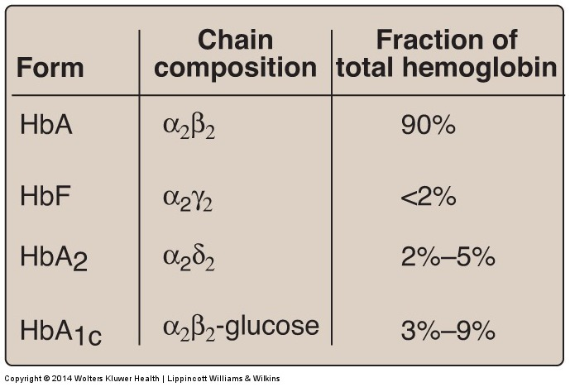
Hemoglobin
Types of hemoglobin in adults
*all the discussion in this lecture will be about hemoglobin A because it is the majority of the normal adult = 90%
*HbA1c is a modified form of HbA by adding glucose
*chain composition means the types of the globin chains which are present
The 4 subunits of the hemoglobin are : 2 alpha and 2 beta and they're present as alpha -beta dimers and you can see this in HbA , in HbA1c the same as HbA but with addition of glucose
HbF is a fetal hemoglobin it is present in the fetus and by the time of delivery the levels of it goes down so in adult it is less than 2% , it composed of 2 alpha and 2 gamma chains
*HbA2 formed before birth and stay for a long time in a very small amount
Hemoglobin
Normal
HbA (90%)
HbA2 (2%)
Abnormal
Carboxy Hb
HbF (1%)
Met Hb
Sulf Hb
HbA1c (6%)
*Abnormal = unable to carry oxygen
*Carboxy Hb = CO (carbon monoxide) is added NOT CO2
*Met Hb = the iron in ferric state NOT ferrous so can not bind to oxygen
*sulf Hb = amount of sulfa increased in blood because of sulfa containing drugs or chronic constipation

Slide 7
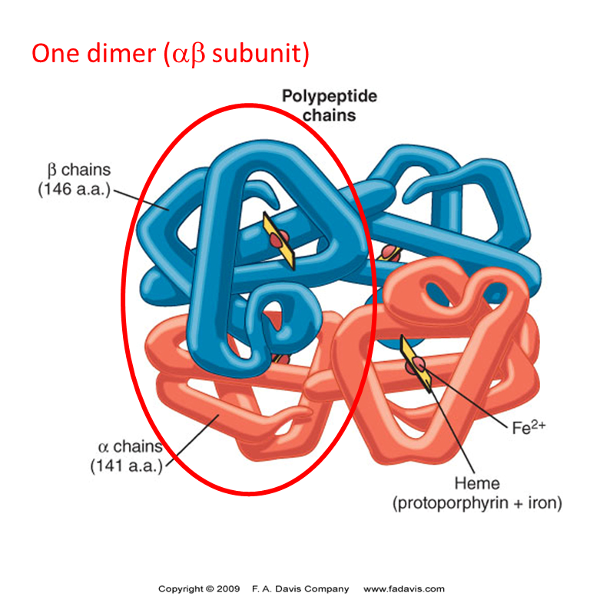
HbA
Hemoglobin A (HbA)
Major Hb in adults.
Composed of four polypeptide chains:
Two α two β chains.
Contains two dimers of αβ subunits (each dimer has 2 heme)
Held together by non-covalent (hydrophobic) interactions.
Each chain is a subunit with a heme group in the center that carries oxygen.
A Hb molecule contains 4 heme groups and carries 4 molecules of O₂
Dimers =(2 sub unites)
*Within the dimer →intradimer bonding it is a strong bond (hydrophobic bonds)
*between 2 dimers→ ionic and hydrogenic bond weaker bond causes a little movement between 2 dimers
4 subunits binding to 4 hems and each heme can bind to 1 molecule of oxygen so when it is maximally saturated how many molecules of oxygen can be bind into one hemoglobin ? Four

Slide 8
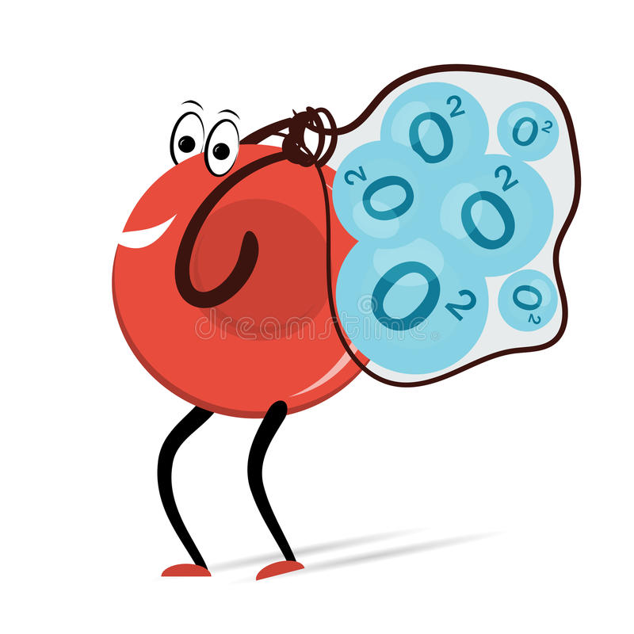
HbA
HbA structure :
T form ( taut form ) | R form ( Relaxed form )
The deoxygenated form of Hb | The oxygenated form of Hb
Taut form | Relaxed form
The movement of dimers is constrained (restricted) | The dimers have more freedom of movement
Low-oxygen-affinity form unloaded oxygen | High-oxygen-affinity form
When 4 oxygen molecules bind to the hemoglobin there will be a conformational change in the globin chains which will break the ionic bonds
R or relaxed structure of oxyhemoglobin = bind to oxygen =broken ionic bonds
T or taut of deoxyhemoglobin = no oxygen bound=present of ionic bond
كيف احفظها ؟
الريلاكسد فورم عندها الكثير من الاوكسجين لذلك تشعر بالحرية وترتبط فيه بشكل قوي .
التوت فورم انسحب منها الاوكسجين لذلك حركتها صعبة وتكونت عندها عقدة انها ما ترتبط بالأوكسجين بشكل قوي

Slide 9
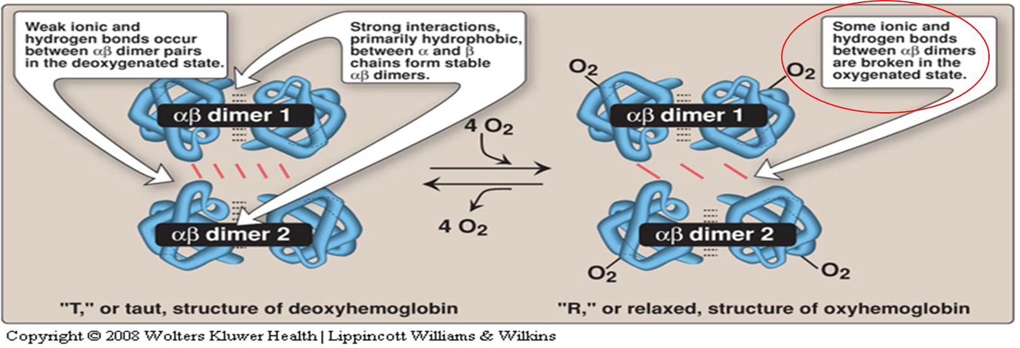
HbA:
مجرد صورة توضيحية للجدول السابق

Slide 10
Hemoglobin function and factors affecting O2 binding:
Hemoglobin functions :
Carries oxygen from the lungs to tissues
Carries carbon dioxide from tissues back to the lungs
Normal levels (g/dL):
Males: 14-16
Females: 13-15
about 10% only but the majority of carbon dioxide goes back to the lung as bicarbonate(major buffer) after dissolved in the blood . Hemoglobin can bind also to protons from tissues and take them back to the lung
Factors affecting O2 binding:
Factors that reduce the ability of hemoglobin to bind to O2 so it can be easily delivered to the tissues .
3 allosteric effectors:
Po2 (Partial oxygen pressure)
pH of the environment
pCO2 (partial carbon dioxide pressure)
Availability of 2,3-BPG
pH: Negative log of ion concentration of hydrogen.
Inverse relationship between hydrogen ion concentration and pH value.
normally (2 molecules of ATP are formed) 1,3-BPG get converted to 3-Phosphoglycerate
But in RBCs glycolysis (no ATP is formed) so they take the BPG shunt to convert 1,3-BPG to 3 Phosphoglycerate by 2,3-BPG .
2,3-BPG is produced in RBCs and its very important abundant there. When it binds to hemoglobin it reduces it’s affinity to bind to oxygen which means make the delivery of oxygen to tissues easier

Slide 11
Oxygen dissociation curve (the curve is explained in details in the next slide)
Oxygen dissociation curve :
The curve is sigmoidal in shape
Indicates co-operation of subunits in O₂ binding
Binding of O₂ to one heme group increases O₂ affinity of others
Heme-heme interaction
The hemoglobin has 4 sites to bind oxygen when the first molecule binds the globin chain of one subunit it creates a conformational change then the binding of the next molecule will be faster then another conformational change occur and so on, the binding of the last one is the fastest and this is called heme-heme interaction .
*myoglobin only one subunit and it can bound to 2 oxygen or don’t bound .
*ODC = Oxygen dissociation curve

Slide 12
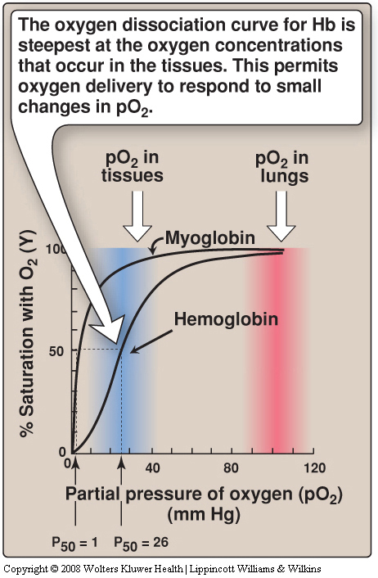
Oxygen dissociation curve
In oxygen dissociation curve we measure the saturation of hemoglobin with oxygen at different partial pressures of oxygen so you keep on increasing the amount of oxygen and notice how the saturation of hemoglobin is affected .
The hemoglobin has 4 sites to bind oxygen when the first molecule binds the globin chain of one subunit it creates a conformational change then the binding of the next molecule will be faster then another conformational change occur and so on, the binding of the last one is the fastest and this is called heme-heme interaction .

Slide 13
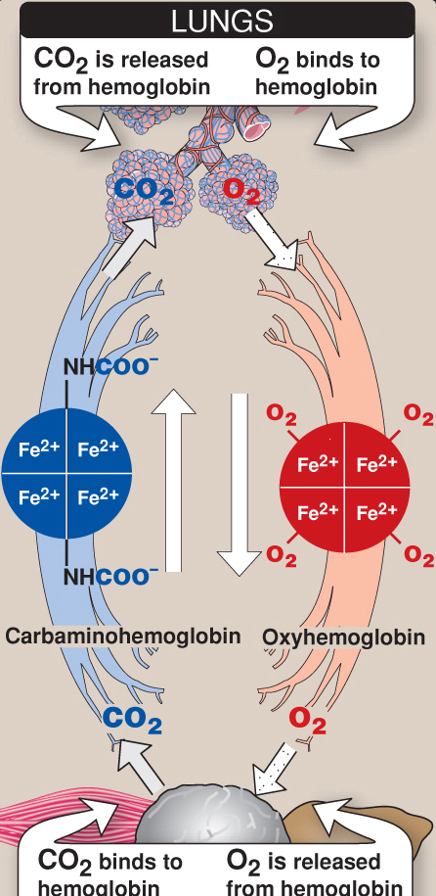
Factors affecting oxygen binding
Factors affecting oxygen binding :
1. pO₂ (partial oxygen pressure) :
P₅₀ (mm Hg): the pressure at which Hb is 50% saturated with O₂
Indicates affinity of Hb to O₂ :
High affinity → slow unloading of O₂ (low P50 value)
Low affinity → fast unloading of O₂ (high P50 value)
Lung pO₂ is 100 mm → Hb saturation 100%
Tissue pO₂ is 40 mm → Hb saturation reduces *
Hence O₂ is delivered to tissues
The mechanism depends on (Km) concept which is the substrate concentration at which an enzyme has achieved half of it is maximal velocity which influences the affinity . So if the Km value is high the affinity is low and vise versa
*When the oxygen in the lungs :
High partial pressure of oxygen so O2 bind to the Hb , saturated completely and we call it oxyhemoglobin, 4 oxygen molecules are bound and it goes to tissues
*in the tissues : the oxygen is released from Hb and from the tissues the hemoglobin carries carbon dioxide and when it binds to hemoglobin we call it carbaminohemoglobin it goes to the lung
*in the lungs: the CO2 get released from Hb and O2 bind to Hb
*CO2 reduce affinity to O2
When it is released the affinity to O2 increases

Slide 14
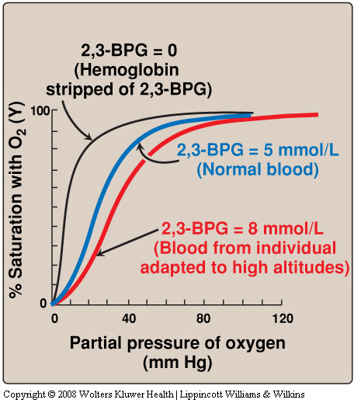
Factors affecting oxygen binding
2. pH of the environment
pH is the negative log of hydrogen ion concentration .
If the hydrogen ion concentration high the ph will be low and if the hydrogen concentration low the ph will be high
1- Decrease in pH = increased acidity
2- increasing carbon dioxide pressure
Are both important factors for oxygen delivery

Slide 15
Factors affecting oxygen binding
3. pCO₂ (partial carbon dioxide pressure) :
The Bohr effect :
It is the shift of the ODC to the right in response to an increase in pCO2 or a decrease in pH
Is the effect of pH and pCO₂ on:
Oxygenation of Hb in the lungs
Deoxygenation in tissues
Tissues have lower pH (acidic) than lungs
Due to proton generation (two reactions):
CO₂ + H₂O H₂CO₃
H₂CO₃ HCO₃⁻ + H⁺
Protons reduce O2 affinity of Hb Causing easier O2 release into the tissues.
The free Hb binds to two protons.
Protons are released and react with HCO3 – to form CO₂ gas
(HCO₃⁻ + H⁺ → CO₂ + H₂O )
The proton-poor Hb now has greater affinity for O₂ (in lungs).
The Bohr effect removes insoluble CO₂ from blood stream and produces soluble bicarbonate .
شرحنا لكمBohr effect هنا
The Bohr effect tells you how affinity of Hb to O2 change with changes in amount of the carbon dioxide and (protons =pH) and that is important because you are generating carbon dioxide and protons in the tissue
*normally without any modifiers or any effectors p50 requires 26 mmHg oxygen pressure to achieve 50% saturation pressure
*shifting the curve to right = p50 value increased and that’s mean affinity is decreased (Faster unloading of O2)
So whenever you need oxygen you will have effectors to increase p50 values = to shift (OCD) to the right
*shifting the curve to the left = p50 value get reduced and that’s mean increased affinity and less delivery to tissues

Slide 16
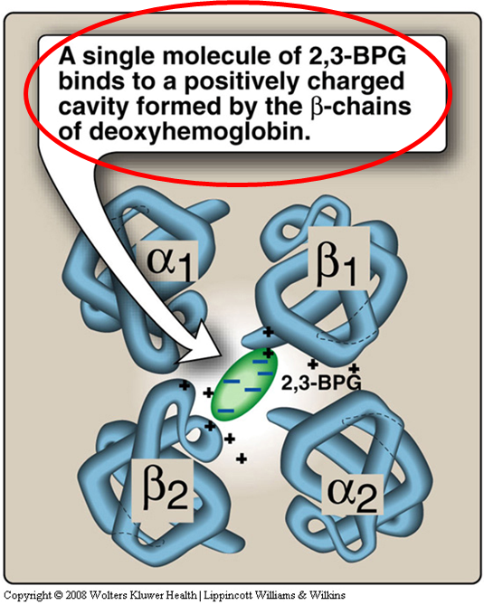
Factors affecting oxygen binding
Availability of 2,3- BPG :
Binds to deoxy-Hb and stabilizes the T-form.
When oxygen binds to Hb, BPG is released.
normally (2 molecules of ATP are formed) 1,3-BPG get converted to 3-Phosphoglycerate
But in RBCs glycolysis (no ATP is formed) so they take the BPG shunt to convert 1,3-BPG to 3 Phosphoglycerate by 2,3-BPG .
2,3-BPG is produced in RBCs and its very important abundant there. When it binds to hemoglobin it reduces it’s affinity to bind to oxygen which means make the delivery of oxygen to tissues easier
*When it stabilizes the t form it reduces the affinity to oxygen which means more O2 needs to be delivered
*due to any reason (e.g. 1- high attitude (hypoxia)
2- anemic people )
the amount of 2,3 BPG increases so it will reduce the affinity of the o2 and more delivery of it

Slide 17
Factors affecting oxygen binding
Compensatory mechanisms:
At high altitudes and “hypoxia” :
RBC number increases
Hb concentration increases
BPG** increases
This decreases O2 affinity of Hb
Thus increases O2 delivery to tissues
People getting multiple blood transfusions their 2,3 BPG becomes low . When you transfused blood to a patient , initially the affinity of Hb to O2 is too high so O2 is not delivered to tissue but if the patient not very sick (compromised) within 6-24 h they will start form 2,3 BPG

Slide 18
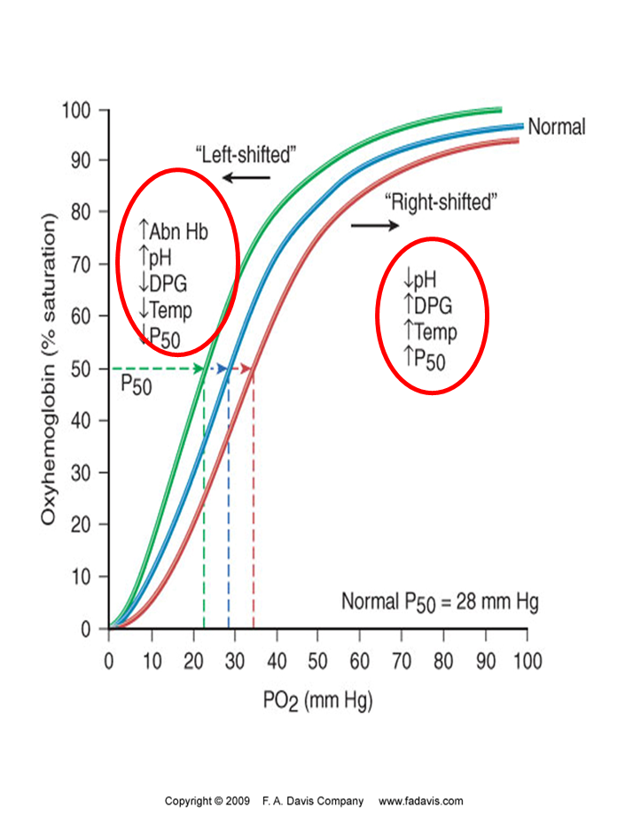
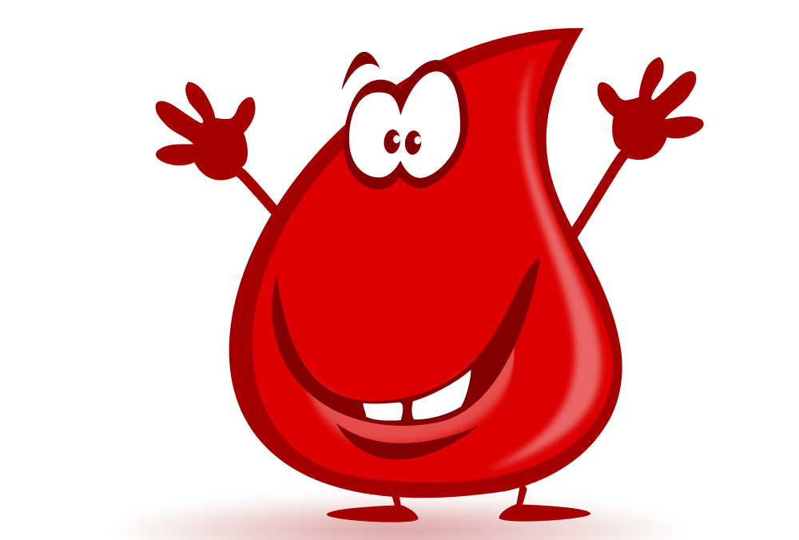
Factors affecting oxygen binding
Oxygen affinity :
High O2 affinity is due to:
Alkalosis
High levels of Hb F
Multiple transfusion of
2,3 DPG-depleted blood
Abnormal hemoglobin :
They are unable to transport O₂ due to abnormal structure
Sulf-HB: Forms due to high sulfur levels in blood
(irreversible reaction)
Carboxy-Hb: CO₂ replaces O₂ and binds 220X tighter than O₂ (in smokers)
Met-Hb: Contains oxidized Fe³⁺ (~2%) that cannot carry O₂
The youtube video in the first slide explains this diagram clearly
Recall : Fe²⁺ called Ferrous while Fe³⁺ called Ferric

Slide 19
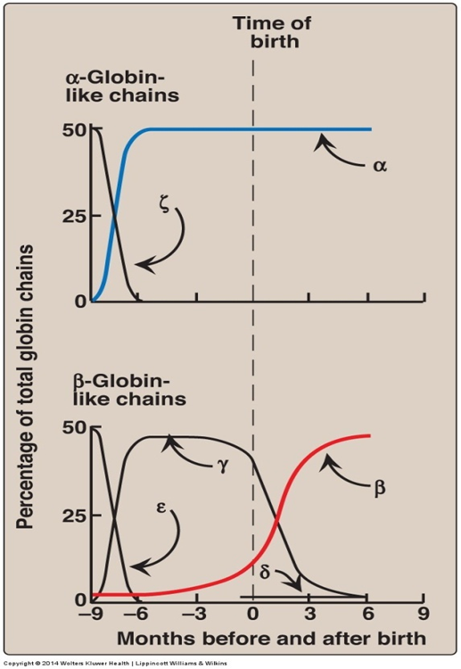
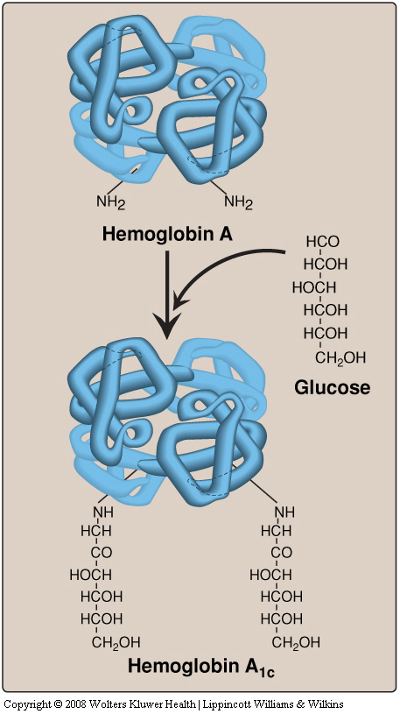
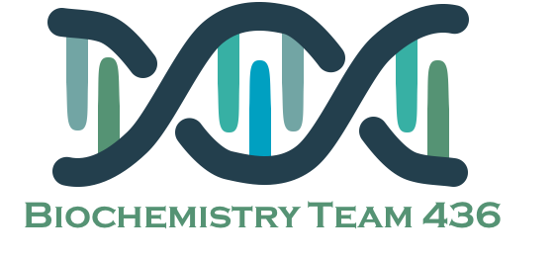
Other hemoglobin forms
Fetal Hemoglobin (HbF) | HbA₂ | HbA_{1c}
Tetramer with two α and two γ chains | Composed of two α and two δ globin chains | Two α and two β -Glucose
Major hemoglobin found in the fetus and newborn | Appears shortly before birth. | HbA1c levels are high in patients with diabetes mellitus
Higher affinity for O2 than HBA Transfers O2 from maternal to fetal circulation across placenta | Constitutes ~2% of total Hb | HbA undergoes non-enzymatic glycosylation Glycosylation depends on plasma glucose levels
Important because the maternal O2 which is mainly HbA has to be delivered to the fetal hemoglobin across the placenta which is HbF so it has to have higher affinity to O2
Because they have higher amount of glucose
*life span of RBCs =120 day so if the glucose bound to HbA1c level because it stays for 120 days so until the patient maintain his blood glucose level over a period of 3 months
*fasten glucose test will show drop in glucose because the patient didn’t eat sugar

Slide 20
Summary
Hb functions :
Carries oxygen from the lungs to tissues .Carries carbon dioxide from tissues back to the lungs
Normal levels :
Males: 14-16 Females: 13-15
Factors affecting oxygen binding | pO₂ | A.High affinity → slow unloading of O₂ (low P50 value) B. Low affinity → fast unloading of O₂ (high P50 value) Lung pO₂ is 100 mm → Hb saturation 100% Tissue pO₂ is 40 mm → Hb saturation reduces
 | pH | Acidosis :Decreased O₂ affinity Alkalosis: increased O₂ affinity
 | pCO₂ | The Bohr effect : Is the effect of pH and pCO₂ on A. Oxygenation of Hb in the lungs B. Deoxygenation in tissues. -Tissues have lower pH (acidic) than lungs CO₂ + H₂O → HCO₃⁻ + H⁺ -Protons reduce O2 affinity of Hb -The free Hb binds to two protons - Protons are released (HCO₃⁻ + H⁺ → CO₂ + H₂O ) -The proton-poorHb now has greater affinity for O₂ (in lungs) -The Bohr effect removes insoluble CO₂ from blood stream and produces soluble bicarbonate .
 | Availability of 2,3-bisphosphoglycerate | -Binds to deoxy-Hb and stabilizes the T-form -When oxygen binds to Hb, BPG is released At high altitudes and “hypoxia” BPG increases This decreases O2 affinity of Hb , Thus increases O2 delivery to tissues
Oxygen dissociation curve | - sigmoidal in shape - Indicates co-operation of subunits in O₂ binding - Binding of O₂ to one heme group increases O₂ affinity of others - Heme-heme interaction

Slide 21
QUIZ
Q1 : Which of the following is irreversible ?
A- Carboxy Hb
B- Met Hb
C- Sulf Hb
D- Non of the above
Q2 : In Met Hb the iron is in the form of … ?
A- Ferrous
B- Ferric
C- Both of them
D- Non of the above
Q3 : What is the form in which majority Carbon dioxide is transported in the blood ?
A- Bicarbonate
B- Carbon Monoxide
C- Carbonic anhydrase
D- Non of the above
Q4 : When does HbA2 appears ?
A- 10 weeks after birth
B- 12 week after birth
C- 20 weeks after birth
D- 22 weeks after birth
Q5 : Which of the following is true about HbA structure ?
A- Weak ionic and hydrogen bonds between αβ dimer pairs
B- Strong interactions between α and β chains from stable αβ dimer
C- Both of them
D- Non of the above
Q6 : What do we expect to see in the CBC of a patient from Abha ?
A- High levels of hemoglobin
B- Low O2 affinity
C- Decreased RBCs
D- Low levels of 2,3 bisphosphoglycerate

Slide 22
QUIZ
Q7 : Which of the following result from Bohr effect ?
A- Removes insoluble CO2 from blood stream
B- Produces soluble bicarbonate
C- Produce CO2 to the blood stream
D- A&B
Q8 : HbA2 is composed of ?
A- Two α and two γ chains.
B- Two α and two δ globin chains.
C- Four α globin chains.
D- Two α and two β chains.
Q9 : determine three factors that induces high O₂ affinity ?
Alkalosis
High levels of Hb F
Multiple transfusion of 2,3 DPG-depleted blood
Q10 : What are the components of heme group?
A complex of protoporphyrin IX and ferrous iron (Fe²⁺) that binds to four nitrogen atoms of the porphyrin ring
Q11 : How does oxygen partial pressure affects the oxygen binding ?
↓ p50 ↑ Increase Hb affinity to O2
↑ p50 ↓ decrease Hb affinity to O2
Q12 : What are normal levels of hemoglobin ?
Males: 14-16
Females: 13-15
Suggestions and recommendations
1) C 2) B 3) A 4) B 5) C 6) A 7) D 8) B

Slide 23
Saleh Altwaijri
Leen Altamimi
Laila Mathkour
Muneerah Alzayed

Slide 24
10:06 mins
Review the notes

