Slide 1
Biochemistry
Believe that you can and you’re halfway there
Biochemical aspects of lipids digestion
Editing file

Slide 2
By the end of this lecture the Second Year students will be able to:
Understand the process of digestion of dietary lipids including, the organs involved, the enzymes required, and the end products.
Study the synthesis of chylomicron
Understand the clinical manifestations of diseases that involve defective lipid digestion and/or absorption (indigestion and malabsorption syndrome)

Slide 3
Dietary lipids
These numbers are from an American person so it may differ from other people but not a very large difference.
Dietary lipids intake is ~81 g/day
Dietary lipids intake
Triacylglycerol 90%
The reminder includes:
Cholesterol
(little amount)
Cholesterol ester.
phospholipids
glycolipids
Free fatty acids
The majority of dietary lipids are in the form of Triacylglycerol
Cholesterol ester is written in some books as cholesteryl ester

Slide 4
Dietary lipids: Organs and Enzymes:
2 organs are involved in the digestion: stomach and small intestine
Organs and enzymes:
stomach (30% of digestion)
Lingual Lipase
Gastric Lipase
Small intestine
(majority of digestion 70&)
Lipase (pancreatic lipase)\Co-lipase
Cholesterol esterase
Phospholipase A2
Lysophospholipase
(produced in the tongue but only works when it reaches the stomach because it has a pH optimum)
Degradation of phospholipids.

Slide 5
1- Lipids digestion in the stomach:
Catalyzed by an acid-stable lipase (lingual lipase)
Triacylglycerols (TAGs) (but not all TAGs, only short and medium fatty acids that have 12 or less carbons – example: milk) are hydrolyzed by the lipases secreted:
Under the tongue and gastric mucosa
Acid lipases are important for lipid (milk fat) digestion in neonates and patients with pancreatic insufficiency (because they don’t have pancreatic lipase)

Slide 6
1- Lipids digestion in the stomach:
*Nothing happens for CE, PL and TAGs.
*Not all of short and medium fatty acids chain are broken down because they are hydrophobic so they are found as balls, and only the outer portion (surface) of these balls can be reached by the enzymes (enzymes are present in the aqueous media), that’s why we need bile salts: bile salts have hydrophilic (which interacts with water) and hydrophobic (which interacts with lipids) ends, so they prevent sticking of lipids after emulsification for further digestion of lipids.
*For digestion of lipids we need: Mechanical mixing (which happens in the stomach) + preventing sticking (which is caused by bile salts that are produced by the gall bladder). This is the reason why only small amount of lipids are digested in the stomach.
*Pancreas release bicarbonate rich solution in order to reduce the acidity of the upcoming food from the stomach to the duodenum.

Slide 7
2- Lipid digestion in the small intestine:
Emulsification:
Occurs in the duodenum
Increases surface area of lipid droplets
To maximize the effect of digestive enzymes
2 mechanisms of lipids digestion:
1. Detergent properties of bile salts in the bile salts emulsify dietary lipid particles
Mechanical mixing by peristalsis movement of stomach.
Emulsification : The breakdown of fat globules in the duodenum into tiny droplets, which provides a larger surface area on which the enzyme pancreatic lipase can act to digest the fats into fatty acids and glycerol.

Slide 8
3- Lipid degradation by pancreatic enzymes:
TAG degradation : | Cholesteryl ester degradation:
Performed by pancreatic lipase, colipase (colipase is produced and interacts with lipase to activate it) | Hydrolyzed by cholesterol esterase
Removes fatty acids at C1 and C3 | Produces cholesterol + FFAs
Leaving 2-monoacyglycerol and free fatty acids (FFAs) | Cholesteryl ester means: cholesterol + fatty acid (like in Retinyl esters: retinol + fatty acid)
Found in high conc. in pancreatic secretion (2-3% of total proteins) Inhibited by Orlistat (inhibits pancreatic lipase > no break down of lipids > no TAGs > no absorption > excreted in feces, one of its side effects is fatty stools), an antiobesity drug | -
& Colipase
Fatty acid is not removed from C2

Slide 9
Digestion of Phospholipids (PL)by Phospholipase A2 & Lysophospholipase
H₂O
Fatty acid
The output is dependent upon which phospholipid is being digested, for example:
Phosphotydil serine > lysophosphotydil serine
PL
Lysophospholipid
Phosphophlipase A2
H₂O
Fatty acid
Glycerolphosphoryl Base (if it’s phosphotydil serine, the output would be serine base)
Lysophospholipid
Fatty acid
Lysophosphophlipase
Excreted in the feces, degraded or absorbed.
If the body needs this base it will absorb it, but if it doesn’t it will excrete it.

Slide 10
Overview of lipid digestion:
The remaining pieces of PL leaves the body.
Free fatty acids, 2-Monoacylglycerol, and Cholesterol are the forms we are left with after digestion, they are taken by the epithelial cells of the intestines, then they are absorbed as mysins which are produced of the bile salts (mixed mysins). Short and medium fatty acid chains are absorbed as such and go to the liver by albumin.
The remaining are stored as chylomicrons.

Slide 11
Pancreatic insufficiency in cystic fibrosis (CF)
CF is due to genetic mutations in CFTR (cystic fibrosis transmembrane conductance regulator protein).
Functions as chloride channel on epithelium.
Defective CFTR causes:
Decreased secretion of chloride.
Increased reabsorption of sodium and water.
Decreased hydration in pancreas thickens the pancreatic secretions.
Pancreatic enzymes are unable to reach the intestine.
Treatment: enzyme and fat-soluble vitamin supplementation.
If there is a mutation in this channel Chloride channels move chloride out of the cells, if it’s not working chloride would accumulate inside the cell leading to absorption of sodium in order to neutralize the negative charge of the cell, sodium brings water with it and cause damage.
If the damage was in the gut, mucosal cells will dehydrate (because they give off water to adjacent cells) and becomes thick, leading to blockage to the pancreatic enzymes so they cannot reach the intestines.

Slide 12
Control of lipid digestion:
Controlled by hormones:
(secreted by the lower part of duodenum and jejunum):
Cholecystokinin (CCK) (stimulus > undigested protein and fat)
Secretin (stimulus > acidity)
Acts on gallbladder to release bile (stimulates contraction(
Acts on pancreas to release enzymes
Decreases gastric motility (slow release of gastric contents)
Low pH stimulates its secretion
Acts on pancreas and liver to release bicarbonate
Neutralizes the pH of the contents before entering the small intestine

Slide 13
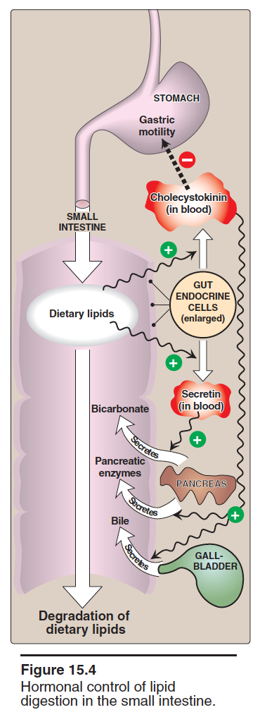
Lipids absorption
Lipid absorption by enterocytes (mucosal cells of the intestines)
Products of lipid digestion (FFAs, free cholesterol, 2-monoacylglycerol) combine with bile salts and fat-soluble vitamins.
They form mixed micelles (disk-shaped particles)
Absorbed by brush border membrane of enterocytes (mucosal cells of intestine).
Short and medium chain length fatty acids are absorbed directly (from enterocytes to blood by albumin).
So in the bile cells>mixed mysins are produced, in enterocytes > mixed micelles are produced and absorb them as chylomicrons for storage.

Slide 14
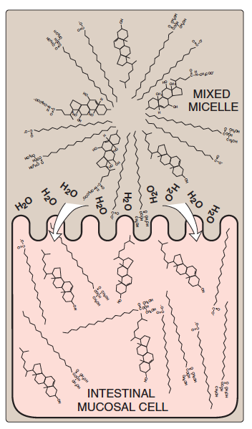
Re-synthesis of TAG / Cholesteryl esters:
Digested lipids absorbed by enterocytes migrate to endoplasmic reticulum for complex lipid biosynthesis.
Fatty acids → activated to acyl CoA (high energy molecule) form.
2-Monoacyglycerols → TAGs (only long chain fatty acids are added).
Mixed micelles are hydrophobic inside
and hydrophilic outside

Slide 15
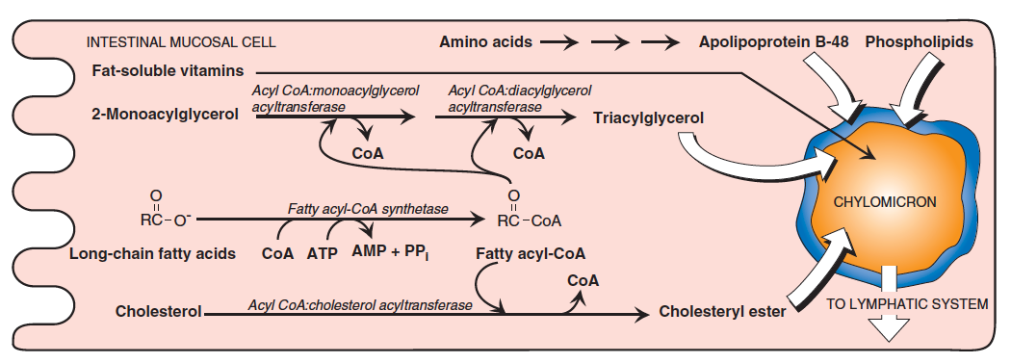
Lipids absorption
The most important enzyme here is acyltransferase, the rest are derived from it depending on the substrate
An enzyme that is not written here but written in the book: Microsomal triglycerol transfer protein (MTTP) > required to synthesis of Triacylglycerol.

Slide 16
Assembly of chylomicrons by enterocytes:
Newly synthesized TAG and cholesterol ester are packaged as lipid droplets surrounded by thin layer of:
Apolipoprotein B-48 (apo B-48)
Phospholipids
Free cholesterol
Secretion of chylomicrons by enterocytes:
By exocytosis into lymphatic vessels around villi of small intestine (lacteals) which enter into systemic circulation
Serum becomes milky after a fatty meal (so a serum of a starving person would be clean)

Slide 17
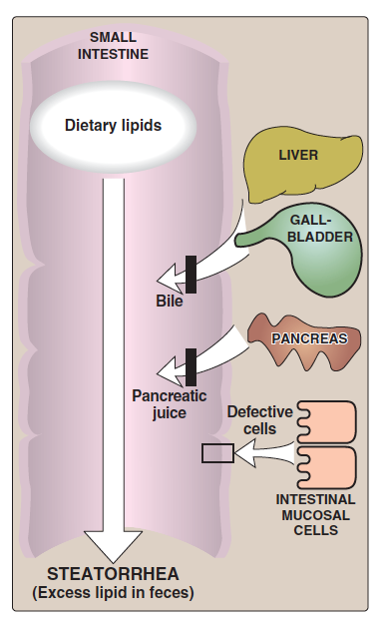
Lipid malabsorption
Lipid malabsorption is decreased absorption due to any enzyme deficiency.
Increased excretion of lipids, fat-soluble vitamins and essential FAs in the feces.
Due to defects in lipid digestion or absorption.
Can be caused by CF or shortened bowel.
Leads to steatorrhea which is an excessive excretion of lipids due to a problem in the absorption or digestion of lipids.

Slide 18
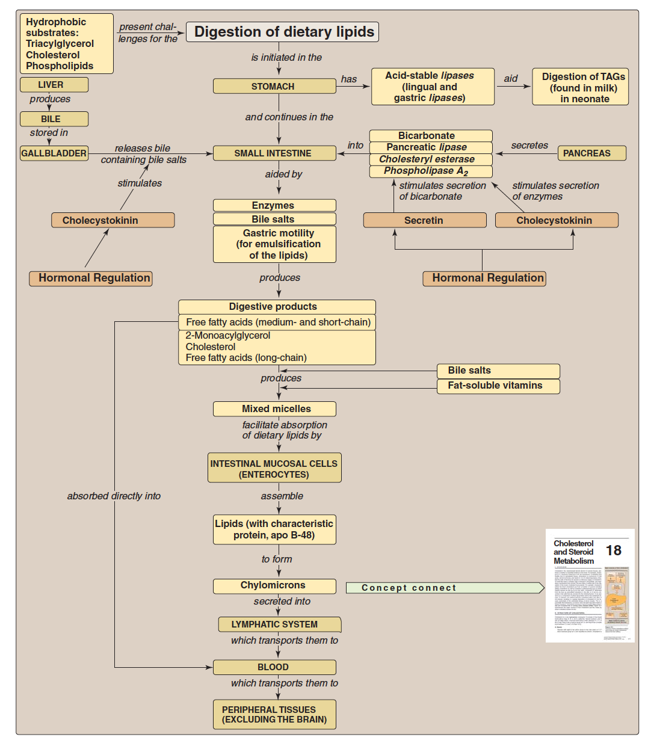
Key concepts for digestion and absorption of dietary lipids:
الصورة مو مطلوبة لكنها تلخص كل النقاط الأساسية في المحاضرة

Slide 19
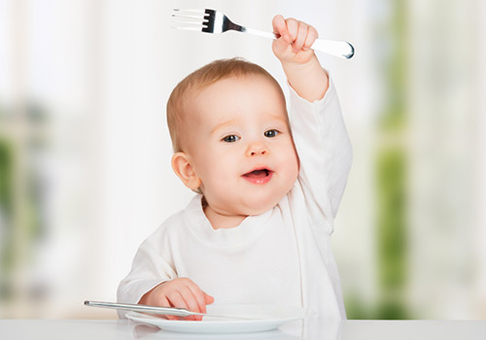
Take home messages :
Lipid digestion begins in stomach.
Emulsification of lipids occurs in duodenum, helped by peristalsis and bile salts.
Intestinal digestion of lipids by pancreatic enzymes.
Lipid absorption by mixed micelles.
Re-synthesis of TAGs, cholesterol ester and PLs inside the intestinal mucosal cells.
Assembly and secretion of chylomicrons into lymphatic lacteals and then into systemic circulation.

Slide 20
Summary
Lipids digestion in the stomach | Lipid digestion in the small intestine | Lipid degradation by pancreatic enzymes | Pancreatic insufficiency in cystic fibrosis (CF) | Control of lipid digestion
Catalyzed by an acid-stable lipase (lingual lipase) Triacyglycerols (TAGs) are hydrolyzed by the lipases secreted: Under the tongue and gastric mucosa Acid lipases are important for lipid (milk fat) digestion in neonates and patients with pancreatic insufficiency | Emulsification: Occurs in the duodenum Increases surface area of lipid droplets To maximize the effect of digestive enzymes Two mechanisms: 1- Detergent properties of bile salts in the bile Bile salts emulsify dietary lipid particles 2- Mechanical mixing by peristalsis | TAG degradation: Performed by pancreatic lipase, colipase Removes fatty acids at C1 and C3 Leaving 2-monoacyglycerol and free fatty acids (FFAs) Cholesteryl ester degradation: Hydrolyzed by cholesterol esterase Produces cholesterol + FFAs | CF is due to genetic mutations in CFTR (transmembrane conductance regulator protein) Functions as chloride channel on epithelium Defective CFTR causes: Decreased secretion of chloride Increased reabsorption of sodium and water Decreased hydration in pancreas thickens the pancreatic secretions Pancreatic enzymes are unable to reach the intestine Treatment: enzyme and fat-soluble vitamin supplementation | Controlled by hormones: Cholecystokinin (CKK) Acts on gallbladder to release bile Acts on pancreas to release enzymes Decreases gastric motility (slow release of gastric contents) Secretin Low pH stimulates its secretion Acts on pancreas and liver to release bicarbonate Neutralizes the pH of the contents before entering the small intestine

Slide 21
Summary
Lipid absorption by enterocytes | Resynthesis of TAG / Cholesteryl esters | Assembly of chylomicrons by enterocytes | Secretion of chylomicrons by enterocytes | Lipid malabsorption
Products of lipid digestion (FFAs, free cholesterol, 2-monoacylglycerol) combine with bile salts and fat-soluble vitamins They form mixed micelles (disk-shaped particles) Absorbed by brush border membrane of enterocytes Short and medium chain length fatty acids are absorbed directly | Digested lipids absorbed by enterocytes migrate to endoplasmic reticulum for complex lipid biosynthesis Fatty acids → activated to acyl CoA form 2-Monoacyglycerols → TAGs | Newly synthesized TAG and cholesterol ester are packaged as lipid droplets surrounded by thin layer of: Apolipoprotein B-48 (apo B-48) Phospholipids Free cholesterol | By exocytosis into lymphatic vessels around villi of small intestine (lacteals) which enter into systemic circulation Serum becomes milky after a fatty meal | Increased excretion of lipids, fat-soluble vitamins and essential FAs in the feces Due to defects in lipid digestion or absorption Can be caused by CF or shortened bowel

Slide 22
QUIZ
Q1 : The major dietary lipid is?
A- Cholesterol
B- Phospholipids
C- Glycolipids
D- Triacylglycerol
Q2 : Deficiencies in the ability to absorb fat will result in ?
A- Excessive amount of chylomicrons in the blood
B- Decrease fat soluble vitamins in the feces
C- Decrease production of chylomicrons
D- Constipation
Q3 : Which of the following is a primary Apolipoprotein contributed in the synthesis of chylomicrons ?
A- APO E
B- APO B100
C- APO B48
D- APO C
Q4 : Lipid digestion Mainly occur in ?
A- stomach
B- small intestine
C- large intestine
D- Pancreas
Q5 : Intestinal digestion of lipids is done by ?
A- Stomach Enzymes
B- Intestinal Enzymes
C- Pancreatic Enzymes
D- Enzymes in Portal Circulation
Q6 : Which one of the following enzymes is not essential for adults but important for infants ?
A- Cholesterol Esterase
B- Phospholipase A2
C- Gastric Lipase
D- Lysophospholipase

Slide 23
QUIZ
Q7 : Explain the changes in blood after high-fat meal ?
Elevated level of chylomicrons which will give the protein serum a milky appearance
Q8 : Describe the two mechanisms of emulsification ?
1- Detergent properties of bile salts in the bile
Bile salts emulsify dietary lipid particles
2- Mechanical mixing by peristalsis
Q9 : What is the treatment of pancreatic insufficiency in cystic fibrosis patients ?
enzyme and fat-soluble vitamin supplementation
Q10 : Mention two enzymes that participate in TAG degradation ?
pancreatic lipase, colipase
Suggestions and recommendations
1) D 2) C 3) C 4) B 5) C 6) C
1) C 2) C 3) B 4) C 5) D 6) D
1) C 2) C 3) B 4) C 5) D 6) D
1) C 2) C 3) B 4) C 5) D 6) D
1) C 2) C 3) B 4) C 5) D 6) D
1) C 2) C 3) B 4) C 5) D 6) D

Slide 24
Ashwaq almajed
Jawaher Alkhayyal
Heba alnasser
Naser abu dujain

Slide 25
Review the notes
Lippincott’s Illustrated Reviews, Biochemistry, 5th edition, Denise R. Ferrier, Lippincott Williams & Wilkins, USA.
Chapter 15: pages 173-180

