Slide 1
Biochemistry
Great things never came from comfort zones ..
Biochemical aspects of the digestion of Protein and carbohydrates
Editing file

Slide 2
By the end of this lecture, the students should be able to know:
Understand the overall digestion process of dietary proteins and carbohydrates
To understand the clinical manifestations of diseases that involve defective proteins or carbohydrates digestion and/or absorption.

Slide 3
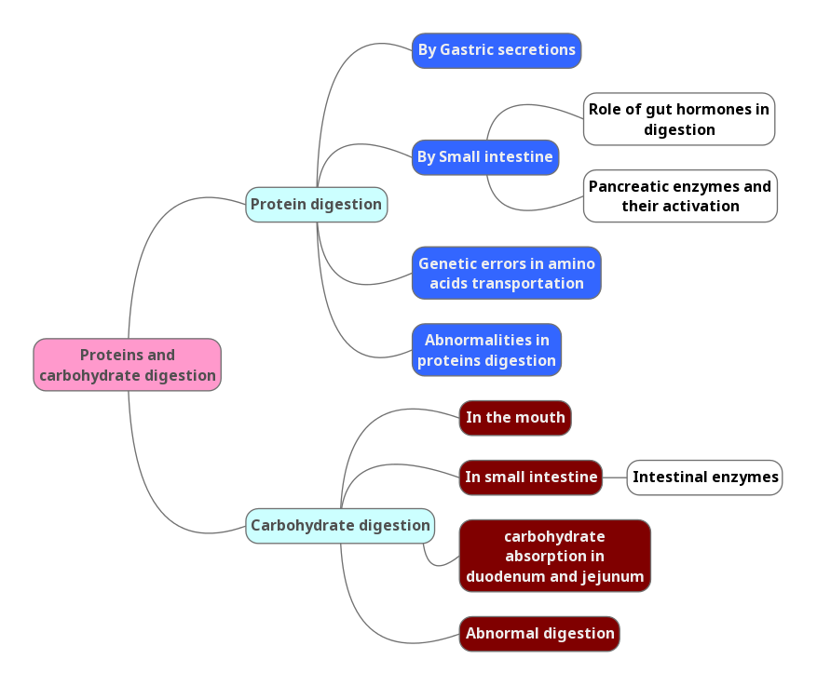
Key principles

Slide 4
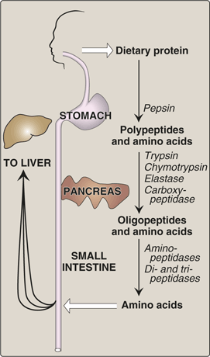
Protein digestion:
Dietary proteins constitute 70-100 g/day.
Proteins are generally too large to be absorbed by the intestine.
They must, therefore, be hydrolyzed to their constituent amino acids, which can be absorbed.
In the mouth protein undergoes only physical cutting and mixing with saliva but no digestion occur in the mouth.
Then it goes to the stomach as a bolus.
____________________________
When proteins are denatured, enzymes can act on it easily because of increased surface area
Pepsin and HCL helps in protein denaturation
____________________________
Only amino acids and di and tri peptides can be absorbed
____________________________
In adults, absorption of protein occur only to be used in renewing cells, otherwise protein levels are constant.
The Source of Proteolytic Enzymes Responsible for Degrading Dietary Proteins
The stomach
The pancreas
The small intestine

Slide 5
1) Digestion of proteins by gastric secretion(stomach):
The gastric juice contains two components important for protein
digestion:
1) Hydrochloric acid (HCL). 2) Pepsin in the form of pepsinogen .
Autocatalysis*: one of the reactions products e.g. (pepsin), acts as a catalyst for the reaction (in activating pepsinogen)
Digesting agent | Description
1-Hydrochloric acid (A strong acid) | kills some bacteria, which is not a part of digestion of proteins. Denatures proteins : denatured proteins are more susceptible to hydrolysis by proteases. protease is any enzyme that performs proteolysis; protein catabolism byhydrolysis of peptide bonds Strong alkaline media can also denature protein
2-Pepsin | Acid-stable Endopeptidase (internal protein enzyme) Cuts the band which is present in the middle of the peptide Secreted as inactive zymogen (pepsinogen) Pepsinogen is activated by: 1) Hydrochloric acid OR 2) Pepsin, i.e. autocatalysis (self-destruction) Protein digestion by stomach end product is (Polypeptides + few free amino acids)

Slide 6
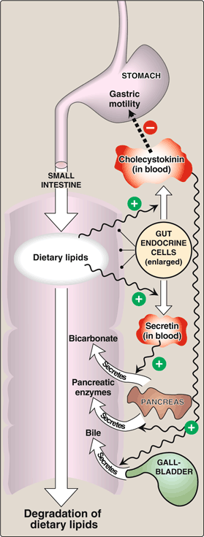
2) Digestion of proteins in small intestine:
A-Digestion by pancreatic enzymes. CCKالي راح تفرز من خلال هرمون
B-Digestion by intestinal aminopeptidase.
The digestion in small intestine is hormonally controlled.
Two small peptide hormones are released from cells of the upper part of small intestine:
Hormone: | Cholecystokinin (CCK) | Secretin
Functions: | Secretion of pancreatic enzymes. | Release of watery solution rich in bicarbonate by pancreas
 | Bile secretion. | -
 | Slow release of gastric contents. (similar to rennin), decreases motility. | -

Slide 7
The gut hormones:
ممكن بعضكم يسال عن الفرق في الكلام الي هنا والسلايد الي قبلها هو نفس الشي اللهم زيادة في التفصيل.
The gut hormones | Stimulus for secretion | Effects
Cholecystokinin(CCK) | The presence of partially digested proteins (& lipids) in the upper small intestine | Stimulates the release of pancreatic digestive enzymes Stimulates the contraction of the gall bladder & release of bile Decreases gastric motility slower release of gastric contents into the small intestine
Secretin | Low pH of the chyme entering the intestine | Stimulates the pancreas to release a watery solution rich in bicarbonate to neutralize the pH of the intestinal contents (to reach the optimum pH for digestive activity by pancreatic enzymes)

Slide 8
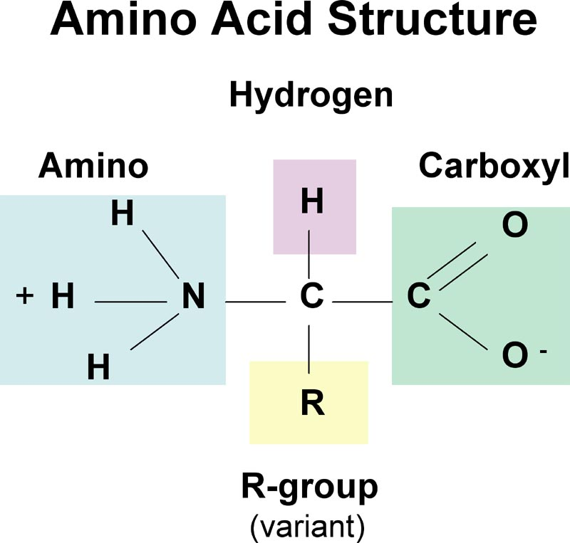
2) Digestion of proteins in small intestine
*In proteins, we have two terminals:
1)N-terminals: containing amino acids.
2)C-terminals: containing carboxyl group.
Carboxypeptidases break the C-terminals
Digestion by pancreatic enzymes:
The pancreatic secretion contains a group of pancreatic proteases
Each of these enzymes has different specificity for the cleavage sites
These proteases are synthesized and secreted as inactive zymogens
Pancreatic enzymes:
Zymogen | Active enzyme | Activating enzyme
Trypsinogen | Trypsin (endopeptidase) | Enteropeptidase Trypsin (autocatalysis)
Chymotrypsinogen | Chymotrypsin (endopeptidase) | Trypsin
Proelastase | Elastase (endopeptidase) | Trypsin
Procarboxypeptidases | Carboxypeptidases (exopeptidases)* Two types A & B | Trypsin
the structure of proteins

Slide 9
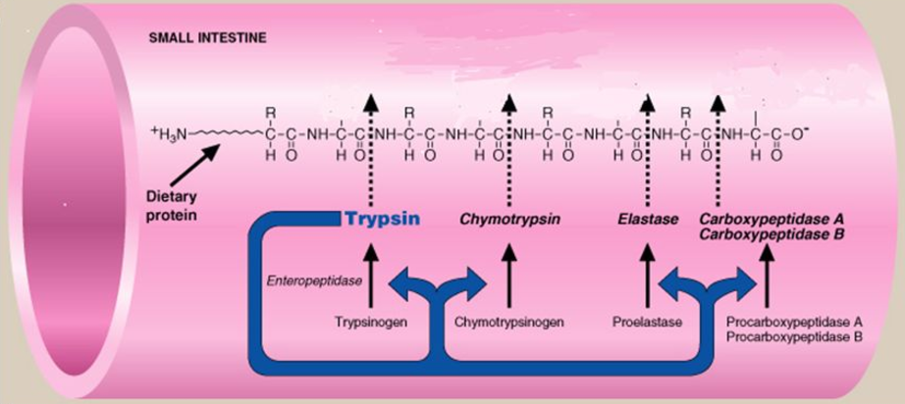
Activation of pancreatic enzymes
Trypsin starts a cascade because it can activate all other pancreatic enzymes. Every protease is specific for different active site, polypeptides are their substrates and their products are oligopeptides and amino acids.
Enteropeptidase is an enzyme synthesized by, and present on the luminal surface of intestinal mucosal cells of the brush border membrane,
It Converts trypsinogen to trypsin (the conversion is initiated by this enzyme)
Trypsin then activates all the other pancreatic zymogens (including itself)
Arginine
Lysine
Trp, Tyr
Phe, Met, Leu
Alanine
Gly, Ser
Arginine
Lysine
*Trp : Tryptophan , Tyr : Tyrosine , Phe : Phenylalanine , Met : Methionine , Leu : Leucine , Gly : Glycine , Ser : Serine

Slide 10
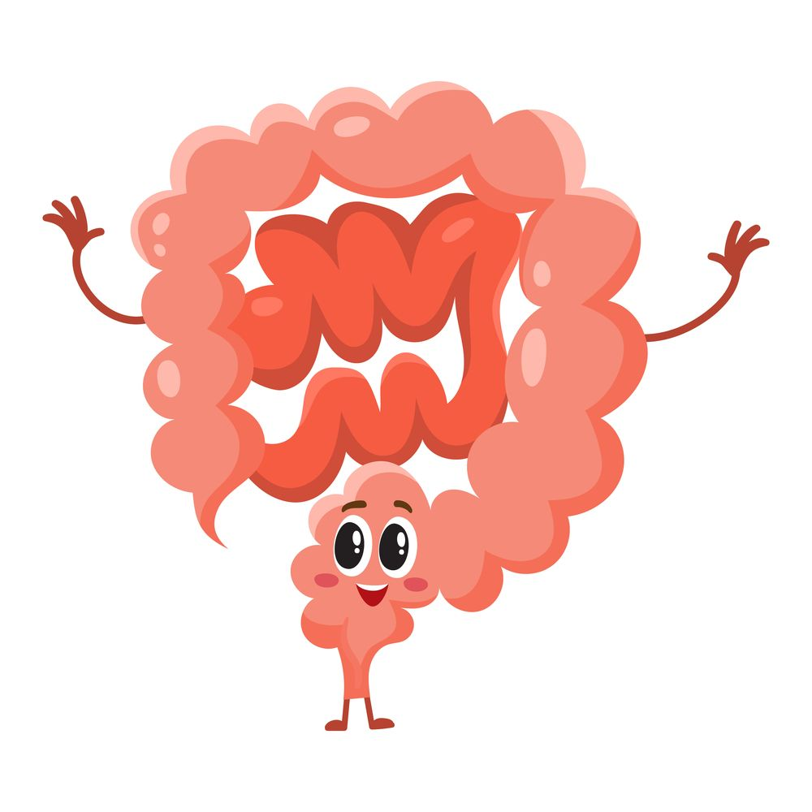
2) Digestion of proteins in small intestine
Digestion by intestinal aminopeptidase, which break the N-terminals of proteins > giving a lot of amino acids.
Oligopeptides that result from the action of pancreatic proteases are cleaved into free amino acids and smaller peptides (di- & tri-peptides) by
intestinal aminopeptidase
(an exopeptidase on the luminal surface of the intestine)

Slide 11
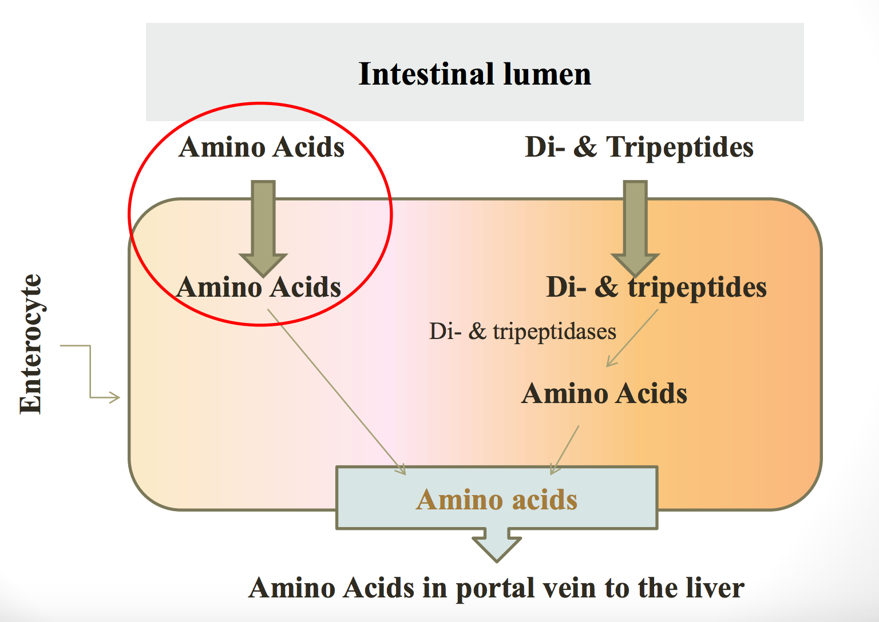
Absorption of digested proteins:
By sodium dependent transporter
By proton
co-transporter
They are formed by enterocyte and present inside it and also in brush boarder membrane in the luminal surface
Released into blood by facilitated diffusion.

Slide 12
Genetic errors in amino acid transport:
Cystinuria
About the disease: | is one of the most common genetic error of amino acid transport
Example of: | inherited disorder in the transport of certain amino acids
Affects: | the transport of Cystine and dibasic amino acids
Organs affected: | small intestine and the kidney
Clinically: | Cystine and dibasic amino acids appear in the urine
 | there is kidney stones formation because they’re not absorbed
Treatment: | Oral hydration (drinking lots of water) is an important part of treatment (to prevent kidney stones formation)
Cystine = Amino acid
Cysteine = 2 cystine (Di-peptide)
Dibasic amino acids : Have two replaceable H atoms (or two amino groups) and they are:
Ornithine.
Arginine.
Lysine.
So the this 3 dibasic amino acids and the cystine are not reabsorbed.
COLA is a mnemonic can help to remember the 4 of them.

Slide 13
Abnormalities of protein digestion
Pancreatic insufficiency
(chronic pancreatitis, cystic fibrosis, and removal of pancreas)
Incomplete digestion and absorption of lipids and proteins because of lack of pancreatic enzymes .
Abnormal appearance of lipids (steatorrhea) & undigested proteins in feces..
Celiac disease (Celiac sprue):
It is a disease of malabsorption resulting from immune-mediated damage to the villi of the small intestine in response to ingestion of gluten.
Gluten is a protein found in wheat, rye, and barley.
Diagnosis is made by looking for anti-gliadin antibodies levels
Auto immune disease , gluten is metabolized to gliadin which will be attacked by anti-gliadin antibodies which will lead to inflammation, damage to enterocytes and malabsorption.
Symptoms are frequent diarrhea, abdominal pain, decrease in weight.

Slide 14
Carbohydrates digestion:
Carbohydrates digestion is rapid:
Generally completed by the time the gastric contents reach the junction of the duodenum & jejunum.
Sites for digestion of dietary carbohydrates:
Mouth
Intestinal lumen
Rapid digestion because it starts in the mouth (physical chewing and alpha amylase enzyme)
No carbs digestion in the stomach (due to high acidity)
ℬ (1 , 4) can not be digested in human because we don’t have enzymes for it
Sucrose = Glucose & fructose
Lactose = Glucose & galactose
Maltose = two glucose units
Dietary carbohydrates
Polysaccharides
Starch from plant origin
Cellulose from plant origin
Disaccharides
Sucrose
Maltose
Monosaccharides
Little amounts
Oligosaccharides
Glycogen from animal origin
Lactose
Contains
⍺ (1 4) &
⍺ (1 6) bonds
Contains ℬ (1 4) bonds

Slide 15
Enzymes for digestion of dietary carbohydrates:
Enzyme | Type of enzyme | Substrate
⍺-amylase | Salivary and pancreatic* | Polysaccharides
Disaccharidase | Intestinal | Disaccharides
Isomaltase= | Intestinal | Branch points of oligo- and di-saccharides
⍺ (1,6) glucosidase
No dietary carbohydrate digestion occurs in the stomach
(the high acidity of the stomach inactivates the salivary ⍺-amylase).
Pancreatic ⍺-amylase continues the process of starch & glycogen digestion in the small intestine.
(Secreted by pancreas and works in small intestine)
*Most of the digestion is due to pancreatic ⍺-amylase because food doesn’t stay in the mouth for a long time.

Slide 16
Serum level of ⍺-amylase:
Normal level in serum: 25 -125 U/L (unit per liter)
The clinical significance of rising circulating levels of ⍺- amylase activity:
Diagnosis of acute pancreatitis:
(damage of pancreatic cells : release & activation of the intracellular enzymes into the blood)
Its level starts to rise within few hours.
Reaches a peak within 12- 72 hours.
Then returns to normal within few days, usually 5 days.
It is usually coming from the pancreas to the serum
⍺-amylase is not specific for pancreatitis so there is another enzyme (pancreatic lipase) when it also elevated we can confirm the diagnosis
So if you make measurement after a week you won’t find elevated levels of ⍺-amylase, but lipase is much more specific when it is elevated it will be maintained for 8 days, then returns gradually to its normal levels within 14 days.

Slide 17
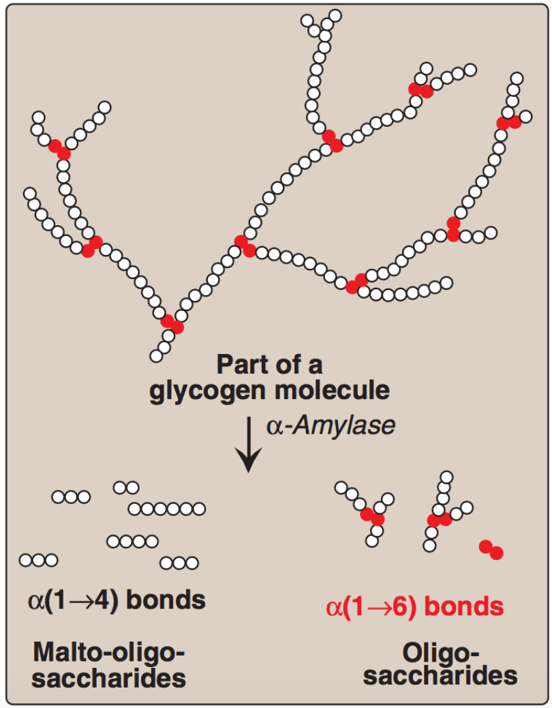
Effects of ⍺-amylase on glycogen:
Hydrolysis | Product
α(1,4) glycosidic bonds | -Mixture of short oligosaccharides (both branched & unbranched) -Disaccharides: Maltose and isomaltose
After every 8 to 10 amino acids we have a branch point

Slide 18
Final digestion of carbohydrates by intestinal enzymes in small intestine:
Enzymes | Source | Location of their action
Disaccharidases ⍺ (1,6) Glucosidase (for branched oligosaccharides) | Secreted by & remain associated with the luminal side of the brush border membranes of the intestinal mucosal cells | the mucosal lining of the jejunum.
Intestinal disaccharides:
Enzymes | Substrate | Product
Isomaltase | Isomaltose | Two glucose
Maltase | Maltose | Two glucose
Sucrase | Sucrose | Glucose + Fructose
Lactase (⍺-galactosidase) | Lactose | Glucose + Galactose

Slide 19
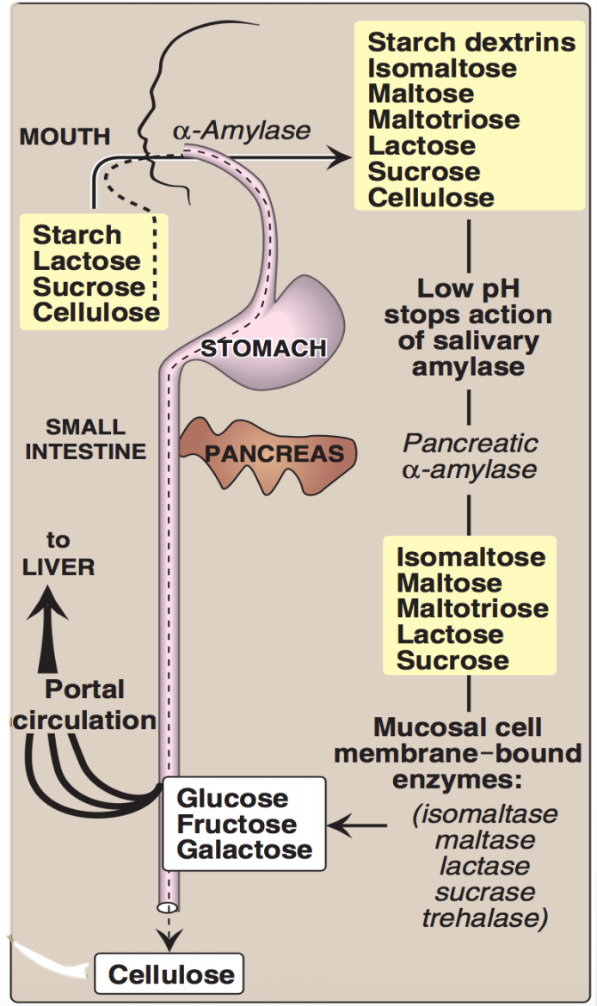
Digestion of carbohydrates:
Dietary cellulose cannot be digested due to the absence of enzyme that can cleave ℬ (1-4) bonds. It passes through the GIT largely intact.
Despite that, it has several beneficial* effects.
*It Increases motility and treat constipation
Maltotriose = 3 glucose molecules connected together by alpha (1,4) bond

Slide 20
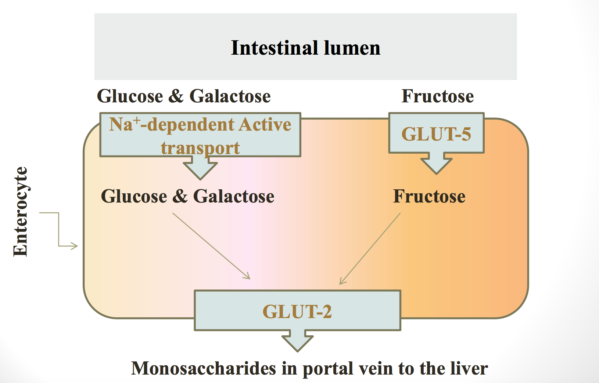
Absorption of monosaccharides by intestinal mucosal cells
Location: Duodenum & upper jejunum.
Insulin: is NOT required for the uptake of glucose by intestinal cells.
Different monosaccharides have different mechanisms of absorption:
Facilitated diffusion (GLUT-mediated) Sodium independent
Active transport (Energy-dependent): Co-transport with Na⁺ Sodium dependent
Absorption of digested carbohydrates
GLUT : Transports all monosaccharaides into the blood stream
Fructose enters the enterocytes by GLUT-5

Slide 21
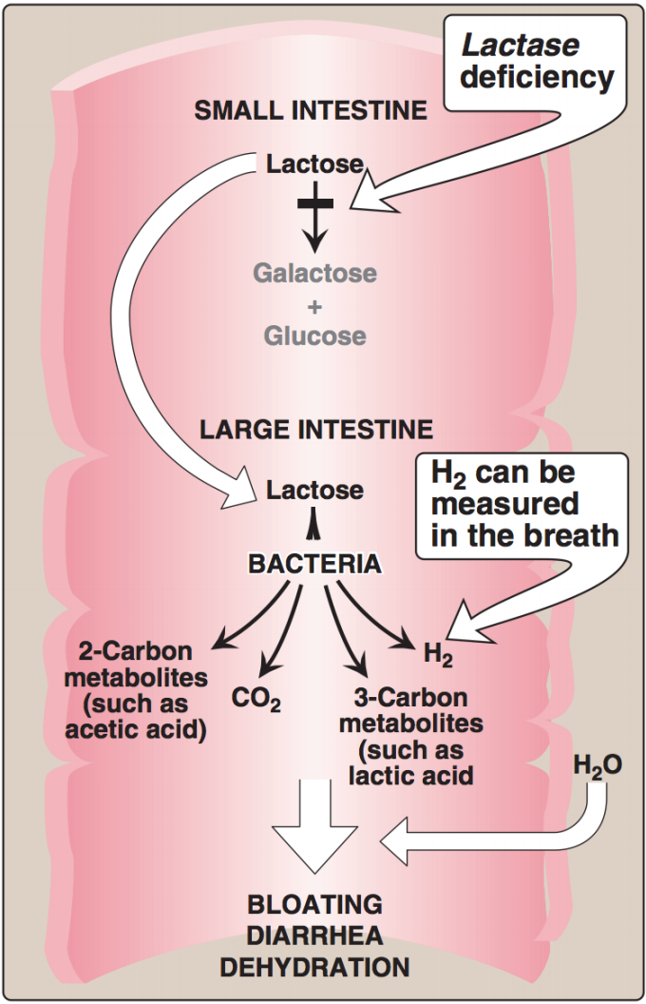
Abnormal digestion of disaccharides (e.g: lactose)
Lactose intolerance (Lactase deficiency)
Lactase (ℬ-galactosidase) deficiency Undigested carbohydrate in large intestine osmotic diarrhea.
Bacterial fermentation of the undigested compounds in the large intestine CO2 , H2 gas abdominal cramps, diarrhea & distension (flatulence)
Lactose intolerance is common in adults
There are bacteria present in the large intestine, and the water reabsorbed to make the feces solid, people who have indigested carbohydrates in large intestine it is osmotically active and it will hold on to the water so these people develop diarrhea

Slide 22
Take Home Messages -Digestion of Dietary proteins:
Proteolytic enzymes responsible for digestion of dietary proteins are produced by the stomach, the pancreas & the small intestine.
The digestion of proteins in the stomach is the result of the action of HCl and pepsin.
Pancreatic proteases are, like pepsin, synthesized and secreted as inactive zymogens.
The intestinal digestion of proteins occurs in the small intestine’s lumen, on the luminal surface of the small intestine, and is completed intracellularly to produce free amino acids.
In pancreatic insufficiency, the digestion and absorption of fat & protein is incomplete → steatorrhea & appearance of undigested proteins in the feces.

Slide 23
Take Home Messages -Digestion of Dietary carbohydrates:
Salivary α-amylase acts on dietary glycogen & starch in the mouth.
Pancreatic α-amylase continues the process of polysaccharide digestion in small intestine.
The final digestive processes of carbohydrates into monosaccharides occur at the mucosal lining of the small intestine by disaccharidases & α(1,6) glucosidase.
Dietary cellulose cannot be digested due to the absence of enzyme that can cleave β (1-4) bonds, so it passes through the GIT largely intact. Despite that, it has several beneficial effects.
Absorption of the monosaccharides requires specific transporters (GLUTs).
Lactose intolerance is due to deficiency of lactase enzyme and causes abdominal cramps, diarrhea & flatulence

Slide 24
Summary
Enzymes in carbohydrate digestion
alpha amylase
Salivary and pancreatic
Substrate: polysaccharides
Disacchridases
Intestinal
Isomaltase and alpha 1,6 glucosidase
Substrate: branch points of oligo and di sacchrides
Substrate: disaccharide
intestinal

Slide 25
Summary
Disease
Genetic errors of amino acid transport
Cystinuria:
Most common gen disorder of amino acid transport
Inherited
Effects transport of cysteine and dibasic amino acids
Organs effected
Appear in urine and form kidney stones
Treated by oral hydration
Abnormalities of protein digestion:
Pancreatic insufficiency:
Like in chronic pancreatitis, CF, and surgical removal
Abnormal appearance of lipids and undigested proteins in feces
Celiac disease:
Increase in malabsorption
kidney and small intestine
gluten in wheat, rye , and barley
resulting in immune mediated damage to villi of small intestine in response to gluten

Slide 26
HCl
denatures protein which makes them more susceptible to by hydrolyzed by proteases
Activation
Enteropeptidase activate trypsinogen to trypsin
Stomach
Pancreas releases enzymes that aid the small intestine
Trypsin the activate trypsin, chymotrypsin, proelastase, carboxypeptidase (exopeptide)
proteolytic enzymes that degrade dietary proteins
Pepsin: acid stable endopeptidase, gives us polypeptides plus a few free amino acids
Cholecytoskinin (CCK):
Secretes pancreatic enzymes
Slow release of gastric contents (decrease gastric motility)
Secretin: releases watery bicarb solution to neutralize chime pH
Bile secretion
By pancreatic enzymes
From polypeptides to oligopeptides as a result of pancreatic proteases
Small intestine:
Amino acids > portal vein
Cleaved into free amino acids and di and tri peptides
By aminopeptidase
Di and tri > broken by tri and di peptides
Intestinal amino peptidase: exopeptide of lumen surface of intestine

Slide 27
Summary
Intestinal Disaccharides |  |  | Absorption of monosaccharides
Enzyme | Substrate | Product | Location: Duodenum and jejunum
isomaltase | isomaltose | 2 glucose | No insulin required for reuptake of glucose by intestinal cells
maltase | maltose | 2 glucose | Mechanisms of absorption:
sucrase | sucrose | Glucose and fructose | GLUT- facilitated
Lactase | lactose | Glucose and galactose | Active – Na co-transport

Slide 28
QUIZ
Q1 : digestion of proteins by pancreatic enzymes result in : A-polypeptides B-fatty acid only C-Oligopeptides?
A- Polypeptides
B- Fatty acids only
C- Oligopeptides
D- None of the above
Q2 : Trypsin activates all pancreatic enzymes including it precursor ?
A- True
B- False
Q3 : Incomplete transport & digestion of Fat and Proteins is a sign of ?
A- Pancreatic Insufficiency
B- Stomach Insufficiency
C- Intestinal Insufficiency
D- Spleen Disease
Q4 : Carbohydrate can not be digested in ?
A- Mouth
B- Stomach
C- duodenum
D- None of them
Q5 : Which ONE of the following causes rising in α-Amylase levels ?
A- Peptic Ulcer
B- Acute Pancreatitis
C- Appendicitis
D- None of the above
Q6 : The final digestion of carbohydrates occurs in ?
A- Mucosal lining of Large Intestine
B- Mucosal lining of Stomach
C- Mucosal lining of Small Intestine
D- None of the above

Slide 29
QUIZ
Q7 : The absorption of monosaccharides occurs in ?
Duodenum & upper jejunum.
Q8 : Mention two hormones that control the digestion of proteins in small intestine?
Cholecystokinin ( CCK )
Secretin
Q9 : Name three disorders that will result in Proteins malabsorption ?
1.Celiac Disease (Celiac sprue)
It is a disease of malabsorption resulting from immune-mediated damage to the villi of the small intestine in response to ingestion of gluten. - Gluten is a protein found in wheat.
2.Pancreatic insufficiency
incomplete digestion & absorption of lipids & proteins abnormal appearance of lipids (steatorrhea)
3. Cystinuria
Inherited disorder - affect the transport of cystine + dibasic Amino Acid which will appear in the urine. - the organ affected is small intestine and kidney. - Kidney stone formation-Oral hydration .
Suggestions and recommendations
1) C 2) A 3) A 4) B 5) B 6) C

Slide 30
Najd altheeb
Hanin Bashaikh
Heba Alnasser
Faisal alfawaz

Slide 31
Review the notes

