Slide 1
Biochemistry
Aim for the moon .
If you miss, you may hit a star
Plasma Proteins
Editing file

Slide 2
By the end of this lecture, the Second Year students will be able to:
Identify types and various functions of plasma proteins
Discuss the role of plasma proteins in the diagnosis of diseases and conditions
Identify the role positive and negative acute phase proteins in various diseases
Interpret the normal and abnormal electrophoretic patterns of plasma proteins

Slide 3
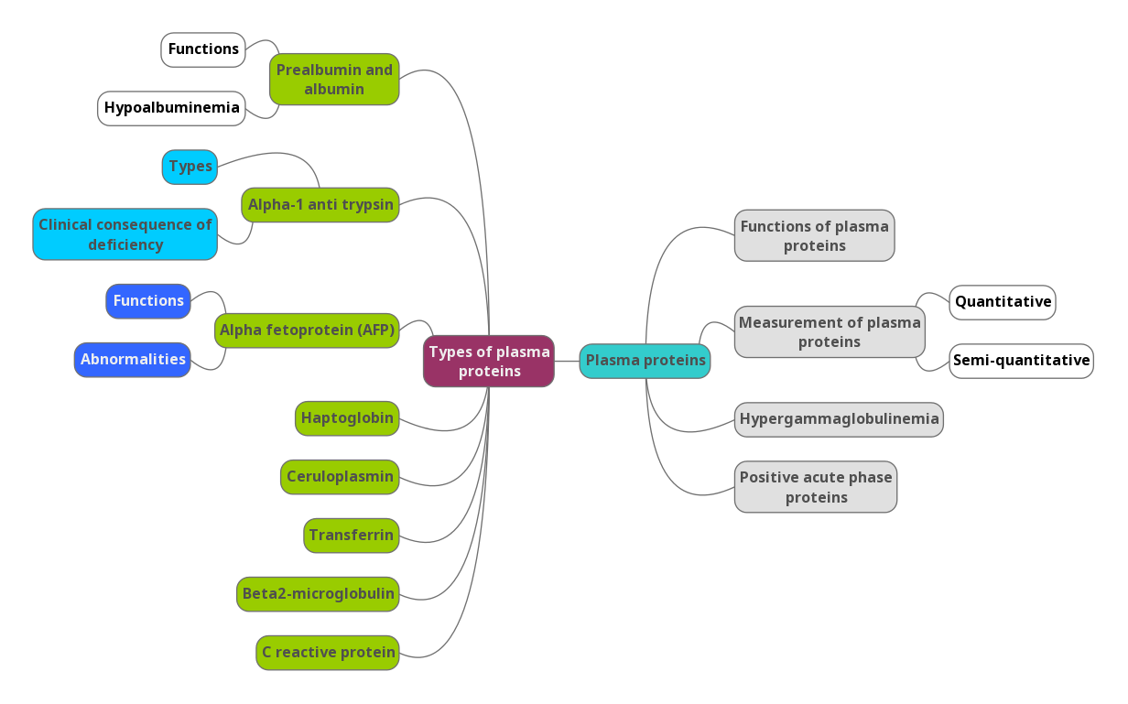
Lecture overview

Slide 4
Plasma Proteins (pps)
Plasma contains > 300 different proteins
Many pathological conditions affect level of pps
Mostly synthesized in the liver
Some are produced in other sites
A normal adult contains ~70 g/L of pps
Such as: antibodies which are produced in lymphocytes

Slide 5
Functions of pps
Functions of pps:
Transport
Maintain plasma oncotic pressure
Defense
(Albumin, prealbumin, globulins)
It’s the pressure that’s caused by protein to pull the water in the blood to the interstitial fluid
(Albumin)
(Immunoglobulins and complement)
Clotting and fibrinolysis
(Thrombin and plasmin)

Slide 6
Measurement of Plasma Proteins
Semi quantitative is getting an idea of the quantity not an exact number.
Ex” There is protein X we study its level in a healthy population we come up with a range and then compare it to a person showing symptoms.
Measurement of Plasma Proteins
A) Quantitative measurement of a specific protein:
B) Semiquantitative measurement by electrophoresis:
Chemical:
immunological reactions:
Immunological reaction: some proteins we can’t design a test sensitive enough to pick up level of the protein; we raise the antibodies against it since they are very specific they increase sensitivity.
both ways give the exact amount of wanted to protein.
specific way to measure specific protein.
Proteins are separated by their electrical charge in electrophoresis
Five separate bands of proteins are observed
These bands change in disease
Electrophoresis: An electrical field is applied to a mixture of proteins to separate it. Separation is based on the size of the molecule. The smallest is the fastest, the heaviest is the slowest. And all of them move to the positive charge.
We’ll also need a medium for the proteins: gel or paper but usually a gel is used. After separation there a couple of ways to visualize them: by staining them or by binding them to antibodies.

Slide 7
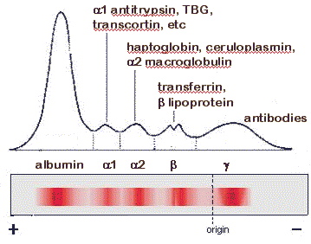
Measurement of Plasma Proteins
5 distinct bands with specific positions for each protein and a specific thickness showing the quantity of it.
Normal Pattern of Plasma Protein Electrophoresis:
Prealbumin is the fastest but it’s not shown in the chart so it’s albumin.
We can call them albumin and the globulins.
Intensities are different so we make a density analysis to show the amount of plasma proteins.
Albumin 50-55%, gamma 20%, a1 and b 7-14%, A1 is the remaining.
Prealbumin is not shown in the classical electrophoresis, we need a more sensitive test (immunoelectrophoresis).

Slide 8
Types of Plasma Proteins
Types of Plasma Proteins
Prealbumin
Albumin
α1-Globulins:
a1-Antitrypsin
α-fetoprotein
α2-Globulins:
Ceruloplasmin,
haptoglobin
β-Globulins:
γ- Globulins
CRP
transferrin
β2-microglobulin
Prealbumin is not a precursor of albumin it’s a different protein.
It’s a good indication of nutrition status it has a half life of 2 days not like albumin which is 20 days.
Because of the loss of blood. Also any condition that increases catabolism in the body.

Slide 9
Types of Plasma Proteins:
1-Prealbumin (transthyretin):
2-Albumin:
A transport protein for:
Thyroid hormones
Retinol (vitamin A)
Migrates faster than albumin in electrophoresis
Separated by immunoelectrophoresis
Lower levels found in:
liver disease, nephrotic syndrome, acute phase inflammatory response, malnutrition
Short half-life (2 days)
Most abundant plasma protein (~40 g/L) in normal adult
Synthesized in the liver as preproalbumin and secreted as albumin
Half-life in plasma: 20 days
Decreases rapidly in injury, infection and surgery

Slide 10
Functions
Functions:
Maintains oncotic pressure:
A non-specific carrier of :
Tissue cells can take up albumin by pinocytosis where it is hydrolyzed to amino acids
The osmotic pressure exerted by plasma proteins that pulls water into the circulatory system
Maintains plasma volume and fluid distribution in and outside cells
80% of plasma oncotic pressure is maintained by albumin
hormones, calcium, free fatty acids, drugs, etc.
Useful in the treatment
of liver diseases, hemorrhage, shock and burns
because if there’s a lot of blood loss or skin burn causing hypovolemia so albumin can maintain oncotic pressure.
It means it attracts water which maintains homeostasis, so for ex. If albumin decreases in blood → edema → like in nephrotic syndrome.
If a person is in shock and needs proteins he goes through pinocytosis where the cell membrane stretches around the molecule and takes it in into a vesicle .

Slide 11
Hypoalbuminemia
Causes: | Effects:
1-Decreased albumin synthesis (liver cirrhosis, malnutrition) | 1-Edema due to low oncotic pressure: Albumin level drops in liver disease causing low oncotic pressure Fluid moves into the interstitial spaces causing edema
2-Increased losses of albumin: | 2-Reduced transport of drugs and other substances in plasma
A-Increased catabolism in infections | When you take a drug, it goes all around the body by blood and get metabolized and cleared . If protein is less then the time it stays in the body increases.
B-Excessive excretion by the kidneys (nephrotic syndrome) | 3-Reduced protein-bound calcium Total plasma calcium level drops Ionized calcium level may remain normal
C-Excessive loss in bowel | No clinical conditions are known that cause the liver to produce large amounts of albumin
D-Severe burns (plasma loss in the absence of skin barrier) | The only cause of hyperalbuminemia is DEHYDRATION,
Another case of low amount of albumin or any other plasma protein is when the nurse wants to draw blood she’ll use a tonica to make the veins more visible, so if she forgot to remove it after inserting the needle and she drew blood, albumin amount would be lower than normal because blood flow is occluded.

Slide 12
3- α1-Antitrypsin
Types of α1-Antitrypsin
Over 30 types are known
The most common is M type
Genetic deficiency of α1-Antitrypsin
Synthesis of the defective α1-Antitrypsin occurs in the liver but it cannot secrete the protein
α1-Antitrypsin accumulates in hepatocytes and is deficient in plasma
Synthesized by the liver and macrophages
An acute-phase protein that inhibits proteases
Proteases are produced endogenously and from leukocytes and bacteria
Digestive enzymes (trypsin, chymotrypsin)
Other proteases (elastase, thrombin)
Infection leads to protease release from bacteria and leukocytes
Trypsin = protease = digesting protein normally produced by cells in the body. Or proteins that is part of leukocytosis.
Antitrypsin is used when proteins are synthesized excessively.
Acute phase protein → the body’s respond is within 24hrs. If increased then its positive if it decreases then its negative.

Slide 13
Clinical Consequences of α1-Antitrypsin Deficiency
Neonatal jaundice with evidence of cholestasis
Childhood liver cirrhosis
Pulmonary emphysema in young adults
Laboratory Diagnosis
Lack of α1-globulin band in protein electrophoresis
Quantitative measurement of α1-Antitrypsin by:
Radial immunodiffusion, isoelectric focusing or nephelometry
If α1-Antitrypsin is diffient excessive cleavage/digestion of proteins happen. Especially in smokers an inflammatory reaction happens where neutrophils produce elastase, and since there’s no α1-Antitrypsin to cleave it, elastase would accumulate causing emphysema

Slide 14
α-Fetoprotein (AFP)
Synthesized in the developing embryo and fetus by the parenchymal cells of the liver
AFP levels decrease gradually during intra-uterine life and reach adult levels at birth
Function is unknown but it may protect fetus from immunologic attack by the mother
No known physiological function in adults
ABNORMALITIES
Elevated maternal AFP levels are associated with:
Neural tube defect (spina bifida), anencephaly
Decreased maternal AFP levels are associated with:
Increased risk of Down syndrome
AFP is a tumor marker for:
Hepatoma and testicular cancer
AFP has different isoforms associated to different types of cancers for ex. L3 → liver cancer, so we measure L3 isoform AFP and we measure total AFP if L3 is more than 10% then it means that in the next 21 months the person would develop cancer.

Slide 15
Haptoglobin
Synthesized by the liver
Binds to free hemoglobin to form complexes that are metabolized in the RES
Limits iron losses by preventing Hb loss from kidneys
Plasma level decreases during hemolysis
Prevent hemoglobin loss especially in people w/ hemolytic disease.
If hemoglobin went to the kidney first there will be loss of it and it’ll cause damage to the kidney and then hemoglobin and iron are lost.
Haptoglobin attaches to hemoglobin + iron complex making it bigger and prevent it being transferred to kidney and takes it to be degraded in reticuloendothelial system, after that hemoglobin and iron are taken back in body.
RES : Reticulo Endothelial System

Slide 16
Ceruloplasmin
Synthesized by the liver
Contains >90% of serum copper
An oxidoreductase that inactivates ROS causing tissue damage in acute phase response
Important for iron absorption from the intestine
Wilson’s disease:
Due to low plasma levels of ceruloplasmin
Copper is accumulated in the liver and brain
It is called apoceruloplasmin.
It carries 90% of copper and the albumin carries the rest 10%.
Diffiency causes oxidative damage.

Slide 17
Transferrin
β2–Microglobulin
A major iron-transport protein in plasma 30% saturated with iron
Plasma level drops in:
Malnutrition, liver disease, inflammation, malignancy
Iron deficiency results in increased hepatic synthesis
A negative acute phase protein
1 molecule transferrin binds to 2 molecules of iron
Iron ↓ liver produces ↑ transferrin
A component of human leukocyte antigen (HLA)
Present on the surface of lymphocytes and most nucleated cells
Filtered by the renal glomeruli due to its small size but most (>99%) is reabsorbed
Elevated serum levels are found in:
Overproduction in disease
May be a tumor marker for:
Leukemia, lymphomas, multiple myeloma
Not a tumor marker for diagnosing, rather it helps determining the size of tumor
Elevated serum levels also in :
Inflammation , infections , rheumatoid arthritis and SLE

Slide 18
CRP
C-Reactive Protein (CRP)
Binds on the surface of the cells to make them more susceptible to phagocytosis by macrophages
An acute-phase protein synthesized by the liver
Important for phagocytosis
High plasma levels are found in many inflammatory conditions such as rheumatoid arthritis
A marker for ischemic heart disease
Ultrasensitive c-reactive protein is the marker for ischemic heart disease and not normal CRP

Slide 19
Hypergammaglobulinemia
May result from stimulation of:
B cells (Polyclonal hypergammaglobulinemia)
Monoclonal proliferation (Paraproteinemia)
Polyclonal hypergammaglobulinemia:
Stimulation of many clones of B cells produce a wide range of antibodies
γ-globulin band appears large in electophoresis
Clinical conditions: acute and chronic infections, autoimmune diseases, chronic liver diseases
Polyclonal → mixture of antibodies from different plasma cells
Monoclonal → specific type of antibody from one type of plasma protein

Slide 20
Monoclonal Hypergammaglobulinemia
Proliferation of a single B-cell clone produces a single type of Ig
Appears as a separate dense band (paraprotein or M band) in electrophoresis
Paraproteins are characteristic of malignant B-cell proliferation
Clinical condition: multiple myeloma
A single thin peak thin peak

Slide 21
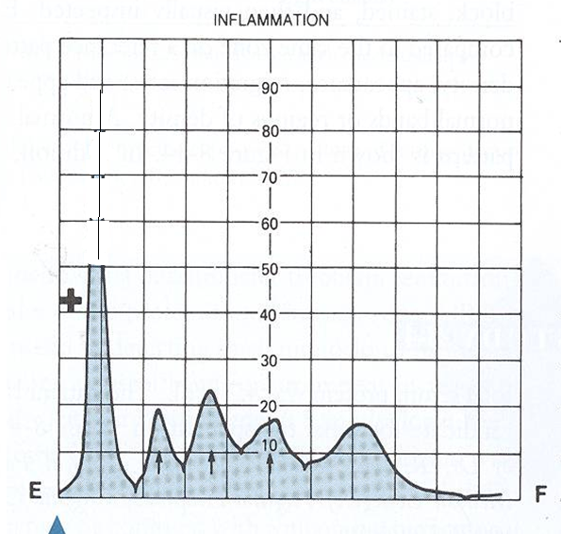
Positive Acute Phase Proteins
Plasma protein levels increase in:
*Infection, inflammation , malignancy, trauma, surgery
These proteins are called acute phase reactants
Synthesized due to: body’s response to injury
Examples: α1-Antitypsin, haptoglobin, ceruloplasmin, fibrinogen, c-reactive protein
Mediators cause these proteins to increase after injury
Mediators: Cytokines (IL-1, IL-6), tumor necrosis factors α and β , interferons, platelet activating factor
Functions:
1. Bind to polysaccharides in bacterial walls
2. Activate complement system
3. Stimulate phagocytosis

Slide 22
Positive Acute Phase Proteins
Negative Acute Phase Proteins
These proteins decrease in inflammation:
- Albumin, prealbumin, transferrin
Mediated by inflammatory response via cytokines and hormones
Synthesis of these proteins decrease to save amino acids for positive acute phase proteins

Slide 23
Plasma proteins summary
Overview:
Functions and characteristics of plasma proteins
Measurement of plasma proteins and diagnosis of
diseases
Electrophoretic patterns of plasma proteins
Acute phase proteins
Plasma Proteins:
Plasma contains >300 different proteins
Many pathological conditions affect level of plasma
proteins
Mostly synthesized in the liver
Some are produced in other sites
A normal adult contains ~70 g/L of pps
Functions of plasma proteins:
Transport (Albumin, prealbumin, globulins)
Maintain plasma oncotic pressure (Albumin)
Defense (Immunoglobulins and complement)
Clotting and fibrinolysis (Thrombin and plasmin)
Measurement of Plasma Proteins:
A) Quantitative measurement of a specific protein:
• Chemical or immunological reactions
B) Semiquantitative measurement by electrophoresis:
Proteins are separated by their electrical charge in electrophoresis
Five separate bands of proteins are observed
These bands change in disease
Normal Pattern of Plasma Protein Electrophoresis:
Types of Plasma Proteins:
Prealbumin Albumin α1-Globulins:
• a1-Antitrypsin, α-fetoprotein α2-Globulins:
• Ceruloplasmin, haptoglobin β-Globulins:
• CRP, transferrin, β2-microglobulin γ- Globulins
Positive Acute Phase Proteins:
• Plasma protein levels increase in: → Infection, inflammation, malignancy, trauma, surgery
• These proteins are called acute phase reactants • Synthesized due to body’s response to injury • Examples: α1-Antitypsin, haptoglobin, ceruloplasmin,
fibrinogen, c-reactive protein • Mediators cause these proteins to increase after injury • Mediators: Cytokines (IL-1, IL-6), tumor necrosis factors α and
β, interferons, platelet activating factor • Functions:
1. Bind to polysaccharides in bacterial walls 2. Activate complement system 3. Stimulate phagocytosis
Negative Acute Phase Proteins:
• These proteins decrease in inflammation → Albumin, prealbumin, transferrin
Mediated by inflammatory response via cytokines and hormones
Synthesis of these proteins decrease to save amino acids for positive acute phase proteins

Slide 24
Plasma proteins summary
Prealbumin (Transthyretin)
A transport protein for:
Thyroid hormones
Retinol (vitamin A)
Migrates faster than albumin in electrophoresis Separated by immunoelectrophoresis Lower levels found in:
liver disease, nephrotic syndrome, acute phase inflammatory response, malnutrition Short half-life (2 days)
Albumin
Most abundant plasma protein (~40 g/L) in normal adult
Synthesized in the liver as preproalbumin and secreted as
albumin Half-life in plasma: 20 days Decreases rapidly in injury, infection and surgery
Functions:
Maintains oncotic pressure:
The osmotic pressure exerted by plasma proteins that
pulls water into the circulatory system
Maintains fluid distribution in and outside cells and plasma volume
80% of plasma oncotic pressure is maintained by albumin
A non-specific carrier of
hormones, calcium, free fatty acids, drugs, etc.
Tissue cells can take up albumin by pinocytosis where it is hydrolyzed to amino acids
Useful in treatment of liver diseases, hemorrhage, shock and burns.
Hypoalbuminemia
Decreased albumin synthesis (liver cirrhosis, malnutrition) Increased losses of albumin
Increased catabolism in infections
Excessive excretion by the kidneys (nephrotic
syndrome)
Excessive loss in bowel (bleeding)
Severe burns (plasma loss in the absence of skin barrier)
Effects:
Edema due to low oncotic pressure Albumin level drops in liver disease causing low
oncotic pressure
Fluid moves into the interstitial spaces causing edema
Reduced transport of drugs and other substances in plasma
Reduced protein-bound calcium Total plasma calcium level drops Ionized calcium level may remain normal
Hyperalbuminemia
No clinical conditions are known that cause the liver to produce large amounts of albumin
The only cause of hyperalbuminemia is dehydration

Slide 25
alpha1 and alpha2 globulins summary
α1-Antitrypsin
Synthesized by the liver and macrophages
An acute-phase protein that inhibits proteases
Proteases are produced endogenously and from leukocytes and bacteria
→ Digestive enzymes (trypsin, chymotrypsin)
→ Other proteases (elastase, thrombin)
Infection leads to protease release from bacteria and
from leukocytes
Over 30 types are known
The most common is M type
Genetic deficiency of a1-Antitrypsin
→ Synthesis of the defective a1-Antitrypsin occurs in the liver but it cannot secrete the protein
→ α1-Antitrypsin accumulates in hepatocytes and is deficient in plasma
Clinical Consequences of a1-Antitrypsin Deficiency
Neonatal jaundice with evidence of cholestasis Childhood liver cirrhosis
Pulmonary emphysema in young adults
Laboratory Diagnosis
Lack of 1-globulin band in protein electrophoresis
Quantitative measurement of 1-Antitrypsin by:
→ Radial immunodiffusion, isoelectric focusing or nephelometry
α1-Antitrypsin
Ceruloplasmin
Synthesized by the liver Contains >90% of serum copper An oxidoreductase that inactivates ROS causing tissue
damage in acute phase response Important for iron absorption from the intestine Wilson’s disease:
→ Due to low plasma levels of ceruloplasmin
→ Copper is accumulated in the liver and brain
-Fetoprotein (AFP) Synthesized in the developing embryo and fetus by the parenchymal cells of the liver
AFP levels decrease gradually during intra-uterine life and reach adult levels at birth
Function is unknown, but it may protect fetus from immunologic attack by the mother
No known physiological function in adults Elevated maternal AFP levels are associated with:
→ Neural tube defect, anencephaly Decreased maternal AFP levels are associated with:
→ Increased risk of Down’s syndrome
AFP is a tumor marker for:
→ Hepatoma and testicular cancer
Haptoglobin
Synthesized by the liver Binds to free hemoglobin to form complexes that are
metabolized in the RES Limits iron losses by preventing Hb loss from kidneys
Plasma level decreases during hemolysis

Slide 26
β and Gamma Globulins summary
Transferrin
A major iron-transport protein in plasma  30% saturated with iron
Plasma level drops in:
→ Malnutrition, liver disease, inflammation,
malignancy
→ Iron deficiency results in increased hepatic
synthesis A negative acute phase protein
C-Reactive Protein (CRP)
An acute-phase protein synthesized by the liver Important for phagocytosis High plasma levels are found in many inflammatory
conditions such as rheumatoid arthritis
A marker for ischemic heart disease
Monoclonal Hypergammaglobulinemia
Proliferation of a single B-cell clone produces a single type of Ig
Appears as a separate dense band (paraprotein or M band) in electrophoresis
Paraproteins are characteristic of malignant B-cell proliferation
Clinical condition: multiple myeloma
Hypergammaglobulinemia
May result from stimulation of B cells (Polyclonal hypergammaglobulinemia)
Monoclonal proliferation (Paraproteinemia)
Polyclonal hypergammaglobulinemia:
Stimulation of many clones of B cells produce a
wide range of antibodies
γ -globulin band appears large in electophoresis
Clinical conditions: acute and chronic infections,
autoimmune diseases, chronic liver diseases
β ₂–Microglobulin
A component of human leukocyte antigen (HLA) Present on the surface of lymphocytes and most
nucleated cells Filtered by the renal glomeruli due to its small size but
most (>99%) is reabsorbed Elevated serum levels are found in
→ Overproduction in disease
May be a tumor marker for:
→ Leukemia, lymphomas, multiple myeloma

Slide 27
QUIZ
Q1 : low levels of prealbumin is found in ?
A- liver disease
B- Arthritis .
C- Vitamin A deficiency .
D- All of the above
Q2 : Which ONE of the following is an effect of hypoalbuminemia ?
A- Edema .
B- inflammation .
C- Increase transport of drugs .
D- Plasma Ca Increase .
Q3 : the most common type of alpha1-Antitrypsin is ?
A- L .
B- N .
C- M .
D- both A & B .
Q4 : Which ONE of the following is the cell that synthesize alpha-Fetoprotein ?
A- parenchymal cells of kidney .
B- parenchymal cells of liver .
C- lumen cells of kidney .
D- lumen cells of liver .
Q5 : What is the function of Haptoglobin ?
A- protect against infection .
B- prevent HB loss from liver .
C- limits iron loss related to kidney .
D- Non of the above
Q6 : Which of the following is true regarding CRP ?
A- Important for phagocytosis .
B- synthesized by kidney .
C- marker for heart failure .
D- All of them .

Slide 28
QUIZ
Q7 : What are the abnormalities associated with impaired alpha-fetoprotein ?
1- Elevated maternal AFP levels are associated with:
Neural tube defect (spina bifida), anencephaly
2- Decreased maternal AFP levels are associated with:
Increased risk of Down syndrome
3- AFP is a tumor marker for:
Hepatoma and testicular cancer
Q8 : Determine two causes and associated conditions of hypoalbuminemia ?
1- Decreased albumin synthesis (liver cirrhosis, malnutrition)
2- Increased losses of albumin
Increased catabolism in infections
Excessive excretion by the kidneys (nephrotic syndrome)
Suggestions and recommendations
1) A 2) A 3) C 4) B 5) C 6) A

Slide 29
Naser abu-dujain
Mohannad alzahrani
Bushra Kokandi
Haifa bin taleb
Zaina alkaff

Slide 30
Review the notes

