Slide 1

Biochemistry
A goal without a plan is nothing but wish
Nutritional requirements
Editing file

Slide 2
By the end of this lecture, the students should be able to know:
Understand the basic terms of nutritional requirements that are important for establishing intake of a nutrient in population
Understand the food pyramid that recommends daily serving size from each food group for vegetarians and non-vegetarians
Identify dietary guidelines and goals that are necessary for good health
Discuss energy requirement in humans including basic energy expenditure and the factors that affect it
Know about total parenteral nutrition (TPN) and its applications

Slide 3
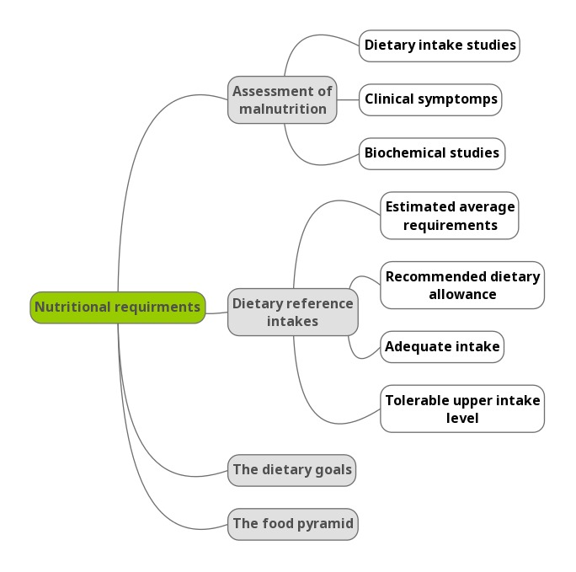
Lecture overview

Slide 4
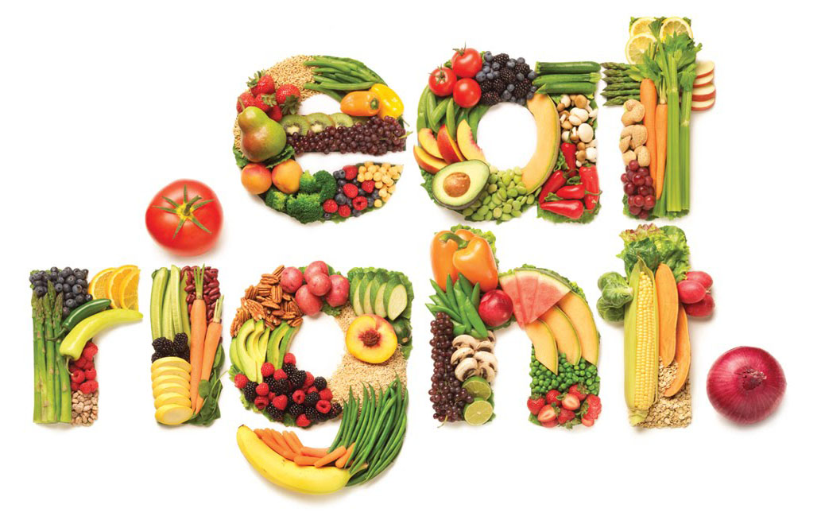
Nutrition
What Is Nutrition ?
Composition and quantity of food intake by living organisms.
Biochemical utilization of food.
Human nutrition is divided into three areas:
  Under-nutrition (nutrient deficiency)
  Over-nutrition (excessive nutrient intake)
  Optimal nutrition (balanced nutrient intake)
  The Ideal condition
Nutrition means whatever you eat and the quality and amounts of it ..
Biochemical utilization : How it’s metabolized by the body to provide energy

Slide 5
Malnutrition
Assessment of malnutrition
Malnutrition in humans is measured by:
Dietary intake studies: identify people with deficient diets
Biochemical studies: identify subclinical nutritional deficiencies
Clinical symptoms: identify clinical nutritional deficiencies
Dietary Reference Intakes (DRIs)
What is it ? Quantitative estimates of nutrient intakes required to prevent deficiencies and maintain optimal health in populations
Recommended by: Food and Nutrition Board of the National Research Council, USA
In malnutrition either the composition of nutrients or amount is impaired
To assess dietary intake studies we have to study the results of 24 hours food recall survey of a healthy selected population and submit the results as the normal amounts of nutrient should be taken per day ..
In biochemical studies it depends in biochemical investigations of some nutrients as vitamins.. where the individual has no clinical symptoms – looks healthy while having a deficiency

Slide 6
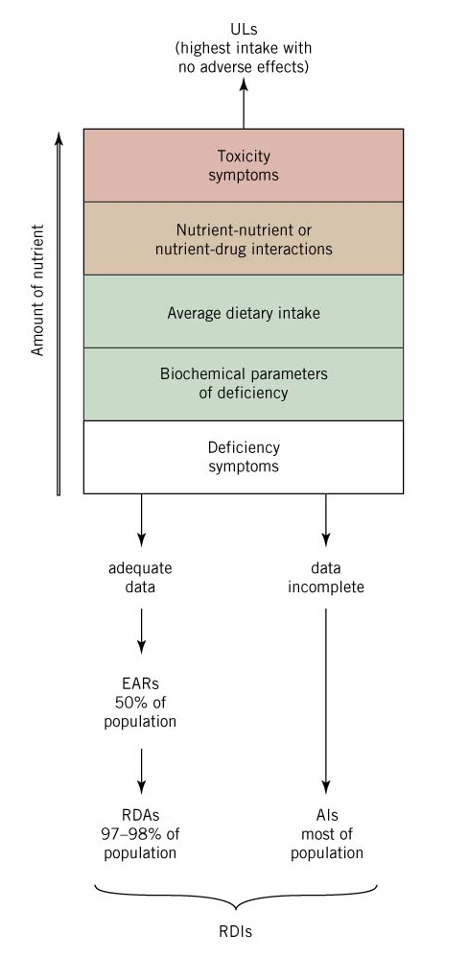
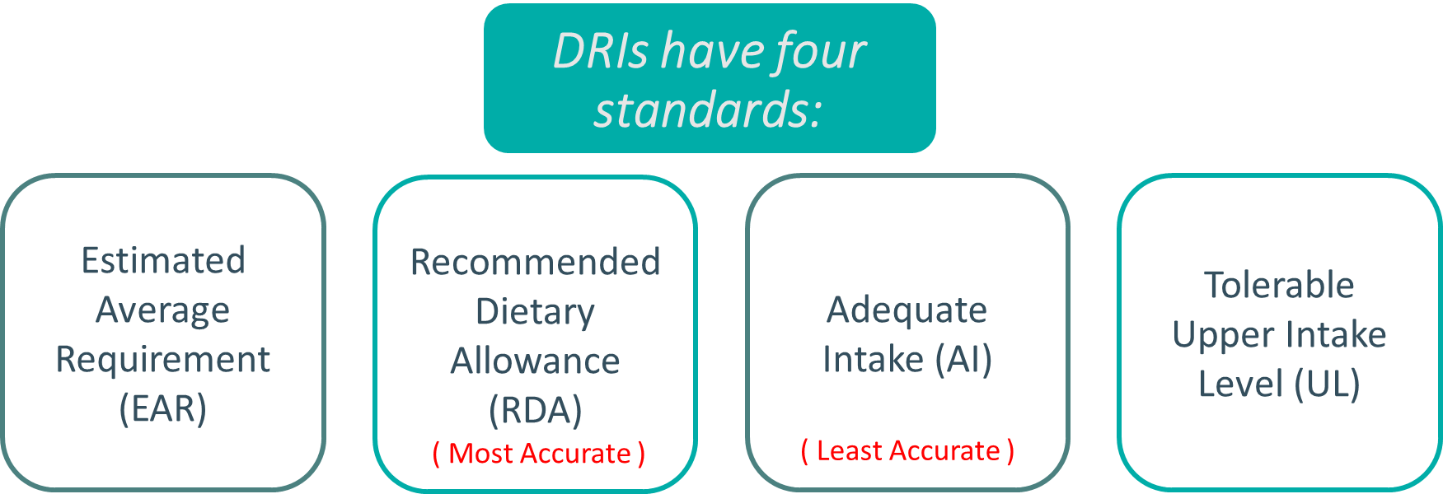
Dietary Reference Intakes (DRIs)
Each standard is explained alone in next few slides

Slide 7
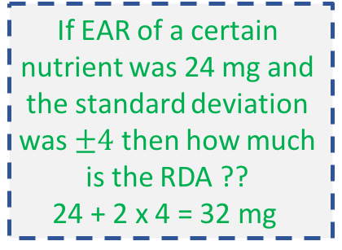
Dietary Reference Intakes (DRIs)
1) Estimated Average Requirement (EAR)
2) Recommended Dietary Allowance (RDA)
The average daily amount of nutrient intake estimated to meet the nutritional requirement of half of the healthy individuals (50%) in an age and gender group
The amount of nutrient intake that is sufficient to meet the nutritional requirement of nearly all (97-98%) healthy
individuals in a group
RDA is two SD above EAR
RDA = EAR + 2 SD
If EAR of a certain nutrient was 24 mg and the standard deviation was $±4$ then how much is the RDA ??
24 + 2 x 4 = 32 mg
تغطي50% من البوبيوليشنن. مثال :
IF we have a population of 1000 individuals, then the EAR is going to be 500
( halve of the population ) and based on that we come up with average number.
ومن هذي القيمة نقدر نحسب RDA
هنا تقريبا اخذنا كل البوبيوليشن بس تركنا نسبة ٢-٣ ٪ هذي النسبة المتروكة نقصد فيها الفئة من المجتمع اللي ما تمشي على RDA’s مثل
1. Pregnant female
2. Lactating
3. Eldery
4. Children and athelets

Slide 8
Dietary Reference Intakes (DRIs)
3) Adequate Intake (AI)
4) Tolerable Upper Intake Level (UL)
- For very nutrient we have to set a number limits so we don’t develop toxicity
- If you crossed the UL THE RISKS for developing toxicity increase, but you DON’T develop toxicity. To develop toxicity you have to go much higher than UL for longer time.
It is used instead of EAR and RDA if:
A nutrient is considered essential but the experimental data are inadequate for determining EAR and RDA
AI covers the nutritional requirement of all individuals in a group with approximation due to insufficient data
The highest level of daily nutrient intake that has no adverse health effects or toxicity in almost all individuals
Over estimation of a group of population. The experts set with data that are available and compute with higher number.. Such as when the study lacks biochemical studies ..
If the nutrients intake is equal to or less than the EAR ( not good )
- If the nutrients intake is less than RDA but between EAR and AI ( better )

Slide 9
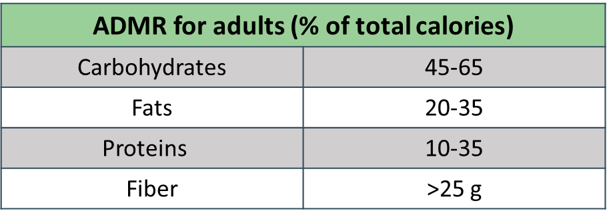
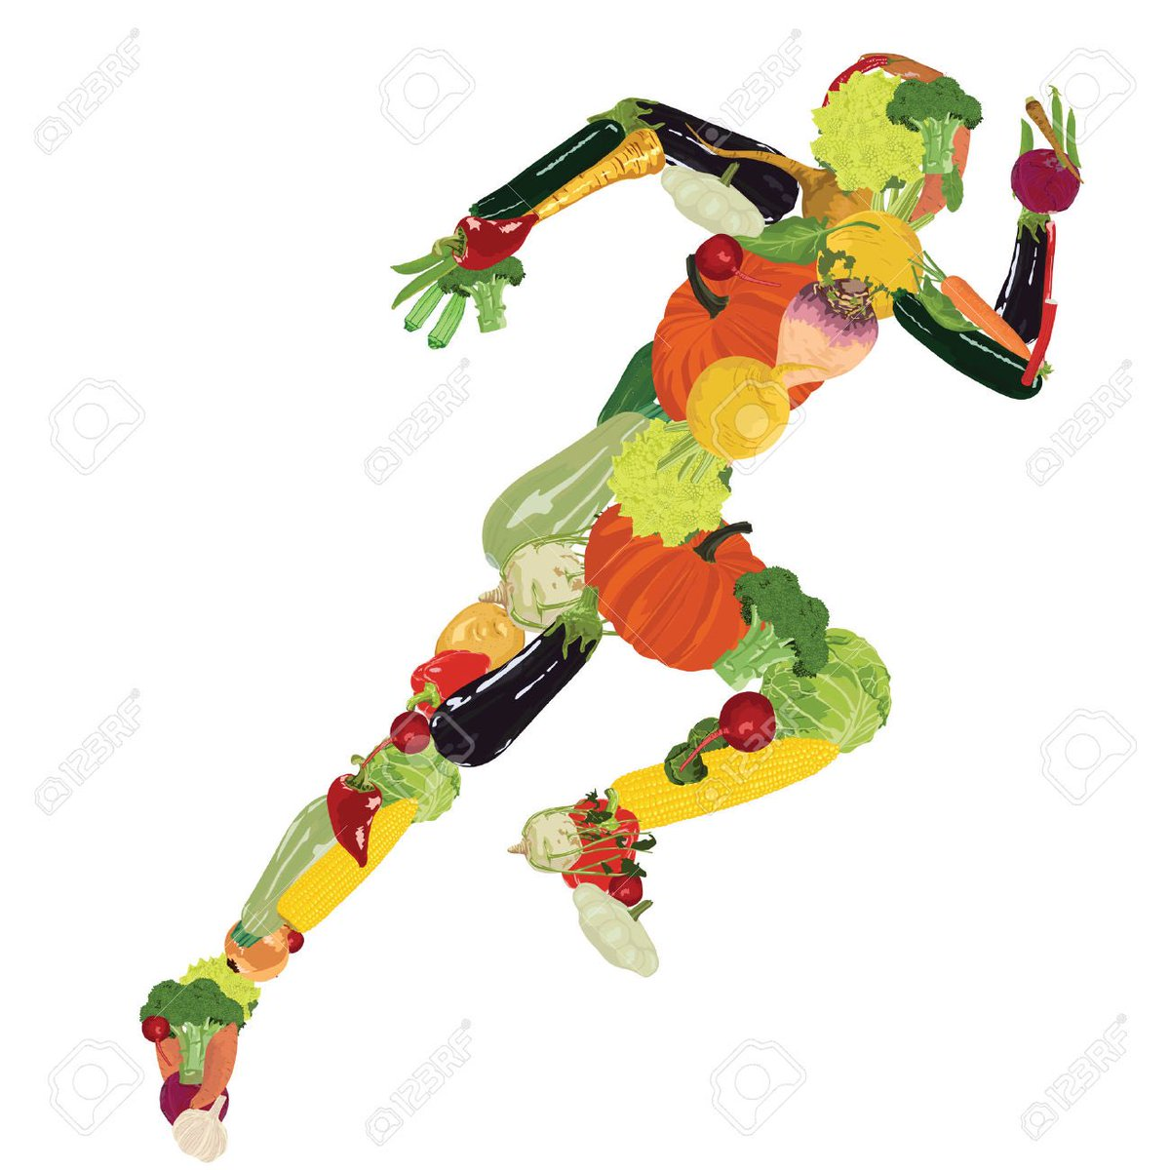
AMDR
Acceptable Macronutrient Distribution Ranges (AMDR)
Range of adequate intake of a macronutrient
associated with reduced risk of chronic diseases
If the diet is modified according to these percentages the individual will have lower risk to develop chronic diseases

Slide 10
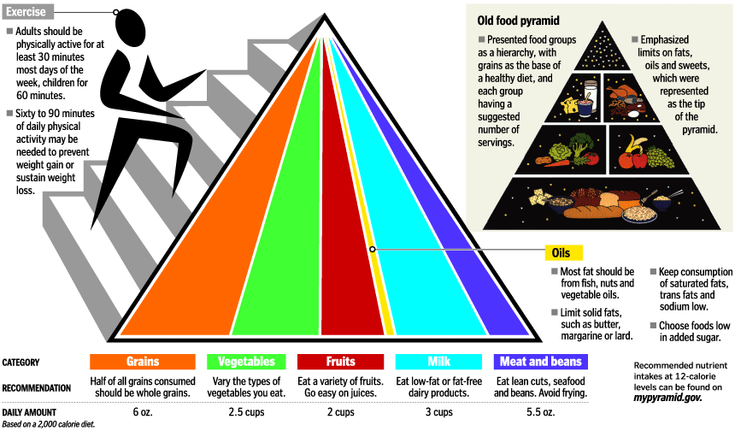
Food pyramid
Public educational tool established in 1992
Recommends size of daily servings
Pyramid shape
Fats, oils and sweets have small serving size
The pyramid now is 3 dimensional because they added exercises as another recommendation along with grains, fruits .. Etc.

Slide 11
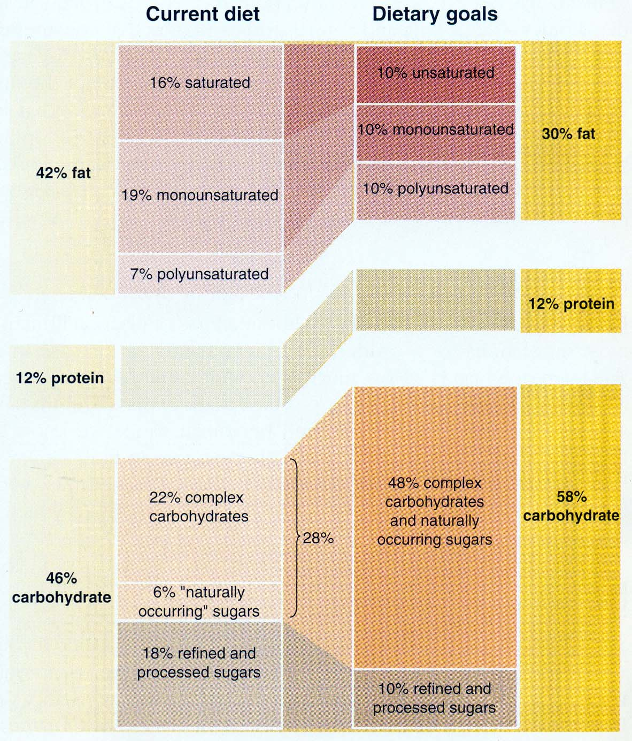
Dietary guidelines
Dietary Guidelines And Goals
Consume a variety of foods from the basic food groups
Control calorie intake to manage body weight
Be physically active everyday
Choose fats and CHOs wisely for good health
Increase daily intake of fruits, vegetables, whole grains, and non-fat or low-fat milk and milk products
Choose and prepare food with little salt
Choose unsaturated fats
This normal studies are modified in the right side of the chart regarding dietary goals

Slide 12
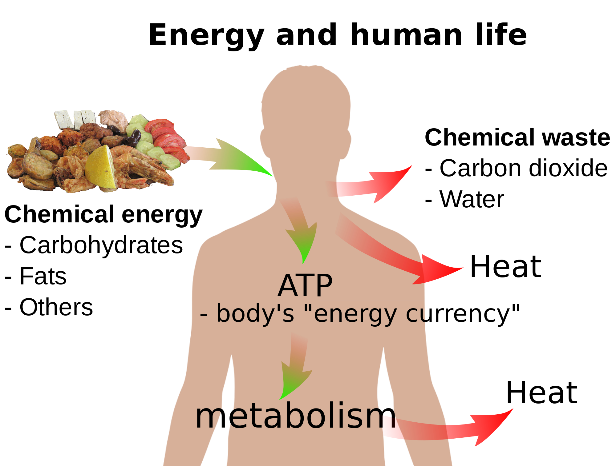
Protein-Energy Malnutrition
Energy Requirement In Humans
How do we calculate these calories:
We take different drips of food and burn them in a calorie meter and we measure how much heat is produced
The dietary energy intake required to maintain energy balance in a healthy individual
Energy balance is maintained by: calorie intake and energy expenditure
Energy content of food is measured in: calories or kilocalories (heat energy)
Avg. Energy Needs (kcal) | Weight (Kg) | Age | Sex
upto 2900 | 70 | 23–50 | Men
upto 2200 | 55 | 23–50 | Women
+300 | - | - | Pregnant
+500 | - | - | Lactating

Slide 13
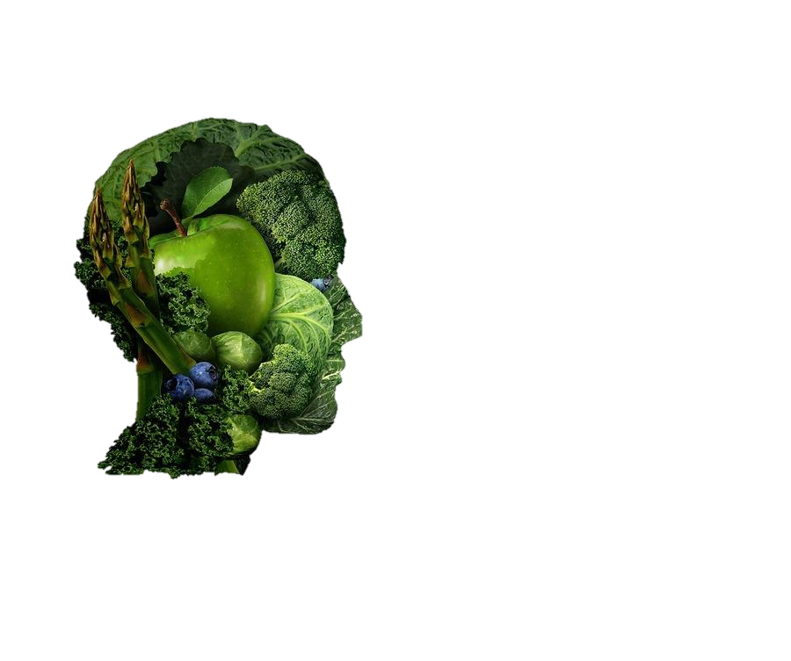
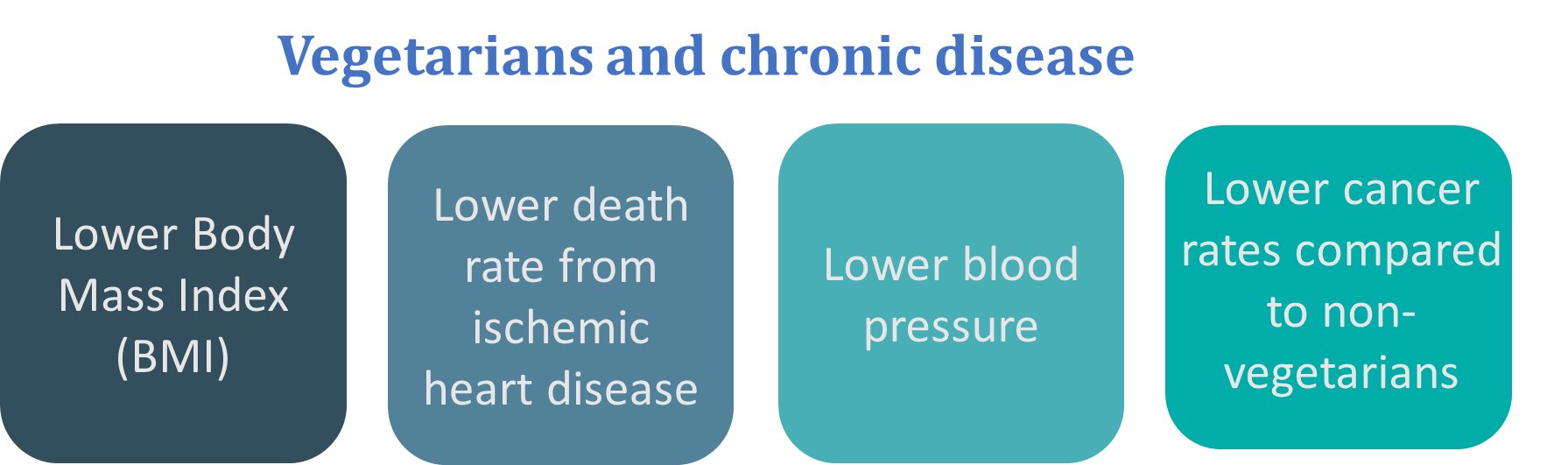
Vegetarians
Vegetarians and nutrient intake
Lower intake of iron, calcium and vitamin D
Long-term vegans may develop megaloblastic anemia due to vitamin B12 deficiency (B12 comes from animal sources )
Most consume enough protein
Lower in total dietary fat
The composition of nutrients that vegans are taking is slightly different thus they have some positive and some negative effects

Slide 14
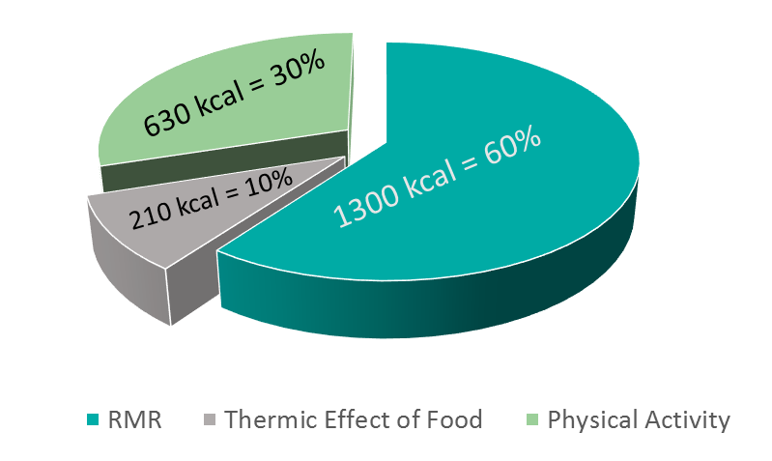
Energy expenditure
Basic Energy Expenditure Depends On :
Resting metabolic rate (RMR) :
Energy expense at rest
Required for : normal body function
Depends on : age, sex, growth, body surface area, fever, fasting, stress
Men: 1800 kcal
Women: 1300 kcal
Physical activity :
Sedentary person: 30-50% above RMR
Active person: 100% + above RMR
Thermic effect of food :
Heat produced by the body due to food digestion and absorption after eating
5-10% of total energy expenditure
When a person is only laying down doing nothing like sleeping.
Just because you’re alive you will consume energy for respiration, blood flow or maintaining the electrolyte balance AKA ( basic physiological cases that require energy )
Sedentary person: is moving and doing something, like walking to the kitchen, grapping the remote control he consumes 30 -50 % calories above the RMR

Slide 15
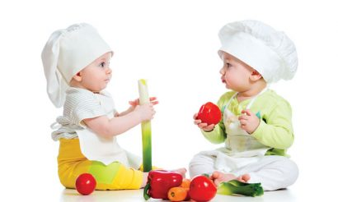
Total Parenteral Nutrition (TPN)
What is it ? A type of exogenous nutrition in which terminally-ill patients are provided with all essential nutrients intravenously Bypassing GI tract or through tube feeding ..
TPN is particularly indicated in severe inflammatory bowel disease, coma, cachexia ”Extreme muscle wasting” , prolonged ileus and extensive burns
Nutrients are pumped into a large central vein to allow rapid dilution of the solution (3 L / 24 hours)
Tube feeding is only provided to patients whose GI tract is intact and supports this type of nutrition
Enteral nutrition not TPN, which you can use only when the GIT is intact and working.
And they right “NPO” beside the name of the patient in the ward
NPO refer to: Nil per os, Latin for "nothing by mouth”
Glucose should be monitored each 6 hours

Slide 16
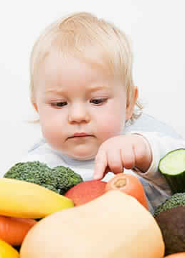
Total Parenteral Nutrition (TPN)
Standard composition of TPN feed 24 hours requirement
Energy content | 2000 kcal
Nitrogen | 12–14 g
Fat | 900 kcal
Glucose | 1000 kcal
Electrolytes, trace elements, vitamins | present
Volume | 3 liters
Individual nutritional requirement of patients may vary
Continuous biochemical, hematological and immunological monitoring of patient on TPN is required

Slide 17
Take home messages
Basic standards of nutritional requirements are important for malnutrition assessment
Establishing these standards is essential for a population in order to avoid disease and maintain good health
Committees of American and Canadian experts organized by the Food and Nutrition Board of National Academy of Sciences have established Dietary Reference intakes (DRIs).
The DRIs replace and expand on the recommended Dietary Allowances (RDA)

Slide 18
Summary

Slide 19
QUIZ
Q1 : Which one of the following standards of RDA we use due to insufficient data?
A- Estimated Average Requirement (EAR)
B- Recommended Dietary Allowance (RDA)
C- Adequate Intake (AI)
D- Tolerable Upper Intake Level (UL)
Q2 : Which of the following will identify asymptomatic dietary deficiency?
A- Dietary intake studies
B- Clinical symptoms
C- Biochemical studies
D- A+B
Q3 : What type of anemia vegans may develope?
A- Sideroblastic anemia
B- megaloblastic anemia
C- normocytic anemia
D- None of the above
Q4 : Energy balance of the body is maintained by?
A- Fats & Carbohydrates
B- Fiber & Proteins
C- Calorie intake & energy expenditure
D- None of them
Q5 : …… has no adverse health effects or toxicity in almost all individuals?
A- Estimated Average Requirement (EAR)
B- Recommended Dietary Allowance (RDA)
C- Adequate Intake (AI)
D- Tolerable Upper Intake Level (UL)
Q6 : Which of the following is considered as lower intake in vegans?
A- Iron
B- Calcium
C- Vitamin D
D- All of the above
1) C 2) C 3) B 4) C 5) D 6) D

Slide 20
QUIZ
Q7 : How the energy balance is maintained ?
By calorie intake and energy expenditure.
Q8 : Why body expenditure 1800 kcal while we are resting ?
Because the functioning body consumes energy (heart, brain and digestive system all are functioning and need energy)
Q9 : Determine three situations where total parenteral nutrition (TPN) is particularly indicated?
severe inflammatory bowel disease, coma, cachexia, prolonged ileus and extensive burns
Q10 : What are the four standards of DRIs ?
Estimated Average Requirement (EAR)
Recommended Dietary Allowance (RDA)
Adequate Intake (AI)
Tolerable Upper Intake Level (UL)
Suggestions and recommendations
1) C 2) C 3) B 4) C 5) D 6) D
1) C 2) C 3) B 4) C 5) D 6) D
1) C 2) C 3) B 4) C 5) D 6) D
1) C 2) C 3) B 4) C 5) D 6) D
1) C 2) C 3) B 4) C 5) D 6) D

Slide 21
Maha alghamdi
Mohannad alzahrani

Slide 22
Review the notes

