Slide 1
Biochemistry
When you choose hope every thing becomes possible
Macro and micro nutrients
Editing file

Slide 2
By the end of this lecture, the students should be able to know:
Understand the nutritional importance of dietary macro and micronutrients
Identify major dietary sources and RDAs of macro and micronutrients
Evaluate the nutritional quality of proteins, the types of dietary carbohydrates, fibers and fats and their benefits
Discuss the role of macronutrients in causing diseases or conditions such as nitrogen imbalance, diabetes, obesity, atherosclerosis and heart disease
Understand the functions of micronutrients and the diseases due to their deficiencies

Slide 3
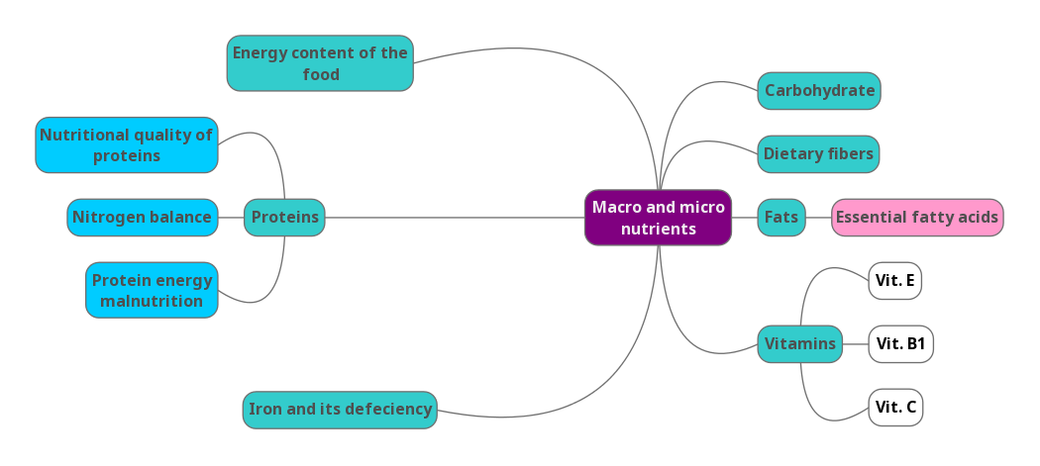
Lecture overview

Slide 4
Macronutrients & Micronutrients
Definitions :
1) Macronutrients: Nutrients needed by the body in large amounts (proteins, carbohydrates, fats)
They provide energy and building blocks for proteins, carbohydrates and fats that are stored.
2) Micronutrients: Nutrients needed by the body in small amounts (vitamins, minerals, trace elements) (Micro=small amounts)
Required for maintaining normal health and preventing various diseases
They do not provide energy
A lot of them work as coenzymes and cofactors supporting the biochemical reactions.
Energy Content of Food:
Calories
Body obtains energy as ATP
The energy content of food is measured in calories (Kilocalories)
One calorie is the heat required to raise the temperature of 1 gm. of water by 1ºC
Proteins → 4 kcal/gm
Carbohydrates → 4 kcal/gm
Fat → 9 kcal/gm
Colorimeter is the instrument used for measuring calories.
-Proteins are not easily digested so avoid taking them in large amounts.
-Carbohydrates are the best source of energy.
-Fats are the most concentrated form of energy, and they have harmful effect if you take them in large amounts.
What does ( 9 kcal/gm ) mean?
It means that if you burn 1 gm of fat, 9 kcal are produced.

Slide 5
Energy Content Of Food
Acceptable Macronutrient Distribution Range (ADMR)
Adequate intake of macronutrients to prevent the risk of disease.
AMDR for adults:
CHOs: 45-65%
Proteins: 10-35%
Fats: 20-35%
These percentages are how they should be distributed in your diet.
Death rate per 100,000 population due to imbalanced nutrition (main cause)
Unintentional injuries are caused by alcohol as well.
These rates show the effect of imbalanced diet, so it makes you at a high risk of heart diseases, cancer, stroke and diabetes.

Slide 6
1- Proteins
Nutritional Importance of Proteins:
Proteins supply amino acids and amino nitrogen for the body
Non-essential amino acids: body can synthesize
*Pneumonic: PVT TIM HALL
Essential amino acids: Body can’t synthesize, must be supplied in the diet. This is the most important benefit of proteins.
Phenylalanine
Valine
Tryptophan
Threonine
Isoleucine
Methionine
Histidine
Arginine
Lysine
Leucine
If you take too much proteins they won’t be stored as proteins and could be stored as fat.

Slide 7
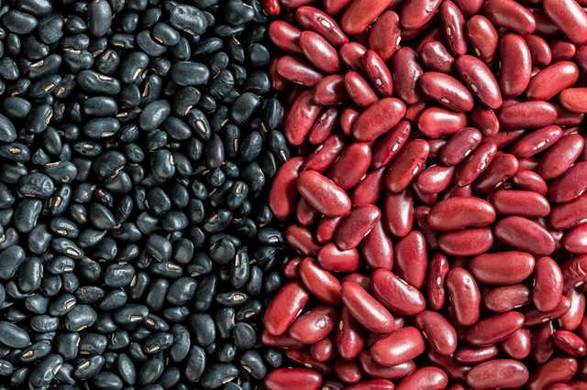
Nutritional Quality of Proteins:
What is it ?
A measure of a protein’s ability to provide the essential amino acids required for tissue maintenance.
Measured in PDCAAS units. (Digestibility-Corrected Amino Acid Scoring)
High value indicates more digestibility and high quality. (maximum score 1.0 > the more the number the higher the quality.)
Proteins from animal sources which is a very good protein : 0.82–1.0 (milk has score of 1)
Proteins from plant sources: 0.4
Sources and RDA:
Meat, poultry, fish, milk (have digestibility score of 1.0), wheat, corn, beans, nuts .
RDA (gms/kg body weight)
Normal adults: 0.8
Athletes: 1.0
Pregnancy / lactation: upto 30 gm
Children: 2.0 They need more because they’re growing up.
Don’t memorize the RDA numbers because they depend on the weight.
- Don’t go into details for PDCAAS measurement.
- A lot of proteins are not easily digested, so a good quality protein would be a protein that is easily digested and has the essential amino acids.
- You can have combinations of of plant sources in order to make it as good as animal sources.
For example: wheat is rich in methionine and poor in lysine, both are essential amino acids, on the other side, kidney beans are rich in lysine and poor in methionine, if you combine these two you’ll get better quality proteins.
EXTRA: black beans vs. kidney beans

Slide 8
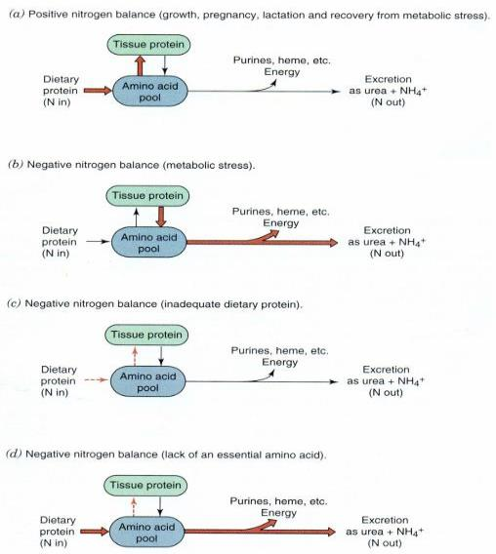
Nitrogen balance
Nitrogen Balance
Nitrogen balance = how much nitrogen going inside the body as proteins and how much nitrogen excreted (mainly as ammonia)
Normal Nitrogen Balance:
In a healthy person, the nitrogen intake is equal to nitrogen loss, but that doesn’t mean that proteins are taken and excreted equally.
Negative nitrogen balance:
When nitrogen loss is more than intake
Occurs in burns, trauma, illness, metabolic stress which cause an abnormal loss, or if proteins in diet are not sufficient.
Positive nitrogen balance:
When nitrogen intake is more than loss
Occurs in growth, pregnancy, lactation, recovery from illness. So you’re storing proteins.
Metabolic stress means increased catabolism.
In point d: proteins have less essential amino acids so they’re less qualified, so the excretion will be high because we don’t need these proteins.

Slide 9
Protein-Energy Malnutrition
What is it?
A condition or disease caused by not eating enough food or not eating a balanced diet.
Malnutrition due to inadequate intake of proteins or energy.
Two conditions:
1. Marasmus
2. Kwashiorkor
Both conditions affect young children and are caused by protein malnutrition.

Slide 10
Protein-Energy Malnutrition
 | Marasmus | Kwashiorkor
Cause | Inadequate intake of energy with adequate protein intake They start breaking down proteins (by using amino acids in gluconeogenesis) because they don’t have adequate source of energy. | Inadequate intake of proteins with adequate energy intake
Age and food intake | 1-3 year Mother’s milk is supplemented with food (cereals) deficient in calories | After weaning (at about 1 year) (few months to 1 year) Diet mainly contains CHOs They don’t get enough proteins from milk because their mothers stopped feeding them (sometimes because they’re poor) so they only get CHO rich food.
Symptoms | Arrested growth Extreme muscle wasting Weakness Weight loss No edema or changes in plasma proteins, because protein intake is enough. | Edema Distended abdomen Diarrhea Dermatitis / thin hair Enlarged fatty liver (due to excess of CHO) Low plasma albumin (because there isn’t proteins)

Slide 11
2- Carbohydrates
Their major role: energy production
RDA: 130 grams/day for adults and children
Types in the diet:
Simple CHOs: sucrose, fructose, lactose, corn syrup
Complex CHOs: whole grains, pasta, wheat, starch
CHO intake above RDA causes weight gain or obesity due to increased fat storage in adipose tissue. (CHO is turned into fat)
RDA = Recommended dietary allowance.
When the body isn’t getting enough carbs, it turns to proteins and breaks them down to get energy.

Slide 12
Dietary Fiber
What is it?
The component of food that cannot be broken down by human digestive enzymes
RDA (gm/day): Men: 38, Women: 25
How they lower LDL levels:
Bile salts are not normally excreted outside the body, they are produced for the digestion of lipids then get reabsorbed.
So dietary fibers bind to bile salts which are made of cholesterol, and excrete them out of the body, which leads to making new bile salts out of carbohydrates.
We have two types of fibers:
1) Soluble fibers: bind to bile salts, they can destroy carcinogens.
2) Insoluble fibers: help in motility and diarrhea.
Benefits
Lowers serum LDL levels
Reduces constipation
Promotes feeling of fullness
Slows gastric emptying (helpful in long-term glucose control in patients with diabetes mellitus)
Reduces exposure of gut to carcinogens

Slide 13
3- Fats
Fats in diet
A concentrated source of energy (9 kcals/gram)
Supply essential fatty acids such as linoleic and linolenic acids*
Provide phospholipids for membrane function
Source of fat-soluble vitamins (A, D, E, K) and help in their absorption
RDA (gm/day)
Total fats: 65 gm Saturated: 20 gm
Excessive fat intake can cause:
Atherosclerosis/heart disease
Obesity
*Which give rise to eicosanoids that provide thromboxane and prostaglandins > play a role in inflammation (they have cardio-protective function)

Slide 14
Essential Fatty Acids
Two essential fatty acids – unsaturated :
a-linolenic acid (w-3 fatty acid)*
linoleic acid (w-6 fatty acid)
Deficiency causes: scaly skin, dermatitis, reduced growth (most common in infants)
Used for eicosanoids synthesis which appear to have cardio-protective effects
decrease blood clotting
decrease blood pressure
*w = omega, w-3 = the first double bond is present in carbon number 3.

Slide 15
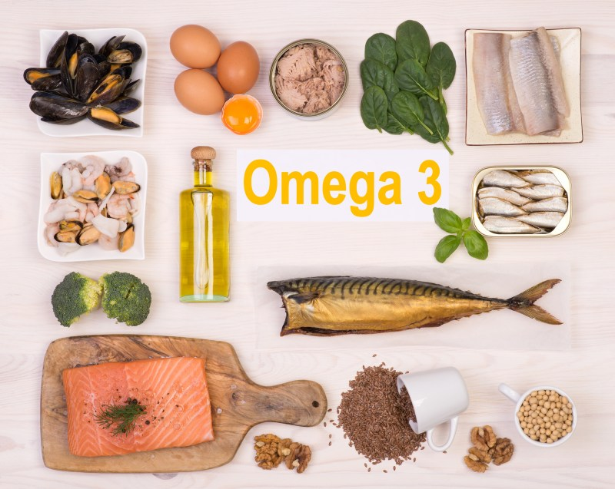
Essential Fatty Acids
Omega-3 Fatty Acids
Effects
Sources
Plants
Fish oil containing docosahexaenoic acid (DHA) and eicosapentaenoic acid (EPA)
Play an important role as:
Structural membrane lipids
Modulator of w-6 fatty acid metabolism
Suppress cardiac arrhythmias
↓ Serum triacylglycerol
↓ Tendency to thrombosis
Lower blood pressure
↓ Risk of cardiovascular mortality
Little effect on LDL or HDL levels

Slide 16
Recommendations for Omega-3 Fatty Acid Intake
By American Heart Association Guidelines
1. Patients without coronary heart disease (CHD) but are at risk of developing it
Fatty fish twice a week
Include oils and foods rich in a-linolenic acid (flaxseed, canola and soybean oils; flaxseed and walnuts)
2. Patients with Chronic Heart Disease
1 gm of EPA+DHA per day from fatty fish
EPA+DHA supplements
CHD = Coronary heart diseases.
EPA = Ecosapentaenoic acid.
DHA = Docosahexaeonic acid.
3. Patients who need to lower triglycerides (fats) and have CHD
2 to 4 grams of EPA+DHA per day

Slide 17
Essential Fatty Acids
Omega-6 Fatty Acids
Trans Fatty Acids
Sources
Nuts
Avocados
Olives
Soybeans
Oils (sesame, cottonseed, corn oil)
Effects
↓ Plasma cholesterol
↓ LDL
↓ HDL , considered as a negative effect, but it can be compensated.
What is it?
Unsaturated fatty acids, behaving more like saturated fatty acids in the body.
increase serum LDL (but not HDL)
risk of CVD
Not found in plants (animals only)
Formed during hydrogenation of liquid vegetable oils
Found in baked food: cookies, cakes, deep-fried foods
They are harmful, much easier to be oxidized and cause thrombosis.

Slide 18
1- Vitamins
Classified Based on Solubility
Organic compounds present in small quantities in different types of food
Help in various biochemical processes in cell
Important for growth and good health
Essential
Noncaloric
Required in very small amounts,
so they are micronutrients.
Fat-soluble vitamins
Water-soluble vitamins
A,D,E and K
ascorbic acid (vitamin C)
thiamin (vitamin B1)
riboflavin (vitamin B2)
Niacin (Vitamin B3)
pyridoxine (vitamin B6)
biotin
pantothenic acid
folate
cobalamin (vitamin B12)
Mnemonic: KADE (Name of a girl)

Slide 19
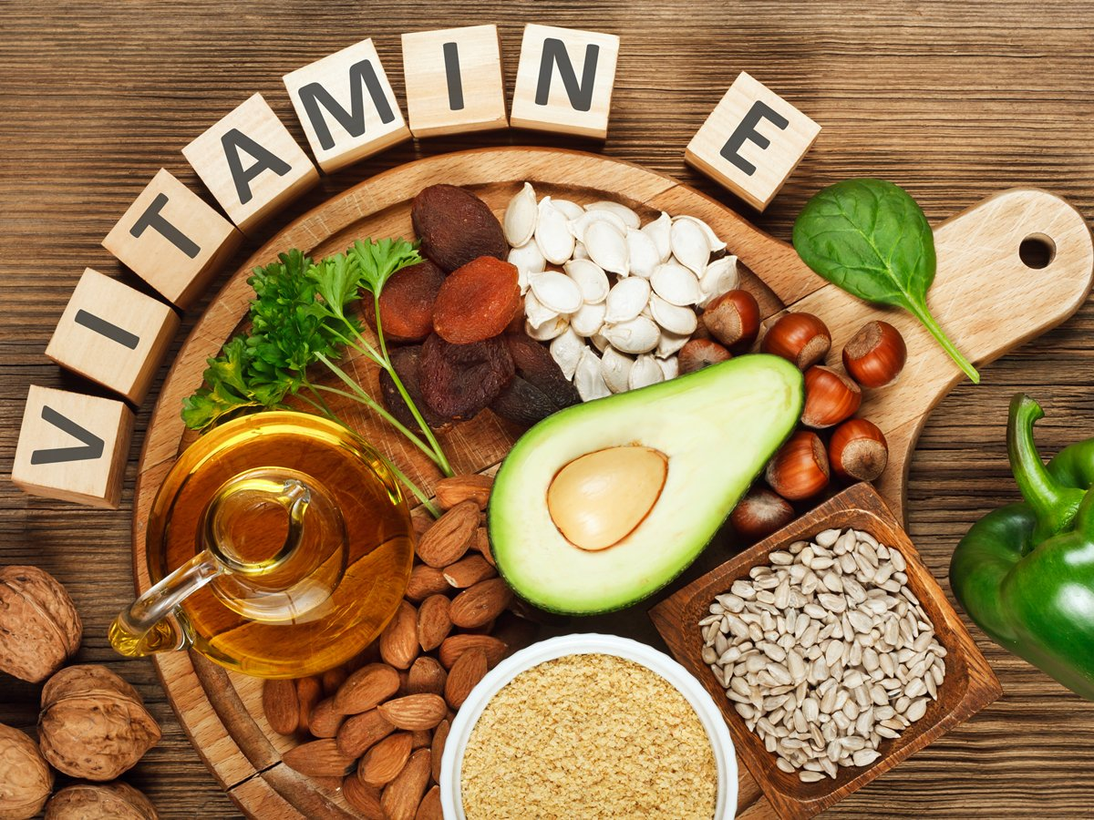
Vitamin E
Antioxidant: prevents oxidation of cell components by molecular oxygen and free radicals
May have a role in fertility and anti-aging effect
a-Tocopherol is the most active form in the body
Sources and RDA (mg/day):
Vegetable Oil, nuts, seeds, vegetables
Adults: 15 mg , Children: 7mg
Deficiency: (mostly observed in premature infants)
Defective lipid absorption
Anemia due to oxidative damage to RBCs.
Neurological problems
Male infertility

Slide 20
Functions of Vitamin B1 (Thiamin)
Active form:
Thiamin pyrophosphate (TPP)
Coenzyme for transketolase (in HMP pathway) and oxidative decarboxylation reactions
In thiamin deficiency, the activity of these two dehydrogenases is decreased Causing : Low ATP production and defective cellular function
Sources and RDA (mg/day)
Plants, cereals, meat
Adults: 1.2mg , Children: 0.6 mg
Disorders of Vitamin B1 (Thiamin) Deficiency
Beriberi : A type of chronic peripheral neuritis due to severe thiamin deficiency causes weakness, neuropathy, disorderly thinking, paralysis
Thiamin has a role in nerve conduction
Neuropathy affects glial cells (astrocytes) of the brain and spinal cord causing neuron death
2. Wernicke-Korsakoff syndrome
Common in alcoholics* due to defective intestinal absorption of thiamin or dietary insufficiency
Causes apathy, loss of memory
*Because alcoholics don’t absorb vitamins properly.

Slide 21
Vitamin C
Functions :
Sources and RDA (mg/day):
Citrus fruits, tomatoes, melon, peppers
Men: 90 mg , Women: 75 mg , Children: 15-25 mg
Powerful antioxidant (prevents some cancers)
Stimulates phagocytic action of leukocytes***
Increases iron absorption**
Helps in dentine, intercellular matrix and collagen formation*
Reduces risk of cataract formation
Promotes wound healing
Helps in the maturation of RBCs
Disorders of Vitamin C Deficiency
Scurvy
Abnormal collagen production
Gums become painful, swollen and spongy
The pulp is separated and the teeth are lost
*So it’s the ground substance.
**That’s why it’s recommended when a person is on iron supplementation (specially as orange juice.
***Increases immunity.

Slide 22
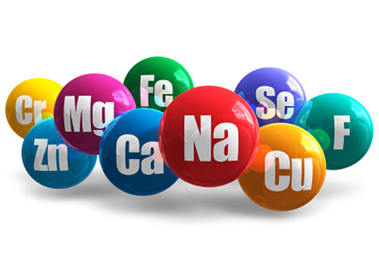
2,3- Minerals and Trace Elements
Macro minerals :
(More than100 mg/day)
Calcium
Phosphorous
Sodium
Potassium
Chloride
Magnesium
Micro minerals :
(Less than100 mg/day)
Iron
Iodine
Copper
Manganese
Zinc
Cobalt
Molybdenum
Selenium
Fluoride
Chromium
Silicon

Slide 23
Iron
Functions:
Oxygen transport and metabolism
Part of hemoglobin, myoglobin, cytochromes
Body stores iron as ferritin, hemosiderin and transferrin
Adult women have much lower iron storage than men
Sources and RDA (mg/day):
Heme iron: Animal products (meat, liver), 25% absorption
Non-heme iron: Plants (spinach, beans) 5% absorption
Men: 8 mg , Women: 18 mg , Children: 7-15 mg
Iron Deficiency:
Iron deficiency anemia is most common
Growing children, pregnant, lactating and menstruating women need more iron
Hemosiderosis (iron overload disorder)
Due to iron excess (toxicity)
Hemosiderin (Iron stored in complex with ferritin protein in liver and spleen)
Occurs in persons receiving repeated blood transfusions
Hemosiderin: a complex of ferritin.
Transferrin: a transporter.
Iron overload disorder is caused by multiple transfusions of blood.

Slide 24
Take home messages
Macro and micronutrients are essential for energy and maintaining good health
Various diseases are associated either with malnutrition or excessive intake of these nutrients

Slide 25
QUIZ
Q1 : Which of the following is a protein source ?
A- Milk
B- Fish
C- Carrot
D- Both A & B
Q2 : Omega-3 fatty acid is mainly found in ?
A- Ocean fish
B- Insects
C- Hot water
D- Both A & B
Q3 : Vitamins are ?
A- Caloric
B- Required daily with large amounts
C- Essential
D- Both B & C
Q4 : Wernicke-Korsakoff syndrome is due to deficiency in which of the following enzymes ?
A- Vitamin B12
B- Vitamin C
C- Vitamin A
D- Vitamin B1
Q5 : Iron is considered as ?
A- Micromineral
B- Macromineral
C- Semi-macromineral
D- Non of the above
Q6 : Iron deficiency anemia is common in ?
A- Breastfeeding women
B- Pregnant women
C- Adults
D- Newborns

Slide 26
QUIZ
Q7 : Mention two conditions associated with inadequate protein intake ?
Marasmus
Kwashiorkor
Q8 : Mention three functions of Vitamin C ?
Increases iron absorption
Powerful antioxidant (prevents some cancers)
Promotes wound healing
Q9 : Mention two benefits of dietary fibers ?
Lowers serum LDL levels
Reduces constipation
Promotes feeling of fullness
Slows gastric emptying (long-term glucose control in patients with diabetes mellitus)
Reduces exposure of gut to carcinogens
Suggestions and recommendations
1) D 2) A 3) A 4) D 5) A 6) B

Slide 27
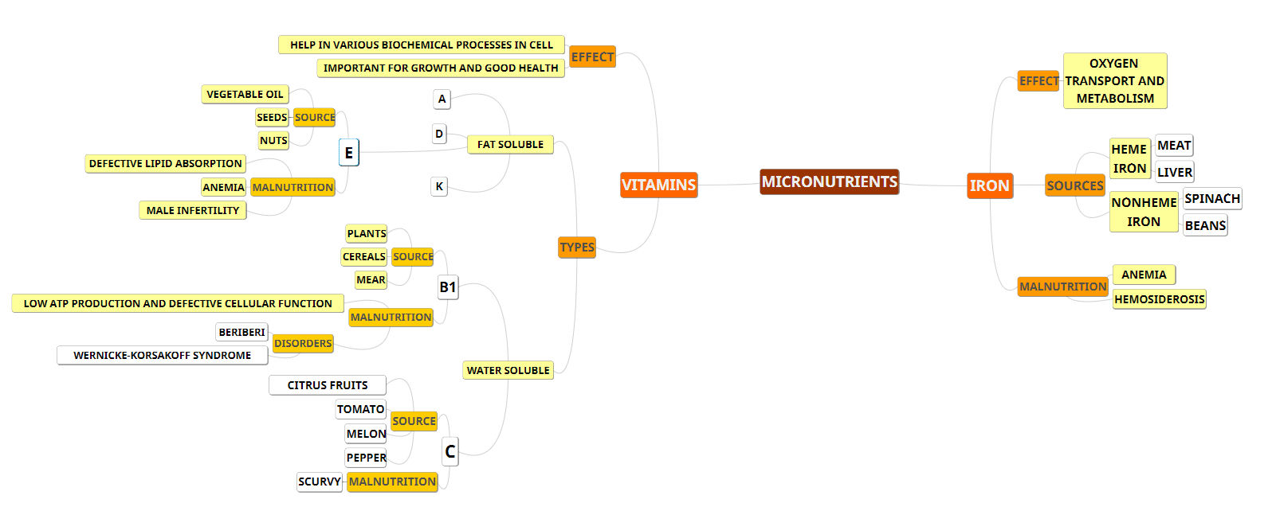
SUMMARY

Slide 28
SUMMARY

Slide 29
Naser abu-dujain
Abdulrahman alrashed
Heba Alnasser
Rana barasain

Slide 30
Review the notes

