Slide 1

Biochemistry
Don’t limit your challenges ..
Challenge your limits
Vitamin K
Editing file

Slide 2
By the end of this lecture, the Second Year students will be able to:
Identify the types and sources of vitamin K
Understand the role of vitamin K in blood coagulation
Recognize the importance of g-carboxylation of glutamic acid in coagulation proteins
Understand the role of anticoagulant drugs in affecting vitamin K function
Discuss the causes and disorders of vitamin K deficiency

Slide 3
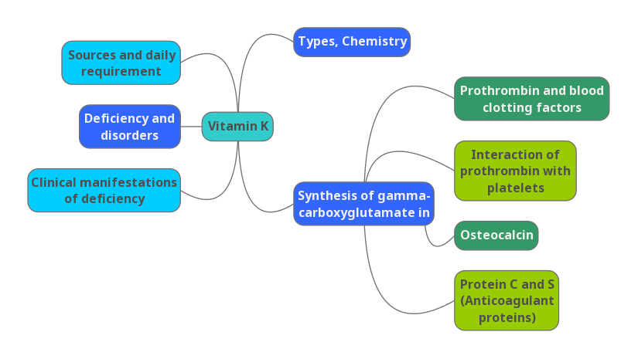
Lecture overview

Slide 4
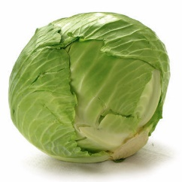
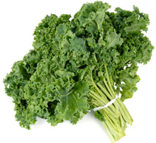
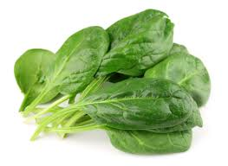
Types and sources
Occurs in several forms
Dietary sources
Chemistry
Cabbage, kale, spinach, egg yolk, liver
Vitamin K₁ (Phylloquinone)
Cabbage
Kale
Spinach
Vitamin K₂ (Menaquinone)
Menadione doesn’t have chains like vit. K1 and k2 , hence it’s water soluble to be supplementary type . So, when we take it we can add the chain in our bodies .
Vitamin K₃ (Menadione) – synthetic form

Slide 5
Sources of Vitamin K
Sources
Phylloquinone
Menaquinone
Menadione
Green leafy vegetables
Plant source
Intestinal bacteria
Intestinal bacterial synthesis meets the daily requirement of vitamin K even without dietary supplement
synthetic form .
precursor of menaquinone
It plays a role in photosynthesis in plants which differs from its role in animals

Slide 6
RDA for Vitamin K (micro g/day)
RDA
Infant (0-1 year): 2-2.5
Children (1-8): 30-55
Men (19+): 120
Women (19+): 90
Pregnancy / lactation: 90 / 90
UL: Not established
Upper limit is not established because toxicity is rare , although it might happens and it’s mentioned at the end of this lecture ..
___________________________
Note that pregnancy and lactation does not affect the RDA of vitamin K

Slide 7
Functions of Vitamin K:
Coenzyme for the synthesis of prothrombin and blood clotting factors in the liver
  Prothrombin and clotting factors are protein in nature
  Synthesis of prothrombin, clotting factors II, VII, IX, X require carboxylation of their glutamic acid (Glu) residue
  Mature prothrombin and clotting factors contain γ-carboxyglutamate (Gla) after carboxylation reaction
  Vitamin K is essential for the carboxylase enzyme involved
  Dihydroquinone form of vitamin K is essential for this reaction
When clotting factors which are proteins are synthesized in the liver they are not active yet .. They have to be activated by carboxylation and the carboxylation step needs vit K as a co-factor to complete it
The carboxylation happens at glutamic acid residues since its one of the amino acids the already have carboxylic acid side chain .. So the other COO- is added during the interaction that is mediated by carboxylase enzyme and that is required for activation of clotting factors

Slide 8
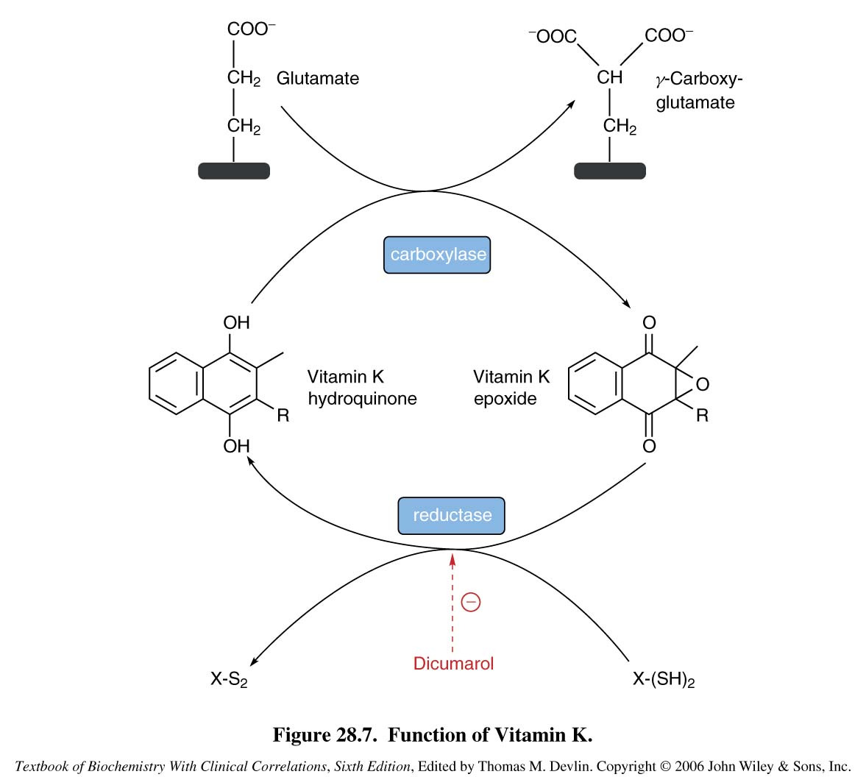
Glutamic residue
1
3
Vit K work as a co-factor for carboxylase converts no.1 into no.3
2
6: If Vit K is in it’s epoxide form and can’t get back to it’s dihydroquinone form(4) that leads to decrease clotting factors and increase prothrombin time
Adds carboxylic acid group
4
6
Active form
Of Vit K
Quinone form “epoxide” is not active so even vit K needs to get activated by being reduced again into dihydroquinone “active form” with the help of the enzyme reductase
5
هنا مجرد شرح لاشكال فيتامين K الاكتيف والان اكتيف والانزيمات التي ستساعد على تحويل كل منهم وما سيؤدي اليه نقصهم
Block the activation of Vit K
Warfarin -competitive inhibitors of reductase - .
Carboxylase enzyme is also called epoxidase since it turn vit k to epoxide form

Slide 9
Analogs of Vitamin K
Anticoagulant drugs: warfarin and dicoumarol
  Structural analogs of vitamin K
They inhibit the activation of vitamin K to hydorquinone form (inhibiting the reductase enzyme)
Prothrombin and clotting factors are not carboxylated
Hence blood coagulation time increases upon injury (Increasing the coagulation time)
Here vit K can’t get back to it’s Dihydroquinone form and that leads to decrease clotting factors and increase prothrombin time
So they work at the reduction step ..
___________________________
Actually the reduction of epoxide form occurs by two steps but we only mentioned the one that can be inhibited by warfarin dicumarol .. Hence if warfarin overdose is administered that will block only one pathway so if we want to reverse the action we need to give high doses of vit K to let the other pathway work and complete the cycle ..

Slide 10
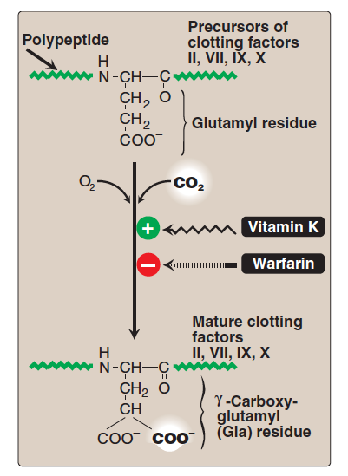
Glutamate
Carboxylation of glutamate requires vitamin K
The process is inhibited by warfarin
This diagram shows that he process of converting glutamic acid residue into gamma-carboxy-glutamate needs oxygen, carbon dioxide and vit k while it get inhibited by warfarin as mentioned before

Slide 11
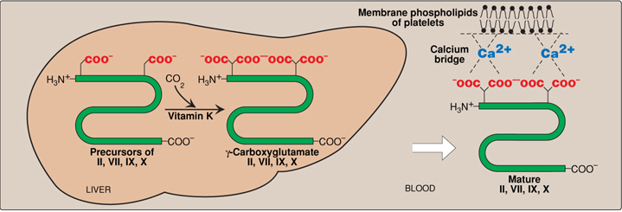
Functions of vitamin K
Prothrombin – platelet interaction
Prothrombin – platelet interaction
Carboxylated prothrombin contains two carboxylate groups (COO–)
These groups bind to Ca2+ forming prothrombin-calcium complex
The complex then binds to phosholipids (Making a bridge) on the surface of platelets (important for blood clotting)
Converting prothrombin to thrombin and initiating clot formation
نفس السايكل اللي بالصورة اللي بالسلايد اللي قبل .. فيتامين كي رح يشتغل كوفاكتور ويحول القلوتاميت لقاما كاربوكسي قلوتاميت (بروثرومبين) في الكبد الفرق ان هنا بعد ما تصير هذي السايكل المعتادة راح يطلع المركب الناتج للدم ويسوي جسر مع الكالسيوم باستخدام الكاربوكسيليك اسيدز اللي عنده ويسوون كومبليكس موجب الشحنة بسبب الكالسيوم بعدها بيرتبطون مع الدهون اللي موجودة على سطح البليتليتس (سالبة الشحنة) عشان يحصل التخثر
Prothrombin > Thrombin > Clot formation

Slide 12
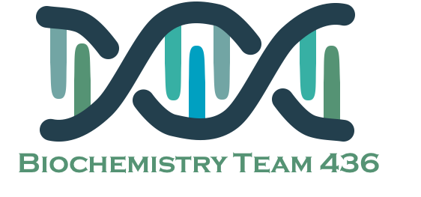
Functions of vitamin K
Synthesis of γ-carboxyglutamate in osteocalcin
Osteocalcin is a bone turnover protein
Also called Bone Gla Protein (BGP)
Involved in bone formation, mineralization and resorption
γ-Carboxyglutamate is required for osteocalcin binding to hydroxyapatite (a calcium mineral) in the bone
The binding mechanism is similar to that of prothrombin-platelet binding
Osteocalcin is another protein that needs similar way of carboxylation and it’s the major non-collagenous protein incorporated in bone matrix during bone formation
Exact function is unknown but people who have less amounts of carboxylated osteocalcin are more prone to develop bone fractures

Slide 13
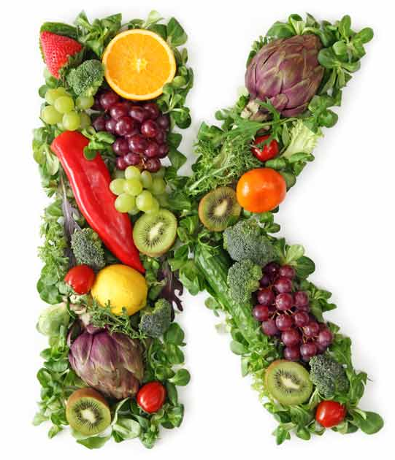
Deficiency of Vitamin K
Deficiencies are rare: it is synthesized by intestinal bacteria
Prolonged antibiotic therapy
Especially in marginally malnourished individuals (eg debilitated geriatric patients)
Hypoprothrombinemia: increased blood coagulation time
Some second-generation cephalosporin drugs cause this condition due to warfarin-like effects (antibiotics given with vit. K)
May affect bone growth and mineralization
Lipid malabsorption can lead to vitamin K deficiency
Because absorption of dietary vitamin K from your small intestine depends on normal fat digestion

Slide 14
Deficiency of Vitamin K
Gastrointestinal infections with diarrhea
Both of the above destroy the bacterial flora leading to vitamin K deficiency
New borns are more susceptible to develop deficiencies because their intestine are sterile with no vit k producing bacteria
Some times that is regulated by giving intramuscular vit k injections
Deficiency most common in newborn infants
Newborns lack intestinal flora
Human milk can provide only 1/5th vitamin K
Supplements are given intramuscularly at birth

Slide 15
Deficiency manifestation and toxicity
Toxicity
Manifestations
Hemorrhagic disease of the newborn
Bruising tendency, ecchymotic patches (bleeding underneath the skin) Purple patches under the skin
Mucus membrane hemorrhage
Post-traumatic bleeding / internal bleeding
Prolonged prothrombin time
And also their bones get fractured easier than normal people “osteocalcin”
Prolonged supplementation of large doses of menadione can cause:
It is occasionally used as a nutritional supplement because of its vitamin K activity.)
Hemolytic anemia
Jaundice
Due to toxic effects on RBC membrane

Slide 16
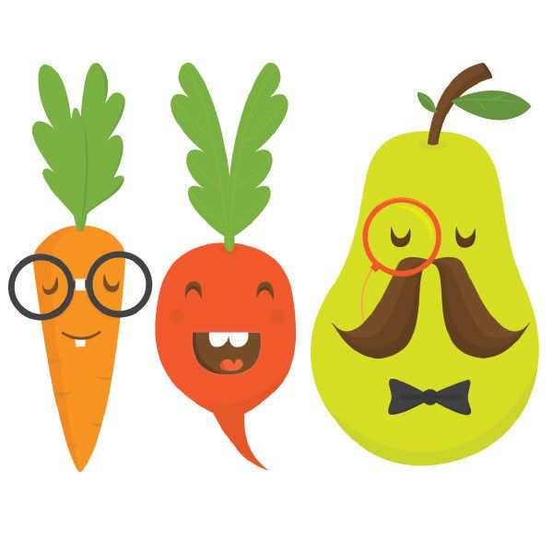
Take home messages
Vitamin K is essential for blood coagulation process
It mediates the process by γ-carboxylation of glutamic acid residues of prothrombin and coagulation factors

Slide 17
Summary:

Slide 18
QUIZ
Q1 : What factors of Vit K are pro-coagulants ?
I , II & X
II , VII, IX, & X
IX , V & X
None of the above
Q2 : Which ONE of the following is synthetic form of Vit k ?
Menaquinone
Menadione
Phylloquinone
Dihydroquinone
Q3 : All factors and proteins in blood clotting are synthesized in ?
Pancreas
Kidney
Liver
Spleen
Q4 : The form of vitamin K that is required for activation of clotting factors is ?
Menaquinone
Menadione
Phylloquinone
Hydroquinone
Q5 : Vitamin K is synthesized in the body by ?
Kidney
Liver
Spleen
Intestinal bacteria
Q6 : What group of people need additional Vitamin K ?
Premature newborns
People with bile production abnormalities
Patients with urinary tract infections
Both A and B

Slide 19
QUIZ
Q7 : Mention the dietary sources of Vitamin K ?
Cabbage, kale, spinach, egg yolk, liver
Q8 : Mention two conditions in which an individual is more prone to be Vitamin K deficient ?
Newborns, prolonged use of antibiotics
Q9 : Describe briefly the biological action of Vitamin K ?
Carboxylation of non-mature clotting factors into mature, functional ones.
Q10 : A patient came with liver cirrhosis and they noticed an increase in prothrombin time. As a prognosis do you suspect the patient to have Vitamin K deficiency and why ?
No, in liver diseases there is an increased prothrombin time
due to deﬁcient synthesis of coagulation factors. Further, vitamin K fails to restore Prothrombin time when administered.
Suggestions and recommendations
1) B 2) B 3) C 4) D 5) D 6) D

Slide 20
Saleh altwaijri
Maha alghamdi
Haneen alsubki
Rana Barsain

Slide 21
Review the notes

