Slide 1

Biochemistry
Work hard in silence, let your success be your noise
Liver Function Tests (LFTs)
Editing file

Slide 2
Upon completion of this lecture, the students should be able to:
Understand the major metabolic functions of the liver and causes of liver dysfunction.
Discuss markers of liver function tests such as liver enzymes, bilirubin, albumin and prothrombin time that can diagnose hepatic injury and assess hepatic function.
you don't have to memorize any number.
Just the numbers that we tell you to memorize
This video is recommended by Dr. sumbul

Slide 3
Information that Dr. Sumbul recalled at the beginning of the lecture:
-The liver is an important organ, everything we take in the body has to go through the liver .
whether we’re eating food (no need)
-Functions of the liver:
1-detoxification, which clears the ammonia from the blood and converts it into urea (less toxic) . Also bilirubin + cholesterol + drugs are all cleared out through the liver.
2-Synthesis of the majority of plasma proteins, some enzymes, bile (which helps in digestion) ,and cholesterol (which is a parent molecule for all the steroids in the body).
3-Storage of fat soluble vitamins such as vitamin A,K,D and E
-so anything that causes damage to the liver by any disease that associated with it assess that we do the liver function test ,so the major metabolic functions of the liver for ex plasma protein albumin + cholesterol + triglycerides.
-which lipoprotein synthesized in the liver ? VLDL, so the triglycerides is carried to the liver and then the liver transport it to the rest of the tissues as VLDL

Slide 4
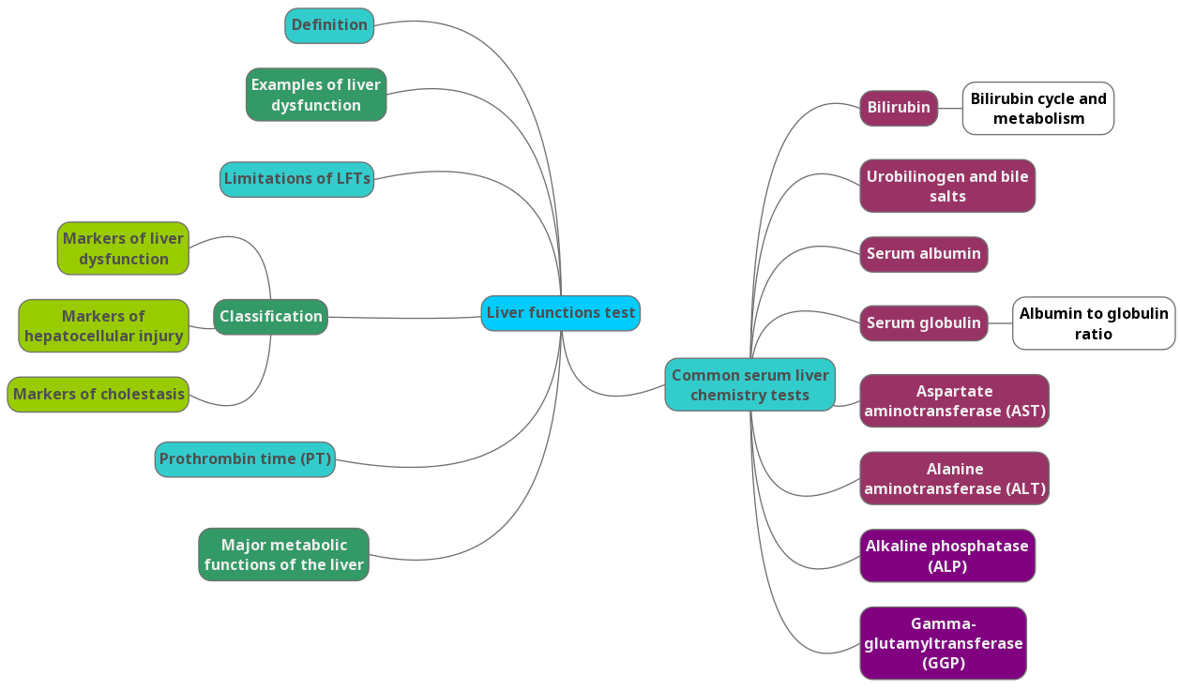
Lecture Overview

Slide 5
Major Metabolic Functions of the Liver
Major Metabolic Functions of the Liver
Synthetic Function
Detoxification and excretion
Storage Function
Production of bile salts
Plasma proteins (albumin, globulins), cholesterol, triglycerides and lipoproteins (VLDL)
Ammonia to urea (urea cycle), bilirubin, cholesterol, drug metabolites
Vitamins A, D, E, K and B₁₂
Helps in digestion

Slide 6
Some example of liver dysfunction
Hepatocellular disease
Cholestasis (obstruction of bile flow)
Cirrhosis
Steatosis (fatty liver)
quite common in a lot of people
Hepatitis
Jaundice
Liver cancer

Slide 7
Some example of liver dysfunction:
Genetic Disorders :
Hemochromatosis (iron storage disease)
To differentiate between hemochromatosis and hemosiderosis
Disease | Hemochromatosis | Hemosiderosis
Etiology: | Genetic | Repeated blood transfusion
Cause: | Due to iron overload disorders
Mechanism: | Iron gets stored in the organ and it’s toxic to the organ majority stored in the liver
Complications: | Causes damage to the liver and other thing
Storage: | Hemochromatosis storage or the accumulation of the iron is happening in the liver. | Iron ( hemosiderin) is stored in macrophages.

Slide 8
Liver Function Tests (LFTs)
We have to check a list of tests to detect a liver disease and we will discuss the major ones.
Noninvasive methods for screening of liver dysfunction
Help in identifying general types of disorder
Assess severity and allow prediction of outcome
Disease and treatment follow up
The good thing is that there are non invasive and invasive so, baiscally it’s not a liver function test it’s liver dysfunction test (don’t think this is necessary)
We are basically testing and screening for liver dysfunction.
Broadly classified as :
Tests to detect hepatic injury: (affecting structure)
  Mild or severe; acute or chronic
  Nature of liver injury (hepatocellular or cholestasis)
Tests to assess hepatic function (affecting function)
what are the indications for doing a liver function test?
1-When there are symptoms like (Jaundice or abdominal pain or anorexia or nausea and vomiting)
2-If a person is on drugs which cause liver toxicity or if you want to start a treatment and you want to make sure that the patient's liver is healthy or not ( so by knowing that you can change the treatment or modify the dose) .
3- Alcoholism

Slide 9
Classification
Classification of LFTs:
Group I: Markers of liver dysfunction
Group II: Markers of hepatocellular injury
Group III: Markers of cholestasis

Slide 10
Classification
Group I: Markers of liver dysfunction
  Serum bilirubin: total and conjugated
  Urine: bile salts and urobilinogen
  Total protein, serum albumin and albumin/globulin ratio
  Prothrombin Time
Group II: Markers of hepatocellular injury
(at the level of the cells) conditions that cause damage to hepatocytes .
  Alanine aminotransferase (ALT)
  Aspartate aminotransferase (AST)
Group III: Markers of cholestasis
markers of obstruction
  Alkaline phosphatase (ALP)
  γ-glutamyltransferase (GGT)

Slide 11
Limitations of LFTs
Limitations of LFTs
Normal LFT values do not always indicate absence of liver disease
Asymptomatic people may have abnormal LFT results
Liver a has very large reserve capacity *
Diagnosis should be based on clinical examination
There are some limitations because non of the markers are perfect and can tell you exactly what is wrong with the liver. That’s why we have more the one marker
Liver is a big organ so a lot of times if the cell injury wasn’t severe (even if we choose more than one marker) we may not see a difference in the levels of the markers. Unless the injury has gone for a long time or the injury is really severe . (because the liver is a large organ that compensates ).
* There could be something wrong in the liver but it may not reflect on the values.

Slide 12
Common serum liver chemistry tests

Slide 13
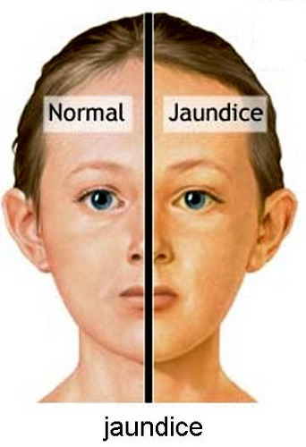
Bilirubin
Bilirubin
A byproduct of red blood cell (hemoglobin) breakdown
It is the yellowish pigment observed in jaundice in sclera, skin and mucous
High bilirubin levels are observed in:
Gallstones, acute and chronic hepatitis

Slide 14
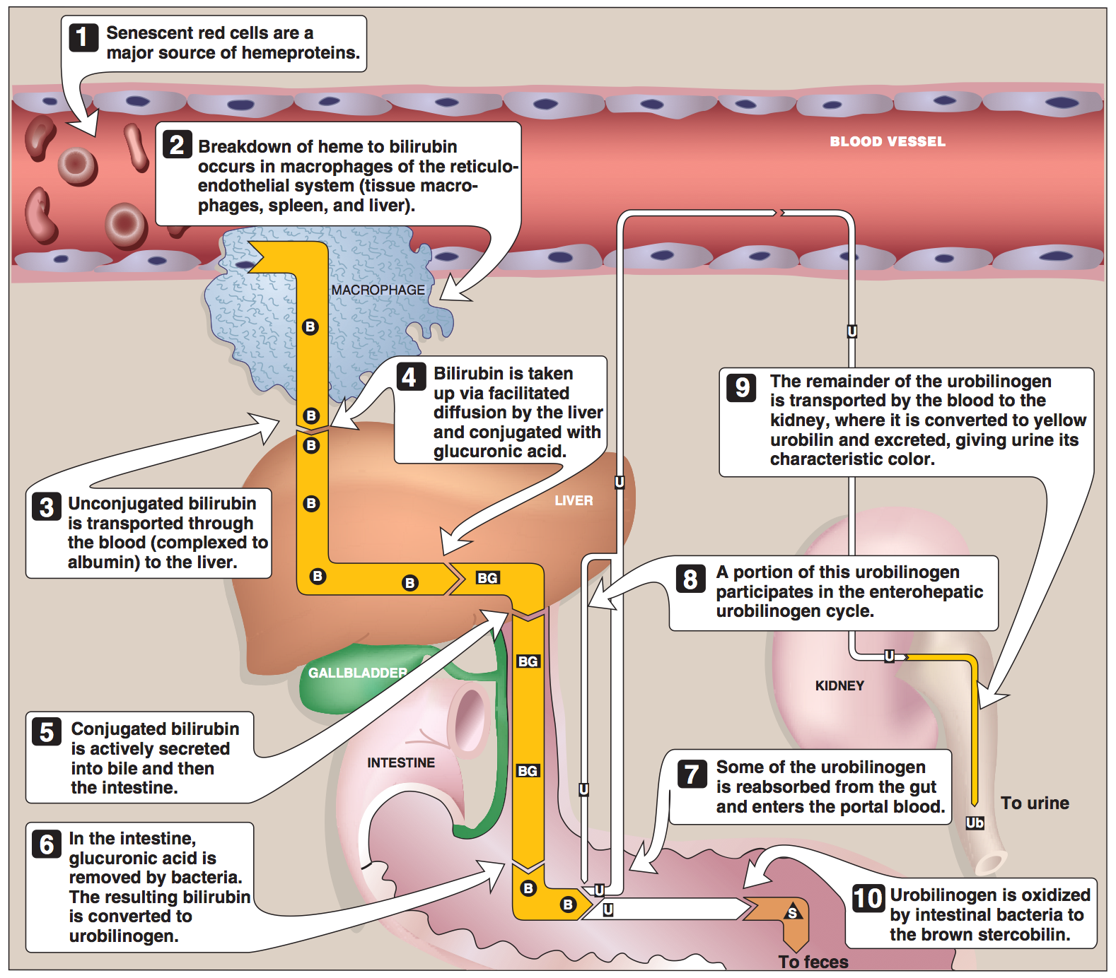
Bilirubin cycle
-The life span of RBC’S is 120 days. The RBC’S keeps on dying in the system and are cleared up by the macrophages (of RES) in the spleen and the liver ,so these macrophages produce bilirubin as byproduct.
-The bilirubin is not soluble it requires a lot of water or fluids to be soluble so it has to go to the liver to become soluble. From the macrophages it goes to the liver as a complex with albumin
- Albumin carries the bilirubin to the liver and once it goes to the liver, the hepatocytes take it in with the help of ……ligandin ……..( it facilitate the transport of bilirubin inside the hepatocyte). Once inside the hepatocyte they are conjugated with a carbohydrate called glucuronic acid. 2 molecules of glucuronic acid are bound to 1 molecule of bilirubin and that is done by the enzyme glucuronyl transferase ( it’s microsomal enzyme present in the endoplasmic reticulum) .
- After that it is actively secreted into bile and enters the bile duct to reach the intestine. Once in the intestine, it’s acted upon by the intestinal bacteria which removes the glucuronic acid from the bilirubin and convert it into a molecule called urobilinogen.
-Majority of urobilinogen gets oxidized ( by intestinal bacteria) to stercobilin which is excreted with the feces (gives the feces it’s brown color) .
-The remaining urobilinogen are reabsorbed into the blood and goes back to the liver through the portal circulation ( known as enterohepatic circulation) . Some of it goes to the kidney where it is converted to urobilin ( that gives urine it’s yellow color) and get excreted in urine. Side note: Bilirubin makes a complex with Albumin and is conjugated with glucuronic acid

Slide 15
Bilirubin cycle
Summary:
Urobilinogen has 3 fates:
1- Oxidized by intestinal bacteria into stercobilin and excreted into feces (majority)
2_ Reabsorbed from the gut and enters the portal blood to go back to the liver ( enterohepatic circulation) (Some)
3- Reabsorbed from the gut and enters the blood to reach the kidney where they are converted into urobillin and excreted in urine.

Slide 16
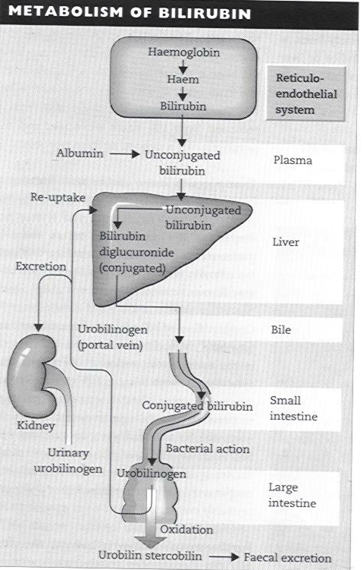
Bilirubin metabolism
The role of the liver is basically conjugation which turns the non soluble bilirubin into a soluble form that can be easily excreted out of the body.

Slide 17
Serum bilirubin levels
Normal | Unconjugated (indirect) | Conjugated (direct) | Latent jaundice | Jaundice
0.2 – 0.8 mg/dL | 0.2 – 0.7 mg/dL | 0.1 – 0.4 mg/dL | Above 1 mg/dL | Above 2 mg/dL
Bilirubin levels and jaundice
Class of Jaundice | Causes
Pre-hepatic or hemolytic (mainly unconjugated bilirubin in the serum) | Abnormal red cells; antibodies; drugs and toxins; thalassemia Hemoglobinopathies, Gilbert’s, Crigler-Najjar syndrome
Hepatic or Hepatocellular (both conjugated and unconjugated) | Viral hepatitis, toxic hepatitis, intrahepatic cholestasis
Post-hepatic (Conjugated) | Extrahepatic cholestasis; gallstones; tumors of the bile duct, carcinoma of pancreas

Slide 18
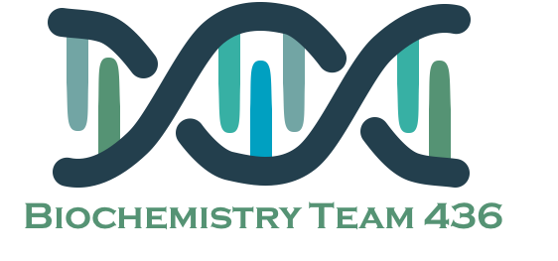
Urobilinogen (UBG), bile salts and serum albumin
Urobilinogen (UBG) and bile salts
Serum Albumin
Most UBG is metabolized in the large intestine but a fraction is excreted in urine (less than 4 mg/day)
If there is too much bilirubin present then this fraction gets increased
Normally bile salts are NOT present in urine
Normally 95% of bile salts are reabsorbed and only 5% gets excreted.
Obstruction in the biliary passages causes:
Leakage of bile salts into circulation
Excretion in urine
Obstruction leads to regurgitation of bile salts into the blood and there for excreted in urine
The most abundant protein synthesized by the liver
One of the most important and abundant protein synthesis in the liver the half life of it is 20 days.
Normal serum levels: 3.5 – 5 g/dL
Synthesis depends on the extent of functioning liver cell mass
Since the liver is a large organ and the 1/2 life of albumin is long . The disease should be either chronic or acute (but really severe) in order to see change in the level of albumin.
Its levels decrease in all chronic liver diseases

Slide 19
Serum Globulin
Globulin
Albumin to globulin (A/G) ratio
Normal A/G ratio: 1.2/1 – 1.5/1
Globulin levels increase in hypoalbuminemia as a compensation
When the synthetic function of the liver is affected, the albumin levels falls . So in order to maintain the osmosis of the system and compensate for the loss of albumin, there is a compensatory increase in the globulin synthesis. you start making lots of globulin that leads to a change in the ratio of albumin/globulin. The ratio will be decreased.
Normal serum levels: 2.5 – 3.5g/dL
a and b-globulins mainly synthesized by the liver
They constitute immunoglobulins (antibodies)
High serum g-globulins are observed in chronic hepatitis and cirrhosis :
IgG in autoimmune hepatitis
IgA in alcoholic liver disease

Slide 20
Prothrombin Time (PT)
Prothrombin time is the time needed for blood clot to form.
Prothrombin is clotting factor number 2
Prothrombin: synthesized by the liver, a marker of liver function .. We should say dysfunction not function
Half-life: 6 hours. (indicates the present function of the liver)
PT is prolonged only when liver loses more than 80% of its reserve capacity
Vitamin K deficiency also causes prolonged PT
Intake of vitamin K does not affect PT in liver disease
You have to give an injection of vitamin K to make sure if it's due to Vit k or liver injury
PT is affected by vitamin K or liver injury

Slide 21
AST and ALT
These numbers are important
Aspartate aminotransferase (AST)
Alanine aminotransferase (ALT)
More liver-specific than AST
Normal range (U/L):
Male: 13-35
Female: 10-30
High serum levels in acute hepatitis (300-1000U/L)
Moderate elevation in alcoholic hepatitis (100-300U/L)
Minor elevation in cirrhosis, hepatitis C and non-alcoholic steatohepatitis (NASH) (50-100U/L)
Appears in plasma many days before clinical signs appear (good thing about it)
A normal value doesn’t always indicate absence of liver damage
Obese but otherwise normal individuals may have elevated ALT levels (minor elevation will appear in obese people)
Normal range: 8 – 20 U/L
A marker of hepatocellular damage
High serum levels are observed in:
Chronic hepatitis, cirrhosis and liver cancer
AST and ALT are both produced by the liver but AST is less specific

Slide 22
Alkaline phosphatase (ALP)
Not specific because :
1- it is present in bone
2- synthesized in the placenta therefore pregnant females have elevated ALP levels.
3- hepatocyte membrane
A non-specific marker of liver disease
Produced by bone osteoblasts (for bone calcification)
Present on hepatocyte membrane
Normal range: 40 – 125 U/L
Moderate elevation observed in:
Infective hepatitis, alcoholic hepatitis and hepatocellular carcinoma
High levels are observed in:
Extrahepatic obstruction (obstructive jaundice) and intrahepatic cholestasis
Very high levels are observed in:
Bone diseases

Slide 23

gamma-glutamyltransferase (GGT)
GGT
It’s a marker for alcohol abuse
Used for glutathione synthesis
Normal range: 10 – 30U/L
Moderate elevation observed in:
  Infective hepatitis and prostate cancers
GGT is increased in alcoholics despite normal liver function tests
  Highly sensitive to detecting alcohol abuse

Slide 24
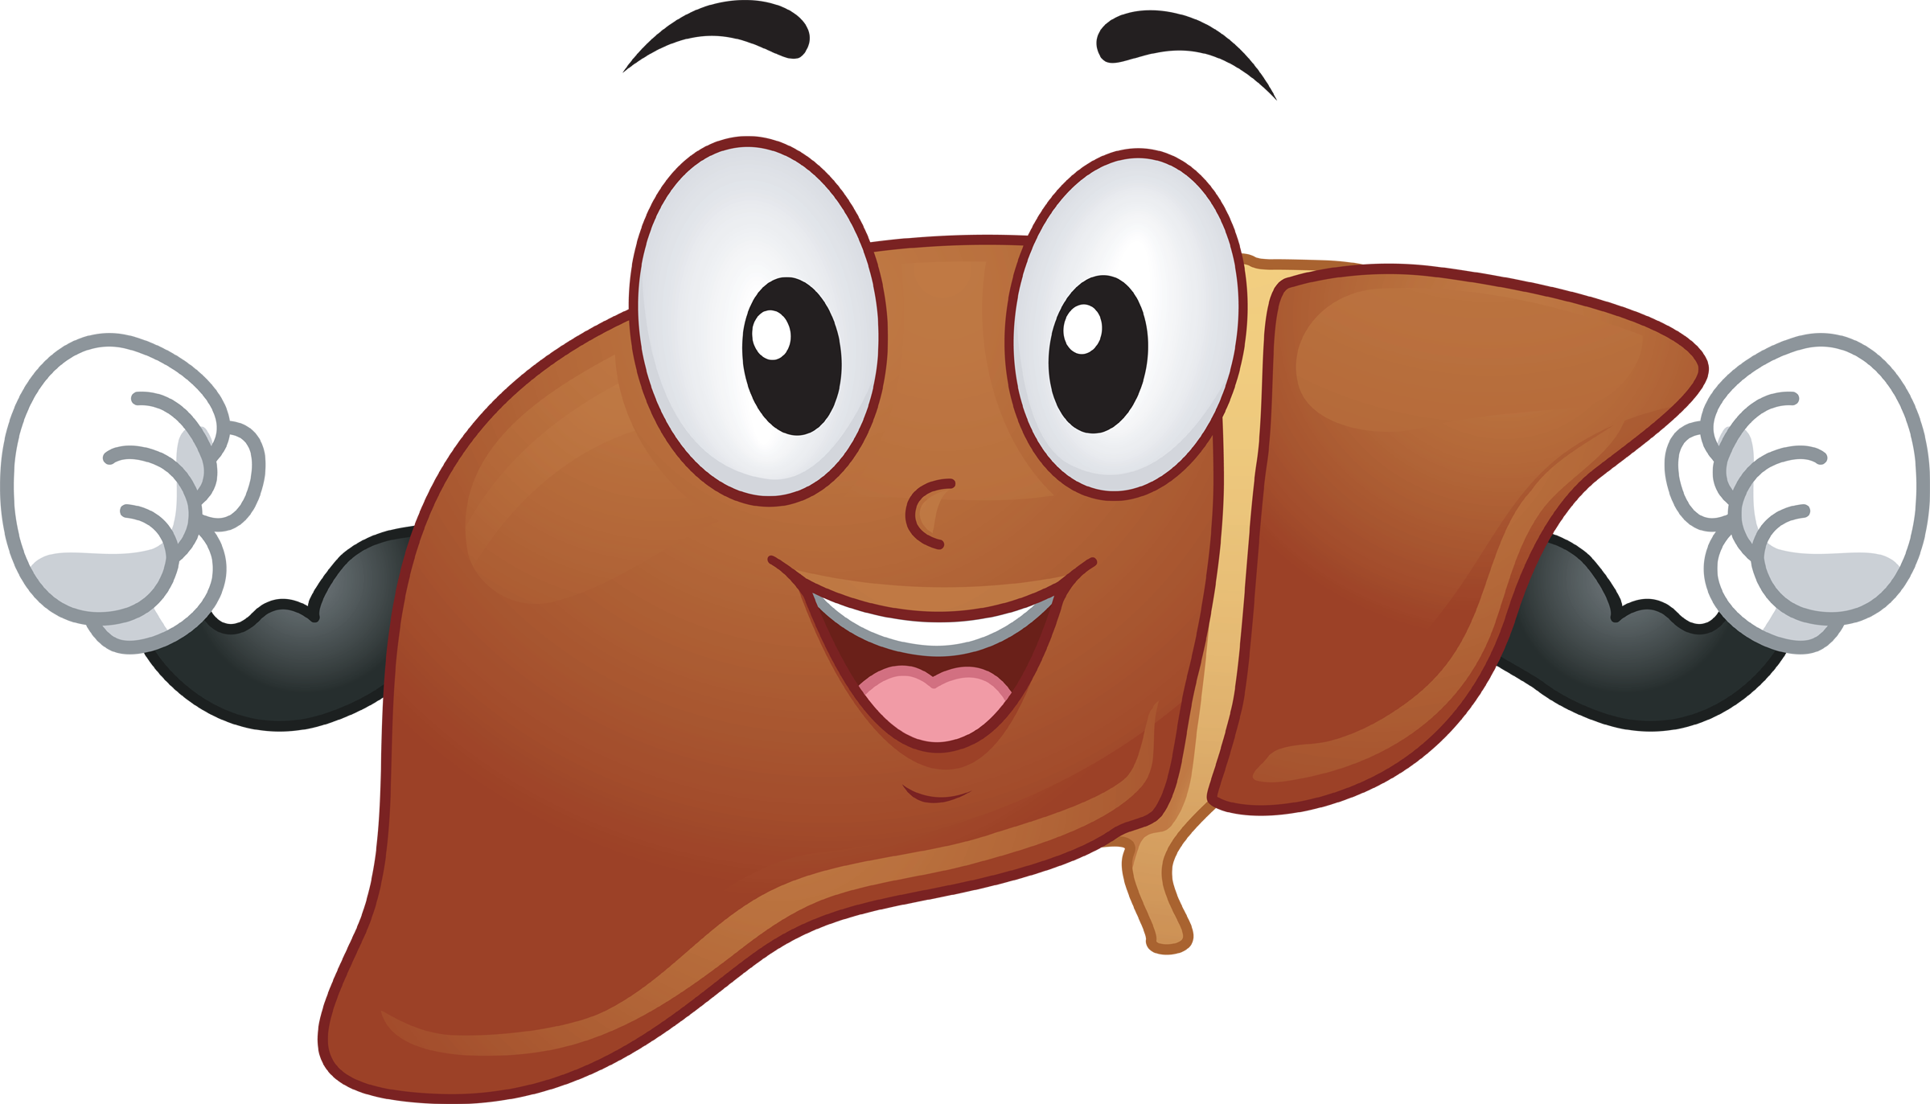
Take Home Messages
LFTs help detect liver injury and function.
LFTs do have some limitations.

Slide 25
Summary

Slide 26
Summary

Slide 27
QUIZ
Q1 : Which ONE of the following enzymes is more liver specific?
ALT
AST
LD
None of them
Q2 : Which of these enzymes are highly sensitive in detecting alcohol abuse?
Alkaline phosphatase (ALP)
gamma–glutamyl-transferase (GGT)
Alanine aminotransferase (ALT)
Aspartate aminotransferase (AST)
Q3 : Increased conjugated bilirubin is due to?
Pre hepatic
Post hepatic
Hepatic
Both (B&C)
Q4 : Jaundice has no clinical manifestation when the bilirubin serum levels are?
Less than 1 mg /dL
Between 2 and 3 mg /dL
More than 3 mg/dL
Both (B&C)
Q5 : ALT & AST are markers of ?
Markers of cholestasis
Markers hepatocellular damage
Markers for biliary obstruction
All of the above
Q6 : Which ONE of the following has a (very high absorbed) level in bone diseases ?
Alkaline phosphatase (ALP)
Aspartate aminotransferase (AST)
Gamma–glutamyl-transferase (GGT)
Both (A&C)

Slide 28
QUIZ
Q7 : Explain why Prothrombin Time (PT) is good as a prognostic tool ?
It has a short half life of 6 hours.
Q8 : What does Prothrombin Time (PT) means? And how is that relevant to liver dysfunction ?
PT means how much time it takes for the blood to clot, PT is synthesized by the liver
Q9 : Explain why albumin is not a good indicator of an acute hepatic dysfunction ?
It has a long half life of 20 days. It’s good in detecting chronic liver diseases.
Q10 : A 26 year old male comes to the clinic with a yellowish tinge to the eyes and skin and complains of abdominal pain, fatigue and weakness, liver function tests only shows mildly elevated bilirubin (mostly unconjugated) and the rest of the parameters were all normal. Which ONE of the following is the most likely diagnosis ?
Gilbert's Syndrome
Suggestions and recommendations
1) A 2) B 3) D 4) D 5) B 6) A

Slide 29
Najd altheeb
Haifa bin taleb
Rana almanea

Slide 30
Review the notes

