Slide 1
Development Of Pancreas And Small Intestine
﴿ إِنَّا خَلَقْنَا الإنسان مِنْ نُطْفَةٍ أَمْشَاجٍ نَبْتَلِيهِ فَجَعَلْنَاهُ سَمِيعًا بَصِيرًا ﴾
Embryology
436
Important
Dr. notes Explanation
M E D I C I N E
KING SAUD UNIVERSITY
- We recommend you to study anatomy of pancreas and small intestine.

Slide 2
O B J E C T I V E S
- At the end of the lecture, the students should be able to :
- Describe the development of the duodenum.
- Describe the development of the pancreas.
- Describe the development of the small intestine.
Identify the congenital anomalies of the small intestine :
Congenital omphalocele.
Umbilical hernia.
Meckel’s diverticulum.

Slide 3
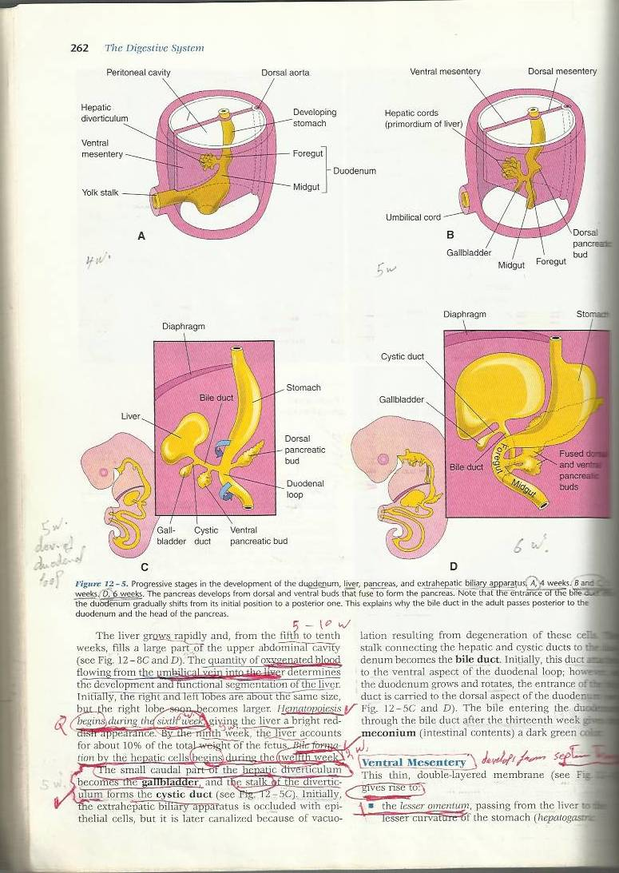
Development Of The Duodenum:
Useful video
- Stages in the development of duodenum, liver, biliary ducts and pancreas (pic.A-D).
- Early in the 4th week, the duodenum develops from the endoderm of primordial gut* of :
1-Caudal تحت))part of foregut 2-Cranialفوق)) part of midgut 3-Splanchnic mesoderm**.
-The junction*** of the 2 parts of the gut lies just below or distal to the origin of bile duct (pic,C -D).
Forgut is(Proximal part)
Midgut is (Distal part )
4th week
5th week
liver
5th week
6th week
*It’s an intra-embryonic endoderm That Divided into:
Foregut, midgut, hindgut
***it’s the junction between the two part of duodenum
**give smooth muscle

Slide 4
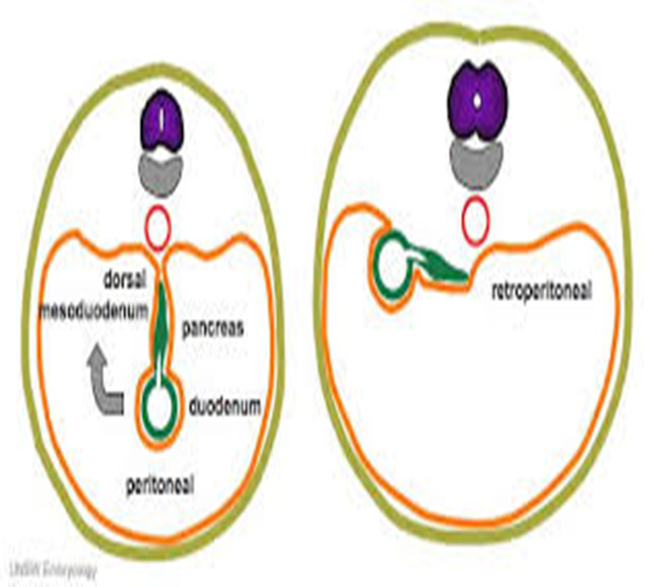
Cont..
-The duodenal loop:
1-The duodenal loop is formed and projected ventrally, forming a C-shaped loop.
2-The duodenal loop is rotated with the stomach to the right. (90) degrees
3- It comes to lie on the posterior abdominal wall retroperitoneally* with the developing pancreas.
*except the first small part of duodenum.
During 5 th and6 th weeks, the lumen of the duodenum is temporarily obliterated because of proliferation of its epithelial cells.
Normally degeneration of epithelial cells occurs
the duodenum normally becomes recanalized by the end of the embryonic period**( end of 8th week)
-الخلاصة: الديودينم عبارة عن أنبوب؛ لذلك في الأسبوع الخامس والسادس الأنبوب يتسد ويتقفل من الوسط موقتا بسبب تكاثر الإبيثيليال سلز، بعدين الخلايا تبدأ تتآكل ومع نهاية الأسبوع الثامن يرجع الأنبوب يفتح من جديد
** the period from fertilization to the end of 8th week
- Fetal period: from 9th week to birth

Slide 5
Development Of Pancreas:
- The pancreas develops from 2 buds arising from the endoderm of the caudal part of foregut:
1- ventral pancreatic bud : which develops from the proximal end of hepatic diverticulum (forms the liver and gall bladder).
2- dorsal pancreatic bud : which develops from dorsal wall of duodenum slightly cranial to the ventral bud.
- But Most of pancreas is derived from the dorsal pancreatic bud.لانها الاكبر))
- When the duodenum rotates​ to the right and becomes C-shaped​,
the ventral pancreatic bud moves dorsally to lie below and behind the dorsal bud.
- Later the 2 buds fused together​ and lying in the dorsal mesentery.
*

Slide 6
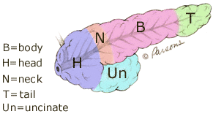
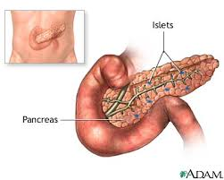
Development Of Pancreas:
This slide is very important ☺
 | A ventral pancreatic bud | A dorsal pancreatic bud (larger )
develops from: | Proximal end of hepatic diverticulum (forms the liver and gall bladder). | dorsal wall of duodenum slightly cranial to the ventral bud
the bud forms: | 1-Uncinate process. 2-(Inferior part of head of pancreas). (so, ventral bud give us small part) | Upper part of head, Neck, Body and Tail of pancreas. (so, dorsal bud give us a lot of parts)
pancreatic ducts:
They are two ducts open in duodenum
After
Before
The main pancreatic duct ( is derived from ) السهمين الاصفر و الزهري يندمجوا مع بعض ويعطونا المين بينكرياتك دكت | The duct of the ventral bud. | The distal part of duct of dorsal bud.
The accessory pancreatic duct ( is derived from ) | ___ | Proximal part of duct of dorsal bud.
The parenchyma of pancreas is derived from the endoderm of pancreatic buds.
Pancreatic islets* develops from parenchmatous pancreatic tissue
Insulin secretion begins at 5th month of pregnancy *important*
*its function is to secrete insulin
And we can found islet a lot in the tail part of pancreatic tissue

Slide 7
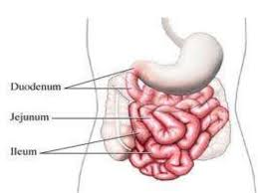
Development Of Small Intestine:
Derivatives of cranial part of the midgut loop : | Distal part of the duodenum Jejunum Upper part of the ileum. لو تخيلنا الأمعاء واعتبرناه تسلسل يسهل (حفظها)
the caudal part of midgut loop: | Lower portion of ileum. Cecum and appendix. Ascending colon proximal 2/3 of transverse colon.**
Derivatives of caudal part of foregut: | proximal part of duodenum
Caudal Foregut
*
مو مرة تهمنا في هذه المحاضرة
Cranial Midgut (distal)
Cranial Midgut
Cranial Midgut
Caudal Midgut
- So, the small intestine is developed from :
Caudal part of foregut.
All midgut.
- Midgut is supplied by superior mesenteric artey (artery of midgut).***
اغلب السمول انتيستانت من الميد قت
Very helpful summarizing pic
* Don’t forget that also from caudal foregut (proximal part)
** 2,3,4 are parts of large intestine,
The rest 1/3 of transvers colon developed from hindgut.
***very important; SMA sometimes called artery of midgut.
- Stages of development of small intestine :
Preherniation stage.
Stage of physiological umbilical hernia****.
stage of rotation of midgut loop.
Stage of reduction of umbilical hernia.
Stage of fixation of various parts of intestine
**** Hernia is a condition in which part of an organ is displaced and protrudes through the wall of the cavity containing it.

Slide 8
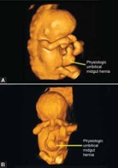
Development Of Midgut Loop
Useful video
1- Preherniation stage:
At the biginning of 6th week, the midgut elongates to form a venteral
U-shaped midgut loop
Midgut loop communicates with the yolk sac by vitelline duct or yolk stalk.
As a result of rapidly growing liver, kidneys and gut ,the abdominal cavity is temporarily too small to contain the developing rapidly growing intestinal loop.
2- physiological umbilical herniation
- So ,Midgut loop projects into the umbilical cord .. this is called physiological umbilical herniation (begins at 6th w.).
1-Preherniation Stage
2-Physiological umbilical hernia.
- الفكرة هنا ان الميدقت يطول ويلتحم مع يولك ساك وهذي المرحلة «preherniation»، بعدين بسبب ان الأعضاء الأخرى الموجودة في الabdominal cavity زي الكبد والكلية تنمو بسرعة وأصلا المساحة صغيرة داخل الجنين فتضغط على الميدقت بالتالي يطلع على برى من فتحة الصرة بشكل مؤقت وينتج شيء اسمه herniation ومعناه فتق وهوا شيء فسيولوجي طبيعي في الجنين لانه يرجع في الأسبوع العاشر (physiological umbilical herniation)
3-Rotation of the midgut loop
ضروري تشوفوا الفيديو
- Midgut loop has a cranial limb (cephalic limb) and a caudal limb.
- Midgut loop rotates around the axis of the superior mesenteric artery.
- Midgut loop rotates first 90 degrees(عكس عقارب الساعة) to bring the cranial limb to the right and caudal limb to left during the physiological hernia.
-The cranial limb of midgut loop elongates to form the intestinal coiled loops (jejunum and ileum).
- so after reduction of physiological hernia it rotates to about 180 degrees
- This rotation is counterclockwise and it is completed to 270 degrees,
.
ركزوا معانا: (الي ماشاف الفيديو او مافهم)
تخيلوا عندنا (عمود=الميدقت لوب) الجزء العلوي هو كرينيال ليمب والجزء السفلي هو الكودال ليمب والمحور حق العمود هو سوبيريور ميزنترك ارتري طيب بعدين؟
حيلف العمود 90 درجة عكس عقارب الساعة (طبعا عكس الساعة في الامبريو هي نفس اتجاه عقارب الساعة عندنا)
المهم الكرينيال تصير في اليمين (يبدا يكبر ويكون الجيوجينم والاليم) والكودال ف اليسار وهذا يصير خلال مرحلة الفيسولوجيكال هيرنيا
بعدين تلف 180 درجة وبكذا يصير التوتال 270 درجة

Slide 9
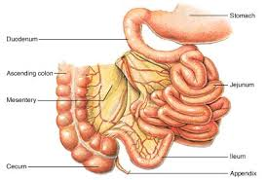
Cont..
4-Return of the midgut to abdomen
- During 10th week, the intestines return to the abdomen due to regression of liver and kidneys + expansion of abdominal cavity.
It is called reduction of physiological midgut hernia. In 10th week !!
- Rotation is completed and the coiled intestinal loops lie in their final position in the left side.
- The caecum at first lies below the liver (A), but later it descends to lie in the right iliac fossa (B)
مهم هذا الوقت
5- Fixation of various parts of intestine
- The mesentry of jejunoileal loops is at first continuous with that of the ascending colon.
- When the mesentry of ascending colon fuses with the posterior abdominal wall
, the mesentry of small intestine becomes fan-shaped and acquires a new line of attachment that passes from duodenojejunal junction to the ileocecal junction.
The enlarged colon presses the duodenum and pancreas against the posterior abdominal wall.( C & F)
Most of duodenal mesentery is absorbed, so most of duodenum except (for about the first 2.5 cm derived from foregut(upper part of duodenum)) and pancreas become retroperitoneal. ( C & F )
Intestine prior fixation
Intestine after fixation

Slide 10
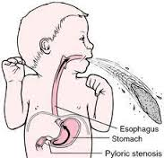
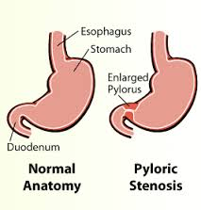
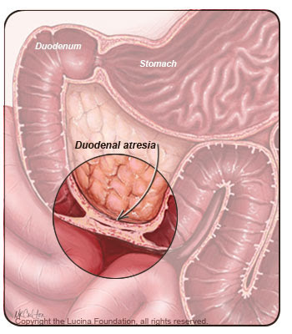
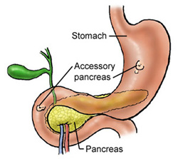
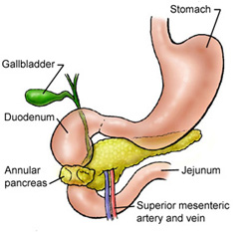
Congenital Anomalies :
Duodenal stenosis and atresia
Organ : | Details :
Duodenum : A. Duodenal stenosis يصير تضيق في الديودينم B. Duodenal atresia جز ء من الديودينم يقفل بشكل كامل وعشان نعالجه يتم استئصال الجزء المقفل وتوصيل باقي الأمعاء مع بعض | A. results from incomplete recanalization of duodenum B. results from failure of recanalization leading to complete occlusion of the duodenal lumen, (autosomal recessive inheritance ).
Pancreas: A. Accessory pancreatic tissue جزء من البنكرياس يخترق ويدخل داخل الديودينم او المعدة B. Anular pancreas انسجة البنكرياس تلف حول السكند بارت اوف الديودينم وتسوي اوبستركشنز | A. located in the wall of the stomach or duodenum. B. A thin flat band of pancreatic tissue surrounding the second part of the duodenum, causing duodenal obstruction.
قلنا ان الديودينم في بداية فترة الجنين طبيعي يتقفل وفي الأسبوع 8 يرجع يفتح؛ لذلك في حال حصلت مشكلة وما فتح سواءً جزئيا أو كليا تطلع هذه الأنوميلس.

Slide 11
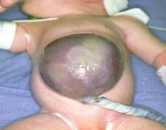
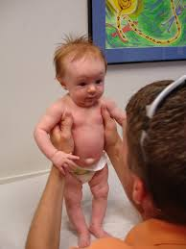
Congenital Anomalies :
This slide is very important ☺
Congenital Omphalocele
Organ : | Details :
Small intestine : important to know The hernial sac is covered by (in every anomalies) A. Congenital Omphalocele | It is a persistence of herniation of abdominal contents into proximal part of umbilical cord due to failure of reduction of physiological hernia to abdominal cavity at 10th week. It is accompanied by small abdominal cavity. Herniation of intestines occurs in 1 of 5000 births – herniation of liver and intestines occurs in 1 of 10,000 births. The hernial sac is covered by the epithelium of the umbilical cord or the amnion. Immediate surgical repair is required
B. Congenital Umbilical Hernia | The intestines return to abdominal cavity at 10th week, but herniate through an imperfectly closed umbilicus. It is a common type of hernia. The herniated contents are usually the greater omentum and small intestine. The hernial sac is covered by skin and subcutaneous tissue. It protrudes during crying , straining or coughing and can be easily reduced through fibrous ring at umbilicus. Surgery is performed at age of 3-5 years. So it’s not an emergency as the one above
مارجع اللوب في الأسبوع العاشر وعشان الابدومنال كافتي صغير ماكبر
. عكس الانوميليس الي بعدها←
الانتستانت رجعت مكانها بس الفتحة ماتقفلت
اذا ضغطنا على مكان الفتاق تدخل الأمعاء جوا بدون مايتألم الطفل لكن ترجع تطلع اذا الطفل بكى او كح او بذل جهد

Slide 12
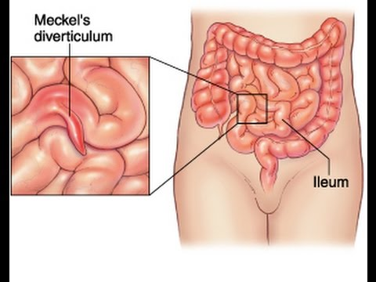
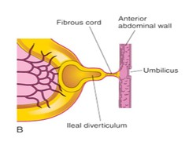
Congenital Anomalies :
This slide is very important ☺
Organ : | Details :
C. ileal (Meckel’s) Diverticulum | It is one of the most common anomalies of the digestive tract, present in about 2% -4% of people, more common in males. It is a small pouch from the ileum, and may contain small patches of gastric and pancreatic tissues causing ulceration, bleeding or even perforation. It is the remnant of proximal part non-obliterated part of yolk stalk (or vitelline duct). Normally, viteline obliterate and disappear , but in this anomalie will not disappear It arises from antimesenteric border of ileum, 1/2 meter from ileocecal junction. It is sometimes becomes inflammed and causes symptoms that mimic appendicitis. 1- It may be connected to the umbilucus by a fibrous cord (vetline ligament), 2- or the middle portion forms a cyst 3- or may remain patent forming the fistula - so, faecal matter is carried through the duct into umbilicus.
لما تلتهب تسوي نفس اعراض التهاب الزائدة
والخطورة هنا انو ممكن الfeces يخرج من الumbilicus
Yolk stalk: A narrow tube present in the early embryo that connects the midgut of the embryo to the yolk sac outside the embryo through the umbilical opening , It is usually obliterated, but a remnant of it may persist: most commonly as a finger-like protrusion from the small intestine known as Meckelis diverticulum. (girls slids only)

Slide 13
Summary
Event | Period | Organ
- Develops from the endoderm of primordial gut | 4th week | Duodenum
- The lumen of the duodenum is temporarily obliterated. - Degeneration of epithelial cells occurs. | 5th & 6th week
- Duodenum normally becomes recanalized. | End of 8th week
- Insulin secretion begins. | 5th month | Pancreas
Elongates to form a venteral U-shaped midgut loop. Communicates with the yolk sac by vitelline duct or yolk stalk. - Projects into the umbilical cord (physiological umbilical herniation). | 6th week | Midgut loop
- Return to the abdomen (reduction of physiological midgut hernia). | 10th week

Slide 14
Summary
Cause And Details | Congenital Anomaly
Incomplete recanalization of duodenum. | Duodenal stenosis
Failure of recanalization of duodenum. | Duodenal atresia
Located in the wall of the stomach or duodenum. | Accessory pancreatic tissue
A thin flat band of pancreatic tissue surrounding the second part of the duodenum, causing duodenal obstruction. | Anular pancreas
Failure of reduction of physiological hernia to abdominal cavity at 10th week. | Congenital Omphalocele
Imperfectly closed umbilicus. | Congenital Umbilical Hernia
Remnant of proximal part non-obliterated part of yolk stalk (or vitelline duct). Sometimes become inflamed and can produce pain. | Ileal (Meckel’s) Diverticulum

Slide 15
MCQ’s
1. Which part of the pancreas the ventral pancreatic bud forms ?
A-Upper part of the head B-Lower part of the head C-Body D-Tail
2. Which artery the midgut loop rotates around its axis ?
A-Splenic artery B-Inferior mesenteric artery C- Superior mesenteric artery D-Celiac trunk
3. The cranial limb of midgut loop gives rise :
A- The liver B-The pancreas C-The stomach D-The jejunum and ilum
4. The umbilical hernia is:
A- Uncommon type.
B- Resulting from imperfect closed umbilicus.
C- Covered by the epithelium of umbilical cord.
D-Not be easily reduced at the umbilicus.
5. The congenital omphalocele is :
A- small pouch from the ileum B-Covered by the epithelium of the umbilical cord C-An abdominal wall defect D-Covered by skin.
6. The Meckel’s diverticulum :
A- Is a duodenal pouch.
B- Arises from the mesenteric border of the ileum.
C- Is a remnant of the proximal nonobliterated part of yolk stalk.
D- Is a physiological hernia of intestine.
1- B
2- C
3-D
4- B
5- B
6- C

Slide 16
References
ANY SUGGESTIONS OR ISSUES
Dr.slides (male and female).
Embryology team 435 .
USEFUL VIDEOS
@Embryology436
Embryology
436
Embryology436@gmail.com
Editing file
Your Suggestion here

Slide 17
TEAM MEMBERS
TEAM LEADERS :
B O Y S :
YAZEED ALMUTAIRI
. Abdulrahman Alomrani
. Saqr Altamimi
NEHAL BEYARI
G I R L S :
Razan Alotaibi
Do’aa Walid
Ohood Abdullah
Nouf Aloqili
Desgined by:
MUHANNED ALZAHRANI

