Slide 1
Approach to Hemolysis
Objectives:
To know the function of platelets and the relationship between the platelet count in peripheral blood and the extent of abnormal bleeding.
• To know about the diseases associated with 1) a failure of platelet production 2) a shortened platelet lifespan, especially immune thrombocytopenic purpura (ITP).
• To know the principles of investigation of patient suspected of having a haemostatic defect.
To understand the role of platelets, blood vessel wall and coagulation factors in normal haemostasis.
• To know the classification of haemostatic defects.
• To know the platelet morphology and life span.
• To know the platelet function and diseases due to platelet function disorders.
• To know the causes of thrombocytopenic purpura and non-thrombocytopenic purpura.
References:
436 girls & boys’ slides
435 teamwork slides
Important. Extra. Notes
Editing file
Do you have any suggestions? Please contact us!
@haematology436 E-mail: Haematology436@gmail.com
or simply use this form

Slide 2
Haemolysis:
It is a Premature destruction of RBCs.
Hemolysis is due to:
Defect in the RBCs (intra-corpuscular) as in congenital hemolytic Anaemia.
Defect in the surrounding environment (extracorpuscular) as in acquired Anaemia
Haemolytic Anaemias:
Haemolysis is the shortening of the lifespan of a mature red blood cell.
haemolysis will result in anaemia more readily
increased red cell output from the bone marrow stimulated by erythropoietin
This mechanism compensates the loss of RBCs, and this requires an adequately function bone marrow and effective erythropoiesis
More marked reductions in red blood cell life span 5-10 days from the usual 120 days
will result in haemolytic anaemia
a suboptimal marrow response is seen
Clinical Features of Hemolysis:
Pallor, lethargy
Jaundice
Splenomegaly
Gall stones (Pigment – bilirubin)
Dark urine (urobilinogen)
Bone deformity (In some types of
haemolytic anaemia) especially in congenital
Leg ulcers (in some types of haemolytic
anaemia). Especially in sickle cell
Intravascular haemolysis: | extravascular haemolysis:
It is the process of breakdown of red cells directly in the circulation. | It is the excessive removal of red cells by cells of RE system in the spleen and liver.
main laboratory features of intravascular haemolysis: Haemoglobinaemia (free Hemoglobin in blood) and Haemoglobinuria. Haemosiderinuria (Iron storage protein in the spun deposit of urine).

Slide 3
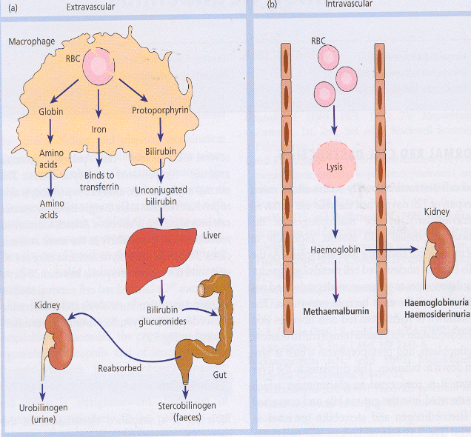
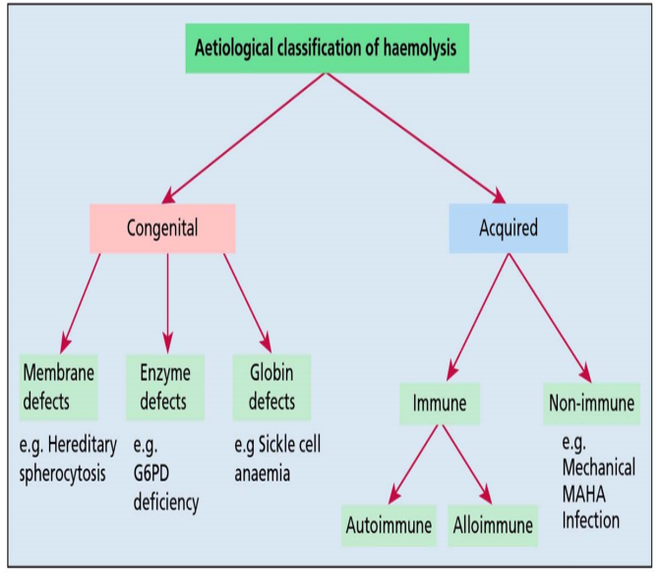
RBC Lysis (Extravascular Vs. intravascular)
Intravascular and extravascular haemolysis:
Causes of intravascular haemolysis:
Mismatched blood transfusion (usually ABO)
G6PD deficiency with oxidant stress
Red cell fragmentation syndromes
Some autoimmune haemolytic anaemias
Some drug-and infection-induced haemolytic anaemias
Paroxysmal nocturnal haemoglobinuria
March haemoglobinuria
Unstable haemoglobin
Important diagram
Laboratory Features of Hemolysis:
Features of increased red cell breakdown | Features of increased red cells production. | Damaged red cells.
serum bilirubin is raised (unconjugated and bound to albumin). urine urobilinogen. Faecal stercobilinogen. lactate dehydrogenase (LDH). | Reticulocytosis Bone marrow erythroid hyperplasia. | Morphology (e.g. microspherocytes, elliptocytes, red cells fragmentation). Increased osmotic fragility, autohaemolysis..etc) Shortened red cell survival (This can be shown by ⁵¹Cr labeling with study of the sites of destruction.
Absent serum haptoglobins. Haptoglobins= binds free hemoglobin fro erythrocyte with high affinity & therefore inhibits its oxidation activity.
Haemolytic Anaemia
Congenital
Acquired
MEMBRANOPATHIES
ENZYMOPATHIES
THALASSAEMIAS
SICKLE CELL DISEASE & OTHER HAEMOGLOBIN DISORDERS
Enzymopathy
thlassemia
From
body
From
outside

Slide 4
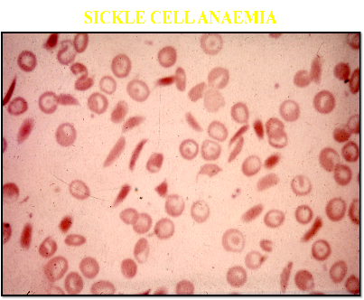
Sickle Cell Anemia
Abnormal Haemoglobins
(Haemoglobinopathies):
Some Known Haemoglobin Mutants : (all in beta chain)
Target cells + sickle shape
Name | Substitution
Hb. S | α2 β2 - 6 GLU → VAL
Hb. C | α2 β2 - 6 GLU → LYS
DNA Coding for the Amino-Acid in the sixth position in the β-chain
Normal:-
5 6 7
Amino Acid pro glu glu
DNA Base Composition CCT G A G G A G
Sickle:-
DNA Base Composition CCT G T G G A G
Amino Acid pro val glu
5 6 7
In position 6 it is supposed to be the amino acid glutamic acid but it transformed into Valine
1910: 1st published report of sickle cell anaemia (Herrick)
1949: Pauling et al : chemical difference between HbA and HbS
1956: Ingram: Fingerprinting
β glu val
It is important to Know that the HbS is Due to abnormal Beta-Chain in Amino Acid number 6 wich transforms from glutamate to valine due to mutation!

Slide 5
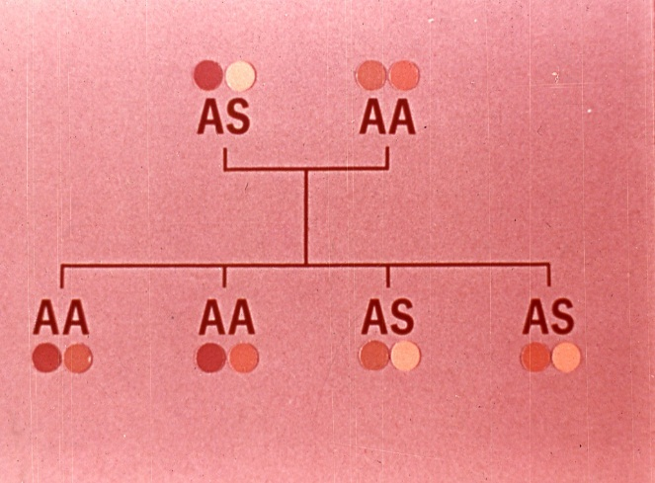
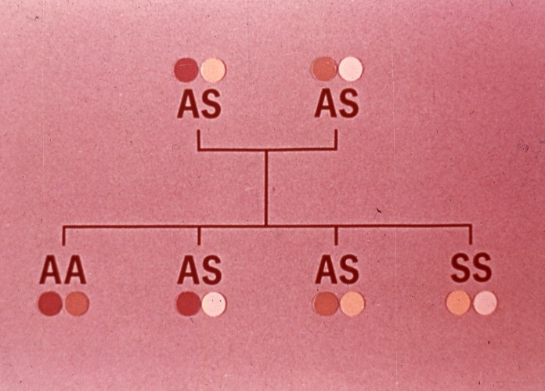
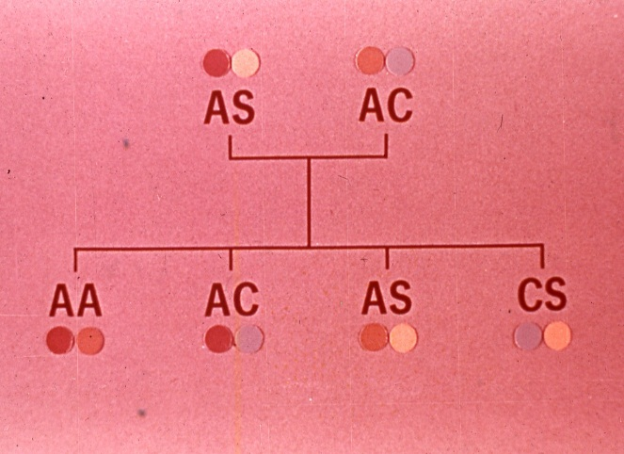
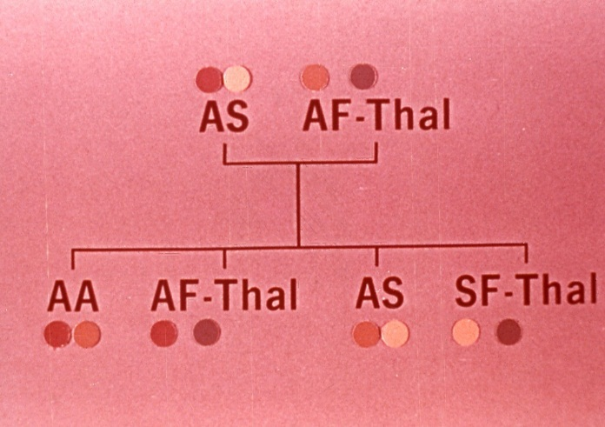
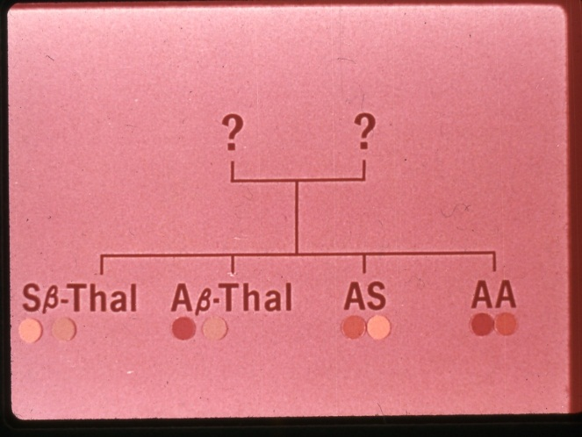
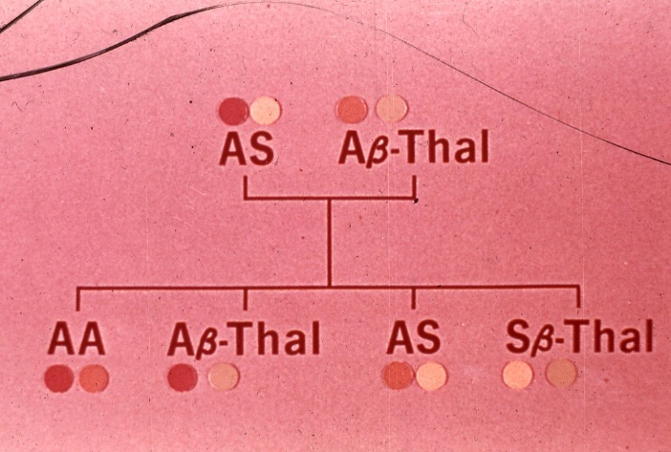
Traits heredity: عشان كذا نسوي فحص الزواج
AA: Normal
AS: trait – carrier (could transmit the disease)
SS: Diseased
AC: Trait (carrier)
AS: Trait (carrier) for another disease.
CS: Diseased
AS: Sicle cell trait
AF-Thal: thalassemia trait
SF-Thal: diseased

Slide 6
Sickle cell disease:
1. The sickle cell trait (AS) | -
2. Homozygous sickle cell disease (ss) | Sickle cell anemia
3. Doubly heterozygous sickle cell disease (2 diseases together) | sickle cell / hemoglobin C disease
 | sickle cell / thalassemia
Properties of Hb S :
Solubility decrease
Conformational changes- “tactoid formation” when exposed to O2
→ Sickled cells
→ Irreversibly sickled cells
Increase mechanical fragility → hemolysis
Increase viscosity → organ infraction
Factors affecting sickling
Oxygen tension:
50-60 mm Hg for SS
20-30 mm Hg for AS
pH :
inhibited at alkaline pH (Alkalosis blood decrease sickling attacks)
Exacerbated by acidification
Concentration of Hb S
Presence of other hemoglobins
Polymerisation: S > D > C > J=A > F
Sickling at low O2 tension
Increased PH Low O2 tension
Viscosity
Slow blood flow

Slide 7
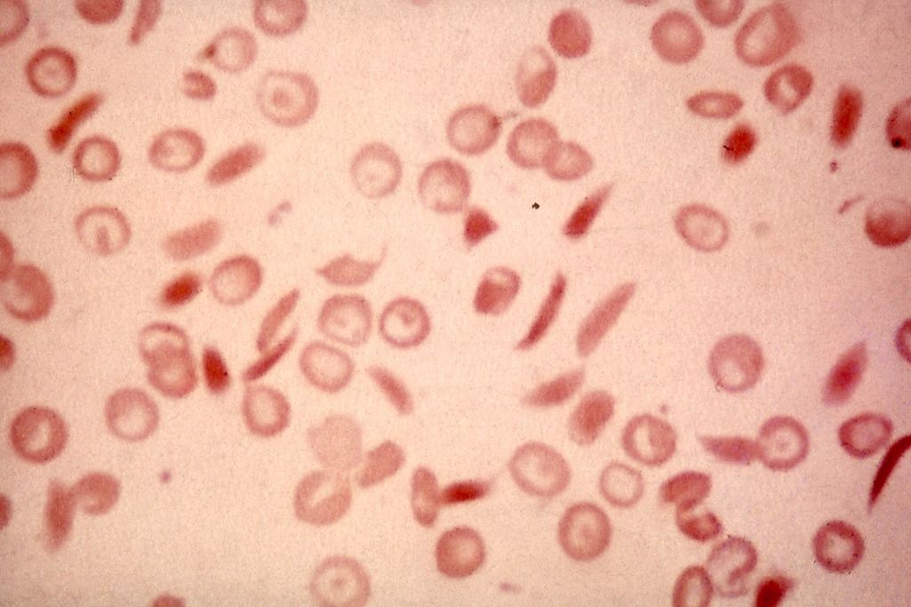
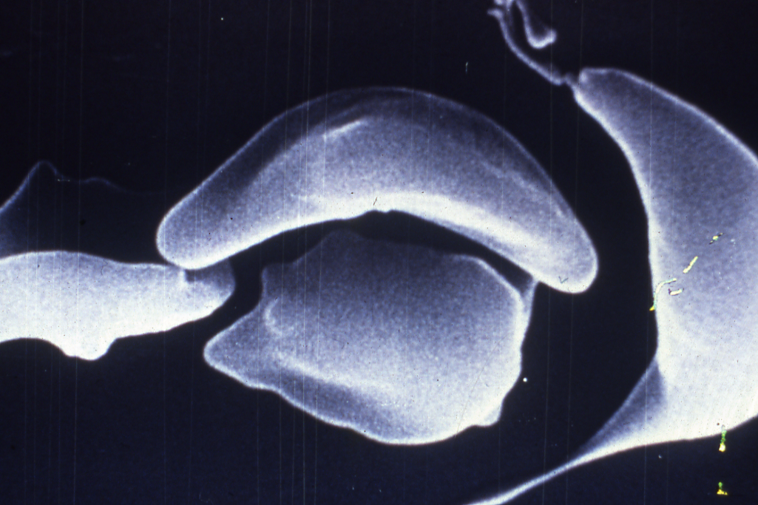
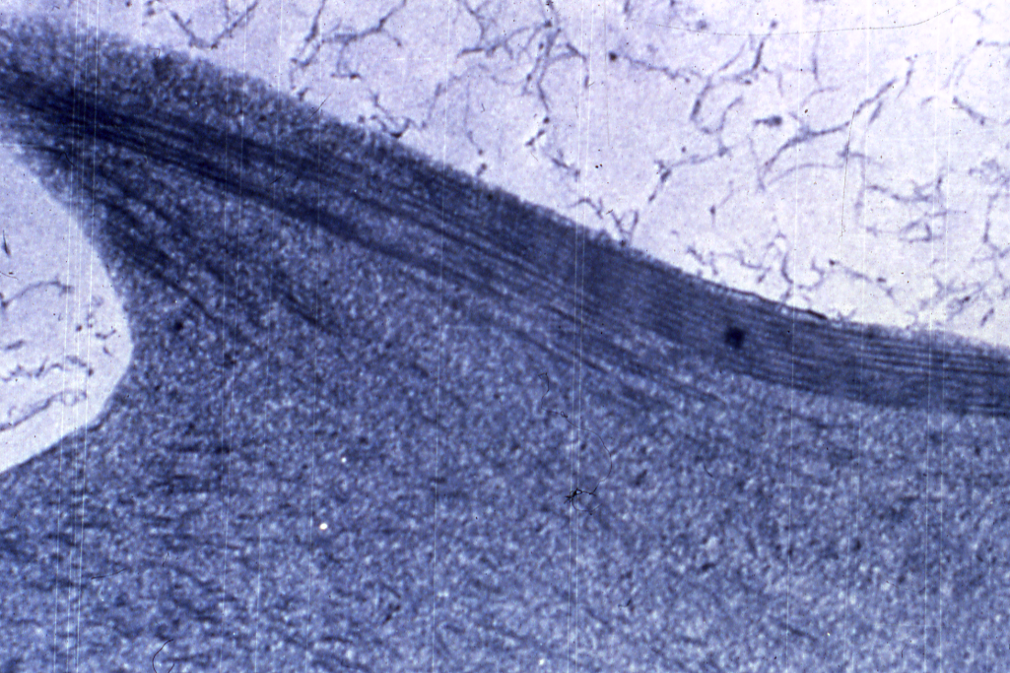
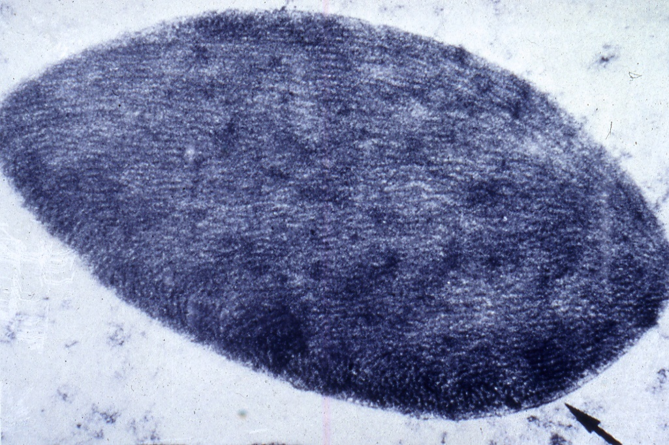
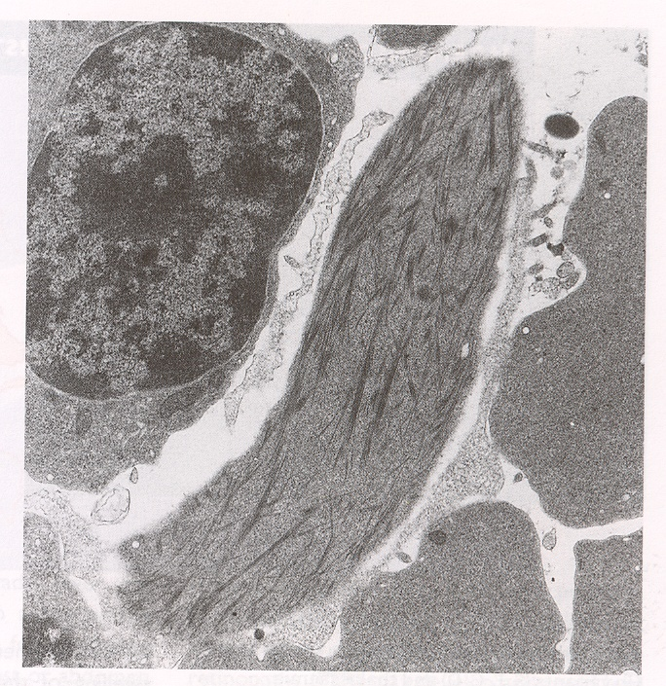
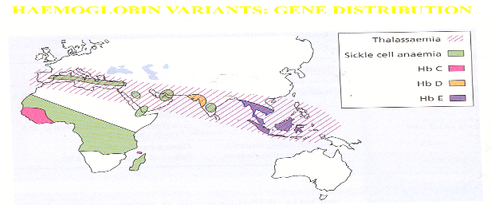
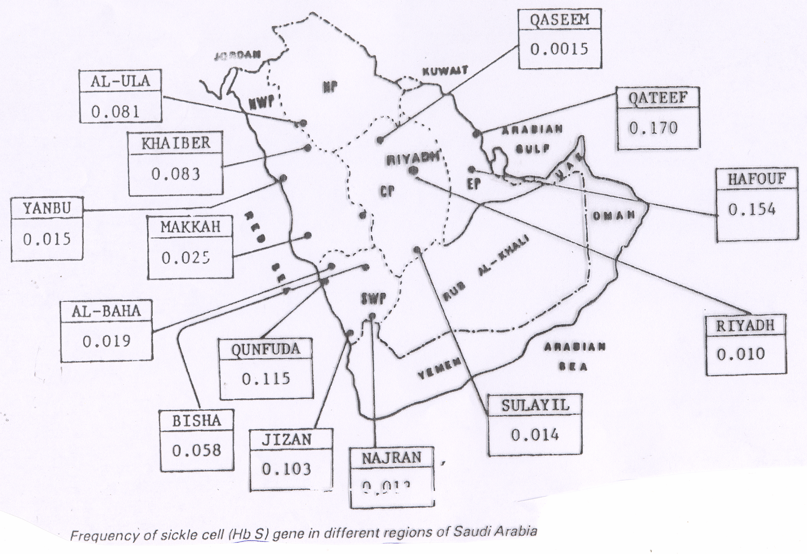
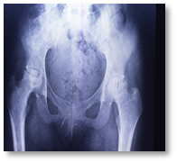
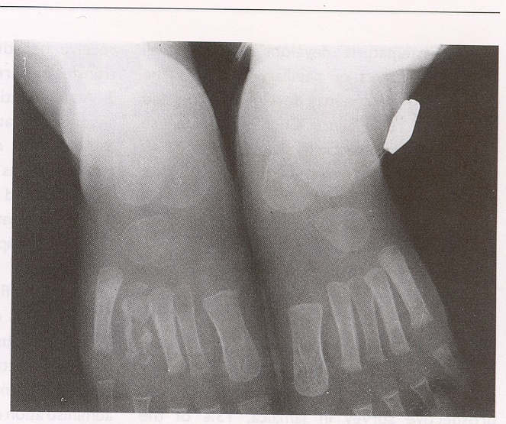
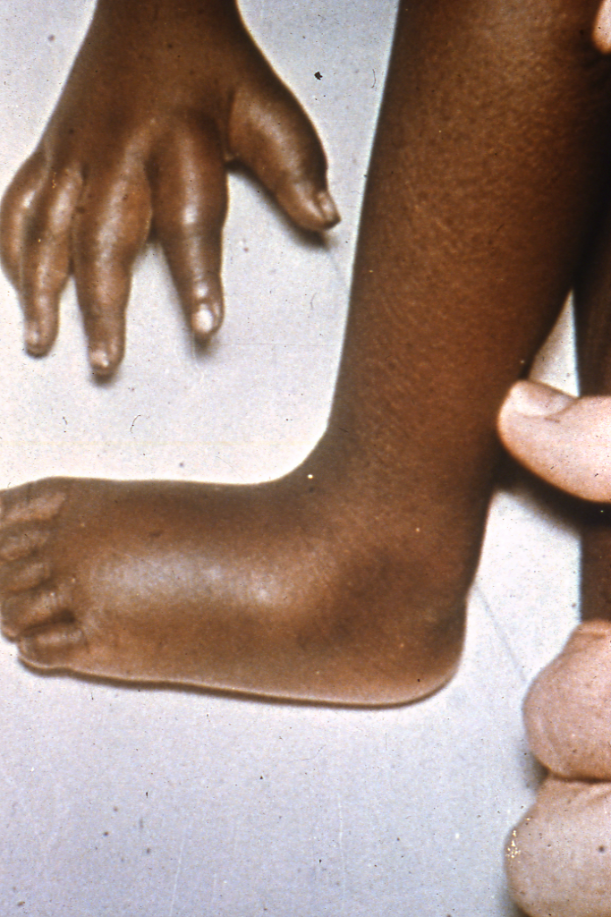
Factors Precipitating Crises In Sickle Cell Disease :
Infections (Especially Malaria)
Pyrexia fever
Exposure To Cold
Dehydration (the most important factor with pregnancy)
Pregnancy
Clinical manifestations of sickle cell disease:
Haemolytic anemia
Tissue infraction
Crises in sickle cell disease:
Hyperhaemolytic.
Aregenerative or aplastic.
Small vessel occlusion.
Clinical Manifestations in Sickle Anaemia
Pallor (Anaemia)
Jaundice & Dark Urine
Apathy & Anorexia
Hand-Foot Syndrome (Young Children) ( one of earliest signs of sickle cells anemia)
Splenic sequestration (Young children) Hepatic Sequestration
Bones and Joints Pain very sever (the patient may scream from pain).
Abdominal Pain
Hand foot syndrome: swelling-pain-inflamed small bones

Slide 8
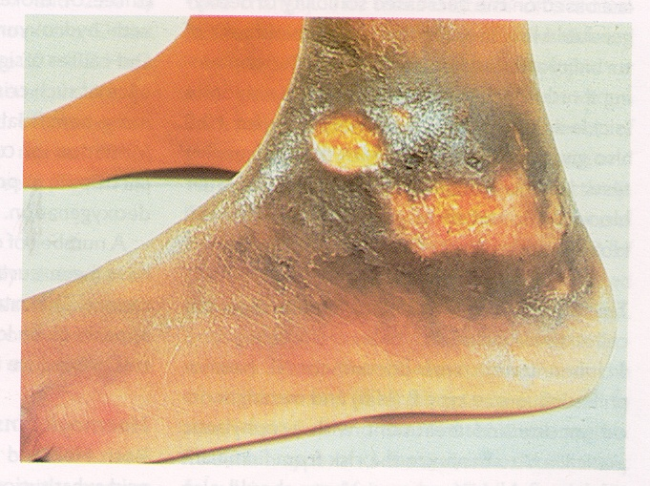
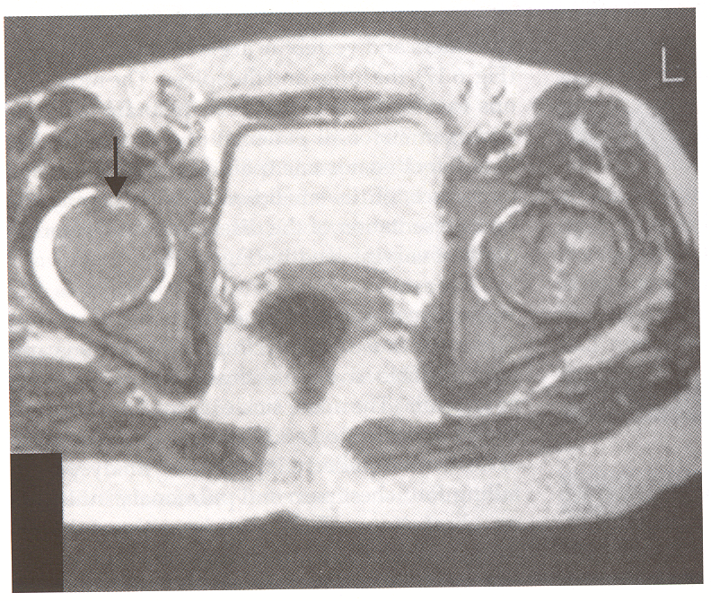
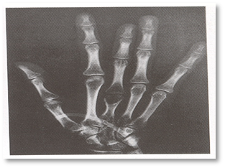
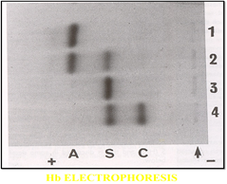
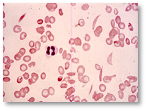
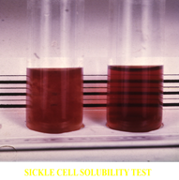
Clinical Manifestations in Sickle Anaemia
Recurrent Infections & Chest Symptoms (Acute Chest Syndrome)
Hepato-Splenomegaly but more significant with thalassemia
→ (Early Childhood)
→ (Association with Thalassaemias)
CNS Presentations
Leg Ulceration characteristic for sickle cell patients
Skeletal Deformity
Laboratory Diagnosis of Sickle Cell Disease:
CBC
Blood Film
Sickle Solubility Test
Hb Electrophoresis (Most accurate)
Genetic Study
We put the blood in a media
Right: normal (translucent).
Left: abnormal (turbid due to RBCs breakdown).
Indications for Blood Transfusion in Sickle Cell Anaemia: Not important
Indications for exchange transfusion: Not important
Strokes
Pulmonary infarcts with infection
Pregnancy (Severe persistent painful crisis)
Priapism prolonged erection of the penis
Preparation for major surgery
Splenic sequestration (Stuck RBCs-spleen enlargment-dysphanction)
Hepatic sequestration
Aplastic crisis
Overwhelming infections
Elective or emergency surgical operation
Severe painful crisis associated with severe
haemolysis
Pregnancy

Slide 9
Summary:
Hemolysis
Clinical features
Pallor, lethargy
Jaundice
Labratory findigs
Features of increased RBCs breakdown
Features of increased RBCs production
Splenomegaly
Gall stones
Dark urine
Bone deformity
Leg ulcers
Damaged RBCs
Mechanisms
Causes
Intravascular haemolysis: inside the circulation
Extravascular haemolysis: in the spleen and liver (RES organs)
Congenital: membrane defects, enzyme defects, globin defects.
Acquired: Immune , Non-immune.
Substitution of amino acid number 6 in beta-chain
(6 GLU > VAL)
Haemoglobin mutation
Sickle cell disease

Slide 10
MCQs:
1-A patient came to the ER complaining of dark urine. On examination, they found jaundice in his sclera, splenomegaly and haemoglobinuria. What is the most common cause of these manifestations?
A-Extravascular haemolysis.
B-Intravascular haemolysis.
C-Both A&B.
2-What is the substitution mutation in Hb.S?
A-α2 β2 - 6 GLU > VAL
B-α2 β2 - 6 GLU > LYS
C-α2 β2 - 26 GLU > VAL
3-Haemolytic anemia is associated congenitally with which of the following:
A-Sickle cell disease.
B-Thalassemia.
C-Both A&B.
4-In Which of the following we will find sickle cell disease & Alpha-Thalassemia in the patient at the same time?
A-The sickle cell trait (AS)
B-Homozygous sickle cell disease (ss)
C-Doubly heterozygous sickle cell disease .
ANSWERS:
1-B
2-A
3-C
4-C
Good Luck!
Team members
Heba Alnasser
Hanin Bashaikh
Shrooq Alsomali
Shahd Alsowaidan
Fahad Al-Askar
Team Leaders
Safa Al-Osaimi
Abdulaziz Al-Hussainy

