Slide 1
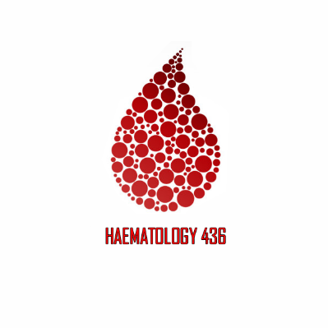
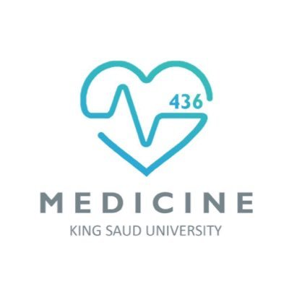
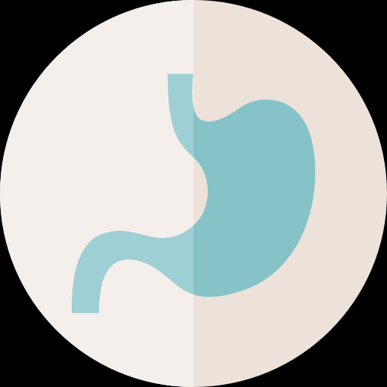
Bleeding Disorders
Objectives:
To know the main sequence of events in the coagulation pathways.
To know the principles underlying PT, PTT, and TT.
To know the principles of investigation of patient suspected of having a hemostatic defect.
To know the mode of inheritance, clinical presentation, method of diagnosis and principles of treatment of hemophilia A, B, C and vWF.
To know the alterations in the hemostatic and fibrinolytic mechanisms associated with DIC and the cause of DIC.
To understand normal fibrinolysis and the principles of fibrinolytic therapy.
Important.
Extra.
Notes
Editing file
References:
436 girls & boys’ slides
435 teamwork slides
Do you have any suggestions? Please contact us!
@haematology436 E-mail: Haematology436@gmail.com
or simply use this form

Slide 2
الحمد لله على التمام، تم بحمد الله تغطية جميع محاضرات الهيماتولوجي لهذا البلوك، فإن أصبنا فمن الله وإن أخطأنا فمن أنفسنا والشيطان، ونرجو أن يكون عملنا حاز على رضاكم ونستميحكم عذرًا عن أي تقصير بدر منا.
قادة التيم: صفاء العصيمي، عبدالعزيز الحسيني.
أتوجه بالشكر لجميع من ساعدنا للخروج بهذا العمل، وأخص بالشكر أخي محمد المطلق الذي كان خير معين وموجه لي في تجربتي، كما أتوجه بالشكر بالنيابة عن نفسي وجميع قادة التيمات إلى القادة الأكاديميين عبدالعزيز العنقري وشوق الأحمري على ما يبذلونه من وقت وجهد في سبيل الارتقاء بالعمل الجماعي.
عبدالعزيز عبدالله الحسيني قائد تيم الهيماتولوجي.
في الختام نتوجه بجزيل الشكر وعظيم الامتنان لمن كانوا بعد الله السبب لإنجاز هذا العمل وهم أعضاء التيم الكرام : (أبجدياً)
أسيل السليماني
أشواق الماجد
بشرى قوقندي
جواهر ابانمي
جواهر الخيال
حنين با شيخ
دانية الكلابي
رنا باراسين
ريما العتيبي
شروق الصومالي
شهد السويدان
عروب الهذيل
غادة المزروع
هبة الناصر
وجدان الزيد
يارا الدعيجي
خالد الحسينان
خالد العيسى
زياد العنزي
عبدالكريم الحربي
عبدالله الطويرقي
عبدالله الناصر
عصام الشهراني
فهد العسكر
محمد الكحيل
محمد المنيع
مساعد النويصر

Slide 3
Normal Coagulation Mechanism
The pathway on the left is called “intrinsic pathway” factors number 8, 9, 11, 12 and the common pathway, Any deficiency in this pathway will lead to prolonged APTT test.
The pathway on the right is called the “extrinsic pathway” factor number 7, tissue factor and the common pathway, any deficiency in the factors associated with it will lead to prolonged PT test.
Any deficiency in any of the factors in the Common Pathway (factors number 2, 5, 10) will lead to prolonged time in both APTT and PT.
Tissue factor and Calcium are also important in the formation of fibrin.
Intrinsic; found in the blood.
Extrinsic; found outside the blood.
PT: prothrombin time
APTT: Activated partial thromboplastin time.
All the coagulation factors are involved in the coagulation cascade except Factor XIII, a deficiency in this factor affects the clotting stability.
Factor XIII or fibrin stabilizing factor, works by cross-linking the fibrin to stabilize it.
Its deficiency leads to poor healing
The fibrinolytic mechanism:
After haemostasis has been achieved, the body has a mechanism for the enzymatic lysis of clots, because if it was formed without a limit it will end up forming a large clot causing many problems. The dissolution of the fibrin into fibrind-degredation products (FDPs) is carried out by the proteolytic plasma enzyme plasmin. Plasmin is present in the plasma in an inactive form. IMP. NOTE: Plasmin is not essential in the coagulation itself, it’s only essential for the degradation of fibrin.

Slide 4
Tests for clotting factors: important! You have to know the test &its factors.
The activated partial thromboplastin time (APTT): estimates the activity of factors XII, XI, IX,VIII, X, V, II and fibrinogen (the ‘intrinsic system’). This is the first test used when we suspect congenital defects, especially hemophilia.
The prothrombin time (PT): estimates the activity of factors VII, X, V, II and fibrinogen (the‘extrinsic system’).
The thrombin time (TT): we add thrombin go the patients plasma and we measure the time taken to clot. it is specific for detection of fibrinogen problems either inherited or acquired deficiencies.
Thrombin time is prolonged when there’s an inherited or acquired deficiency of fibrinogen or abnormal fibrinogen (dysfibrinogenemia) or in the presence of heparin or raised levels of FDPs.
Coagulation Disorders They include inherited and acquired blood vessel disorders, platelets disorders and coagulation disorders.
 | Congenital (inherited) | Acquired
Onset | Early in life (children) There has to be a family history of a similar condition | Late in life (Adults)
Examples | 1- Hemophilia A (Factor VIII deficiency. The most common among the three types. 2- Hemophilia B (Factor IX deficiency) 3- Hemophilia C (Factor XI deficiency) 4- vWD (von willebrand disease) | Severe liver disease (because hepatocytes are the major cell type involved in the synthesis of the coagulation factors) DIC (Disseminated intravascular coagulation) Acquired Hemophilia Anticoagulant drugs (heparin, warfarin) Direct oral thrombin inhibitors and direct oral Xa inhibitors The antiphospholipid syndrome
Inhirited or acquired abnormalities of natural anticoagulant (Protein C/S, AT) may lead to a prothrombotic state (Thrombophilia).

Slide 5
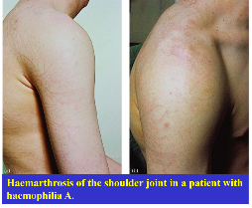
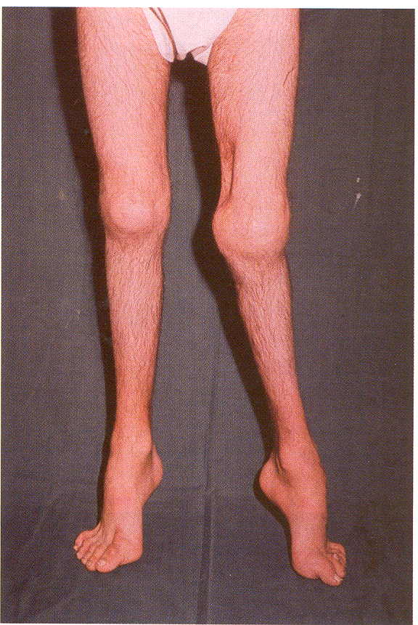
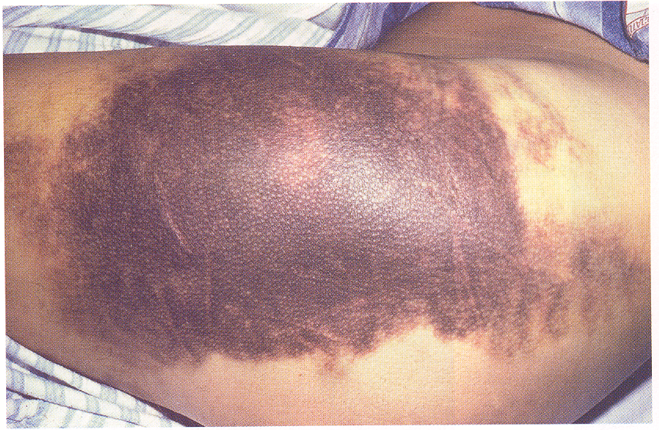
Congenital coagulation disorders.
 | Hemophilia A | Hemophilia B (Christmas disease)
Deficiency | Factor VIII | Factor IX
Incidence | More common | Less common
Genetics | Sex linked abnormal gene, single point mutation located on chromosome X. (males are affected whereas females are carriers unless both her parents are affected)
Clinical Features | If the % of coagulation factors activity is less than 1%: severe disease, bleeding occurs without trauma (spontaneous) and with joint deformities and crippling if not treated(very important). Bleeding into the joints (Hemarthrosis and less frequently into the muscles) The characteristic clinical feature of severe hemophilia is the occurrence of spontaneous bleeding into the joints (Haemarthrosis) “the knees, elbows, and ankles are most commonly affected” *If it’s from 1%-5% : moderate disease, post-traumatic bleeding and occasional spontaneous episodes. Less joint deformity. *If it’s from 5%-20% : mild disease (Post-traumatic bleeding) Hematuria, epistaxis and gastrointestinal bleeding are less common in hemophilia and Intracranial bleeding (most dangerous) is the most common cause of death from the disease itself
Detection of carriers and antenatal diagnosis | Genetic mutational analysis is accurate and is the method of choice. we use it if there was a family history and the mother is pregnant. To know whether the fetus has hemophilia or not: Chorionic villus sampling between 11.5 and 14 weeks gestation Amniocentesis after 16 weeks. Sometimes we ask the mother to abort the baby if it was fatal to him.
Diagnosis | Normal PT Prolonged APTT Normal platelet count and bleeding time.
 | Decreased Factor VIII | Decreased Factor IX
crippling
Intramuscular bleeding

Slide 6
In the plasma, Factor VIII is only found complexed with vWF, which acts as a carrier and prolongs its plasma half-life.
Other single deficiencies of factors (other than VIII and IX) are very rare, and they all give rise to bleeding disorders EXCEPT factor XII “Glass Factor”
Treatmment of hemophilia (not important) :
باختصار نعطيهم الشيء اللي ناقصهم
1- replacement therapy (replacing the deficient factor):
IV injection of plasma-derived high purity factor VIII concentrate or recombinant factor VIII preparations in hemophilia A (same but factor IX in hemophilia B)
Note that:
* we usually want to maintain factor activity 30% of normal activity. If hemophilia patient will undergo surgery we give more to raise factors activity to 100% of normal.
Approximately 25% of patients with hemophilia, usually after treatment with factor VIII develop antibodies that inhibit its functional activity
Haemorrhage in patients with high-titre inhibitors may require treatment with ‘bypassing agents’ such as recombinant factor VIIa or FEIBA (factor eight inhibitor bypassing activity; that is, a plasma-derived activated prothrombin complex concentrate), which activate the coagulation cascade below the level of factor VIII.
2- The administration of factor VIII may be avoided in mild to moderate haemophilia by using the vasopressin analogue desmopressin (DDAVP), which causes a temporary increase in factor VIII and VWF by provoking the release of these factors from endothelial cells.
3- treat the cause of hemophilia (if it was caused by hepatitis or liver disease try to treat it and in late stages liver transplant)
4- treat orthopedic symptoms.

Slide 7
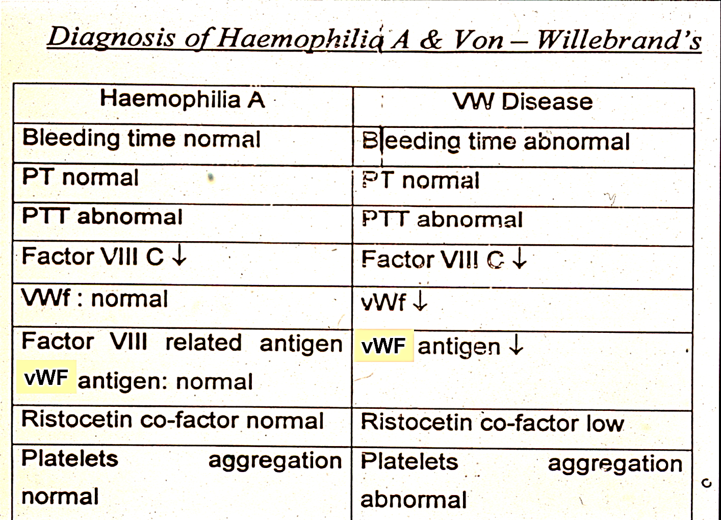
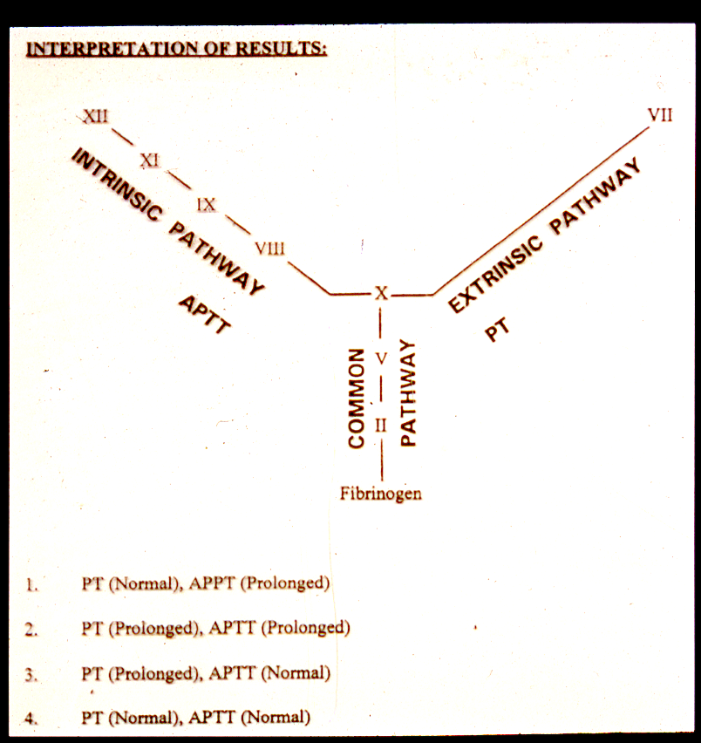
Congenital coagulation disorders cont.:
 | Von Willebrand Disease
Deficiency | Deficiency in Von Willebrand Factor (vWF or Abnormal Platelet Aggregations) and low von willebrand antigen deficient factor VIII activity
Incidence | most common inherited coagulation disorder
Genetics | Autosomal disorder (NOT X-linked!) and present on chromosome 12, and has 3 types
Clinical Features | Spontaneous bleeding (mostly superficial) confined to mucous membranes and skin and takes the form of epistaxis and ecchymoses Bleeding into joints and muscles is rare except in type 3 disease (types of disease discussed in later slides)
findings | Abnormal bleeding time. The most important finding, in hemophilia it was normal. Abnormal Platelet Aggregations What’s the function of vWF? Its adhesive molecule that binds to sub-endothelial tissues act as carrier to factor VIII (its reduction reduces factor VIII concentration)
Diagnosis | Normal PT Prolonged APTT Abnormal bleeding time. Prolonged PFA closure time Reduced factor VIII clotting activity Reduced levels of VWF and impaired ristocetin-induced platelet aggregation
Treatment Not important | باختصار نعطيهم الشي اللي ناقصهم desmopressin (DDAVP), which increases plasma levels of both VWF and factor VIII Very high purity VWF may be used
= problem in intrinsic pathway
= problem in common pathway
= problem in extrinsic
= normal
important
helpful image to test yourself

Slide 8
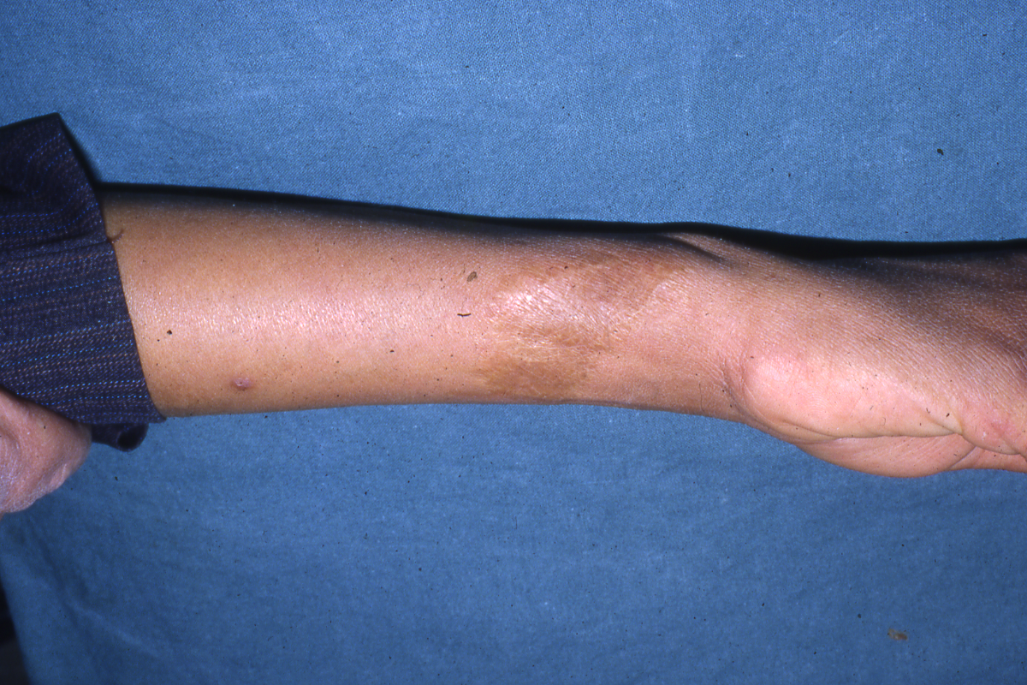
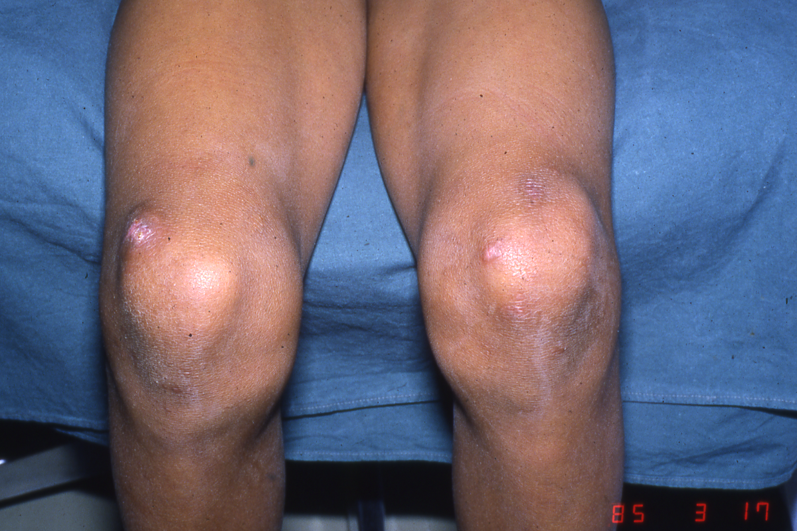
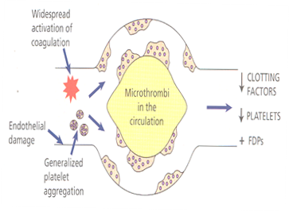
Level of Factor VIII Desirable 15 mins. After the First Transfusion (IU/DL) *EXTRA*
Major surgery → 70%-100%
Treatment of Inhibitors
Immunosuppressors
The New Classification of Von -Willebrand’s Disease*EXTRA*
Type 1. Partial quantitative deficiency of WF
Type 2. Qualitative deficiency (functional abnormality) of vWF.
Type 3. Virtually complete deficiency of vWF.
Factor XIII deficiency*EXTRA*
Bruising with minor injury
Hematoma after trauma
Bleeding (secondary bleeding)
Abnormal healing of wounds with excessive scar formation (keloid formation)
Laboratory diagnosis of factor XIII deficiency*EXTRA*
Normal PT & Normal APTT
Normal Bleeding time & Normal Platelet aggregation
Normal fibrinogen level
Abnormal clot stability with five molar urea
Low Factor XIII level
Acquired hemophilia:
Usually due to 2 causes:
1- liver problem (it makes coagulation factors and lever disease may affect spleen causing thrombocytopenia)
2- DIC (Disseminated intravascular coagulation)
just to understand: small disseminated clots throughout blood happen thus coagulation factors are almost depleted
Acquired Coagulation disorders:-
DIC:-
Disseminated intravascular coagulation
‘Consumption coagulationpathy’
‘Defibrination syndrome’
Continue in the next slide

Slide 9
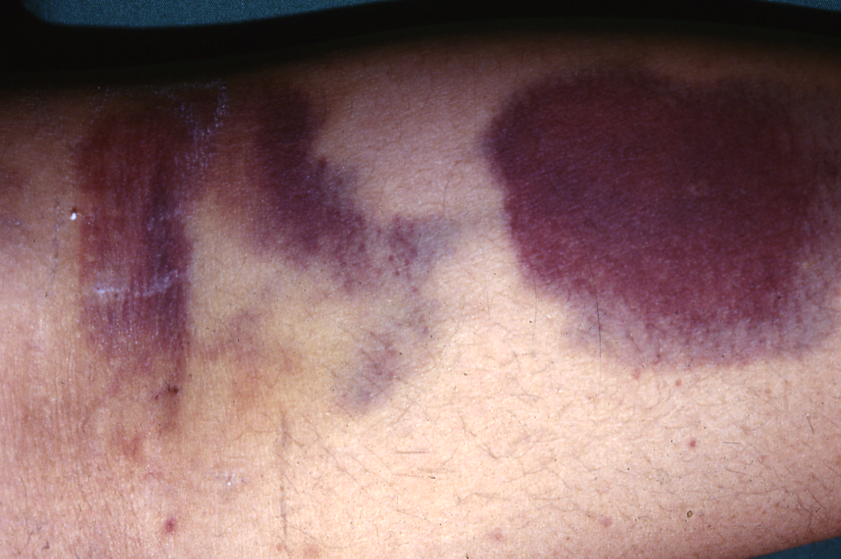
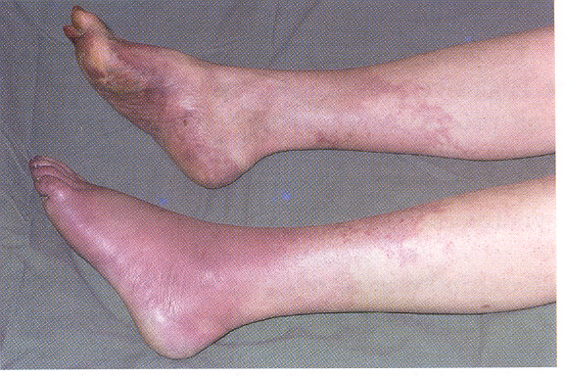
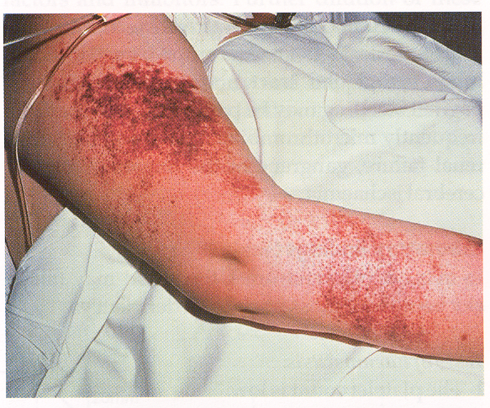
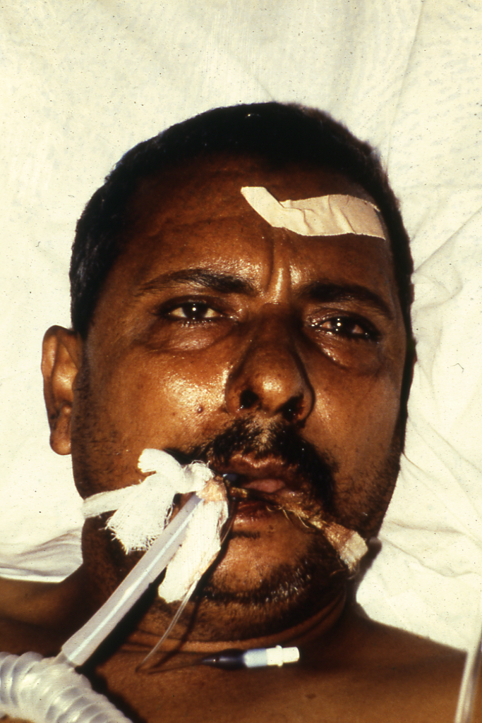
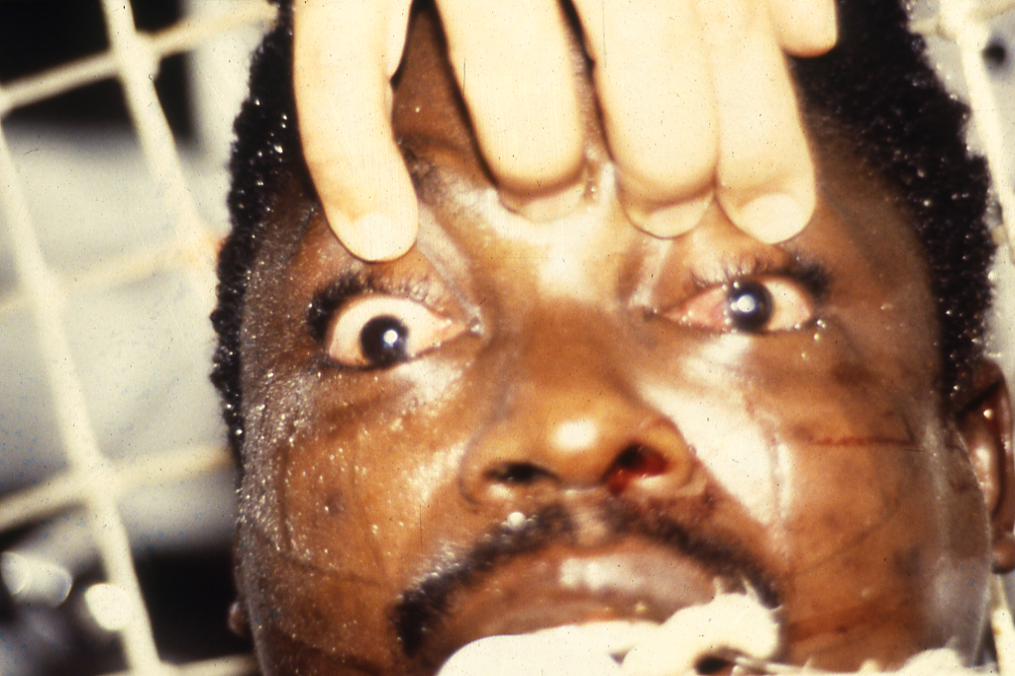
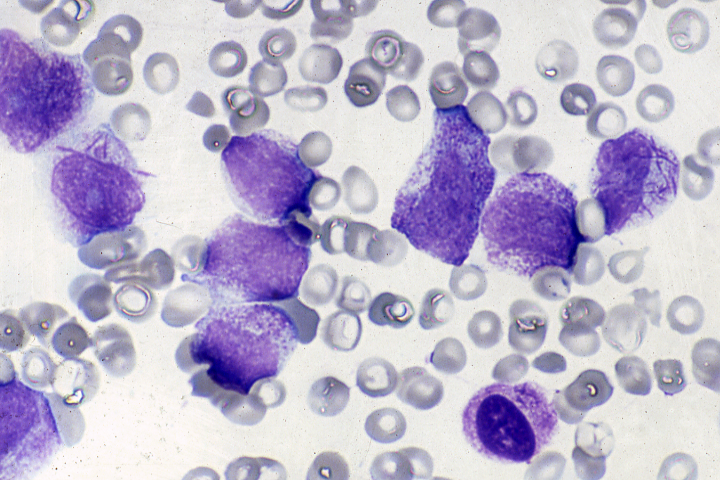
DIC Cont’d:-
DIC describes a process in which there is a generalized activation of the clotting system followed by marked activation of the fibrinolytic system.
It is a common complication following intravascular haemolysis of red cells after a mismatched transfusion.
Clotting cascade may be activated in various ways; namely:
by the release of TF from damaged tissues
by damage to endothelial cells
by abnormal activators of coagulation
DIC Presentation:-
Acute promyelocytic leukaemia (M3)
Infections
Gram-negative bacteria
Malignancy
Clostridium
Falciparum malaria
Viral infection – HIV, hepatitis
Adenocarcinoma
Acute promyelocytic leukaemia (M3)
Causes of disseminated intravascular coagulation
Obstetric complications
Amniotic fluid embolism
Premature separation of placenta
Septic abortion
Miscellaneous
Liver failure
Snake bites
Hypothermia
Heat stroke
Acute hypoxia
When someone dies from a snake bite, he dies from DIC not from the toxicity of biting.

Slide 10
Diagnosis of DIC All factors reduced
Platelet counts
Coagulation profile
The APTT and the PT are prolonged
Depletion of clotting factors
The fibrinogen concentration is reduced
The thrombin time is prolonged
FDPs including D-dimers are increased
Treatment of DIC *EXTRA*
Treatment is aimed at preventing further coagulation by removal of the initiating cause.
Supported with transfusions of blood, fresh-frozen plasma and platelet concentrates in order to restore blood volume and replace clotting factors and platelets.
Aquired Heamophilia للاستفادة
A rare but devastating acquired bleeding disorder is due to autoantibody-mediated factor VIII deficiency. It can occur in either sex, is more common in the elderly and has a high mortality. It is treated with ‘bypassing agents’ such as recombinant factor VIIa or FEIBA and immune suppression.
Anticoagulant drugs:*EXTRA*
Heparin | Warfarin (vitamin K antagonist )
Administered intravenously or subcutaneously | Administered orally
Used for long surgeries & first days of surgery | Used for recurrent DVT or PE
Doesn’t cross the placenta → could be given in pregnancy | Crosses the placenta → contraindicated in pregnancy

Slide 11
Investigation
Prothrombin time (PT)
Normal: 10 – 14 sec
Activated partial thromboplastin time (APTT)
Normal: 30 – 40 sec
Plasma fibrinogen
Coagulation factor assays
Indications for the use of fresh frozen plasma
Coagulation factor deficiency (where specific or combined factor concentrate is not available)
Reversal of warfarin effect.
Screening Tests of Hemostasis مهم الجدول
Screening tests | Defects
B.T. Prolonged | Platelets (↓ or dysfunction) + Von Willebrand’s disease
APTT prolonged | Factors: XII, XI, VIII, IX, X, V, II, I
P.T. Prolonged | Factors: VII, X, V, II, I
T.T. Prolonged | Fibrinogen (Factor I) high FDPS
Reptilase time prolonged | Fibrinogen (factor I) high FDPS. Not effected by Heparin therapy
FDPS high | ▪ D.I.C. ▪ Snake Bite ▪ Thrombolytic therapy ▪ Dysfibrinogenemia
Platelet Count Low | Thrombocytopenia
Platelet Count Normal | Platelet dysfunction
Oral Anticoagulants Indications*EXTRA*
Venous thrombosis and pulmonary embolism.
Atrial fibrillation.
Heart valve prostheses.
Myocardial infarction (Selected cases)
Oral anticoagulant control tests:
INR and ISI for the thromboplastin reagent used.
كل مرض له رينج محدد ولازم يكون المريض في هذا الرينج

Slide 12
Summary
HEMATOLOGY TEAM 436
Platelet
aggregation
Symptoms |  |  |  |  |  | disease
Hematourea,hemathroses -Severe (<1): spontaneous bleeding, joint deformity -moderate(1-5): post traumatic -mild(5-20): post traumatic |  |  | X | ↑ |  | Haemophilia A
- spontaneous bleeding (mucous membrane and skin) |  | ↓ | 12 | ↑ |  | VW
-abnormal healing wounds -excessive scar formation(keloid formation) -hematoma after trauma |  |  |  |  |  | Factor 13 Deficiency
-↑ Thrombin time -thrombocytopenia |  |  |  | ↑ | ↑ | DIC
-venous/arterial thrombosis Thrombocytopenia -antiphospholipid found in SLE |  |  |  |  |  | Anti-phospholipid syndrome
VW factor
Chromosome
PT
APTT
Normal
Normal
Normal
Normal
Abnormal
Normal
Normal
Normal
11

Slide 13
MCQs
1- synthesis of coagulation factors in the:
A-Bone marrow
B- spleen
C- liver
D- A&B
2- The most common acquired deficiency of coagulation factors is:
A-liver disease
B- DIC
C-hemophilia
D-A&B
3- which one of the following characteristics related to DIC ?
A-has normal PT , ↑ APTT
B- both PT & APTT normal
C- ↑ both PT & APTT
4- which one of the following characteristics related to VW ?
A-has normal PT , ↑ APTT
B- both PT & APTT normal
C- ↑ both PT & APTT
ANSWERS:
1-C
2-D
3-C
4-A
Good Luck!
Team Members
Yara AlDigi
Bushra Kokandi
Dania AlKelabi
Aroob AlHuthail
Heba Alnasser
Team Leaders
Safa Al-Osaimi
Abdulaziz Al-Hussainy

