Slide 1
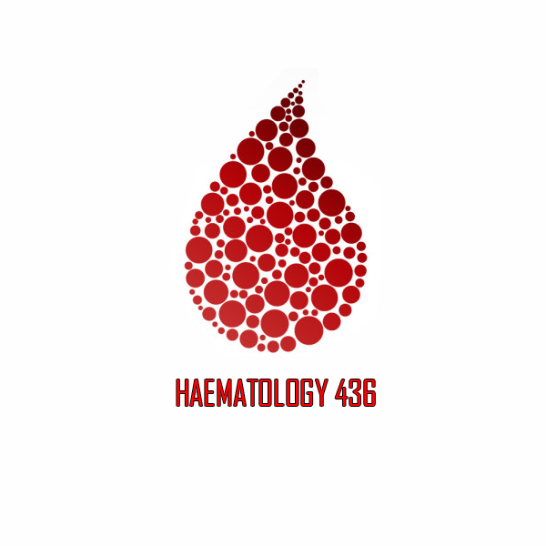
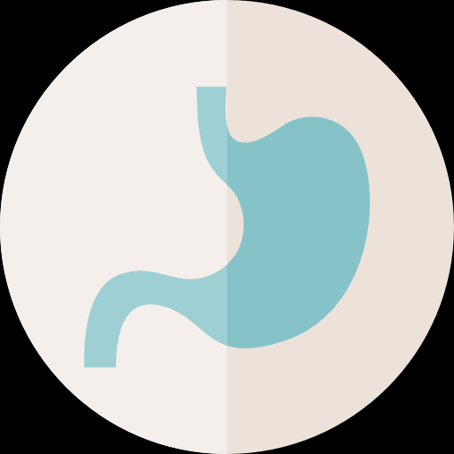
HAEMOGLOBINOPATHIES
Objectives:
normal structure and function of haemoglobin.
how the globin components of haemoglobin change during development, and postnatally.
the mechanisms by which the thalassaemias arise.
appreciate the clinical presentations and complications of thalassaemia
appreciate the contribution of haemolysis and ineffective erythropoiesis to the pathophysiology of thalassaemia
pathophysiology of sickle cell anaemia
clinical presentation and complications of sickle cell anaemia
role of haemoglobin electrophoresis and high performance liquid chromatography in the investigation of globin disorders.
appreciate the haemoglobin variants associated with disease
Color code:
Important.
Extra.
Doctor’s Notes
References:
436 girls & boys’ slides
435 teamwork slides
Editing file
Do you have any suggestions? Please contact us!
@haematology436 E-mail: Haematology436@gmail.com
or simply use this form

Slide 2
Haemoglobinopathies: usually related to pediatrics
1- Thalassaemias : reduction of the number of Haemoglobin.
2- Abnormal haemoglobins: Abnormal structure.
A
B
C
PICTURE 1 :Bone marrow in long bones, stops in the adult life, but the flat bones throughout life. unless there is increased demand, that will activate the long bones .
Image B : | Image A : Each type of hemoglobin has a specific time of synthesis. 1- EMBRYONIC HB: -Time :the first 6-8 weeks of pregnancy (prenatal) -location :formation of hemoglobin occurs in the yolk sac 2- FETAL HB: -location : liver and spleen 3-ADULT HB: -location: bone marrow -Note that sometime before birth ,the liver and spleen begin to shut down so that the HB synthesis occurs in bone marrow. -This is the site of HB synthesis until death! (so ,adult HB formation begins before birth until death) . Where exactly? -Vertebra -Sternum -Pelvic bone (these three until death) -Ribs -femur (till 25) and tibia (till 20)
-Note that 𝛂 chain starts from the beginning of embryonic life till death(continuously synthesized) -Epsilon ε and Zeta ζ :formed in yolk sac in embryonic life in the first 8 weeks only , then they stop. If they continue =disease manifestation. -Gamma: from liver and spleen ,decrease in adult life. -Beta: starts in embryonic life and continues until death. -Delta: starts from 30 weeks and continues till death.
Image C: VERY IMPORTANT
-It is important to know the types of embryonic HB: (gower 1, portland ,gower 2) -these do not emerge except in embryonic life. -Chromosome 16 codes for embryonic HB (for 𝛂 and zeta globin chains) -The normal adult person has : Mainly HBA ,HBA2 ,and very little amount of fetal HB. Adult in here above 1 year of age -fetus only has: FETAL HB. -chromosome 11 codes for all other globin chains (beta ,gamma (A,G), epsilon , delta).
you sholud know that ⍺ chain is made up with 141 amino acid
start with valine and ends with arginin .
you sholud know that β -chain is made up of 146 amino acid
start with valine and ends with histidine .
Change of amino acid No. 6, 26 and 121 in beta- globin chain may cause abnormal Globin chain.

Slide 3
Hemoglobin Types:-
Age | Hemoglobin | Chains |  | Percentage in Saudis %
Adult | Haemoglobin A | α2 | β2 | 95.0%
 | Haemoglobin F | α2 | γ2 | 3.5%
 | Haemoglobin A2 | α2 | δ2 | 1.5%
Fetal | Haemoglobin A | α2 | β2 | -
 | Haemoglobin F | α2 | γ2
EMBRYONIC (Up to 8 Weeks gestation) | Haemoglobin Gower I | ζ2 | Є2
 | Haemoglobin Gower II | α2 | Є2
 | Haemoglobin portland | ζ2 | γ2
Diseased | Haemoglobin H | - | β4
 | Haemoglobin Bart’s | - | γ4
 | Haemoglobin Lepore (may found in β-Thalassaemia) | α2 | (δβ)2
Hemoglobins present at birth in normal newborn:
Haemoglobin | Percentage
Haemoglobin F | 60 - 85%
Haemoglobin A | 15 - 40 %
Haemoglobin A2 | < 0.3 %
Haemoglobin Bart’s | < 0.5 %

Slide 4
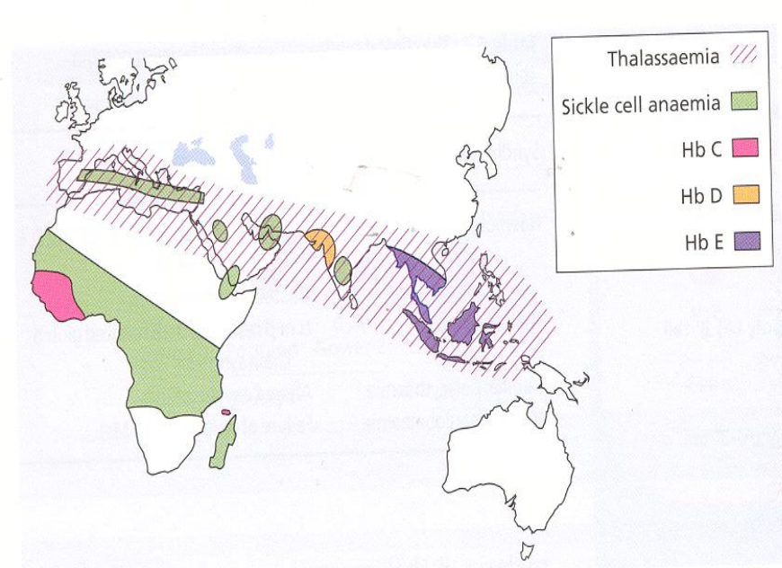
Thalassemia: inherited autosomal recessive disorder in which the protein part (Globin) of the hemoglobin is completely or partially missed, Due to missed genes.
-The Pathophysiology reflects the impact of an imbalance in the expression of α and β globin chains. Remember: Thalassemia considered as Microcytic Hypochromic Anaemia (1st lecture Recall)
Effects of thalassaemias:
The chains which are present in excess will precipitate in the precursor red cells, leading to their premature death prior to release from the bone marrow (ineffective erythropoiesis). ineffective erythropoiesis that’s mean the bone marrow is forming the red blood cells but not releasing .
The resulting anemia leads to an increased erythroid drive.
There is further expansion of the marrow into bones not typically used
for haemopoiesis, and into the spleen, so
The long-term consequences of thalassaemia will lead to
1- Splenomegaly. Due to compensation because bone marrow is not working normally, body will request from the spleen and the load on spleen will increase and lead to splenomegaly
2- Bony deformities. Because the bone marrow expand to compensate and take the bony space leading to the deformities.
3- Iron excess as well as chronic anaemia. iron because of repeated blood transfusions given to a patient suffering from thalassemia ,so with each blood transfusion more iron is acquired
-Normal alpha chain is made from 141 amino acid
-Normal beta chain is made from 146 amino acid
It is divided into:
1- α-Thalassaemias: defect in the synthesis of α-Globin chains
2- β-Thalassaemias: defect in the synthesis of β-Globin chains

Slide 5
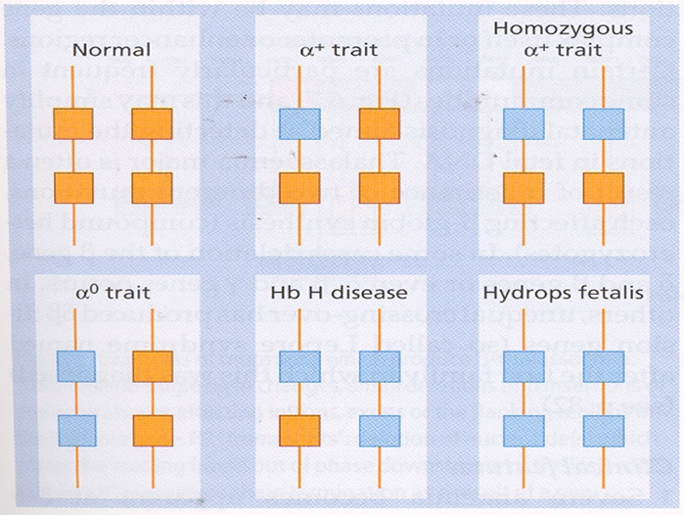
1. α – Thalassaemia:
Could be Either:
Heterozygous.
Homozygous.
This picture is important for the next 2 slides
Normally We have 4 genes of α- globin chains in our chromosome 16 , Each 2 genes located in one allele, each allele comes from each parent. (Picture No#1)
So we can sub-divide the α-Thalassaemia according to how many genes is defect in which allele into:
1- α⁺-Thalassaemia trait (Alpha Plus): when there is deletion in One or Two α- globin chain genes, it could be either (the silent carrier) :
Heterozygotes α⁺-Thalassaemia trait: When there is deletion of 1 Gene from 1 Allele. (Picture No#2)
Homozygous α⁺-Thalassaemia trait: When there is deletion of 2 Genes from 2 different Allele. (Picture No#3)
Affected individuals are asymptomatic, although they have minor haematological changes such as slight reductions in mean cell volume (MCV) and mean cell haemoglobin (MCH) (Microcytic Hypochromic Anaemia).
2-α⁰-Thalassaemia trait (Alpha 0): When there is deletion of 2 Genes from the same allele. (Picture No#4)
The Haemoglobin is either normal or slightly reduced and the MCV and MCH are low (Microcytic Hypochromic Anaemia).
3- Haemoglobin H disease (3 Genes deletion) Usually this patient come seeking for treatment : When there is deletion of 3 Genes from the alleles. (Picture No#5).
This chronic haemolytic anaemia results from the inheritance of both the α⁺- and α⁰-thalassaemia alleles, leaving one functioning α-globin gene per cell.
α-globin chains are produced at very low rates, leaving a considerable excess of β-chains, which combine to form tetramers (β4). This tetramer is known as Haemoglobin H.
1
2
3
4
5
6

Slide 6
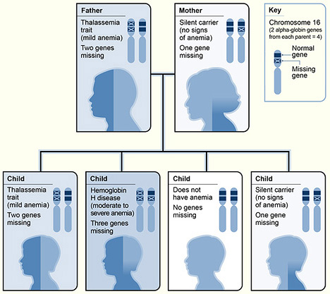
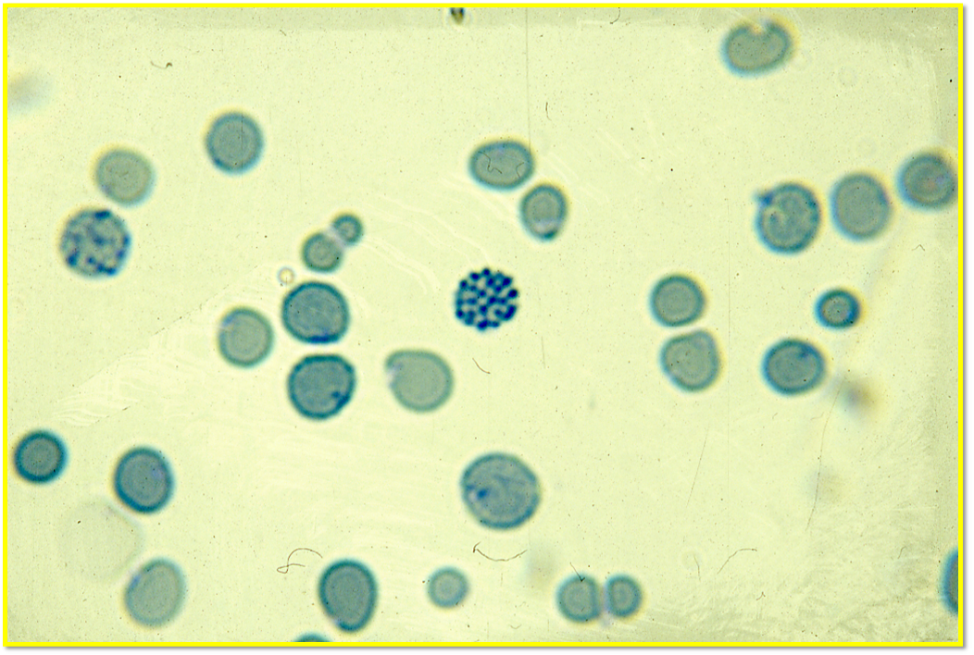
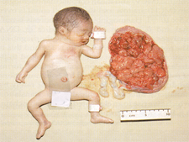
α – Thalassaemia (cont.)
α-globin chains are produced at very low rates, leaving a considerable excess of β-chains, which combine to form tetramers (β4). This tetramer is known as Haemoglobin H.
Haemoglobin H is unstable and precipitates as the erythrocytes become aged, forming rigid membrane-bound inclusions that are removed during the passage of affected red cells through the spleen.
The damage to the membrane brought about by this removal results in a shortened red cell lifespan.
Findings :
Most patients are moderately affected, with anaemia of 7-11g/dl (Moderate anaemia) and markedly hypochromic, microcytic indices.
Supravital staining of the blood film demonstrates cells with many HbH inclusions, giving a characteristic ‘golf-ball’ appearance.
Most patients will be transfusion independent. Some of them need .
Splenomegaly is seen in most patients.
Hb H
Inheritance of Hb H
Supravital staining shows “Golf-Ball“ appearance
4- Hb Bart’s hydrops fetalis syndrome (ALL Genes deletion): When there is deletion of all four α-globin genes. (Picture No#6).
No α-chains can be formed and the fetal γ-globin forms tetramers known as Haemoglobin Bart’s. (all the 4 are γ)
This haemoglobin is not useful for oxygen transport, despite the persistence of the embryonic haemoglobin (Hb Portland) There is intrauterine or neonatal death due to hydrops.
If he lived maximum for 1 hour then he die because there is no oxygen transfusion.

Slide 7
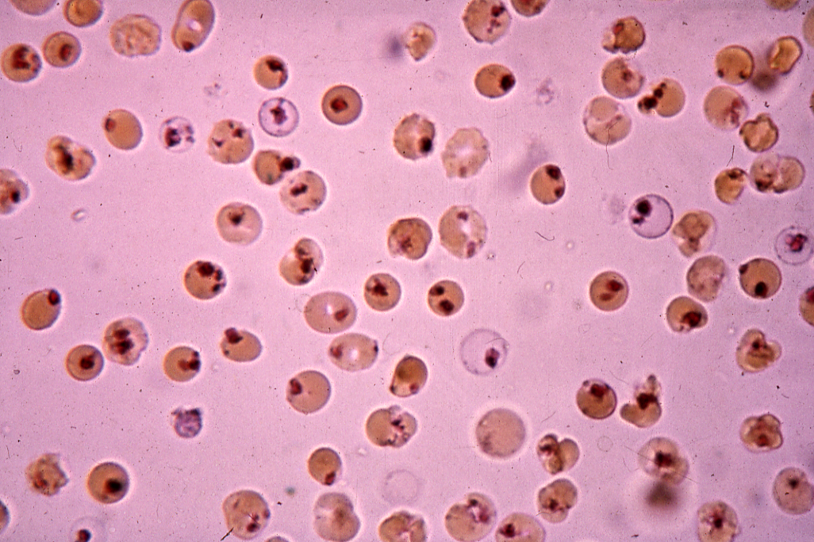
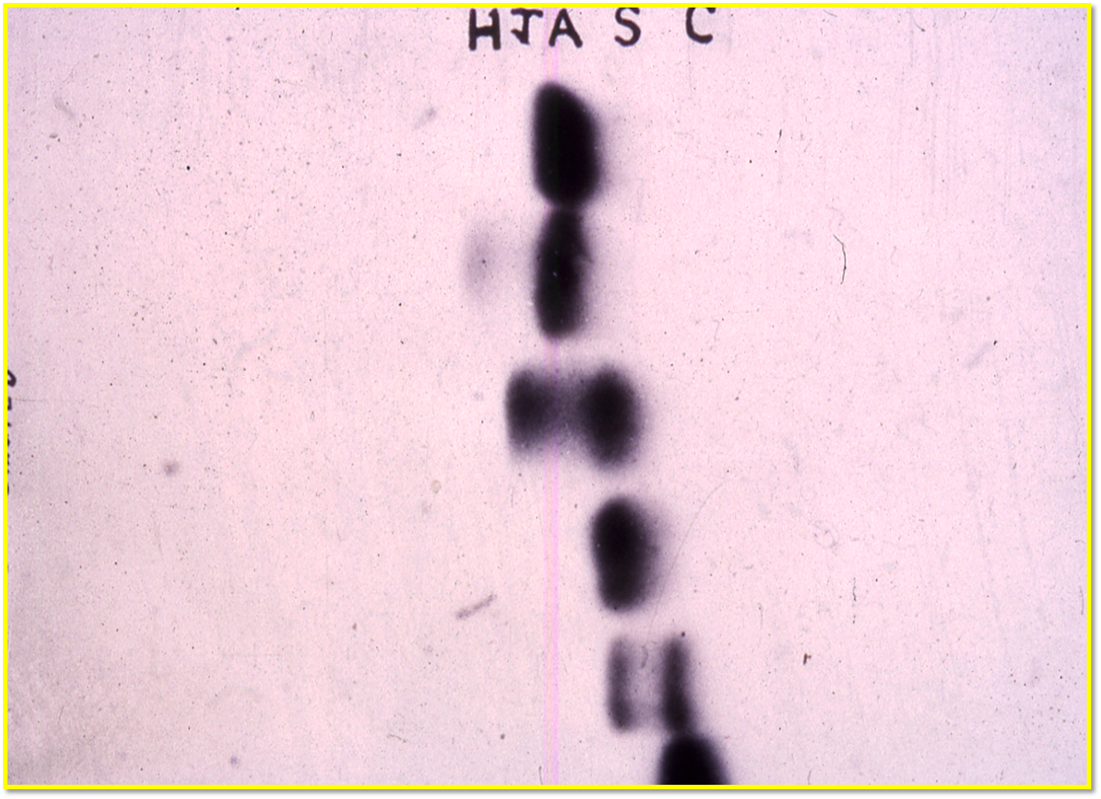
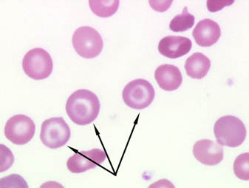
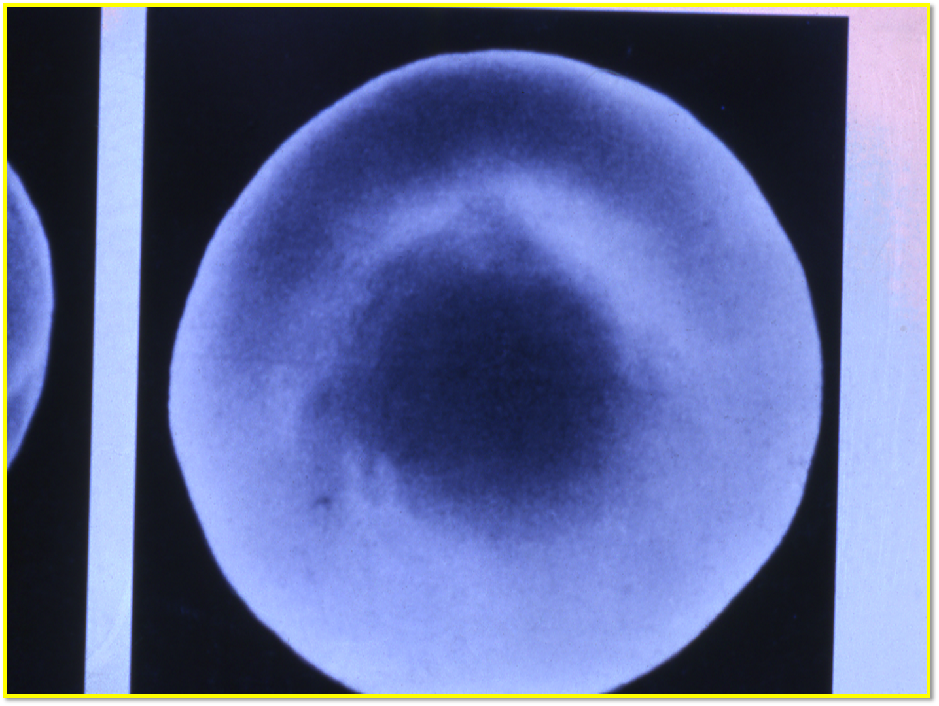
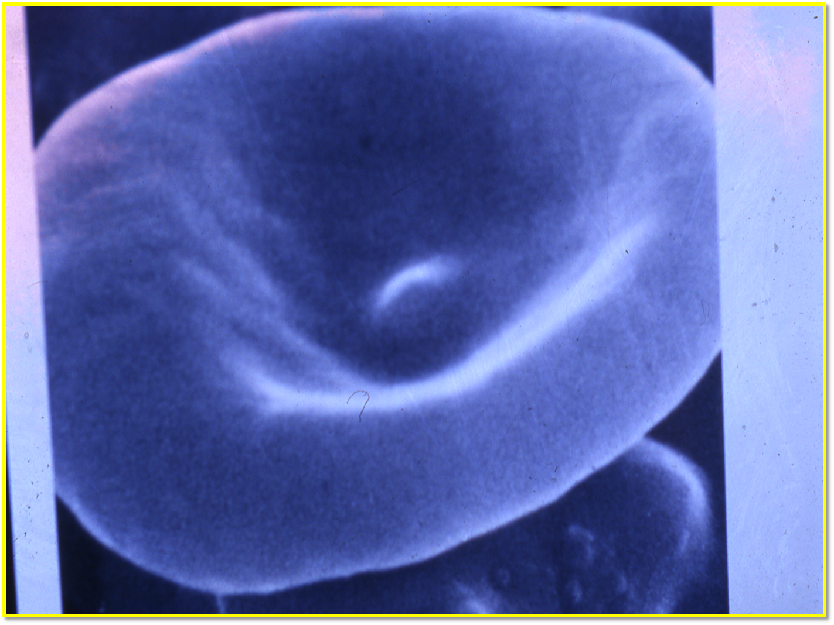
Laboratory Diagnosis Of Alpha Thalassemia Syndrome
High red cell count in the trait. To compensate for the anemia
Hypochromic microcytic red cells & target cells.
Normal serum iron or low in children.
Normal total iron binding capacity or high in children.
Positive Hb H inclusion bodies in the blood film preparation & positive Heinz bodies with vital stains .
Hemoglobin electrophoresis show presence of hemoglobin H (Hb H disease).
Hemoglobin electrophoresis show low Hb A2 level.
Genetic study to confirm the diagnosis.
Heinz bodies
electrophoresis
Heinz bodies we mix the violate stain (methyl violate) or supravitally stain with blood and then we have red pink inclusions bodies .
Sever Hb H golf cell
Target cell
Increase or folding of the membrane in the middle .
(نقطة في وسط الكرية الحمراء)
Normal cell
Target cell

Slide 8
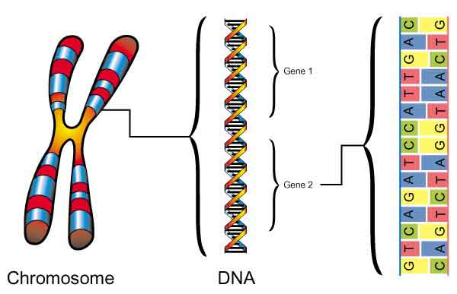
2. Β – Thalassaemia it has 60 variants :
According to WHO there are 1.5% of the world’s population are carriers of β-thalassaemia.
The prevalence of the β-thalassaemia trait is particularly high in southern Europe (10-30%) and south-east Asia (5%), common in Africa, the Middle East, India, Pakistan and southern China. (Italy) جزيرة قبرص اكثر شيء في العالم
Difference between α & β-thalassaemias:
α –Thalassaemia : arises from gene deletions.
β-Thalassaemia: results from a multiplicity of different single nucleotide substitutions, insertions or small deletions affecting the β-gene itself.
- Nucleated Red cells & increase in A2 hemoglobin are the markers of β-Thalassaemia.
Normally we have 2 normal Genes responsible for β - Globin chain in Chromosome 11, So we can divide β-thalassaemia according to number of genes defect to :-
Single nucleotide
1- Heterozygous β-thalassaemia (Beta thalassaemia trait):
Most affected subjects with beta thalassaemia trait are asymptomatic.
Haemoglobin concentration is either normal or slightly reduced, hypochromic and microcytic red cell indices are seen.
Peripheral blood film may show red cell abnormalities such as target cells and poikilocytes (variation in shape).
HbA2 levels will be raised above the normal range to 3.5-7.0%.
Slightly increased HbF levels, in the range of 1-5%.
2- Homozygous β-Thalassaemia more sever
Defects of β-globin on both copies of chromosome 11
Marked anaemia .(usally below 7) .
Transfusion dependent. 2 units of blood .
That will lead to increase the infection risk and hemosiderosis will lead to deposition of iron in vital organs like brain , liver

Slide 9
Clinical classification of the thalassaemias (Mainly beta):
describes the presence of a thalassaemia mutation that is without clinical consequences. genes studies كل شيء طبيعي بس تكتشفه عن طريق | Thalassaemia minima:
describes patients with microcytosis and hypochromic red cells secondary to thalassaemia mutations, but with only mild anaemia (between 10-12 ) or a normal haemoglobin. Patients who inherit a single affected allele are usually in this category. (Heterozygous β-thalassaemia) | Thalassaemia minor or thalassamia trait (other name )
Patients will also have a microcytic hypochromic anaemia. Increased erythroid drive (Erythropoiesis) to maintain their haemoglobin. Packed bone marrow with a decreased myeloid:erythroid ratio. Normally myeloid is more than erythroid, because myeloid have short life . . Myeloid : erythroid ratio is normally 3:1 respectively Here it will be 1:5 Rbcs life span is 22 day We can see few Nucleated Red cells. extramedullary haematopoiesis giving splenomegaly. It’s hematopoiesis occurring outside of the medulla of the bone (bone marrow), e.g. spleen. Transfusion may be required to maintain the haemoglobin at times of additional physiological stress. Stress like pregnancy or infection or surgery . | Thalassaemia intermedia:
Have severe anaemia and are transfusion dependent. The most prominent type of hemoglobin is Hb F (up to 90%). We can see Nucleated Red cells Their increased erythroid drive(Erythropoiesis) leads to a packed erythroid marrow and splenomegaly . Development of bony abnormalities secondary to unchecked marrow expansion. Patients in this category are those with complete loss of β-globin expression from both copies of chromosome 11 . | Thalassaemia major:

Slide 10
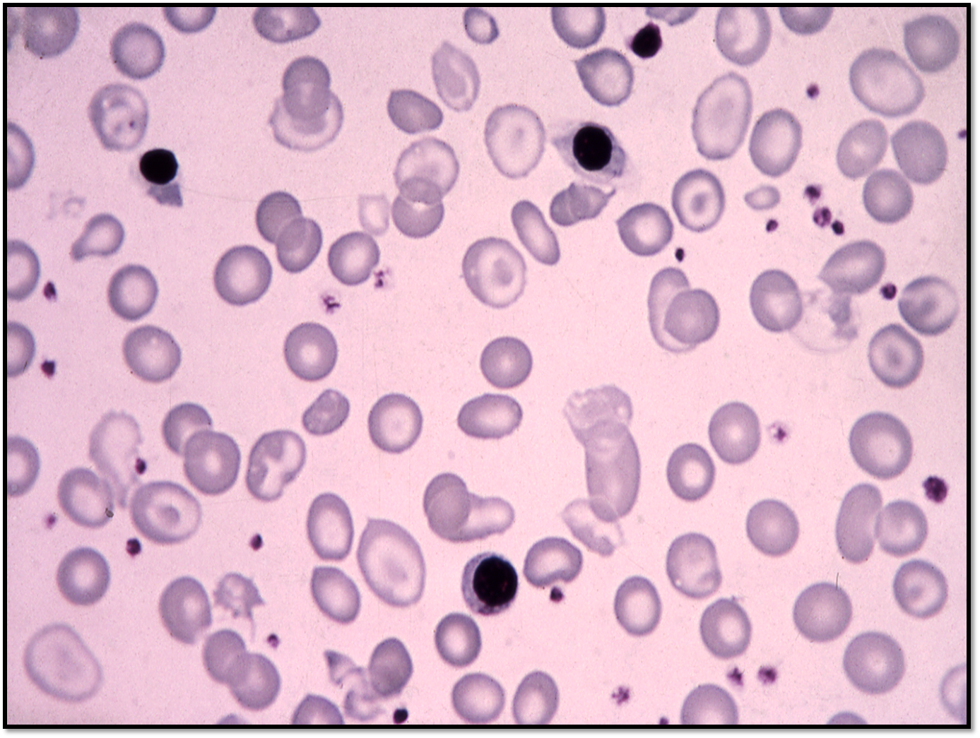
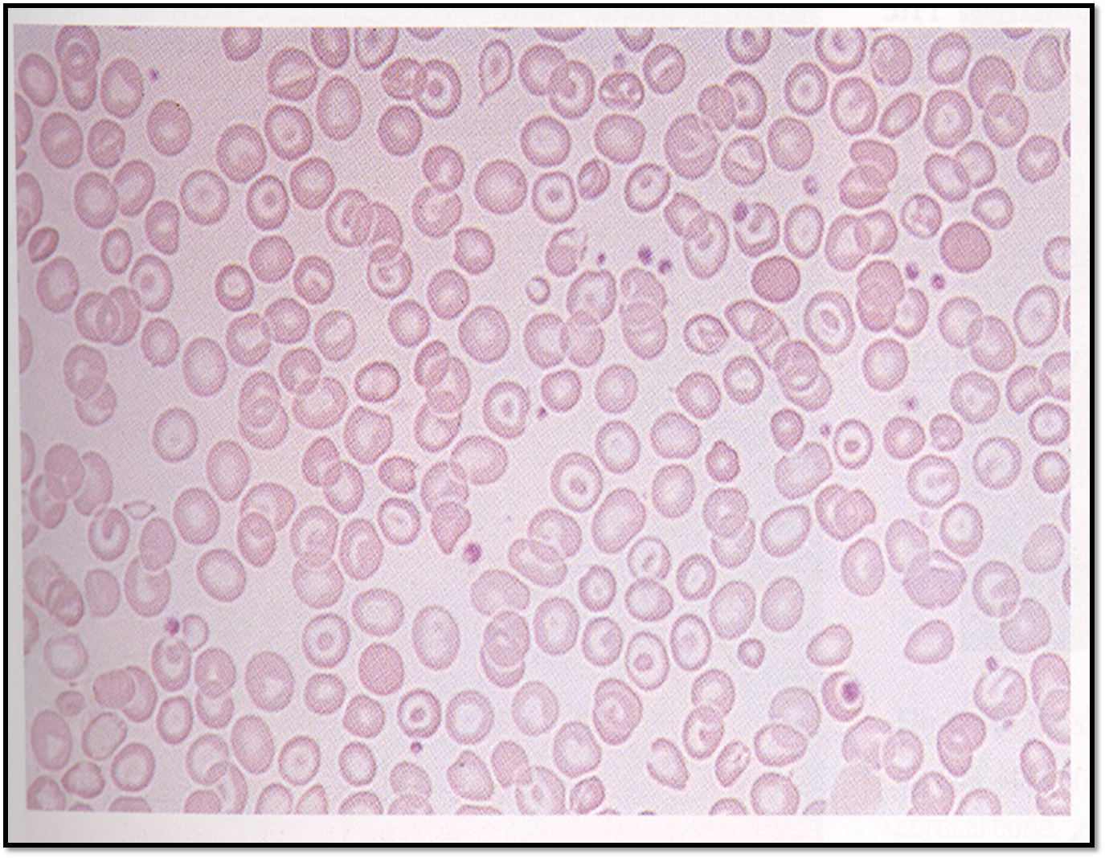
Histological Features of thalassaemias:
1-Histological Features of β-thalassaemia (It has Nucleated RBCs)
Nucleated red cells
Microcytosis
Target cells
Hypochromia
2- Histological Features of α-thalassaemia (there is NO Nucleated RBCs)

Slide 11
Clinical and Hematologic Features
of the β-Thalassemia Syndrome
(DON’T PANIC, this table is understandable and very easy)
 | Major | Intermedia | Minor | Minima
Severity of mainfestations | ++++ | ++ | +, ± | ±, 0
Genetics | Homozygotes, double heterozygotes | Homozygotes, double heterozygotes, rarely heterozygotes | Heterozygotes | Heterozygotes
Splenomegaly | ++++ | ++,+++ | +,0 (mild or No) | 0 (No)
Jaundice | +++ | ++,+ | 0 | 0
Skeletal changes | ++++,++ | +,0 | +,0 | 0
Anemia (Hb, g/dl) | <7 | 7 – 10 | >10 | Normal
Hypochromia | ++++ | +++ | ++ | +
Microcytosis | +++ | ++ | + | 0
Target cells | 10 – 35% | ++ | + | ±
Basophilic stippling | ++ | + | + | 0, +
Reticulocytes (%) | 5 – 15 | 3 – 10 | 2 – 5 | 1 – 2
Nucleated red cells | +++ | +, 0 | 0 | 0
±, little or no abnormality; +, mild abnormality; ++++, prominent abnormality

Slide 12
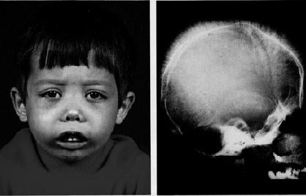
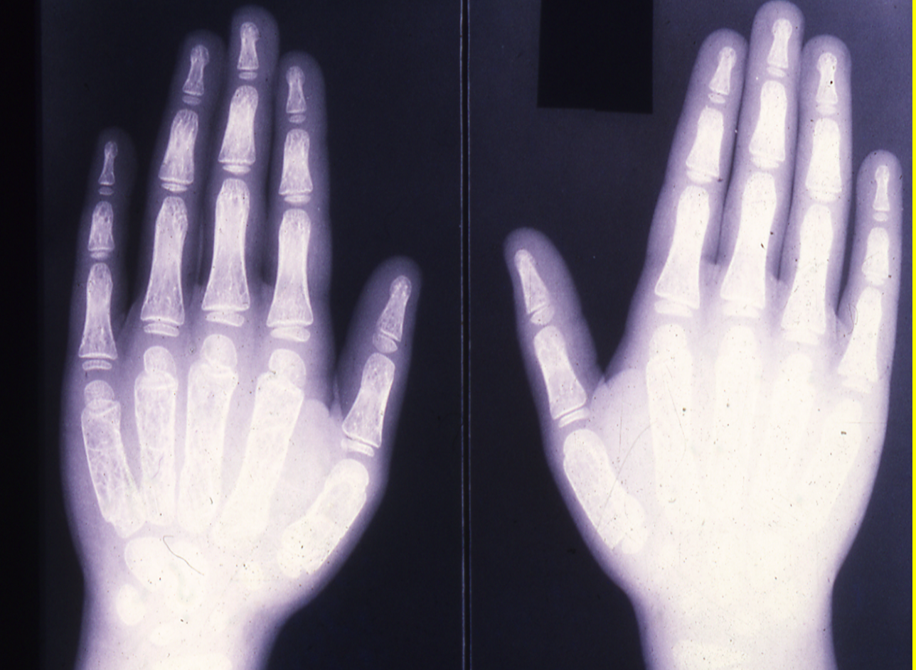
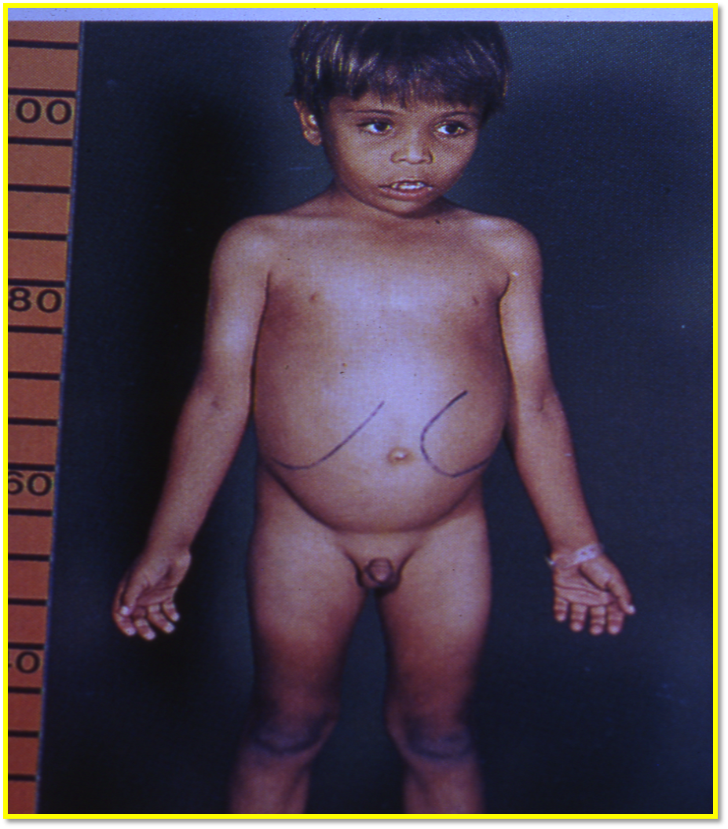
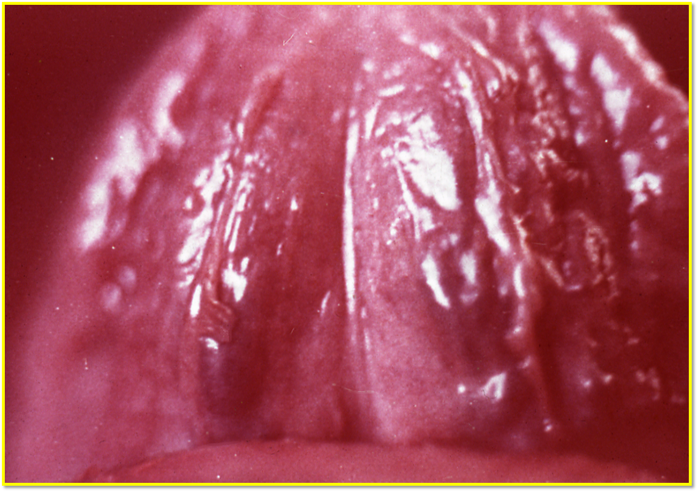
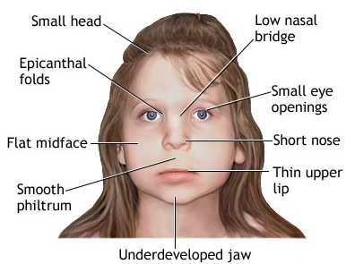
Clinical Manifestations in Thalassaemias: (Important)
Pallor.
Jaundice (There is No jaundice in IDA).
Apathy (lack of interest, enthusiasm, or concern). (Be inactive)
Anorexia (lack or loss of appetite) .
Failure to Thrive. No or slow growth duo to endocrine failure .
Hepato-splenomegaly.
Skeletal Deformity (Due to over growth of bone marrow).
Iron Overload manifestations (Due to blood transfusion dependency)
hair on end appearance
Abnormal
Normal
Hepato-splenomegaly
Become less dense because of bone marrow expansion
The best site to see jaundice is the tongue not the sclera because some of the black people normally have yellow sclera.
Thalassemia Face:
in β-thalassemia major They have the same facial characteristics:
● Forehead bossing (protrusion) because of over growth of bone marrow
● Prominent maxilla
● Widen space between eyes Because of increasing the demand on bone
marrow, facial bones become expanded.
● Nose depression
.
X-Ray (we have to do it) : Hair-on-ends appearance. (as a result of skeletal
deformity) very clearly. Hemolytic anemia has the same manifestation but
here is more obvious

Slide 13
Diagnosis of Haemoglobinopathies including Thalassaemias:
Personal & Family History
Physical Examination
Laboratory Investigation:
1. Haematological Tests – CBC, Red cell indices, blood film Morphology, reticulocyte count.
2. Sickling Tests – Sickle cell test, Sickle cell solubility test.
3. Hb Electrophoresis at alkaline/acidic pH and quantitation.
4. Quantitation of Hb A2 and Hb F (it will increase)
5. Serum iron total iron binding capacity and ferritin level.
In thalassaemia major we will have high storage of iron
- ferritin level measure iron storage indirectly the best way to measure iron is liver biopsy and bone marrow is useful as well
6. Biochemical tests:
-Liver functions tests, renal function tests, blood gases and acid-base status, bone profile and urine analysis.
7. Special Tests
A. Family studies (Laboratory Investigations)
B. Measurement of Alpha/Non-Alpha chain ratio
Gene Studies most accurate
Some of the differences between iron deficiency anemia and thalassemia :
IDA | ⍺-Thalassemia | β-Thalassemia
NORMAL HbA2 | HbA2 | HbA2
Red cell count | Red cell count | Red cell count
Pale | Pale & Jaundice | Pale & Jaundice

Slide 14
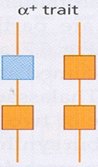
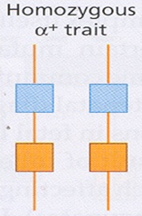
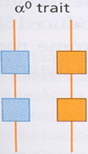
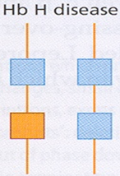
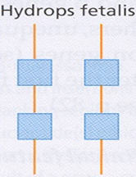
We didn’t put the Extra slides if you want to read it you can check it from the original doctor’s lecture slides
Summary

Slide 15
MCQs:
Q1- Andrea Pirlo 5 years old Italian patient come to your clinic, you noticed that he looks pale & yellowish, after further investigations you found that he has Nucleated red cells & increase in Hb A2, What is your diagnosis according to these findings?
A- Iron deficiency anemia B- Polycythemia
C- β-thalassaemia D- α-thalassaemia
Q2- How many amino acids forms Alpha chain ?
A- 141 B- 146
C- 23 D- 121
Q3- Beta globin chain’s Gene found in which of the following chromosome?
A- 11 B- 16
C- 1 D- 3
Q4- Which ONE of the following Types of anemia describe Thalassemia?
A- Normochromic Normocytic B- Hypochromic Microcytic
C- Macrocytic D- Iron deficiency
1- C
2- A
3- A
4- B
Good Luck !
Team members:
Fahad Al-Askar
Abdulaziz Al-Hussainy
Monera Al-Ayuni
Team Leaders
Abdulaziz Al-Hussainy
Safa Al-Osaimi

