Slide 1






BLOOD TRANSFUSION& CROSS-MATCHING
Objectives:
To identify the key elements in the current blood bank services.
To appreciate the implemented measurements and standards for obtaining the highest quality in the blood bank services.
To have a general idea about the donation process and main blood components.
To understand the inheritance and significance of the ABO system.
To understand the nature and significance of the Rh blood group system.
To understand the cross-matching process, including the antiglobulin test.
To have an overview about main hazards of blood transfusion.
Color code:
Important. Extra. Doctors notes
References:
436 girls & boys’ slides
435 teamwork slides
Editing file
Do you have any suggestions? Please contact us!
@haematology436 E-mail: Haematology436@gmail.com
or simply use this form

Slide 2
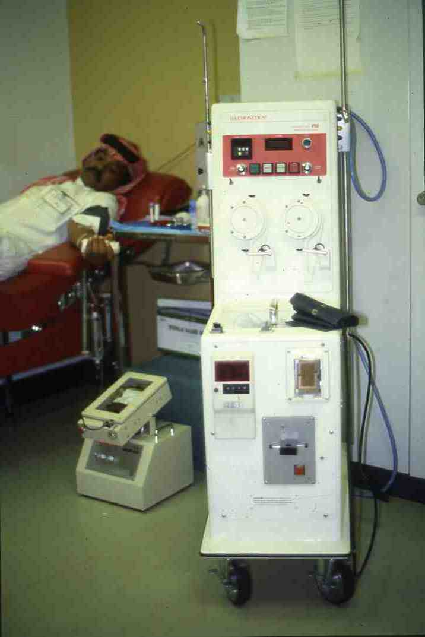
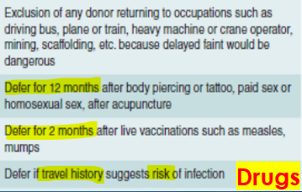
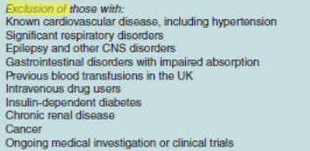
Blood Bank Units
Traditionally, two parts: (important to know what happened in each service)
1) Donation services: donor area, component separation, infectious testing, ABO typing and RhD screening, inventory.
2) Transfusion services: inventory, Patient (recipient) ABO grouping, RhD and antibody identification screening, cross-match, component issuing*.
Currently in the major hospital, there is a apheresis unit (technique by which a particular substance or component is removed from the blood, the main volume being returned to the body.) (donation, therapeutic or prophylaxis).
In many tertiary hospitals, stem cell unit, cord blood unit and tissue banking.
For your info..
the device’s name is shaker, The patient sits at a 45 angle and the blood is collected into the bags within 30 min
Donor Selection
-Allogenic: form others
-Autologous : from ones self (People storing blood for themselves in the future to avoid any reaction in case if transfusion)
What are the criteria for accepting blood donation?
Age: 17-70 y.o
Weight: above 50kg
Haemoglobin: more than 134g/l for men & more than 120g/L for women
All donors must pass the physical and health history examinations given prior to donation.
Minimum donation: no blood donation in the last 3 months, (16 weeks advised), and a maximum of 3 donations per year.
Pregnant and lactating women excluded (because of high iron requirements) donation referred 9 months after pregnancy
Two units of red blood cells can be donated at one time, using a process known as red cell. apheresis. This type of donation can be made every 16 weeks.
Aphaeresis for platelets or plasma up to 24 times in 12 months.
Everything highlighted is very important
Donor form (the form that we give the donor to fill before donating blood)
1-Powerful tool for screening.
2-Identify high risk behaviors.
3-Some issues can only be ruled out by systemic questionnaire.

Slide 3
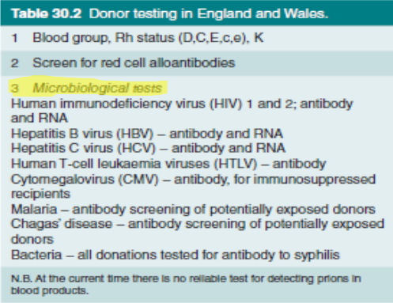
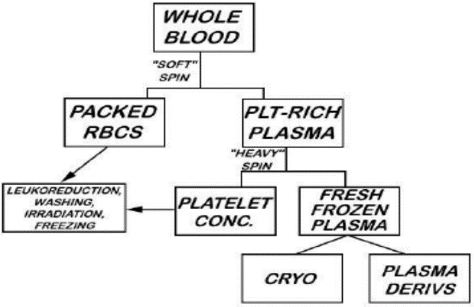
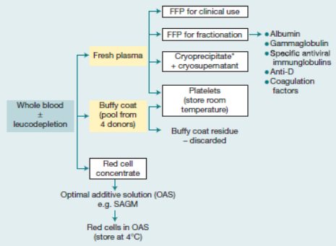
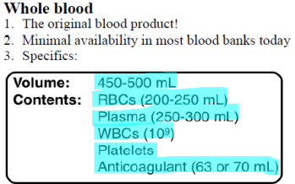
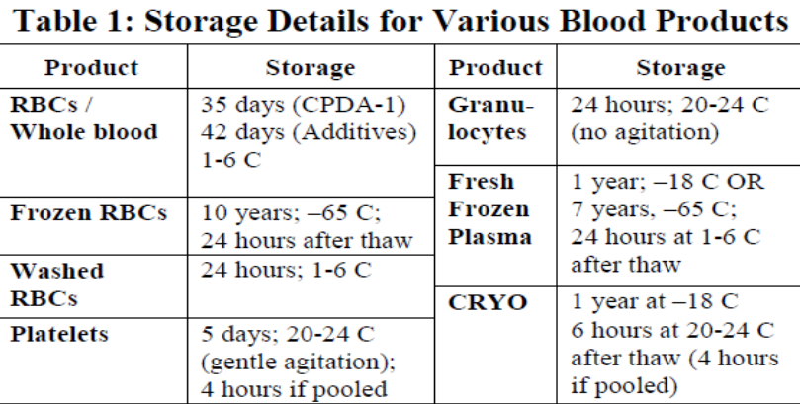
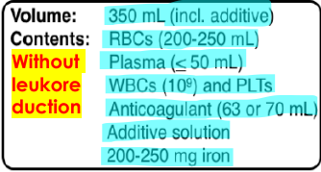
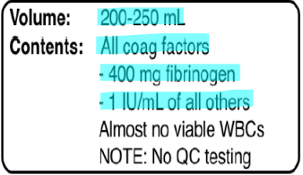
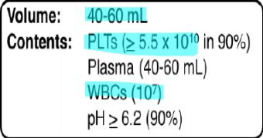
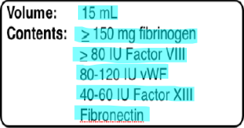
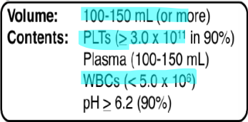
Infectious Testing
Extra testing (not in all cases):
1-Sickle cell.
2-G6PD level
Component Separation
Component Storage
-Packed RBC unit
الكميه اللي نسحبها
In the fridge
-Whole blood donor (5-6 pooled)
Stored In room temp.
-Single donor (apheresis) adult dose
In freezer
Cryoprecipitate
The most important substance is the fibrinogen

Slide 4
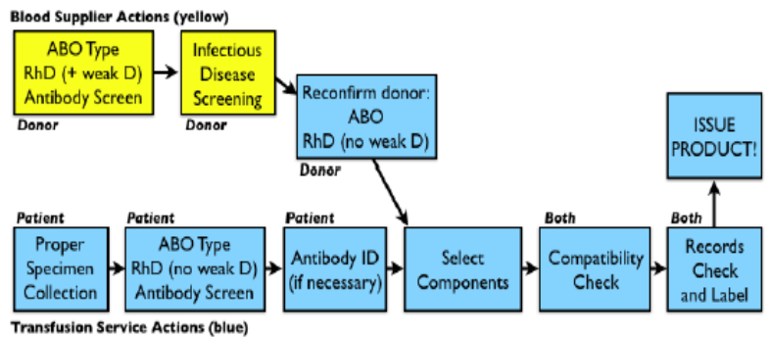
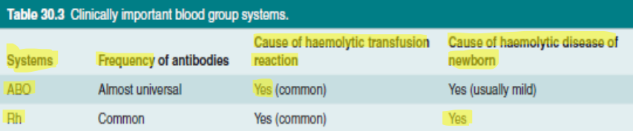
Transfusion Unit
These investigation are applied on both blood donor and patient
Blood group systems
One of the main problems in the transfusion of blood is the avoidance of immunological reactions resulting from the differences between donor and recipient red cells.
When the red cells of a donor are transfused into a recipient who lacks these antigens, they may induce an immunological response.
There are at least 30 major blood group systems (e.g. the ABO group, Rh group).
other clinical important group systems (just know its name): Kell, Duffy, Kidd, Lutheran, lewis, P, MNS, Li.
1-ABO system
Practically all red cells have the H antigen, a carbohydrate group attached mainly to proteins on the cell membrane (FUT1, Ch19q).
• This antigen is the basis for the ABO blood groups.
• The ABO locus is encoded on chromosome 9q, where one of three possible alleles may be found.
Haemolytic reactions will occur immediately in the event of incompatible transfusion, and may be fatal.
The most important thing is the immunological reaction, The infection substance takes time to come out
If the blood groups are totally different then it is fatal within minutes.
The most
More then the ABO
A allele | H antigen + N-acetylgalactosamine = A antigen | By encoding for a glycosyltransferase.
B allele | H antigen + galactose = B antigen | By encoding an alternative glycosyltransferase.
Allele O | The H antigen remains unmodified | Encode no functional enzyme at all.

Slide 5
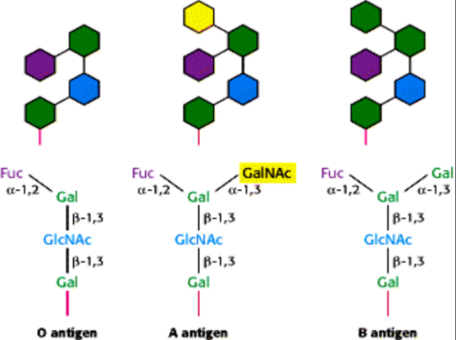
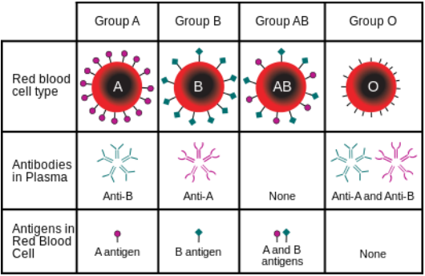
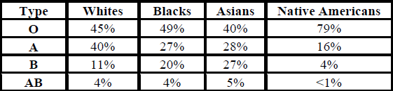
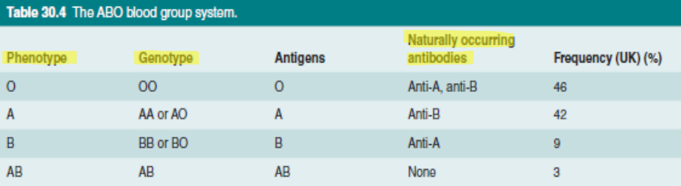
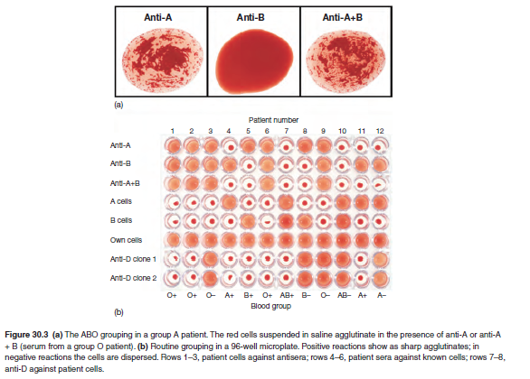
1-ABO system cont.
highest
lowest
Distribution may be different for special racial and ethnic groups? YES!
Cross match test
The importance if this test:
1-Forward grouping
2-Backward grouping
3-RhD grouping for patient and donor.

Slide 6
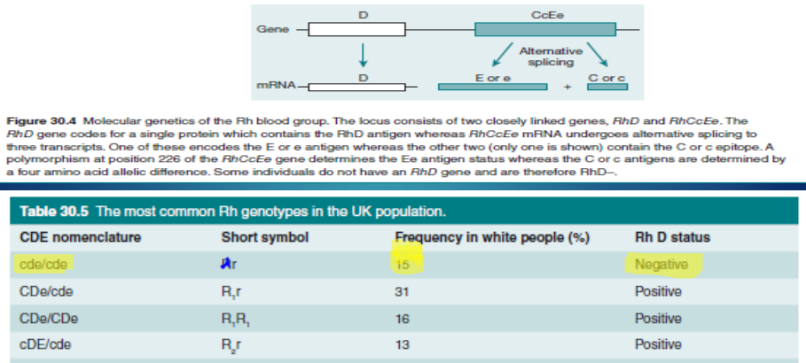
2-Rh system
The Rh system is also of great importance and can cause problems with both transfusion and pregnancy.
The inheritance of the Rh blood group system is slightly more complex than that of the ABO system.
Two separate genetic loci on chromosome 1 encode for a total of five antigens.
The first locus, RHD, has alleles D or d; D encodes a transmembrane protein featuring the D antigen, while the allele d encodes a variant that does not bear this antigen.
RHCE is an adjacent locus that encodes a transmembrane ion channel bearing the antigens C (or its variant, c) and E (or its variant, e). Alleles at this locus may be described as CE, Ce, cE and ce, denoting the set of antigens they encode. If positive capital D and if negative small d
A complete description of the Rh haplotype for a patient will include alleles at both RHD and RHCE loci. The commonest haplotypes are DCe, dce and DcE.
The D antigen is the most clinically important of the Rh group antigens, due to its high immunogenicity.
An RhD-negative person (e.g. dce/dce) has over a 50% chance of developing anti-D antibodies after the transfusion of one unit of RhD-positive blood: it is therefore important that RhD-negative patients receive RhD-negative blood.
Note that unlike the ABO system, Rh antibodies are not naturally occurring; they must be raised by exposure of an antigen-negative individual to the appropriate antigen, either through transfusion of incompatible blood or through pregnancy.
After the exposure, IgG antibodies come to predominate, and hemolysis is generally extravascular (major cause of HDFN/HDN).
The Rh system is most important in pregnancy

Slide 7
Management of mother and child
Women who are negative for RhD are given routine antenatal anti-D prophylaxis at 28 weeks, 34 weeks and within 72 hours of delivery.
This involves an intramuscular injection of anti-D immunoglobulin, which prevents active immunization in the case of red cell transfer across the placenta.
Any potentially sensitizing event is also treated with additional anti-D administration: such events include abdominal trauma, threatened abortion, or any spontaneous abortion after 12 weeks
3-Other blood group systems
Other blood group antibodies, which are sometimes a problem during blood transfusion, include the following:
  -anti-K (Kell system)
  -anti-Fya (Duffy system)
  -anti-Jka (Kidd system)
  -anti-S (part of the MNSs blood group system).
These antigens are relatively poorly immunogenic.
Their potency in stimulating antibody production is 10-1000 times less than that of RhD.
Consequently, these antigens may not need be routinely assessed prior to transfusion.
Compatibility
- The purpose of cross-matching blood before transfusion is: to ensure that there is NO antibody present in the recipient’s plasma that will react with any antigen on the donor’s cells. (Major cross-match, IAT)
The basic technique for detecting such antibodies relies on their ability to agglutinate red cells that bear the appropriate antigen.
important
Very rare and weak (immunological affect is less then RhD)
Blood Transfusion:
Don’t worry, basics
Blood compatibility testing (CROSSMATCH)
Front type | Back type
Determines which antigens(“Flags") in the ABO blood group system are on the patient's Red Blood Cells as follows: | identifies the isohaemagglutinin (Naturally Occurring AntiBody in the patient's serum and should correspond to the antigens found on the Red Blood Cells as follows:
B antigen only < Type B A and B antigens <Type AB Neither A or B <Type O | Anti-A <Type B Anti-A and anti-B <Type O Neither anti-A or anti-B <Type AB
In addition, RBCs are Rh typed and identified as "D“ positive or negative

Slide 8
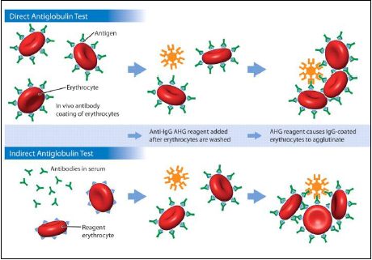
Antiglobulin Test: Its purpose is to detect antibodies to red cell surface constituents, either bound to the red cell surface or free in the serum. can be used in two ways :
detect antibody already on the patient’s cells in vivo. (direct antiglobulin test) | detect the presence of antibody in serum (indirect antiglobulin test)
-Red cells are washed to remove the free IgG in the plasma, which would otherwise react with and neutralize the antiglobulin. -After washing, anti-human globin is added and, if the red cells are coated with antibody, agglutination takes place -used in the diagnosis of autoimmune haemolytic anaemia | -as in the crossmatching of blood for transfusion. -In this case, serum from the patient who requires transfusion is incubated with donor red cells. -Any antibody present in the recipient’s serum that has specificity for antigens on the donor’s cells will interact with those cells. -After washing, addition of anti-human globulin will bring about red cell agglutination.
Hazards of blood transfusion:
very important
Measures to protect recipient
Donor selection Being that he fits the criteria and right choices | Leucodepletion* of cellular product
Donor deferral /exclusion | Post-collection viral inactivation of FFP
Stringent arm cleaning | Monitoring and testing for bacterial contamination
Microbiological testing of donations | Pathogen inactivation of cellular component
immunohaematological testing of donation | Safest possible source of donor for plasma products
Discarding the first 20-30 ml of blood collected | FFP fresh frozen plasma
*White blood cells removal

Slide 9
Complications of blood transfusion
Immediate Transfusion Reactions | Delayed Transfusion reactions
Hemolytic reactions (Immediate IgM or delayed IgG) Allergic reactions Clotting abnormalities after massive transfusion Transfusion related acute lung injury (TRALI) Bacterial contamination Circulatory overload (From over transfusion ) citrate toxicity Air embolism Hyperkalemia Hypocalcemia (infants, massive transfusion) Pyrogenic reactions(to plasma proteins/HLA ABs) Post-transfusion purpora Anaphylaxis Thrombophlebitis* Reactions caused by infected blood | Transmission infection Transfusional iron overload Immune sensitization e.g to red cells, platelets or RhD antigen Transfusion associated Graft vs Host disease. Solution: irradiation
Management of Transfusion Reactions
The first action is always to stop the transfusion and clarify that the correct patient’s details are on the component being transfused.
The reaction happens after 50 cc of blood or within 10 -15 min the reaction happens.
If there is any complication we have stope the blood transfusion immediately
Any suspicion of ABO incompatibility should lead to the institution of circulatory support with IV fluids, careful monitoring of pulse, blood pressure and urine output, and supportive management of any developing DIC.
The component bag should be returned to the transfusion laboratory with a fresh cross-match sample from the patient.
Samples should also be sent to assess for intravascular hemolysis - including a full blood count, serum haptoglobin, and hemoglobinuria.
It is important to ensure that the possibility of bacterially contaminated units has been addressed through taking blood cultures.
*an inflammatory process that causes a blood clot to form and block one or more veins, usually in your legs.

Slide 10
Management of Transfusion Reactions (Cont’d)
If necessary, broad-spectrum antibiotics may be commenced empirically after cultures have been drawn.
Severe allergic reaction should be treated initially by stopping the transfusion and returning the unit to the laboratory.
Chlorpheniramine may help, but severe reactions are likely to require oxygen and nebulized salbutamol, plus intramuscular adrenaline in the case of circulatory collapse.
With mild fevers only, simple interventions may suffice (e.g. giving an antipyretic and slowing the transfusion); similarly, if a mild allergic reaction is evident (e.g. urticaria), chlorpheniramine followed by a slower reinstatement of the transfusion may help.
Appropriate investigations include a full blood count, a direct antiglobulin test, serum bilirubin and assessment of renal function
Massive Transfusion
What is massive transfusion:
The replacement of one blood volume over 24 hours, or as the replacement of 50% of circulating volume in 3 hours.
When to use it:
Patients with acute hemorrhage (i.e loss of red cells snd plasma) may need to be transfused with large quantities of packed red cells.
Complications:
With the transfusion of many units of packed red cells, the patient may become deficient in key plasma components such as clotting factors and may also become Thrombocytopenic (even in the absence of disseminated intravascular coagulation DIC )
Solution
1- the administration of one unit of FFP per unit of red cells may be effective in replacing clotting factors.
2- Fibrinogen and platelets should also be replaced, with 2 pools of cryoprecipitate and 1 adult dose of platelets per 6-8 units of packed red cells.

Slide 11
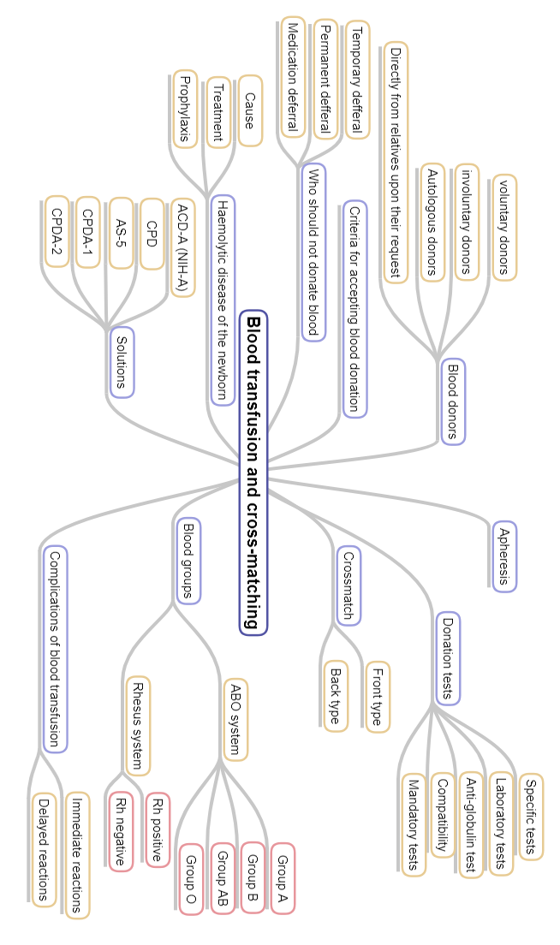
Summary:

Slide 12
MCQs:
Q1: Sarah is scheduled for a Rhinoplasty next month and she wishes to donate blood, what is the type of donation in her case?
A- Voluntary donation
B- Involuntary donation
C- autologous donation.
Q2: Ali is an AIDS patient, when is it allowed for him to donate blood?
A- After 3 years
B- Never
C- After 6 months
Q3: The basis of the ABO blood groups is?
A- H antigen
B- anti-K
C- anti-D
Q4: You are covering a shift in the A&E department and you have a motor vehicle accident patient who lost a lot of blood and requires an immediate blood transfusion, there is no prior history of this patient and his blood type is unknown, what should you do?
A- Wait for the lab results
B- Give him O-ve
C- give him O+ve
Q5: An RhD-positive mother is pregnant with an Rhd-negative baby, what is the appropriate response? a- There is no danger in this case b- Exchange transfusion for the infant c- anti-D injection for the mother
1-C
2- B
3- A
4-B
5- A
Good Luck!
Team members:
Girls
Ghadah AlMazrou
Aseel Alsulaimani
Yara Aldigi
Wejdan Alzaid
Team Leaders
Safa Al-Osaimi
Abdulaziz Al-Hussainy

