Slide 1
Megaloblastic Anemia
Objectives:
To understand the mechanisms by which macrocytic anaemia may arise
To appreciate the signs and symptoms of macrocytic anaemia
To understand how macrocytic anaemia can be classified
To be able to know the causes of macrocytic anaemia
To understand the normal metabolism of vitamin B12 and folic acid, and to appreciate how megaloblastic anaemia may arise
To suggest some normoblastic causes of microcytosis.
Important
Extra.
Notes
References:
436 girls & boys’ slides
435 teamwork slides
Editing file
Do you have any suggestions? Please contact us!
@haematology436 E-mail: Haematology436@gmail.com
or simply use this form

Slide 2
Normal adult red cell values
Female | male
115-155 | 135-175 | Haemoglobin* (g/L)
36-48 | 40-52 | Haematocrit (PCV) (%)
3.9-5.6 | 4.5-6.5 | Red cell count (x10¹²/L)
27-34 |  | Mean cell haemoglobin (pg)
80-95 |  | Mean cell volume (FL)
300-350 |  | Mean cell haemoglobin concentration g/L)
25-125 (1-2 %) |  | Reticulocyte count (x10⁹/L)
*In children normal hemoglobin values are: newborn, 150 – 210g/L , 3 months, 95 – 125g/L , 1 year to puberty, 110 – 135g/L.
* PCV, packed cell volume.
Normal White Cells (WBC) Count In Adults
4.0 - 11.0 X 10⁹/L | TOTAL
2.5 - 7.5 x 10⁹/L | Neutrophils
1.5 - 3.5 x 10⁹/L | Lymphocytes
0.2 - 0.8 x 10⁹/L | Monocytes
0.04 - 0.44 x 10⁹/L | Eosinophils
0.01 - 0.1 x 10⁹/L | Basophil
150-450 x 10⁹/L | Platelets
* Children have higher lymphocytes count

Slide 3
Normocytic, Normochromic Anaemia | Microcytic, Hypochromic Anaemia
MCV 80 – 95 fL | MCV< 80 fL
MCH>26pg | MCH<27pg
Types: Many haemolytic anaemias Anaemia of chronic disease (some cases) After acute blood loss Renal disease Mixed deficiencies Bone marrow failure, e.g. post-chemotherapy, infiltration by carcinoma, etc. | Types: Iron deficiency Thalassaemia Anaemia of chronic disease (some cases) Lead poisoning Sideroblastic anaemia (some cases)
Macrocytic Anaemia:
Macrocytic anaemias can be divided into those showing
Normoblastic erythropoiesis | Megaloblastic erythropoiesis
describes the normal appearance of red cell maturation - but may still be associated with a macrocytosis (enlargment of red blood cells) in the peripheral blood | describes abnormal red cell development characterized by a lack of synchrony between the maturation of the red cell nucleus and its cytoplasm. It arises as a consequence of disordered DNA synthesis and results in a macrocytic anaemia.

Slide 4
Conditions in which Macrocytosis or hypersegmented neutrophils
may occur in the absence of megaloblastic anaemia
Macrocytosis:
Alcohol (affect the membrane by affecting the phosphate)
Liver disease (especially alcoholic)
Reticulocytosis (haemolysis or haemorrhage)
Aplastic anaemia or red cell aplasia
Hypothyroidism
Myelodysplasia (bone marrow is not making enough blood cells) including acquired Sideroblastic anaemia
myeloma and macroglobulinaemia
Leucoerythroblastic anaemia (resulting from space occupying lesion in the bone marrow)
Myeloproliferative disease
Pregnancy (physiological)
Newborn (physiological)
Chronic respiratory failure
2. Hypersegmented Neutrophils
Renal failure
Congenital (familial) abnormality
Iron deficiency
Note:- High MCV recorded when cold agglutinins or paraproteins are present.
Macrocytosis with Normoblasts
Normal neonates (Physiological)
Chronic alcoholism
Myelodysplastic syndromes
Chronic liver disease
Hypothyroidism
Normal pregnancy
Therapy with anticonvulsant drugs
Haemolytic anaemia
Chronic lung disease (with hypoxia)
Hypoplastic and aplastic anaemia
Myeloma
Causes of megaloblastic anaemia : Important
Cobalamin deficiency or abnormalities of cobalamin metabolism
Folate deficiency or abnormalities of folate metabolism
Therapy with anitfolate drugs (e.g. methotrexate)

Slide 5
Cont’d
Independent of either cobalamin or folate deficiency and refractory to cobalamin and folate therapy. a. Some cases of acute myeloid leukaemia, myelodysplasia.
b. Orotic aciduria (responds to uridine)
c. Therapy with drugs interfering with synthemis of DNA (e.g.
cytosine arabinoside, hydroxyurea, 6-mercaptopurine, azidothymidine (AZT)
d. Thiamine responsive
Suggested but poorly documented causes of megaloblastic anaemia not due to cobalamin or folate deficiency or metabolic abnormality: a. Vitamin E deficiency
b. Lesch-Nyhan syndrome (responds to adenine)
Others causes
Abnormalities of nucleic acid synthesis
Drug therapy: Antipurines (mercaptopurine, azathioprine), Antipyrimidines (fluorouracil, zydovudine (AZT)), Others (hydrozyurea)
Orotic aciduria
Uncertain aetiology: Myelodysplastic syndromes, erythroleukaemia Some congenital dyserythropoietic anaemias
Vitamin B₁₂ and folate nutrition and absorption:Important!
 | Vitamin B12 | Folate
Diterary sourse | Only food of animal origin, especially liver Our bodies are not able to synthesize it | Most foods, especially liver, green vegetable and yeast; destroyed by cooking
Average daily intake* | 7 - 30 µg | 200-250 µg
Minimum daily requirement* | 1-3 µg | 100-200 µg† This value and the previous one are higher comparing to vitamin B12
Body stores* | 3-5 mg, mainly in the liver | 8-20 mg, mainly in the liver
Time to develop deficiency in the absence of intake or absorption* | Anaemia in 2-10 years | Macrocytosis in 5 months.
Requirements for absorption | Intrinsic factor (To modify the absorption) secreted by gastric parietal cells | Conversiion of polyglutamates to monoglutamates by intestinal folate conjugase
Site of absorption | Terminal ileum | Duodenum and jejunum
* In adults. † Higher during pregnancy and lactation.

Slide 6
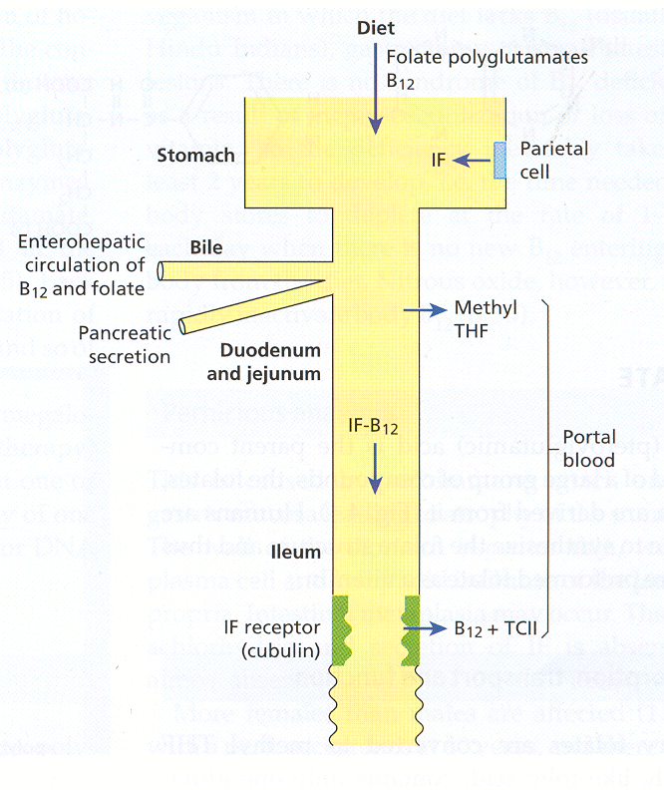
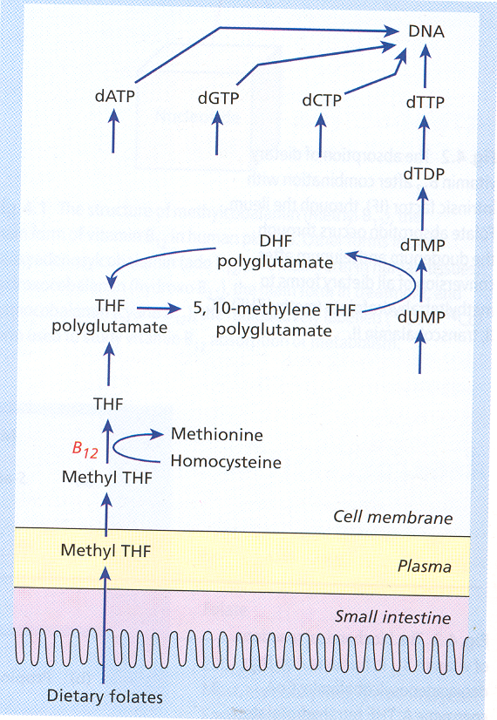
The intrinsic factor is attached to stomach wall
.
The receptor is located in the microvilli of Iluim wall
After attachment of IF and B12 its passage become facilitated to the circulation, after disassociation B12 will by transmitted by transcobulamine in blood
= Tetrahydrofolate
Most important step before DNA synthesis
This summaries the pathogenesis of megaloblastic anemia

Slide 7
Causes of vitamin B12 and folate deficiency:
folate deficiency | Vitamin B₁₂ Deficiency
Inadequate dietary intake Malabsorption Coeliac disease, jejunal resection, tropical sprue Increased requirement Pregnancy, premature infants, chronic haemolytic anaemias, myelofibrosis, various malignant diseases Increased loss Long-term dialysis, congestive heart failure, acute liver disease Complex mechanism Anticonvulsant therapy, * ethanol abuse* * Only some cases with macrocytosis are folate deficient. | Inadequate intake Veganism but they have normal enterohepatic circulation so even a small amount of B12 maybe enough for them Inadequate secretion of intrinsic factor Pernicious anaemia Total or partial gastrectomy Congenital intrinsic factor deficiency (rare) Partial gastrectomy, vagotomy, gastritis, acid-suppressing drugs, alcohol abuse Abnormal intestinal bacterial flora, multiple jejunal diverticula, small intestinal strictures Diphyllobothrium latum Malabsorption Crohn’s disease, ileal resection, chronic tropical sprue
Pernicious Anaemia:
It is a severe megaloblastic anemia due to autoimmune attack on the gastric mucosa leading to atrophy. so there is lack of intrinsic factor
More common in elderly female patients than males (1.6:1) at the age of 60 and above
More common in Northern European and tends to be in families
Pathogenesis:
The mucosa become thin with plasma cells and lymphoid infiltration of the lamina propria.
Intestinal metaplasia may occur. gastric carcinoma
It maybe associated with autoimmune diseases including the autoimmune poly-endocrine syndrome.
Findings:
Achlorhydria* and absent secretion of intrinsic factor (IF).
Progressive neuropathy is a common feature
Absent serum vitamin B12 level or almost absent level
Raised serum gastrin levels
Helicobacter pylori infection may be the cause which present in younger age as iron deficiency anaemia and in the elderly as pernicious anaemia may occur at early stage of the anemia
Increased incidence of gastric carcinoma in (2-3% of pernicious anaemia patients).
* Combination of Vit.b12 and IF need acidic environment

Slide 8
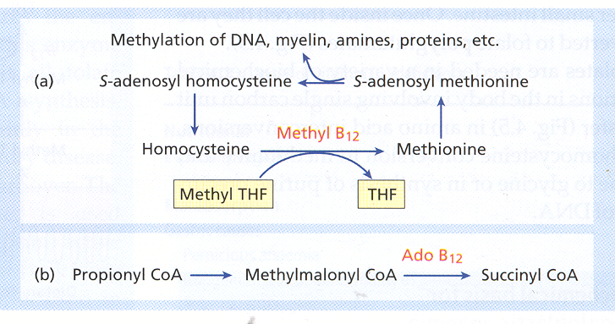
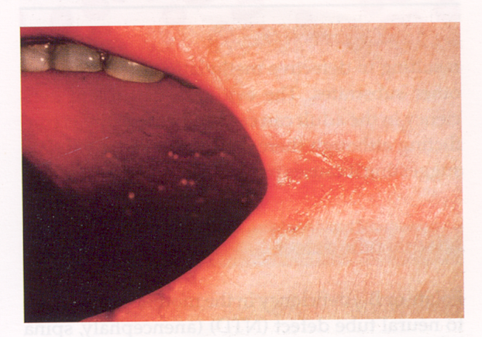
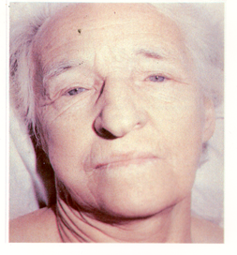
Homocysteine
Methyltransferase
Methylcobalamin
The integration between B12 and IF
Homocysteine
Methionine
5-Methylterahydrofolate
Tetrahydrofolate
The chemical bases of B12
Clinical Features of Megaloblastic Anaemia:
-Progressive symptoms and signs of anaemia
Weakness, anorexia, weight loss, diarrhoea or constipation, tiredness, shortness of breath, angina of effort, heart failure
Mild jaundice, glossitis, stomatitis, angular cheilosis
Purpura, melanin pigmentations
Infections
angular cheilosis
jaundice
red swollen painful tongue with beef like appearance angular somatitis

Slide 9
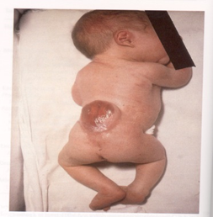
Neuropathy due to Vit B₁₂ and folate deficiency:
Progressive neuropathy affecting:
The peripheral sensory nerves
Posterior and lateral columns (sensory ataxia) of the spinal cord (subacute combined degeneration of the cord)
Optic atrophy
Psychiatric symptoms
Pathogenesis:
- The neuropathy is likely due to accumulation of S-adenosyl homocysteine and reduced level of S-adenosyl methionine in nervous tissue resulting in defective methylation of myelin and other substrates.
- Neuropathy is mostly due to vitamin B₁₂ deficiency. In new born (encephalopathy)
Neural tube defect (NTD):
Anencephaly, spina bifida or encephalocoele in the fetus due to folate or Vit B₁₂ deficiency in the mother
This results in
build-up of homocysteine and S-adenosyl homocysteine in the fetus which impair methylation of various proteins and lipids.
Polymorphism in the enzyme 5,10 methylene tetrahydrofolate reductase (5,10-MTHFR). This mutation (677 C→T) in the MTHFR gene results in low serum and red cell folate and high serum homocysteine in the parents and fetus with NTD.
Cleft palate and hair lip

Slide 10
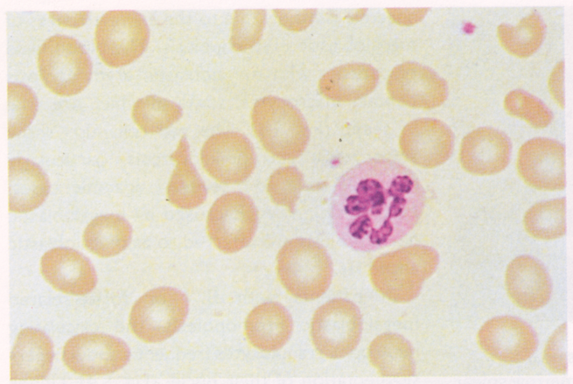
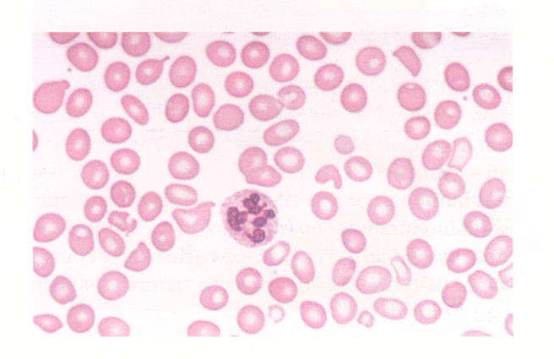
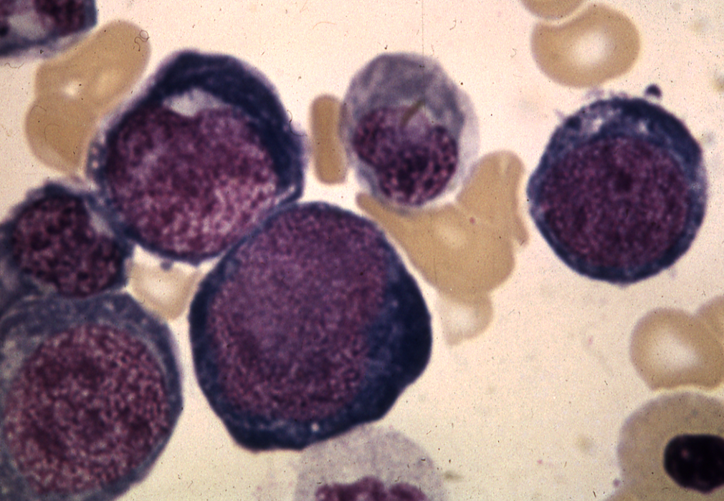
Haematological findings in Megaloblastic Anaemia:
1- Peripheral Blood:
Macrocytic anaemia, oval macrocytes, anisocytosis, poikilocytosis high MCV.
Dimorphic anaemia when it is associated with iron deficiency or with thalassaemia trait.
Hypersegmented neutrophils.
Leucopenia and thrombocytopenia
2-Bone Marrow: important
Hypercellular (increased cell count.) marrow with M:E ratio in normal or reduced.
Accumulation of primitive cells due to selective death of more mature cells.
Megaloblast (large erythroblast which has a nucleus of open, fine, lacy chromatin).
Dissociation between the nuclear and cytoplasmic development in the erythroblasts.
Mitosis and dying cells are more frequent than normal.
Giant and abnormally shaped, metamyelocytes, polypoid megakaryocytes.
Increased stainable iron in the macrophage and in the erythroblasts.
Hypersegmented neutrophile (normal segments 3-5) but it is not charactristic for megaloplastic
Erythroblast (Early precursor) Nucleated

Slide 11
Other laboratory abnormalities:
Chromosomal abnormalities
Ineffective haemopoiesis (erythrocytosis) . (Intramedullary cell death by apoptosis) associated with increased serum indirect bilirubin.
↑ urobillinogen and faecal stercobillinogen.
↑ LDH ↑ serum iron ↑ blood carbon monoxide.
↑ serum lysozyme
↓ reduced haptoglobins
Positive schumm’s test
Positive urine haemosiderin.
All are symptoms of hemolysis (increased turnover of the cell)
Treatment of megaloblatic anaemia: NOT IMPORTANT!
 | Vitamin B₁₂ deficiency | Folate deficiency
Compound | Hydroxocobalamin | Folic acid
Route | Intramuscular | Oral
Dose | 1000 µg | 5mg
Initial dose | 6X1000 µg over 2-3 weeks | Daily for 4 months
Maintenance | 1000 µg every 3 months | Depends on underlying disease; life-long therapy may be needed in chronic inherited haemolytic anaemia, myelofibrosis, renal dialysis
Prophylactic | Total gastrectomy Ileal resection | Pregnancy, severe haemolytic anaemias, dialysis, prematurity

Slide 12
Summery:
CAUSES: | TYPES
Iron deficiency Thalassaemia Lead poisoning Sideroblastic anaemia | Microcytic, Hypochromic
Anemia of chronic disease After acute blood loss Renal disease Mixed deficiencies Bone marrow failure, e.g. post-chemotherapy | Normocytic, Normochromic
Pregnancy Newborn Alcohol Liver disease Aplastic anemia | MACROCYTIC Has 2 types : Megaloplastic & Normoblastic
Cobalamin (B12) deficiency Folate deficiency Drugs, ex:(methotrexate, mercaptopurine) Myeloid leukemia Vitamin E deficiency Lesch-Nyhan syndrome
Inadequate intake Veganism Inadequate secretion of intrinsic factor Pernicious anaemia Total or partial gastrectomy Malabsorption Crohn’s disease, ileal resection | Vitamin B12 Deficiency
Inadequate dietary intake pregnancy Malabsorption Coeliac disease, jejunal resection Long-term dialysis, congestive heart failure acute liver disease | Folate Deficiency
Anemia
A-megaloplastic

Slide 13
MCQs:
1-Pernicious anemia it’s autoimmune disease against:
A- IF
B- parietal cell
C- chief cell
D- A&B
2- B12 absorbed in the:
A-duodenum
B-jejunum
C-ileum
D- A&b
3- which one of the following cause folate deficiency?
A- total gastrectomy
B- veganism
C- ileal resection
D- long term dialysis
4-bone marrow failure can cause:
A-microcytic, hypochromic anemia
B-normocytic, normochromic anemia
C- macrocytic anemia
Answers:
1-D
2-C
3-D
4-B
Good Luck!
Team Members:
Ashwaq AlMajed
Shahd Alsowaidan
Aroob AlHuthail
Hanin Bashaikh
Fahad Al-Askar
Team Leaders
Safa Al-Osaimi
Abdulaziz Al-Hussainy

