Slide 1
Chronic Leukemia
Objectives:
To understand the general features of Myeloproliferative neoplasms
To understand the clinicopathological differences between acute myeloid leukemia (AML) and chronic myeloid leukemia (CML)
To understand the diagnostic approach for chronic leukemia and the major differential diagnosis of CML
To recognize the importance of genetic study in diagnosis and treatment of CML.
To understand the general aspect of myelodysplastic syndrome (MDS) including definition, pathogenesis, clinical features and prognosis
To understand the general aspect of chronic myelomonocytic leukemia (CMML) including definition, pathogenesis, clinical features and prognosis.
Color code:
Important.
Extra.
Doctor’s Notes
References:
436 girls & boys’ slides
435 teamwork slides
Editing file
Do you have any suggestions? Please contact us!
@haematology436 E-mail: Haematology436@gmail.com
or simply use this form

Slide 2
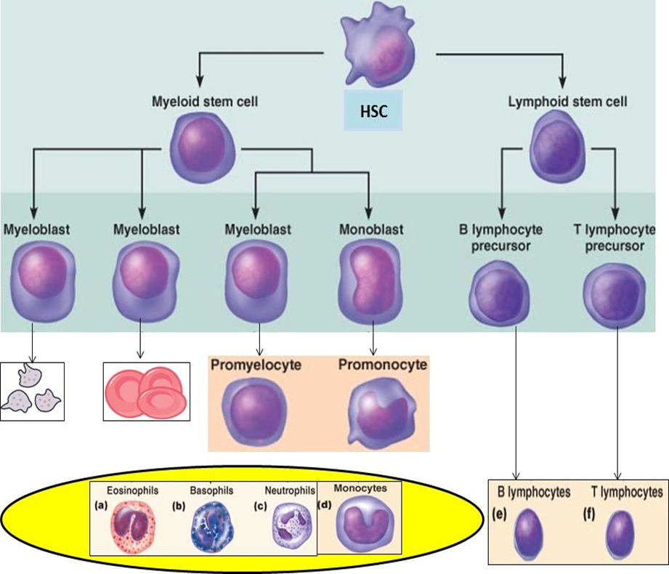
Chronic leukemias
● Heterogeneous group of hematopoietic neoplasms
●Uncontrolled proliferation and decreased apoptotic activity with variable degrees of differentiation this the main difference between MPN and MDS where MDS there is proliferation but apoptosis is enhanced
● Composed of relatively mature cells the retain the ability to differentiate unlike AML
● Indolent (progress slowly)(If untreated, the course is in months or years, patient might be asymptomatic for years)
● Occurs mainly in adults
When we have more than 20% blasts it is acute leukemia, and when there is less than 20% it is chronic leukemia
Acute leukemia
Chronic leukemia or lymphoma
The cells affected or the disease manifestation is in this stage
-Main Types of Leukemia:-
Chronic | Acute
LPN(CLL) | ALL | Lymphoid
MPN/MDS (CML) | AML | Myeloid
 | Acute Biphenotypic | Mixed
 | Acute Undifferentiated | Non

Slide 3
Myeloid Neoplasm
Myeloproliferative neoplasms (MPN)
Myelodysplastic syndromes (MDS)
acute myeloid leukemia (AML)
MDS/MPN
-Before we start you have to know the classification of Myeloid Neoplasm According to WHO :-
Main divisions
Sub divisions
chronic myeloid leukemia (CML)
Chronic myelomonocytic leukaemia(CMML)
-Myeloproliferative Neoplasms (MPN):-
Malignant proliferation of myeloid cells (maturing cells) in blood and bone marrow.
Occur mainly in adults
Slow onset and long course (may be silent)
MPN features:- important!
Cytoses increase in the number of cells (may be more than one lineage)
Organomegaly (mainly splenomegaly) due to accumulation of the cells and the extra hematopoietic role of the spleen
High uric acid the cells are defective and destroyed forming the uric acid from the purines of DNA
Hypercellular bone marrow the bone marrow is about 50% cellular but in case of MPN proliferation ( malignancy) increases and could lead to fibrosis
Progression to acute leukemia ( mainly AML) the parameter is blast count if above 20% it is considered as acute
-Chronic Myeloid Leukemia (CML):
Stem cell MPN.
Predominant proliferation of granulocytic cells.
Consistently associated with the BCR-ABL1 fusion gene (Most important feature of CML) located in the Philadelphia (Ph) chromosome (abnormal chromosome) which results from t(9;22)
The main types of cells that found in CML are: Myelocyte & Neutrophils

Slide 4
These are normally present in the blood but if we find any of the precursors it is abnormal.
How do they enter the blood? The bone marrow becomes hypercellular and the cells become crowded and start leaving and enter the blood.
-Pathogenesis of Chronic myeloid leukemia:
It acts like ON/OFF Button in many processes and proliferation is one of them
Translocation of the ABL segment on chromosome 9 to BCR locus on chromosome 22 fusing together in the chromosome the result is named Philadelphia chromosome 22 chromosome
This fusion gene has a binding site for ATP(the activity of Imatinib treatment is binding to this site and blocking it) that initiate the process of phosphorylation- activation- by tyrosine kinase of a substrate like JAK-2 involved in the transduction pathway that give rise to a state of uncontrolled proliferation
.
-Clinical Presentation:
Asymptomatic presentation (20-40%)
Routine CBC : marked leukocytosis
Common symptoms : Fatigue ,weight loss or night sweating
Abdominal discomfort due to splenomegaly
Splenomegaly (Massive) الدمام عنده كبير !!
Splenomegaly
Very important finding!

Slide 5
-Main Differential Diagnosis: (كيف أفرق بين الكرونيك مايلويد لوكيميا والأمراض الثانية):-
1.Chronic myelomonocytic leukemia (CMML) (monocytosis ,BCR-ABL –ve) .
2.Leukemoid reaction: Leukocytosis due to physiological response to stress or infection.
 | CML | Leukaemoid
Age | Adult | Any age
WBC count | High | High but <100,000
Differential | Mainly myelocytes and segmented and neutrophils. | Mainly Bands
Morphology | Hypogranular | Toxic
Splenomegaly | + (massive) | -/+
NAP score هذا يفرق بينهم بسرعة | Low | High
BCR/ABL مكلف | +ve اذا كان بوسيتيف احلف لهم انه CML | -ve
Onset | Chronic | Acute
- Neutrophil Alkaline Phosphatase (NAP)score:
Cytochemical stain that estimate the amount of alkaline phosphatase enzyme in neutrophils.
CML dysfunction cell do not have alkaline phosphate . But leukmoid is function cell
اللي يقتل البكتيريا هو هذا الانزيم فـ الخلايا الطبيعيه تحتوي هذا الانزيم اما الخلايا الغير طبيعيه لا تحتوي هذا الانزيم.
CML= Low
Leukemoid = High

Slide 6
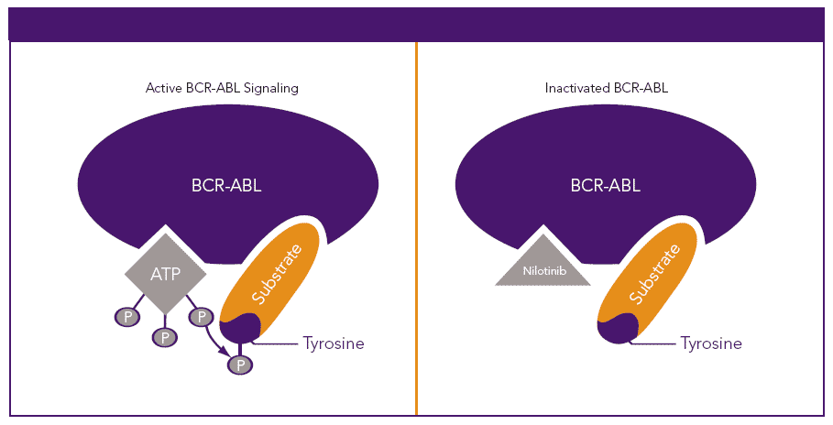
Chronic Myeloid Leukemia Phases:- المريض ينتقل من مرحلة لمرحلة اذا ما علجناه وكل مرحلة اخطر من اللي قبلها
- Treatment:
1st line targeted therapy (tyrosine kinase inhibitors like Imatinib)
-Excellent response (5 years survival ≥ 90%) 2nd line therapy If no response : stem cell transplantation.
This drug bind to ATP site of BCR-ABL competing with tyrosine kinase stopping its action
Chronic phase
Leukocytosis (12-1000×10⁹/L).
Accelerated phase
Increasing counts
Blastic phase (AML or ALL)
(≥20% blasts = Acute Leukemia)
Mainly neutrophils and myelocytes.
Stable course (years)
Blasts ≤10% ,Basophils≤ 20%
10-19% blasts (basophils ≥20%) (Why 19% ? because if it is 20 it will be AML)
Unstable course (months)
(80% AML & 20% ALL)
Coarse (Weeks)
مثال لتسهيل المفاهيم: تخيل ان فيه مصنع سيارات صغير في مدينة صغيرة كان يصنع على قد حاجة المدينة 10 سيارات في اليوم مثلا (نورمال) فجأة جاء ميوتيشن داخل المصنع فـ زاد الإنتاج من 10 سيارات صار ينتج 100 سيارة في اليوم ، اولاً بتزدحم شوارع المدينة بالسيارات وثانياً بيزدحم المصنع نفسه لأن الإنتاج فوق طاقته الاستيعابية هذا هو اللي يصير في .
اما اللي يصير في نفس مثال المصنع اللي فوق بس لما صار ميوتيشن هنا انهبلت المكائن وصارت تصنع سيارات مشوهة مثلاً تسوي سيارة بمكينتين أو سيارة بدون قير أو بدون كفرات فلما تطلع للشوارع بتخرب اول ما تطلع فبيجي المرور ويوقف هذي السيارات ويتلفها لأن ما منها فايدة فبيصير عندي مصنع قاعد يصنع سيارات خربانة ومزدحم من كثرتها ،أما الشوارع بتكون فاضية لأن المرور قاعد يتلف السيارات
(Peripheral blood)
CML
)Bone Marrow(
MDS
(Apoptosis)
(Peripheral blood)
)Bone Marrow(

Slide 7
- Myelodysplastic syndromes (MDS):- ضروري تقرون المثال نهاية السلايد اللي قبل هذا
Group of myeloid neoplasm's characterized by:
1- Peripheral cytopenia (low Hemoglobin ± low WBC & low PLT).
2- Dysplasia (abnormal morphology). خلايا مشوهة
Ineffective hematopoiesis (hypercellular bone marrow)
Progression to AML (preleukaemic disease).
Enhanced apoptosis. in the peripheral blood cause cytopenia
Normal
Dysplastic
No Granules! and ↓ number of lobes
BM: Hypercellular with dysplasia
Blood: Pancytopenia with dysplasia.
↑ proliferation - ↑ apoptosis = Ineffective hematopoiesis
- MDS subtypes classified according to:-
1- Blast count. prognosis depends on the number of blast the higher blast count prognosis is worse.
2- Degree of dysplasia.
3- Genetics: Variable genetic abnormalities mainly -5q (good prognosis more in female) , -7q (bad prognosis more in male)
- Treatment:
supportive +/- chemotherapy
- Chronic Myelomonocytic Leukemia (CMML)
- Clonal Hematopoietic malignancy characterized by proliferation of both monocytes and neutrophils it is classified as MDS/MPN disease.
MDS/MPN disease: has both (takes features from both) :-
-Features of MDS (dysplasia & enhanced apoptosis).
-Features of MPN ( marked proliferation).
Philadelphia chromosome must be negative.
Blast must be less than 20%,
Aggressive course (survival rate around 2.5y)
Treatment: Chemotherapy ±SCT
(if it is +ve then it is CML)
(more than 20% → acute)

Slide 8
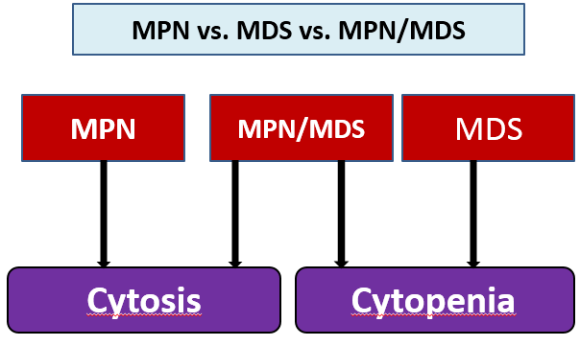
Effective proliferation
Ineffective proliferation
- Difference between Chronic Myeloid Leukemia & Acute Myeloid Leukemia
 | CML | AML
onset | Indolent course . Symptoms appear after a long period | Rapid
phases | Three phases 1.Chronic phase 2.Accelerated phase 3.Blastic phase | No known phases
etiology | Gene mutation known as Philadelphia gene T(9;22) | Many mutations e.g. t(15;17)
hepatosplenomegaly | Marked ( sometimes severe or massive especially spleen) | moderate
Blasts | Fewer than 20% | > 20%
Cell count | Cytosis | Cytopenia

Slide 9
MCQs:
1. The mutation responsible for the effects and manifestations of CML is :
A. t(15;17)
B. Philadelphia chromosome
C. Chromosome 5 monosomy
D. Chromosome 7 monosomy
2. The distinguishing feature of AML is:
Blast > 20%
Cytosis
bone marrow failure
Hepatomegaly
3. A 55 year old patient came to the clinic for a regular check up. He does not complain of any symptoms. His results are as follows:
High WBC count, Mainly bands, High NAP score. What is the most likely diagnoses:
CML
AML
CMML
infection
4. CMML is presented with cytopenia and decreased apoptosis:
True
False
5. Which one of the following genes Must be positive in CML?
APC
BCR-ABL
REKA-B
P53
Answers: 1. B , 2. A , 3. D , 4. B, 5. B
Good Luck !
Team members:
Abdullah Al-Twerki
Ziad Al-Anazi
Team Leaders
Abdulaziz Al-Hussainy
Safa Al-Osaimi

